Slide 1

Choir at the Classical Academy

Slide 2

Agenda
Introduction
Overview of Choir
Choir Progression
Outside of Class Requirements
Fine Arts Credit Path
FAQs

Slide 3

introduction
Our Purpose:
To provide students a place to develop in body, mind, and spirit
To provide students a space to develop their skills in the vocal and choral arts
To prepare them for music after high school

Slide 4


Overview of Choir
Emphasis placed on establishing good vocal technique, general musicianship, sight singing, and aural skills
Choir curriculum and choir classes are designed for a gradual progression of growth in areas of choral skills, leadership, and rhetoric-level conversation around music

Slide 5

Choir progression
Teachers thoughtfully make the choir placement decisions based on a combination of factors
Openings for senior choir classes are determined by distribution of grade level and balance of voice parts

Slide 6

Outside of class requirements
Evening Requirements:
Evening requirements are not frequent
3 to 4 times per year
Daytime Performances:
Depending on the choir group, students may participate in a daytime performance such as Grandparent’s Day

Slide 7
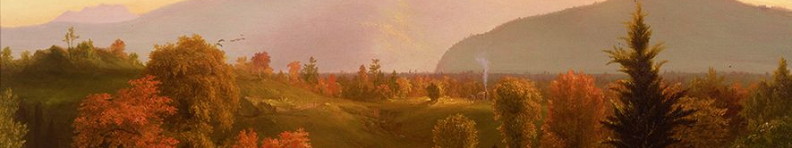

Fine Arts Tracks
1
2
3
4 Years of TCA Band
Or
4 Years of Art (I-IV)
Must complete a minimum of 3 years of choir to include junior and senior year
Sophomore level entry requires a successful audition.
1 Semester Art & Music Appreciation
+
1 Fine Arts Elective credit

Slide 8

FAQs
A few of our frequently asked questions are
  Auditions?
  Athletics?

Slide 9


Thank you
David Webb
JH & HS Choirs
dwebb@asd20.org

