Slide 1
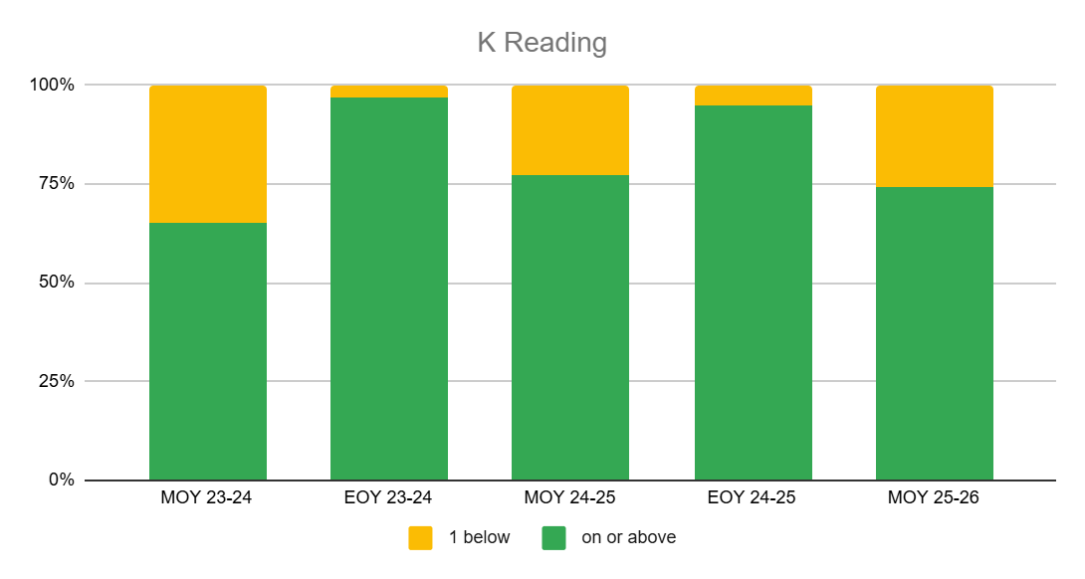
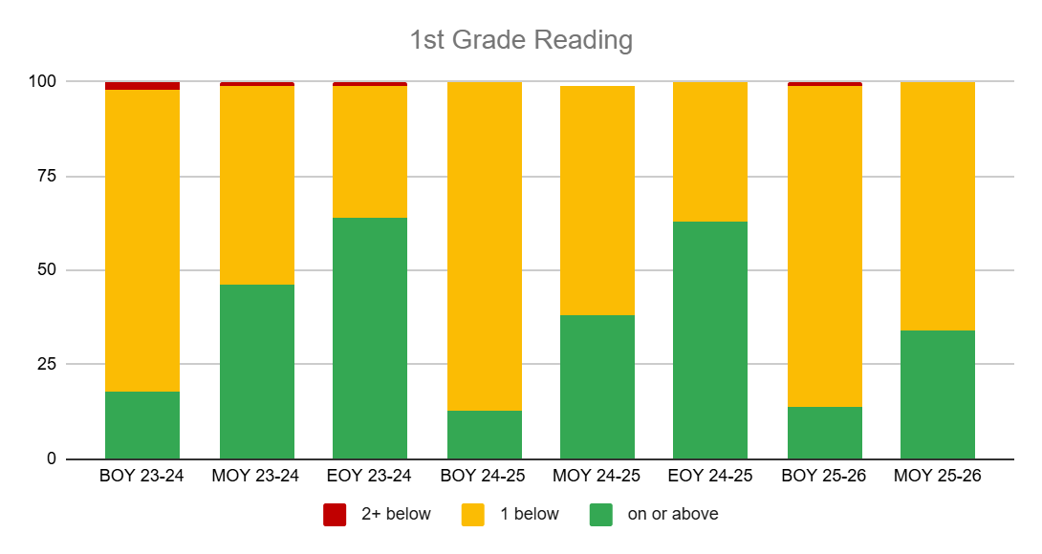
23-24
24-25
25-26
23-24 24-25 25-26

Slide 2
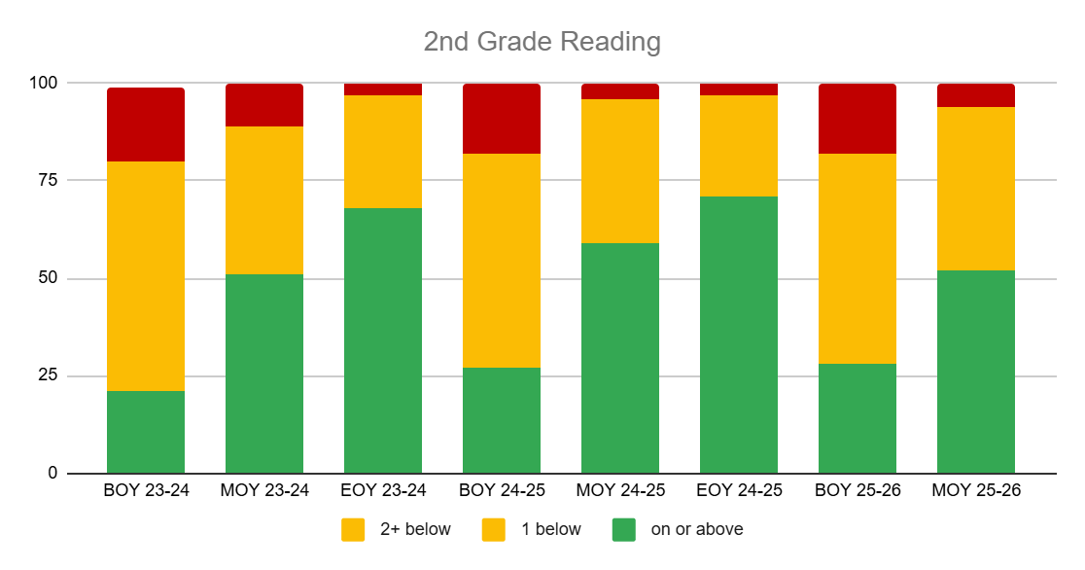
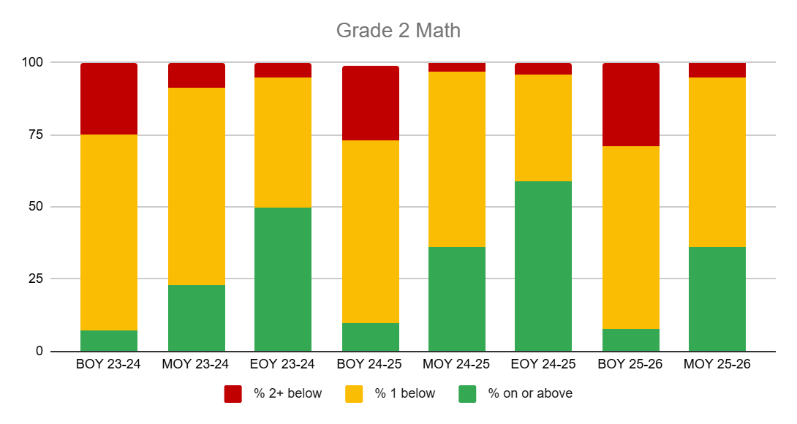
23-24 24-25 25-26
23-24 24-25 25-26

Slide 3
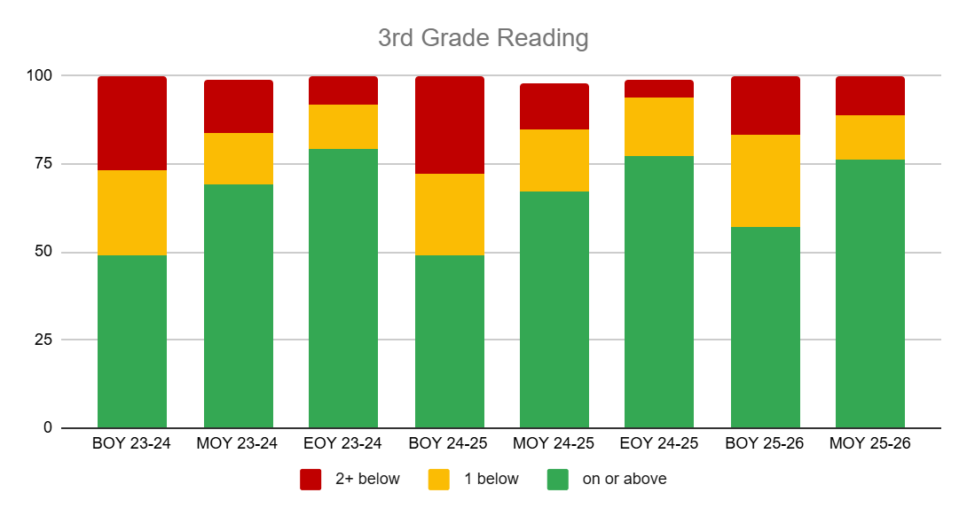
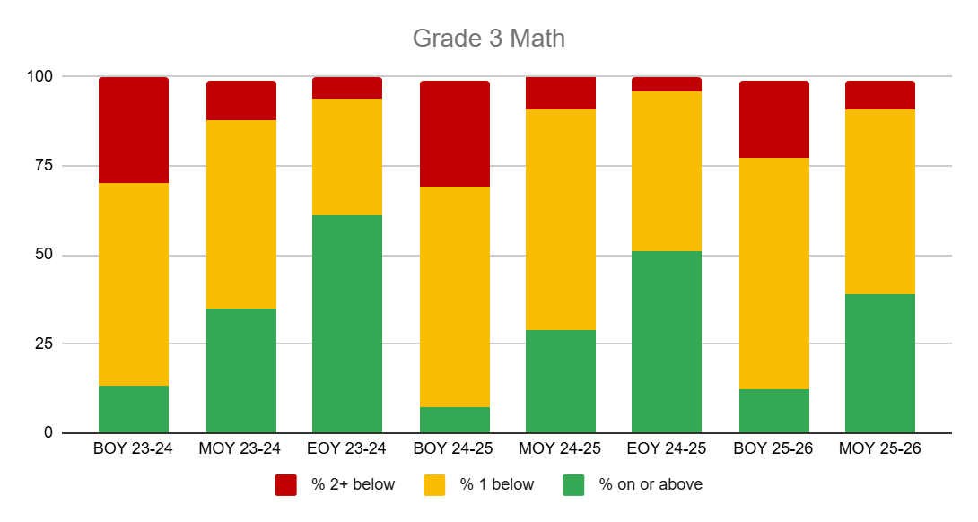
23-24 24-25 25-26
23-24 24-25 25-26
Notes:
Highest reading yet MOY 76% on or above GL; strong math MOY w/ 39%.
Low math 24-25, and will see they are still struggling in 4th grade

Slide 4
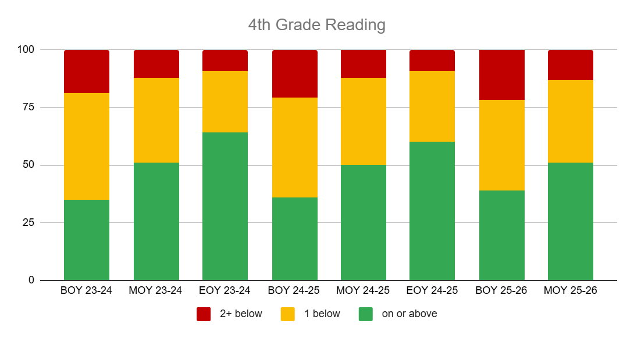
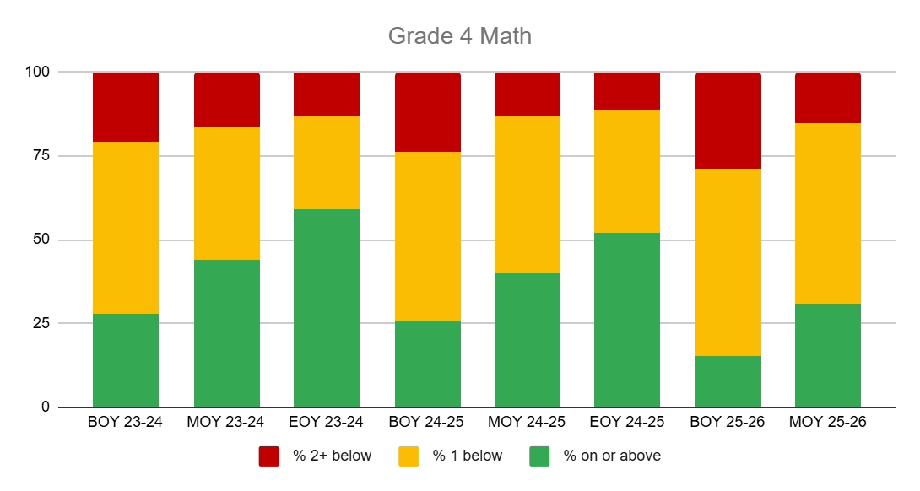
23-24 24-25 25-26
23-24 24-25 25-26
Notes:
Low 3rd grade 24-25, still low 4th. Looking to departmentalize math instruction more in 4th grade - rotations of 3 ela/math/ss&sci

Slide 5
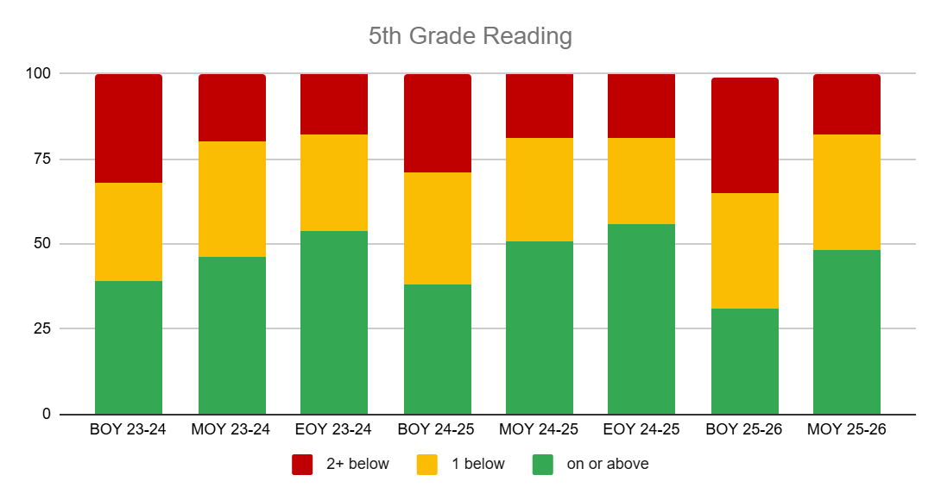
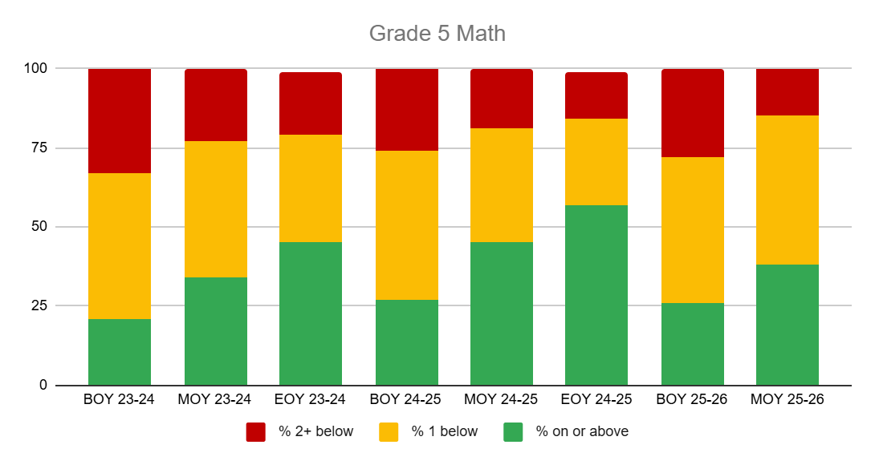
23-24 24-25 25-26
23-24 24-25 25-26
Notes:
1 or our 2 5th grade math teachers is a 1st year teacher, so these results are encouraging.smallest red band MOY so far

Slide 6
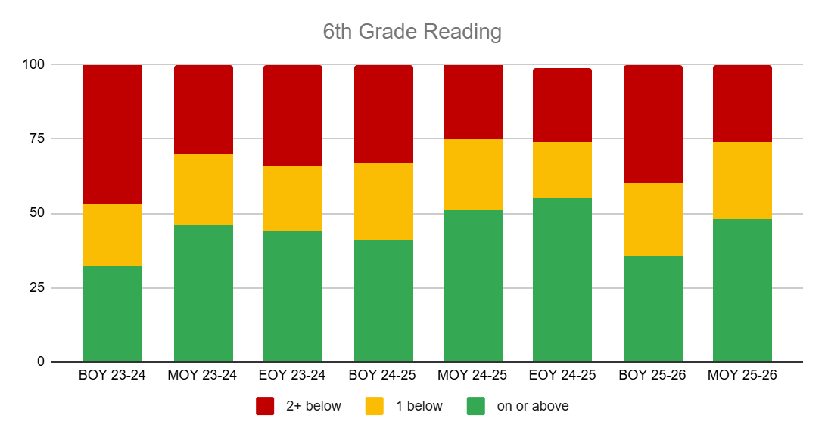
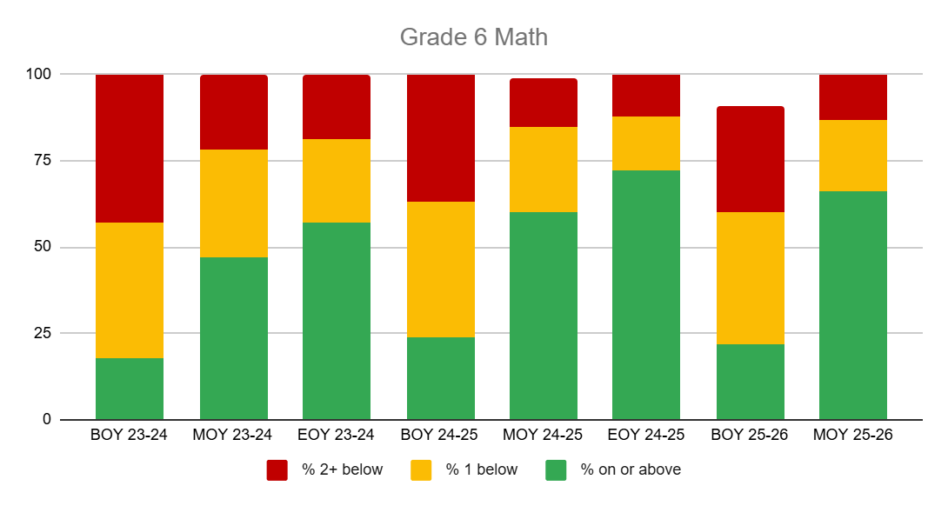
23-24 24-25 25-26
23-24 24-25 25-26
Notes:
Highest math MOY in 3 yrs; 66% at or above GL

Slide 7
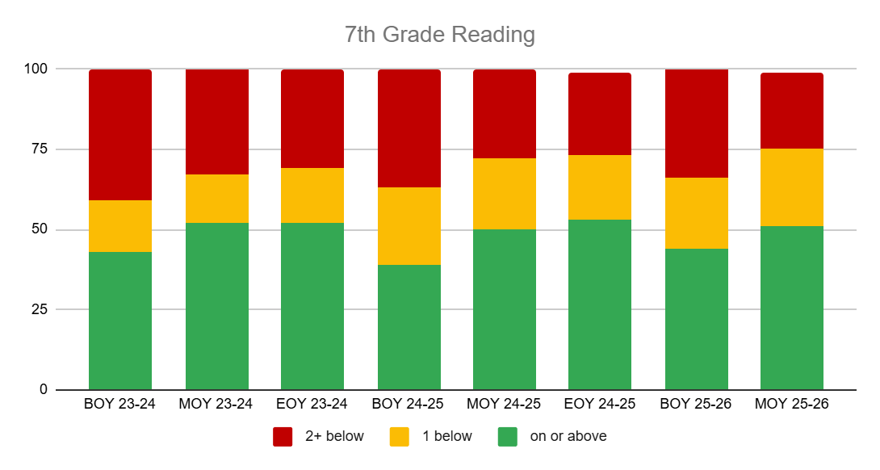
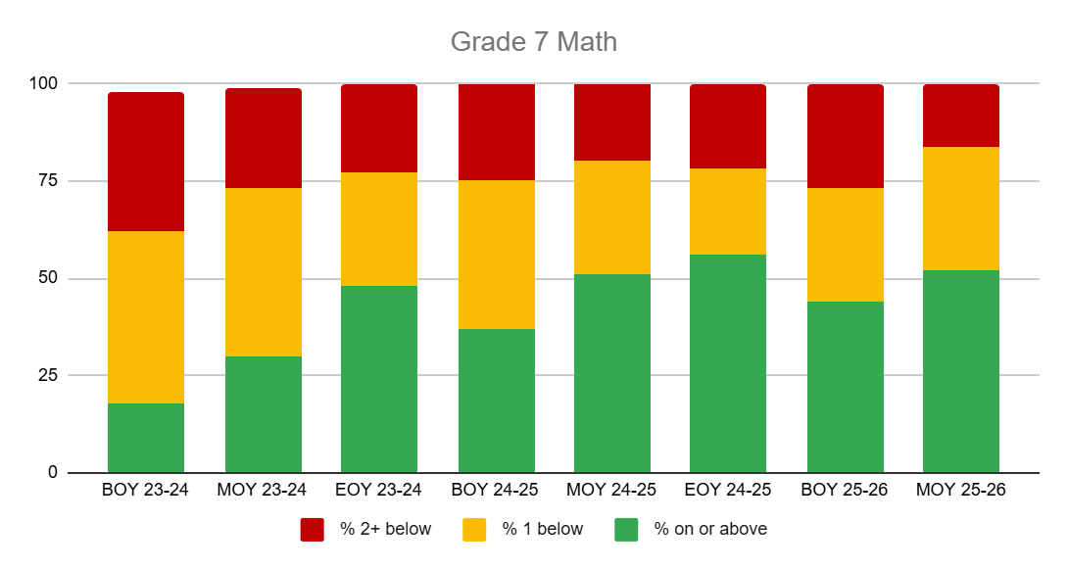
23-24 24-25 25-26
23-24 24-25 25-26
Notes:
6th grade gains carrying ito 7th grade - look at BOY trend; also highest MOY in 3 yrs 52%

Slide 8
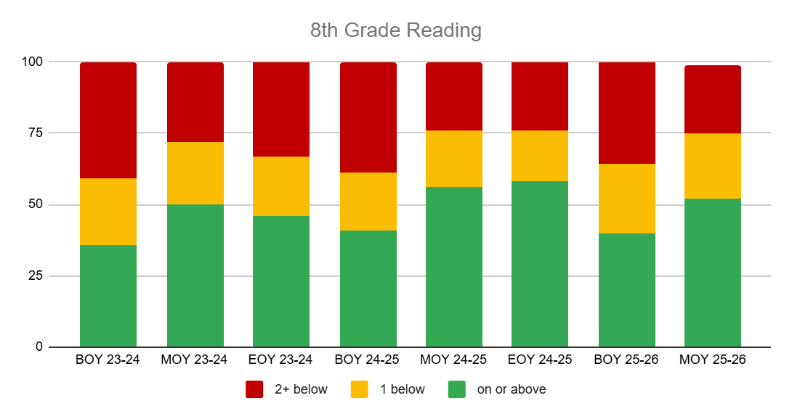
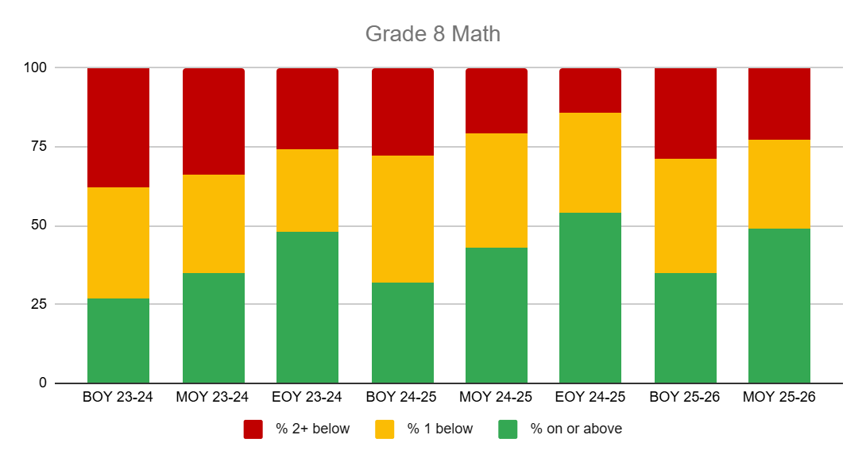
23-24 24-25 25-26
23-24 24-25 25-26
Notes:
Highest MOY for 8th grade math in 3 yrs 49%

