Slide 1
2025-26 Update
Notes:
Introduce ourselves
Ask demographic of audience (who is in the room)

Slide 2
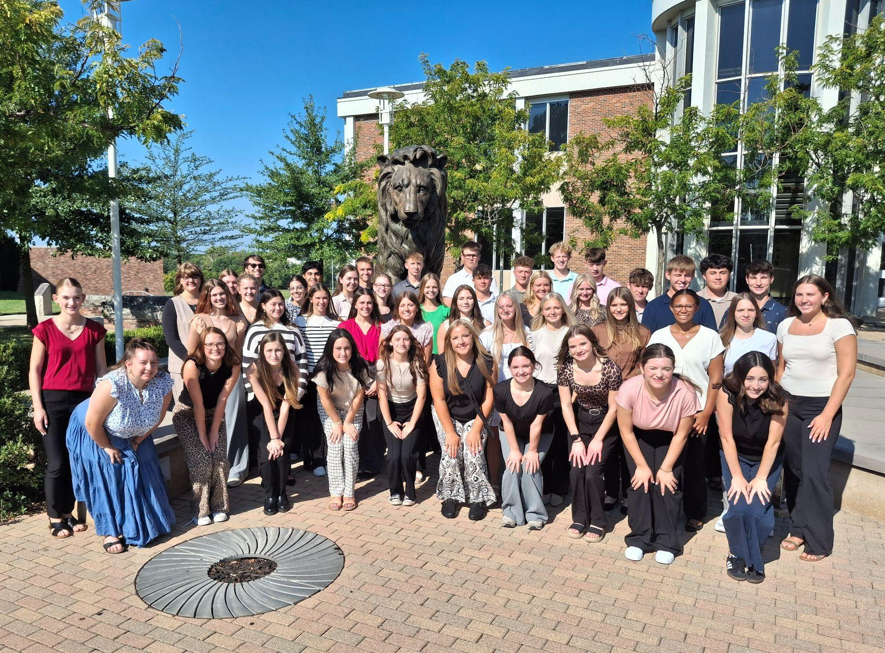
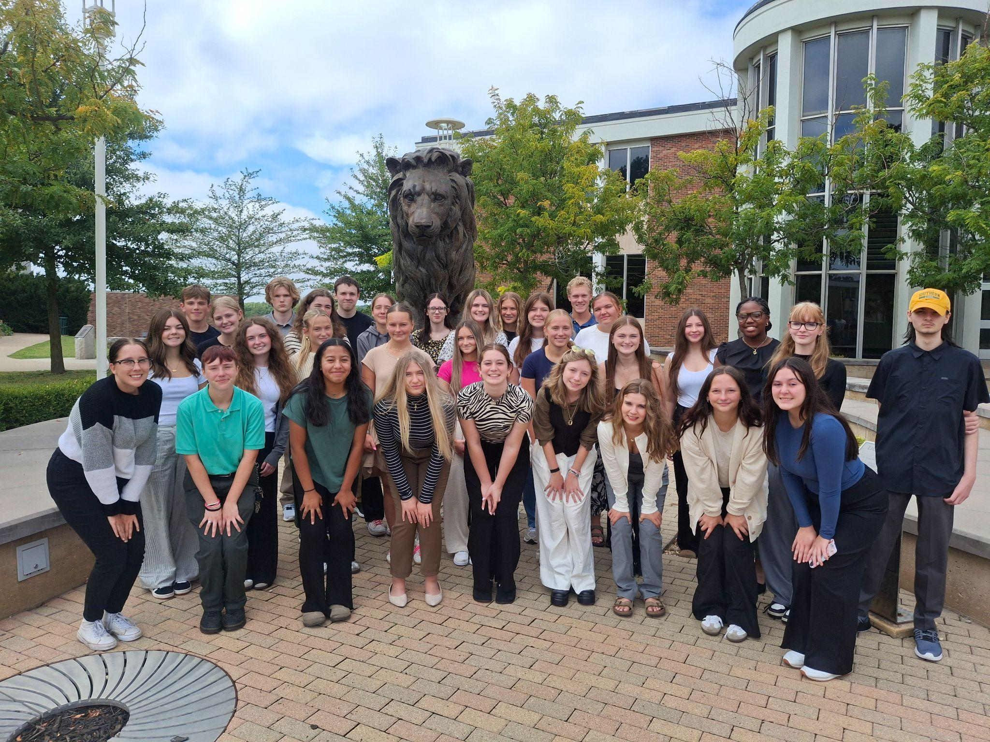
25-26 Morning and Afternoon Student Associates

Slide 3
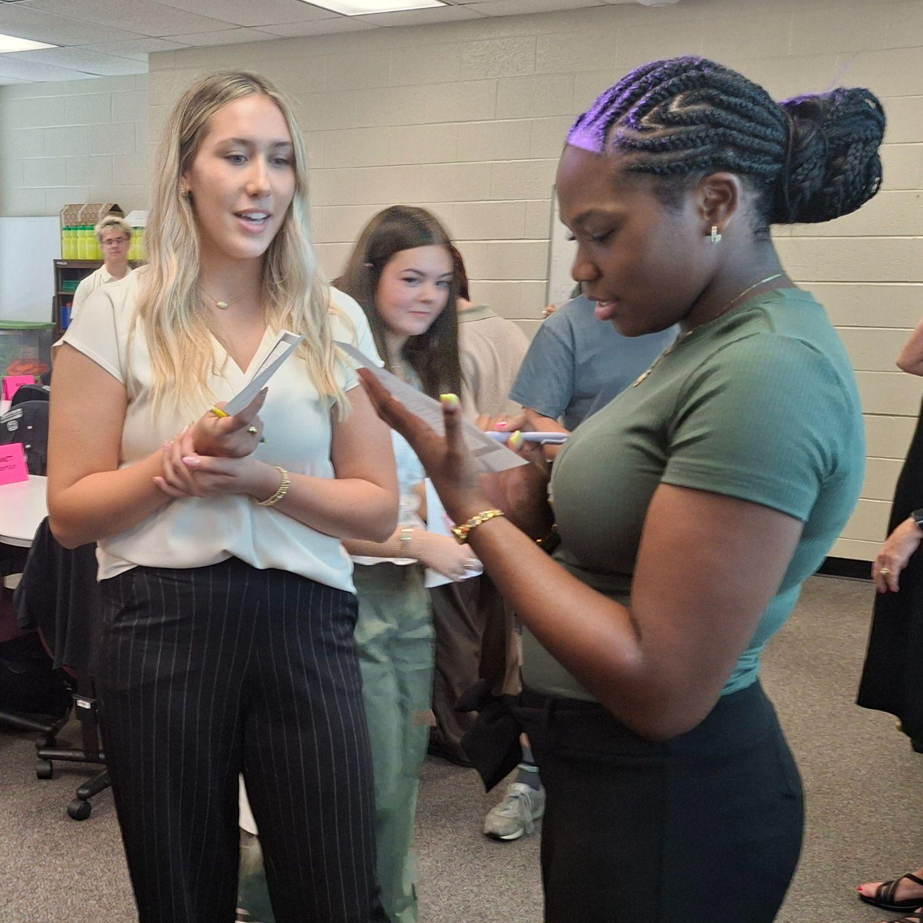
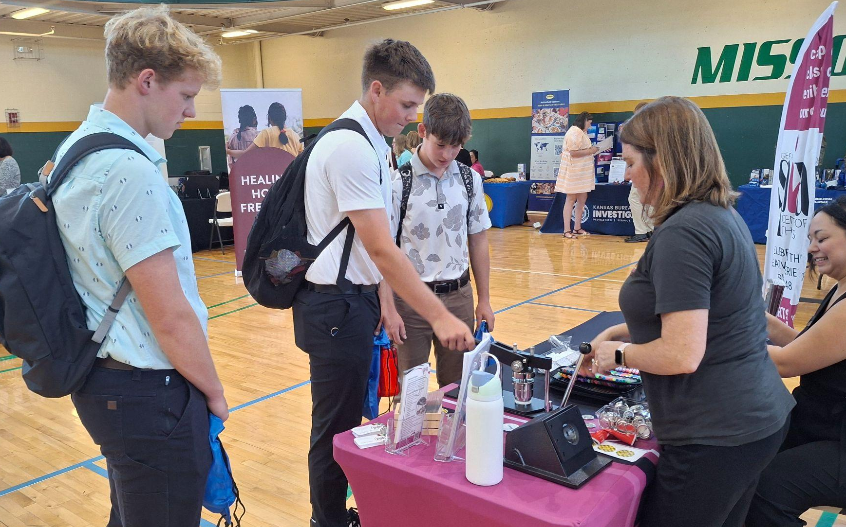
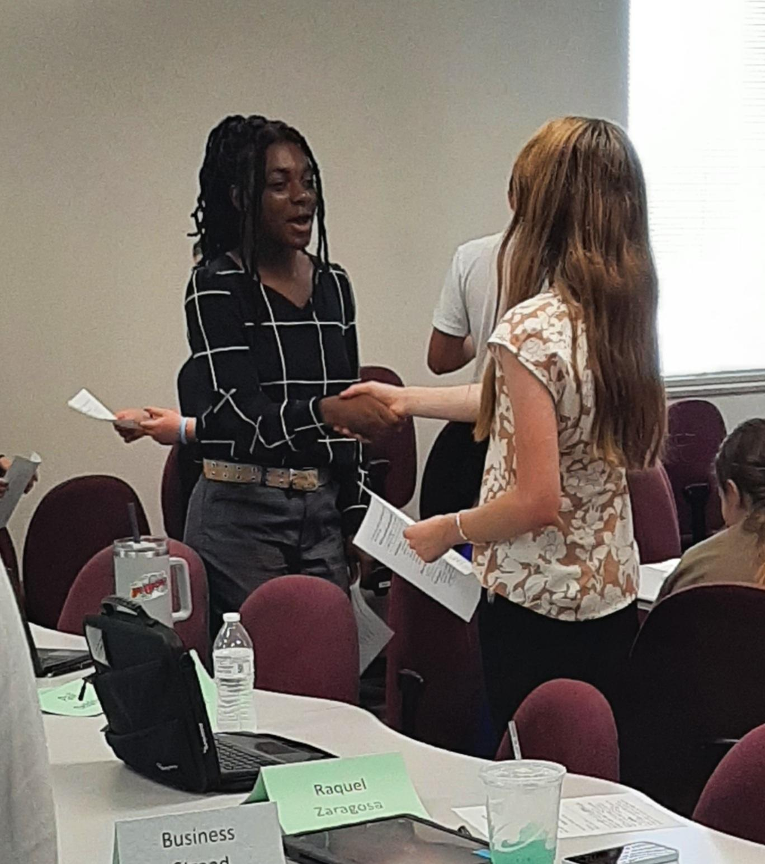
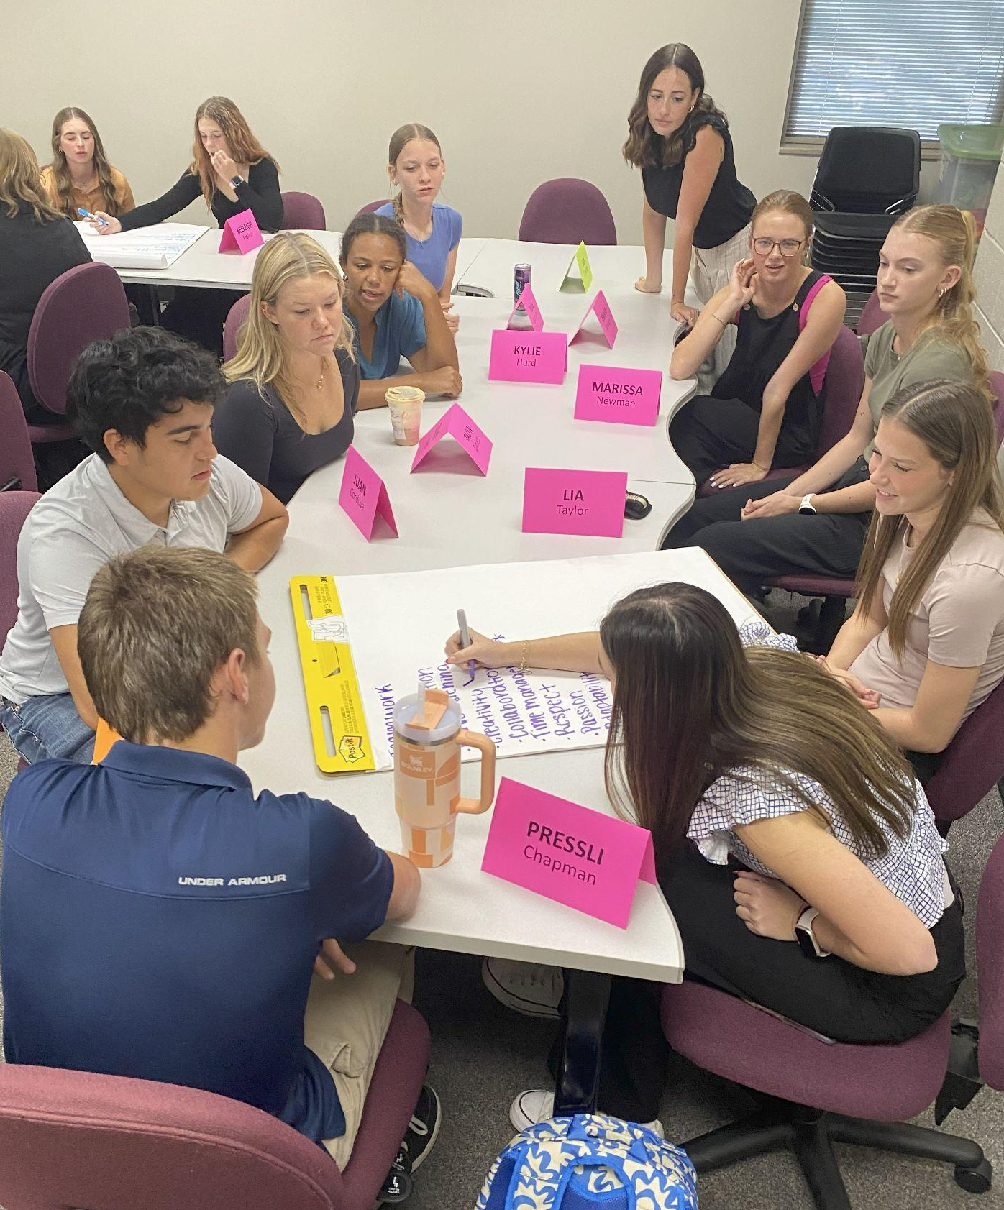
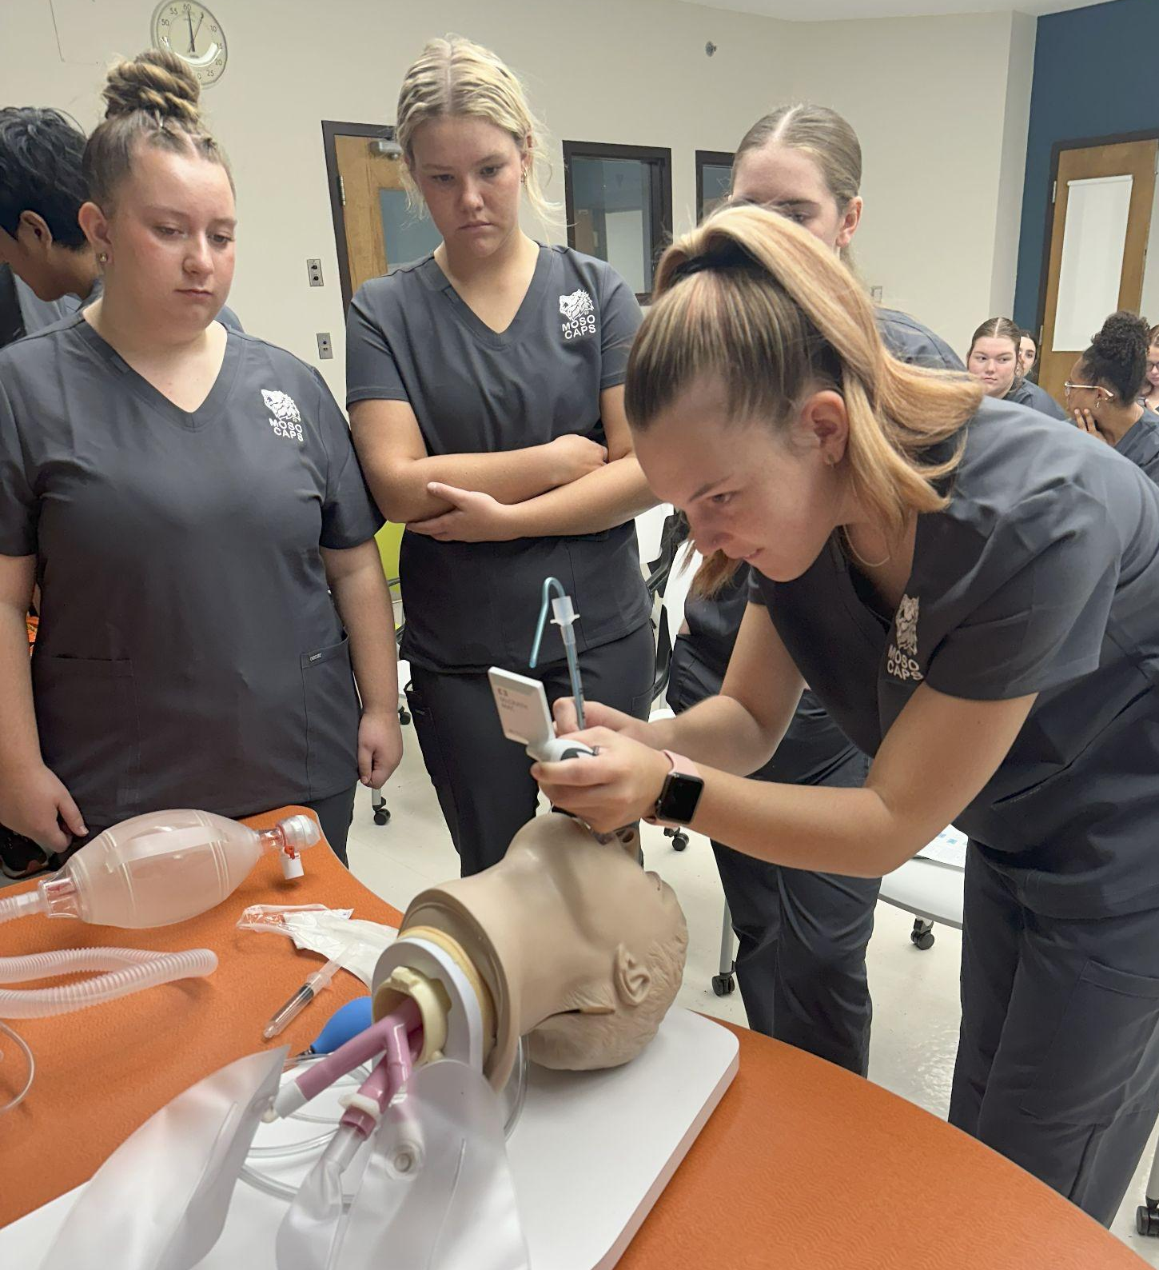
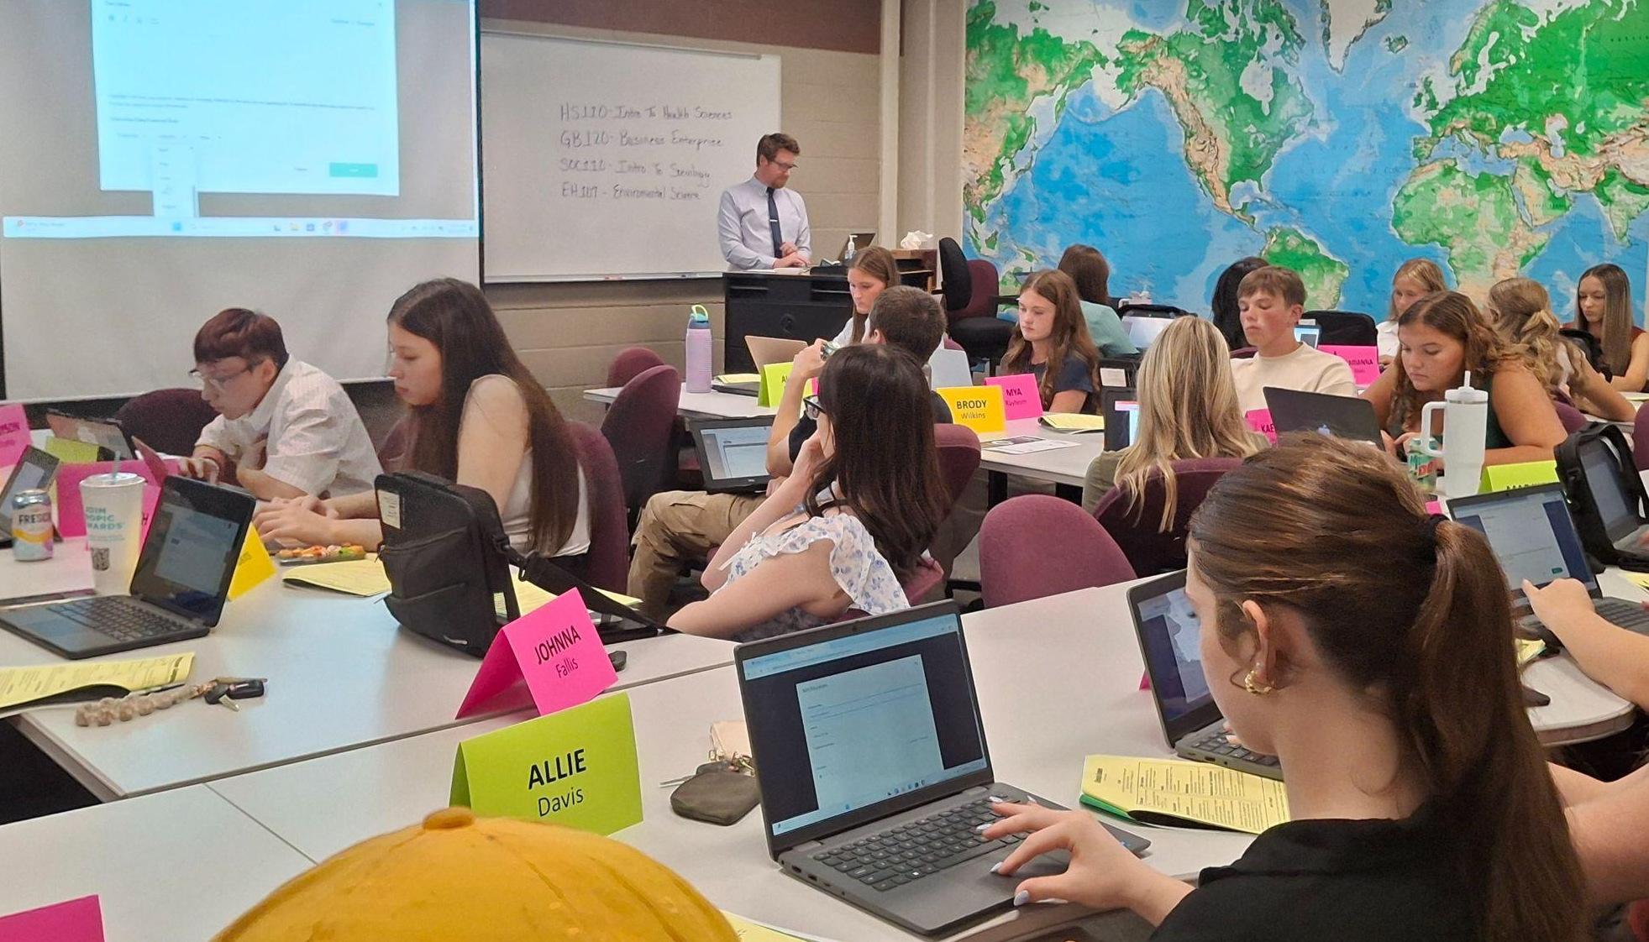
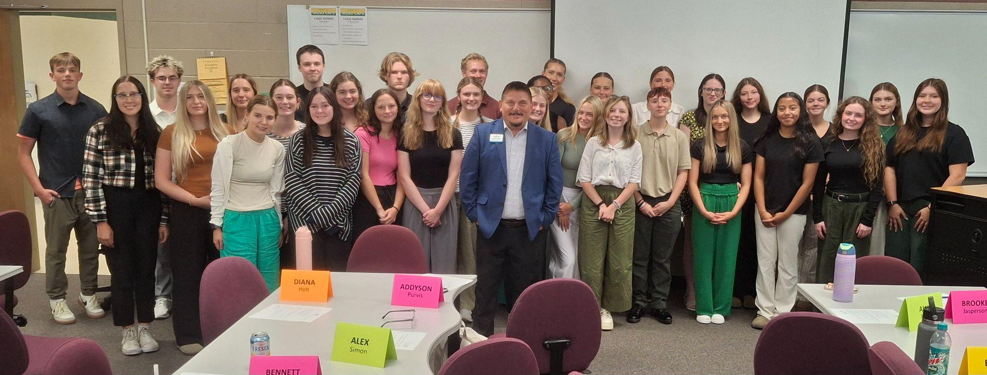
CAPSPrep Fall ‘25!

Slide 4
Year 3: MOSO CAPS Numbers for CJHS
26 Seats Secured
Academic Year | Applicants | Enrolled | Completers
2022-2023 | 38 | 26 | 25
2023-2024 | 14 | 13 | 13
2024-2025 | 28 | 23 | 23
2025-2026 | 54 | 27* Charged for 26* | 27

Slide 5
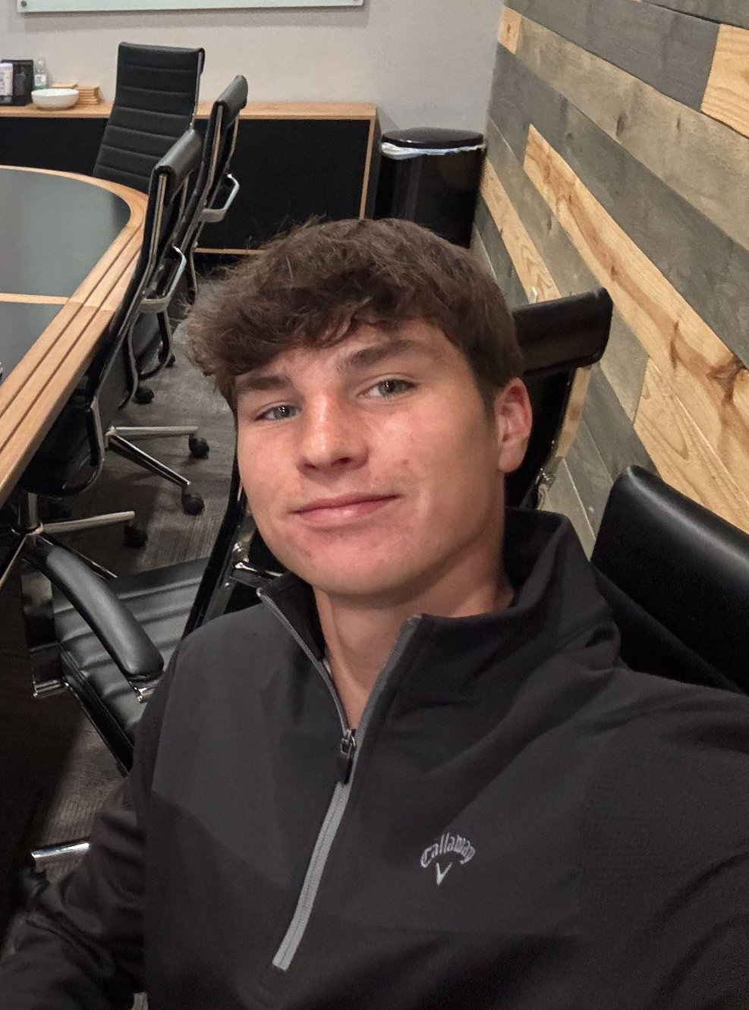
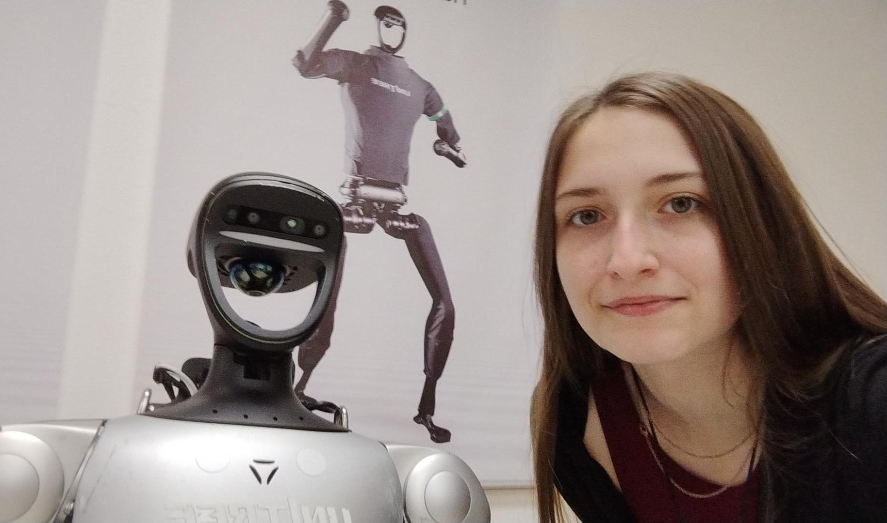
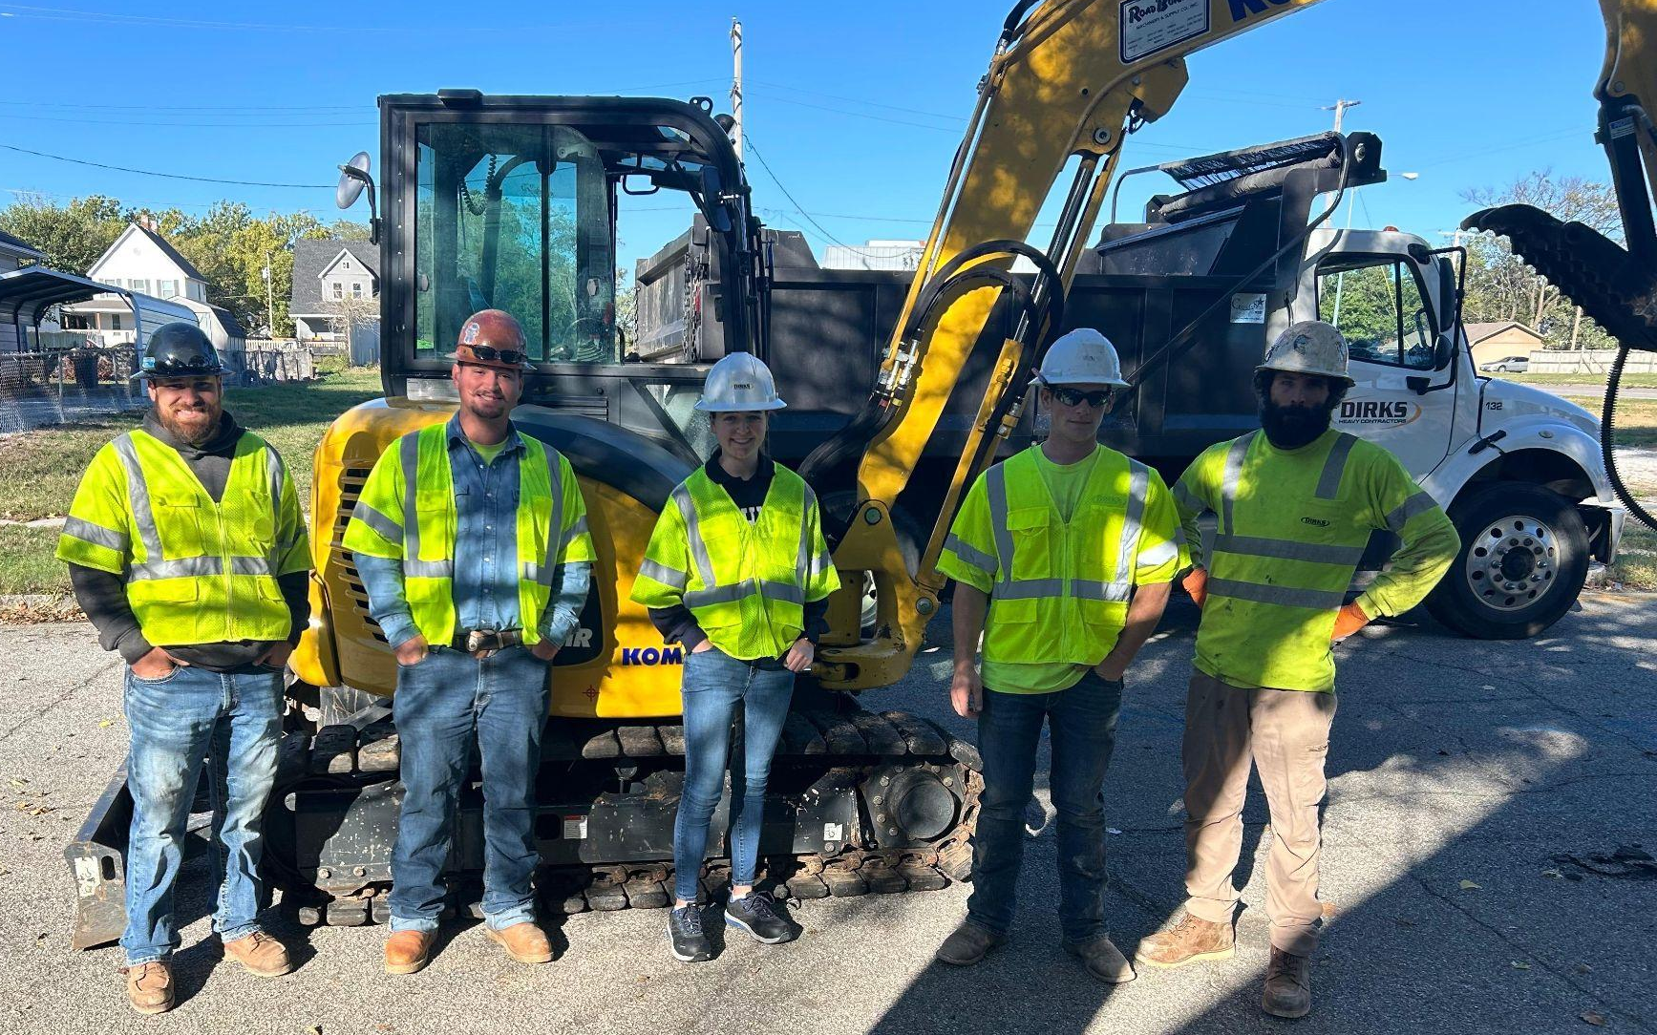
Business Strand
Fall Coursework
  GB 120: Business Enterprise (3CR) - 1st Year
  EH 107: Environmental Science (3CR) - 2nd Year
  Industry Partner Experience – 80 hours (1CR)
Spring Coursework
  PSY 100: General Psychology (3CR) - 1st Year
  2nd Year Based on Individual Need (3CR)
  Industry Partner Experience – 80 hours (1CR)

Slide 6
Business Strand Fall Experiences
 | R1: 9/22-10/10 | R2: 10/15-1031 | R3: 11/3-11/21 | R4: 12/1-12/17
Journalist | KGCS - Sports (9/8-10/24) (play-by-play games) |  | MSSU Athletic Media Relations (10/27-12/17)
Civil Engineer | #Dirks Heavy Construction (9/8-10/24) |  | OWN Engineering (10/27-12/17)
Engineering | Stokes Robotics | #Liberty - Engineering | #Dyno Nobel | #Mercy - Engineering
Finance/Investments | #Southwest Missouri Bank (instestment services) | American Ramp Company | Financial Integrators, Tyler Burgess Edward Jones, Philip Mitchell LPL Financial, Tina Hallmark | Cornerstone Wealth Management
Veterinarian | Smith Pet Care | Academy Animal Hospital | Trinity Circle Horses Healing Hearts | Animal Clinic of the 4 States
Accountant | Baker Davis Roderique | Hardy, Wrestler & Associates | Hiland Dairy | #Southwest Missouri Bank (internal audit, accounting, credit analysis)
Accounting | American Ramp Company | #Southwest Missouri Bank (internal audit, accounting, credit analysis) | Hardy, Wrestler & Associates | MSSU Human Resources
Civil Engineering | OWN Engineering | #City of Joplin - Engineering | Olsson Engineering | Twin Oaks Custom Cabinets
Realtor | Forrest Real Estate | Realty ONE Group | #Southwest Missouri Bank (lending) | #Joplin Planning, Development & Neighborhood
Veterinarian/Accountant/Lawyer | Hardy, Wrestler & Associates | #Madison Pet Clinic | #Leggett & Platt Corporate Law | American Ramp Company
Marine Biology | Madison Pet Clinic | MSSU Ecotoxicology Lab | #MO Dept of Conservation Shoal Creek / Wildcat Glades | Animal Clinic of the 4 States

Slide 7
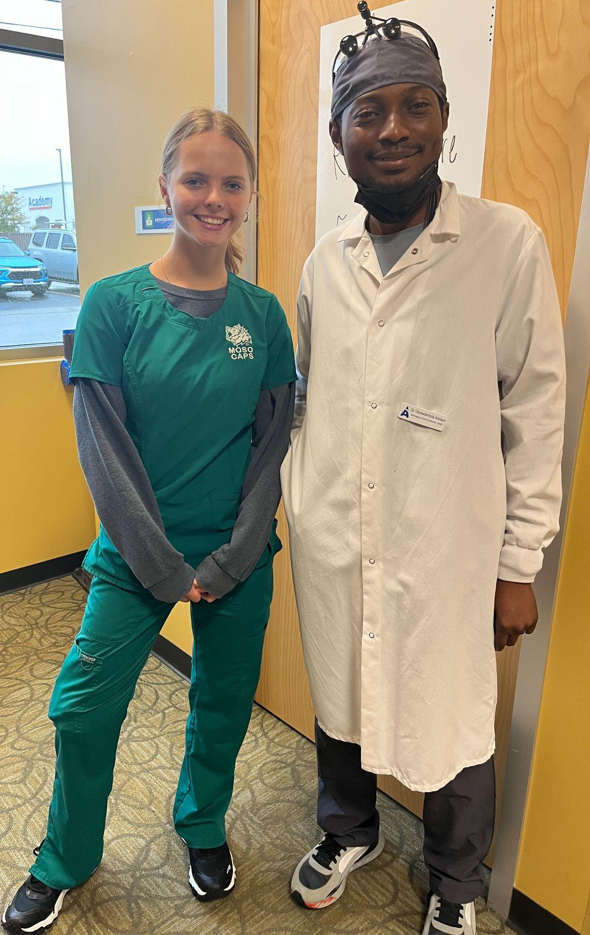
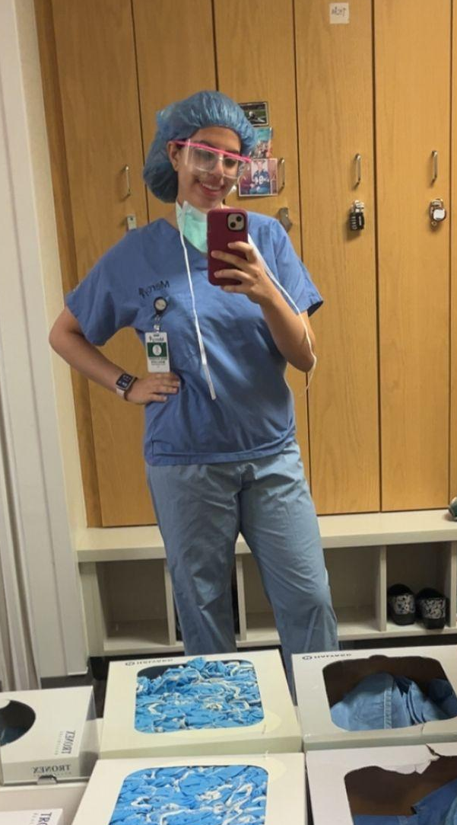
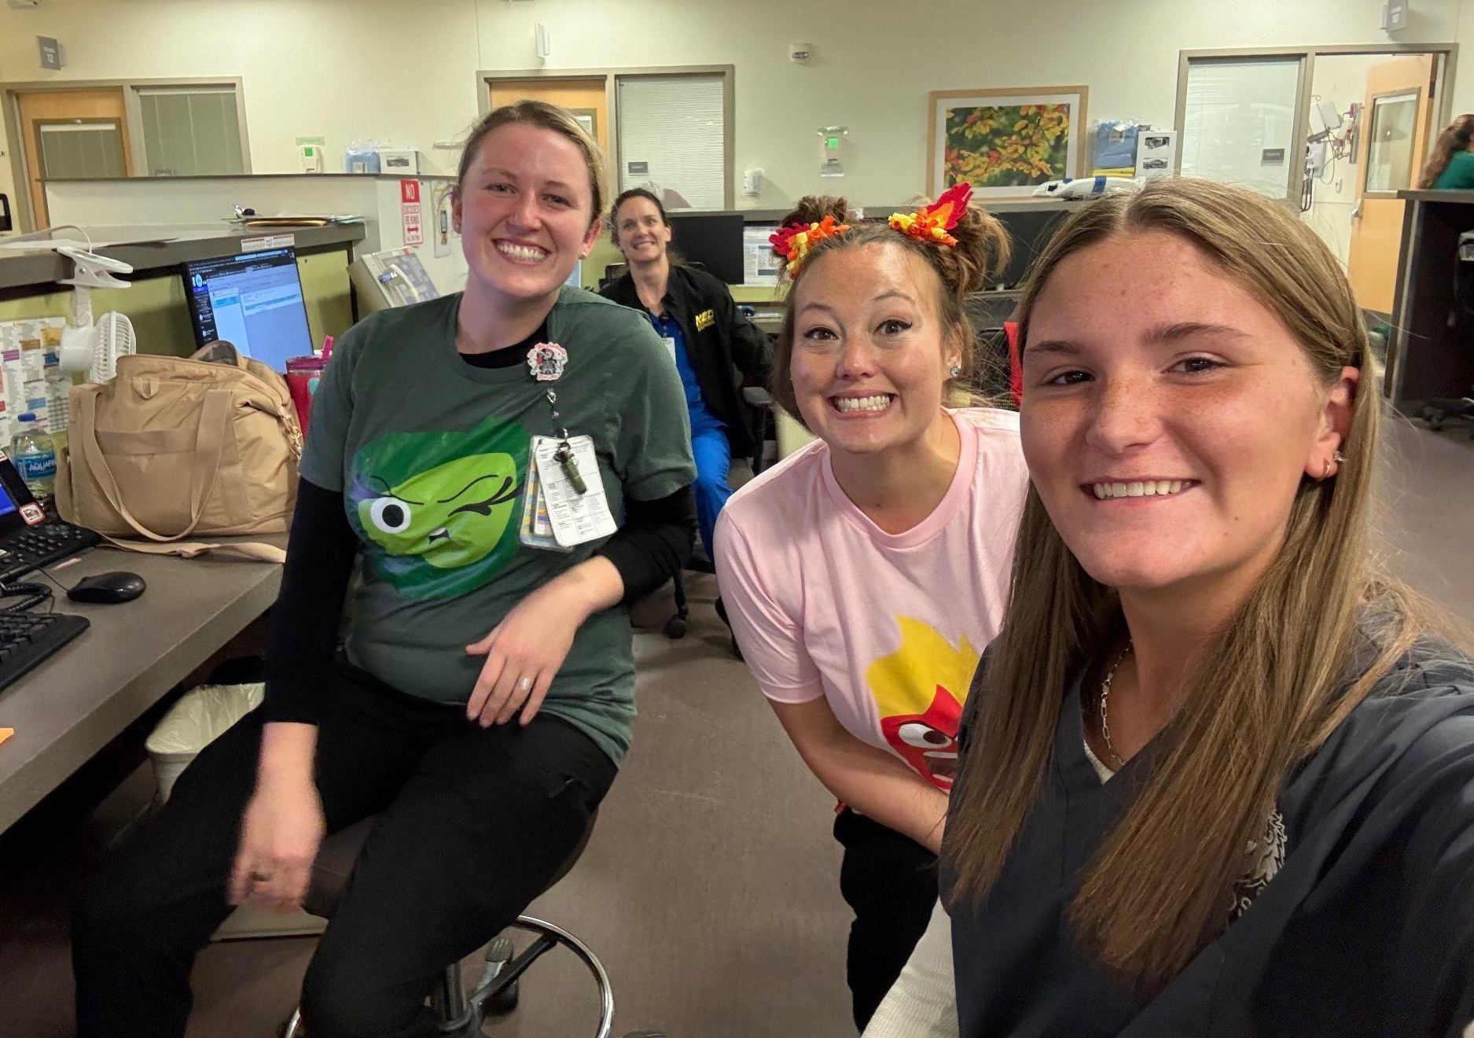
Health Sciences Strand
Fall Coursework
  HS 110: Intro to Health Sciences (3CR) - 1st Year
  EH 107: Environmental Science (3CR) - 2nd Year
  Industry Partner Experience – 80 hours (1CR)
Spring Coursework
  HS 111: Medical Terminology (3CR) - 1st Year
  PSY 100: General Psychology (3CR) - 2nd Year
  Industry Partner Experience – 80 hours (1CR)

Slide 8
Health Sciences Strand Fall Experiences
 | R1: 9/22-10/10 | R2: 10/15-10/31 | R3: 11/3-11/21 | R4: 12/1-12/17
Trauma Nurse | M: ED (9/8 to 10/10) | M: Behavioral Health (10/15 to 11/7) |  | M: ICU (11/10 to 12/17)
Returning | M: ICU (9/8 to 10/10) | M: CVICU (10/15 to 11/7) | F: Respiratory Therapy (11/10 to 12/17)
Surgeon / Anesthesiologist | F: Anesthesia (9/8 to 10/10) | M: ICU (3-week experience) | METS (11/3 to 12/17)
Dentistry | Uncommon Ortho (9/8 to 10/10) | Aspen (10/15 to 11/7) | ACCESS: Dental (11/10 to 12/17)
Pediatrician | F: Pediatrics (9/8 to 10/10) | M: OR (10/15 to 11/7) | M: Pediatrics IP (11/10 to 12/17)
Physician Assistant | M: OR | METS | M: ICU | M: Family Medicine Jackson St Clinic
Pediatric Physical Therapy | M: OT IP | F: Sports Medicine | SERC Joplin | F: PT IP
Physical Therapy | M: PT Galena | M: PT IP | Mercy RT, but pending diff. placement | F: Nursing - Ortho floor
Radiology | M: Radiology | F: ECHO | F: Radiation Oncology | Downtown Imaging
Nursing/Dental Hygienist | WEBB CITY Dental (Hygienist) | M: ED | School Nurse CJ | NCAD
Cardiologist/Nurse | M: CVICU | F: Radiation Oncology-EAST | Downtown Imaging | F: Radiology
Nurse Practitioner/ Anesthesia/ CRNA | CJ School Nurse | Uncommon Ortho | ASPEN Dental | Webb City Dental
Esthetician/Botox | F: Nursing - Ortho floor | La Boussole | F: Anesthesia | ACCESS: Women's Health
Navy Flight Medic/ police | METS | NCAD | M: ED | M: OR
Nursing or Radiology/Pediatric Oncology | M: Cardiac Med Surg 3rd floor | F. Gen. Surg. 3rd floor | F: Radiology | F: OT IP
Physical Therapist | M: Family Medicine (Jackson) | M: PT Rangeline | NCAD | F: Pediatric Therapy- EAST, closed on Fridays
Physical Therapist | F: Sports Medicine | SERC (Joplin) | Fyzical | M: Respiratory Therapy
Orthodontist | ACCESS: Dental | Webb City Dental | Uncommon Ortho | Aspen Dental
Sports Medicine | M: OT OP (Rangeline) | SERC WC | M: PT OP Galena | F: Sports Medicine

Slide 9
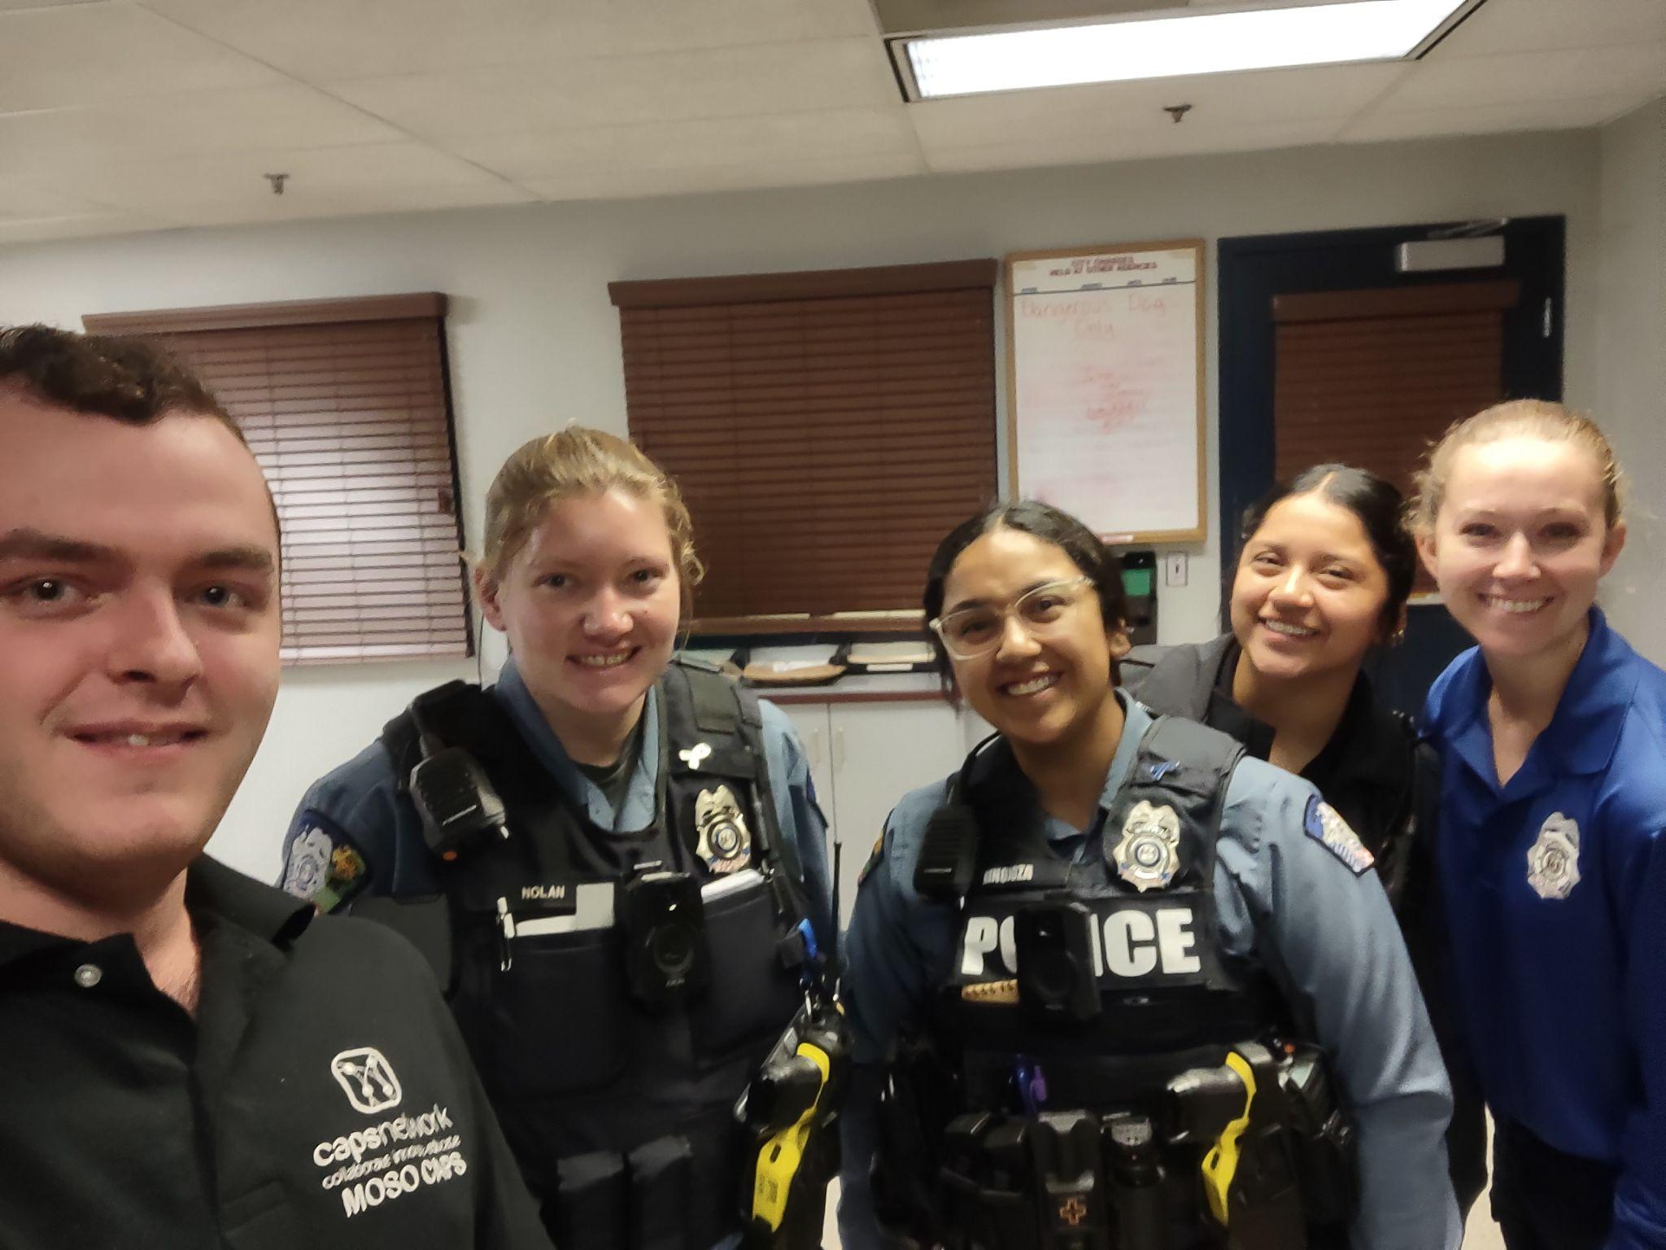
Human Services Strand
Fall Coursework
  SOC 110: Intro to Sociology (3CR) - 1st Year
  EH 107: Environmental Science (3CR) - 2nd Year
  Industry Partner Experience – 80 hours (1CR)
Spring Coursework
  PSY 100: General Psychology (3CR) - 1st Year
  2nd Year Based on Individual Need - (3CR)
  Industry Partner Experience – 80 hours (1CR)

Slide 10
Human Services Strand Fall Experiences
R1: 9/22-10/10 | R2: 10/15-1031 | R3: 11/3-11/21 | R4: 12/1-12/17
CJ Primary 2-3 w/ P. Bennett (9/8 to 10/24) | CJ Primary Continued to 10/24 | MSSU IT | MSSU IT
WCFD (9/8) | WCFD | WCFD | WCFD
Treatment Court | Stevenson | JC Prosecutor | CPD
WCPD | CPD | JCSO | JPD
Grand Falls | Mercy BH | Ronald McDonald House | Unearth Potential
Stevenson | JC Prosecutor | JPD | Treatment Court
JPD | Treatment Court | Mason Woodard | JCSO
Unearth Potential | NALA | Grand Falls | Melissa Talbott at JEC
Mercy BH | Unearth Potential | Treatment Court | Ronald McDonald House
NALA (Closed Fridays) | Mercy Care Man. | Freeman SS | Grand Falls
Ronald McDonald House | Grand Falls | Unearth Potential | Mercy BH
Health Teacher/IT
Fire Science/Public Safety
Attorney
Law Enforcement
Psychologist
Lawyer/Criminal Justice
Forensic Toxicologist
Child Psychologist
Psychology
Social Work
Psychology

Slide 11
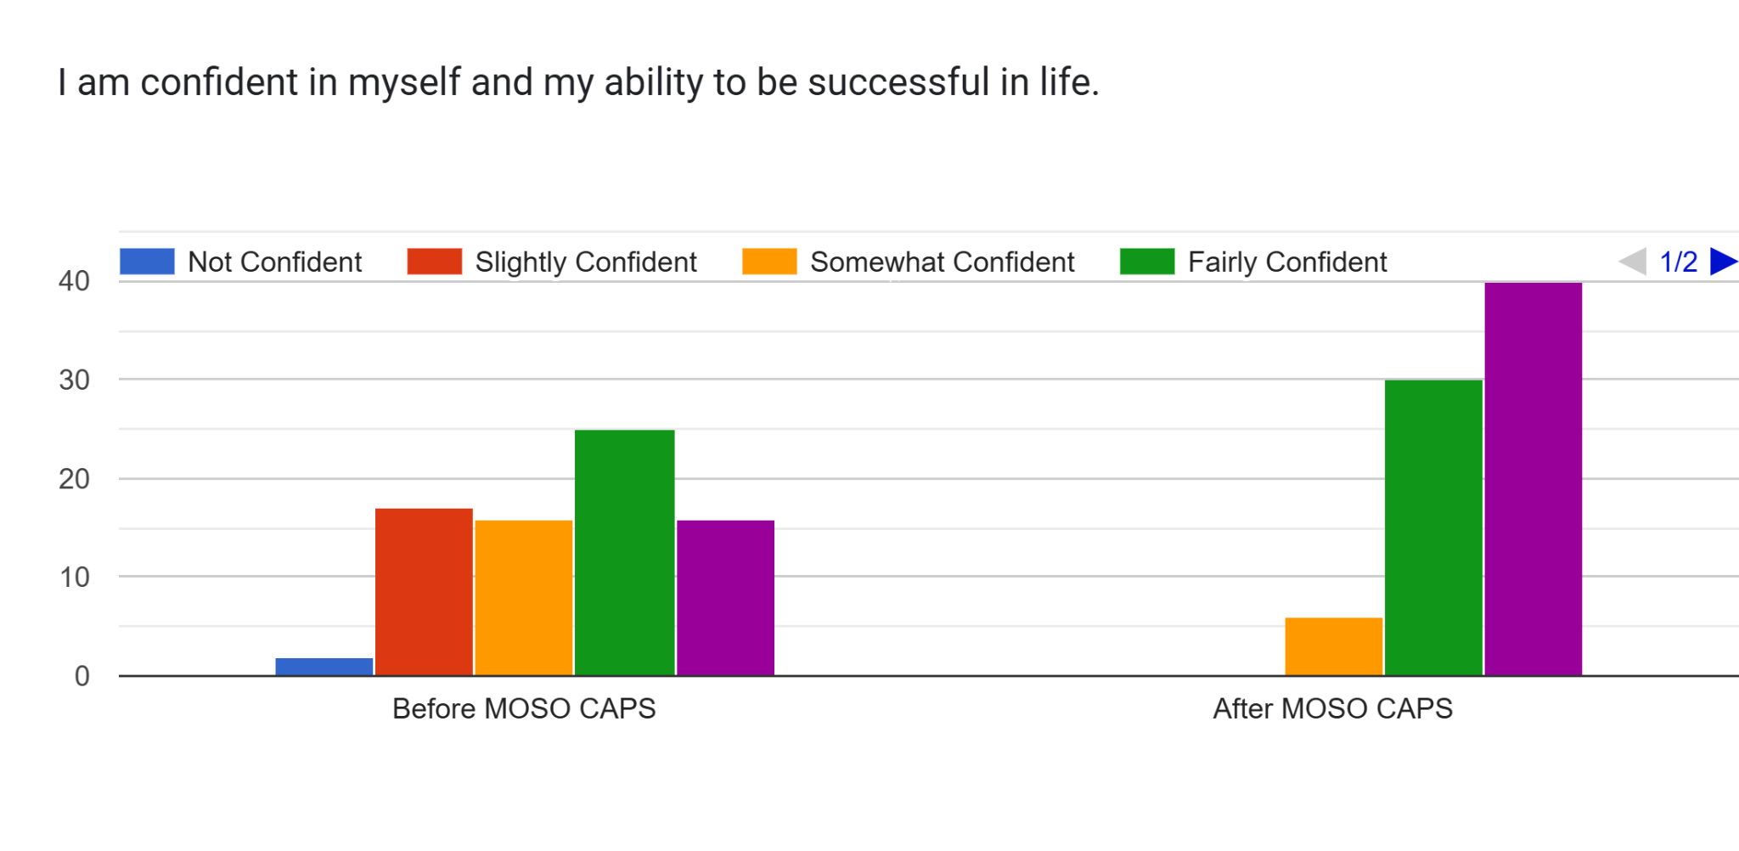
MOSO CAPS Survey Results

Slide 12
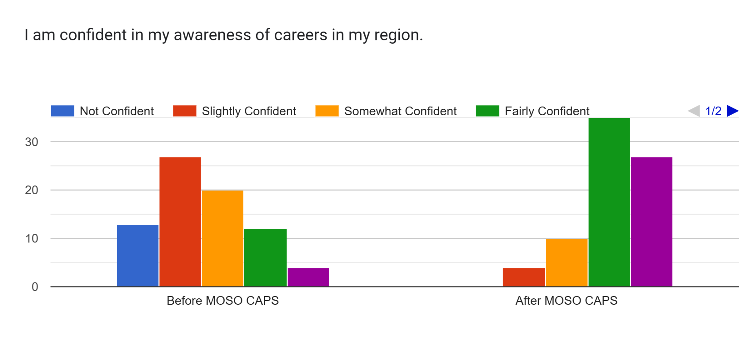
MOSO CAPS Survey Results

Slide 13
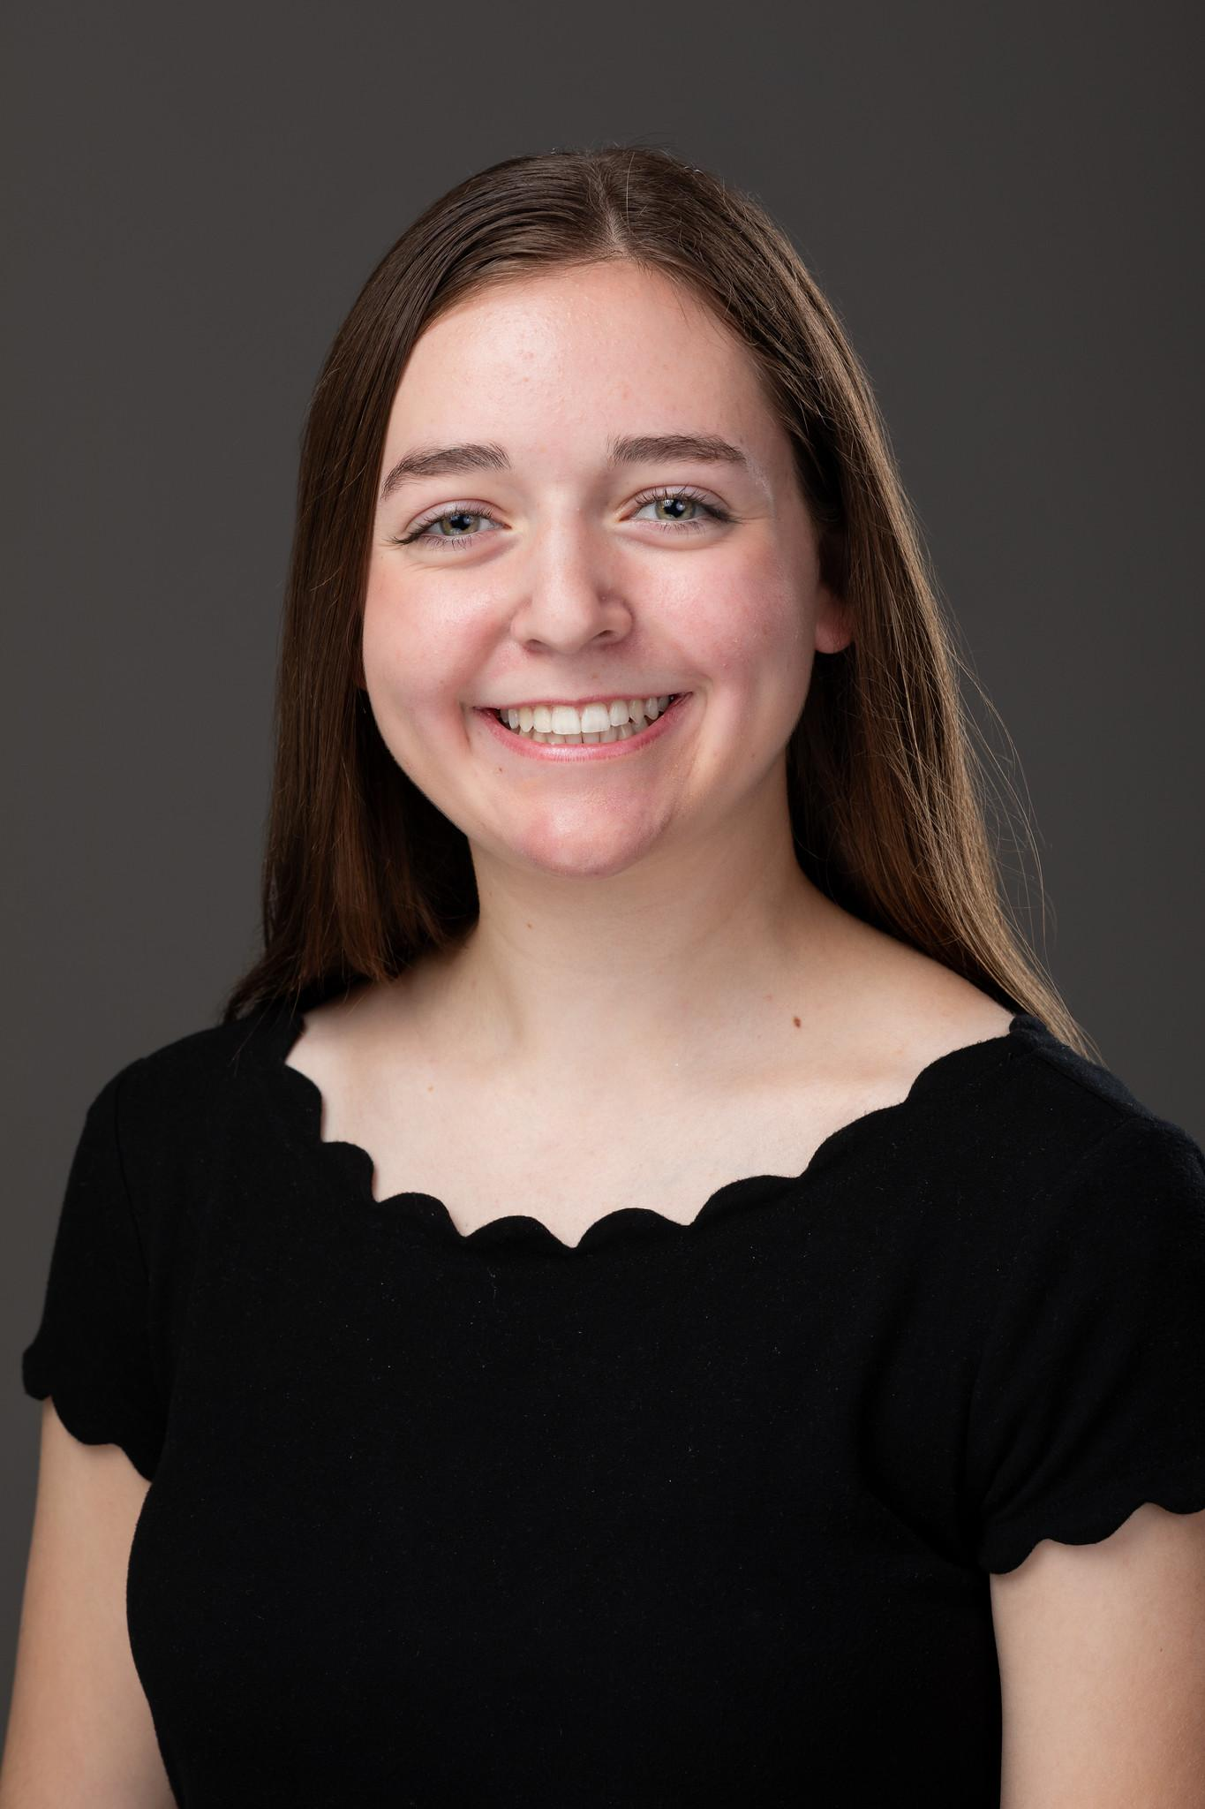
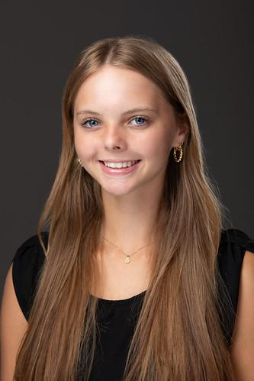
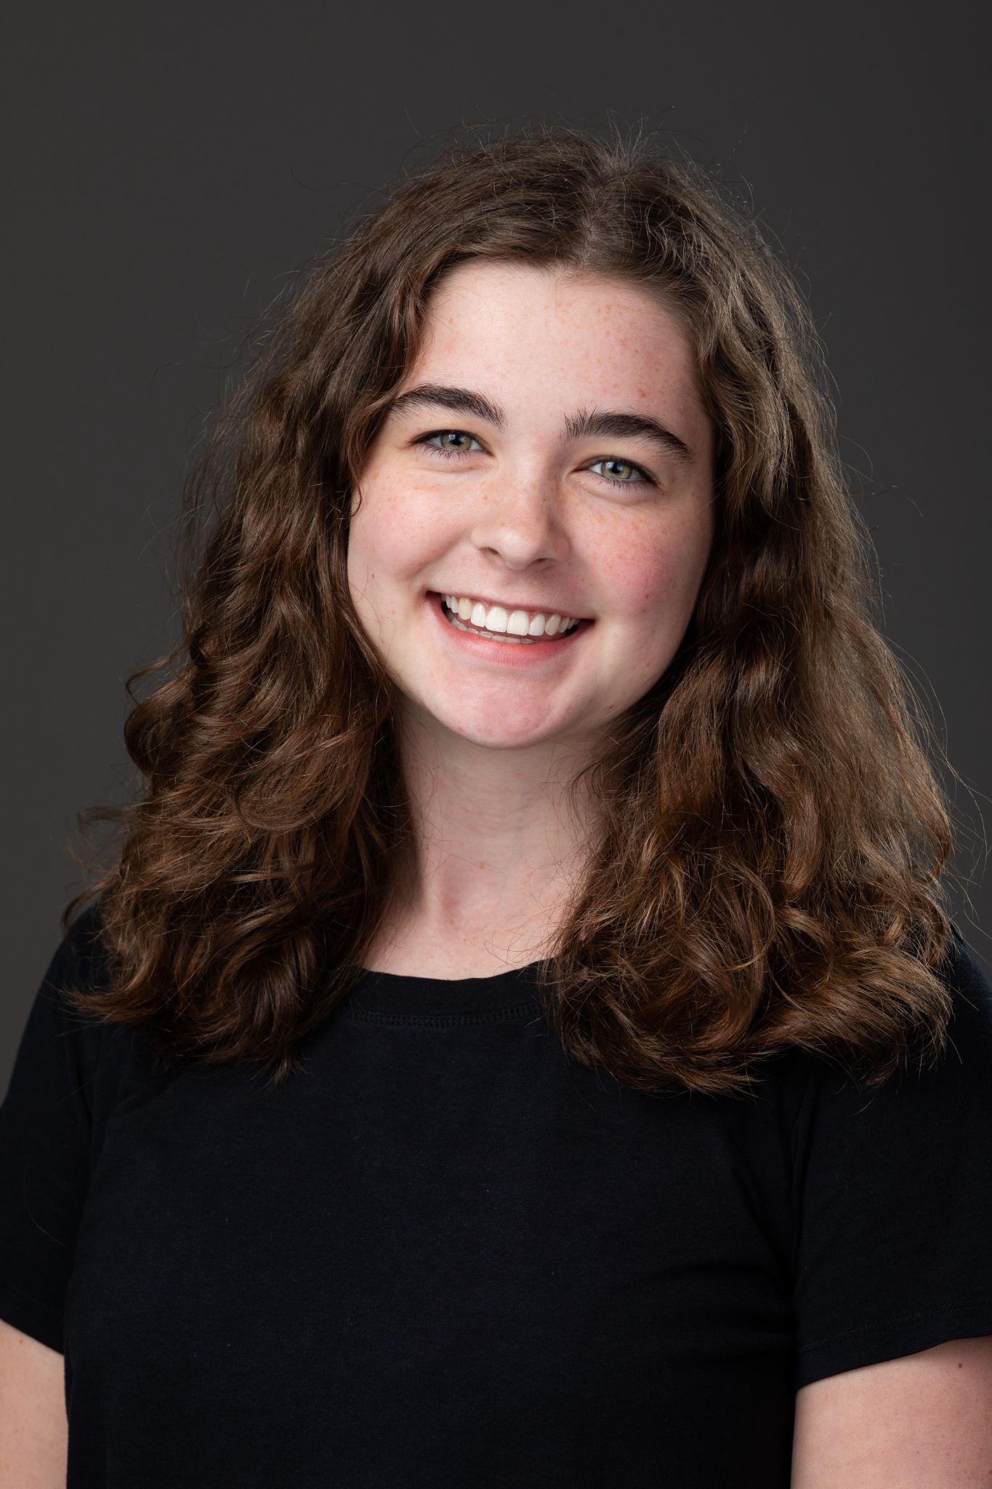
MOSO CAPS Student Associate Experiences
Addie Eaker
Business Strand
Hailey Hunter
Health Sciences Strand
Jenna Golden
Human Services Strand

Slide 14
Questions?

