Slide 1
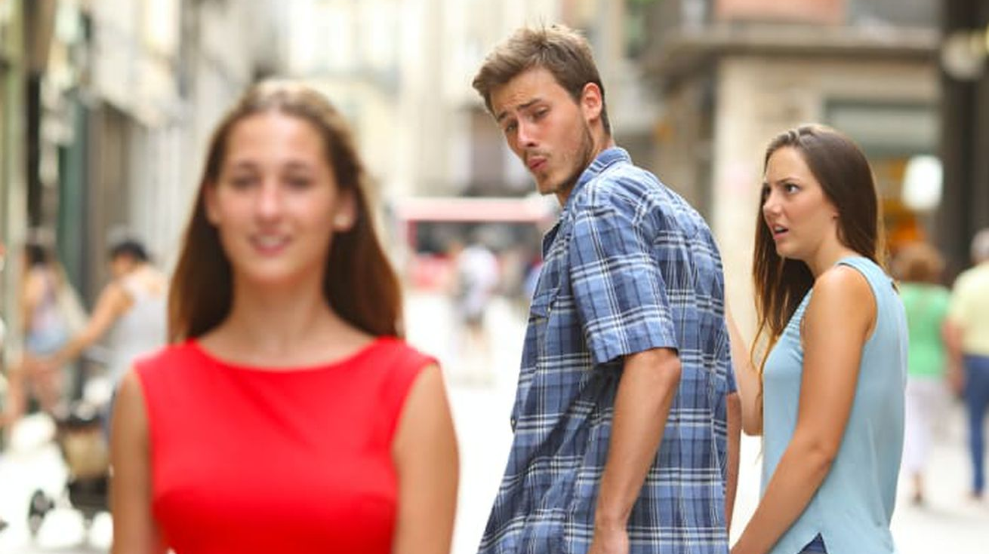

Title IX
Sexual Harassment
BEQUETTE, BILLINGSLEY & KEES, P.A.
JACQUELYN HARRISON
JHARRISON@BBPALAW.COM

Slide 2



What is Sexual Harassment Under Title IX?
OFFERING A BENEFIT CONDITIONAL ON THE INDIVIDUAL'S PARTICIPATION IN SEXUAL CONDUCT.
USING THE REJECTION OF SEXUAL CONDUCT AS A BASIS FOR ACADEMIC DECISIONS AFFECTING THAT INDIVIDUAL.
THE CONDUCT IS UNWELCOMED AND DETERMINED TO BE REASONABLY SO SEVERE, PERVASIVE AND OFFENSIVE THAT IT DENIES EQUAL ACCESS TO EDUCATION.

Slide 3

What is Sexual Harassment?
ANYTHING THAT CONSTITUTES:
EXAMPLES:
Making Sexual Propositions or pressuring for Sexual activity
Unwelcome touching
Telling sexual or crude jokes
Discussions of sexual experiences
Name calling in relation to sex or gender roles
Sexual Assault
Dating Violence
Domestic Violence
Stalking

Slide 4

What is Sexual Harassment, Continued…
Actionable sexual harassment is generally established when an individual is exposed to a pattern of objectionable behaviors or when a single, serious act is committed. What is, or is not, sexual harassment will depend upon all of the surrounding circumstances and may occur regardless of the sex(es) of the individuals involved.

Slide 5
What is Sexual Harassment- School Setting
Sexual harassment in a school setting may look much milder but must still be taken seriously.
    Female/Male student brushing against another in the hallway
    Female/Male student thrusting themselves against another student
    Student sending unsolicited and unwelcomed “sex pics”
    Female/Male student making suggestive comments to another student

Slide 6
Bullying or Sexual Harassment??
Evaluate every complaint to determine if it can be handled through your bullying policies/procedures, first.
A Title IX investigation will cover all bases (including bullying), but it is more rigorous. An investigation under the bullying policy may be warranted and is preferable, if applicable.
Ex: Johnny the Bully- if he is bullying students because of their funny hair, and they are majority female students, that can typically be handled under the bullying policy. If Johnny is targeting girls, because they are girls, then you need to bring in Title IX procedures.

Slide 7

  Who is covered (jurisdiction)?
  The complainant MUST be a current student or attempting to enroll (does not cover former employees)
  Covers any school event and any location where a school event was taking place (does not cover actions off campus and not school-related)
    Includes remote/ virtual learning
  If the respondent is no longer enrolled the school may end its investigation
  The complainant may withdrawal the complaint and the school may end its investigation. The Title IX Coordinator should confirm withdrawal in writing.

Slide 8
TITLE IX COORDINATOR
TITLE IX COORDINATOR (Melissa Edwards)
WEBSITE (INCLUDING ADDRESS, EMAIL AND PHONE)
TRAINED ANNUALLY
SHE IS NOT THE PERSON DOING THE INVESTIGATION, BUT OVERSEEING IT FOR COMPLIANCE
SERVES AS AN EXTRA LAYER OF COMPLIANCE
HAS A SEPARATE RECORD KEEPING SYSTEM
MUST BE SEPARATE FROM THE INVESTIGATOR AND DECISION MAKER

Slide 9
TITLE IX COORDINATOR
THE TITLE IX COORDINATOR NEEDS TO BE INFORMED OF THE HARASSMENT CLAIM
TITLE IX COORDINATOR SHALL CONTACT COMPLAINANT TO:
Parents and Students can bring concerns to any employee of the District
That District employee must take the those concerns to the Title IX coordinator
Discuss the availability of supportive measures;
Consider the complainant’s wishes with respect to supportive measures;
Inform the complainant of the availability of supportive measures with or without the filing of a formal complaint; and
Explain to the complainant the process for filing a formal complaint.

Slide 10

Supportive Measures
Designed to restore or preserve equal access to the District’s education program without unreasonably burdening the other party before or after the filing of a formal complaint, or where no formal complaint has been filed.
The District shall provide individualized supportive measures to complainant.
If they choose to deny the measures, a complainant must notify the district in writing that they have declined the supportive measures.
The complainant can decide later to request supportive measures, and the District shall provide appropriate measures based on the circumstances.
No punitive measures can be taken against Respondent until the conclusion of the grievance process.
Supportive measures are to be put in place immediately upon notification of Title IX allegations and remain throughout the grievance process.

Slide 11
Example
Johnny & Susie are students in the same home economics class. Students work in groups on various projects.
Susie stays after class one day to talk to the teacher.
Susie tells the teacher that Johnny has touched her bottom and breasts over her clothes on numerous occasions and she wants to be moved from his group. She also claims that Johnny has made crude comments about his own private parts.

Slide 12

Overview of Grievance Process
First, a formal complaint is filed with the district alleging the sexual harassment.
  This can be a phone call or email from a parent, student or staff member.
    Once notification of a potential Title IX complaint has been received, the Title IX Coordinator needs to be informed on the matter.
  Title IX Coordinator needs to get involved when the District determines the issues raise Title IX (i.e. sex, sex or more sex is at issue)
  Title IX Coordinator needs to confirm with the Complainant that he/she indeed wants an investigation to occur.
    SIDE BAR: Office of Civil Rights (OCR) places emphasis on the complainant having right to privacy and decision to move forward or not. However, the District can still investigate if it makes sense. I.e. District has multiple complaints against this same student or District believes the Complaint was withdrawn out of fear.
    Send the Complainant a copy of the Formal Title IX Complaint form to fill out and return to the Coordinator.
    Should always provide the Title IX Complaint form to a potential Complainant to show the District did in fact advise on the right to initiate the grievance process.
  UNDERSTAND THIS: When you get a complaint against Johnny that raises Title IX issues- you can no longer go directly to Johnny to discuss like you may have in the past. Johnny has safeguards, too.

Slide 13
Overview of Grievance Process
Formal Complaint and Susie....
The teacher needs to report what Susie told her to the Title IX Coordinator.
It is only an informal complaint at this point. Title IX Coordinator needs to determine if this is a Title IX matter or if it can be handled as bullying/poor conduct.
If we go the Title IX route, Title IX Coordinator must contact Susie's parent(s) and share the information so the parent(s) can decide if a formal complaint needs to be filed.
  But still, the District will still need to act regardless...
  When contacting the parent(s), advise on supportive measures will be put in place from the outset of the investigation.
  Provide the parent(s) with a copy of the District’s Title IX Policy.
Supportive Measures: These can be put in place during the investigation. I.e. separating Susie and Johnny in the class.

Slide 14

Grievance Process & Investigating Sexual Harassment
The District Shall:
Ensure that the burden of proof and evidence gathering rests with the District and not on the parties;
The burden of proof is a preponderance of the evidence (i.e., 50.01% or more likely than not sexual harassment did or did not occur)
Not use information or evidence that constitutes legally privileged information without consent of the party or the party’s legal guardian;
Provide an equal opportunity for the parties to present witnesses, including fact and expert witnesses as part of the grievance process;
Not restrict the ability of either party to discuss the allegations under investigation or to gather and present relevant evidence.

Slide 15

Formal Complaint and Notices
Upon receipt of a formal complaint, the District must provide these written notices:
Notice of Complaint
  Once the Title IX Formal Complaint has been received by the Coordinator, both Complainant and Respondent are to be simultaneously sent Notice of Formal Complaint, a copy of the Complaint, and a copy of the District’s Title IX Grievance Procedures;
  The Complaint must provide notice of the allegations of sexual harassment including sufficient details known at the time and with sufficient time to prepare a response before any initial interview;
  Details will include all party identities, the alleged conduct constituting sexual harassment, and the date and location of the alleged incident;
  A statement that the respondent is presumed not responsible for the alleged conduct and that a determination regarding responsibility is made at the conclusion of the grievance process
Notice of Interview
  Title IX Coordinator or Investigator needs to send out Notice of Interview prior to conducting the investigative interviews.
  The Notice should advise the parent(s) that each party has a right to an advisor.

Slide 16
Formal Complaint and Notices
Upon receipt of a formal complaint, the District must provide these written notices:
That the parties may have an advisor of their choice, who may or may not be an attorney.
That the parties may inspect and review evidence relevant to the complaint of sexual harassment.
That the District’s code of conduct prohibits knowingly making or submitting false information or statements.

Slide 17

Overview of Grievance Process
Next, the District begins an evidence gathering investigation.
  The Title IX Coordinator cannot investigate.
  Title IX Coordinator alerts the Complainant that the District will be investigating the matter—simple email to confirm the allegations.
    Attach the sexual harassment policy and copy of the Title IX Formal Complaint form.
  The evidence gathering will include statements from parties and witnesses.
  The Investigator should also gather other relevant evidence such as video footage, attendance records, grades, etc.
  The respondent (Johnny) has several additional rights in the process:
    He/ she gets a right to an advisor, copy of the policy, statement that he is presumed not responsible until otherwise, etc.
    The Respondent cannot be punished prior to the conclusion of the grievance process.
    The Respondent gets to submit evidence, witnesses and respond to the allegations.
  Parties will be given the opportunity to present relevant evidence.
  Parties will be notified of relevant evidence so to have an opportunity to assess and respond.

Slide 18
Overview of Grievance Process
Next, both parties get ALL the relevant evidence collected before a decision.
  This may feel uncomfortable, but Title IX requires transparency and overrules FERPA concerns
    Very tricky to navigate
    Best Practice
      Use initials when possible
      Redact student witness names from final report, but witness NEVER get confidentiality
      Provide adult witness names
      Notify parents when their student is involved in a Title IX investigation (if under 18)
Once the investigative interviews have concluded, the Investigator shall provide copies of the interview summaries and evidence gathered to both parties (complainant and respondent) allowing 10 days to review and provide a Response.

Slide 19

Grievance Proceedings Continued…
The District Shall:
Provide the parties with equal opportunities to present at the grievance proceeding, including the opportunity to be accompanied by the advisor of their choice;
Provide written notice to all parties expected to participate in the Grievance proceeding;
Provide both parties an equal opportunity to inspect and review any evidence obtained as part of the investigation that related to the formal complaint, giving each party a meaningful opportunity to respond to the evidence.

Slide 20

Investigative Report
The District shall create an investigative report that fairly summarizes relevant evidence.
At least ten (10) days prior to completion of the investigative report, the District shall send each party and the party’s advisor, the evidence subject to inspection and review in an electronic format or hard copy.
The parties will have approximately ten (10) days to submit a written response to the evidence.
The Investigator will consider the written responses prior to completion of the investigative report.
The District may hire an individual or individuals to conduct the investigation or to act as the decision-maker when necessary.

Slide 21

Decision Maker
Following the completion of the investigation period, the Decision Maker shall issue a written determination regarding responsibility including the following:
Outline the allegations constituting sexual harassment;
Outline of the procedural steps taken, beginning with the formal complaint and ending with this written determination;
What and How the parties were notified;
Site visits and methods used to gather evidence;
Findings of fact supporting the determination;
Conclusions regarding the application of the District’s code of conduct, applicable to the facts found;
Statement of results regarding each allegation alleged;
  Who was responsible
  Disciplinary sanction imposed on respondent
  What remedies will be provided to the complainant, by the District, to restore or preserve equal access to education

Slide 22

Reasons to Dismiss the Formal Complaint:
The Complainant notifies the Title IX coordinator in writing that they would like to withdraw the formal complaint;
The respondent is no longer enrolled at the District;
Specific circumstances prevent the District from gathering evidence sufficient to reach a determination as to the formal complaint or its allegations;
If the district determines that the formal complaint would not constitute sexual harassment as defined in the Title IX policy; Did not occur in the District’s program; Did not occur against a person in the US;
Upon Dismissal, all parties shall be notified by written notice, simultaneously.

Slide 23

Appeals
Either party may appeal a determination regarding responsibility or from a dismissal of a formal complaint, or any allegation therein, on the following bases:
The existence of a procedural irregularity that affected the outcome of the matter;
Discovery of new evidence that was not reasonably available at the time of the determination or dismissal that could affect the outcome of the matter;
The Title IX coordinator, investigator, or decision-maker had a conflict of interest or bias that could have affected the outcome of the matter;
An appeal of the disciplinary sanctions from the initial determination.

Slide 24

An Appeal is NOT a Do-Over, but only opportunity to correct the Appealable Issue
For all appeals, the District Shall:
As always, notify all parties in writing;
Provide all parties a written copy of the District’s procedures governing the appeal process;
Implement appeal procedures equally for both parties;
Use a different decision-maker for the appeal;
If the investigator or Title IX coordinator had a conflict, or contributed to the appealable issue, ensure you have different individuals to inherit those roles.
Provide parties a reasonable, equal opportunity to submit a written statement in support of, or challenging the outcome;
Issue a written decision, to both parties, describing the result of the appeal and the rationale for the result.

Slide 25

Reports of sexual harassment, both informal reports and formal complaints, will be treated in a confidential manner to the extent possible. Limited disclosure may be provided to:
Investigators and decision-makers involved in the determination of the Districts grievance process;
Submission of a report to the child maltreatment hotline;
Submission of a report to the Professional Licensure Standards Board for reports alleging sexual harassment by an employee towards a student;
The extent necessary to provide either party due process during the grievance process.

Slide 26

Important Information
EMERGENCY REMOVAL
RETALIATION PROHIBITED
The District may remove a respondent from the District’s education program on an emergency basis only after the completion of an individualized safety and risk analysis that determines that there is an immediate threat to the physical health or safety of any student or individual.
Any student or parent that submits a formal complaint, or participates in a grievance process, shall not be subject to retaliation or reprisal in any form.
The District shall be responsible to take steps to prevent all forms of retaliation.

Slide 27
Important Information Continued…
DISCIPLINARY SANCTIONS
No disciplinary action, other than supportive measures, may be taken against a respondent until the conclusion of the grievance process;
Any student who is found by the evidence to have “more likely than not” engaged in sexual harassment may be subject to expulsion, or any other disciplinary action up to expulsion;
A student who knowingly fabricates allegations of sexual harassment or purposely provides inaccurate facts shall be subject to disciplinary action up to and including expulsion;
A finding that the allegations to don’t rise to sexual harassment is not in itself sufficient evidence to conclude an allegation is false or in bad faith.

Slide 28
Important Information Continued…
THE DISTRICT SHALL MAINTAIN THE FOLLOWING RECORDS FOR A MINIMUM OF SEVEN (7) YEARS:
Each sexual harassment investigation;
Any determination regarding responsibility;
Any disciplinary sanctions imposed on the respondent;
Any remedies provided to the complainant designed to restore or preserve equal access to the District’s education program or activity.
Any appeal and the result therefrom;
All materials used to train Title IX coordinators, investigators, and decision-makers;
Any actions, including any supportive measures, taken in response to a report or formal complaint of sexual harassment, which must include:
  The basis for the District’s conclusion that its response was not deliberately indifferent
  Document the supportive measures provided to restore or preserve equal access to education
  If no supportive measures taken, document why it was not clearly unreasonable to do so, in light of the circumstances.

Slide 29


