Slide 1


Information Session

Slide 2
What is the College Credit Plus Program?
College Credit Plus is Ohio’s dual credit program
  Students can earn high school and college credit simultaneously
  Ohio residents in grades 7-12; enrolled at a public/private high school or homeschooled
  Take a variety of courses at any public and participating private college in Ohio
  Courses can be held at the high school, on a college campus, or online
  Tuition, fees and textbooks related to the coursework are provided to the student free of charge.
  Get a head start on career planning and earn degrees or certificate completions
  Experience college early to understand the expectations of college life
ORC 3365.02, ORC 3365.03

Slide 3

Potential College Credit Plus Expenses
Students must pay tuition expenses to the school district for any course withdrawals or failed courses.
Parking fees are the responsibility of the student if taking classes on the campus.

Slide 4
Selective Service
Male students who are at least 18 years of age and Ohio residents are required to be registered with the Selective Service System
Students are required to provide their Selective Service number to the public college or university within 30 days of their 18th birthday
Failure to submit the Selective Service number will result in the student not being considered a College Credit Plus participant for that semester or term
  The student will be responsible for any tuition, textbooks, or fees associated with the course(s) as well as an additional surcharge.
ORC 3345.32
Notes:
Additional Notes for Presenters:
- Some schools post a fee for students that fail to comply with selective service requirements

Slide 5


Students must submit an Intent to Participate Form to the high school by APRIL 1 to participate for the full upcoming academic year (Summer, Fall and Spring.)
Forms Must Be Submitted Each Year.
Intent to Participate Deadlines
Students who did not submit an Intent to Participate Form to the high school by the APRIL 1 deadline may submit a form to the high school by November 1 to participate in Spring semester only.

Slide 6
How can students participate?
Step 1
Eligibility
Step 2
Admission
Step 3
Registration

Slide 7
How can students participate?
  Step 1: Eligibility
  A student is eligible for the College Credit Plus program if the student meets any of the following criteria:
    Has a cumulative unweighted high school grade point average of at least 3.00
    Has a cumulative unweighted high school grade point average of at least 2.75 but less than 3.00 and received an "A" or "B" grade in a relevant high school course.
    Obtains a remediation-free score on one of the standard assessment exams
ORC 3365.03, OAC 3333-1-65.14

Slide 8
Student Eligibility Assessment Exams
Students’ scores must show that they are ready for “college-level” courses in at least one subtest on an exam
Exams include ACT, SAT, Accuplacer, ALEKS, PlaceU, or MapleSoft
  Students need to confirm exam requirements with the college
  Colleges and universities will review students’ scores using statewide standards
ORC 3365.03, OAC 3333-1-65.14

Slide 9
How can students participate?
Step 2: College Admission
  Students must apply for admission at each institution
    Please use a personal email address when applying
    Admission is reviewed per the requirements of the college or university; contact the college to find specific information
College applications include the permission slip for mature content and a questionnaire about emotional maturity
Colleges have the final decision on student admission
ORC 3365.05, 3365.035, OAC 3333-1-65.3

Slide 10
How can students participate?
Step 3: Course Registration
  If the student is considered eligible and has been admitted to the college, then:
    The college will discuss course options with the student, based on assessment scores, prerequisites, and other requirements
      Students may be required to complete an orientation and meet with a college advisor in order to enroll in classes
      Please note, even though a student may qualify for eligibility based on the high school GPA, they may still be required to complete placement testing for course placement.
    School counselors can help students understand graduation requirements and CCP course substitutions
    High schools and colleges develop 15 and 30 credit hour pathways to help you determine your plan
ORC 3365.13

Slide 11
Course Eligibility Rules
Allowable Courses
Students may only enroll in “Level I” courses within the First 15 Credits
Level I Allowable Courses Include:
Transferable courses: Ohio Transfer 36 (OT36), Transfer Assurance Guide (TAG) or Career-Technical Assurance Guide (CTAG)
Courses in computer science, information technology, Anatomy & Physiology, or foreign language, including American Sign Language
Courses that are part of a technical certificate
Courses that are part of a 15- or 30-credit pathway
Courses in study skills, academic or career success
Most Level I courses are part of the General Education Program at The University of Akron.
Level II - Any other college course that is not a Level I course
Exceptions to the “First 15” Rule may be made if the student wishes to continue with course in the same subject or tests directly into Level II course. Students who have attained the required scores on AP or IB course examinations may count the course toward the First 15.

Slide 12
Non-Allowable Courses
Non-allowable courses are not funded by the state regardless of how many credits a student may have completed.
Non-allowable courses include:
Private applied courses with one-on-one instruction (such as music lessons)
Courses with high fees
Study abroad courses
Physical education courses
Pass/Fail graded courses
Remedial courses
Sectarian/religious courses
OAC 3333-1-65.12, ORC 3365.13

Slide 13
Class Selection
College Credit Plus students may take a wide variety of university classes, but many take General Education classes which also fulfill high school graduation requirements. Most core classes meet the “Level I” allowable course rule. Students must meet necessary placement and/or prerequisite requirements.
Classes have included:
  Government & Politics in the U.S.
  Economics
  English Composition
  Sciences
  Foreign Languages
  Psychology
  Sociology
  Public Speaking
  Mathematics

Slide 14
Online courses
Most online classes are asynchronous, meaning they do not meet on specific days and times. However, there will be specific due dates and deadlines for assignments, quizzes and tests.
Online courses are a significant time commitment!
  A 3-credit online course requires at least 3 hours of coursework per week, but for many classes a student may need to spend 6-9 hours per week.
  That time is in addition to all other obligations – school, sports, band, work, etc.
Students must reach out directly to professors if they have questions or need clarification.

Slide 15
30 Credit Limit for Public School Students
Between the high school and University, the maximum number of credits that can be taken in a school year (summer, fall and spring semesters) is 30 credits. Students can earn up to 120 total college credit hours while in the program.
Students wishing to enroll in more than 30 credits can choose to pay. Credits would be billed at the regular tuition and fee rate.
Credit Conversion and Credit Limit
College courses worth 3 or more college credits
=
1 full high school credit
Ex. English Composition 111 (3 credits) fulfills one full credit of high school English.
College courses worth less than 3 college credits are divided by 3 to determine equivalent high school credits.
OAC 3333-1-65.12, ORC 3365.13

Slide 16

Sample Schedule
School Name | Course | Duration | HS Credits | College Credit Equivalency
Bayside HS | Algebra II | All Year | 1 | 3
Bayside HS | Chemistry | All Year | 1 | 3
Bayside HS | American History | All Year | 1 | 3
Bayside HS | Spanish 3 | All Year | 1 | 3
Bayside HS | Band | All Year | 1 | 3
The University of Akron | English Composition I | Fall | 1 | 3
The University of Akron | Intro to Public Speaking | Fall | 1 | 3
The University of Akron | English Composition II | Spring | 1 | 3
The University of Akron | Intro to Psychology | Spring | 1 | 3
Total Credits = 27

Slide 17

Grades are Applied to High School Transcripts
The final grades you earn in the college courses will be recorded on the high school transcript and factored into the high school and college GPAs.
The grades may satisfy high school required or elective classes.
College courses must be weighted equally to the greatest weight of Advanced Placement, International Baccalaureate or honors classes, in the same subject area.
AP, IB, Honors
Class
College
Course
ORC 3365.12, OAC 3333-1-65.2

Slide 18
Differences Between High School & College
 | High School | College
Study Time | Required homework ranges between 1-3 hours per day | 2-3 hours of studying/reading for each hour of class
Knowledge Acquisition | Information provided mostly in class, assignments to follow what was covered | Out-of-class work in advance of in class discussion
Tests | Given weekly or at the end of each unit | Less frequent and cover more material
Grades | Numerous quizzes, tests, homework, assignments, etc. | Fewer tests and few homework assignments
Role of Parents/Guardians | Guardians advocate, involved and work with teachers & counselors | Student has more responsibility; guardians more of a mentor/support
Accommodations | Parents & students work with high school staff to determine what assistance or accommodations can be made for students with IEPs or 504 plans | Students must work directly with college staff to determine if accommodations are needed; IEPs and 504 plans may not be included in the discussions

Slide 19
What does it mean to be “college-ready”?
Being “college-ready” is more than just being academically ready
Consider emotional and social transition and college expectations
Consider time management and organizational skills

Slide 20
CCP Probation & Dismissal
Students will be placed on CCP Probation if the college cumulative GPA falls below a 2.0, or if they withdraw from two or more courses in one term.
Students on probation may enroll in no more than one course in the subsequent semester and cannot take courses in the same subject area that they earned D or F grades.
  Students may appeal to take a course in the same subject in which they previously earned a non-passing grade or received no credit
If the students on CCP Probation do not increase their cumulative GPA to a 2.0 or higher during the subsequent probation term, they are eligible for CCP Dismissal.
Within 5 days of being dismissed, the student may submit an appeal to the secondary school to appeal CCP Dismissal or the student may appeal at the end of the CCP Dismissal semester
ORC 3365.09, 3365.091; OAC 3333-1-65.13

Slide 21
Consequences of Underperforming
Failures and Withdrawals
Families may be asked to reimburse courses if:
The student does not earn a passing grade in their course
The student withdraws after the no-fault deadline at the college
NOTE: A student that is considered “economically disadvantaged” can not be asked to reimburse the cost of the course(s)
ORC 3365.09, 3365.091; OAC 3333-1-65.13

Slide 22
Consequences of Underperforming
After HS Graduation:
Grades earned in CCP will remain on students’ college transcripts permanently
If students fail or withdraw often, future financial aid may be also impacted negatively
  Satisfactory Academic Progress (SAP) is a requirement for financial aid
  Standards vary by institution
ORC 3365.09, 3365.091; OAC 3333-1-65.13

Slide 23
What are support services are available for students?
Students receive support from both the HS and College:
High school counselors continue to provide assistance to all College Credit Plus students
College advisors provide course selection assistance
Colleges provide academic supports to CCP students such as tutoring, library access, advising, etc.’
Accommodations in high school for an IEP or 504 plan do not automatically apply to college classes. Students must register with an accessibility office at the college to be assessed for accommodations in college classes.

Slide 24
Athletic Eligibility
Student athletes should:
Learn the Ohio High School Athletic Association (OHSAA) requirements
Summer term CCP courses cannot be used to bring a student into compliance with the OHSAA requirements for interscholastic athletic participation

Slide 25

Options after High School
Always remember that your participation in College Credit Plus is the start of your college transcript.
Even if you plan continue at the same institution after graduation, you must reapply in your senior year.
  The state universities and community colleges in Ohio will still consider you a new freshman so you can be considered for scholarships and selective opportunities such as an honors colleges.

Slide 26
Applying to Other
Colleges and Universities
All subsequent colleges/universities will require an official copy of your college transcript when you apply.
Transferability vs. Applicability
Although credits taken will transfer within the state university system of Ohio, the receiving institution will ultimately determine how the credits apply.
Visit the Ohio Department of Higher Education website to learn how your credits may transfer within the University System of Ohio: https://transfercredit.ohio.gov/students
Create an account at www.transferology.com to learn how credits may transfer to public, private and out-of-state colleges.

Slide 27
Save All Course Syllabi
Make sure to print copies of syllabi for all classes to keep track of assignments and grades, and so you have contact information for your professors.
Remember to save all syllabi in the event you need to send copies to other colleges and universities.

Slide 28

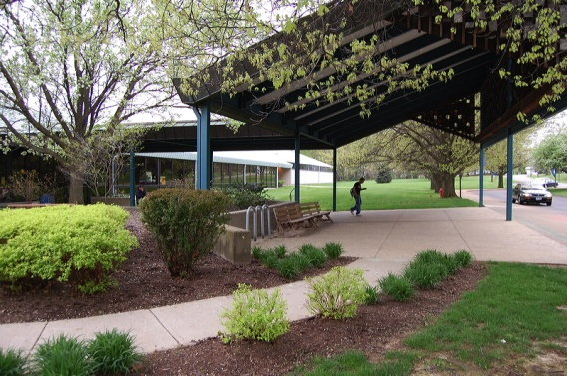

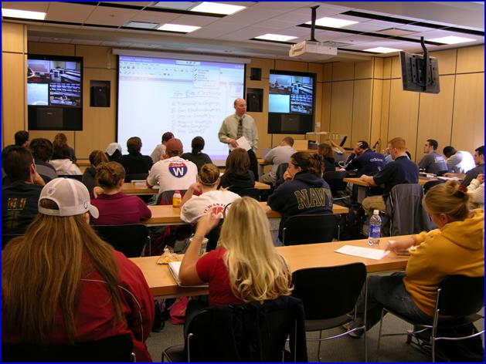
Options for Classes through UA…
Akron Campus
Wayne College
Online
Onsite in the
High School

Slide 29
CCP Courses at Revere HS
Fall Courses
English Composition I (ENGL:111) – 3 credits
Government & Politics in the US (POLIT:100) – 3 credits
US History to 1877 (HIST:250)
Intermediate Spanish I (SPAN:201)
Intermediate French I (FREN:201)
Spring Courses
English Composition I (ENGL:111) – 3 credits
English Composition II (ENGL:112) – 3 credits
Government & Politics in the US (POLIT:100) – 3 credits
Intermediate Spanish II (SPAN:202)
Intermediate French II (FREN:202)
Courses require placement scores and/or completion of prerequisites.

Slide 30
CCP Admission Requirements
3.00 cumulative unweighted high school GPA
OR
Obtain at least one remediation-free score on the ACT or SAT as determined by the Ohio Department of Higher Education:
· ACT English of 18, ACT Reading of 22 or ACT Math of 22.
· SAT Evidence-based Reading & Writing of 480 or SAT Math of 530.
Students with at least a 2.75 cumulative unweighted high school GPA will be evaluated by the Office of Admissions to determine if ACT or SAT scores are required.
7th and 8th grade applicants without an established high school GPA must take the ACT or SAT.
Applicants admitted without ACT/SAT test scores, or applicants with ACT/SAT test scores who do not automatically place into college-level courses will be required to complete placement testing through the University.

Slide 31
How to Apply
Complete an Undergraduate Admission Application
Please use a personal email address when applying. Your school district email may block outside emails.
Submit school transcripts
Print and Submit the Signature Page & Permission Slip
Submit ACT or SAT scores (required for applicants who do not meet eligibility based on GPA)
The summer/fall application deadline is April 15
The spring application deadline is October 15
CCP Website: www.uakron.edu/ccp

Slide 32
Placement Testing
Students admitted without ACT/SAT scores, or students with test scores who do not place you into college-level courses, you will be required to complete placement testing through the University.
The University of Akron uses the ACCUPLACER for Writing and Reading Placement.
  Testing is administered in-person by a proctor.
  The Writeplacer is used for placement in English Composition.
  The Next-Generation Reading test is used for placement in Social Science courses (Psychology, Sociology, Government, Economics, or History) Only required for students admitted with less than a 3.0 unweighted cumulative high school GPA.
Mobius (Maplesoft) is administered online for Math placement testing.
Students must complete placement testing prior to their enrollment.

Slide 33
Orientation
All College Credit Plus students must attend a New Student Orientation.
During Orientation you will:
  Review important state and University policies
  Discuss course options and placement
    Necessary placement testing must be completed prior to enrollment
  Learn how to access MyAkron & Brightspace

Slide 34
College Credit Plus Contacts:
Greg Landis, Admissions
Sr. Associate Director of Admissions
(330) 972-5827 or 1-800-655-4884
e-mail: glandis@uakron.edu
Greg Dieringer, Director
Director of College Credit Plus
(330) 972-7572
e-mail: gdierin@uakron.edu

Slide 35
Next Steps
Meet with your school counselor to discuss scheduling and graduation requirements
Contact the college and discuss assessment testing requirements
Complete the Intent to Participate form and provide to the school office by April 1 (Full Academic Year) or by November 1 (Spring only)
Apply for admission at the college of choice by the deadline
Attend the required CCP Orientation at your CCP Institution

Slide 36
Questions?

