Slide 1

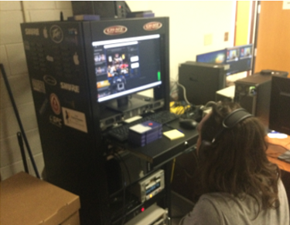
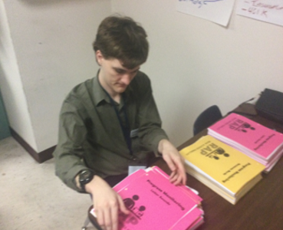
        Pinellas County Schools Administration Building
        Level 1- Project Search- Community-Based Vocational Education (CBVE)
        “To help young adults with disabilities, gain employability and independent living skills within an inclusive work environment.”
Our Program Day in the Life
Pinellas County Schools Administration (PCS-Admin) oversees the district's public education system, with leadership, resources, and initiatives.
The PCS-Admin program is a one-year Project SEARCH program. After completion, students agree to accept their HS diploma.
Students participate in an orientation followed by three, 10-week rotations in various PCS-Admin departments.
Opportunities across multiple departments include copy services, HR, Admin, and cafeteria services.
Participants learn to use public transportation to and from the internship independently.
Hours: 8:30 am-2:30 pm
Location: PCS Admin Building, Largo
Students begin their day with an hour-long class, spend up to five hours learning job skills at their internship, and return to the classroom to reflect on their day.
In the classroom, participants meet with a job coach for work skills development, and daily job planning, to discuss challenges and evaluate progress.
On-the-job training requires the students to work independently in assigned departments alongside PCS Admin employees.
Work assignments are based on needs, students’ skill sets, and interests.
Collaboration
Skills
The program collaborates with Interagency organizations to provide additional services.
These organizations include:
Florida Vocational Rehabilitation (VR)
Goodwill Industries- Suncoast
Agency for Persons with Disabilities (APD)
Family Network on Disabilities (FND)
Note: Some agencies have eligibility requirements..
Entry
High Independence- Ability to work independently.
High Motivation- Personally motivated and committed to gaining employability skills.
Low Support- Can work independently with limited support or supervision.
Stamina and concentration for 4+ Hours of work.
Able to work around the public in an integrated environment.
Guardians are committed and involved in supporting student progress.
Exit
Work readiness- skills (technical & soft), personal traits, abilities, work ethic, professionalism.
Job search- resume writing, job applications, interview preparation, and skills.
Self-advocacy- self-awareness, self-confidence, ability to know when and how to ask for help.
Social- communication, teamwork, conflict resolution, problem-solving, building and maintaining relationships.
Ability to use public transportation.

Slide 2
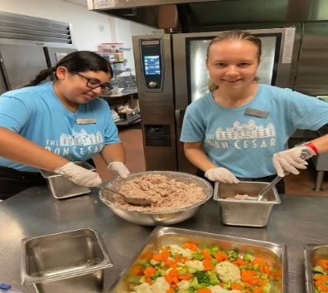
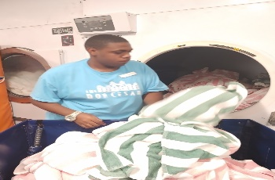
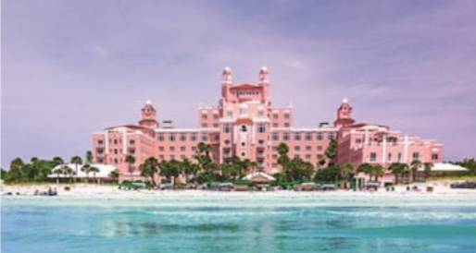

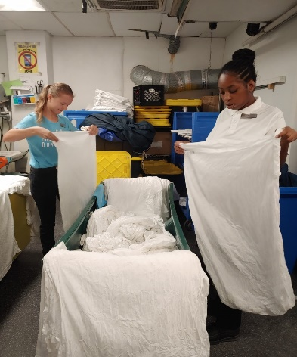
        Don CeSar Hotel
        Level 1-Community-Based Vocational Education (CBVE)
        )
        “To help young adults with disabilities, gain employability and independent living skills within an inclusive work environment.”
Our Program Day in the Life
The Don CeSar Hotel is a historic luxury resort that opened in 1928. It offers elegant accommodations, fine dining, and event spaces.
Don CeSar is an extended transition program for new and returning students who want to work in a professional hospitality environment.
Students experience a variety of jobs across multiple departments and interact with employees/ guests.
Opportunities include jobs in Laundry, Fitness Center, Banquet, Restaurant, Kitchens, and Break Room
Students will meet at Pinellas Technical College-South (PTC-S) and be provided transportation, breakfast, and lunch.
Hours: 6:45 am-1:15 pm
Location: Don CeSar Hotel, St. Pete Beach
Program includes classroom instruction at PTC-South and on-the-job training at the hotel.
In the classroom, students will develop work skills (i.e. job interviews), work habits, and behaviors.
On-the-job training students will work independently, 4+ hours a day.
Students will be under supervision and guidance from their instructors and engage in learning entry-level job skills. Jobs Include:
Basic food prep for the salad bar and kitchens.
How to polish and roll silverware, fold napkins, fill condiments, set up and wipe tables.
Run the towel folding machine, sort, stack, fold laundry items, and run the press machine.
Sanitize fitness equipment, vacuum, and fold fitness towels
Collaboration
Skills
The program collaborates with Interagency organizations to provide additional services.
These organizations include:
Florida Vocational Rehabilitation (VR)
Agency for Persons with Disabilities (APD)
Family Network on Disabilities (FND)
Note: Some agencies have eligibility requirements..
Entry
High Independence- Ability to work independently.
High Motivation- Personally motivated and committed to gaining employability skills.
Low Support- Can work independently with limited support or supervision.
Stamina and concentration for 4+ Hours of work.
Able to work around the public in an integrated environment.
Guardians are committed and involved in supporting student progress.
Exit
Work readiness- skills (technical & soft), personal traits, abilities, work ethic, professionalism.
Job search- resume writing, job applications, interview preparation, and skills.
Self-advocacy- self-awareness, self-confidence, ability to know when and how to ask for help.
Social- communication, teamwork, conflict resolution, problem-solving, building and maintaining relationships.
Ability to use public transportation.

Slide 3
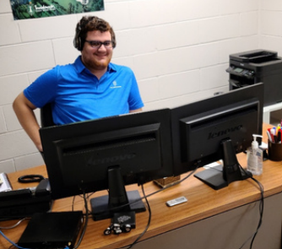

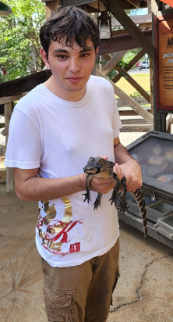
        Innisbrook Resort and Golf Club
        Level 1- Community-Based Vocational Education (CBVE)
        )
        “To help young adults with disabilities, gain employability and independent living skills within an inclusive work environment.”
Our Program Day in the Life
Innisbrook Resort and Golf Club is a resort that offers world-class golf courses, tennis facilities, accommodations and spa.
Innisbrook Resort and Golf Club is an extended transition program for new and returning students to experience working in a professional environment in hospitality.
Students experience a variety of jobs at various worksites around the resort and train alongside employees and interact with guests.
Students will meet at Palm Harbor HS and be provided transportation, breakfast, and lunch.
Hours: 7:25 am- 1:25 pm
Location: Innisbrook Resort/Golf Club, Palm Harbor
Program includes classroom instruction and on-the-job training at the resort.
In the classroom, students will develop work skills (i.e. job interviews), work habits, and behaviors.
On-the-job training students will work independently for 4+ hours with limited support.
Students will be under supervision and guidance from their instructors and engage in learning entry-level job skills.
Students can take part in events at the club such as the Valspar PGA Gold tournament and the U.S Pro Woman’s Clay Court Championship
Opportunities: Kitchen, Housekeeping, Golf Services
Jobs Include: Kitchen Food Prep, Dishwashing, Laundry, Housekeeping, Golf Services Support
Collaboration
Skills
The program collaborates with Interagency organizations to provide additional services.
These organizations include:
Florida Vocational Rehabilitation (VR)
Agency for Persons with Disabilities (APD)
Family Network on Disabilities (FND)
Note: Some agencies have eligibility requirements..
Entry
High Independence- Ability to work independently.
High Motivation- Personally motivated and committed to gaining employability skills.
Low Support- Can work independently with limited support or supervision.
Stamina and concentration for 4+ Hours of work.
Able to work around the public in an integrated environment.
Guardians are committed and involved in supporting student progress.
Exit
Work readiness- skills (technical & soft), personal traits, abilities, work ethic, professionalism.
Job search- resume writing, job applications, interview preparation, and skills.
Self-advocacy- self-awareness, self-confidence, ability to know when and how to ask for help.
Social- communication, teamwork, conflict resolution, problem-solving, building and maintaining relationships.
Ability to use public transportation.

Slide 4
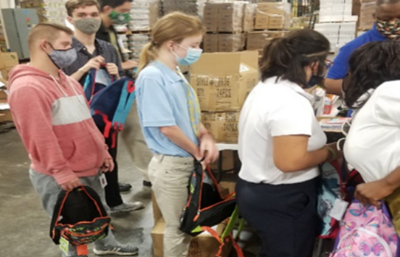
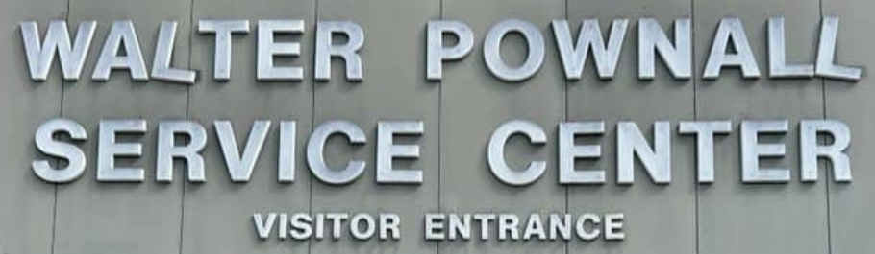
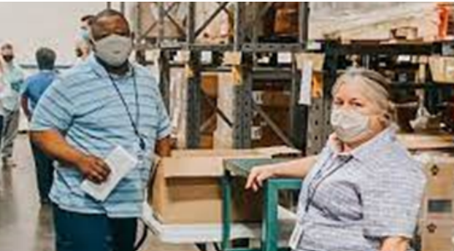
        Walter Pownall Service Center (WPSC)
        Level 1- Community-Based Vocational Education (CBVE)
        “To help young adults with disabilities, gain employability and independent living skills within an inclusive work environment.”
Our Program Day in the Life
Walter Pownall Service Center is the operational services department for Pinellas County.
The Walter Pownall extended transition program is designed for new and returning students.
Students experience a variety of jobs and interact alongside employees.
Focus is on employability skills that will help gain employment and remain employed.
Students will be provided transportation, breakfast, and lunch
Hours: 9:30 am-3:30 pm
Location: Walter Pownall Service Center, Largo
Program includes classroom instruction and on-the-job training. at the Walter Pownall Center.
In the classroom, students will develop work skills, habits, and behaviors.
On-the-job training students will work independently 4+ hours a day.
Students will be under close supervision and guidance from their instructors.
Managing a class-run snack cart, tracking and restocking inventories, and tallying the proceeds.
  Progress will be monitored by a checklist that includes over 100 jobs/tasks.
Opportunities: Maintenance and Janitorial services, Laundry, Food Services, Warehouse Packaging.
Jobs Include: Food Court Processes (Cleaning, Organization, Trash); Packaging and Counting, Washing & Drying Laundry.
Collaboration
Skills
The program collaborates with Interagency organizations to provide additional services.
These organizations include:
Florida Vocational Rehabilitation (VR)
Agency for Persons with Disabilities (APD)
Family Network on Disabilities (FND)
Note: Some agencies have eligibility requirements..
Entry
High Independence- Ability to work independently.
High Motivation- Personally motivated and committed to gaining employability skills.
Low Support- Can work independently with limited support or supervision.
Stamina and concentration for 4+ Hours of work.
Able to work around the public in an integrated environment.
Guardians are committed and involved in supporting student progress.
Exit
Work readiness- skills (technical & soft), personal traits, abilities, work ethic, professionalism.
Job search- resume writing, job applications, interview preparation, and skills.
Self-advocacy- self-awareness, self-confidence, ability to know when and how to ask for help.
Social- communication, teamwork, conflict resolution, problem-solving, building and maintaining relationships.
Ability to use public transportation.

Slide 5
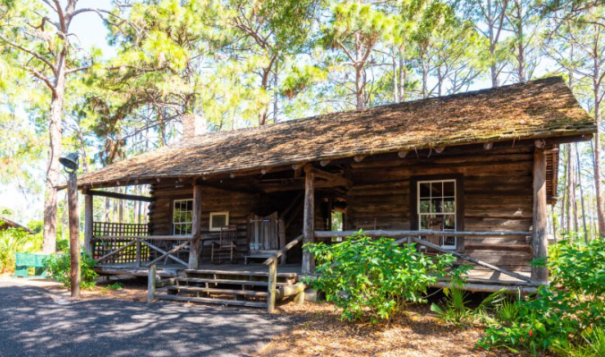

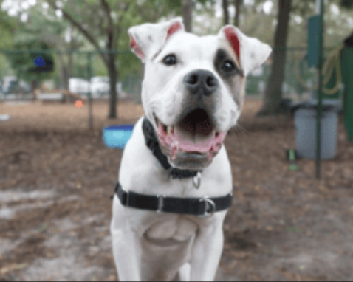
        Heritage Village
        Level 2- Community-Based Vocational Education (CBVE)
        “To help young adults with disabilities, gain employability and independent living skills within an inclusive work environment.”
Our Program Day in the Life
Heritage Village is a living history museum that preserves and showcases history through education and exhibits.
The Heritage Village extended transition program is designed for new and returning students.
Students will interact with Pinellas County employees and adult volunteers.
Students will be evaluated for the performance of tasks and the quality of their projects. They will develop a portfolio of completed work.
Students will be provided transportation, breakfast, and lunch
Hours: 8:30 am-2:30 pm
Location: Heritage Village, Largo
Program includes classroom instruction and on-the-job training.
In the classroom, students will develop work skills, work habits, and behaviors.
On-the-job training will occur at Heritage Village, students will work in small groups for 3+ hours a day.
Students will be under close supervision and guidance from their instructors.
Opportunities: Animal services, Landscaping, Janitorial, and Plant Operations.
          Jobs Include: Train in maintenance and repair. Janitorial tasks including maintenance, PVC repair, and irrigation. Lawn Service and Groundskeeping.
Collaboration
Skills
The program collaborates with Interagency organizations to provide additional services.
These organizations include:
Florida Vocational Rehabilitation (VR)
Agency for Persons with Disabilities (APD)
Family Network on Disabilities (FND)
Note: Some agencies have eligibility requirements..
Entry
Intermediate Independence-ability to work independently with minimal prompting.
Intermediate Motivation- Motivated with external direction to complete tasks.
Intermediate Support- Can work independently with support or supervision.
Stamina and concentration for 3+ Hours of work.
Able to work around the public in an integrated environment.
Guardians are committed and involved in supporting student.
Exit
Work readiness- technical and soft skills to work in entry-level jobs, job content math, and basic money skills.
Job search- job applications and job interviews.
Self-advocacy- self-awareness, self-confidence, ability to know when and how to ask for help.
Social- communication, teamwork, conflict resolution, problem-solving, building and maintaining relationships.
Travel training on how to use public transportation (PSTA).

Slide 6
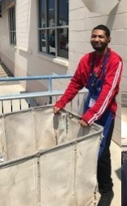

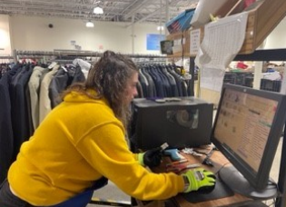
        Goodwill Industries-Suncoast- Gandy
        Level 2- Community-Based Vocational Education (CBVE)
        “To help young adults with disabilities, gain employability and independent living skills within an inclusive work environment.”
Our Program Day in the Life
Goodwill Industries is a nonprofit organization that empowers individuals through job training, employment, and community-based services.
The Goodwill Industries extended transition program is designed for new and returning students..
Students have a home base at Walter Pownall Service Center and travel daily to Goodwill.
Students will interact with employees and customers and become registered volunteers.
Focus is on employability skills that will help gain employment and remain employed.
Students will be provided transportation, breakfast, and lunch
Hours: 9:30 am-3:30 pm
Location: Goodwill Industries, Gandy
Program includes classroom instruction and on-the-job training.
In the classroom (Walter Pownall Service Center) students will develop work skills, work habits, and behaviors.
On-the-job training will occur at Goodwill, students will work in small groups for 3+ hours a day.
Students will be under close supervision and guidance from their instructors.
Opportunities: Customer Support, Receiving, Quality Control, Stock Management.
Jobs Include: Receiving and Sorting Donated Goods, Pulling & Hanging Textiles, Cleaning, Sorting, Labeling & Pricing, Placing wares on Shelves, Rotating Stock, Organizing and Cleaning Stockroom Shelves.
Collaboration
Skills
The program collaborates with Interagency organizations to provide additional services.
These organizations include:
Florida Vocational Rehabilitation (VR)
Agency for Persons with Disabilities (APD)
Family Network on Disabilities (FND)
Note: Some agencies have eligibility requirements..
Entry
Intermediate Independence-ability to work independently with minimal prompting.
Intermediate Motivation- Motivated with external direction to complete tasks.
Intermediate Support- Can work independently with support or supervision.
Stamina and concentration for 3+ Hours of work.
Able to work around the public in an integrated environment.
Guardians are committed and involved in supporting student.
Exit
Work readiness- technical and soft skills to work in entry-level jobs, job content math, and basic money skills.
Job search- job applications and job interviews.
Self-advocacy- self-awareness, self-confidence, ability to know when and how to ask for help.
Social- communication, teamwork, conflict resolution, problem-solving, building and maintaining relationships.
Travel training on how to use public transportation (PSTA).

Slide 7
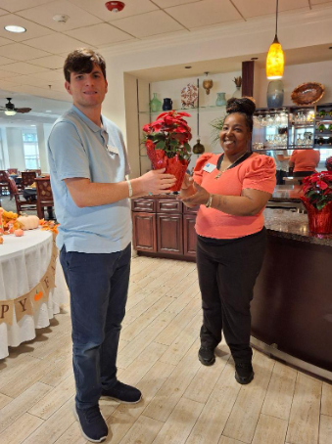
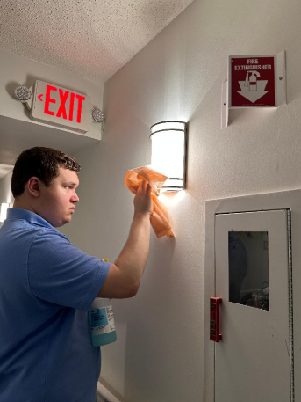

        Stratford Court of Palm Harbor
        Level 2- Community-Based Vocational Education (CBVE)
        “To help young adults with disabilities, gain employability and independent living skills within an inclusive work environment.”
Our Program Day in the Life
Stratford Court is an independent and assisted living facility.
The Stratford Court extended transition program is designed for new and returning students.
Opportunities include jobs in Students will have a home base at Paul B. Stevens Exceptional Center and visit Stratford Court daily.
Students will interact with employees and the public.
Focus is on employability skills that will help gain employment and remain employed.
Students will be provided transportation, breakfast, and lunch.
Hours: 10:00 am-4:00 pm
Location: Stratford Court, Palm Harbor
Program includes classroom instruction and on-the-job training.
In the classroom (Paul B. Stevens Exceptional Center) students will develop work skills, work habits, and behaviors.
On-the-job training will occur at Stratford Court, students will work in small groups and work for 3+ hours a day.
Students will be under close supervision and guidance from their instructors.
Opportunities: Sales/ Marketing/ Administration Department, Food & Beverage, Maintenance, and Housekeeping.
Jobs Include: Creating Sales & Marketing Packets, Housekeeping Duties (Dusting, Windows, Vacuuming), Cleaning and Sanitizing Surfaces, and maintaining the dining room.
          .
Collaboration
Skills
The program collaborates with Interagency organizations to provide additional services.
These organizations include:
Florida Vocational Rehabilitation (VR)
Agency for Persons with Disabilities (APD)
Family Network on Disabilities (FND)
Note: Some agencies have eligibility requirements..
Entry
Intermediate Independence-ability to work independently with minimal prompting.
Intermediate Motivation- Motivated with external direction to complete tasks.
Intermediate Support- Can work independently with support or supervision.
Stamina and concentration for 3+ Hours of work.
Able to work around the public in an integrated environment.
Guardians are committed and involved in supporting student.
Exit
Work readiness- technical and soft skills to work in entry-level jobs, job content math, and basic money skills.
Job search- job applications and job interviews.
Self-advocacy- self-awareness, self-confidence, ability to know when and how to ask for help.
Social- communication, teamwork, conflict resolution, problem-solving, building and maintaining relationships.
Travel training on how to use public transportation (PSTA).

Slide 8
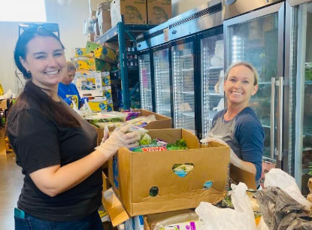

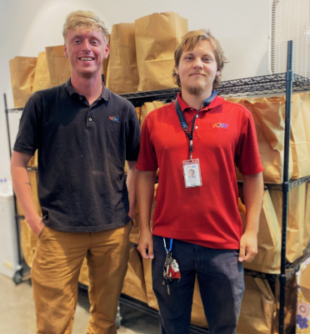
        Daystar
        Level 2- Community-Based Vocational Education (CBVE)
        “To help young adults with disabilities, gain employability and independent living skills within an inclusive work environment.”
Our Program Day in the Life
Daystar Life Center is a community-based non-profit organization providing essential resources to the community.
The Daystar Life Center extended transition program is designed for new and returning students.
Students will have a home base at Pinellas Technical College and visit the Daystar Life Center on most days.
Students will interact with employees, volunteers, and the public.
Focus is on employability skills that will help gain employment and remain employed.
Students will be provided transportation, breakfast, and lunch.
Hours: 7:00 am-1:00 pm
Location: Daystar Life Center, St. Pete
Program includes classroom instruction and on-the-job training.
In the classroom (Pinellas Technical College) students will develop work skills, habits, and behaviors.
On-the-job training will occur at the Daystar Life Center, students will work in small groups and will work for 3+ hours a day.
Students will be under close supervision and guidance from their instructors.
Opportunities Healthy Food Pantry, Edible Garden, and Clothing Closet.
Jobs Include: Receiving and Sorting Donated Goods, Stocking Shelves, Fill Bags for Clients, Setting up Clothing Displays, Quality Control on Clothing, Planting Seeds and Plants, Harvesting and Packaging..
Collaboration
Skills
The program collaborates with Interagency organizations to provide additional services.
These organizations include:
Florida Vocational Rehabilitation (VR)
Agency for Persons with Disabilities (APD)
Family Network on Disabilities (FND)
Note: Some agencies have eligibility requirements..
Entry
Intermediate Independence-ability to work independently with minimal prompting.
Intermediate Motivation- Motivated with external direction to complete tasks.
Intermediate Support- Can work independently with support or supervision.
Stamina and concentration for 3+ Hours of work.
Able to work around the public in an integrated environment.
Guardians are committed and involved in supporting student.
Exit
Work readiness- technical and soft skills to work in entry-level jobs, job content math, and basic money skills.
Job search- job applications and job interviews.
Self-advocacy- self-awareness, self-confidence, ability to know when and how to ask for help.
Social- communication, teamwork, conflict resolution, problem-solving, building and maintaining relationships.
Travel training on how to use public transportation (PSTA).

Slide 9
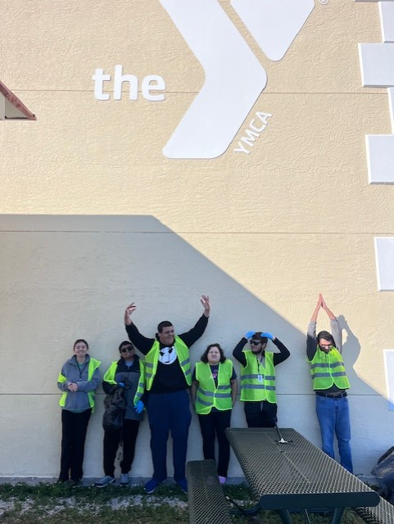

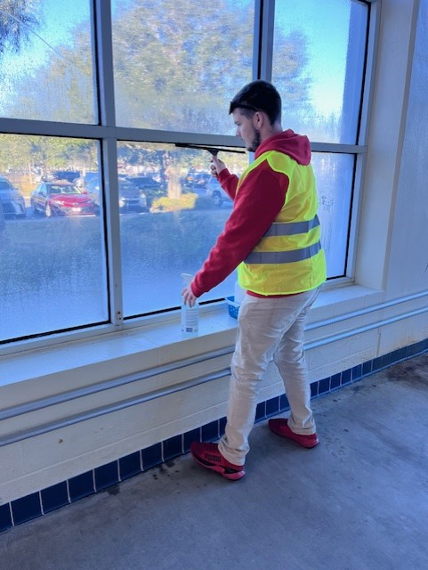
        Gillis YMCA
        Level 2- Community-Based Vocational Education (CBVE)
        “To help young adults with disabilities, gain employability and independent living skills within an inclusive work environment.”
Our Program Day in the Life
YMCA is a non-profit organization that offers programs and services to promote youth development, healthy living, and social responsibility.
The YMCA extended transition program is designed for new and returning students.
Students will have a home base at Pinellas Technical College and visit the Jim and Heather Gills YMCA on most days.
Students will interact with employees, volunteers, and the public.
Focus is on employability skills that will help gain employment and remain employed.
Students will be provided transportation, breakfast, and lunch.
Hours: 7:00 am-1:00 pm
Location: Jim and Heather Gills YMCA, St. Pete
Program includes classroom instruction and on-the-job training.
In the classroom (Pinellas Technical College) students will develop work skills, habits, and behaviors.
On-the-job training will occur at the YMCA, students will work in small groups and will work for 2-3+ hours a day.
Students will be under close supervision and guidance from their instructors.
Opportunities: Maintenance, Janitorial
Jobs Include: Cleanliness and basic maintaance of all workout areas.
Collaboration
Skills
The program collaborates with Interagency organizations to provide additional services.
These organizations include:
Florida Vocational Rehabilitation (VR)
Agency for Persons with Disabilities (APD)
Family Network on Disabilities (FND)
Note: Some agencies have eligibility requirements..
Entry
High Independence- Ability to work independently.
High Motivation- Personally motivated and committed to gaining employability skills.
Low Support- Can work independently with limited support or supervision.
Stamina and concentration for 4+ Hours of work.
Able to work around the public in an integrated environment.
Guardians are committed and involved in supporting student progress.
Exit
Work readiness- skills (technical & soft), personal traits, abilities, work ethic, professionalism.
Job search- resume writing, job applications, interview preparation, and skills.
Self-advocacy- self-awareness, self-confidence, ability to know when and how to ask for help.
Social- communication, teamwork, conflict resolution, problem-solving, building and maintaining relationships.
Ability to use public transportation.

Slide 10
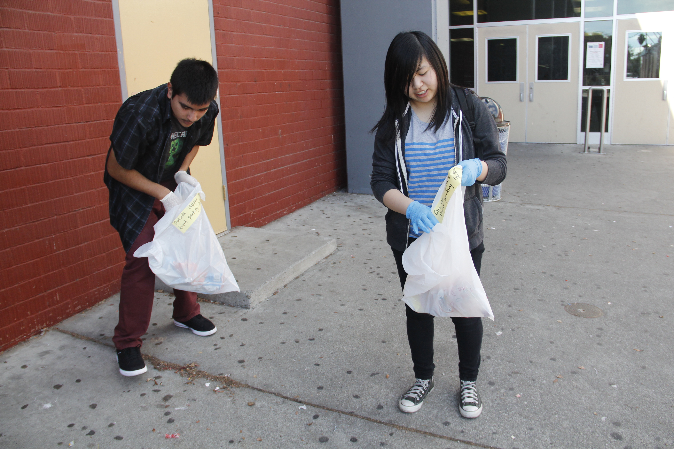

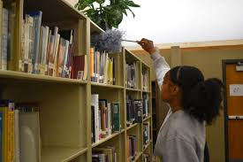
        Countryside Extended Transition
        Level 4 – Campus Based Instruction (CBI)
        “To help young adults with disabilities, gain employability and independent living skills within an inclusive work environment.”
Our Program Day in the Life
The Countryside extended transition program is designed for new and returning students.
Students will have a home base at Countryside High School and visit community locations on scheduled days.
Students will interact with school staff, volunteers, and peers.
Focus is on employability skills that will help gain employment and remain employed.
Students will be provided transportation, breakfast, and lunch.
Hours: 7:25 am-1:55 pm
Location: Countryside High School
Program includes classroom instruction and on-the-job training.
In the classroom students will develop work skills, habits, and behaviors.
On-the-job training will occur throughout the Countryside High School campus
Students will be under supervision and guidance from their instructors and classroom assistants.
Opportunities: Office, Janitorial, Grounds Keeping, Food Service, and selective Retail.
Jobs Include: Clerical, Cleanliness and basic maintenance, Clean-up, Sorting, Creating.
Collaboration
Skills
The program collaborates with Interagency organizations to provide additional services.
These organizations include:
Florida Vocational Rehabilitation (VR)
Progressive Abilities Support Services (PASS)
Agency for Persons with Disabilities (APD)
Family Network on Disabilities (FND)
Note: Some agencies have eligibility requirements.
Entry
Intermediate Independence- Ability to work independently.
Medium to High Motivation- Personally motivated and committed to gaining employability skills.
Medium Support- Can work independently with limited support or supervision.
Stamina and concentration for 4+ Hours of work.
Guardians are committed and involved in supporting student progress.
Exit
Work readiness- skills (technical & soft), personal traits, abilities, work ethic, professionalism.
Job search- resume writing, job applications, interview preparation, and skills.
Self-advocacy- self-awareness, self-confidence, ability to know when and how to ask for help.
Social- communication, teamwork, conflict resolution, problem-solving, building and maintaining relationships.
Ability to use public transportation.

Slide 11
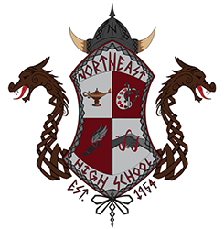
        Northeast Extended Transition
        Level 4 – Campus Based Instruction (CBI)
        “To help young adults with disabilities, gain employability and independent living skills within an inclusive work environment.”
Our Program Day in the Life
The Northeast extended transition program is designed for new and returning students.
Students will have a home base at Northeast High School and visit community locations on scheduled days.
Students will interact with school staff, volunteers, and peers.
Focus is on employability skills that will help gain employment and remain employed.
Students will be provided transportation, breakfast, and lunch.
Hours: 7:25 am-1:55 pm
Location: Northeast High School
Program includes classroom instruction and on-the-the-job training.
In the classroom students will develop work skills, habits, and behaviors.
On-job training will occur throughout the Northeast High School campus
Students will be under supervision and guidance from their instructors and classroom assistants.
Opportunities: Office, Janitorial, Grounds Keeping, Food Service, and selective Retail.
Jobs Include: Clerical, Cleanliness and basic maintenance, Clean-up, Sorting, Creating.
Collaboration
Skills
The program collaborates with Interagency organizations to provide additional services.
These organizations include:
Florida Vocational Rehabilitation (VR)
Progressive Abilities Support Services (PASS)
Agency for Persons with Disabilities (APD)
Family Network on Disabilities (FND)
Note: Some agencies have eligibility requirements.
Entry
Intermediate Independence- Ability to work independently.
Medium to High Motivation- Personally motivated and committed to gaining employability skills.
Medium Support- Can work independently with limited support or supervision.
Stamina and concentration for 4+ Hours of work.
Guardians are committed and involved in supporting student progress.
Exit
Work readiness- skills (technical & soft), personal traits, abilities, work ethic, professionalism.
Job search- resume writing, job applications, interview preparation, and skills.
Self-advocacy- self-awareness, self-confidence, ability to know when and how to ask for help.
Social- communication, teamwork, conflict resolution, problem-solving, building and maintaining relationships.
Ability to use public transportation.

Slide 12
