Slide 1
Annual Information Session
for Public Schools

Slide 2
What is College Credit Plus?
College Credit Plus is Ohio’s dual credit program
  Students can earn high school and college credit at the same time
  Ohio residents in grades 7-12; enrolled at a public/private high school or homeschooled
  Take a variety of courses at any public and participating private college in Ohio
  Courses held at the high school, on a college campus, or online
ORC 3365.02, ORC 3365.03
Notes:
Additional Notes for Presenters:
Students in the state of Ohio only
Variety of college courses available, HS credits can meet graduation requirements
3+ college credit hours = 1 HS unit
All public colleges/universities in Ohio, some private colleges, very few eligible out-of-state
Take classes in fall, spring or summer
Adhere to policies/requirements of college
‹#›

Slide 3
Partnerships
Schools we have partnered with in the past:
  Central Ohio Technical College
  Ohio University Zanesville/Lancaster
  Ohio State University Newark (“Academy Program”)
  Zane State University
  Mount Vernon Nazarene College
  Bowling Green State University
  Columbus State Community College

Slide 4
Potential In-House Offerings 26-27
ENGL 100: Composition 1
ENGL 211: Survey of American Literature
SPCH 205: Public Speaking
CIT 160: Database Application
CIT 100: Programming 2
SOC 100: Introduction to Sociology
SOC 110: Cultural Diversity
HLT 110: Medical Terminology
BIO 130: Anatomy & Physiology 1
* All are pending board approval, student interest and available faculty

Slide 5
One Period: Four Classes
Semester 1 Monday, Wednesday: Class 1
Semester 1 Tuesday, Thursday: Class 2
Semester 2 Monday, Wednesday: Class 3
Semester 2 Tuesday, Thursday: Class 4

Slide 6
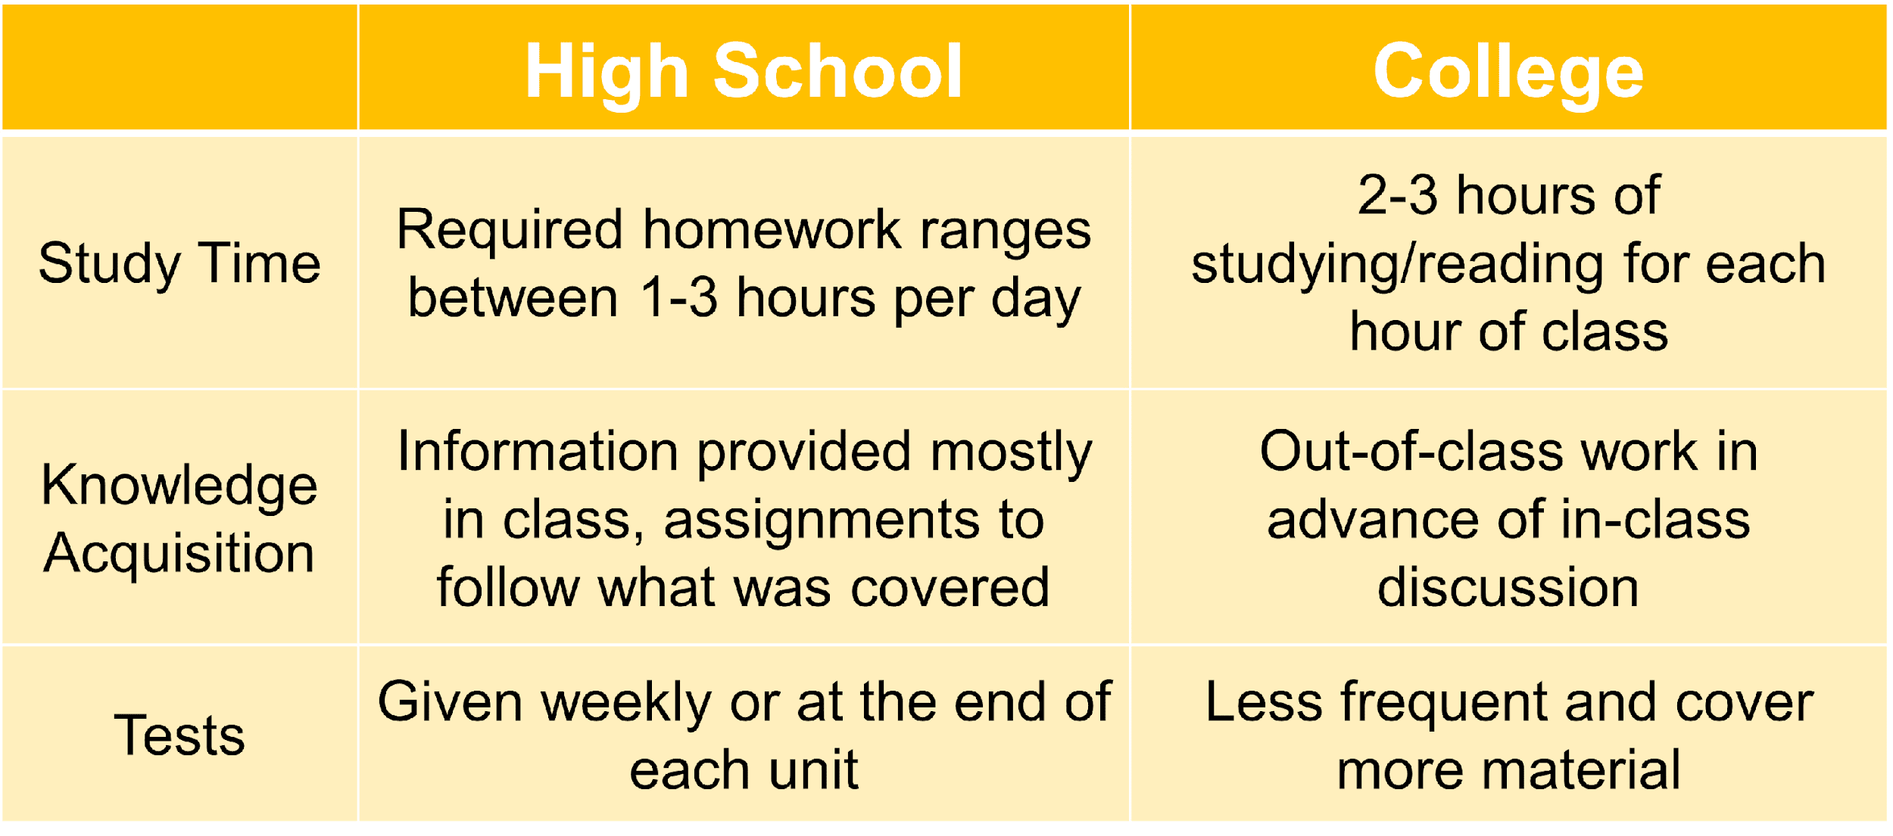
What are differences between high school & college?

Slide 7
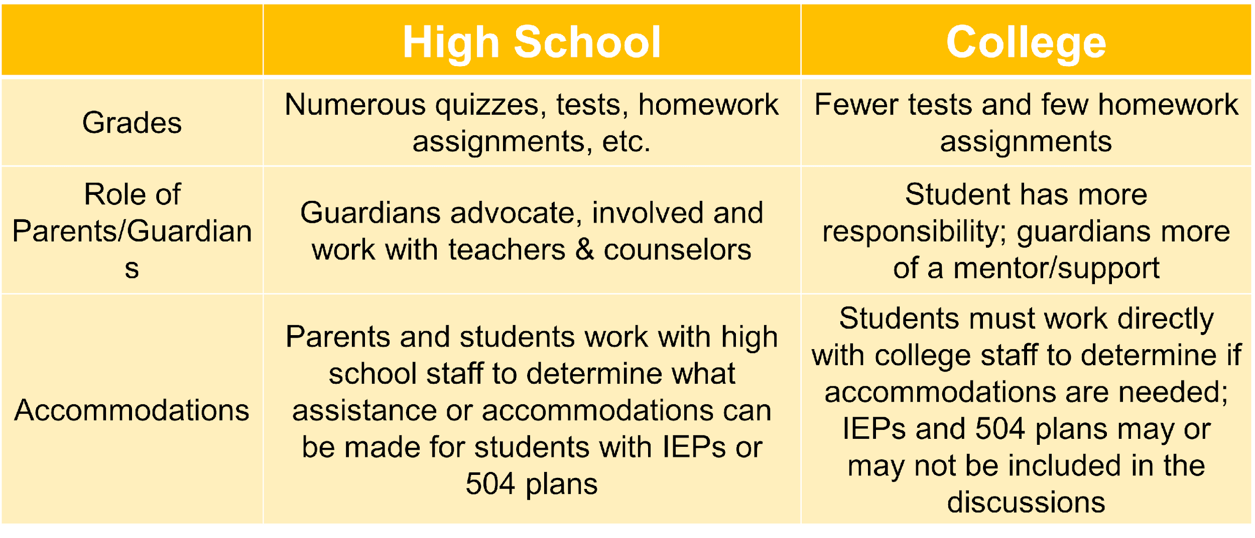
What are differences between high school & college?

Slide 8
Role of parents
  High school
    Parents work closely with teachers and counselors
  College
  Student is independent; parent serves as support
  FERPA protects student records (parents don’t have the right to view grades, etc.)

Slide 9
What does it mean to be “college-ready”?
Being “college-ready” is more than just being academically ready
Consider emotional and social transition and college expectations
Consider time management and organizational skills
Making phone calls, setting up email, picking up textbooks, etc.

Slide 10
How can students participate?
  Step 1: Eligibility
  A student is eligible for the College Credit Plus program if the student meets any of the following criteria:
    Obtains a remediation-free score on one of the standard assessment exams (ACT, SAT, Accuplacer, etc.)
    Has a cumulative unweighted high school grade point average of at least 3.00
    Has a cumulative unweighted high school grade point average of at least 2.75 but less than 3.00 and received an "A" or "B" grade in a relevant high school course.
ORC 3365.03, OAC 3333-1-65.14
Notes:
Additional Notes for Presenters:
Must meet only one, “multiple measures” of eligibility
Remediation free scores on ACT, SAT, Accuplacer, ALEKS, PlaceU, MapleSoft
May differ from tests taken for course placement
‹#›

Slide 11
How can students participate?
Step 2: College Admission
Students must apply for admission at each institution
  Admission is reviewed per the requirements of the college or university; contact the college to find specific information
  In-house classes are offered through COTC
  Note: Ohio State runs an “Academy” program – application is due May 1
College applications include the permission slip for mature content and a questionnaire about emotional maturity
ORC 3365.05, 3365.035, OAC 3333-1-65.3

Slide 12
How can students participate?
Step 3: Course Registration
The college will discuss course options with the student, based on assessment scores, prerequisites, and other requirements
  The college may require placement testing for some courses (e.g., math)
If you are taking courses at a local university (either in-person or online), you will register for your classes with your college advisor
If you are taking courses at LHS (through COTC), you will register for your classes with Mrs. Maybury
ORC 3365.13
Notes:
Additional Notes for Presenters:
Students work with both a college advisor and their HS counselor to plan their courses
Some HS may have additional graduation requirements beyond the state requirements
Students are not limited to only taking courses on the pathways, they just exist as a guide/resource
‹#›

Slide 13
Course Eligibility Rules
Students must complete their first 15 credits in Level I courses, which include:
Transferable courses
Courses in IT, Computer Science, Anatomy & Physiology, foreign language
Courses that are part of a technical certificate
Courses that are part of a 15- or 30-credit pathway
Courses in study skills, academic or career success
Notes:
Additional Notes for Presenters:
Colleges must post their Level 1 courses
Students can move on to Level II courses after completing 15 credit hours of Level I
Level II courses are any other allowable college courses that they meet the prerequisites for
‹#›

Slide 14
Course Eligibility Rules
Non-allowable courses include:
Private applied courses with one-on-one instruction (such as performing art lessons)
Courses with high fees
Study abroad courses
Physical education courses
Pass/Fail graded courses
Remedial courses or sectarian/religious courses
OAC 3333-1-65.12, ORC 3365.13

Slide 15
What are benefits of participating in College Credit Plus?
Students can:
  Earn high school and college credits at the same time
  Get a head start on career planning and earn degrees or certificate completions
  Experience college early to understand the expectations of college life
  Save tuition and textbook costs
Notes:
Additional Notes for Presenters:
Students get more flexibility in taking courses that interest them
Utilizing pathways can help cut down time to earning a degree
Many students are now graduating with a certificate, associates degree, or bachelor’s degree when they graduate HS
‹#›

Slide 16
What are the consequences of underperforming?
Appeals for Underperformance:
CCP Probation:
  Student may appeal to take a course in the same subject in which they previously earned a non-passing grade or received no credit
CCP Dismissal:
  Within 5 days of being dismissed, the student may submit an appeal to the secondary school to appeal CCP Dismissal or the student may appeal at the end of the CCP Dismissal semester
Note: Each school district must have a policy describing the process for appeals
ORC 3365.09, 3365.091; OAC 3333-1-65.13

Slide 17
What are the consequences of underperforming?
After HS Graduation:
Grades earned in CCP will remain on students’ college transcripts permanently
If students fail or withdraw often, future financial aid may be also impacted negatively
  Satisfactory Academic Progress (SAP) is a requirement for financial aid
  Standards vary by institution
ORC 3365.09, 3365.091; OAC 3333-1-65.13

Slide 18
What are the consequences of underperforming?
College Credit Plus Dismissal
If a student does not raise their grade during the probation term, they are dismissed from CCP
While on CCP Dismissal, students may not enroll in any College Credit Plus courses
A student can request (appeal) to be reinstated in the program
ORC 3365.09, 3365.091; OAC 3333-1-65.13

Slide 19
What are the consequences of underperforming?
Families may be asked to reimburse courses if:
The student does not earn a passing grade in their course
The student withdraws after the no-fault deadline at the college
NOTE: A student that is considered “economically disadvantaged” can not be asked to reimburse the cost of the course(s)
ORC 3365.09, 3365.091; OAC 3333-1-65.13

Slide 20
What are the consequences of underperforming?
College Credit Plus Probation
A student will be placed on CCP probation if:
  They earn less than a cumulative 2.0 GPA in CCP courses or
  They withdraw from 2 or more courses in one academic term
ORC 3365.09, 3365.091; OAC 3333-1-65.13

Slide 21
What are the consequences of underperforming?
While on CCP Probation, the student:
May only enroll in one College Credit Plus course for one college term (semester or quarter)
May not enroll in a college course in the same subject in which student previously earned D, F, NC grade (or equivalent grade)
If students on CCP probation do not increase their CCP GPA to a 2.0 or above during the probation term, they will be placed on CCP Dismissal
ORC 3365.09, 3365.091; OAC 3333-1-65.13
Notes:
‹#›

Slide 22
How many classes can students take?
Students may be enrolled in up to 30 credits per year, which includes high school courses:
The maximum number of college credits a student can complete while participating in the program is 120
If a student enrolls in more than 30 credits for the year, they can:
  Drop the course prior to the no-fault withdrawal date
  Pay for the entire course at the college’s standard rates (Option A)
OAC 3333-1-65.12, ORC 3365.13
Notes:
Additional Notes for Presenters:
The HS is responsible for calculating hours each year
The 30 credits per year is calculated with both HS and college credits; the 120 hours for the program is college credit only
Students who exceed 30 hours per year and choose to self pay would pay the college’s standard rate and the cost includes tuition, fees, and books
More info on option A later in presentation
‹#›

Slide 23
Additional Considerations
Grades
  The final grades earned in the college course are the same grade that will be on the high school transcript
    CCP course grades will be factored into the high school and college GPAs
Grade Weighting
  CCP courses are weighted on a 5.0 scale
ORC 3365.12, OAC 3333-1-65.2

Slide 24
What are the expenses for College Credit Plus?
Option A:
The family/student can choose to self-pay for college courses at the standard rate of tuition, fees, and textbooks
  Students/families should arrange a plan for payment with the college or university
Students can choose to earn college credit and high school credit OR only college credit
  Students must inform the school of their choice of credit for courses
ORC 3365.06
Notes:
Additional Notes for presenters:
Families must confirm with both the college and high school if they choose Option A
The deadline to choose is the college’s no fault withdraw date
‹#›

Slide 25
What are the expenses for College Credit Plus?
Option B:
The “default” or standard option for College Credit Plus
All college course tuition, fees, and textbooks will be paid by the state of Ohio
  Supported by the school’s foundation funds and the college’s funds
Students will earn college credit and high school credit
ORC 3365.06
Notes:
Additional Notes for Presenters:
The default choice, but families can still confirm their choice of Option B by the no fault withdraw deadline
Students may be asked to confirm during the college advising process
‹#›

Slide 26
What are support services are available for students?
Students receive support from both the HS and College:
High school counselors continue to provide assistance to all College Credit Plus students
College advisors provide course selection assistance
Colleges must provide the same academic supports to CCP students such as tutoring, library access, advising, etc.

Slide 27
What about athletic eligibility?
Student athletes should:
Know the Ohio High School Athletic Association (OHSAA) requirements
One 3-hour CCP course counts as 2 units for being a full-time student/eligibility for athletics
Must be passing 5 classes/units in order to be eligible (Lakewood rules)

Slide 28
Additional Considerations
Selective Service
Male students who are at least 18 years of age and Ohio residents are required to be registered with the Selective Service System
Students are required to provide their Selective Service number to the public college or university within 30 days of their 18th birthday
Failure to submit the Selective Service number will result in the student not being considered a College Credit Plus participant for that semester or term
  The student will be responsible for any tuition, textbooks, or fees associated with the course(s)
ORC 3345.32
Notes:
Additional Notes for Presenters:
- Some schools post a fee for students that fail to comply with selective service requirements
‹#›

Slide 29
Will the course credits transfer?
Certain general education and technical courses will transfer, especially from one Ohio public college to another Ohio public college (next slide)
Students must check with colleges to confirm transferability
Students should also visit https://transfercredit.ohio.govStudents should also visit https://transfercredit.ohio.gov or https://www.transferology.com/login.htm for transfer information

Slide 30
Ohio Transfer 36
These are courses that are guaranteed to count as General Education requirements at in-state state colleges.
Get Gen Eds out of the way in high school
Some “major” courses must be taken at your university when you start your program after graduation
I have lists for every area college

Slide 31
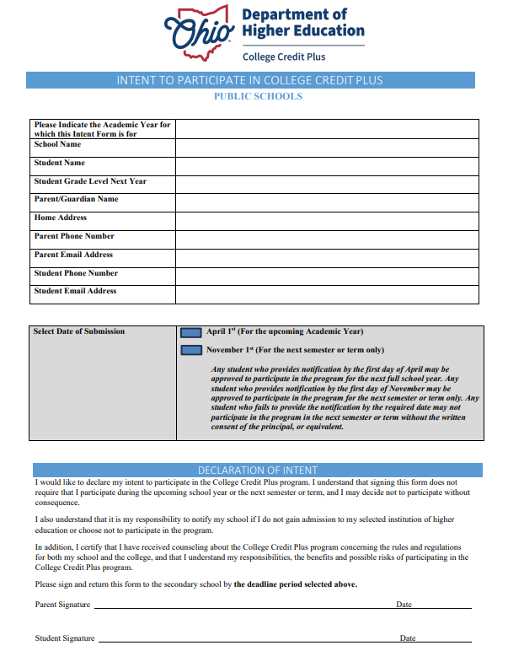
What are the deadlines?
Intent to Participate
April 1: Complete and return the form to the school office. Submitting your form before this deadline allows you to participate in CCP for the full academic year.

Slide 32
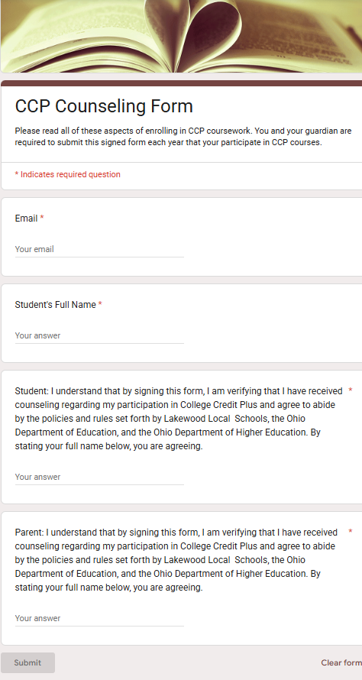
What are the deadlines?
CCP Counseling Form
April 15: Google Form acknowledging you reviewed the slides and understand the CCP policies.
For student and parent/guardian.

Slide 33
CCP Next Steps
Visit the LHS Counseling Department CCP Page for more information
Decide whether CCP is right for your student (family decision)
Submit the CCP Intent to Participate (green form) to Mrs. Maybury by APRIL 1
Submit the CCP Counseling Form (Google Form) by APRIL 15.
Email Mrs. Maybury to set up a required CCP meeting
Apply to college(s) where you want to take courses
  COTC for in-house courses
  Ohio State runs an “Academy” program – application is due May 1

Slide 34
Do you have other questions?
Visit the CCP website for additional resources:
https://highered.ohio.gov/initiatives/access-acceleration/college-credit-plus
Follow up with us:
Phil Sikorski (last names A-K): psikorski@lakewoodlocal.org
Janessa Maybury (last names L-Z): jmaybury@lakewoodlocal.org

