Slide 1

Community Advisory Committee
February 17, 2026

Slide 2
Opening Procedures
Call to Order
Attendance and Verification of Quorum
Review of Minutes
Purpose and Agenda Review

Slide 3
SELPA Presentation

Slide 4
Open Seats Review

Slide 5
South County District Highlights

Slide 6
Coronado Unified School District
The district is changing the cell phone policy.
Informative discussion held on Cyber Security with the assistance of Safe Hope, one of the district's community partners. Be aware of Google Docs and Notes app for use in unsafe situations.

Slide 7
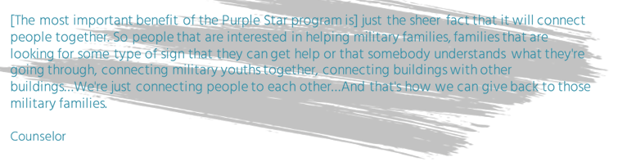
National School District
NSD is currently in the middle of our Social/Emotional Learning survey and gearing up for the CA Healthy Kids survey in a few weeks.
We are also very excited to share that all school sites in NSD applied and qualified for the Purple Star designation. This is a big recognition since no other district in San Diego County received the designation for all schools within the district. Purple Star School Information

Slide 8
San Ysidro School District
District recently held a Community Forum with San Diego County District Attorney on Consumer Fraud and Online Safety (human trafficking awareness/social media safety).
Ocean View Hills School was recognized as a 2025 Honor Roll school from Educational Results Partnership.

Slide 9
South Bay Union School District
SBUSD Labor Update: SBUSD has reached a tentative agreement with its certificated union after approximately 18 months of negotiations.
District Planning for 2026–27: SBUSD is planning for the 2026–27 school year, including the consolidation of one of its campuses, Central Elementary School, due to declining enrollment.
Teacher Representative Vacancy: The District’s teacher representative has resigned from her position, and SBUSD is actively recruiting a new teacher representative.
Board Actions (February 12): At Thursday’s Board meeting, resolutions were brought forward regarding:
the elimination and reduction of classified positions and direction to notify affected employees, and
the elimination/release of certificated positions and direction to notify affected employees.

Slide 10
South Bay Union School District
Despite declining enrollment and potential staff reductions, the entire SBUSD team remains committed to improving student achievement. At the January Board meeting, Dashboard data were presented showing that students with disabilities continue to demonstrate improvement in both English Language Arts (ELA) and Mathematics.
ELA Performance (Change from Prior Year):
2022–23: +11.6 points
2023–24: +4.4 points
2024–25: +16.9 points
Trend: Consistent growth across all three years
Math Performance (Change from Prior Year):
2022–23: +11.9 points
2023–24: +4.4 points
2024–25: +10.9 points
Trend: Consistent growth across all three years

Slide 11
Sweetwater Union High School District
CAC Member Advocacy!
Sweetwater CAC Members met with SE Director and Program Manager and discussed status of Open Seats. Currently 3 parents in East Chula would like to join, district is seeking West Representation which there has been no applicants for this SY.
Seeking Buddy Recognition by the district (such as Titan Buddies or Spartan Closet)
Sweetwater CAC members asked for the inclusion survey to be emailed by the district. Was emailed on January 21, 2026 and since that survey went out to just Sweetwater SE parents, we had over 60 MORE responses!
Collaboration!
Sweetwater District Representative will present a district update at the April CAC meeting.
Sweetwater CAC members spoke at the Sweetwater Monthly Psychologist meeting about the CAC, open seats, and how we would like to help.
Sweetwater CAC Members subsequently invited to Chula Vista High School (from their School Psych) that night to attend the Wish Well series.
Sweetwater CAC Members went and observed what Wish Well does: Great Program!

Slide 12

Sweetwater Union High School District
Inclusive Sports!
There have been wonderful Unified Sports Basketball games throughout the district:
Eastlake High played Hilltop High (February 11, 2026) and recognized the Senior Unified athletes.
This event was very inclusive (where some of the Gen Ed students were there watching and cheering).
Castle Park High also recently played Southwest High for an amazing event with cheer athletes and community cheering them on.
Need to request Special Services website to include information about Unified events.

Slide 13
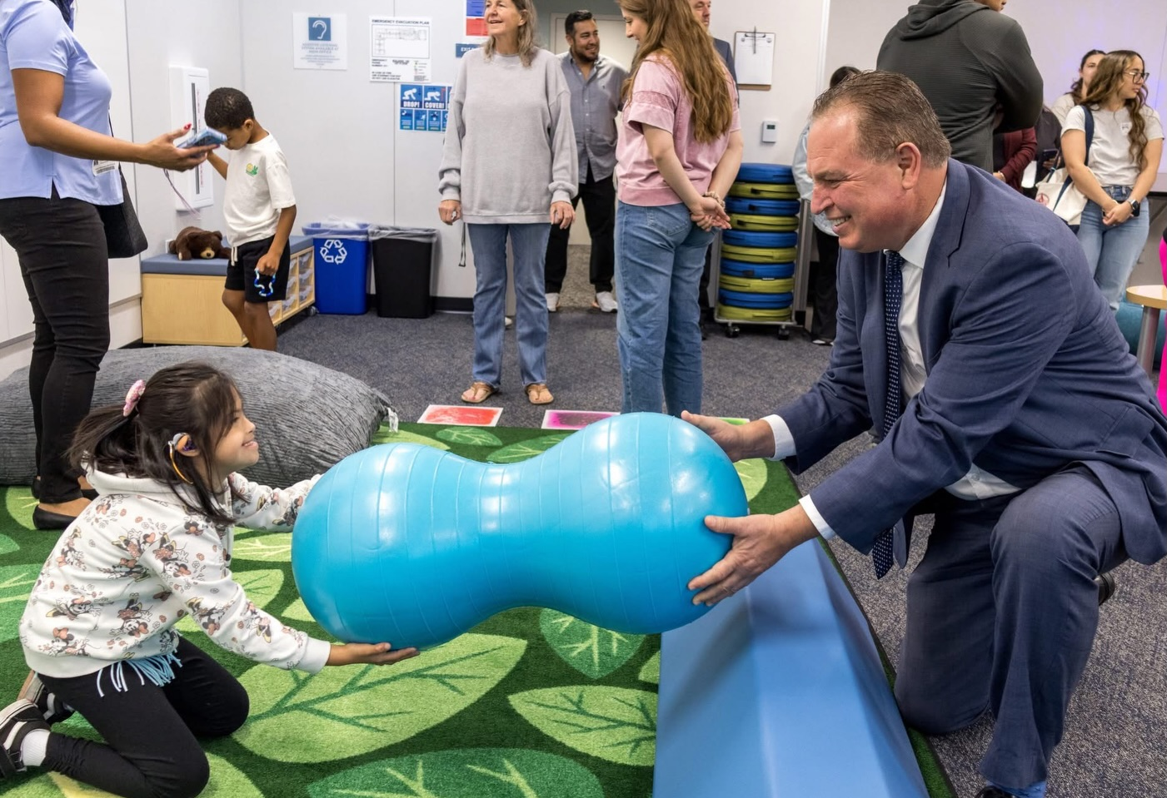
Chula Vista Elementary School District
What the District has been doing in Special Education (SE)
Inclusive Practices Professional Development
Related Service Provider Training
Preschool Transition Workgroup
More Parent Engagement + Workshop opportunities
Latest Sensory Room opened at Sonia Sotomayor Elementary
Other Notable Updates
At the recent Feb. 11 2026 board meeting some relevant positions were recommended for discontinuance next SY including Early Childhood Special Education Teacher (6), Program Specialist (1), Counselor (20). Teacher positions remain up for discussion (43). Some positions were discussed to be outsourced to SELPA such as Visually-Impaired Teacher (1).
Our Special Education Director is retiring in July. Happy Retirement Rose! Thank you for your collaboration.

Slide 14

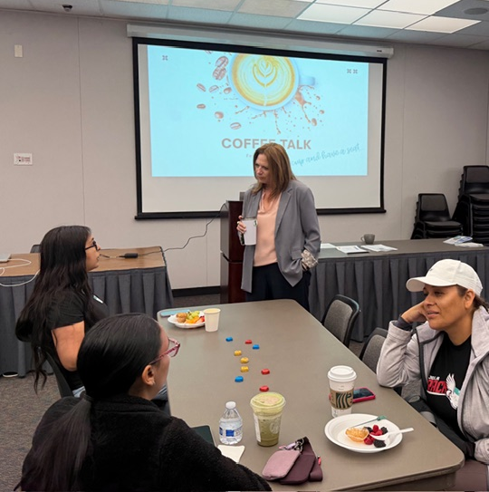
Chula Vista Elementary School District
Feb 2026 Coffee Talk held
LCAP Presentation
Accessibility Resources for Testing
Testing Resources for Parents
District SE Happenings
ESY Information

Slide 15

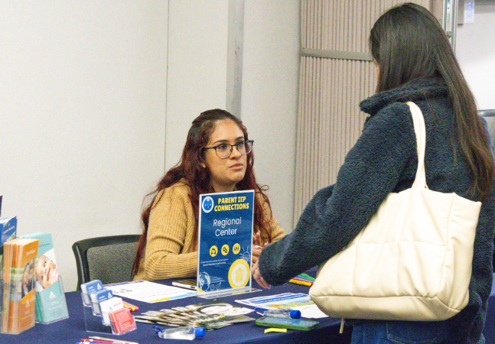
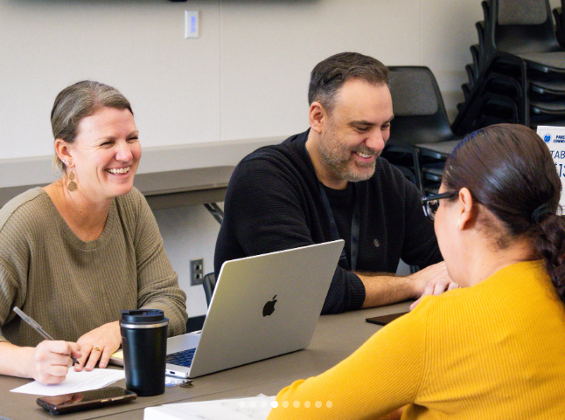
Chula Vista Elementary School District
Food + Childcare provided
15 individual Q&A Sessions done
Booths hosted by SELPA, CAC, CVPD (Blue Envelope Program), Regional Center, SEL + other district resources.

Slide 16

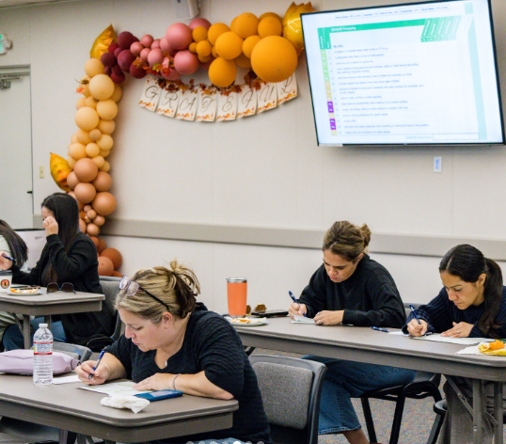
Chula Vista Elementary School District
CVESD University + Brain Balance Workshop Partnership continued. Sensory Processing Struggles Workshop was held in December 2025
Managing Meltdowns and Behaviors to be held Feb 17, 2026 (Open to the Public)

Slide 17
CAC Subcommittee Updates
CAC Handbook | Special Education Student Inclusion | Parent & Staff Education
CVESD + SYSD | SUHSD + CUSD | NSD + SBUSD
Chair: Rosemary Lowry (CVESD)
Co-Chair: Melissa Dolo (SBUSD)

Slide 18
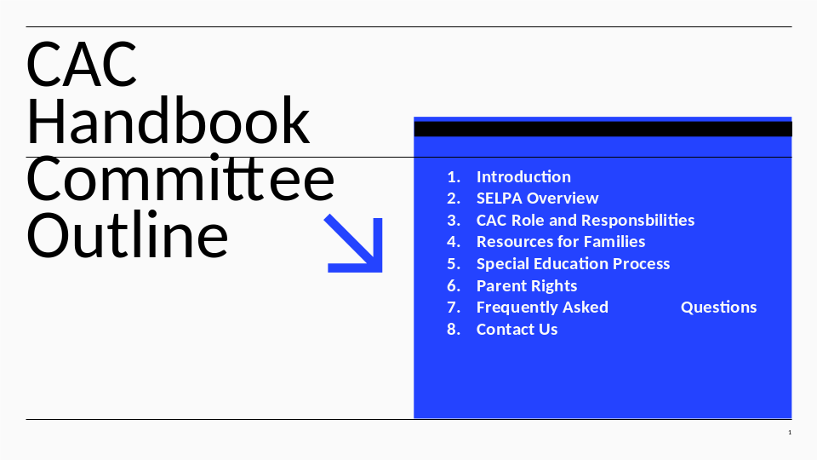
CAC Handbook Update
Attached Presentation

Slide 19

Student Inclusion Subcommittee Update
Attached Presentation

Slide 20
Parent & Staff Education Update
Note: Motioned to be presented next meeting due to time constraints.
CAC Subcommittee requested feedback from members to help strengthen staff and parent education. Families were asked: “As parents/caregivers — what do you wish you had known when you first started the Special Education journey?”
Next slides are the key themes shared by families.

Slide 21
Theme 1: Better Transition from Diagnosis to Educational Support
Many parents shared that when they first received a diagnosis (for example, through a medical provider like Cortica), there were no clear next steps provided on the educational side.
Families expressed a need for:
• A stronger connection between the medical world and the educational/autism/disability world
• Immediate guidance on what to do next
• Clear direction on who to contact
Suggested supports at the time of diagnosis:
• SELPA contact information
• List of local autism/disability organizations
• Parent support groups (in-person and online)
• Social media community pages
• Regional Center next steps
• Educational workshops and conferences
This is a critical moment for families. Instead of feeling empowered, many parents described feeling isolated and anxious.

Slide 22
Theme 2 : A “SPED 101” Welcome or Onboarding for Families
Parents consistently expressed a desire for a “Welcome to Special Education” orientation.
Ideas included:
• A SPED 101 onboarding session
• Overview of district services
• Clear explanation of the IEP process
• Opportunities to connect with district specialists
• Informative workshops tailored to family needs
Families want early access to information, not a “learn as you go” experience.
Discussion: SELPA offers a Parent IEP Academy. Can this be offered as an online resource? Pre-recorded?
Is Parent Handbook covering these theme topics? If not, could we add some of these topics in a future version of the handbook? District services are in the Local Plan. This can be linked in handbook.

Slide 23
Theme 3 : School-Based Community & Connection
Connection with other families was described as essential.
Suggested ideas:
• Coffee with the principal for special education families
• School-based parent support groups
• Parent meetups
• Opportunities to connect informally with other families
Many parents emphasized that simply meeting other families going through similar experiences can make a significant difference.
Discussion: What districts are we routinely having Coffee with the Principal for Special Education families? Are you having opportunities at your district for connection with other families like yours?

Slide 24
Theme 4 : The IEP & District Services
Families expressed a strong need for clearer explanations about:
• What services can the district offer?
• What services or accommodations can parents request?
• What do different assessments mean and evaluate?
• What do each section (“box”) of the IEP means?
• How can Special Education parents support the classroom and district?
• Steps and reasons for a SCIA (Special Circumstances Instructional Assistant)
• Least Restrictive Environment (LRE) → Most Restrictive Environment
• Early intervention services offered by the district
We found that many parents want to be collaborative partners but need clearer guidance on how to do so.

Slide 25
Theme 5 : Programs & Services That Made a Significant Difference
Parents highlighted programs that were especially impactful:
• Project Impact (through Regional Center)
Described as making the biggest difference, with more noticeable improvement than speech therapy (ST) and occupational therapy (OT) alone.
• TBS (Therapeutic Behavioral Services) through Medi-Cal
More intensive than ABA and very helpful for families.
TBS providers were also able to collaborate effectively with the school district.
Discussion: How can we share programs that are recommended by experienced Special Education families to new Special Education Families?

Slide 26
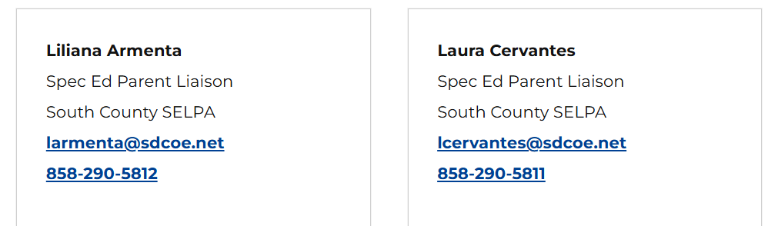
Summary
Families are asking for:
• Earlier connection to resources
• Clear, plain-language explanations
• Community and emotional support
• Collaboration between medical providers and schools
• Empowerment instead of confusion.
The Special Education journey should feel supported and guided, not isolated.
SELPA Parent Liasons
Free Parent IEP Support

Slide 27
Workshop Topics
Possible Topics for SELPA workshops as polled by parent community:
AAC – All about AAC
Assistive technology (accommodations, programs, when does this apply?)
ADHD beyond attention: Executive functioning, emotional regulation, impulsivity
Navigating bullying in special education
How to engage in your schools beyond volunteering: LCAP, School Site Councils, District advisory Committees workshop
Supporting students with PDA – strategies for demand avoidant learners
Caregiver burnout + balance – signs, supports, strategies
Navigating 504 plans

Slide 28

Art Show
Date: April 22, 2026, 3:30 pm
Theme: Splash of Imagination
CAC Volunteers Requested!

Slide 29
CAC 26/27 Officer Nominations
Chair Nominations:
Rosemary Lowry CVESD Parent
Co-Chair Nominations:
Erika Lowry Coronado Parent
Melissa Dolo South Bay Parent
Secretary Nominations:
Melissa Dolo South Bay Parent
Raquel Lopez CVESD Special Education Teacher
Elections will be held next CAC Meeting April 2026

Slide 30
Public Comments
Individual speakers will be allowed three (3) minutes to address the committee
Speakers are asked to fill out a Public Comment Form and submit it to the CAC Chair or Co-Chair prior to the start of the meeting
No action, comment or agreement can be taken by the CAC on oral communications
Notes:
At this time, we will have public comment.
Erika will be calling out names of those who have completed a public comment card.
She will be keeping track of time. At the one minute mark, she will hold up one finger. And at the end of three minutes, she will hold a hand up. She make verbally inform you of these time warnings, as well.
Please respect others as they speak to allow them to share their comments with the CAC. Note that the CAC is not able to take action, comment or agreement on oral communications but that your comments will be heard and considered for future agenda items.

Slide 31
Adjournment
Thank you all for coming!
Chula Vista Elementary (619) 425-9600 | Coronado Unified (619) 522-8900 | National (619) 336-7500 | San Ysidro (619) 428-4476 | South Bay Union (619) 628-1660 | Sweetwater Union High (619) 407-6300

