Slide 1
Payroll
Tammy Rice, Payroll and Benefits Coordinator
Nikki Calderon, Payroll Specialist

Slide 2
agenda
Supplemental Time Sheets
Employee Injuries
Frontline Time Sheets
Pay Dates

Slide 3




Frontline time sheets
✅ Clock In & Out – 4 Times Daily
Morning In
Lunch Out
Lunch In
End of Day Out
📱 If Your Badge/Card Doesn’t Work:
Use a laptop or the Frontline app on your phone
⏱ Time Rounding:
Rounds to the nearest 15-minute increment
Forget a punch and need an edit?
Write notes in Frontline for your supervisor

Slide 4
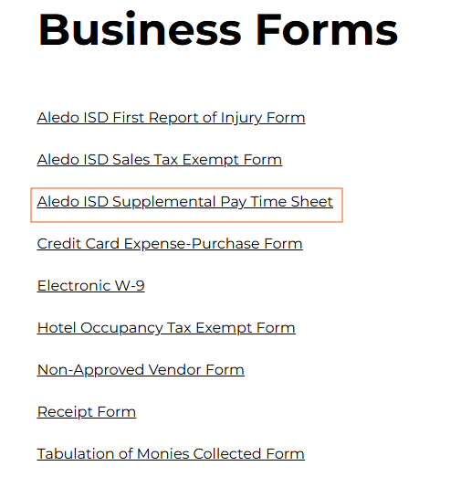
Supplemental Timesheets
Staff are required to use the Supplemental Pay Time Sheet when submitting extra duty pay to the Payroll Department.
Go to www.aledoisd.org
Click on Departments
Click on Business Office
Click on Business Forms
Click on Aledo ISD Supplemental
Pay Time Sheet

Slide 5
How To Complete a Supplemental Timesheet
Form must contain the employee’s legal printed name and employee ID number.
Description of Pre-Approved Activity.
Month work was completed.
Exact in and out times (including lunch breaks) must be entered on the date worked.
Form must be completed in legible ink (no pencil).
Include a budget code.
Form must be signed by the employee and designated Supervisor.
Original form must be received in the payroll department by the due date.
Late forms will be included on the next payroll.
We must have original signatures. Emailed forms will NOT be accepted.

Slide 6

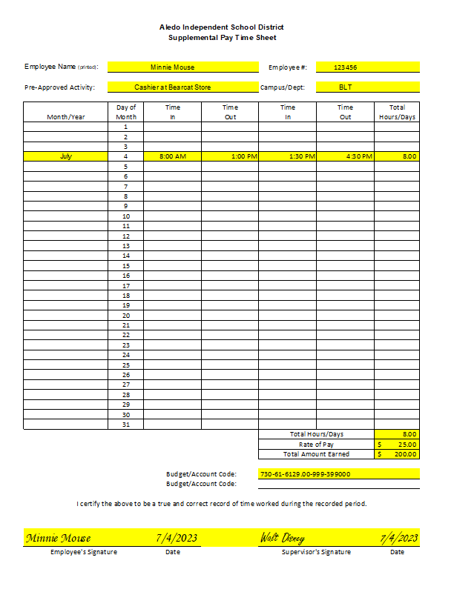

Slide 7
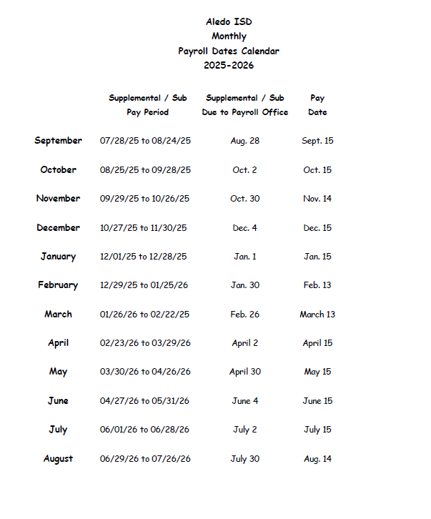



Slide 8
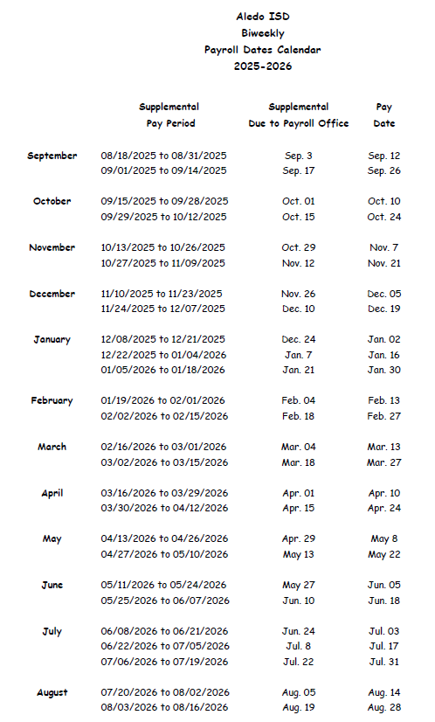



Slide 9
Employee Injuries
If an employee is injured at work, please use the new First Report of Injury form. Once submitted, it automatically emails a PDF copy to everyone who needs it.
Don’t print blank forms—delete any old versions you have. The online form keeps the process smooth and avoids delays from scanning or mailing paperwork.
If the employee can’t fill it out themselves, go ahead and complete the form for them as best you can.

Slide 10
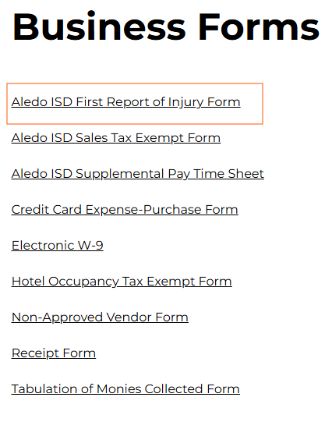
Employee Injuries
Go to www.aledoisd.org
Click on Departments
Click on Business Office
Click on Business Forms
Click on Aledo ISD First Report of
Injury Form

Slide 11

Questions

Slide 12

Contact Information
(817) 441-8327 Ext. 1009 trice@aledoisd.org
• Tammy Rice
Payroll and Benefits Coordinator
• Nikki Calderon
Ext. 1133 Payroll Specialist
acalderon@aledoisd.org

