Slide 1
Frewsburg Central School District
2026-2027 Budget
Workshop #1
February 12, 2026
Lynda Quick
Jerome Lee Yaw

Slide 2

Reminder
Budget Development Process

Slide 3
Budget Development Calendar
February 12, 2026 | Department Reviews (Instructional, Administrative, PPS, Interscholastic, Buildings and Grounds, Transportation), Debt Service, Review of Governor’s Executive Budget and Property Tax Cap
March 12, 2026 | Salaries, Fringe Benefits, BOCES, Special Ed, Review Draft Budget Scenarios
March 13-April 15, 2026 | Review and verify State Aid and BOCES estimates, Finalize Expenditures, complete final Budget Draft
April 16, 2026 | Adopt Final Budget
May 7, 2026 | Public Budget Hearing
May 19, 2026 | Budget Vote and Election of Board Members

Slide 4


Proposed Executive Budget

Slide 5
Aid Category | 2025-26 | 2026-27 | Change | % Change
Foundation Aid | $11,071,309 | $11,182,022 | 110,713 | 1.00%
Full Day K Conversion | $0 | $0
Universal Pre-Kindergarten | $476,324 | $481,615
BOCES | $1,367,570 | $1,254,839
Special Services | $0 | 0
High Cost- Excess Cost | $438,718 | $473,398
Private Excess Cost | $0 | $47,671
Hardware & Technology | $14,443 | $14,098
Software, Library, Textbook | $54,806 | $54,212
Transportation Inc Summer | $989,768 | $1,099,906
Building + Bldg Reorg Incent | $2,083,590 | $2,017,299
Operating Reorg Incentive | $0 | 0
Charter School Transitional | $0 | 0
Academic Enhancement | $0 | 0
High Tax Aid | $0 | 0
Supplemental Pub Excess Cost | $0 | 0
Total | $16,496,528 | $16,625,060 | $128,532 | 0.78%

Slide 6
The Governor’s Proposal…
School Meals
  Invests an additional $55 million to continue the statewide subsidy that fully reimburses schools that participate in the federal Community Eligibility Provision program, allowing participating schools to serve all of their students free breakfast and lunch.
Keeps NYSTRS Retirement Waiver for the 2026-27 school year
Keeps “Save Harmless”
  Save-harmless now ensures districts receive no less Foundation Aid than in the prior year, notwithstanding what the actual formula would deliver.
Childcare & Early Learning
  Proposals include:
  Pathway to universal childcare for children under 5, with a $4.5 billion investment in FY27, including expanded Pre-K and 2-year-old care pilots.
  Strengthening 3K access statewide and launching an Office of Child Care and Early Education.
  Continued support for child care subsidies (CCAP) to improve affordability.

Slide 7
Key Areas of Concern
Health Insurance and Personnel Costs:
  Health Insurance is projected to increase by $433,927
  Salary increases are projected to increase by $350,298
Debt Service is increasing by $305,917, which is largely offset by state aid
Enrollment is projected to decline slightly, which can impact future Foundation Aid
Governor’s Executive Budget Proposal only increased Foundation Aid by 1%

Slide 8
Summary of Major Cost Drivers
Category | Estimated Increase | % Change
Health Insurance | $433,927 | 15.00%
Salaries | $350,298 | 3.82%
Debt Service | $305,917 | 16.00%
Retirement & SS | $110,555 | 5.38%
Legal Costs | $18,000 | 56.25%
Liability Insurance | $17,780 | 20.07%

Slide 9
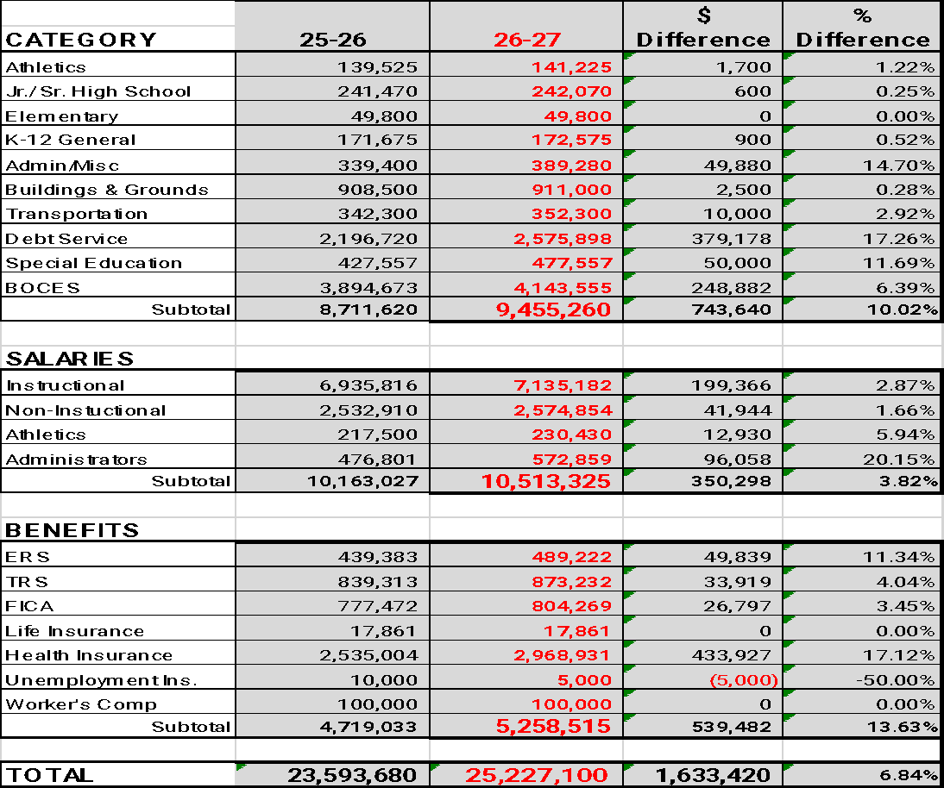
Notes:
This needs to be changed

Slide 10
Current Status of Budget Development
Total Projected Revenue Increases $598,068
Total Project Expenditure Increases $1,633,420
Current Projected Deficit ($1,035,352)

Slide 11

2026-27 Proposed Budget - Draft # 1
Revenues |  |  | Expenditures
State Aid - Governor Budget - 01/20/2026 | 16,458,445 |  | Athletics |  |  |  | 141,225
Appropriation | 600,000 |  | Jr/Sr High |  |  |  | 242,070
Capital Outlay Building Aid | 95,000 |  | Elementary |  |  |  | 49,800
Local Revenues | 191,078 |  | K-12 General |  |  |  | 172,575
Medicaid | 20,000 |  | Admin/Misc. |  |  |  | 389,280
2025 Tax Levy | 6,369,828 |  | Buildings & Grounds |  |  |  | 911,000
Trans. From Unemployment Reserve | 10,000 |  | Transportation |  |  |  | 352,300
Trans. Retirement Contribution Reserve | 110,000 |  | Debt Service |  |  |  | 2,575,898
Trans. From Debt Service | 60,000 |  | Special Education |  |  |  | 477,557
 | 23,914,351 |  | BOCES |  |  |  | 4,143,555
Possible Additional Revenue |  |  | Salaries |  |  |  | 10,513,325
Boces and Public Excess | 150,000 |  | Benefits |  |  |  | 5,258,515
Additional Tax Levy (2.00%) | 127,397
Total 2026-27 Revenues | 24,191,748 |  | Total 2026-27 Expenditures |  |  |  | 25,227,100
 |  |  | Note: Red items reviewed at 2/12/26 BOE meeting
 | 2026-27 Proposed Budget
 | 2025-26 Budget |  |  | 2026-27 Budget Tax Levy Increase 2.00%
 | 23,593,680 |  |  | 24,191,748
 | $ Increase/(Decrease) |  |  | 598,068
 | % Increase/(Decrease) |  |  | 2.53%
 | Cuts needed to meet Tax Levy Cap |  |  | 1,035,352
Every $63,698 change in the budget will result in a 1% change in the Tax Levy

Slide 12

Questions

