Slide 1




Earning College Credit in High School

Slide 2

An introduction to earning college credits through
Advanced Placement, Concurrent Enrollment, College in the Schools, PSEO Program, and Articulated Credit

Slide 3

Key Terms
Transcripts
College
  High School
  College
  Ordering
  Credits
  Graduation Requirements
  Major/Minor
  Goal Areas
  Liberal Education
  Core Curriculum
  Transfer Curriculum
High School
Miscellaneous Terms
  Graduation Requirements
  Post Secondary Enrollment Options (PSEO)
  Concurrent Enrollment (CE)
  College in the Schools (CIS)
  Advanced Placement (AP)
  Career & Technical Education (CTE)
  ACT
  College Board
  SchooLinks

Slide 4






Reasons to Consider Taking College Credit in High School
Save money or graduate from college early
Exposure to wide range of subjects
Develop skills for college
Prepare for career
Potential to earn college credit
Addition to college resume

Slide 5
Research About Early College Credits
The average cost of tuition per credit hour at a public, 4-year institution like the University of Minnesota is $406.
The average cost a tuition per credit at a two-year school like Century is $217.83.
Students with dual credits are about 1.5× more likely to receive scholarships/grants, and in one national sample got on average $1,229 more in combined aid (need + merit) vs non‐dual credit peers. -NACEP
Dual enrollment students more often complete credentials, persist in college, and graduate at higher rates than non‐dual counterparts. -NACEP

Slide 6
Opportunities for College Credit at Stillwater Area High School
Project Lead the Way
Bilingual Seal
Articulated Credit/ Advanced Placement
916 Career & Technical Education
Concurrent Enrollment/ College in the Schools (Mn-TC & AA)
Post Secondary Enrollment Options

Slide 7
Articulated Credit
Articulated credit agreements between high schools and colleges allow students to earn college credit for approved technical and career-focused courses
Get college credit
If you get a certain grade in the course, you can get college credit for it without retaking it
Save time and money
Earning college credits in high school allows students to save on college tuition
costs
Take technical/ CTE courses
Earn college credit for technical and career courses taken in high school

Slide 8
Concurent Enrollment/ College in the Schools
CE allows students to get a head start on
college while still in high school. We offer both the Minnesota Transfer Curriculum and Associates of Arts degree.
Earn College
Credits
Students earn both high school and college credits by passing the course
Save Money
on Tution
Earning college credits in high school allows students to save on college tuition
costs
Take College
Level Courses
Qualified high school teachers teach college level courses at the high school

Slide 9
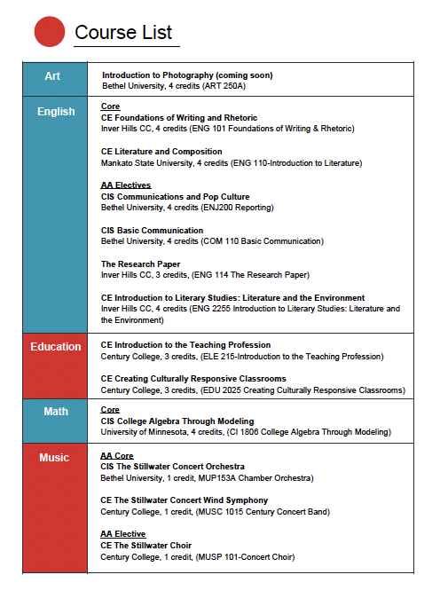
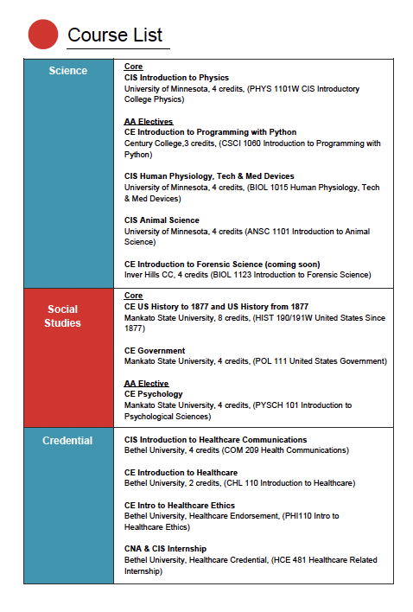
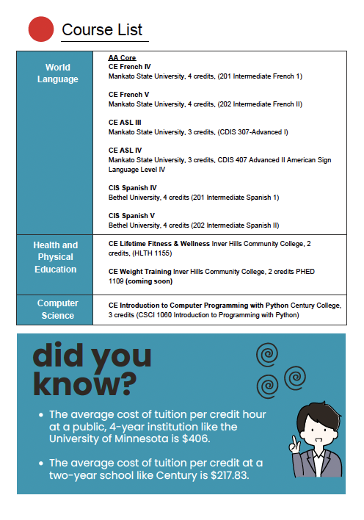

Slide 10
Bilingual Seals
Students in Minnesota can earn college credit while still in high school by demonstrating proficiency in a variety of languages on standardized exams. In order to earn college credit, students must take the exam 10th-12th grade. Exams are given in the spring each year.
MN SEALS tests are currently available in: ASL, Amharic, Arabic, Bulgarian, Chinese (Mandarin), Czech, Dakota, Dari, French, German, Hindi, Hebrew, Hmong, Hungarian, Italian, Japanese, Karen, Korean, Latin, Ojibwe, Oromo, Pashto, Polish, Portuguese, Russian, Somali, Spanish, Swahili, Tamil, Telugu, Ukrainian, and Vietnamese.

Slide 11
Project Lead the Way
Students who successfully complete the end-of-course assessments at the high school may receive college credit, scholarships, or admissions preferences at various higher education institutions, workforce certifications, and/or internship and other employment opportunities with industry partners.
  Civil Engineering and Architecture
  Intro to Engineering & Design
  Principles of Engineering

Slide 12
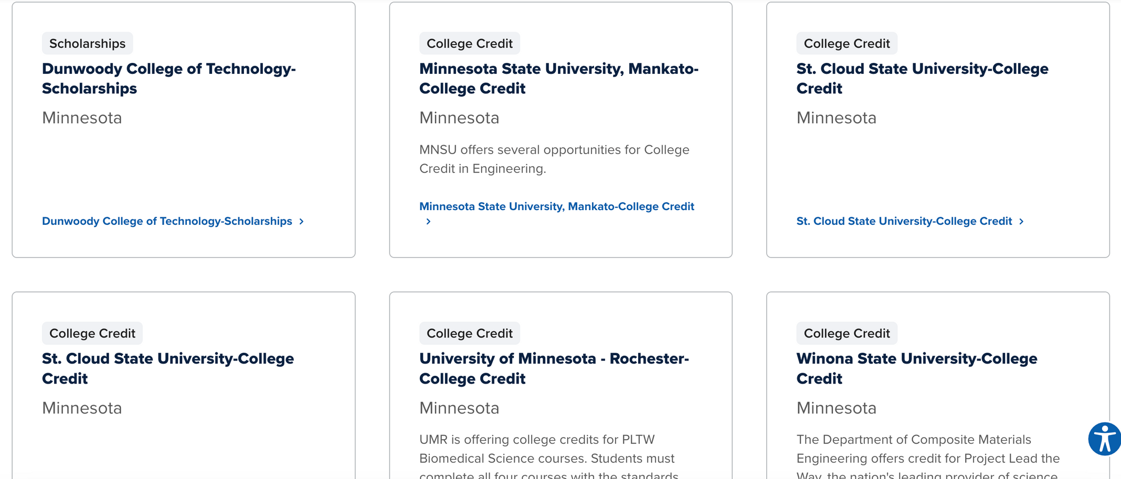

Slide 13

916 Career & Technical Education
Nearly 1,000 high school juniors and seniors get their competitive advantage at the 916 Career & Tech Center located on the East Campus of Century College.

Slide 14











916 Career and Tech Center
2026 Course Guide
at a glance
Architecture & Construction Engineering
Career pathways:
Architect • Mechanical Engineer • Structural/Civil/Electrical Engineer • Project Manager Carpenter • Electrician • Plumbing & HVAC Technician • Finishing Trades
Automotive Technology
Career pathways:
Shop Assistant • Parts Consultant • Light Duty Technician • Service Advisor • Automotive Engineer • Service Director • General Manager
Automotive Trades
Career pathways:
Body Shop Proprietor • Collision Technician • Reﬁnisher/Painter • Frame Straightener • Parts Supplier • Collision Estimator • Windshield /Glass Installer • Truck Driver (CDL licensed)
Construction Trades
Career pathways:
Carpenter• Residential Electrician • Residential Plumbing & HVAC technician • Construction Manager • Finishing Trades
Cosmetology: General
Career pathways: Cosmetologist • Hair Color Specialist • Cosmetology Teacher • Competition Stylist Salon Owner
Cosmetology: Nails and Esthetics
Career pathways:
Cosmetologist • Make-up Artist • Cosmetology Teacher • Competition Stylist • Salon Owner Nail Technician • Esthetician
Criminal Justice & Law Enforcement
Career pathways: Probation/Parole Officer • State Police Officer • Corrections Officer • Park Ranger • Security Officer • Military Police • Safety Inspector or Supervisor
APPLY NOW!
#916impaCT: Are you READY?

Slide 15








916 Career and Tech Center
2026 Course Guide
at a glance
Dental Careers
Career pathways: Licensed Dental Assistant • Licensed Orthodontic Assistant • Treatment Coordinator Dentist • Dental Hygienist • Orthodontist • Periodontist • Oral Surgeon
Emergency Medical Technician (EMT)
Career pathways: EMT • Paramedic • Firefighter •Physician •Registered Nurse • Lifeguard
Entrepreneurship & Marketing
Career pathways:
Business Owner • Social Media Influencer • Travel Agent • Advertising • Podcaster
Intro to Medical Careers & Nursing Assistant (Hybrid)
Career pathways: Nursing Assistant • Physician • Phlebotomist • Registered Nurse • Radiologist • Physical Therapist • Occupational Therapist
IT Careers
Career pathways:
Cybersecurity • Technology Repair • Hardware/Software Design • Network Consultant Technical Support Specialist • Network Specialist • Computer Systems Analyst
Nursing Assistant & Phlebotomy
Career pathways: Nursing Assistant • Physician • Phlebotomist • Registered Nurse • Radiologist • Physical Therapist • Occupational Therapist
Metal Fusion
Career pathways:
Underwater Welder • Production Welder • Materials Engineer • Welding Inspector • Metal Fabricator • Maintenance Welder • Ironworker • Boilermaker • Sheet Metal Welder • CNC Plasma Welder
APPLY NOW!
#916impaCT: Are you READY?

Slide 16
Advanced Placement
  AP Art & Design
  AP Computer Science Principals
  AP Computer Science Adv. Topics
  AP Calc AB
  AP Calc BC
  AP Stats
  AP Music Theory
  AP Biology
  AP Environmental Science
  AP Human Geography
  AP World History
  AP Microeconomics
Students who successfully complete these college-level courses taught at the high school, and pass an AP exam, may be able to earn college credit at participating institutions.

Slide 17
Post Secondary Enrollment Option (PSEO)
What is it?
State program for public, private and home school students.
College courses taught on college campus (or online) by college faculty.
Dual credit: Students receive high school and college credit by passing the course.

Slide 18
Post Secondary Enrollment Option (PSEO)
Who can participate?
Institutions:
Minnesota public and private 4-year and 2-year colleges
Courses:
Offerings vary by institution.
No central database of courses
Students:
11th and 12th graders
10th graders may enroll in one Career Technical Education course at specific institutions

Slide 19

Post Secondary Enrollment Option
How does it work?
Step 01
Step 02
Step 03
Step 04
Talk to your high school counselor, and parents.
Research institutions and courses, as well as enrollment deadlines
Talk to your high school counselor to discuss graduation requirements
Complete admissions and enrollment process outlined by the college
May 30th Deadline for public school students.

Slide 20
Considerations with PSEO
College Student Experience
College Transcript
Responsibility
Time Management
Communication and Privacy
FERPA
Expectations- Email, Website / Resources,
Reading
Logistics
Transportation
Courses

Slide 21
How Credit Works
Earning College Credit
Transferring College Credit
Credit Evaluation
Students can transfer earned college credits to colleges and university they attend after high school. Each institution has policies on accepting transfer credits.
Students should meet with a college advisor to evaluate how credits will transfer and apply to their degree plan.
Students can earn credit while in high school through AP, PSEO, CE, CIS and other opportunities.

Slide 22
Conclusion
Earning college credit in high school can give students a head start on college, but the best option depends on the individual
Several options exist for earning college credit in high school
Each option has pros and cons to consider
Meet with your school counselor to determine the best fit
AP classes, PSEO, CE, CIS and more allow students to earn college credit
Level of rigor, time commitment, and future career plans should be evaluated
Counselors can help evaluate options based on student goals and abilities

Slide 23
Thank you to our Guests
Mike Altomari- Mankato

Slide 24
Questions?

