Slide 1

West Manor
FY27 Budget Feedback Meeting
02/10/26

Slide 2
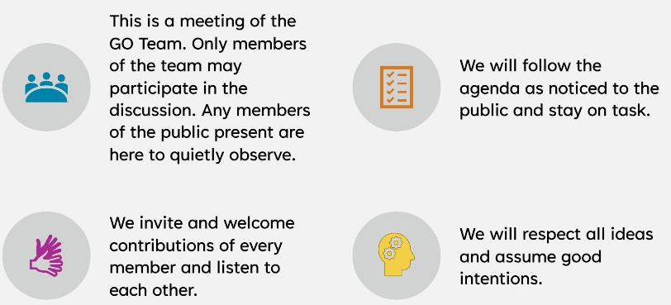
Purpose, Agenda, & Norms
During this meeting the GO Team will discuss the proposed school budget, how it supports the school's programmatic needs and aligns to the School’s Strategic Plan. The GO Team will also review and provide feedback on proposed use of school-level flexibility in the FY27 Budget.
Meeting Agenda
Meeting Norms
Action Items Approval of Agenda
  Approval of Previous Minutes
Discussion Items
  Budget Development Presentation
    ACTION ITEM: GO Team vote on Draft Budget
Information Items
  Principal’s Report
Announcements
Public Comment
Notes:
As a reminder this is the district's 2025-2030 Strategic Plan. We will use this as a guide as we continue our work today to develop our school's 2025-2030 Strategic Plan that is aligned to the district's new plan.

Slide 3

FY 27 GO Team Budget Development Process Timeline
Step 3 Principals & Assoc. Supt. Discussions
Step 1 Finalize Strategic Plan & Rank Objectives
Step 6 Principals HR Staffing Conferences Begin
February 23-27
Step 2 District-wide Budget Allocation Training
January 2026
Step 7* GO Team Budget Finalization Meeting
Budgets finalized by March 13th
Step 5 Associate Supt. Review
Step 4* GO Team Feedback Mtg. Completed February 2026 (BEFORE STAFFING CONFERENCE)
GO Teams are encouraged to have ongoing conversations
* GO Teams will need to take ACTION on the budget at these meetings.
Notes:
As a reminder this is the district's 2025-2030 Strategic Plan. We will use this as a guide as we continue our work today to develop our school's 2025-2030 Strategic Plan that is aligned to the district's new plan.

Slide 4
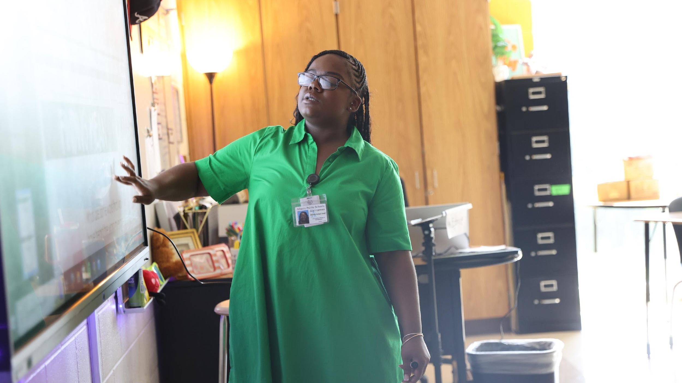

West Manor FY27 Strategy and Budget Alignment
Strategic Resource Allocation to Support Student Outcomes
One District. One Goal. Every Child.

Slide 5
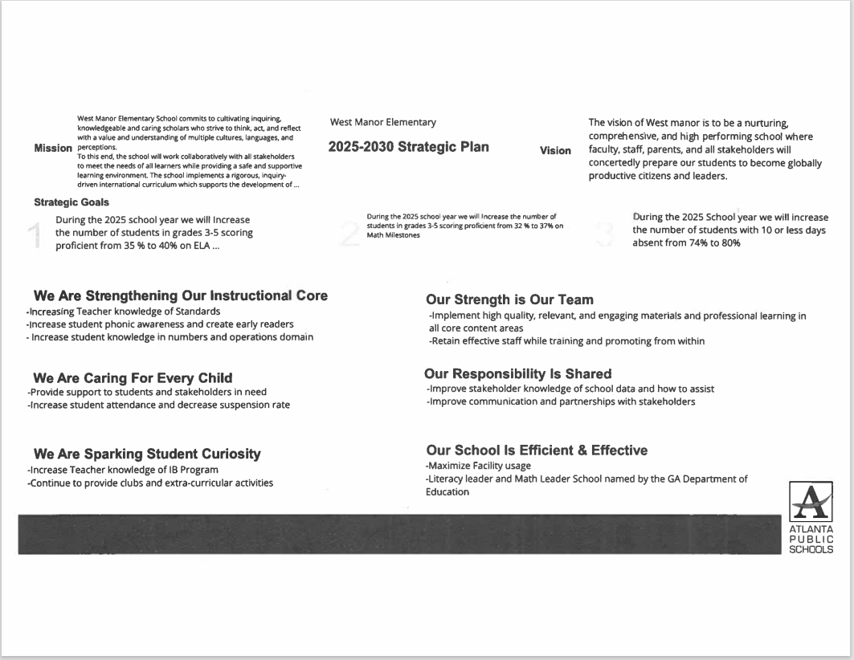
West Manor Strategic Plan
Notes:
As a reminder this is the district's 2025-2030 Strategic Plan. We will use this as a guide as we continue our work today to develop our school's 2025-2030 Strategic Plan that is aligned to the district's new plan.

Slide 6
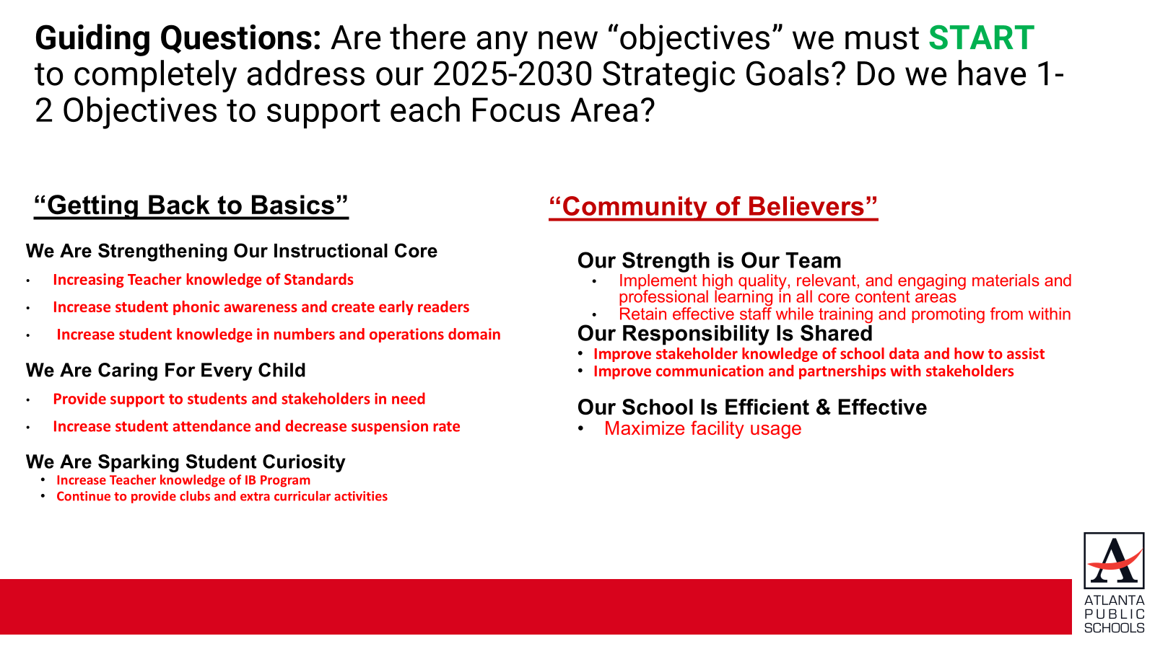

Slide 7
Strategic Plan Objective Rankings
1.Increase student phonic awareness and create early readers
2.Increase student knowledge in numbers and operations domain
3. Increase student multiplication skills
4. Increase student attendance and decrease suspension rate
5.Increasing Teacher knowledge of Standards
6.Increase Teacher knowledge of IB Program
7. Improve stakeholder knowledge of school data and how to assist
8. Provide support to students and stakeholders in need
Notes:
As a reminder this is the district's 2025-2030 Strategic Plan. We will use this as a guide as we continue our work today to develop our school's 2025-2030 Strategic Plan that is aligned to the district's new plan.

Slide 8
Strategic Plan Objective Rankings w/School Context
FY27 Ranked Objectives Insert the Strategic Objectives as ranked by the GO Team from Highest to Lowest | What Does This Mean for West Manor in the 2026-2027 School Year?
Increase student phonic awareness and create early readers | Focus on grades k-2 literacy with small class sizes and providing paraprofessionals for intentional small groups, intervention support
Increase student knowledge in numbers and operations domain | Math PLC reviewing new standards, small group instruction, intervention support
Increase student multiplication skills | Use technology to increase fluency with mathematical functions, PLC, small group instruction, MTSS intervention
Increase student attendance and decrease suspension rate | Care Team, attendance incentives, Social emotional learning
Increasing Teacher knowledge of Standards | Instructional Coaches reviewing best practices of implementing new standards, extended planning block
Increase Teacher knowledge of IB Program | IB Coordinator, IB PLC, Toddle for evidence and planning,
Improve stakeholder knowledge of school data and how to assist | IB APTT meetings, Parent Liaison in contact with community, parent university, data days, student conferences, title One meetings
Provide support to students and stakeholders in need | Care Team, Social Worker Services , Counseling groups, Nurse, SRO
Notes:
As a reminder this is the district's 2025-2030 Strategic Plan. We will use this as a guide as we continue our work today to develop our school's 2025-2030 Strategic Plan that is aligned to the district's new plan.

Slide 9
Strategic Use of Resources: Category Descriptions
WHAT? |  | HOW MUCH? | WHY?
Focus Area | Strategic Objective | FY27 Resource Recommendation | Additional Information (OPTIONAL)
We Are Sparking Student Curiosity | Increase STEAM Integration | K-5 Science Lab Materials ($10,000) | To ensure we have the appropriate supplies for students to complete project-based learning opportunities
WHAT?
What are we doing to achieve our goals?
Focus Area: Which focus area is the objective aligned with?
Objectives: FY27 Objectives from the school’s strategic plan, ranked by the order of importance.
HOW MUCH?
What resources (financial, staffing) are recommended to support this work in your school?
FY27 Resource Recommendation: Shares what resources you have allocated to support the objective in your FY27 Budget Proposal. Can be staffing and/or non-staffing resources.
WHY?
Why is this important?
Additional Information: Share why this recommendation is important to achieving your goals. Is it new for FY27?

Slide 10
Strategic Use of Resources (Required)
Focus Area | Strategic Objective | FY27 Resource Recommendation
We Are Sparking Student Curiosity | Continue IB Program Continue Gifted inquiry lab, Clubs and activities | 280,000 IB Coordinator and Gifted teacher
We Are Strengthening Our Instructional Core | Increase student phonic awareness and create early readers Increase student knowledge in numbers and operations domain Increase student multiplication skills | 305,000 MTSS Interventionist and Instructional Coach, additional Teacher cost
We are Caring for Every Child | Provide support to students and stakeholders in need Increase student attendance and decrease suspension rate | 310,000 Nurse, Social Worker, Counselor
Notes:
As a reminder this is the district's 2025-2030 Strategic Plan. We will use this as a guide as we continue our work today to develop our school's 2025-2030 Strategic Plan that is aligned to the district's new plan.

Slide 11
West Manor
FY27 Proposed Use of Staffing & Non-Staffing Allocation
and School-Level Flexibility
One District. One Goal. Every Child.

Slide 12
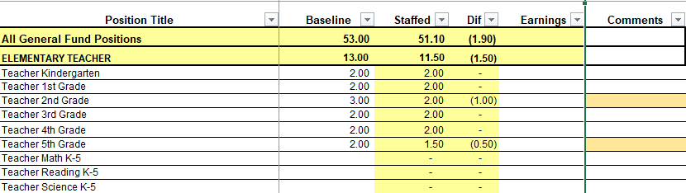
Summary Tab Overview
The Summary Tab provides a summary of the staff in our school. The columns show how many positions are:
Baseline – District’s recommended staffing for positions where there is some school-level flexibility with staffing the position.
Staffed – This shows how the principal is proposing to staff the position for the FY27 school year.
Difference—This shows the difference between the recommendation from the District and the Principal's proposed FY27 staffing plan.
Comments: The principal must provide comments if there is a difference in what is Baseline and Staffed. Principals and GO Teams will discuss the rationale for the use of school-level flexibility.
Notes:
As a reminder this is the district's 2025-2030 Strategic Plan. We will use this as a guide as we continue our work today to develop our school's 2025-2030 Strategic Plan that is aligned to the district's new plan.

Slide 13
FY27 Staffing Proposal and Use of School-Level Flexibility (Required)
Row | Position | Baseline | Staffed | Difference | Comment
13 | All General Fund Positions | 40.05 | 40.65 | 0.6
14 | ELEMENTARY TEACHER | 13 | 12 | -1
15 | Teacher Kindergarten | 2 | 2 | 0
16 | Teacher 1st Grade | 2 | 2 | 0
17 | Teacher 2nd Grade | 3 | 2 | -1
18 | Teacher 3rd Grade | 2 | 2 | 0
19 | Teacher 4th Grade | 2 | 2 | 0
20 | Teacher 5th Grade | 2 | 2 | 0
34 | EIP/REP TEACHERS | 1.5 | 3 | 1.5
36 | Teacher EIP 1-3 | 0 | 1 | 1
37 | Teacher EIP 4-5 | 0 | 2 | 2
42 | ELECTIVES/ENRICHMENTS | 3.9 | 4 | 0.1
43 | Teacher Art 1-5 | 0.6 | 0.5 | -0.1
45 | Teacher Music 1-5 | 0.6 | 0.5 | -0.1
47 | Teacher Physical Ed 1-5 | 0.6 | 1 | 0.4
49 | Teacher World Language 1-5 | 0.6 | 1 | 0.4
66 | Teacher Gifted | 1.5 | 1 | -0.5

Slide 14
CTE/JROTC/SPED | 4.9 | 4.9 | 0
Teacher ESOL | 0.6 | 0.6 | 0
Teacher Interrelated | 3.5 | 3.5 | 0
Lead Teacher Special Ed | 0.5 | 0.5 | 0
Speech Language Pathologist | 0.3 | 0.3 | 0
PARAPROFESSIONALS | 3 | 3 | 0
Paraprofessional Special Ed | 1 | 1 | 0
Paraprofessional Kindergarten | 2 | 2 | 0
SCHOOL ADMINISTRATION | 4.5 | 3 | -1.5
Principal Elementary | 1 | 1 | 0
Assistant Principal Elementary | 1 | 1 | 0
School Secretary | 1 | 1 | 0
Bookkeeper | 0.5 | 0 | -0.5
School Clerk 211 day | 1 | 0 | -1
STUDENT AND SCHOOL SUPPORT | 9.25 | 10.75 | 1.5
Counselor Elementary | 1 | 1 | 0
Instructional Coach 211 Day | 0 | 1 | 1
Instructional Coach Readers are Leaders 211 Day | 1 | 0 | -1 | flex fte
Media Specialist | 1 | 1 | 0
School Nurse LPN | 1 | 1 | 0
Signature Prgm Coach 211 day | 0 | 1 | 1
Social Worker 211 Day | 1 | 0.5 | -0.5 | Approved 1.13.26
Specialist SST Intervention | 0 | 1 | 1
Psychologist | 0.25 | 0.25 | 0
Custodian | 2 | 2 | 0
Site Manager | 1 | 1 | 0
School Resource Officer 202 Day | 1 | 1 | 0

Slide 15
FY27 Non-Staffing Tab Overview
The Non-Staffing Tab shows how funds are allocated for non-staff items in the school. There is school-level flexibility for most of these items. The tab has columns for:
Recommended—District’s recommended amount to spend on the line item.
Allocation – This shows how much the principal is proposing to allocate towards the line item in FY27.
Difference—This shows the difference between the recommended amount and the allocation.
Notes: The principal must provide comments if there is a difference in what is Recommended and what is Allocated. Principals and GO Teams will discuss the rationale for the use of school-level flexibility.
Description | Rec. | Allocation | Diff | Notes
Reserve | $ 95,045 | $ 95,045 | $ -
Custodian Overtime | $ 1,650
School Resource Officer Overtime | $ 4,000
Teaching/Other Supplies | $ 18,650 |  | $ (18,650)
Media Supplies | $ 2,984 |  | $ (2,984)
Academic Stipends | 20,500 | $ 20,500 | $ -
Fine Arts Stipends | 0 | $ - | $ -
Teacher Subs | $ 49,984 | $ 49,984 | $ -
Substitute FICA | $ 725 | $ 725 | $ -
Example
Notes:
As a reminder this is the district's 2025-2030 Strategic Plan. We will use this as a guide as we continue our work today to develop our school's 2025-2030 Strategic Plan that is aligned to the district's new plan.

Slide 16
FY27 Non-Staffing Proposal and Use of School-Level Flexibility (Required)
Row | Description | Recommended | Allocation | Difference | Notes
13 | Reserve | $66,424.92 | $66,424.92 | $-
15 | Secretary Overtime | $- | $5,000.00 | $5,000.00
16 | Custodian Overtime | $1,650.00 | $- | $-
17 | School Resource Officer Overtime | $4,000.00 | $- | $-
22 | Web-based Subsc and Licenses/ Computer Software | $- | $10,000.00 | $10,000.00
30 | Teaching/Other Supplies | $12,950.00 | $15,172.00 | $2,222.00
34 | Media Supplies | $2,072.00 | $- | $(2,072.00)
41 | Dues & Fees (Signature Programs) | $- | $9,600.00 | $9,600.00 | Authorization fee
47 |  | Stipends
48 | Academic Stipends | 20,500 | $20,500.00 | $-
86 |  | Turnaround
93 |  | Substitutes
94 | Teacher Subs | $41,008.00 | $41,008.00 | $-
99 | Substitute FICA | $594.62 | $594.62 | $-
100 |  | Hourly Staff
105 | Hourly Cafeteria Monitor | $- | $9,196.20 | $9,196.20
119 | Hourly Paraprofessional | $- | $19,794.24 | $19,794.24
136 | Hourly Teacher Tutor | $- | $25,200.00 | $25,200.00
150 | Hourly Non Instructional Aide Security | $- | $38,836.80 | $38,836.80
153 | 0 | $- | $133.34 | $133.34
154 | 0 | $- | $652.42 | $652.42
174 | 0 | $- | $563.13 | $563.13
179 | FICA for Hourlies | $- | $1,348.89 | $1,348.89
180 | TOTAL | $128,699.53 | $262,675.67 | $119,126.13

Slide 17
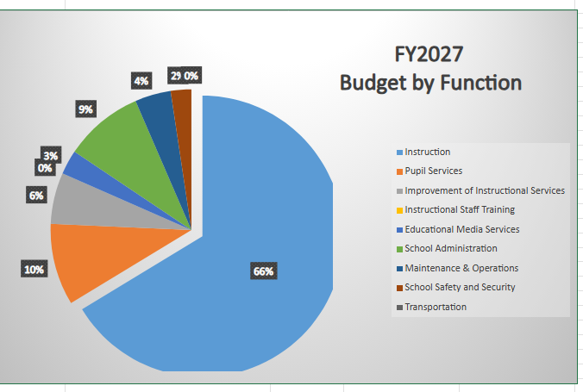
FY27 BUDGET BY FUNCTION
(Required)
School | West Manor Elementary School
Location | 2569
Level | ES
Principal | Reginald Lawrence
Projected Enrollment | 259
Account | Account Description | FTE | Budget | Per Pupil
1000 | Instruction | 26.90 | $3,536,039 | $13,653
2100 | Pupil Services | 3.75 | $501,156 | $1,935
2210 | Improvement of Instructional Services | 2.00 | $313,556 | $1,211
2213 | Instructional Staff Training | - | $- | $-
2220 | Educational Media Services | 1.00 | $149,632 | $578
2400 | School Administration | 3.00 | $485,423 | $1,874
2600 | Maintenance & Operations | 3.00 | $220,043 | $850
2660 | School Safety and Security | 1.00 | $126,054 | $487
2700 | Transportation | - | $- | $-
Total |  | 40.65 | $5,331,904 | $20,587

Slide 18
Discussion of Reserve Funds
One District. One Goal. Every Child.

Slide 19
Plan for FY27 Leveling Reserve (Required)
$_66425 ___​
FOCUS AREA | STRATEGIC PLAN OBJECTIVE | FY27 Resource Recommendation
We Are Strengthening Our Instructional Core | Increase student phonic awareness and create early readers Increase student knowledge in numbers and operations domain Increase student multiplication skills | Provide materials and extra paraprofessional materials for small group instructional assistance (possible teacher)
Notes:
As a reminder this is the district's 2025-2030 Strategic Plan. We will use this as a guide as we continue our work today to develop our school's 2025-2030 Strategic Plan that is aligned to the district's new plan.

Slide 20
Does the budget proposal support our school's strategic objectives and lead to achieving our goals?
If new positions, resources, or programs are being added, what data or feedback supports these changes?
What trade-offs being made in this budget? Are any current programs or resources being adjusted or reduced, and how will that impact our students?
If we are sharing staff positions (e.g., nurse, counselor, teacher), how will this affect student support and service delivery at our school?
Questions for the GO Team To Discuss
Notes:
As a reminder this is the district's 2025-2030 Strategic Plan. We will use this as a guide as we continue our work today to develop our school's 2025-2030 Strategic Plan that is aligned to the district's new plan.

Slide 21
Action on the FY27 Draft Budget
The GO Team needs to TAKE ACTION (vote) on the proposed FY27 budget.
After the motion and a second, the GO Team may have additional discussion.
Once discussion is concluded, the GO Team will vote.
Notes:
As a reminder this is the district's 2025-2030 Strategic Plan. We will use this as a guide as we continue our work today to develop our school's 2025-2030 Strategic Plan that is aligned to the district's new plan.

Slide 22
Next Meeting: Budget Finalization Meeting
(Insert Date, Time)
Step 3 Principals & Assoc. Supt. Discussions
Step 1 Finalize Strategic Plan & Rank Objectives
Step 6 Principals HR Staffing Conferences Begin
February 23-27
Step 2 District-wide Budget Allocation Training
January 2026
Step 7* GO Team Budget Finalization Meeting
Budgets finalized by March 13th
Step 5 Associate Supt. Review
Step 4* GO Team Feedback Mtg. Completed February 2026 (BEFORE STAFFING CONFERENCE)
GO Teams are encouraged to have ongoing conversations
* GO Teams will need to take ACTION on the budget at these meetings.
Notes:
As a reminder this is the district's 2025-2030 Strategic Plan. We will use this as a guide as we continue our work today to develop our school's 2025-2030 Strategic Plan that is aligned to the district's new plan.

Slide 23
Information Items, Announcements and
Public Comment
One District. One Goal. Every Child.

Slide 24
Principal's Report
Notes:
As a reminder this is the district's 2025-2030 Strategic Plan. We will use this as a guide as we continue our work today to develop our school's 2025-2030 Strategic Plan that is aligned to the district's new plan.

Slide 25
Announcements
Notes:
As a reminder this is the district's 2025-2030 Strategic Plan. We will use this as a guide as we continue our work today to develop our school's 2025-2030 Strategic Plan that is aligned to the district's new plan.

Slide 26


GO Team Declarations: Open NOW – Feb. 28
During the GO Team election, each school will fill:
2 parent/guardian seats
2 instructional staff seats
Scan the QR Code to
Declare Your Candidacy!
http://tinyAPS.com/?2026GOTeamDeclaration

Slide 27
Thank you

