Slide 1

2025-2026
BUSD Local Control & Accountability Plan
(LCAP)
Meeting # 3 - Selected Program Data

Slide 2



Instructional Goals for 2025–2026
3rd Grade Literacy
Ensure all students read proficiently (fluency and comprehension) by third grade to build a strong academic foundation.
Middle School Math Progression
Strengthen math skills in middle school with foundations established in elementary schools to prepare students for high school challenges.
College & Career Readiness
Increase A-G course completion rates to equip students for college admission and careers.
Increase “College and Career Readiness” (measures graduation rate, performance on state tests and college credit courses)

Slide 3
Instructional Goals for 2025–2026
3rd Grade Literacy
Ensure all students read proficiently (fluency and comprehension) by third grade to build a strong academic foundation.
Metric | Baseline | Year 2 Outcome
Percent of All Students who score Exceeds or Meet Standards on the English Language Arts CAASPP will increase by 3 percentage points over 3 years | In 2022-2023, 58.43% of All Students scored Exceeds or Meets Standards on the ELA CAASPP. 56.84% in 3rd Grade for ELA. | In 2024-2025, 58.02% of All Students scored Exceeds or Meets Standards on the ELA CAASPP. 51.94% in 3rd Grade for ELA. | -
Percent of English Learners making progress towards English language proficiency as reported on the California Dashboard will increase by 3 percentage points over 3 years | In 2022-2023, 57.7% of English Learners making progress towards English language proficiency as reported on the California Dashboard | In 2024-2025, 58.8% of English Learners making progress towards English language proficiency as reported on the California Dashboard | +
Percent of Socioeconomically Disadvantaged Students Exceeding or Meeting Standards on the English Language Arts CAASPP will increase by 3 percentage points over 3 years | In 2022-2023, 47.15% of Socioeconomically Disadvantaged scored Exceeds or Meets Standards on the ELA CAASPP. 43.64% in 3rd Grade for ELA. | In 2024-2025, 43.82% of Socioeconomically Disadvantaged scored Exceeds or Meets Standards on the ELA CAASPP. 38.34% in 3rd Grade for ELA. | -
Percent of students proficient in English Language Arts as Measured by District Assessment will increase by 3% over 3 years | In 2023-2024, 66% of Elementary students scored proficient on the I-Ready end-of-year reading assessment. | TBD

Slide 4
Instructional Goals for 2025–2026
Middle School Math Progression
Strengthen math skills in middle school with foundations established in elementary schools to prepare students for high school challenges.
Metric | Baseline | Year 2 Outcome
Percent of All Students who score Exceeds or Meets Standards on the Mathematics CAASPP will increase by 3 percentage points over 3 years | In 2022-2023, 44.40% of All Students scored Exceeds or Meets Standards on the Mathematics CAASPP. Grade 6 – 39.43%; Grade 7 – 41.23%; Grade 8 - 37.66% | In 2024-2025, 46.56% of All Students scored Exceeds or Meets Standards on the Mathematics CAASPP. Grade 6 – 42.97%; Grade 7 – 45.82%; Grade 8 - 41.57% | +
Percent of Socioeconomically Disadvantaged Students Exceeding or Meeting Standards on Math CAASPP will increase by 3% over 3 years | In 2022-2023, 32.74% of Socioeconomically Disadvantaged Students scored exceeds or Meets standards on the Math CAASPP Grade 6 – 26.00%; Grade 7 – 29.89%; Grade 8 – 30.73% | In 2024-2025, 33.74% of Socioeconomically Disadvantaged Students scored Exceeds or Meets Standards on the Math CAASPP Grade 6 – 28.58%; Grade 7 – 35.70%; Grade 8 – 25.00% | +
Percent of students proficient in Mathematics as measured by District Assessment will increase by 3% over 3 years. | In 2024-2025, 59.81% of Middle School students scored proficient on the end-of-year math assessment. | TBD

Slide 5
Instructional Goals for 2025–2026
College & Career Readiness
Increase A-G course completion rates to equip students for college admission and careers.
Increase “College and Career Readiness” (measures graduation rate, performance on state tests and college credit courses)
Metric | Baseline | Year 2 Outcome
Graduation Rate for All Students will increase by 1 percentage point over 3 years. | In 2022-2023 93.2% of All Students were graduated from high school | In 2024-2025, the District-wide graduation rate was 97.4% for all students. | +
Percent of "D" and "F" Grade Rate in Secondary will decrease by 3 percentage points over 3 years. | Fall of 2023 - 7.7% of middle school grades were a "D" or "F“; 11.2% of high school grades were a "D" or "F" | Fall of 2025 – 6.89% of middle school grades were a "D" or "F“; 11.53% of high school grades were a “D” or “F” | +
Percentage of students completing the A-G requirements. The completion rate will increase by 2% percentage points per year. | In 2022-2023 48.0% of high school students met A-G completion rate | In 2024-2025, 49.2% of high school students met A-G completion requirements | +
Percent of students college/career ready will increase annually by 2% percentage points annually | In 2022-2023, 49.6% of students were prepared. | In 2024-2025, 55.2% of students were prepared as indicated on the California Dashboard/Data Quest. | +

Slide 6
Data Dive and Program & Services Highlights
Monterey High School – Dual Immersion – FSA Counseling & Mental Health

Slide 7
25-26 Budget Planning
Supplemental Funding (LCAP)
Goal 2 Monterey Action Items | Allocation
Monterey Teachers (5 FTE) | 560,604
SOAR Program Staffing (Monterey) (1 teacher; 1 paraeducator; 2 specialists) | 343,083

Slide 8
Monterey High School Enrollment Snapshots (October 5th)
Academic Year | Total | African American | American Indian or Alaska Native | Asian | Filipino | Hispanic or Latino | Pacific Islander | White | Two or More Races | Not Reported
2024-25 | 91 | 5.5% | 1.1% | 2.2% | 2.2% | 49.5% | 0.0% | 35.2% | 3.3% | 1.1%
2023-24 | 93 | 4.3% | 0.0% | 3.2% | 3.2% | 48.4% | 0.0% | 34.4% | 5.4% | 1.1%
2022-23 | 92 | 4.3% | 0.0% | 0.0% | 3.3% | 55.4% | 1.1% | 31.5% | 2.2% | 2.2%

Slide 9
LCAP Goal 2 Metrics
MONTEREY High School
Metric | Baseline | Year 2 Outcome
Graduation Rate for All Students will increase by 1 percentage point over 3 years as reported on the California Dashboard. | In 2022-2023 93.2% of All Students were graduated from high school Monterey 88.2% | In 2024-2025, the District-wide graduation rate was 97.4% for all students. Monterey – 98.4% | +
Graduation Rate of Socio-Economically Disadvantaged Students will increase by 2 percentage points over 3 years as reported on the California Dashboard. | In 2022-2023, 91.0% of Socio-economically Disadvantaged Students were graduated from high school Monterey – 85.7% | In 2024-2025, 95.5% of Socio-economically Disadvantaged Students graduated Monterey 97.8% | +
Suspension Rate District wide will be maintained or at least decrease by 1 percentage point over 3 years as reported on the California Dashboard. | In 2022-2023, 3.2% of students were suspended at least once Monterey 12.1% | In 2024-2025, 2.5% of students were suspended at least once Monterey 14.2% | -

Slide 10
Monterey Program Highlights
WASC Accreditation – 6 Year Accreditation (Highest possible)
First Area of Strength: Dedicated Faculty and Staff – Staff consistently go above and beyond to meet academic, social-emotional, and behavioral needs, creating strong student connections.
Second Area of Strength: Targeted and Individualized Student Supports – Counseling, SOAR, and credit recovery programs provide tailored pathways toward graduation and postsecondary transitions.
Distinguished Model High School Award
Statewide Recognition: MHS has been recommended for the CCEA Plus Model High School Award, a prestigious honor given to outstanding continuation and community day high schools in California.
What It Represents: This recognition highlights our school as a model of excellence in supporting students academically, socially, and emotionally.
Why We Earned It: The award reflects our strong programs, dedicated staff, positive school culture, and commitment to helping every student succeed and graduate.
Who It Honors: This achievement belongs to our students, families, teachers, counselors, and staff—it is a true community effort.
What’s Next: Our school will be formally honored at a statewide education conference and awards gala later this spring.

Slide 11
25-26 Budget Planning
Supplemental Funding (LCAP)
Dual Immersion Action Items | Allocation (Hourly/FTE)
Dual Immersion Teacher Cost Share (14 Elementary FTE up to 39%) | 733,719
Dual Immersion Instructional Assistants (8 FTE) | 184,029

Slide 12
Dual Immersion Enrollment Snapshots (October 5th)
Year | Kinder | 1st | 2nd | 3rd | 4th | 5th | 6th | 7th | 8th | 9th | 10th | 11th | 12th | Total
2022-23 | 48 | 47 | 40 | 43 | 47 | 43 | 35 | 24 | 22 | 16 |  |  |  | 365
2023-24 | 51 | 48 | 45 | 38 | 42 | 46 | 37 | 35 | 19 | 20 | 14 |  |  | 395
2024-25 | 74 | 52 | 46 | 47 | 40 | 40 | 31 | 35 | 33 | 16 | 20 | 1 |  | 435
2025-26 | 71 | 72 | 49 | 41 | 44 | 38 | 22 | 29 | 29 | 30 | 16 | 18 | 0 | 459

Slide 13
LCAP Goal 1 Metrics
Metric | Baseline | Year 2 Outcome
Percent of All Students who score Exceeds or Meet Standards on the English Language Arts CAASPP will increase by 3 percentage points over 3 years | In 2022-2023, 58.43% of All Students scored Exceeds or Meets Standards on the English Language Arts CAASPP 56.48% in 3rd Grade for ELA 62.51% in 4th Grade for ELA 61.80 % in 5th Grade for ELA | In 2024-2025, 58.02% of All Students scored Exceeds or Meets Standards on the English Language Arts CAASPP 51.94% in 3rd Grade for ELA 56.43% in 4th Grade for ELA 62.77% in 5th Grade for ELA | -
Percent of English Learners Exceeding or Meeting Standards on English Language Arts CAASPP will increase by 3 percentage points over 3 years | In 2022-2023, 13.41% of English Learners scored Exceeds or Meets Standards on the English Language Arts CAASPP 39.76% in 3rd Grade for ELA 46.07% in 4th Grade for ELA 45.15 % in 5th Grade for ELA | In 2024-2025, 15.99% of English Learners scored Exceeds or Meets Standards on the English Language Arts CAASPP 29.47% in 3rd Grade for ELA 33.68% in 4th Grade for ELA 46.86% in 5th Grade for ELA | +

Slide 14
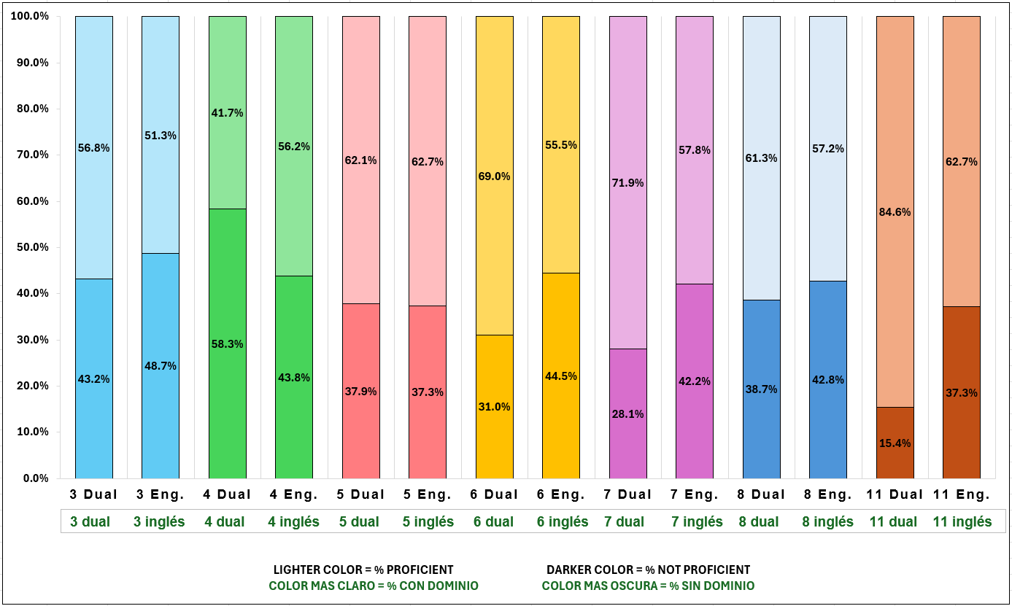
LCAP Goal 1 Metrics
Dual Immersion Program

Slide 15
Dual Immersion Program Highlights
For Students
Biliteracy & Seal of Biliteracy:
Students graduate prepared to earn the California State Seal of Biliteracy, strengthening college and career readiness.
Academic Achievement:
Strong literacy instruction aligned to CA Common Core State Standards (ELA & Math) and CA ELD Standards supports long‑term academic success.
Cultural Competence:
Students develop cross‑cultural skills and global awareness aligned to California’s diverse communities.
For Families
Language & Culture Valued:
Home languages are affirmed as assets, supporting family pride and intergenerational communication.
Meaningful Engagement:
Multilingual communication and inclusive school practices strengthen family‑school partnerships.
Equitable Access:
Public‑school access to enrichment programming traditionally available only through private options.
For the District
Equity & Access:
Additive (not remedial) language development supports English Learners while benefiting all students.
Enrollment & Retention:
Dual immersion programs attract and retain families, stabilizing enrollment.
Workforce Readiness:
Prepares graduates for California’s multilingual workforce in healthcare, education, business, and public service.

Slide 16
25-26 Budget Planning
Supplemental Funding (LCAP)
Goal 2 Monterey Action Items | Allocation
FSA School Based Counseling Program for All Schools | 131,500

Slide 17
LCAP Goal 2 Metrics
Mental Health Services
Metric | Baseline | Year 2 Outcome
Chronic Absenteeism Rate will decrease by 9 percentage points over 3 years as reported on the California Dashboard. | 18.9% of students are chronically absent in 2022-2023 | In 2024-2025, 11.8% of students are chronically absent | +
School Attendance Rate will increase by 1 percentage point over 3 years as reported on the California Dashboard/Data Quest. | In 2022-2023, the attendance rate was 91.71% | In 2024-2025, the attendance rate was 94.2% | +
Surveys of pupils, parents, and staff, on the sense of care will improve by 6 percentage points over 3 years | In 2022-2023, School Satisfaction Survey analysis indicated the following: School is a positive and supportive learning environment: Staff - 82%; Students - 64%; Parents: 75% | In 2023-2024, School Satisfaction Survey analysis indicated the following: School is a positive and supportive learning environment: Staff - 83%; Students - 70%; Parents: 79% | +

Slide 18
LCAP Goal 2 Metrics
Mental Health Services
Metric | Baseline | Year 2 Outcome
To what extent would some of your close friends benefit from the following counseling or support services? (% Beneficial) | 2023: Anxiety or stress-related counseling or support services – 75% Bullying prevention counseling or support services – 53% Depression or suicide prevention counseling or support services – 62% Interpersonal relationships counseling or support services – 64% Substance abuse counseling or support services – 48% | 2025: Anxiety or stress-related counseling or support services – 72% Bullying prevention counseling or support services - 51% Depression or suicide prevention counseling or support services – 57% Interpersonal relationships counseling or support services – 60% Substance abuse counseling or support services – 45%
To what extent would you benefit from the following counseling or support services? (% Beneficial) | 2023: Anxiety or stress-related counseling or support services – 68% Bullying prevention counseling or support services – 53% Depression or suicide prevention counseling or support services – 46% Interpersonal relationships counseling or support services – 50% Substance abuse counseling or support services – 29% | 2025: Anxiety or stress-related counseling or support services – 65% Bullying prevention counseling or support services - 51% Depression or suicide prevention counseling or support services – 40% Interpersonal relationships counseling or support services – 47% Substance abuse counseling or support services – 27%

Slide 19
LCAP Goal 2 Metrics
Mental Health Services
Metric | Baseline | Year 2 Outcome
How would you rate the effectiveness of these school-provided services or programs? (% Very Effective & Extremely Effective) | 2023: Family Service Agency of Burbank (i.e., school-based counseling) – 31% Group counseling – 16% Individual counseling – 28% Parent/family counseling – 31% Wellness Center at Burbank High School – 43% Wellness Center at Burroughs High School – 39% | 2025: Family Service Agency of Burbank (i.e., school-based counseling) – 33% Group counseling – 19% Individual counseling – 32% Parent/family counseling – 16% Wellness Center at Burbank High School – 39% Wellness Center at Burroughs High School – 30%
How would you rate the effectiveness of these school-provided services or programs? (% Not Effective) | 2023: Family Service Agency of Burbank (i.e., school-based counseling) – 9% Group counseling – 16% Individual counseling – 10% Parent/family counseling – 10% Wellness Center at Burbank High School – 12% Wellness Center at Burroughs High School – 9% | 2025: Family Service Agency of Burbank (i.e., school-based counseling) – 1% Group counseling – 8% Individual counseling – 8% Parent/family counseling – 4% Wellness Center at Burbank High School – 13% Wellness Center at Burroughs High School – 14%

Slide 20
Burbank Family Services Programs with Burbank Unified
Area | School‑Based Counseling | Wellness / CARE Center | IEP Counseling
Who it’s for | All students | High School Students | Students with qualifying disabilities
Access | Referral or request | Voluntary, drop‑in | IEP team decision
Focus | Short‑term support | Prevention, stress relief | Educational access & goals
Frequency | Limited | As needed | Defined in IEP
Legal requirement | No | No | Yes (IDEA)

Slide 21
BUSD LCAP Budget Update
Learning Recovery Emergency Block Grant Funds

Slide 22
Impact to the Budget Overview for Parents
(BOP)
When Burbank Unified adopted its LCAP and Budget, the State Budget Act had not yet been finalized. The final state budget included additional funds (LREBG) that were not anticipated by Burbank Unified, and the impact on the adopted Budget Overview for Parents (BOP) didn’t include these additional funds.
Item | As adopted in BOP | Amount per Budget Act
Total LCFF Funds | $170,073,136.01 | $170,066,333*
LCFF Supplemental/Concentration Grants | $11,970,073.00 | $11,877,971*
Other State Fund: LREBG | $0 | $559,496
* In preparation of
second Interim

Slide 23
Pending
Additional LREBG granted in 25-26 will be reserved for 26-27 and/or 27-28 school years.
BUSD received $559,496 for 25-26 and will receive the same amount the next two years.

