Slide 1

Endeavour Kindergarten Information Night - 2026
Welcome Class of 2039

Slide 2
Tonight’s Agenda
Meet
Meet the Endeavour Team
Go through
Go through a lot of kindergarten & enrollment information
Ask & Answer
Ask & Answer Questions – Please jot down your questions or ask in the moment
GOAL
GOAL: Ease some jitters!
Notes:
Gary

Slide 3

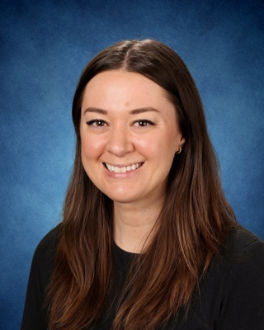
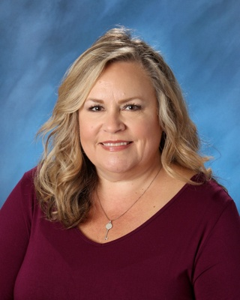
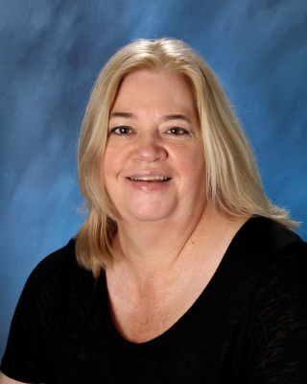
We are happy to meet you…
Gary Aguilar –
Interim Principal
Emily Pehl –
Dean of Students
Deborah Donohoe –
Assistant to the Principal
Janine Kotan–
Registrar

Slide 4
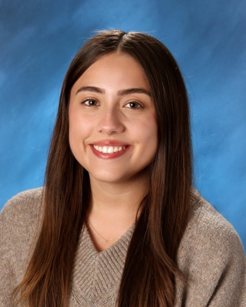
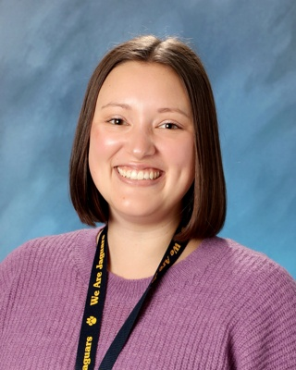
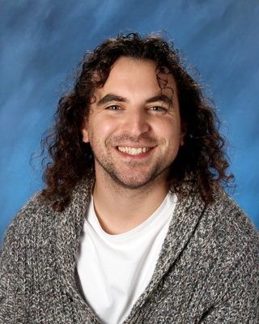
Endeavour Kindergarten Team
Ms. Aizaga
Ms. Bentsen
Mr. Silva
Notes:
5:01-5:06: - K Team
Introduce self and one thing they should know about kindergarten

Slide 5

WE ARE JAGUARS!
Endeavour Jaguars strive to create an inclusive learning community so all students are inspired and empowered to be kind, life-long learners.
The Golden Circle. Reprinted from Simon Sinek: Find Your WHY, by Simon Sinek, 2019. Retrieved from https://simonsinek.com/find-your-why/?ref=mainNav.
Notes:
Gary Presents

Slide 6

What to expect in Kindergarten to expect in Kindergarten
State requires full day kindergarten be available to all students
  School hours:
    9:15-3:45 p.m. M, Tu, Th, F
    9:15-1:30 p.m. Wednesday
  Morning and afternoon transportation provided for eligible students
Parents may opt for half-day
Notes:
Gary Presents

Slide 7
What to expect in Kindergarten…
No cost to families
Provides maximum learning opportunity for students
Offers full access to specialists (PE, Music, Library)
  30 minutes sessions
  2 sessions of PE, 2 sessions of Music, and 1 session of Library each week
Developmentally appropriate and student centered
Integrated content with rich, hands-on experiences
Based on rigorous common core standards
Notes:
Gary Presents

Slide 8
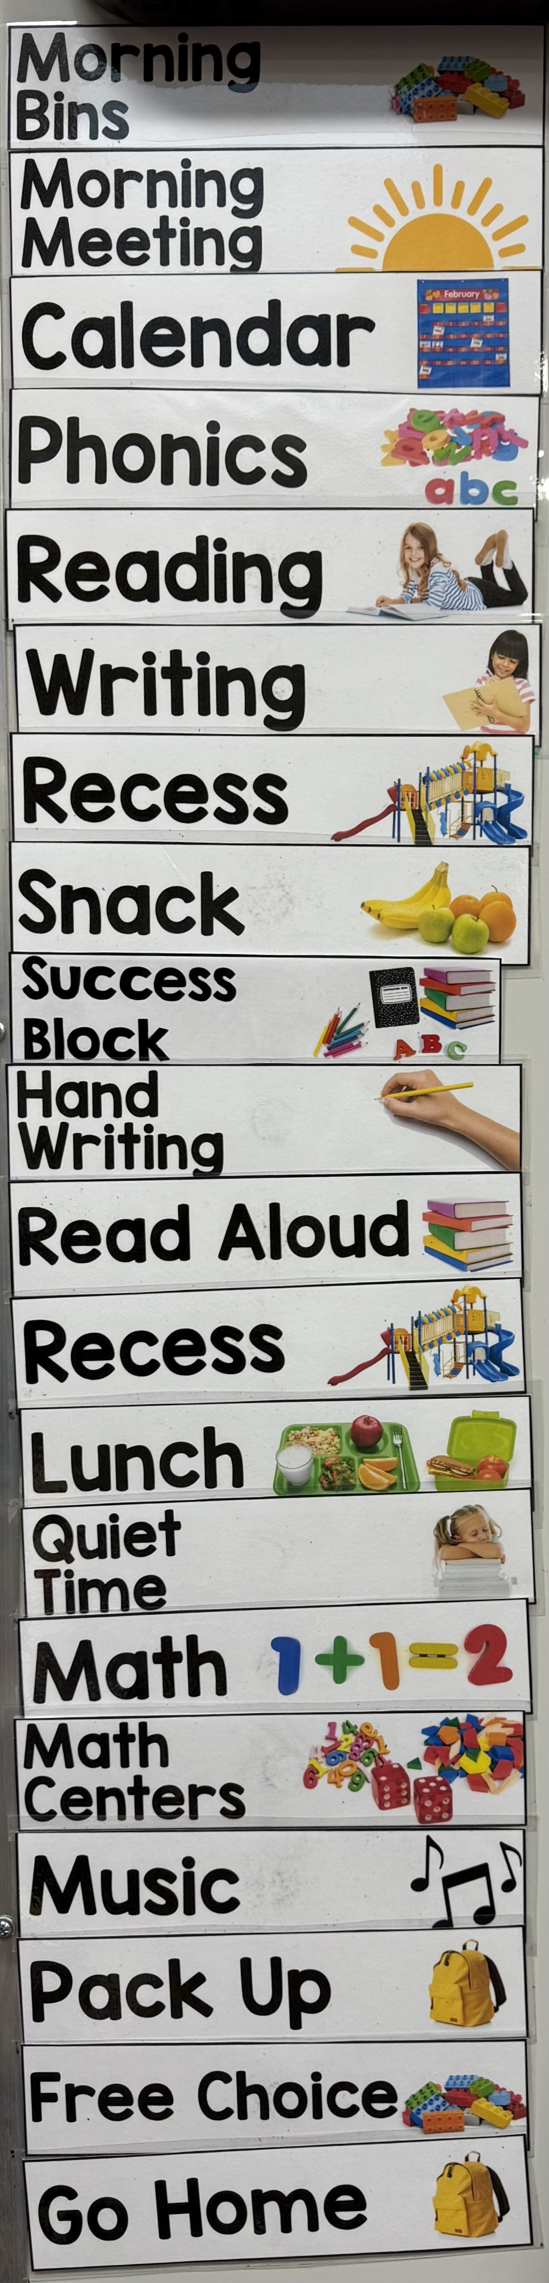
Kindergarten: A Day in the Life
(SAMPLE SCHEDULE – Schedules will vary each year and for each teacher)
9:15 – Welcome
9:15-9:30 – Morning Meeting
9:30-10:00 – Reading
10:00-10:40 – Writing
10:40-11:00 – Recess & Snack
11:00-11:30 – Phonics
11:30-12:00 – Success Block
12:00-12:30 -- SEL/Social Studies/Science/ Handwriting
12:30-1:05 – Recess & Lunch
1:05-2:10 – Math
2:10-2:40 – Specialist (Music/ Library/ PE)
2:40-3:40- Purposeful Play
3:45 – End of Day!
Notes:
Zach Present
Reading
Writing
Recess & Snack
Phonics
Success Block
Science/Social Studies
Recess & Lunch
Math
Play
Zach Presents

Slide 9
As the year goes on…
Sept – Oct
Looks & feels more like preschool
Transition through Kindergarten
May – June
Looks & feels more like 1st grade
By the end of the year, the goal is for students to be reading simple decodable texts fluently & work with numbers up to 100 (counting, adding, taking apart, etc.)
Notes:
Mackenzie Presents

Slide 10



What do decodable books look like?
Unit 1
Unit 5
Unit 10
Notes:
Mackenzie Presents

Slide 11
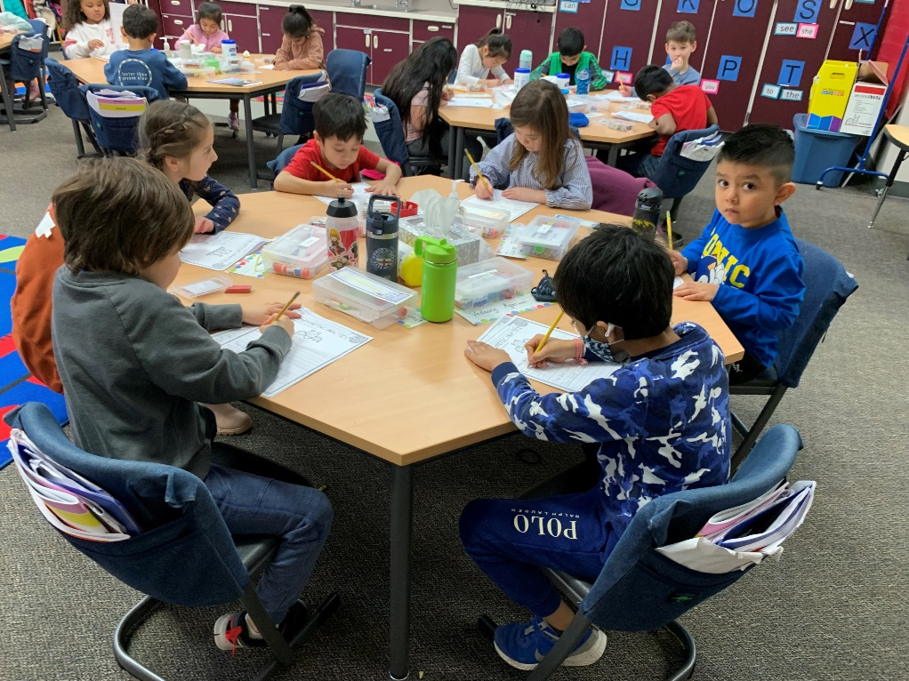
It is Time to Enroll!
Complete Enrollment Includes:
Step 1: Online Enrollment
  Available from February 7th – February 27th
  Go to the ISD Website
Step 2: Return forms/documents to the Endeavour Office
  Office is open Monday - Friday from 8:30am to 4:30pm
Notes:
Janine Presents

Slide 12
Information Packets
Information Only
Required Documents
ISD Timeline for 2026-2027
Kindergarten Readiness
FAQ
Kindergarten Ride-Along (Learn how to ride the bus – August)
Before & After School Care Information
ISD Kindergarten Welcome Event –March 9th
Full Day K Opt Out Form
Transportation Release Form (Endeavour is a non-walking school)
Certificate of Immunization Status – Washington State requirements
Healthcare needs & Life- Threatening Conditions (If applicable)
Notes:
Janine Presents

Slide 13

Online Enrollment
Go to the ISD Website: www.isd411.org
Click on “ENROLLMENT”
Select “Kindergarten Registration”
Notes:
5:12-5:30
Janine

Slide 14
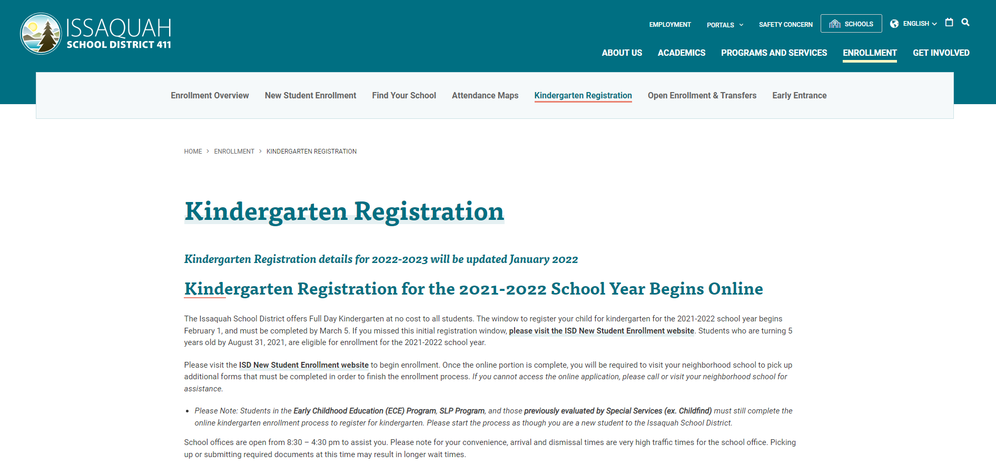
Online Enrollment
Select “ISD New Student Enrollment website” in the middle of the page
Notes:
5:12-5:30
Janine

Slide 15

Online Enrollment
To begin registration & enrollment – Select “New Student Enrollment” on the right hand side
Electronic copies of information handouts also available on this page (“Enrollment Forms page”)
Notes:
5:12-5:30
Janine

Slide 16
Required Documents &
Enrollment Reminders
Proof of Birth Date: Birth Certificate or passport must be provided
Proof of Address: Your signed lease or purchase agreement, or a utility bill no more that 30 days old.
Photo ID: The person registering the child must be the legal parent/guardian listed on the registration form.
Immunizations: Signed Certificate of Immunization Status (CIS) form with supporting documentation Or from MyIR (MyIRmobile.com)
Enrollment will not be complete without these documents.
Documents can be scanned and uploaded directly through the ISD website and enrollment pages.
**Enrollment Closes on
February 27th**
Notes:
5:12-5:30
Janine

Slide 17
Welcome Ms. Abbi – School Nurse
REQUIRED HEALTH INFORMATION:
Immunization Record Requirements –
Students will need a completed Certificate of Immunization Status (CIS) or Certificate of Exemption (COE) on file at school before the first day of attendance.​
Medically verified by a health care provider
A medically verified record can come directly from the Washington State Immunization Information System (WAIIS). ​
​
Confidential Health information
Conditions that may impact a student's school day or first aid or emergency care
If applicable:
Life Threatening Health Conditions
  Diabetes, Seizures, Asthma, Cardiac or Metabolic Disorder
  Allergies requiring Epi-pens, etc.
Notes:
Abbi

Slide 18
Children may begin school only if they have received all required immunizations they are due to receive as evidenced by medically verified immunization record
WAIIS – state immunization registry
  consent for school nurse to enter is part of the supplemental enrollment questionnaire
ALL STUDENTS MUST BE COMPLIANT TO START KINDERGARTEN
“No Immunizations, No School”
Required Vaccines to start Kindergarten
Notes:
Abbi

Slide 19
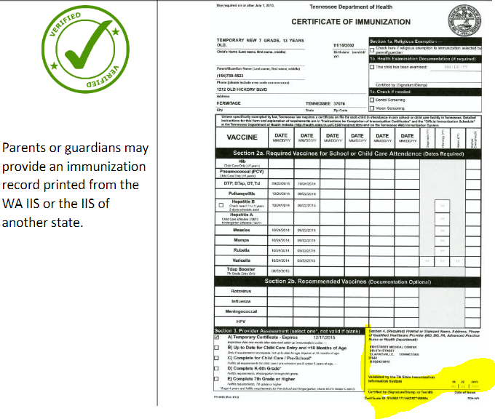
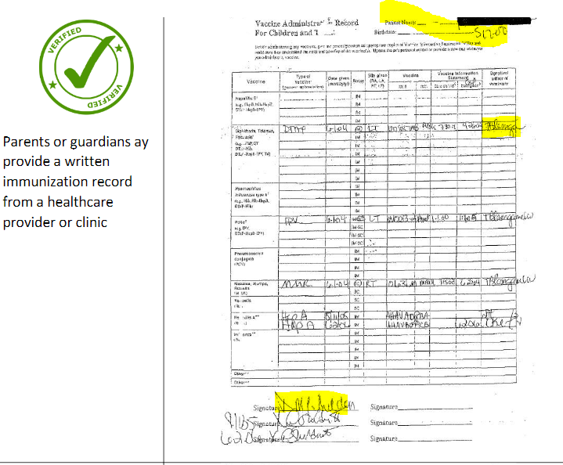
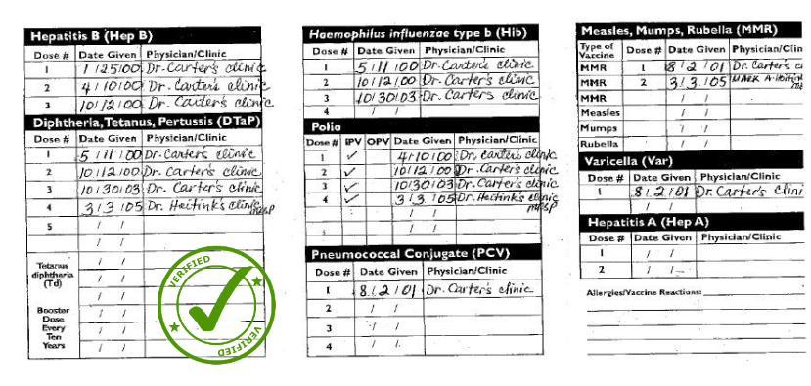
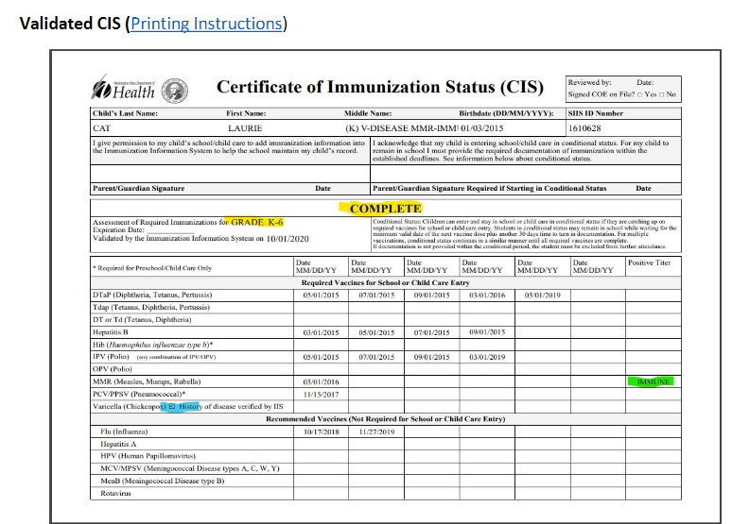

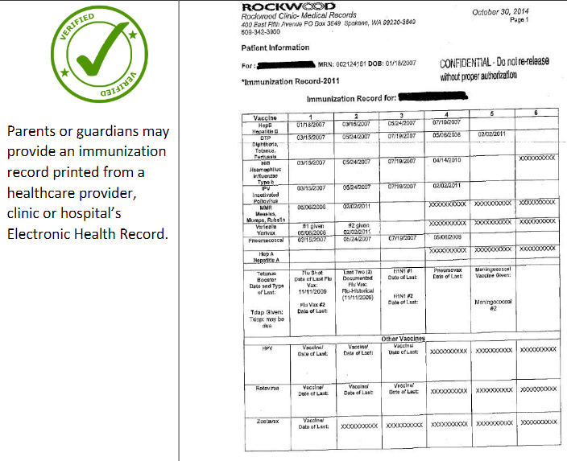
Medically Verified Records
Additional detail in "Immunization Update" link on school website
Notes:
Abbi

Slide 20
Health Conditions Questionnaire
General health concerns
Life threatening:
any health condition that will put a student in danger of death during the school day if a medication or treatment order and emergency health plan developed by a school nurse are not in place
  Diabetes, Seizures, Asthma, Allergies requiring Epi-pens, etc
Appropriate forms will be sent to families after review of the Life-Threatening Health Conditions (yellow form in packet)
Confidential Emergency Health Information (CEHI): Facilitates care and safety of students
Notes:
Abbi

Slide 21
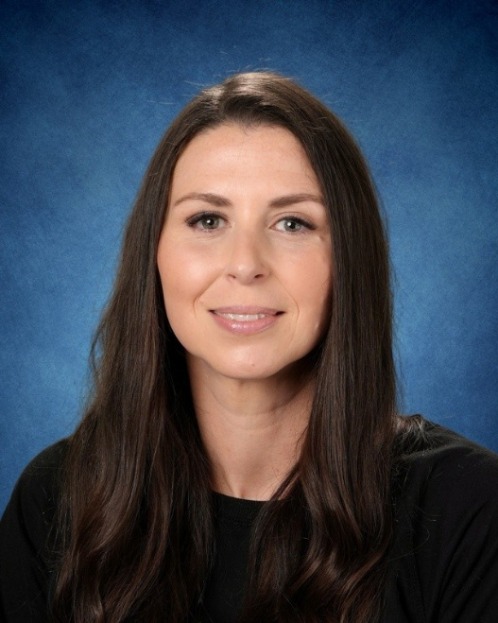
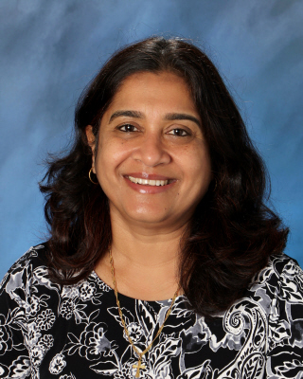
Health or Immunization Questions?
Abbi Hunter, BA, ADN, RN
School Nurse
huntera@issaquah.wednet.edu
425-837-7371
Abbi Hunter
School Nurse
Ivy Rasquinha
Health Room Specialist

Slide 22
School Supports: Family Partnerships, BASC & PTSA

Slide 23
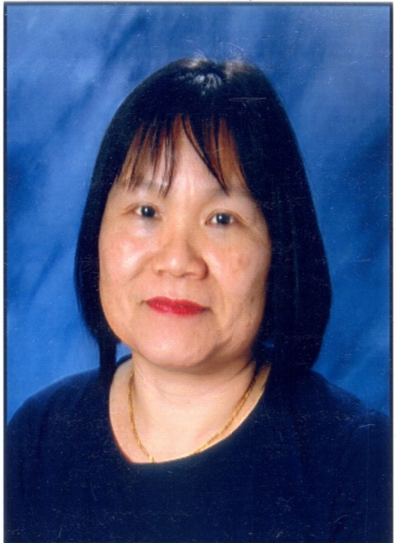

Family Liaison
Wenli Mithal
mithalw@issaquah.wednet.edu
Ph / 電話: (425) 837-7106,
Text / 短信: (978) 252-3686
English, 普通話
The Family Liaison role:
  Supports families new to the Issaquah School District ​
  Helps families navigate the school system​
  Helps new families with registration process or enrollment verification process (interpretation to complete forms or to answer questions)​
  Helps families find out about academic and financial resources ​
At Endeavour on Tuesday - available any time. Please contact me if you need help with registration or answer questions.
Notes:
Serve as a bridge between staff and parents for parents who are transitioning to the district
Supports families in teaching how to communicate with school staff for their children's needs at school and in the community
Work with school administration and staff (especially the registrar) to support families with school communications such as but not limited to
Registration process
Family Access
Interpreters and language line
School activities such as clubs and sports
Communications around absences and attendance issues
Communication with staff (teachers and administrators)
Resources available to families and students (tutoring, meal programs, school supplies)
Work with ISF VOICE mentors in matching and supporting parents and students
Support family outreach events such as curriculum night, literacy family nights
Send information via Blackboard, robo calls in Mandarin and Spanish (Wenli Mithal – Mandarin speaker, Francisca – Spanish speaker)

Slide 24

Completing forms and communicating with the school
Please let any school staff know if you need help completing forms or if you have questions.

Slide 25


SCHOOL AGE CARE
SERVING K-5 STUDENTS
REGISTRATION INFORMATION
www.isd411.org
Programs and Services ->
Before and After School Care ->
Registration Information
QUESTIONS?
Email Michelle Morrison
morrisonm@Issaquah.wednet.edu
The Before and After School Care Program (BASC) provides a positive environment for children to grow socially, emotionally, and intellectually under the guidance of our well-trained team. We offer diverse activities to meet the interests and skill levels of our participants, including STEM, cooperative games, community service learning, art, and cooking.
During out of school time, children will be able to access many areas of our schools, including the gym, playground, and multi-purpose room. In addition to our well stocked club rooms, we provide a designated homework time, morning and afternoon snacks, family nights, enrichment activities, school break care, and summer day camps.
DAYS OF OPERATION
MONDAY – FRIDAY
School break services are available through a separate registration process
PROGRAM HOURS
6:30 AM – school start
School end – 6:30 PM
There is no care provided during the school day for ½ day kindergarten students.
LOCATIONS
All 16 Elementary Schools
Notes:
Update?

Slide 26

Endeavour PTSA Mission
PTSA STEM Night: April 2nd
Dedicated to providing enriched educational and social experiences by partnering with parents, staff, and students to support and inspire the children of our community.
Notes:
Janine

Slide 27




How to Get Involved:
Check out what we do: www.endeavourptsa.org
Follow us on social media:
“Endeavour Elementary PTSA”
“endeavourptsa”
This August, during EVP:
  Become a member ​– $25 fee per family/school year
  Sign up to volunteer – we are 100% volunteer driven
  Make a donation – corporate sponsorships available
Notes:
Janine

Slide 28
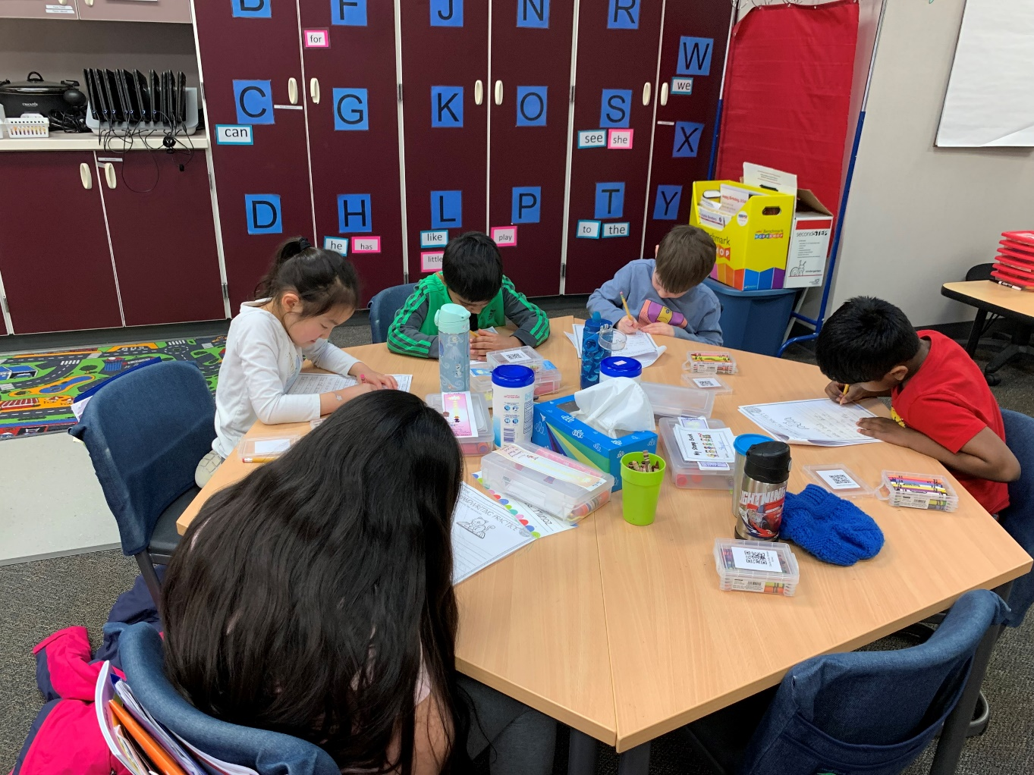
After Registration – What Comes Next?
Spring Kindergarten Screener
In order to assist us in making appropriate classroom placement decisions, we will be assessing all incoming kindergarten students. You will have an opportunity to schedule a time when you return your completed enrollment packet.
Testing Date – TBD
Sign up for 15-minute assessment. Email to follow.
“Show us what you know…”
Notes:
Emma Present

Slide 29
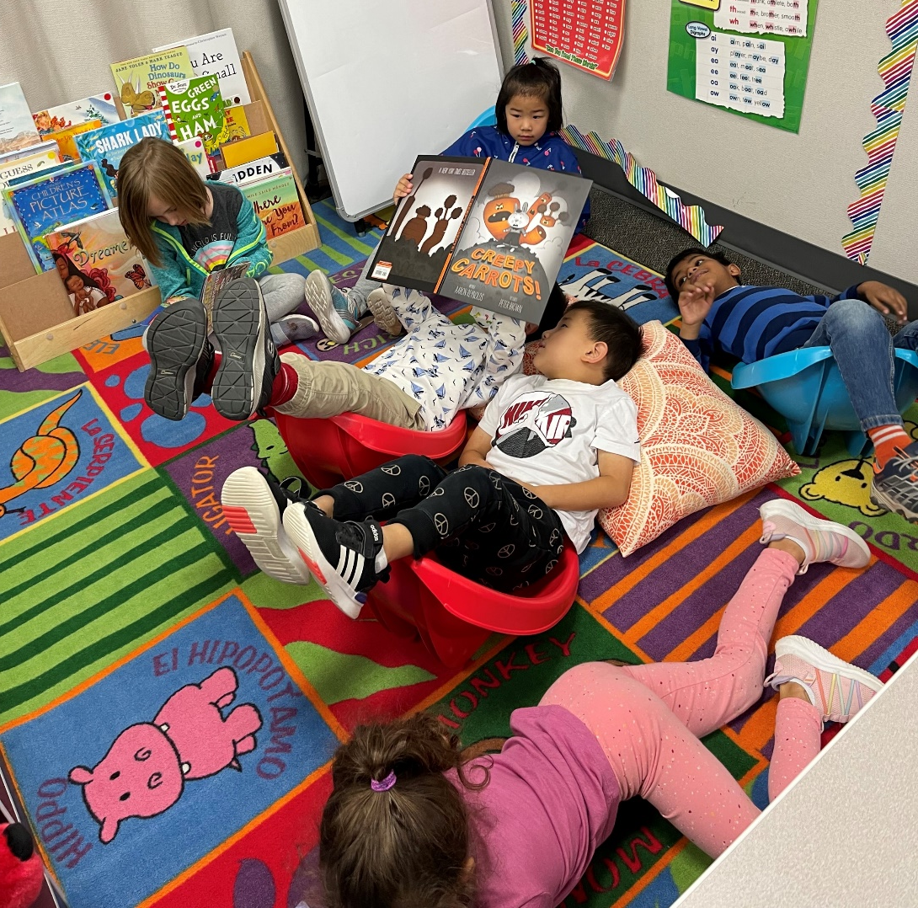
Things to practice so your student is ready for September
Restroom
  How to Use the Restroom Independently
Coats
  Putting on & Zipping Up
Lunch
  How to open containers
Backpacks
  Able to load, zip & put on
Shoes
  Be able to tie or Velcro on own
Notes:
Emma Present

Slide 30
Summer Events to look out for
July
Office closed in July
July–Aug.
Kindergarten Play Dates in July/August
Set up by PTA/check website
August TBD
EVP (Enrollment Verification Process) opens and directions are in the Weekly Bulletin
June TBD
Jaguar Jumpstart: Practice "school" with a Parent Q&A & tour
Notes:
Gary Present

Slide 31
Looking Ahead to the Fall
Family Connection Meeting (Aug. 27th-Aug. 31st) | Whole-Child Assessment (September and October)
Classroom teacher meets with each kindergarten family (including student) Curriculum Night (for PARENTS) TBD – will be in September First day of school for kindergarteners September 1st | Kindergarten teacher observes children during everyday classroom activities Helps teachers find out what each child knows and can do at the beginning of the year Inventory taken of each child’s developing skills in six areas Social-emotional Physical Cognitive Language Literacy Mathematics
Washington Kindergarten Inventory of Developing Skills (WAKIDS) is a required component of State-funded Full Day Kindergarten. It is a transition process that helps to ensure a successful start to kindergarten and beyond.
Notes:
Zach Present

Slide 32


Any Questions
Notes:
5:42-6:00
Gary, Janine & K Team

Slide 33
Thank you for joining us tonight
We cannot wait to meet our newest Jaguars!

