Slide 1
Pattonville
District Wellness Committee
February 4, 2026

Slide 2
Agenda
Welcome
  Introductions
  Purpose of Committee
  Public Comment

Slide 3
High School PE/Health Update -
Anna Braswell, PE/Health Department Leader
High School Highlights
Department is working hard at curriculum updates
A few Personal Fitness students led the class in a fitness activity they planned for the class as part of their choice for a project
Unified PE students competed at their Special Olympic Bowling competition using the skills they have been practicing in class
Outdoor Adventure class took a field trip Ice Skating
Health class is preparing to begin their “Stop the Bleed” training
Power Walking classes are focusing on pacing along with speed work preparing for timed walks.

Slide 4
Middle School PE/Health Update -
Travis Williams, Middle School PE/Health Lead
Middle school staff have been working on curriculum updates.
Students have been designing 10-15 minute workouts and leading the classes in those workouts to begin class!
Students have been training for their physical fitness tests that will take place in the spring.

Slide 5
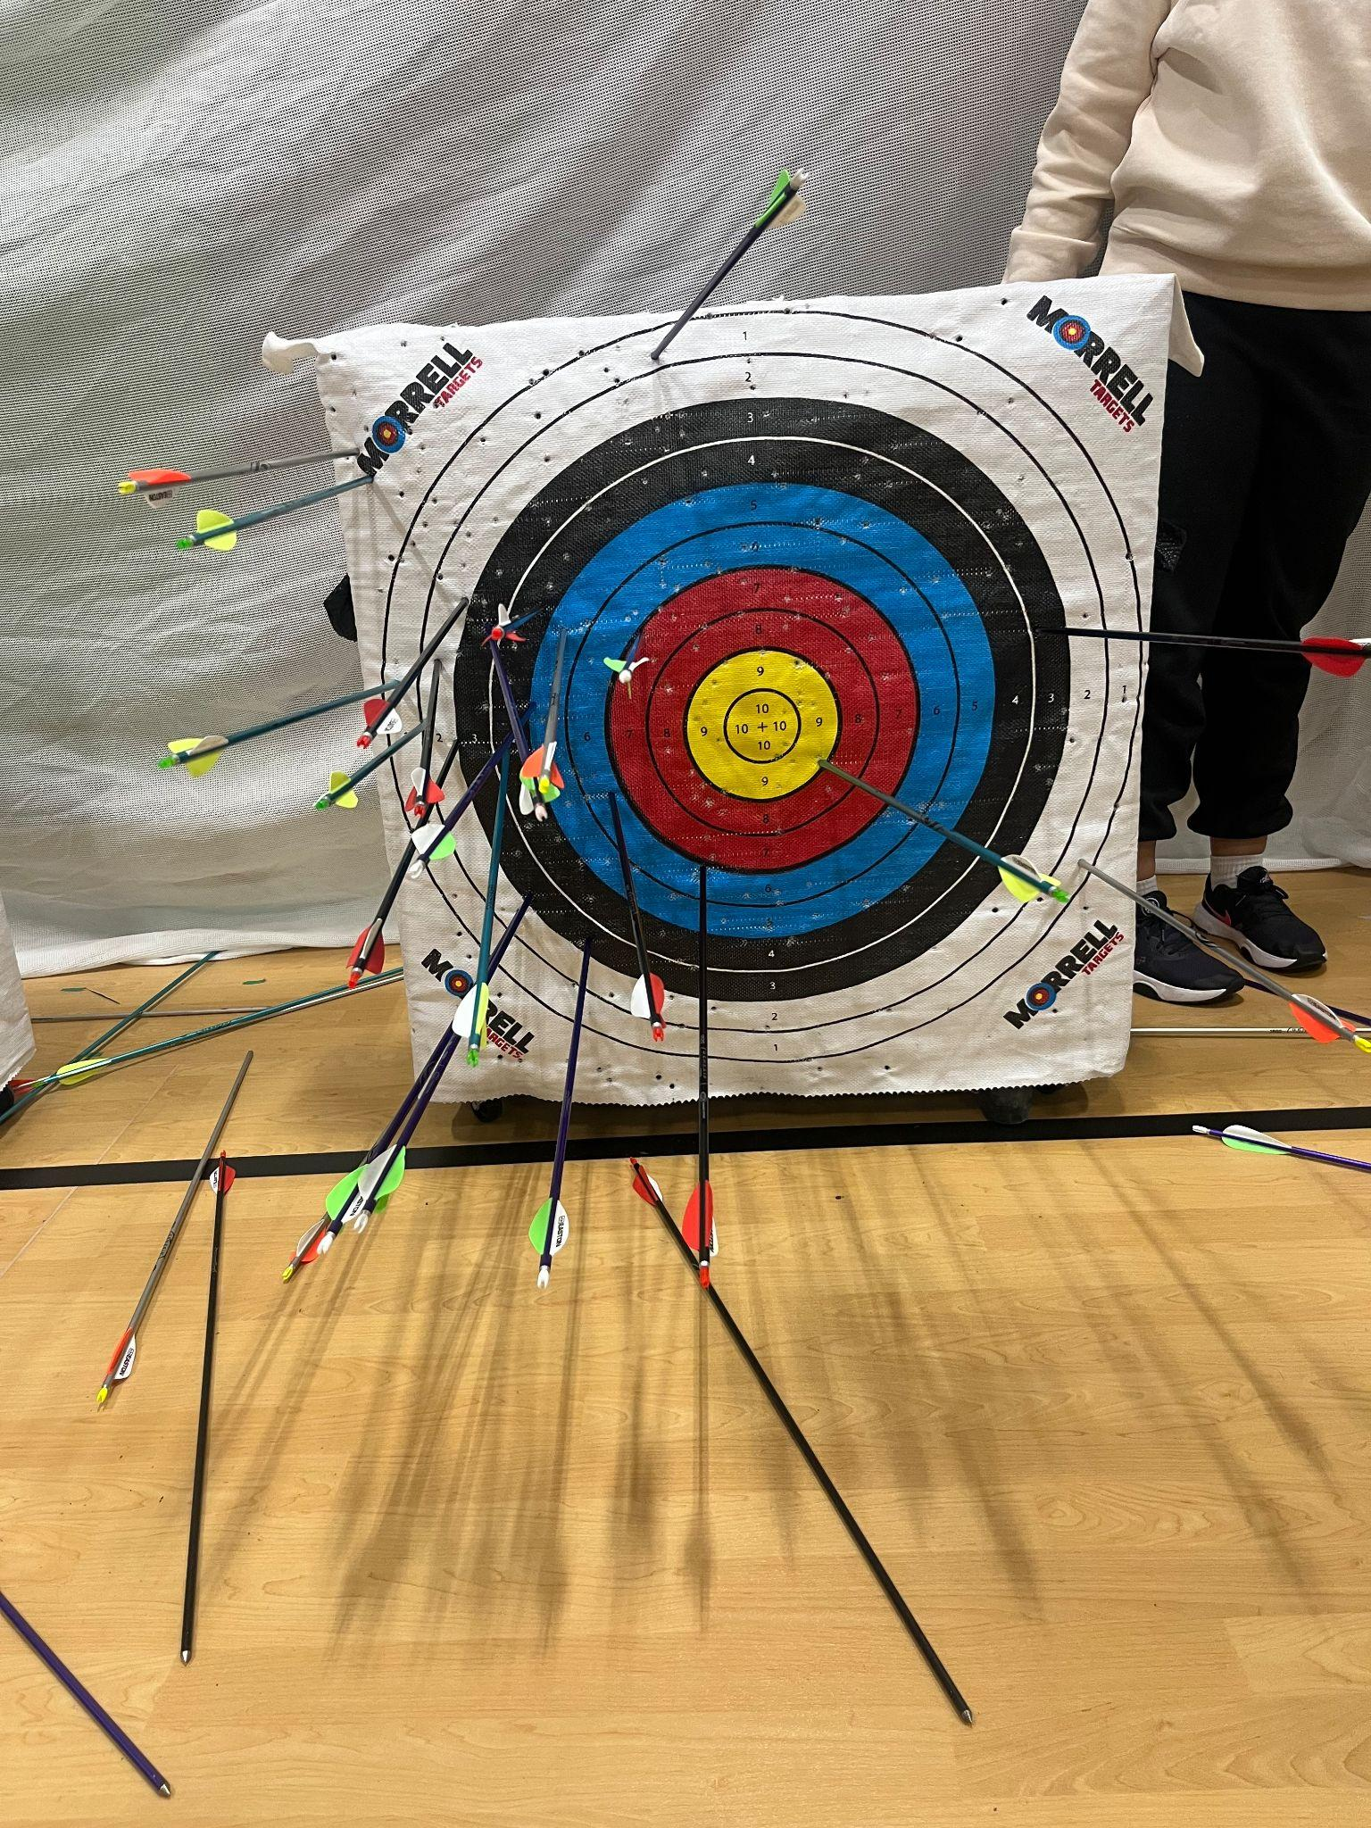
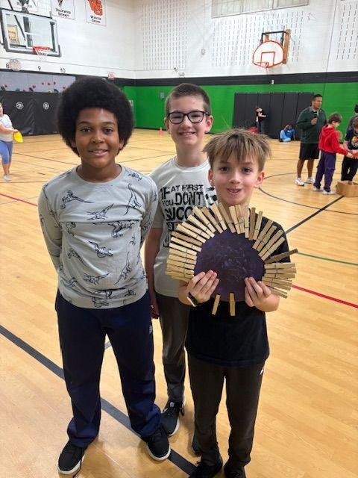
Elementary PE/Health Update -
Denise Grimshaw, Elementary PE/Health Lead
K-5 curriculum updates are in progress
Some of our schools have completed units such as Archery, which is always a great experience for the students!
Kids Heart Challenge has begun in conjunction with American Heart Association at some of our schools during our jump rope unit.
Tumbling units are being done at several K-5 schools
Health units are also going on during these colder months.
      All schools are working on fitness concepts everyday to improve physical fitness. We find fun ways to count laps.
      Picture below has students counting laps with clothespins to make a turkey!

Slide 6

Food Service update
Audrey Westrich, Director of Food Service
Food Service Professional Development
Organizing a Food Show to showcase K12 Products and Vendors to all Chartwells Food Service associates in the St. Louis area.
Sample new products!
Training from Chartwells Regional Support
Networking for Hourly Associates

Slide 7

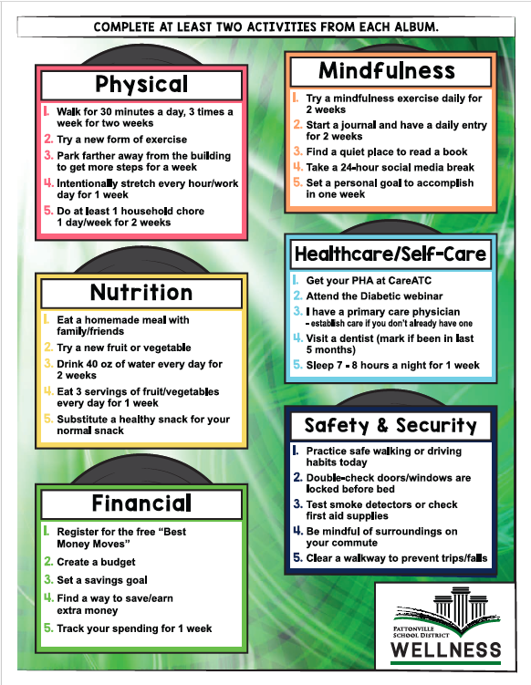

Staff Wellness update
JoAnn Greenwell, Director of Community and Staff Engagement

Slide 8
Staff Wellness update
JoAnn Greenwell, Director of Community and Staff Engagement
Wellness Captains Meeting today
Training by Dr Eric Armbecht
Reviewed Nutrition PD Day on Feb 6
Brain storm May wellbeing month
Focuses for 2026-27 school year

Slide 9
K-8 Athletics
JoAnn Greenwell, Director of Community and Staff Engagement
Collaboration with high school athletics
Middle School teams to High School games
Host Middle School Instructional League (MSIL) games and meets with the high school teams
  Track and Field at Heights
  Volleyball at Heights
  Cross Country at Tiemeyer Park

Slide 10
K-8 Athletics
JoAnn Greenwell, Director of Community and Staff Engagement
Spring Sports
Middle School
Boys and Girls Track and Field
Girls Field Hockey
Boys Volleyball
Elementary
Boys and Girls Kickball
Boys and Girls Track and Field

Slide 11
MO Healthy Schools/CDC Grant
JoAnn Greenwell, Director of Community and Staff Engagement
Ongoing incentives
  K-12 Physical Education and Health Curriculum revisions
  Staff attended MOShape conference
  Focus on areas where we struggle to fill teams
  Assisted health services - Nurses manual revised this summer
  Supplies and materials for greenhouse and culinary class at the high school

Slide 12
Questions?
Next meeting
May 13, 2026

