Slide 1

Parent Orientation for Kindergarteners 2026-2027
January 27, 6:00 pm
Welcome to Newcastle Elementary Dr. Tod Wood, Principal
Family Liaison Lina Marin
Newcastle PTSA Fiorella Tapiarene
Registration Materials\Timeline Pam Stucky, Registrar
Immunizations\Health Forms Jamie Heintz, Nurse
A Day in the Life of a Kinder Student! Kinder Teachers
Q & A

Slide 2
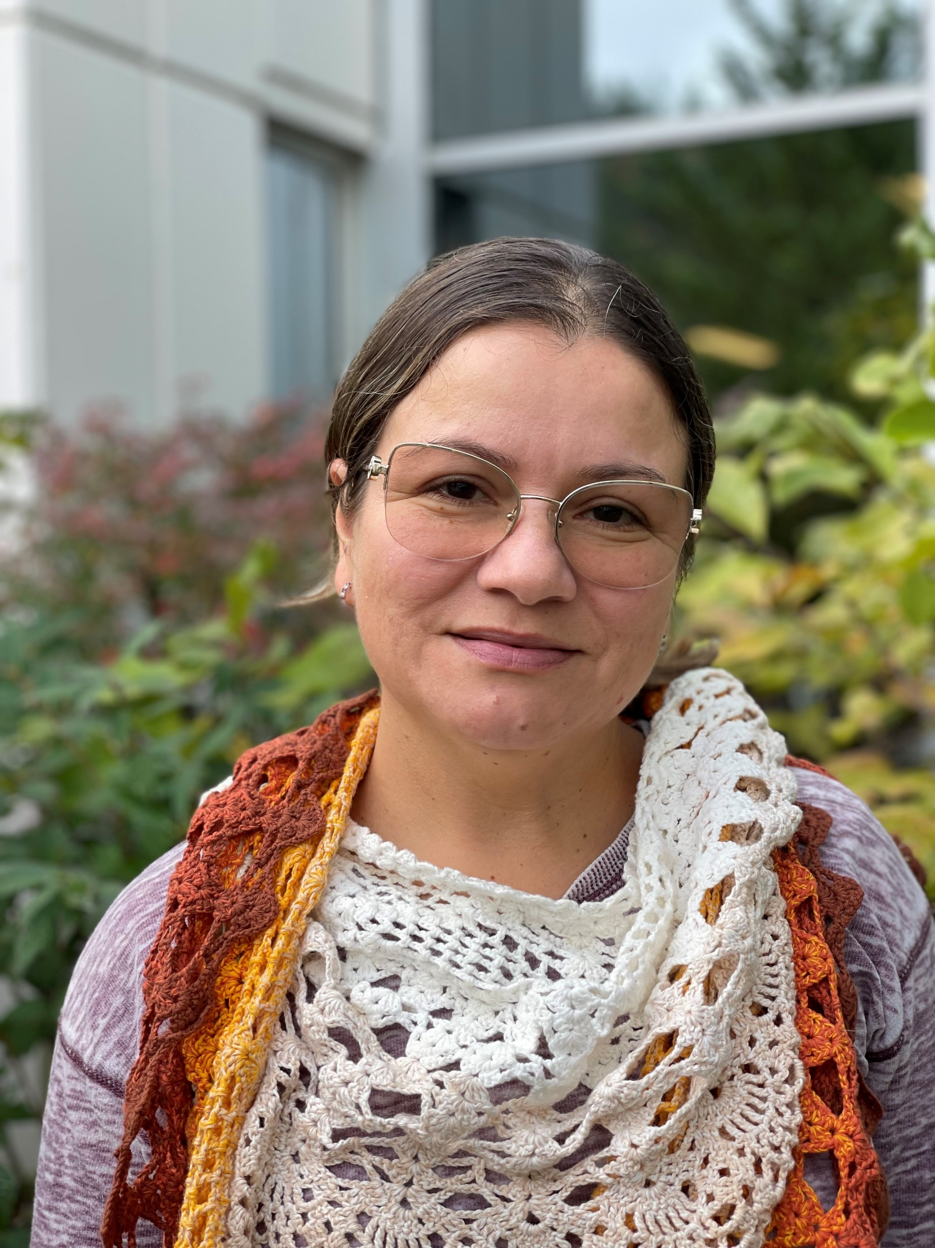

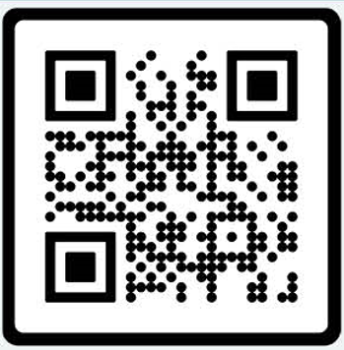
Welcome Families,
My name is Lina Marin, your Family Liaison.
I am part of the ISD Equity, Belonging and Family Partnership Department. We host information sessions for families with a wide variety of topics throughout the school year. Family Partnerships - Issaquah School District 411
If you need interpretation, we arrange to host these sessions in your preferred language.
Feel free to contact me.
MarinIsazaL@issaquah.wednet.edu
Office: (425) 837-7008
Cell: 425 651-9245
Text: 252 563 3498
Languages spoken: English, Spanish.
How can I help you?
Help families understand school systems, policies, and procedures.
Understand and use school tools such as Family Access, Canvas and Clever as you support your child.
Navigate the school district website and resources.
Support you in connecting with school and district staff.
Schools I support:
Apollo, Briarwood, Cougar Ridge, Grand Ridge, Maple Hills, Newcastle,
Cougar Mountain, Maywood, and Liberty

Slide 3

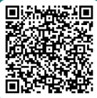

When: Monday, March 9, 2026 from 6:30 to 8:00 p.m. Register here
Where: Zoom – Presentations in English, Español, and 普通話
Who: All incoming Kindergarten families are invited to learn more about the Issaquah School District’s Kindergarten program. While everyone is welcome, this session will be especially helpful for families who are new to the U.S. public school system.
What: Information will include:
  Kindergarten Preparedness
  General school day schedule (lunch and recess)
  Classroom general information
  Transportation
  Immunization
  On-Site Before- and After-School Care Program
  Differences between school systems in the U.S. vs. some other countries
Hosted by the Issaquah School District Family Partnership Team, we warmly welcome you to our community and look forward to supporting you as you navigate our schools.
If you have any questions or need interpretation in another language at the event (한국어, 日本語, Русский, or Tiếng Việt), please contact Lorna Gilmour at gilmourl@issaquah.wednet.edu.

Slide 5


Slide 6

Qualifications for Kindergarten Registration
Your child must be 5 by August 31, 2026.
Live in Newcastle Attendance Area.
Complete the online registration process.
Provide required documents as requested following registration.

Slide 7
Documents Required to Complete Online Registration
Birth Certificate, Passport, Adoption Record, or Hospital Record
Parent/Guardian Picture ID
Record of Immunizations
Residency Documents Required to Complete Online Registration (one of the following):
Purchase Agreement or Unexpired Lease Agreement
Property Tax Statement
Homeowner's or Renter's Insurance Policy
Mortgage Statement
Current Utility Bill

Slide 8
Your Next Steps…
Once your online application is approved, Pam will contact you with a timeline to pick up your Kindergarten Information Packet.
This packet includes additional materials that are required and will need to be completed and returned to the office.

Slide 9
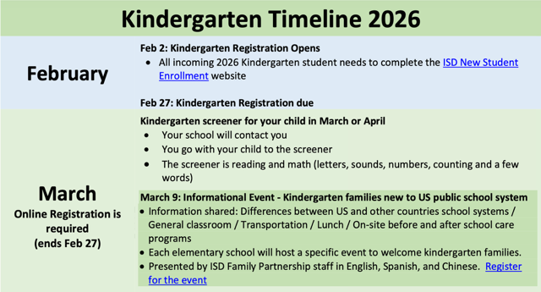

Slide 10
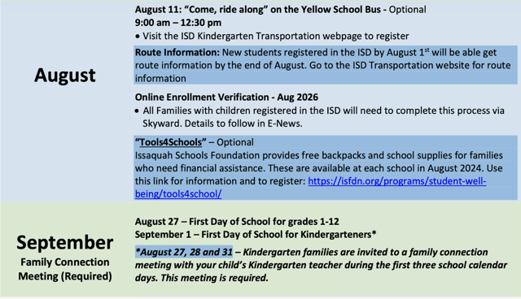

Slide 11

Timeline of Events and Highlights
February 2: Kindergarten registration portal opens- please do not complete an application before then
February 27: Deadline to complete online registration and provide additional documents
March/April: Pre-Kinder Assessment Appointments (we will contact you and you will accompany your student to this appointment)
August 11: Kindergarten Bus Ride-Along (see packet to register)
August 27, 28, & 31: Kindergarten Family Connection Meetings (REQUIRED)
September 1: First day of class for Kindergarten Students (grades 1-5 begin on August 27, 2026)
Any Questions? Please contact Pam Stucky at 425.837.5802 or email her at stuckyp@issaquah.wednet.edu

Slide 12

HEALTH CONDITIONS QUESTIONNAIRE
If your child has any health condition that could be considered life-threatening such as asthma, food allergies, seizures, diabetes……
According to the law, your child must have an emergency health plan, which includes medication orders from your child’s health care provider in place before he/she can attend school.
Forms will be sent to family after review of questionnaire by Nurse.

Slide 13

Immunizations &
Life-Threatening Health Conditions
Requirements for Incoming Students
  2026-27 School Year

Slide 14
Proof of Immunization Required
New students need to provide a medically verified immunization record at the time of registration. ​
​
A medically verified record can come directly from:
  The Washington State Immunization Information System (WAIIS). ​
  A medical clinic or office where immunizations were given
  Pharmacy records of immunizations given
  Another state’s or country’s formal immunization database
  Immunizations verified by the State Dept.

Slide 15
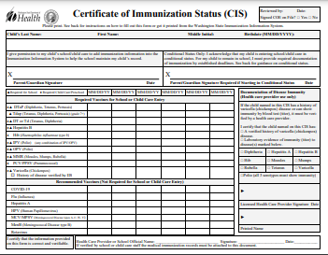
CIS or WAIIS Documentation​
A completed Certificate of Immunization Status (CIS) printed directly from the Washington State Immunization Information System (WAIIS) ​
A physical copy of the State CIS form with a healthcare provider signature. ​
A CIS printed from MyIR.
Access your Family's Immunization Information | Washington State Department of Health
MyIRmobile.com

Slide 16
Required Immunizations for K-6 Students
5 doses of DTaP (diphtheria, tetanus & pertussis) given in the appropriate time frames​
  1 Tdap for students 7th grade and above
3 doses of Hepatitis B, given in the appropriate time frames
4 doses of polio (IPV) given in a specific time frames​
​2 doses of MMR (measles, mumps and rubella) given in the appropriate time frames​
2 doses of varicella given in the appropriate time frames

Slide 17
Missing Doses
If students are missing doses, they will need to get all the doses they are eligible to receive before starting school.
They can then attend school in a Conditional Status until the minimum valid date of the next vaccine is reached.
They then have 30 calendar days to turn in documentation of having received the dose.
This continues on until all vaccines have been administered and documented.

Slide 18
Example
If a child has all their immunizations except the 2-dose MMR series, and they get dose 1 of MMR the day before school starts (and it is documented with the school that day) the child can enter school because…​
  Dose 2 of the MMR cannot be given until 28 days after the first dose. ​
  Beginning on day 29 after the first dose, the child has 30 days to get MMR dose #2.

Slide 19
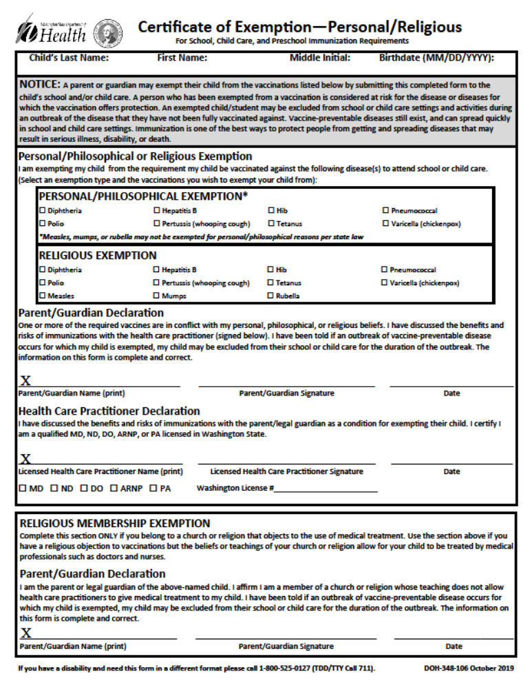
Exemptions
Parent and Child’s Provider signatures
  Medical Exemption
  Philosophical/Personal Exemption
    Except MMR
  Religious Exemption
Religion restricting care from medical professional
  Religious Membership Exemption

Slide 20

Is My Kindergartener Too Young?
Children can receive their school immunizations at age 4. Contact your healthcare provider to schedule your appointment. ​

Slide 21
Where Can I Get My Child Immunized?
Your child’s healthcare provider​
WithinReach, Family Health Hotline:
800-322-2588​
http://www.withinreachwa.org/​
Community Health Access Program:
206-284-0331 or 800-756-5437​
https://kingcounty.gov/en/dept/dph/health-safety/health-centers-programs-services/access-outreach-program/community-health-access-program
Your school nurse is a resource for you if you need assistance

Slide 22
SUMMARY of IMMUNIZATION INFORMATION
Washington State Law states that your student may register for school, but MAY NOT attend school until provider-verified immunizations have been received and validated by the school nurse. ​
The child must have all immunizations they are eligible to receive prior to starting school.
Or there is a Certificate of Exemption on file signed by the parent AND the licensed healthcare provider.
​

Slide 23
Notify the School if your Child has a Life-Threatening Health Condition such as:
Allergy requiring an Epipen™
Insulin-dependent Diabetes​
Severe Asthma​
A Seizure disorder​
A Cardiac condition​
Adrenal Insufficiency​
Other conditions

Slide 24
Why does the school need to know?
If your child has a life-threatening condition, WA state law says there must be an emergency care plan and any associated medication in place in the school building before the child can attend school.
​
This is to keep the student safe in the event they experience a medical emergency during the school day. ​
If your child has a life-threatening condition, let the school nurse know:
  School Care Plan signed by provider, parent and RN
  Medication prescribed by provider with ISD paperwork

Slide 25

Questions?
Nurse Contact Info:
Jamie Heintz, RN
Office: 425-837-5808
Email: heintzj@issaquah.wednet.edu

Slide 26


SCHOOL AGE CARE
SERVING K-5 STUDENTS
REGISTRATION INFORMATION
www.isd411.org
Programs and Services ->
Before and After School Care ->
Registration Information
QUESTIONS?
Email Michelle Morrison
morrisonm@Issaquah.wednet.edu
The Before and After School Care Program (BASC) provides a positive environment for children to grow socially, emotionally, and intellectually under the guidance of our well-trained team. We offer diverse activities to meet the interests and skill levels of our participants, including STEM, cooperative games, community service learning, art, and cooking.
During out of school time, children will be able to access many areas of our schools, including the gym, playground, and multi-purpose room. In addition to our well stocked club rooms, we provide a designated homework time, morning and afternoon snacks, family nights, enrichment activities, school break care, and summer day camps.
DAYS OF OPERATION
MONDAY – FRIDAY
School break services are available through a separate registration process
PROGRAM HOURS
6:30 AM – school start
School end – 6:30 PM
There is no care provided during the school day for ½ day kindergarten students.
LOCATIONS
All 16 Elementary Schools

Slide 27
Kindergarten Teachers
Ms. Aja
Ms. Afman
Ms. Henne
Mrs. Miller

Slide 28
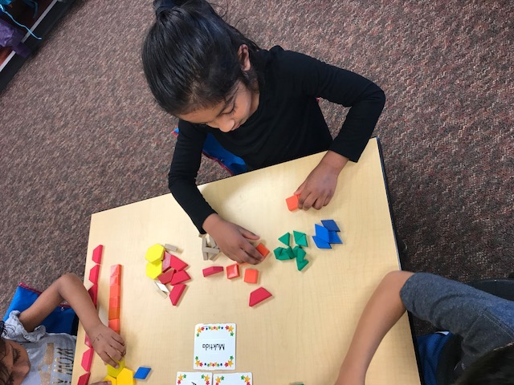
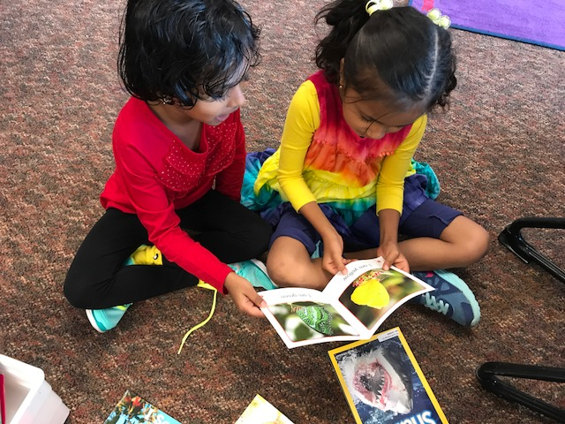
First Days of K
EVP (Enrollment Verification Process) – August
Meet the Teacher
Curriculum Night
Family Connection Conferences & Assessment
  WA Kids
  Scheduling will happen over the summer

Slide 29
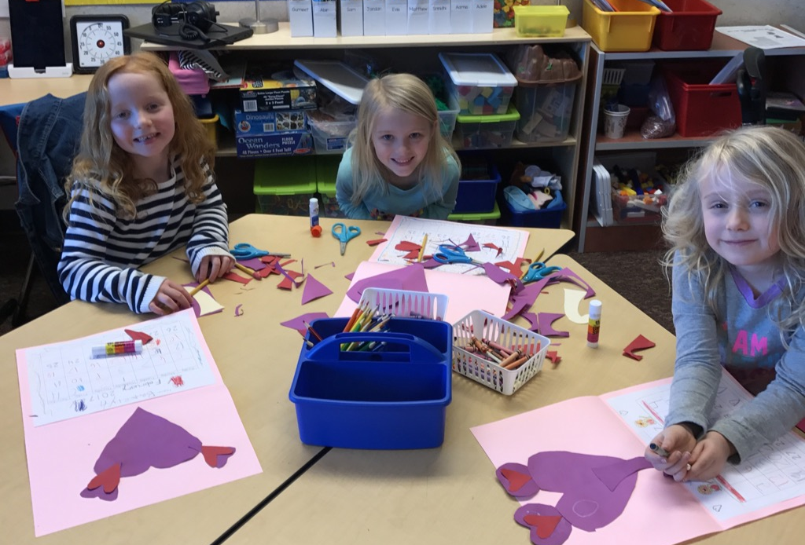
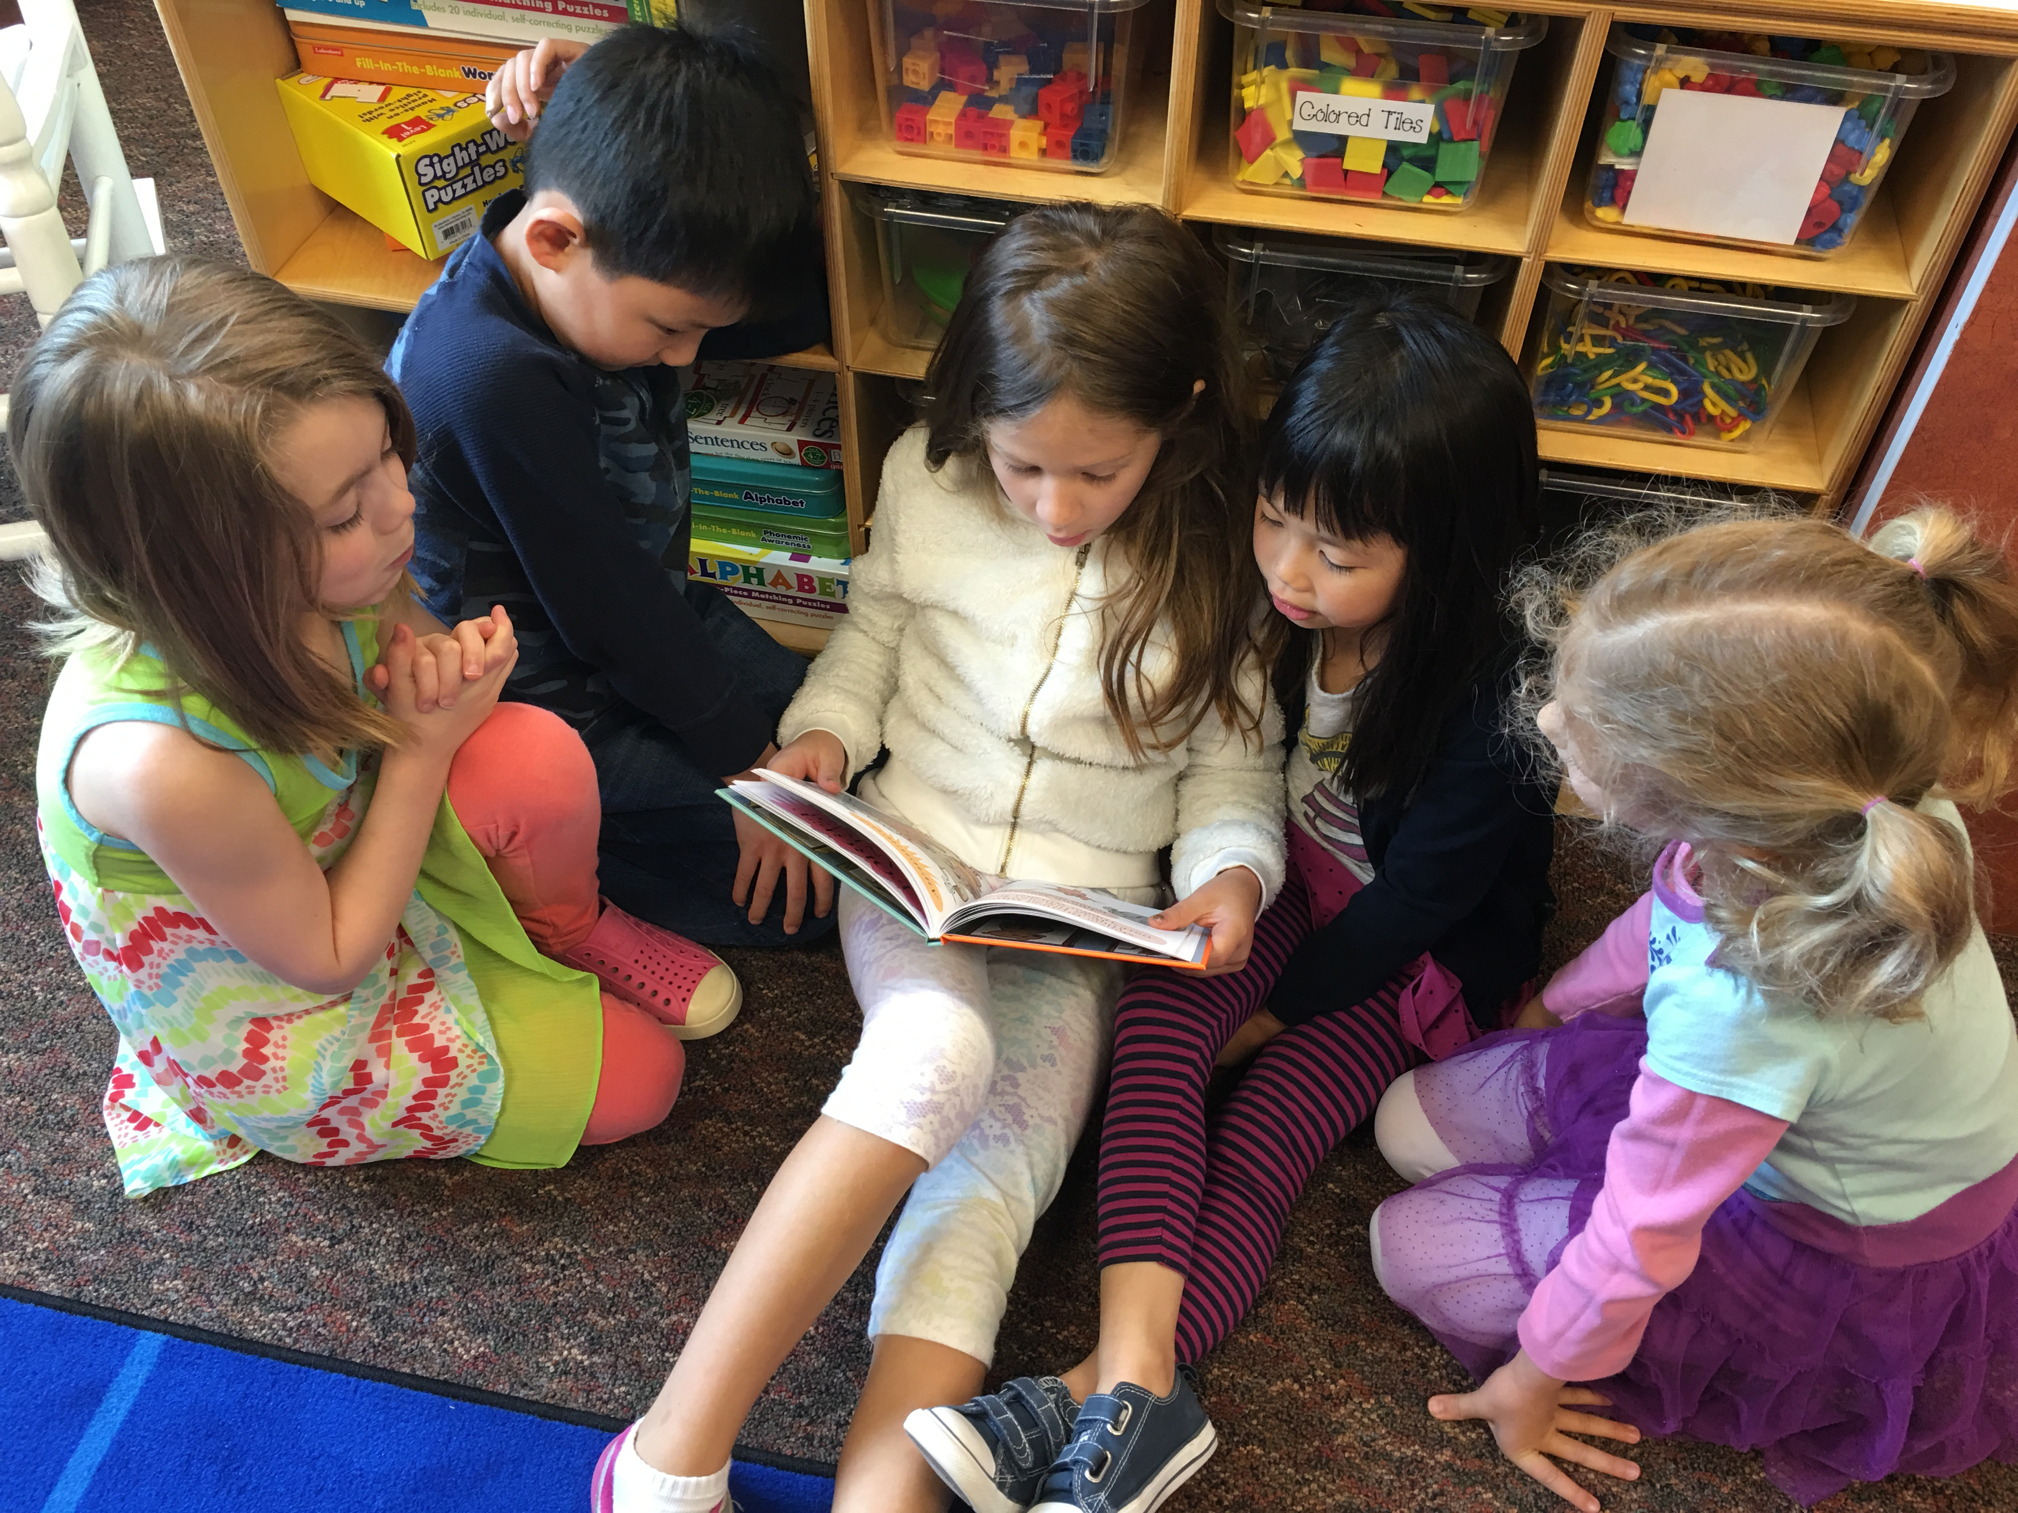
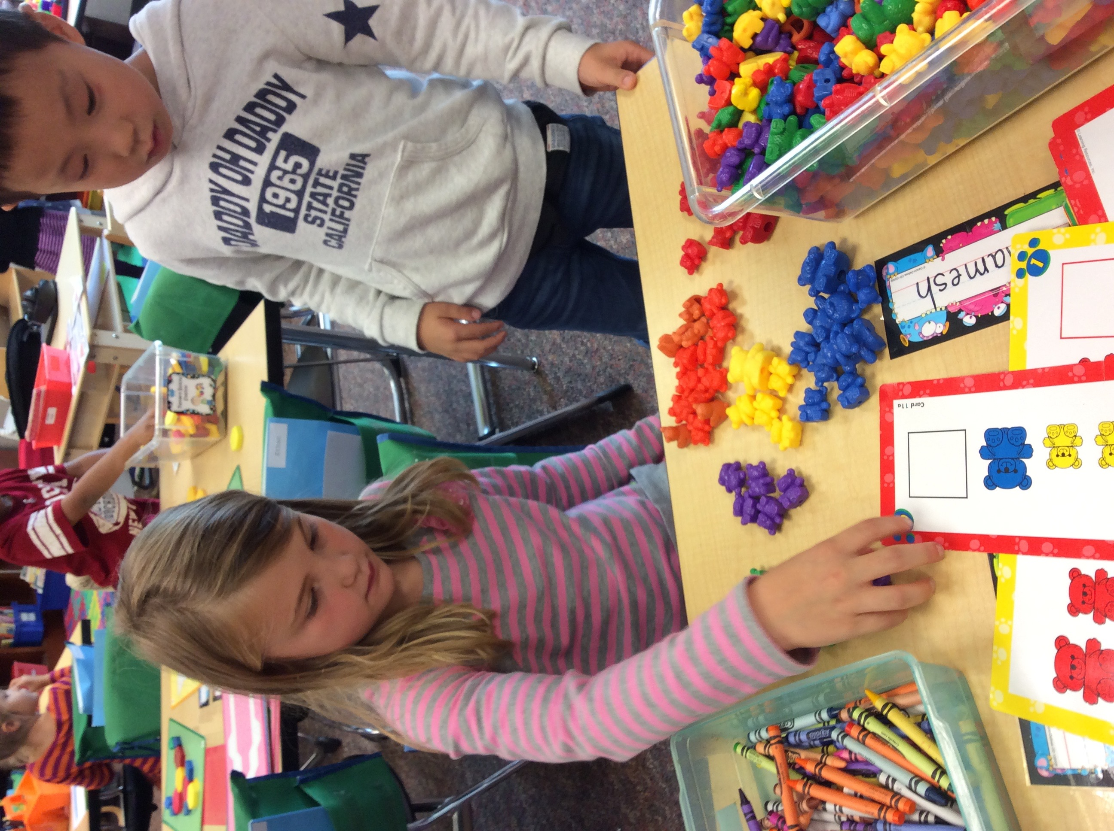
Day to Day in K
Afternoon
Morning
Morning Work
Reading Block
Morning Recess
Snack
Math Block
Writing Block
Lunch and Recess
Handwriting
Second Step/Social Emotional Learning
Purposeful Play
Specialists

Slide 30
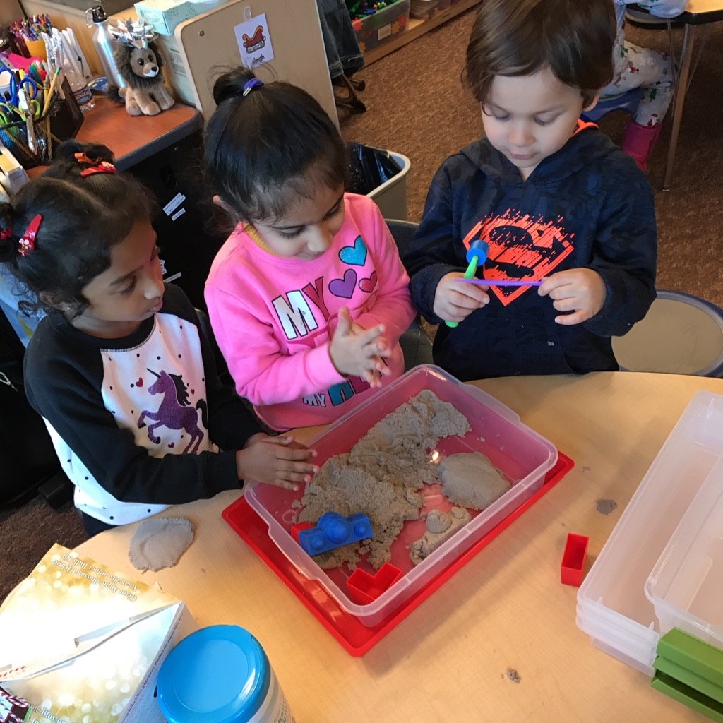
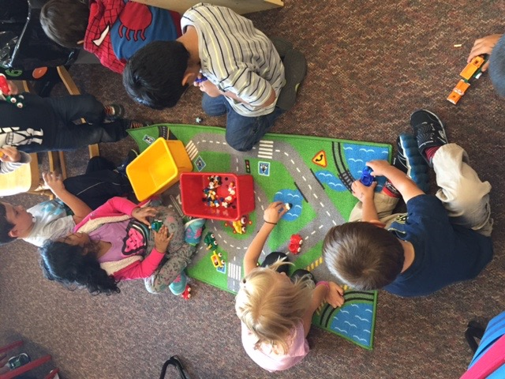
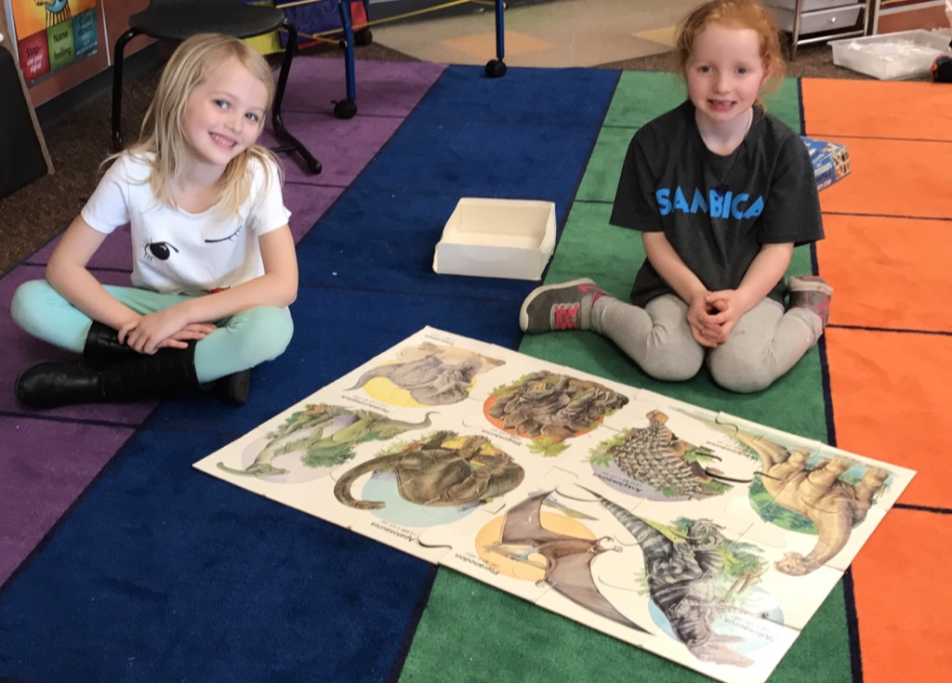
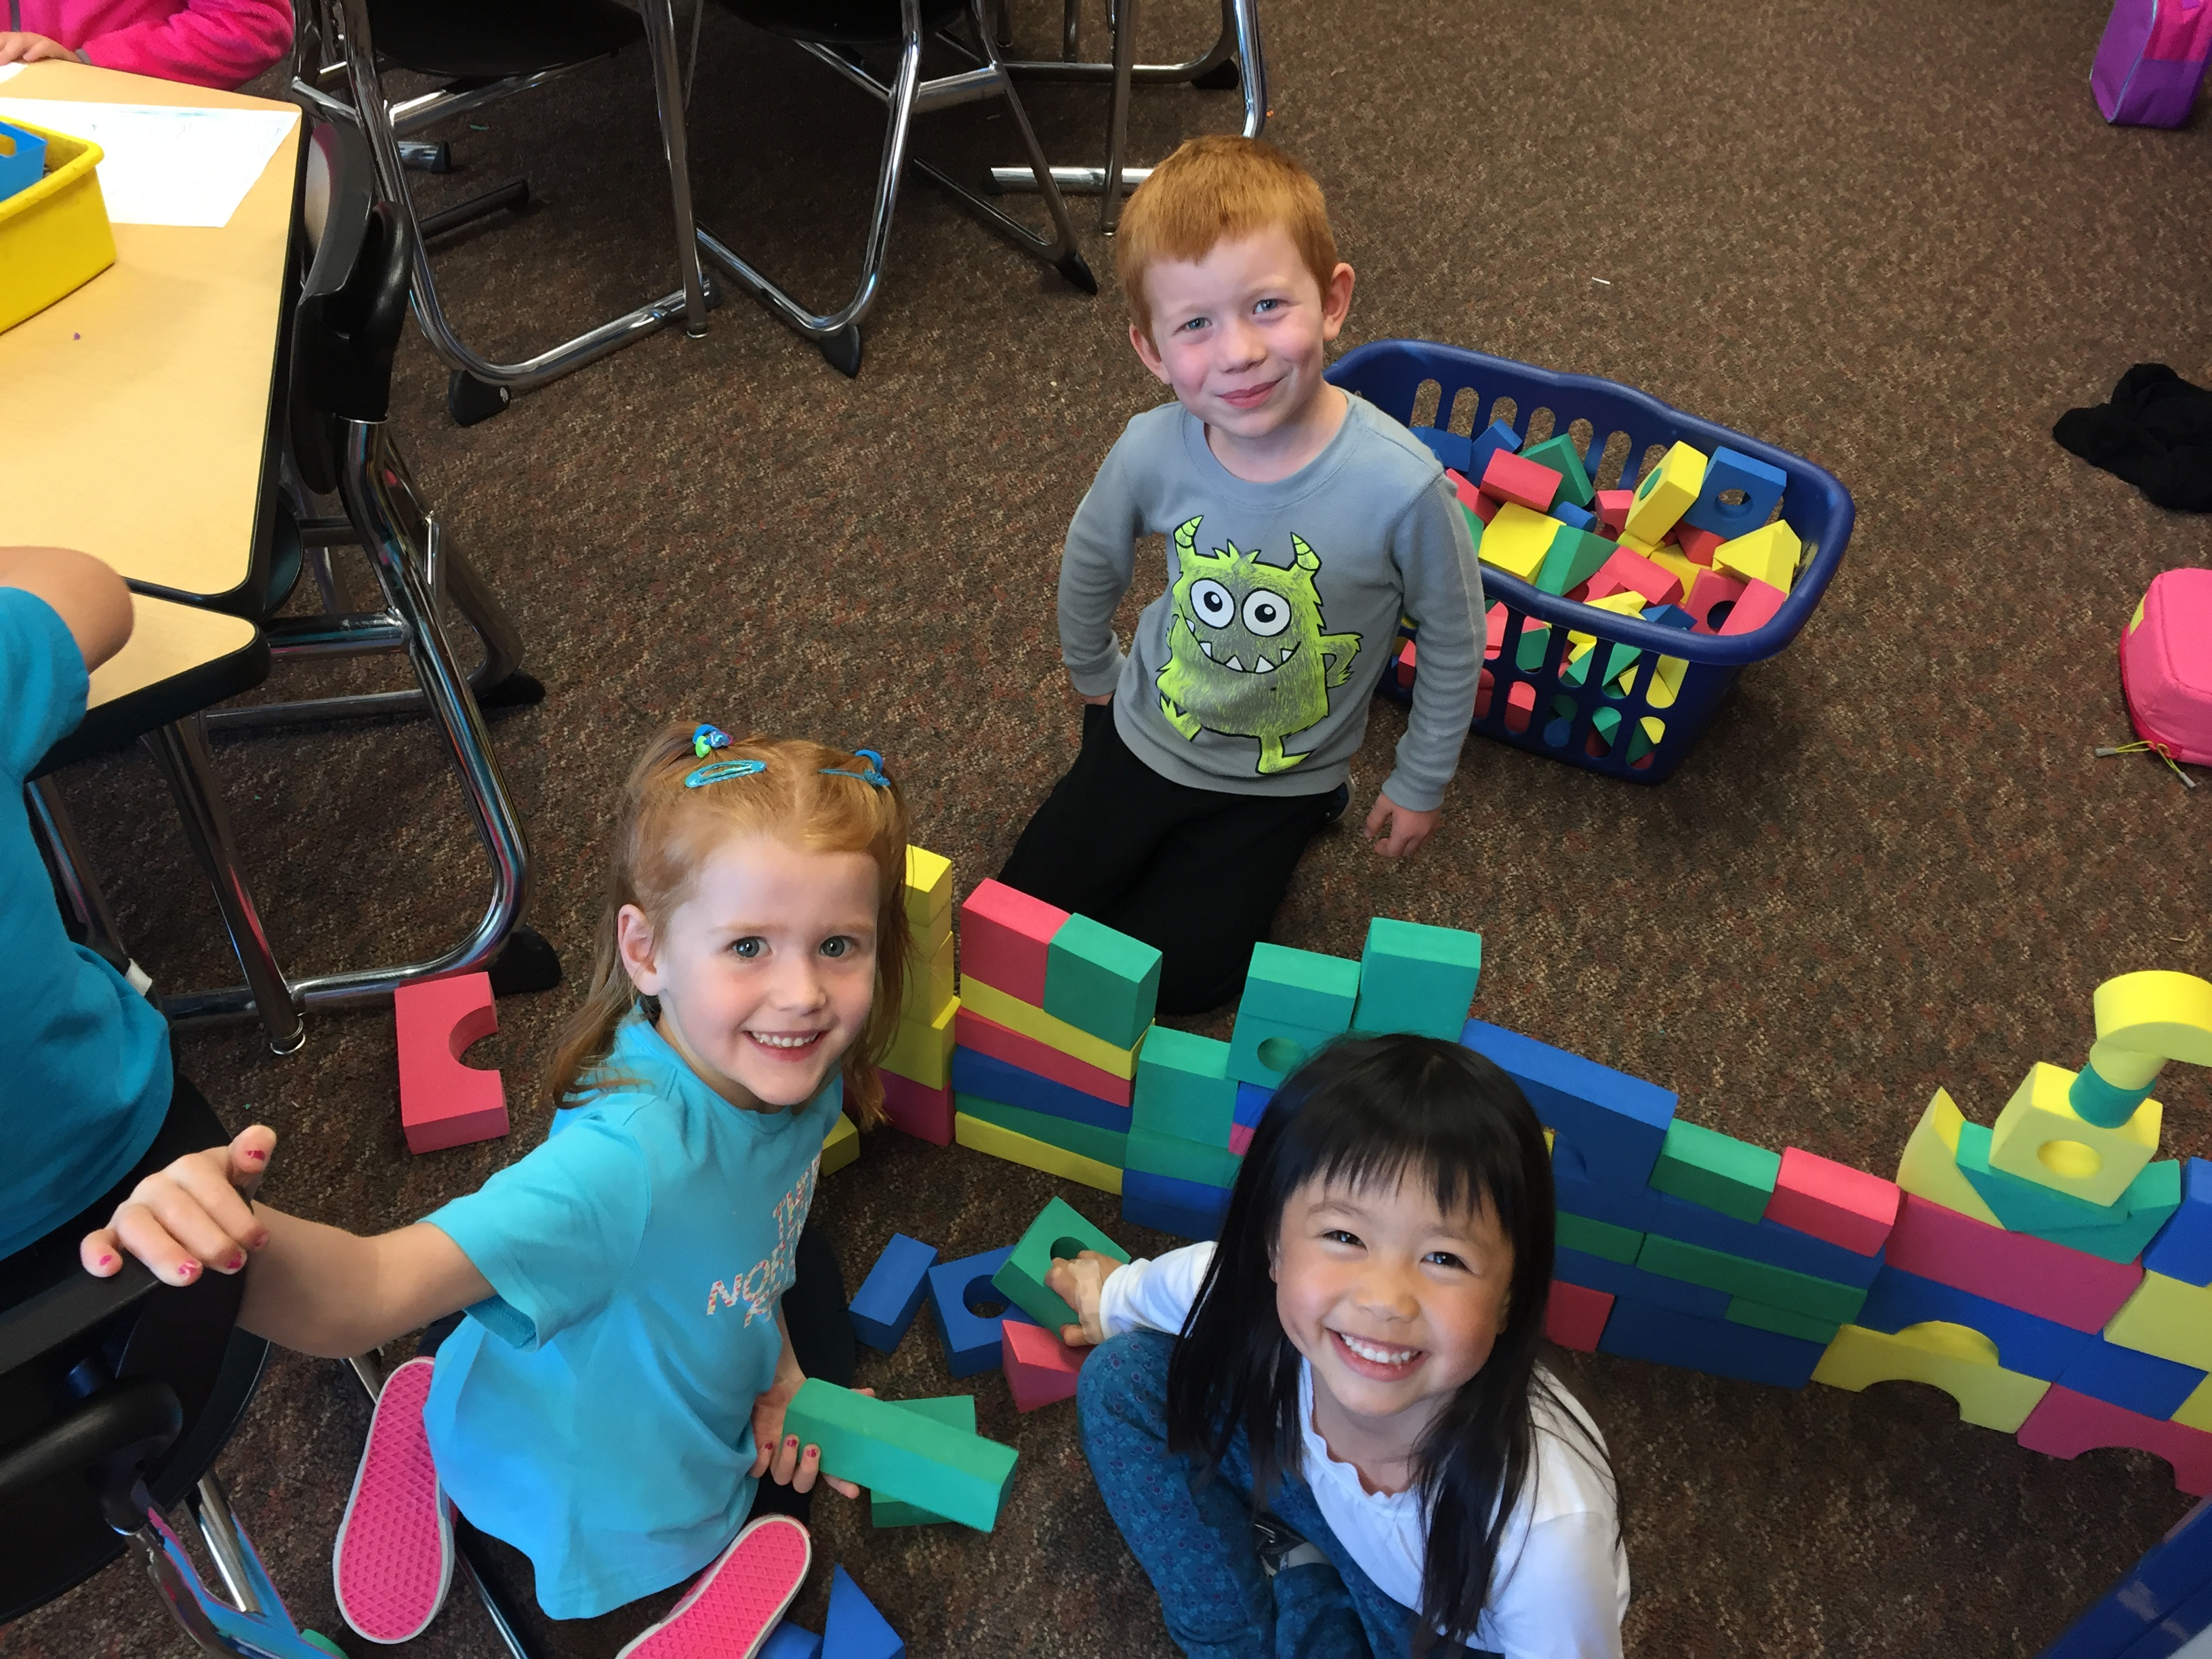
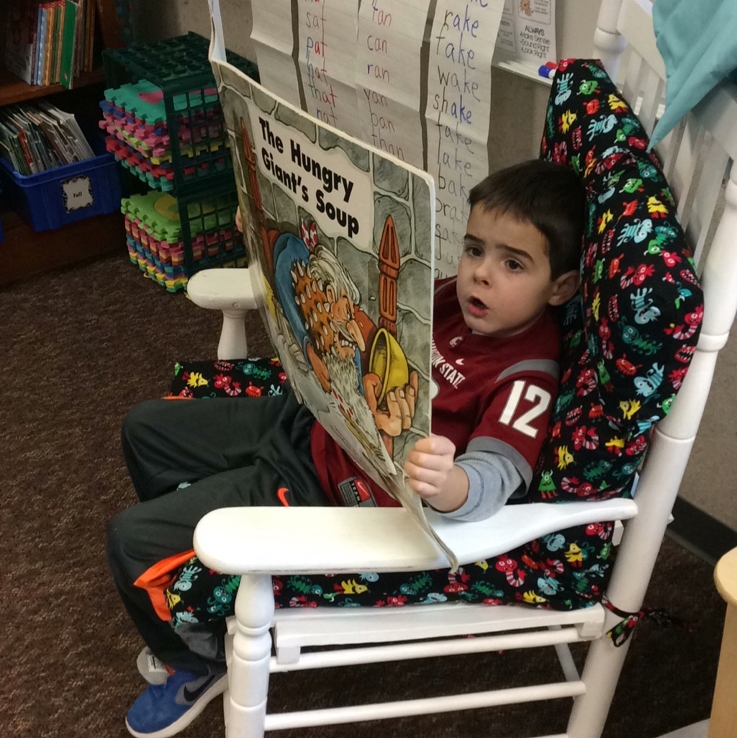
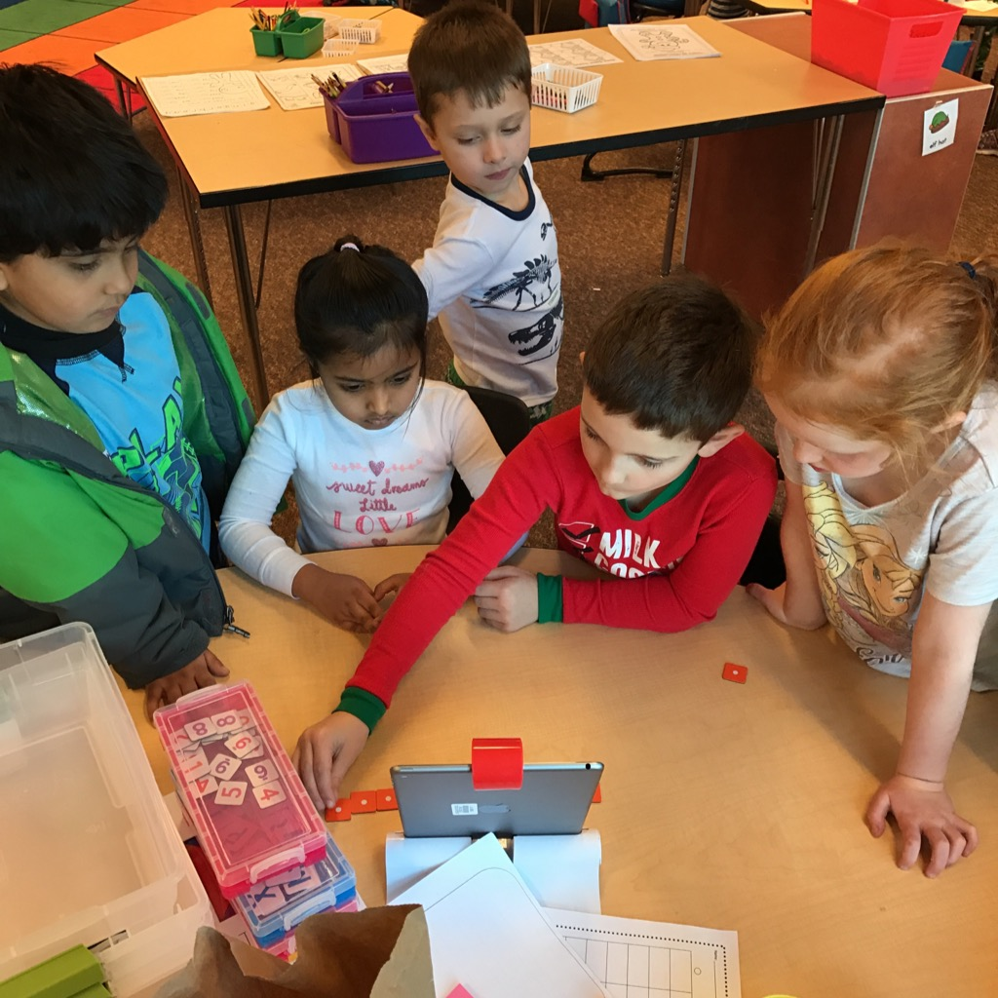
Purposeful Play
Choice
Social development
Problem solving
Building motor skills

Slide 31
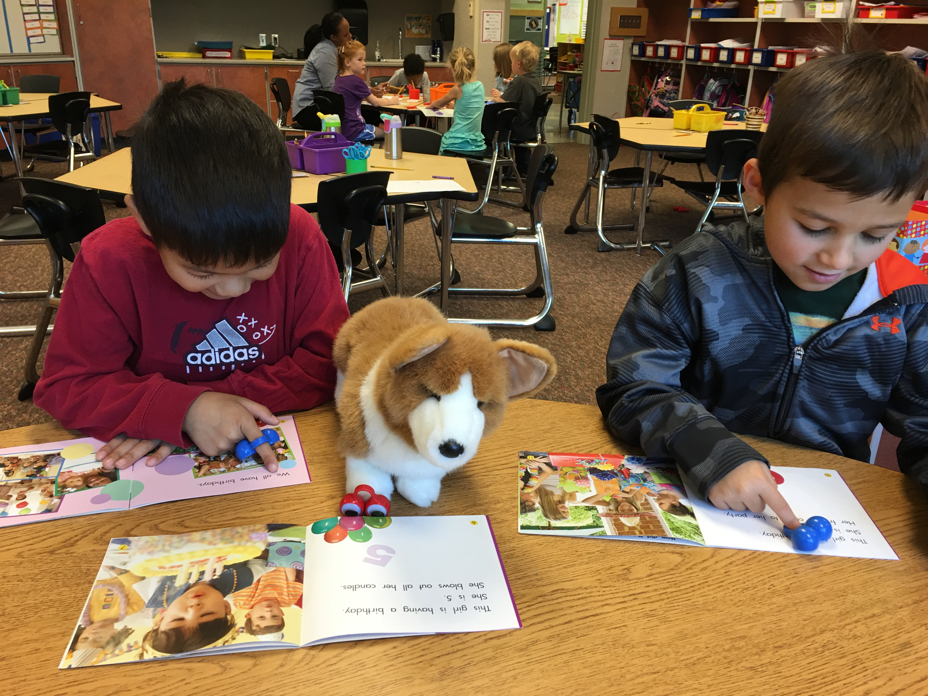


What REALLY Matters
Growth Mindset
Social Skills
Self-regulation
Independence
Following Classroom and School Expectations
Playful Learning vs. Formal Teaching

Slide 32
What are Kindergarteners Learning?
Social Emotional
Academic
Learning Habits
Thinking Skills
Routines, Self-Regulation
Engagement

Slide 33
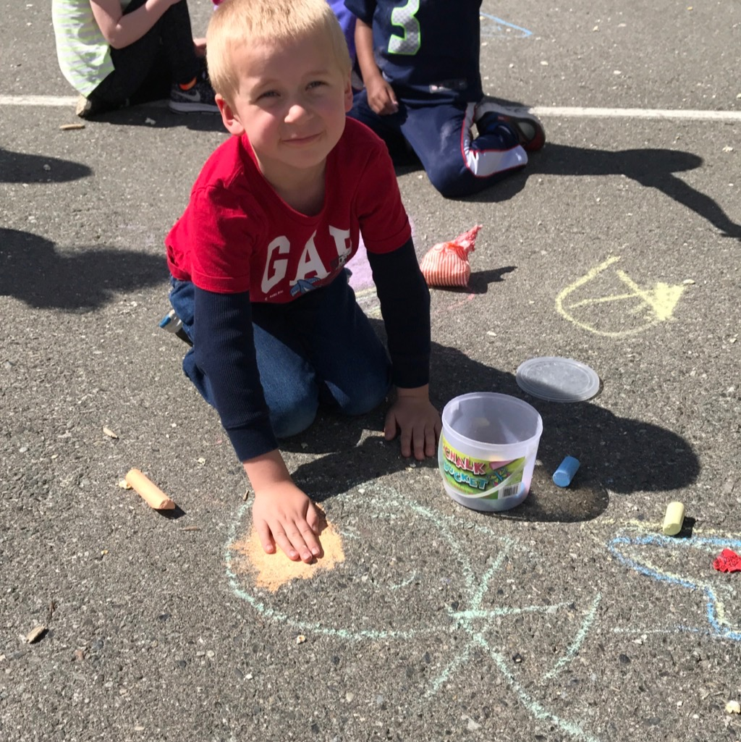

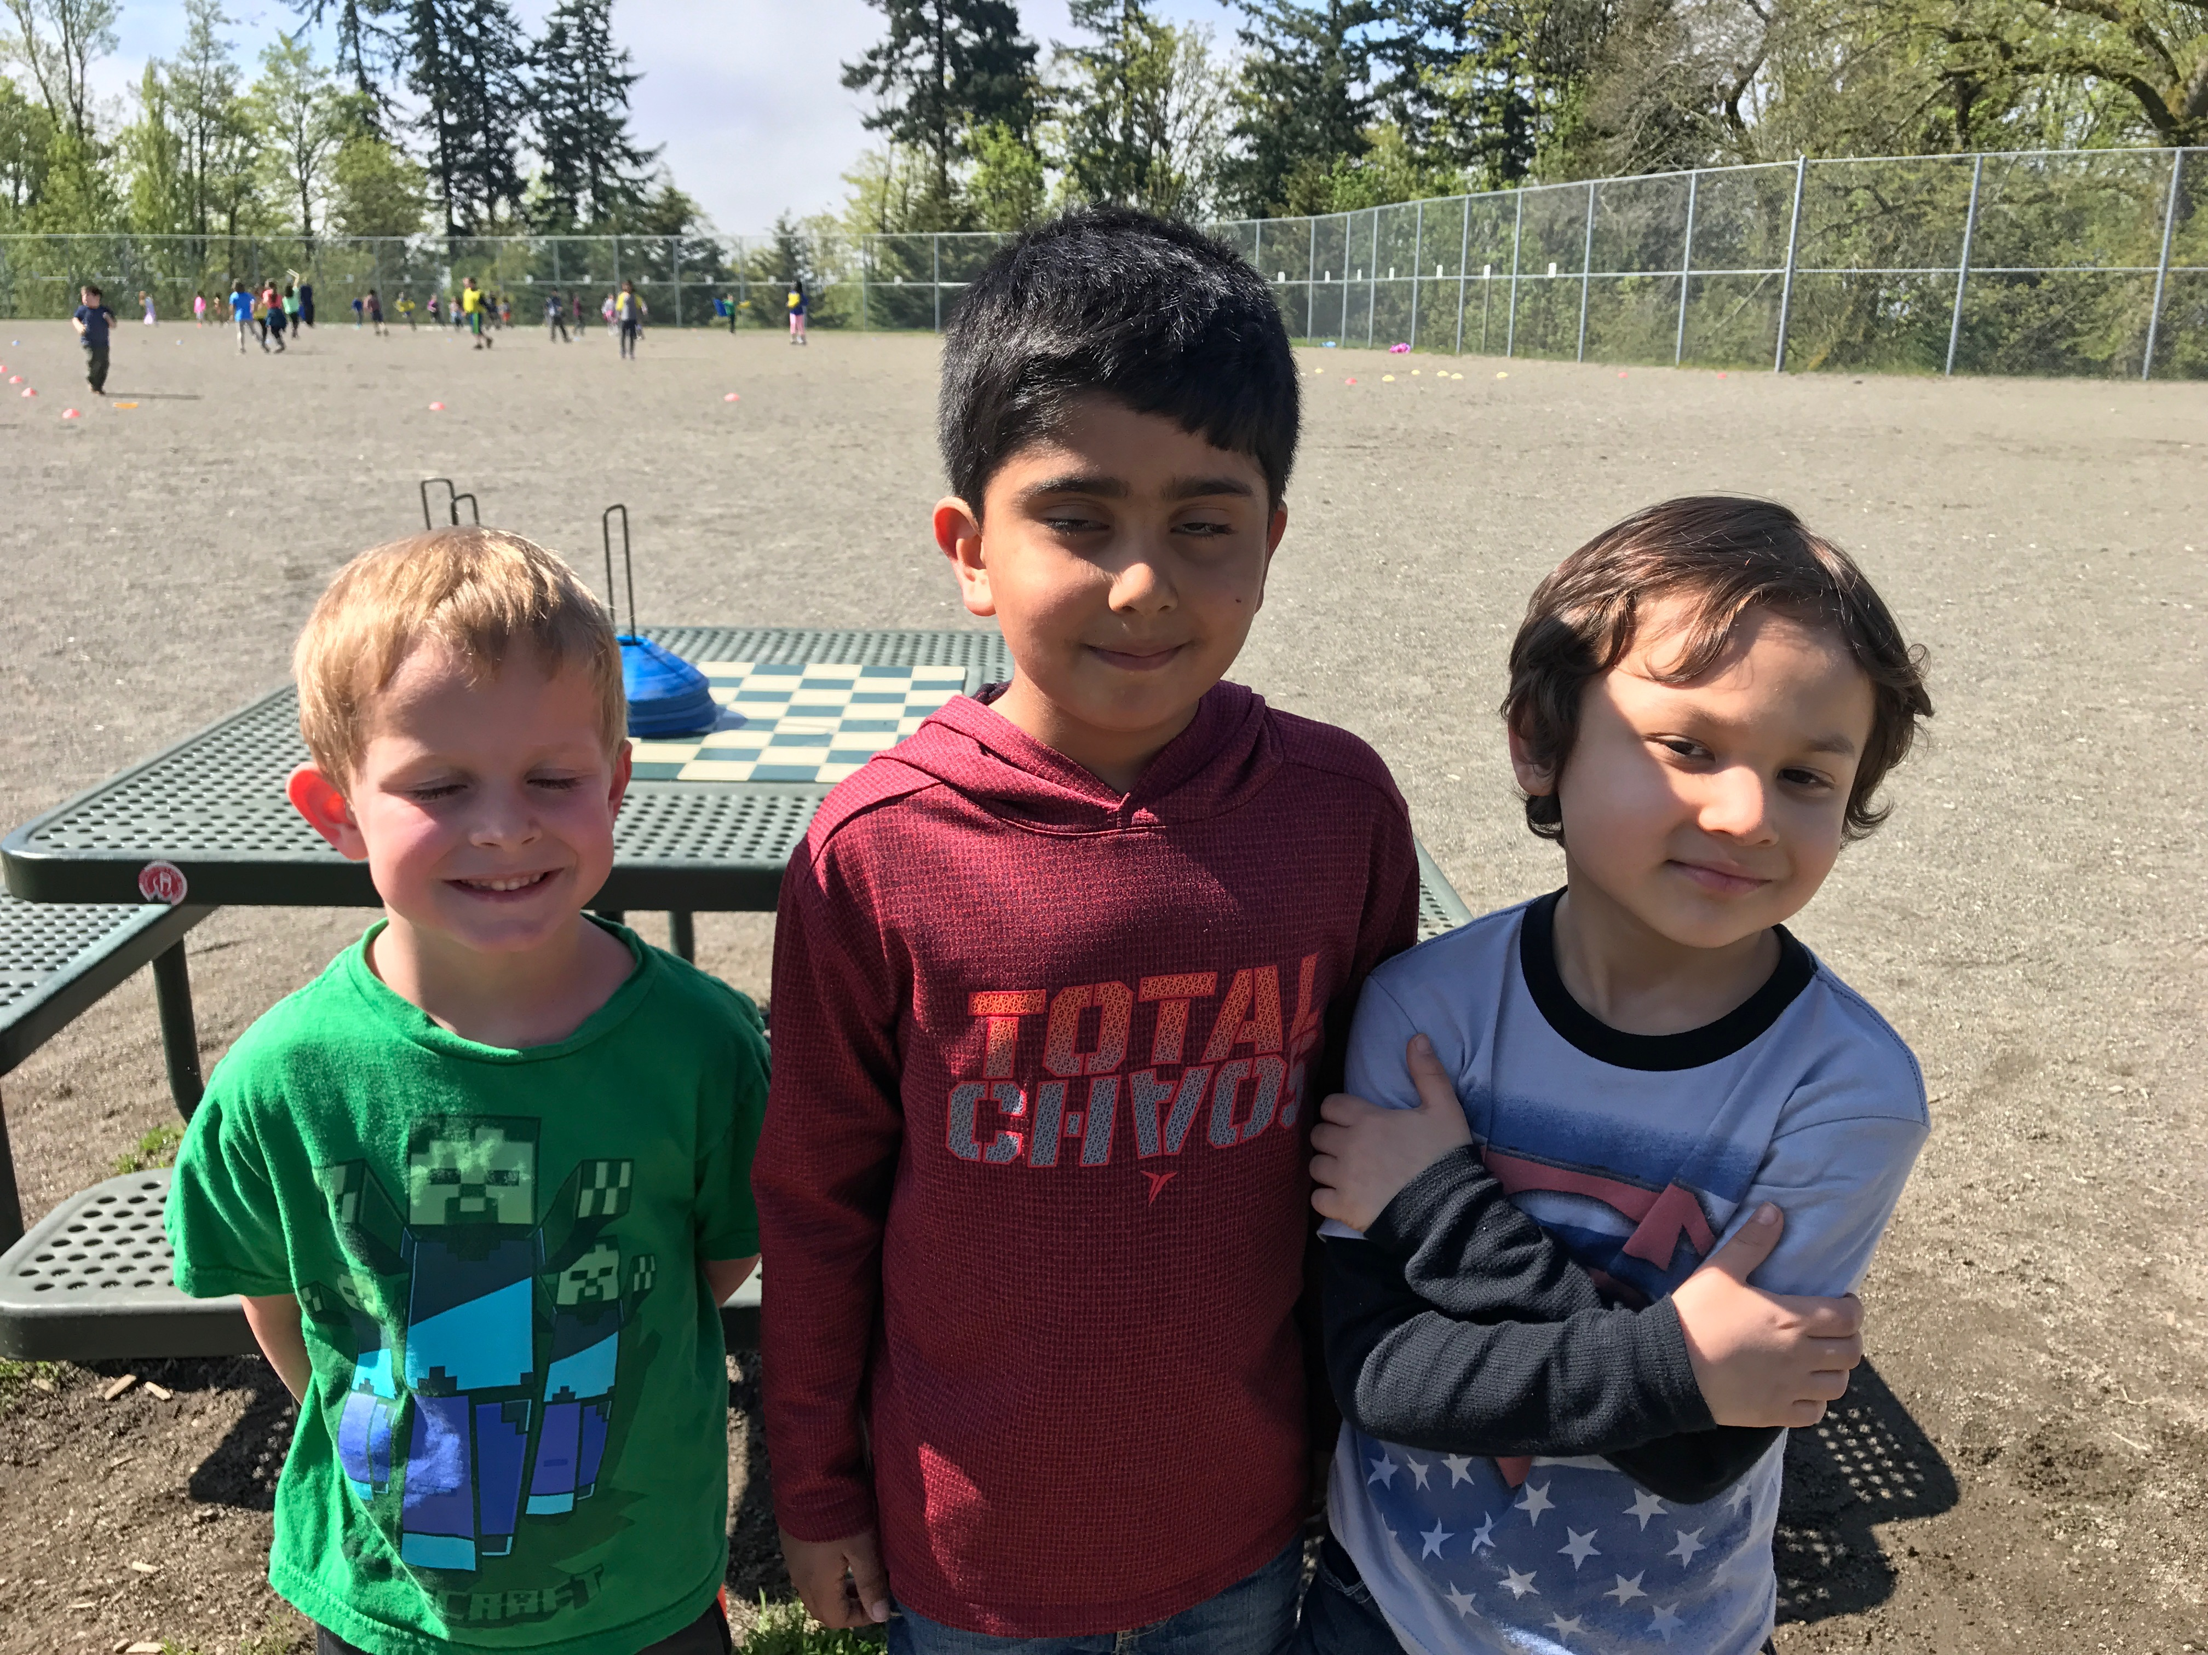

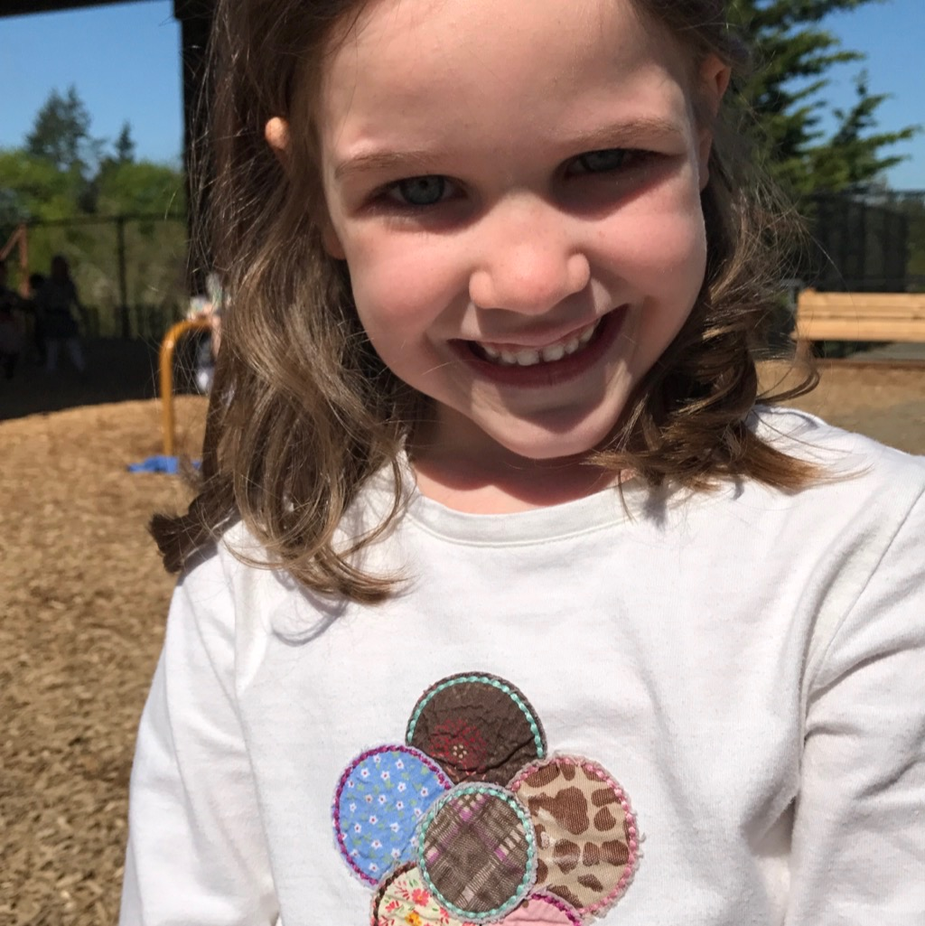
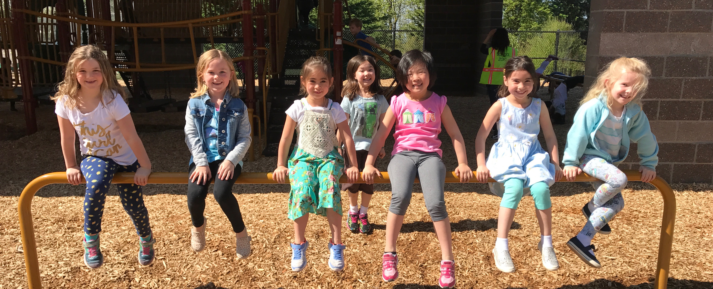
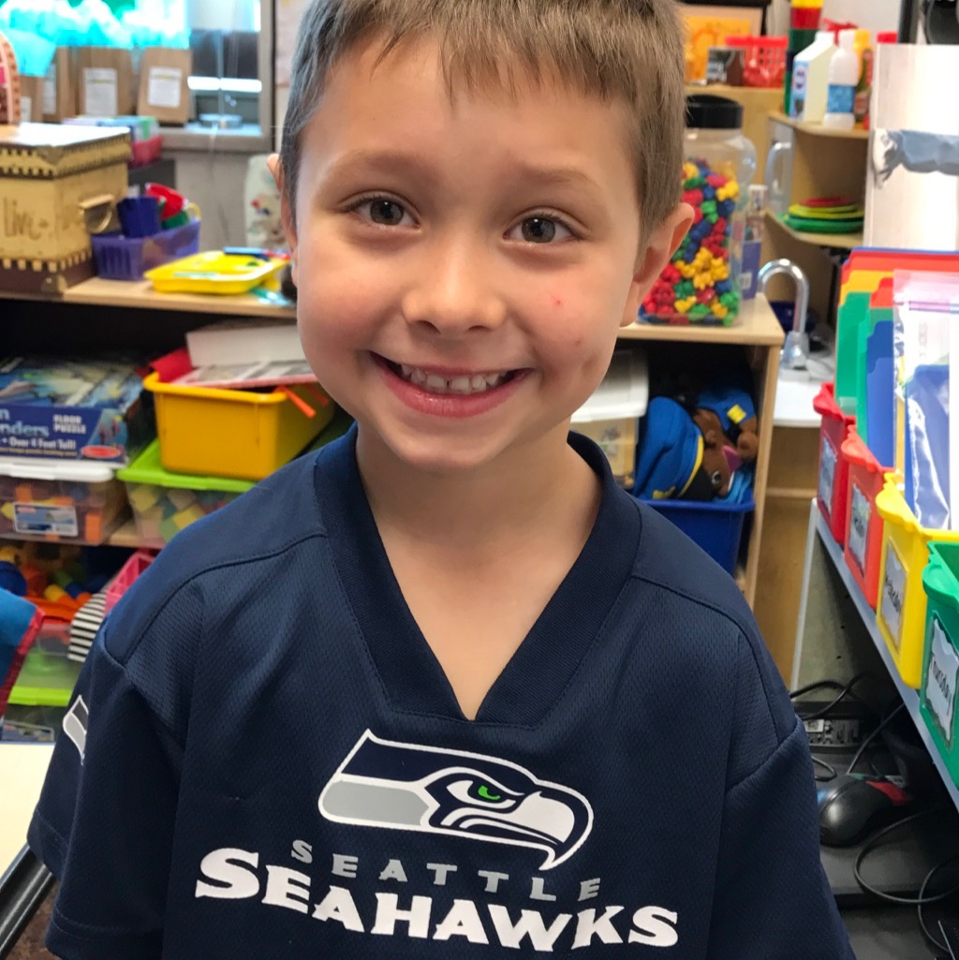
Thank you!

Slide 34
Q & A
What else do you want to know?

