Slide 1


OHS ENROLLMENT 2026-2027
OHS ADMINISTRATORS
TIFFANI COOPER - PRINCIPAL
AUSTIN HIGGS - A-G
GINA OSBURN - H-O
KRISTI VRSKA - P-Z
KEVIN DOTSON - ACTIVITIES
OHS COUNSELORS
KASSIE DYSON - A-G
EMILY DRAKE - H-O
JAYME RISENHOOVER - P-Z

Slide 2
GRADUATION TRACKS
2 TRACKS TO GRADUATION:
COLLEGE PREP TRACK (OK PROMISE REQUIREMENT) - DEFAULT
4X4 - PATH TO DISTINGUISHED GRAD

Slide 3
CLASS OF 2029 GRADUATION REQUIREMENTS
ENGLISH (4 CREDITS)
ENGLISH I
ENGLISH II
ENGLISH III
ENGLISH IV
MATH (3 CREDITS IN HIGH SCHOOL, ALGEBRA I AND ABOVE)
ALGEBRA I
GEOMETRY
ALGEBRA II
4TH MATH OPTIONS (PRE-CALCULUS/PRE-CALCULUS PREP, STATISTICS, ALGEBRA III)
SCIENCE (3 CREDITS)
PHYSICAL SCIENCE
BIOLOGY
3RD SCIENCE (CHEMISTRY ENCOURAGED)
HISTORY (3 CREDITS)
OKLAHOMA HISTORY/US GOVERNMENT
HISTORY (WORLD HISTORY, AP WORLD, AP EUROPEAN, AP HUMAN GEOGRAPHY),
US HISTORY
23 CREDITS ARE REQUIRED FOR GRADUATION

Slide 4
ELECTIVES
REQUIRED ELECTIVES
2 FOREIGN LANGUAGE OR COMPUTER CREDITS
1 FINE ARTS CREDIT OR ONLINE COMPETENCY COURSE
  FINE ARTS COURSE LIST
PERSONAL FINANCIAL LITERACY (PFL)
  PFL COURSE LIST
OTHER ELECTIVES
AGRICULTURAL EDUCATION
FAMILY AND CONSUMER SCIENCE
HEALTH AND FITNESS
TECHNOLOGY AND BUSINESS
SERVICE LEARNING
COMPETITIVE ATHLETICS
FINE ARTS
FIND A FULL LIST OF ELECTIVES AND COURSE DESCRIPTIONS AT THIS LINK
SOME ELECTIVES REQUIRE AN APPLICATION OR TRYOUT BEFORE YOU CAN BE PLACED IN THE CLASS

Slide 5
ADDITIONAL GRADUATION REQUIREMENTS
YOU MUST COMPLETE THE FOLLOWING COMPETENCIES:
NATURALIZATION TEST (given in 8th grade)
PERSONAL FINANCIAL LITERACY (PFL) in *10th-12th Grade
CPR INSTRUCTION
INDIVIDUAL CAREER ACADEMIC PLAN (ICAP)
ACT, US HISTORY, AND SCIENCE STATE TESTS
COMPLETE THE FREE APPLICATION FOR FEDERAL STUDENT AID (FAFSA) - SENIOR YEAR ONLY

Slide 6
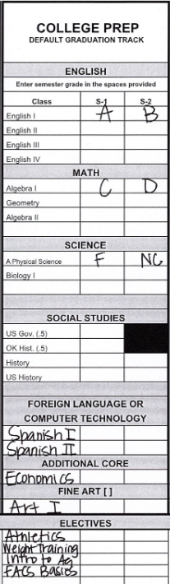
CREDIT CHECK
CREDIT CHECK FORM
EACH SEMESTER OF A CLASS CAN EARN 0.5 CREDIT. ONE WHOLE YEAR OF A CLASS CAN EARN 1 WHOLE CREDIT
IF A GRADE OF F OR NC IS RECEIVED, NO CREDIT IS GIVEN (0 CREDIT) FOR THAT SEMESTER.
YOU WILL NEED TO SPEAK WITH YOUR OHS COUNSELOR ABOUT MAKING UP THAT CREDIT.
ALL OHS STUDENTS ARE AUTOMATICALLY PLACED ON THE OKLAHOMA COLLEGE PREP WORK READY PLAN.
EMAIL YOUR COUNSELOR TO CHANGE GRADUATION TRACKS.
4X4 IS THE PATH TO DISTINGUISHED GRADUATE.

Slide 7
ICAP
PLEASE COMPLETE THE FOLLOWING STEPS:
PLACE YOUR TRANSCRIPT AND CREDIT CHECK IN YOUR BACKPACK TO TAKE HOME AND SHARE WITH YOUR PARENTS/GUARDIANS.
THESE ARE CONFIDENTIAL DOCUMENTS.
CLICK THE LINK BELOW TO COMPLETE AN ICAP GRADUATION REQUIREMENT
ICAP

Slide 8
Thinking Ahead?
NCAA?
CREATE AN ACCOUNT AND TALK TO YOUR COUNSELOR FRESHMAN YEAR!
TAKE WORLD LANGUAGE, COMPUTER TECHNOLOGY DOES NOT COUNT.
OKLAHOMA’S PROMISE?
APPLY HERE
Other Tulsa Tech programs?
LOOK AT PROGRAMS AND TALK TO MS. COTTLE SOPHOMORE YEAR!
TCC/Concurrent Enrollment?
TALK TO MRS. SEWELL or MS. MARTIN AT THE END OF YOUR SOPHOMORE YEAR!
This is for 11th and 12th grade students and more information will be given during pre-enrollment your 10th grade year.

Slide 9

TULSA TECH
TULSA TECH OFFERS A 2 YEAR ENGINEERING PROGRAM FOR FRESHMEN AND SOPHOMORES
INTRO TO ENGINEERING (FRESHMEN)
PRINCIPLES OF ENGINEERING (SOPHOMORES)
THIS COURSE COUNTS AS ONE COMPUTER CREDIT PER YEAR AND TAKES PLACE AT OWASSO HIGH SCHOOL (DOES NOT INVOLVE TRAVELING TO A TULSA TECH CAMPUS)
FOUNDATIONS OF ENGINEERING VIDEO
STUDENTS THAT PLAN TO ATTEND TULSA TECH IN THEIR JUNIOR YEAR MUST APPLY DURING THEIR SOPHOMORE YEAR.
EMAIL MS. COTTLE FOR MORE INFORMATION
mary.cottle@tulsatech.edu

Slide 10
4 YEAR PLANS
PLAN YOUR FUTURE
EXAMPLE 4 YEAR PLANS YOUR 4 YEAR PLAN

Slide 11
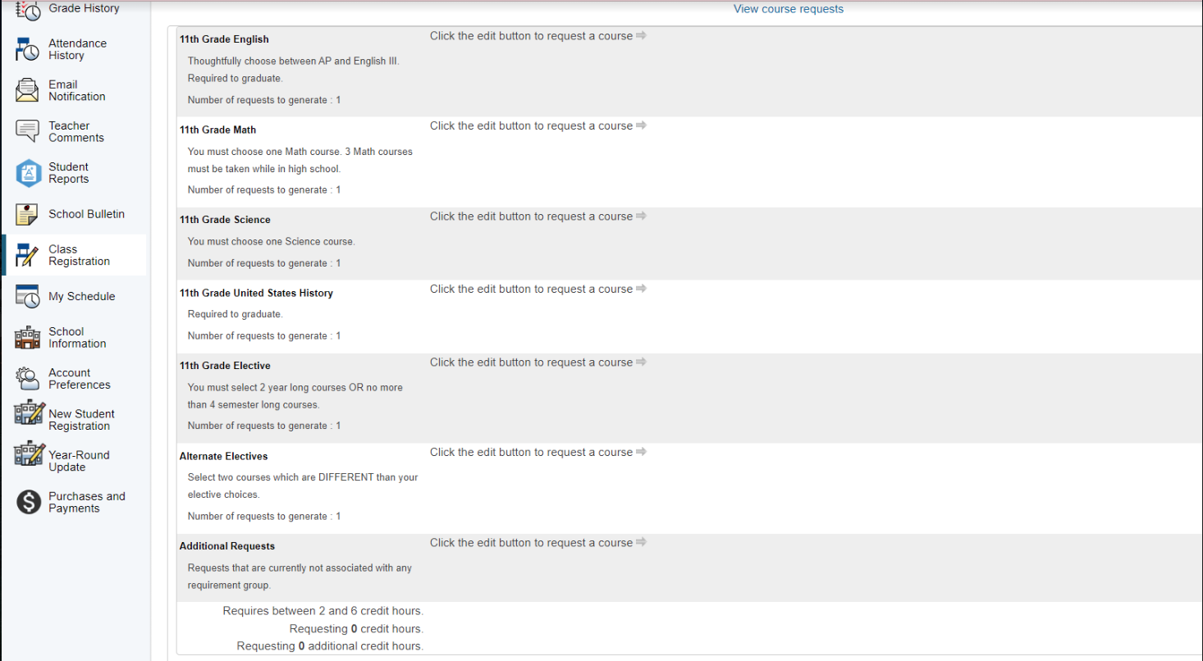
CLASS REGISTRATION
CLICK CLASS REGISTRATION ON THE LEFT.

Slide 12
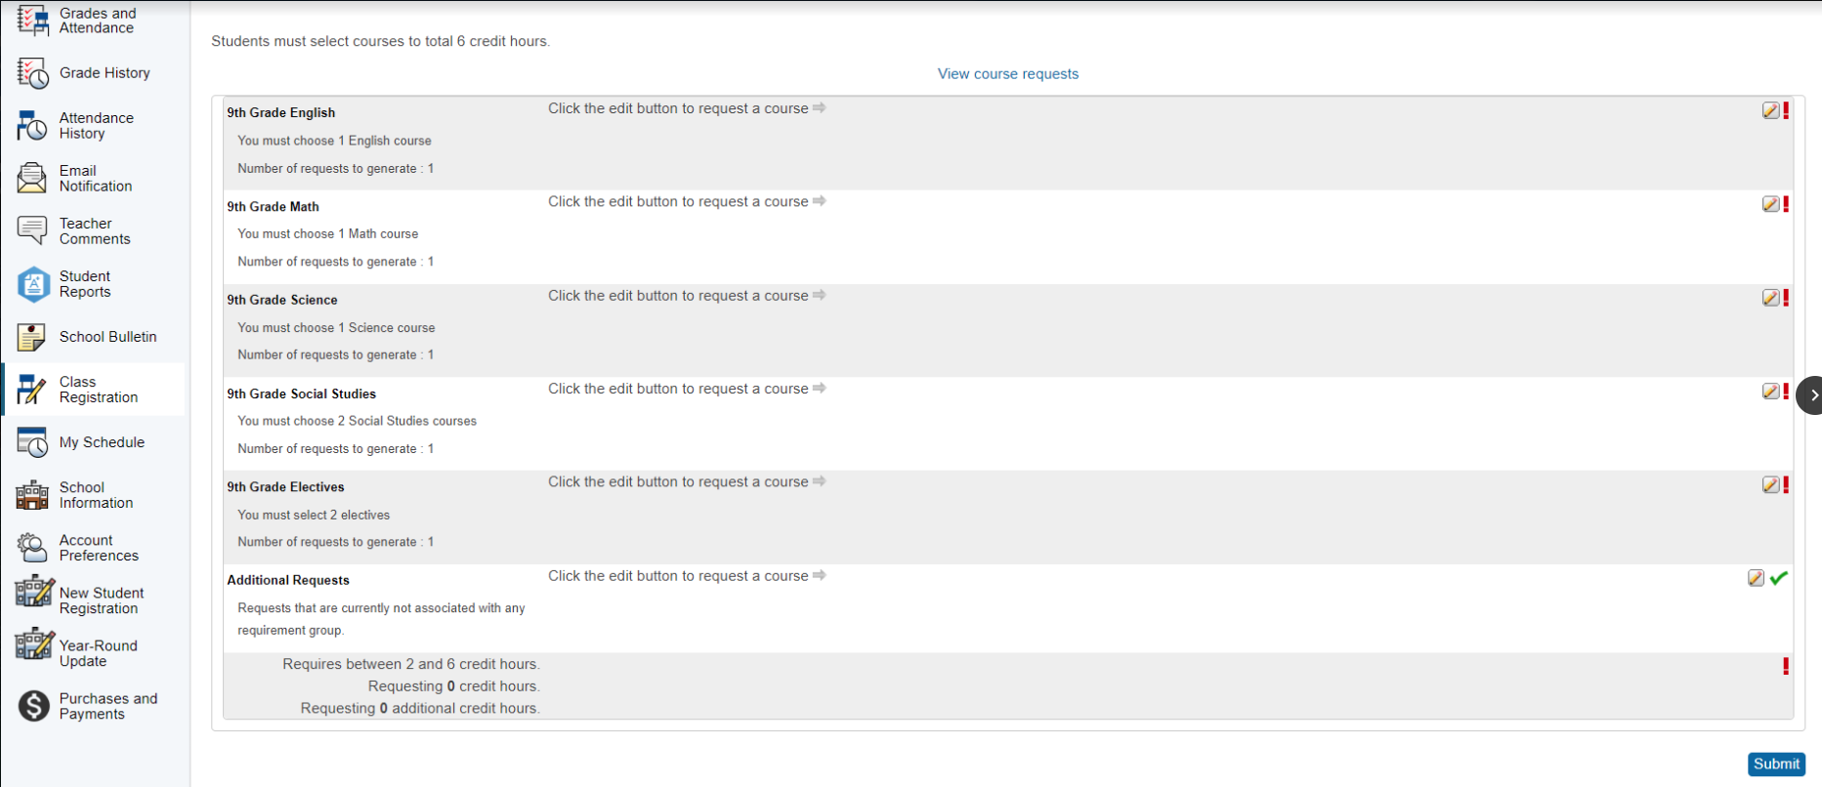
CLASS REGISTRATION
COURSE GUIDE
CLICK THE PENCIL AND PAPER ICON.

Slide 13
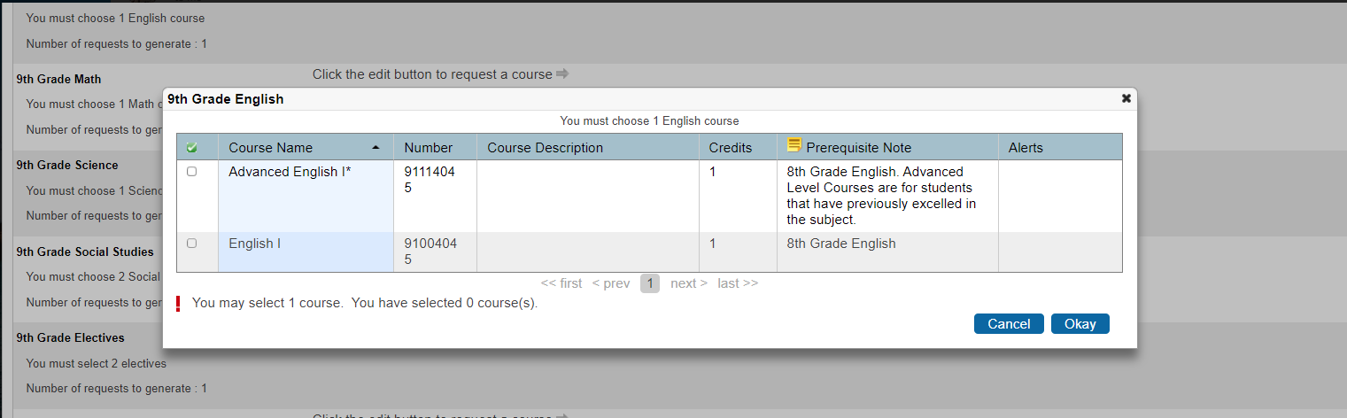
CLASS REGISTRATION
MAKE YOUR ENGLISH SELECTION.
CLICK BLUE OKAY BUTTON TO SAVE.

Slide 14
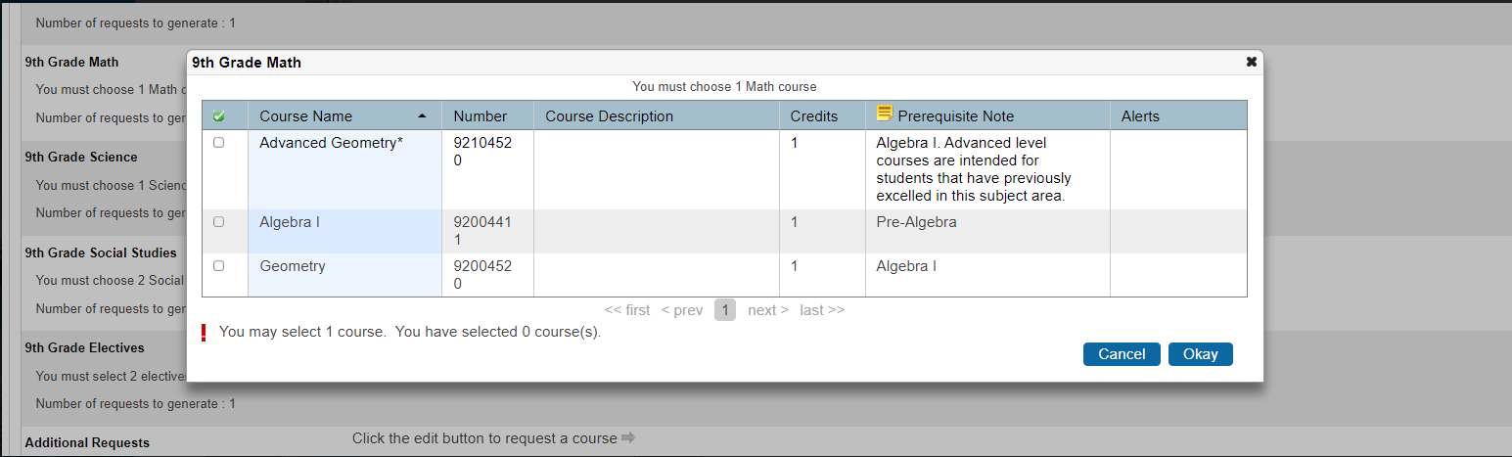
CLASS REGISTRATION
MAKE YOUR MATH SELECTION.
ORDER OF MATH CLASSES: ALGEBRA I, GEOMETRY, ALGEBRA II
CLICK BLUE OKAY BUTTON TO SAVE.
MATH PATHS

Slide 15
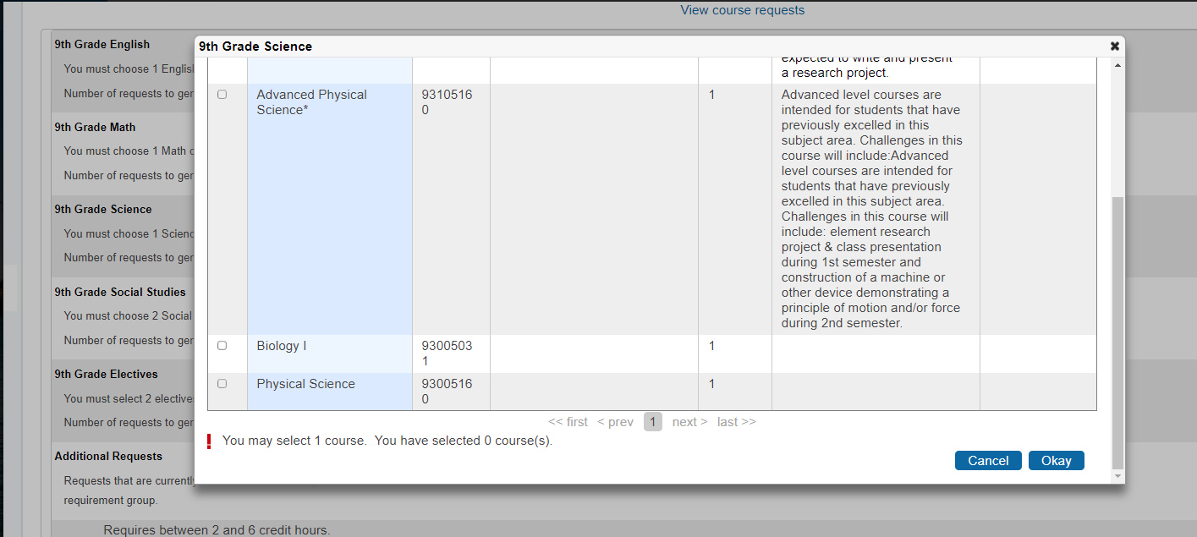
CLASS REGISTRATION
MAKE YOUR SCIENCE SELECTION.
SCIENCE REQUIREMENTS: A PHYSICAL SCIENCE, BIOLOGY, SCIENCE ELECTIVE.
IF YOU ARE ON THE 4X4 TRACK, YOU ARE ENCOURAGED TO TAKE CHEMISTRY.
CLICK BLUE OKAY BUTTON TO SAVE.

Slide 16
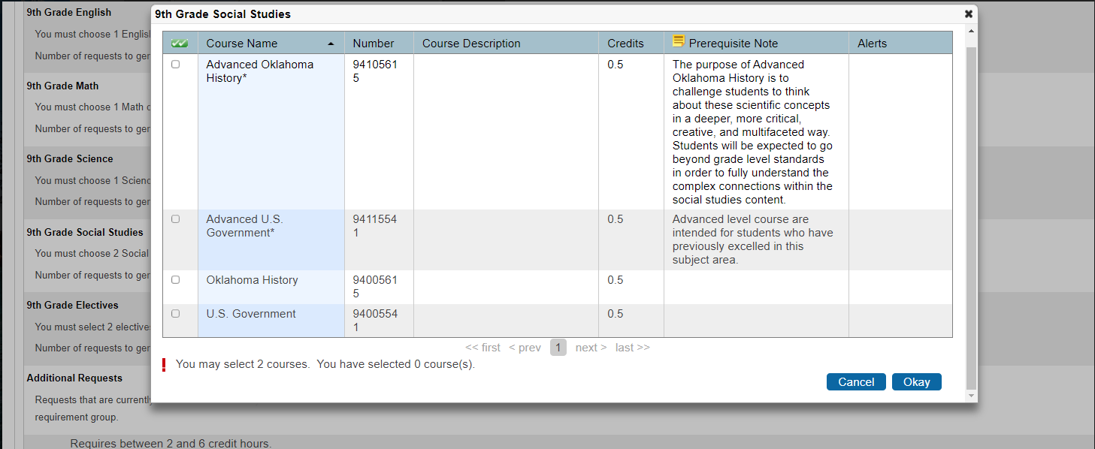
CLASS REGISTRATION
MAKE YOUR SOCIAL STUDIES SELECTION.
SOCIAL STUDIES PATH: OK HIST/US GOV, HISTORY ELECTIVE, US HISTORY
CLICK BLUE OKAY BUTTON TO SAVE.

Slide 17
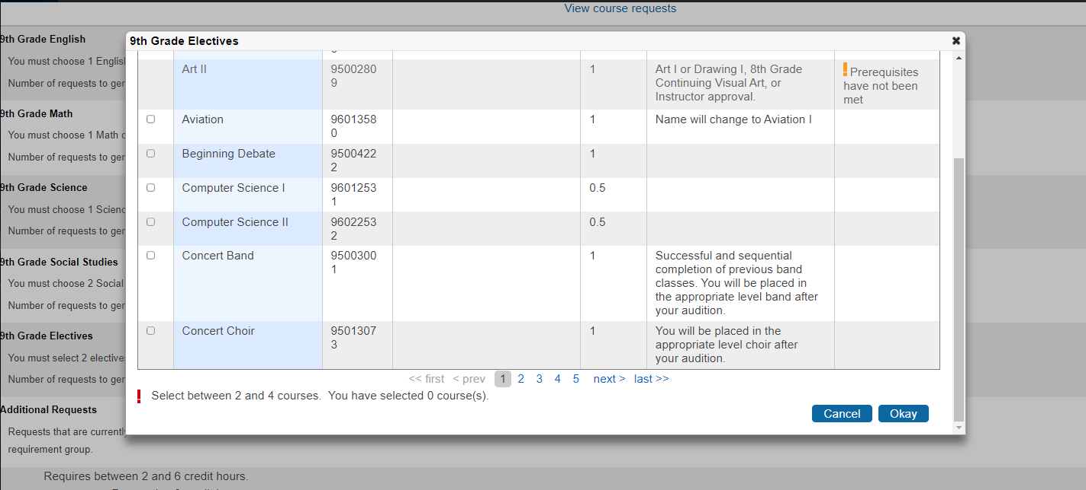
CLASS REGISTRATION
MAKE YOUR ELECTIVE SELECTIONS. (YOU WILL SELECT 2 CREDITS)
CLICK BLUE OKAY BUTTON TO SAVE.
COURSE GUIDE
APPLICATION ONLY CLASSES

Slide 18
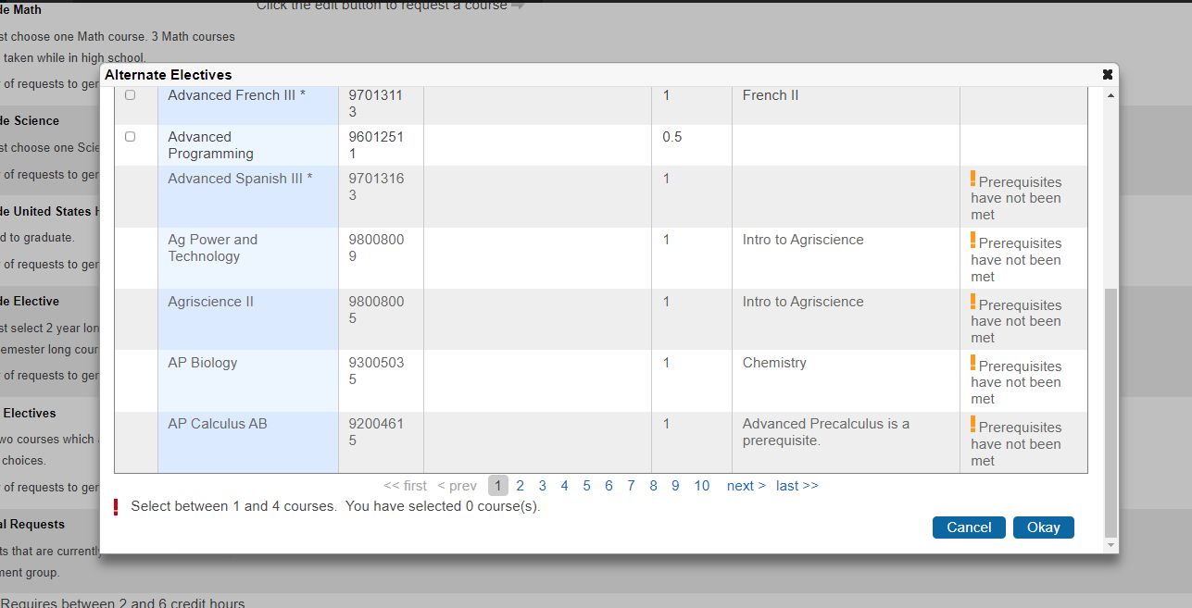
CLASS REGISTRATION
MAKE YOUR ALTERNATE SELECTIONS. (YOU WILL SELECT 2 CREDITS)
CLICK BLUE OKAY BUTTON TO SAVE.
COURSE GUIDE

Slide 19
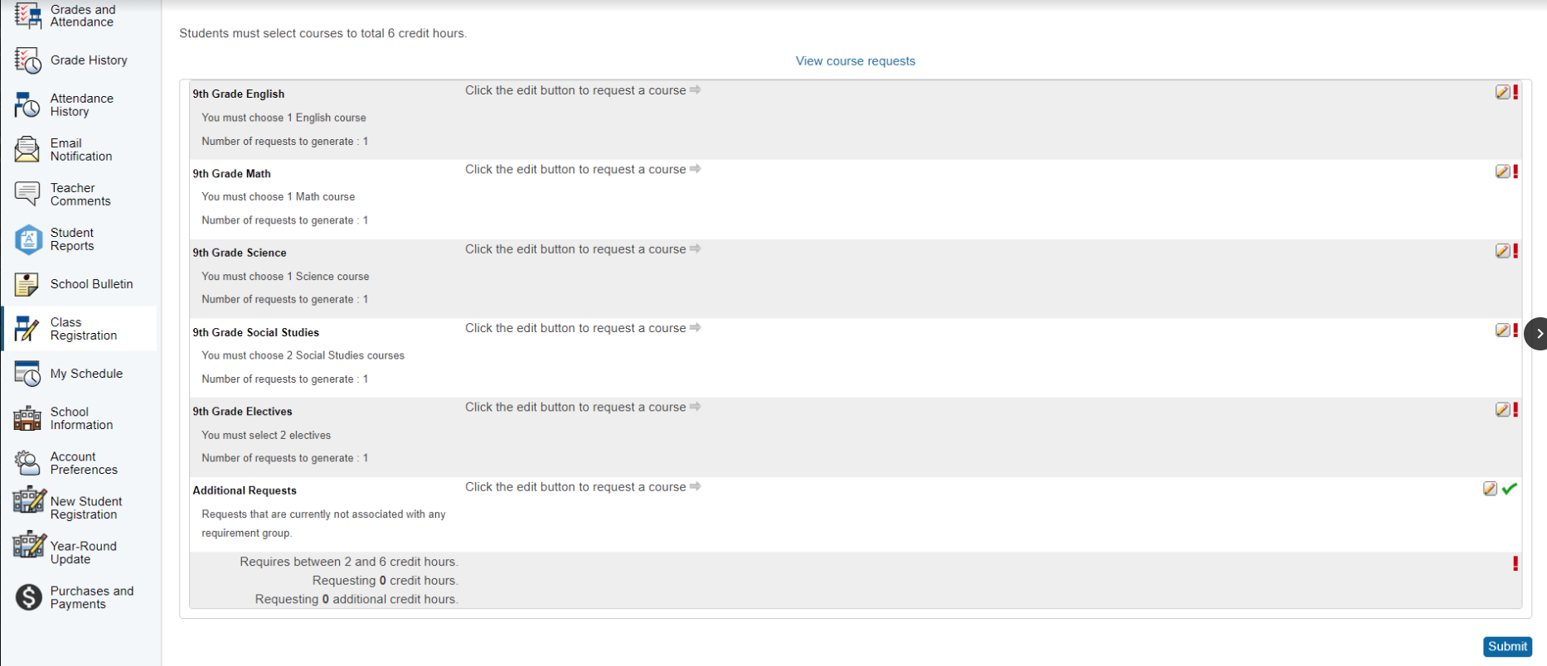
CLASS REGISTRATION
CLICK SUBMIT TO SAVE YOUR CLASS CHOICES.
YOU CAN MAKE EDITS TO YOUR CHOICES UNTIL MARCH 4TH, 2026.

Slide 20


Slide 21
CONTACT INFORMATION
PLEASE CONTACT WITH ANY ENROLLMENT QUESTIONS!
KASSIE DYSON (A-G)
kassie.stoutdyson@owassops.org
EMILY DRAKE (H-O)
emily.drake@owassops.org
JAYME RISENHOOVER (P-Z)
jayme.risenhoover@owassops.org

Slide 22
DID YOU KNOW?
We have resources for you if:
You and your family live with another family
You are staying with someone other than your legal guardian
You are temporarily not living in your home
You need food
You need school supplies
You need a coat
You want counseling
Use this CONFIDENTIAL FORM to alert your counselor of your need(s).

