Slide 1


OHS ENROLLMENT 2026-2027
OHS ADMINISTRATORS
TIFFANI COOPER - PRINCIPAL
DANIELLE PETTY - SENIORS
DYLAN CAHWEE - JUNIORS
KEVIN DOTSON - ACTIVITIES
OHS COUNSELORS
SALLY RANDOLPH - A-G
STEPHANIE CURFMAN - H-O
BECKY COPELAND - P-Z
ADDISON SEWELL & AIMEE MARTIN - COLLEGE AND CAREER
Notes:
DONE

Slide 2
GRADUATION TRACKS
2 TRACKS TO GRADUATION:
COLLEGE PREP TRACK (OK PROMISE REQUIREMENT) - DEFAULT
4X4 - PATH TO DISTINGUISHED GRAD
Notes:
DONE

Slide 3
CLASS OF 2027 & 2028 GRADUATION REQUIREMENTS
ENGLISH (4 CREDITS)
ENGLISH I
ENGLISH II
ENGLISH III
ENGLISH IV
MATH (3 CREDITS IN HIGH SCHOOL, ALGEBRA I AND ABOVE)
ALGEBRA I
GEOMETRY
ALGEBRA II,
4TH MATH OPTIONS: PRE-CALCULUS/PRE-CALC PREP, CALCULUS, STATISTICS, ALGEBRA III
  USE THIS LINK TO SEE WHAT YOUR MATH PATH SHOULD LOOK LIKE
SCIENCE (3 CREDITS)
PHYSICAL SCIENCE (OR CHEMISTRY OR PHYSICS)
BIOLOGY
3RD LAB SCIENCE
HISTORY (3 CREDITS)
OKLAHOMA HISTORY/US GOVERNMENT
HISTORY (WORLD HISTORY, AP WORLD, AP EUROPEAN, AP HUMAN GEOGRAPHY)
US HISTORY
23 CREDITS ARE REQUIRED FOR GRADUATION
Notes:
DONE

Slide 4
ELECTIVES
REQUIRED ELECTIVES
2 FOREIGN LANGUAGE OR COMPUTER CREDITS
1 FINE ARTS CREDIT OR ONLINE COMPETENCY COURSE
  FINE ARTS COURSE LIST
1 COURSE EMBEDDED WITH PERSONAL FINANCIAL LITERACY (PFL) OR ONLINE COMPETENCY COURSE
  PFL COURSE LIST
OTHER ELECTIVES
AGRICULTURAL EDUCATION
FAMILY AND CONSUMER SCIENCE
HEALTH AND FITNESS
TECHNOLOGY AND BUSINESS
SERVICE LEARNING
COMPETITIVE ATHLETICS
FINE ARTS
CCP - Internship
FIND A FULL LIST OF ELECTIVES AND COURSE DESCRIPTIONS AT THIS LINK
***SOME ELECTIVES REQUIRE AN APPLICATION OR TRYOUT BEFORE YOU CAN BE PLACED IN THE CLASS
Notes:
DONE

Slide 5
ADDITIONAL GRAD REQUIREMENTS
NATURALIZATION TEST - GIVEN IN 8TH GRADE
PERSONAL FINANCIAL LITERACY (PFL)
CPR INSTRUCTION
INDIVIDUAL CAREER ACADEMIC PLAN (ICAP)
ACT, US HISTORY, AND SCIENCE STATE TESTS - JUNIOR YEAR
COMPLETE THE FREE APPLICATION FOR FEDERAL STUDENT AID (FAFSA) - SENIOR YEAR ONLY
Notes:
DONE

Slide 6
CONCURRENT ENROLLMENT/DUAL CREDIT
EARN HIGH SCHOOL AND COLLEGE CREDIT AT TCC OR OTHER ACCREDITED UNIVERSITIES
CONCURRENT COURSES CAN FULFILL GRADUATION REQUIREMENTS
STUDENTS ARE ALLOWED 2 TRAVEL HOURS MAXIMUM ON THEIR SCHEDULE
GRADUATION REQUIREMENT | CONCURRENT COURSE
ENGLISH III AND ENGLISH IV | COMPOSITION I AND II
US HISTORY | US HISTORY CIVIL WAR TO PRESENT
3RD LAB SCIENCE | BIOLOGY, CHEMISTRY, ETC.
FOREIGN LANGUAGE REQUIREMENTS | SPANISH, GERMAN, ASL, ETC.
EXAMPLES
CLICK HERE TO APPLY FOR TCC CONCURRENT ENROLLMENT
EMAIL MRS. SEWELL AND MRS. MARTIN FOR MORE INFORMATION
addison.sewell@owassops.org
aimee.martin@owassops.org
Notes:
DONE

Slide 7
CONCURRENT ENROLLMENT/DUAL CREDIT
4 STEPS FOR DUAL ENROLLMENT
Step 1. Apply for Admissions to Tulsa Community College (TCC) (NOW)
Step 2. Check course enrollment requirements (NOW)
Step 3: Complete course selection in the Dual Credit Enrollment Portal (MARCH)
Step 4. Confirm your enrollment
CLICK HERE FOR MORE INFORMATION
*Students may be admitted using test scores and a 3-semester transcript. If using GPA, you will be able to enroll in June with a 4-semester transcript or Accuplacer.
EMAIL MRS. SEWELL AND MRS. MARTIN FOR MORE INFORMATION
addison.sewell@owassops.org
aimee.martin@owassops.org
Notes:
4 Steps for Dual Enrollment: https://ohs.owassops.org/apps/pages/index.jsp?uREC_ID=1423976&type=d&pREC_ID=2060977
DONE

Slide 8
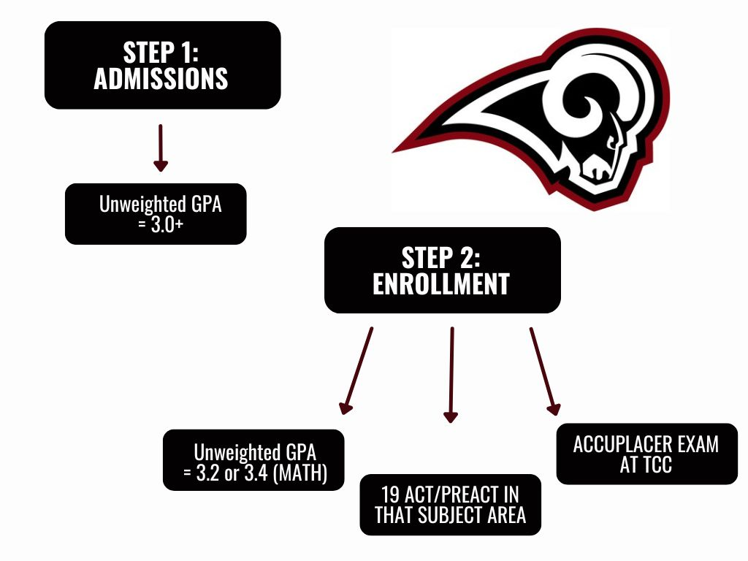
CONCURRENT ENROLLMENT/DUAL CREDIT
EMAIL MRS. SEWELL AND MRS. MARTIN FOR MORE INFORMATION
addison.sewell@owassops.org
aimee.martin@owassops.org
Notes:
4 Steps for Dual Enrollment: https://ohs.owassops.org/apps/pages/index.jsp?uREC_ID=1423976&type=d&pREC_ID=2060977
DONE

Slide 9

TULSA TECH
TULSA TECH OFFERS MULTIPLE PROGRAMS FOR FREE FOR JUNIORS AND SENIORS
MOST COUNT AS ELECTIVE CREDITS, HOWEVER SOME CAN COUNT AS A SCIENCE, MATH, OR COMPUTER CREDIT
WILL TAKE 3 HOURS OF YOUR DAILY SCHEDULE
PRIORITY DEADLINE IS FEBRUARY 26, 2026
APPLY ONLINE
EMAIL MRS. COTTLE FOR MORE INFORMATION
mary.cottle@tulsatech.edu
Notes:
DONE

Slide 10
CAREER CONNECTIONS PROGRAM (ELECTIVE)
What is the Career Connections Program (CCP)?
Students either secure their own job or internship or we help place you with a business partner or within Owasso Public Schools (paid or unpaid)
1 hour on your schedule (110 hrs semester) and 2 hours on your schedule (220 hrs semester)
Program Requirements:
Must be able to provide own transportation
Must be credit sufficient for junior and senior years
Maintain a 2.0 GPA/70% or better in each class
Student employed by family will not be considered
Maintain job/internship throughout the entirety of the school year
Program paperwork AND in person orientation are required at the beginning of the semester to be released to your job/internship
Notes:
DONE

Slide 11
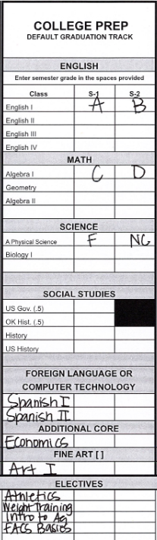
CREDIT CHECK
CREDIT CHECK FORM
EACH SEMESTER OF A CLASS CAN EARN 0.5 CREDIT. ONE WHOLE YEAR OF A CLASS CAN EARN 1 WHOLE CREDIT
IF A GRADE OF F OR NC IS RECEIVED, NO CREDIT IS GIVEN (0 CREDIT) FOR THAT SEMESTER.
YOU WILL NEED TO SPEAK WITH YOUR OHS COUNSELOR ABOUT MAKING UP THAT CREDIT.
ALL OHS STUDENTS ARE AUTOMATICALLY PLACED ON THE OKLAHOMA COLLEGE PREP WORK READY PLAN.
EMAIL YOUR COUNSELOR TO CHANGE GRADUATION TRACKS.
4X4 IS THE PATH TO DISTINGUISHED GRADUATE.
Notes:
DONE

Slide 12
ENROLLMENT
PLEASE COMPLETE THE FOLLOWING STEPS:
PLACE YOUR TRANSCRIPT AND COMPLETED CREDIT CHECK IN YOUR BACKPACK TO TAKE HOME AND SHARE WITH YOUR PARENTS. THESE ARE CONFIDENTIAL DOCUMENTS.
CLICK THE LINK BELOW TO COMPLETE AN ICAP GRADUATION REQUIREMENT
ICAP GOOGLE FORM
Notes:
DONE

Slide 13
MORE TO THINK ABOUT
NCAA?
CREATE AN ELIGIBILITY ACCOUNT HERE
TAKE WORLD LANGUAGE, COMPUTER TECHNOLOGY DOES NOT COUNT.
OKLAHOMA’S PROMISE?
APPLY HERE BY END OF 11TH GRADE
SCHOLARSHIPS?
JOIN THE SCHOLARSHIP GOOGLE CLASSROOM: hwmnnz6h
COLLEGE APPLICATIONS?
WORK WITH YOUR ASSIGNED COUNSELOR FOR
RECOMMENDATION LETTERS, ETC.
USE PARCHMENT FOR TRANSCRIPT REQUESTS
Notes:
DONE

Slide 14
COURSE SELECTION
EXAMPLES OF 4 YEAR PLANS
YOUR 4 YEAR PLAN

Slide 15
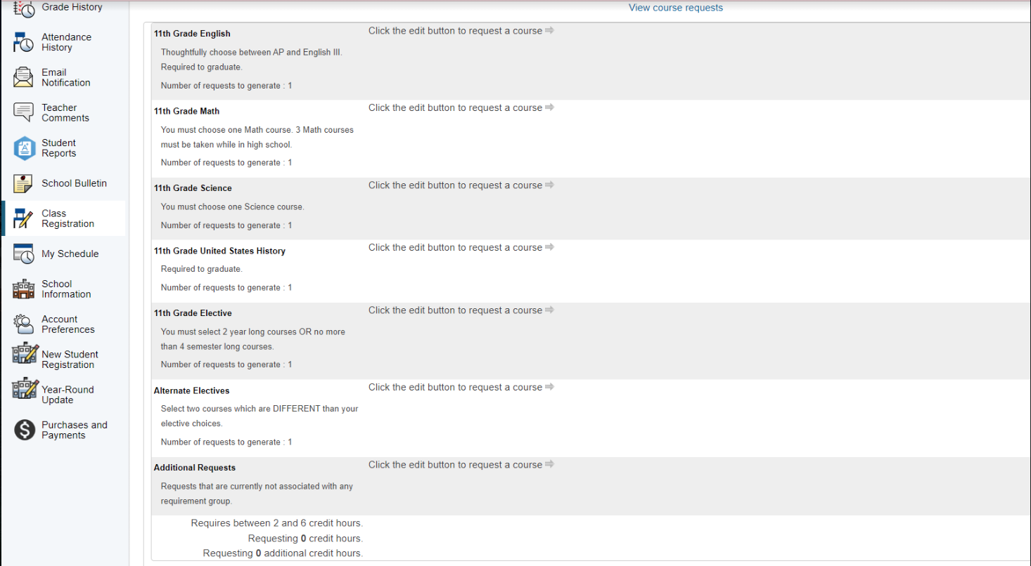
CLASS REGISTRATION
CLICK “CLASS REGISTRATION” ON THE LEFT

Slide 16
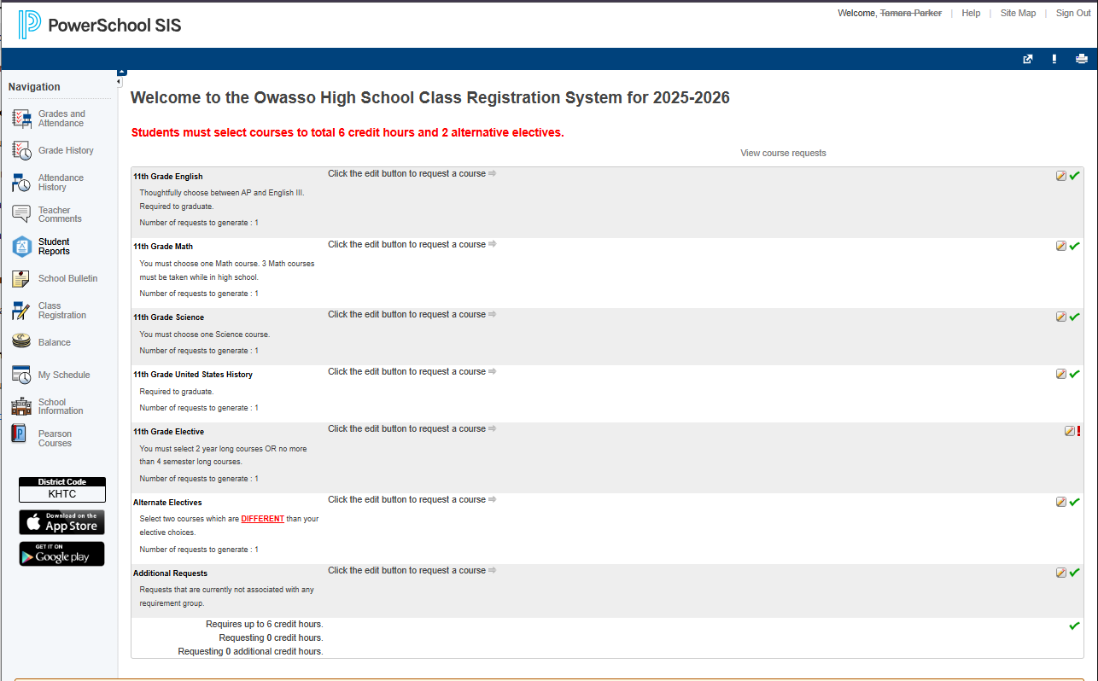
CLASS REGISTRATION
CLICK ON THE PENCIL AND PAPER ICON ON THE ENGLISH LINE.

Slide 17
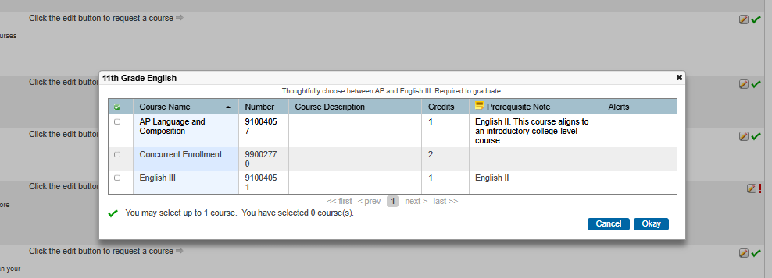
CLASS REGISTRATION
MAKE YOUR ENGLISH SELECTION. CLICK “OKAY”
IF YOU PLAN TO TAKE CONCURRENT ENGLISH, YOU WILL SELECT “CONCURRENT ENROLLMENT.” PLEASE REMEMBER TO ALSO SELECT A “CONCURRENT TRAVEL” HOUR IN ELECTIVES.

Slide 18
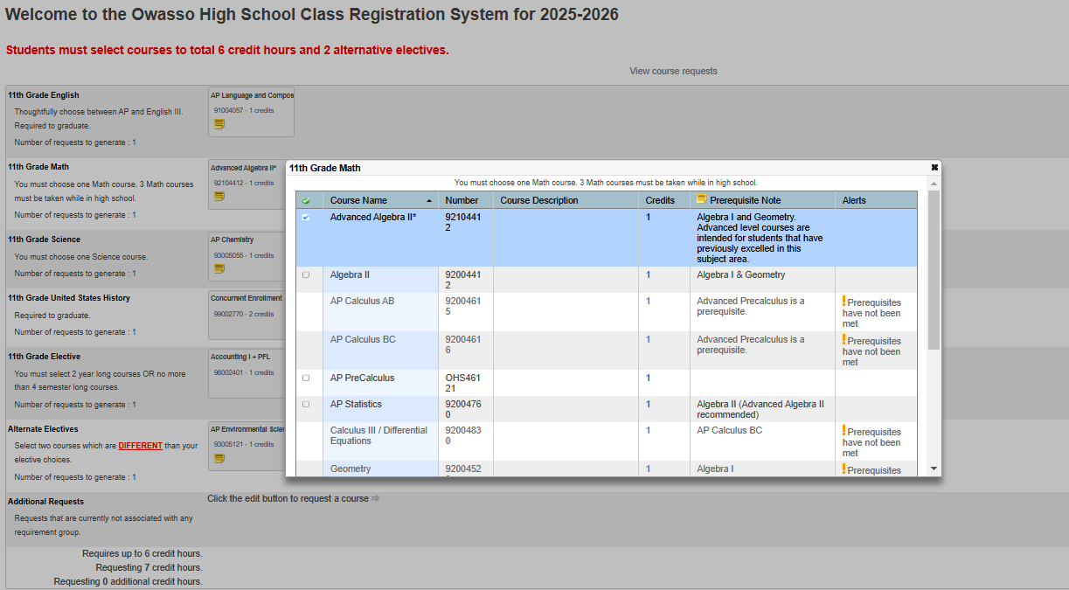
CLASS REGISTRATION
MAKE YOUR MATH SELECTION. CLICK “OKAY”
YOU CANNOT SELECT A CONCURRENT MATH, SO PLEASE BE SURE TO SELECT AN OHS MATH. IF YOU ENROLL IN TCC MATH, WE WILL UPDATE IT ON YOUR SCHEDULE.
MATH PATHS

Slide 19
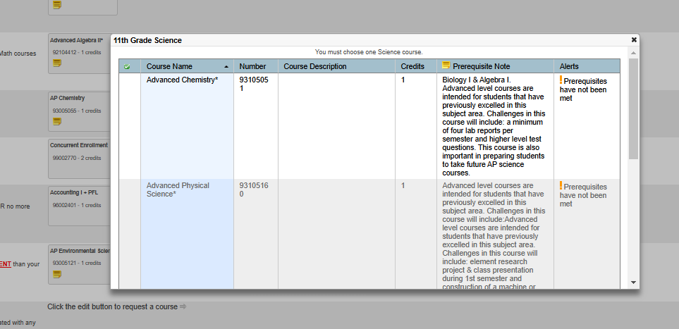
CLASS REGISTRATION
MAKE YOUR SCIENCE SELECTION. CLICK “OKAY”
YOU CANNOT SELECT A CONCURRENT SCIENCE, SO PLEASE BE SURE TO SELECT AN OHS SCIENCE. IF YOU ENROLL IN TCC SCIENCE, WE WILL UPDATE IT ON YOUR SCHEDULE.
IF YOU ARE ON THE 4X4 PLAN, YOU ARE ENCOURAGED TO TAKE CHEMISTRY.

Slide 20
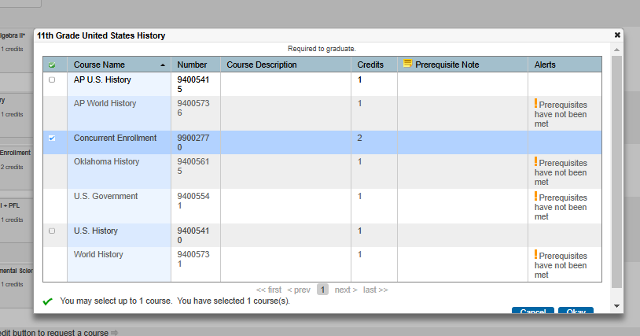
CLASS REGISTRATION
MAKE YOUR US HISTORY SELECTION. CLICK “OKAY”
IF YOU PLAN TO TAKE CONCURRENT HISTORY, YOU WILL SELECT “CONCURRENT ENROLLMENT.” PLEASE REMEMBER TO ALSO SELECT A “CONCURRENT TRAVEL” HOUR IN ELECTIVES.

Slide 21
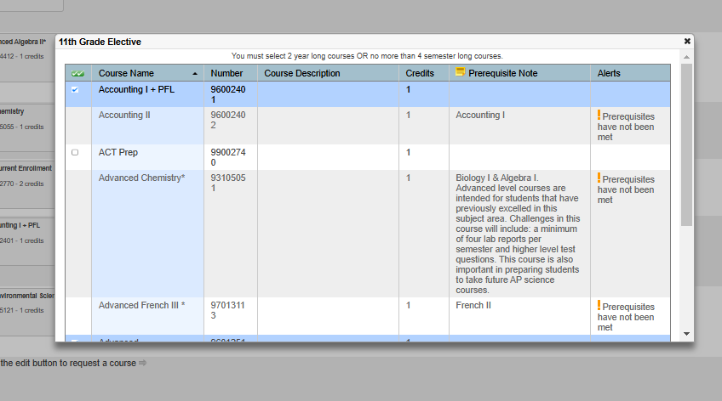
CLASS REGISTRATION
MAKE YOUR ELECTIVE SELECTIONS. CLICK “OKAY”
SELECT TWO ELECTIVE CREDITS.
IF YOU SELECTED ANY CONCURRENT COURSES FOR ENGLISH AND/OR US HISTORY, PLEASE BE SURE TO SELECT THAT SAME NUMBER OF TRAVEL HOURS HERE. EX: TWO CONCURRENT HOURS WOULD NEED TWO TRAVEL HOURS.
COURSE GUIDE
APPLICATION ONLY CLASSES

Slide 22
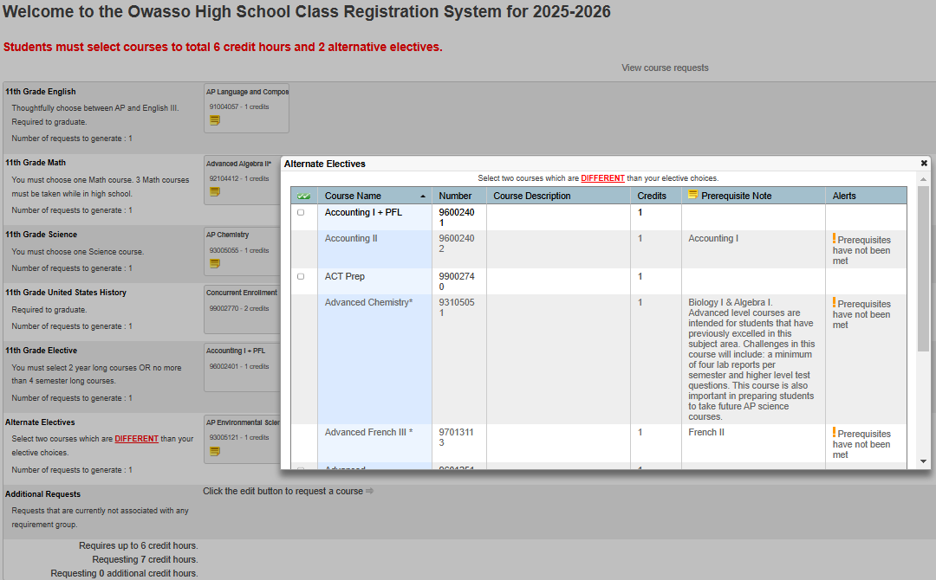
CLASS REGISTRATION
MAKE YOUR ALTERNATE SELECTIONS. CLICK “OKAY”
SELECT TWO ALTERNATE CREDITS.
COURSE GUIDE

Slide 23
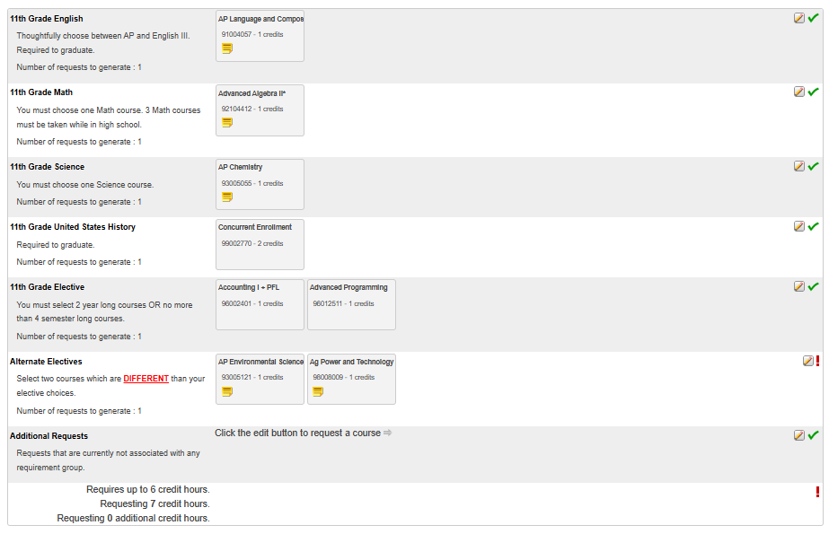
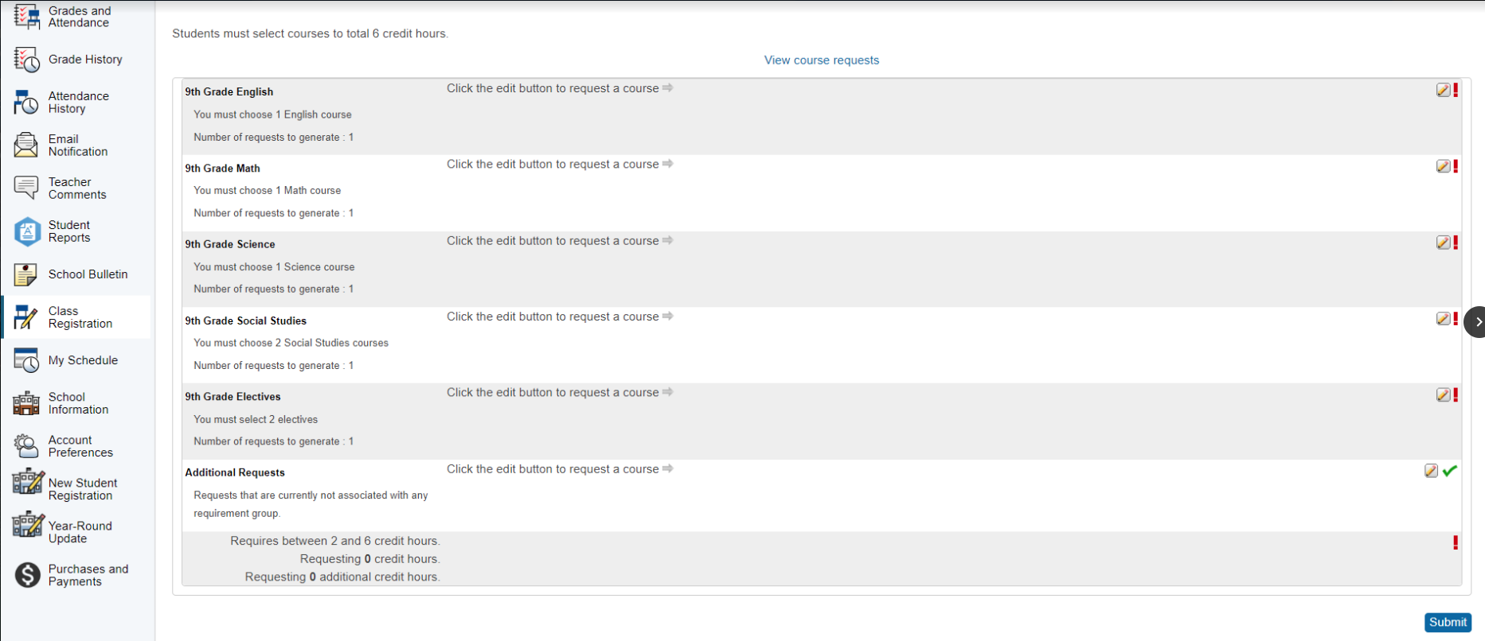
CLASS REGISTRATION
WHEN ALL SELECTIONS HAVE BEEN MADE, CLICK “SUBMIT” IN THE BOTTOM RIGHT CORNER.
IF YOU DO NOT, SELECTIONS WILL NOT BE SAVED AND COUNSELORS WILL MAKE SELECTIONS FOR YOU.
YOU CAN MAKE EDITS TO YOUR CHOICES UNTIL MARCH 4TH, 2026.

Slide 24

NAVIGATE YOUR FUTURE
Notes:
DONE

Slide 25
CONTACT INFORMATION
PLEASE CONTACT WITH ANY ENROLLMENT QUESTIONS!
SALLY RANDOLPH (A-G)
sally.randolph@owassops.org
STEPHANIE CURFMAN (H-O)
stephanie.curfman@owassops.org
BECKY COPELAND (P-Z)
becky.copeland@owassops.org
Notes:
DONE

Slide 26
DID YOU KNOW…
WE CAN HELP IF:
YOUR FAMILY LIVES WITH ANOTHER FAMILY
YOU ARE STAYING WITH SOMEONE OTHER THAN YOUR PARENTS/LEGAL GUARDIANS
YOU ARE NOT LIVING IN YOUR HOME (TEMPORARILY OR LONG-TERM)
YOU NEED A COAT FOR THE WINTER, FOOD, SCHOOL SUPPLIES, ETC.
YOU WANT COUNSELING
USE THIS LINK TO CONFIDENTIALLY LET US KNOW IF YOU OR SOMEONE YOU KNOW NEEDS ANY OF THE ABOVE SERVICES.
Notes:
DONE

