Slide 1


OHS ENROLLMENT 2026-2027
OHS ADMINISTRATORS
TIFFANI COOPER - PRINCIPAL
AUSTIN HIGGS - A-G
GINA OSBURN - H-O
KRISTI VRSKA - P-Z
KEVIN DOTSON - ACTIVITIES
OHS COUNSELORS
KASSIE DYSON - A-G
EMILY DRAKE - H-O
JAYME RISENHOOVER - P-Z

Slide 2
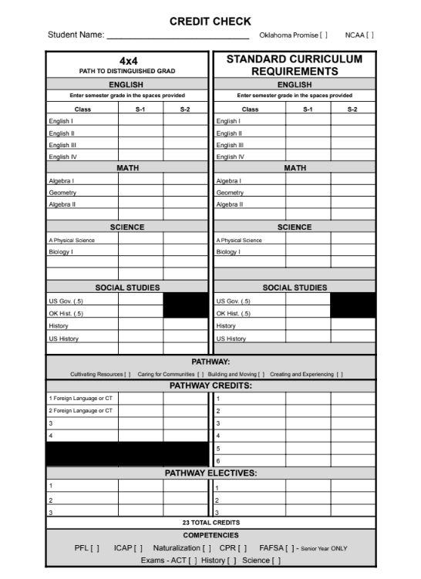
GRADUATION TRACKS
2 TRACKS TO GRADUATION:
STANDARD CURRICULUM REQUIREMENTS - State Requirements
4X4 - PATH TO DISTINGUISHED GRAD - Owasso

Slide 3
CLASS OF 2030 GRADUATION REQUIREMENTS
ENGLISH (4 CREDITS)
ENGLISH I
ENGLISH II
ENGLISH III
ENGLISH IV
MATH (4 CREDITS IN HIGH SCHOOL, ALGEBRA I AND ABOVE)
ALGEBRA I - can be taken in 8th grade (will count toward the 4)
GEOMETRY
ALGEBRA II
4TH MATH of your choice (PRE-CALCULUS/PRE-CALCULUS PREP, STATISTICS, ALGEBRA III, locally approved math course)
SCIENCE (3 CREDITS)
PHYSICAL SCIENCE
BIOLOGY,
3RD SCIENCE
HISTORY (3 CREDITS)
OKLAHOMA HISTORY/US GOVERNMENT
HISTORY (WORLD HISTORY, AP WORLD, AP EUROPEAN, AP HUMAN GEOGRAPHY),
US HISTORY
23 CREDITS ARE REQUIRED FOR GRADUATION

Slide 4
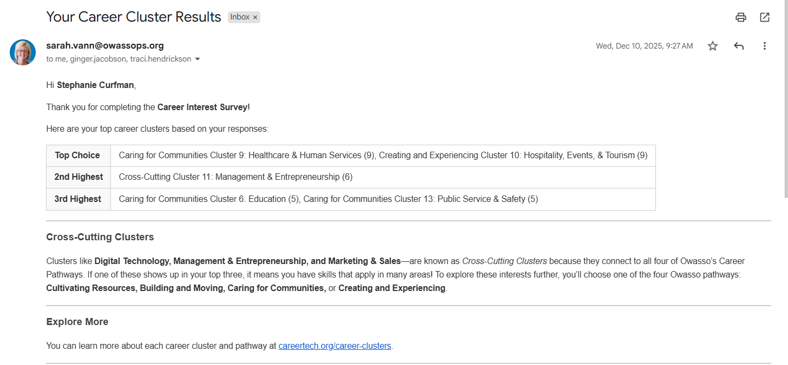
DETERMINING YOUR PATHWAY

Slide 5
Pathway Credits
4 Pathways:
Cultivating Resources class lists
Caring for Communities class lists
Building and Moving class lists
Creating and Experiencing class lists
6 Pathway Core Credits
must be direct or cross cutting
3 Pathway Electives
any class of their choice
FIND A FULL LIST OF ELECTIVES AND COURSE DESCRIPTIONS
SOME ELECTIVES REQUIRE AN APPLICATION OR TRYOUT BEFORE YOU CAN BE PLACED IN THE CLASS

Slide 6
ADDITIONAL GRADUATION REQUIREMENTS
YOU MUST COMPLETE THE FOLLOWING COMPETENCIES:
NATURALIZATION TEST (given in 8th grade)
PERSONAL FINANCIAL LITERACY (PFL) in 10th - 12th grade
CPR INSTRUCTION
INDIVIDUAL CAREER ACADEMIC PLAN (ICAP)
ACT, US HISTORY, AND SCIENCE STATE TESTS
COMPLETE THE FREE APPLICATION FOR FEDERAL STUDENT AID (FAFSA) - SENIOR YEAR ONLY

Slide 7
CREDIT CHECK
CREDIT CHECK FORM
EACH SEMESTER OF A CLASS CAN EARN 0.5 CREDIT. ONE WHOLE YEAR OF A CLASS CAN EARN 1 WHOLE CREDIT
ALL OHS STUDENTS ARE PLACED ON THE STANDARD CURRICULUM GRADUATION PLAN.
EMAIL YOUR COUNSELOR TO CHANGE GRADUATION TRACKS.
4X4 IS THE PATH TO DISTINGUISHED GRADUATE

Slide 8
Thinking Ahead?
NCAA?
CREATE AN ACCOUNT AND TALK TO YOUR COUNSELOR FRESHMAN YEAR!
TAKE WORLD LANGUAGE, COMPUTER TECHNOLOGY DOES NOT COUNT.
OKLAHOMA’S PROMISE?
APPLY HERE
Other Tulsa Tech programs?
LOOK AT PROGRAMS AND TALK TO MS. COTTLE SOPHOMORE YEAR!
TCC/Concurrent Enrollment?
TALK TO MRS. SEWELL or MRS. MARTIN AT THE END OF YOUR SOPHOMORE YEAR!
This is for 11th and 12th grade students and more information will be given during pre-enrollment your 10th grade year.

Slide 9

TULSA TECH
TULSA TECH OFFERS A 2 YEAR ENGINEERING PROGRAM FOR FRESHMEN AND SOPHOMORES
INTRO TO ENGINEERING (FRESHMEN)
PRINCIPLES OF ENGINEERING (SOPHOMORES)
FOUNDATIONS OF ENGINEERING VIDEO
STUDENTS THAT PLAN TO ATTEND TULSA TECH IN THEIR JUNIOR YEAR MUST APPLY DURING THEIR SOPHOMORE YEAR.
EMAIL MS. COTTLE FOR MORE INFORMATION
mary.cottle@tulsatech.edu

Slide 10
4 YEAR PLANS
PLAN YOUR FUTURE
YOUR 4 YEAR PLAN

Slide 11
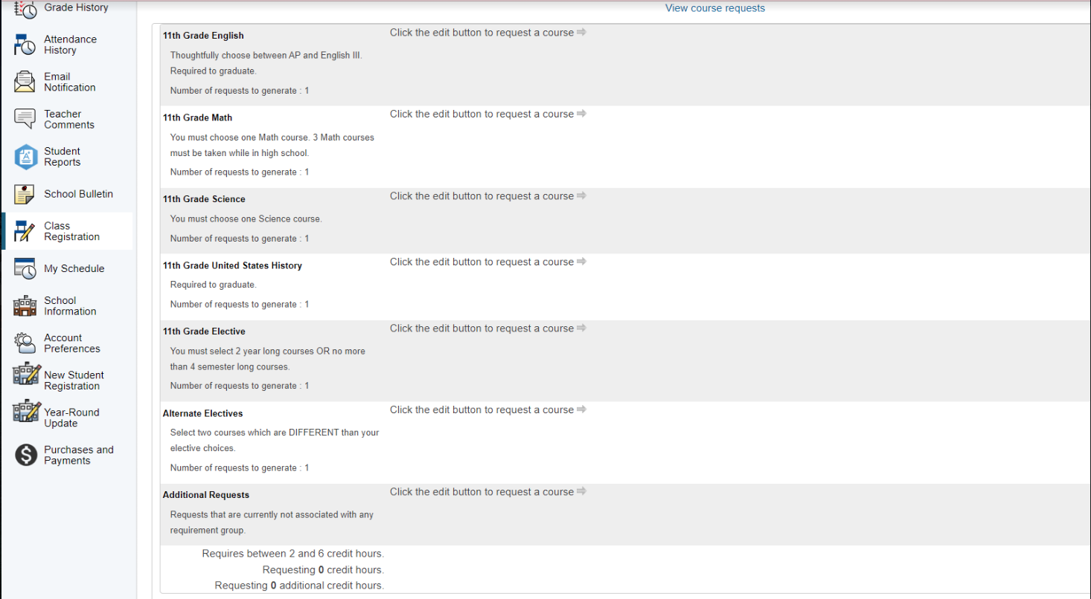
CLASS REGISTRATION
CLICK CLASS REGISTRATION ON THE LEFT.

Slide 12
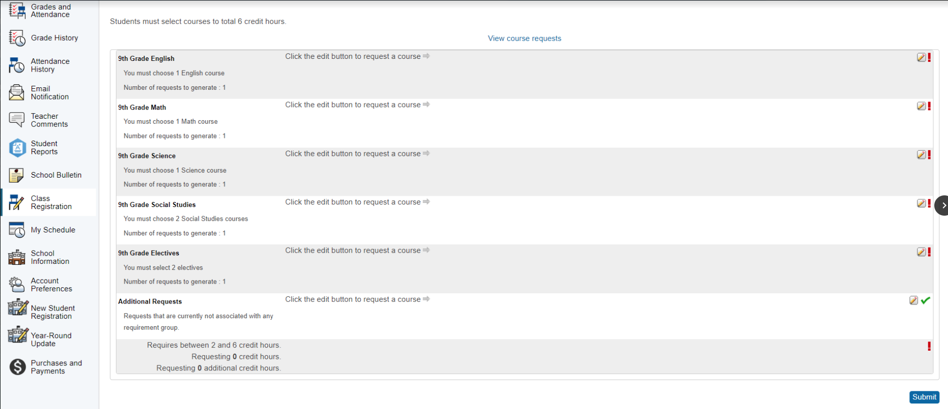
CLASS REGISTRATION
COURSE GUIDE
CLICK THE PENCIL AND PAPER ICON.

Slide 13
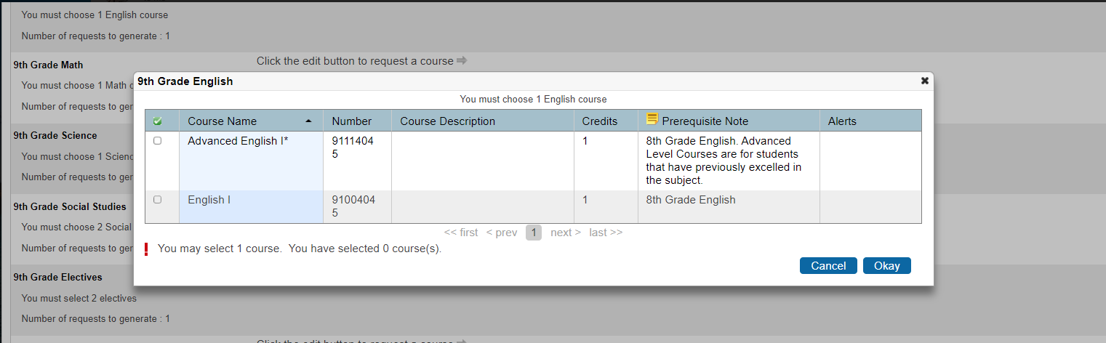
CLASS REGISTRATION
MAKE YOUR ENGLISH SELECTION.
CLICK BLUE OKAY BUTTON TO SAVE.

Slide 14
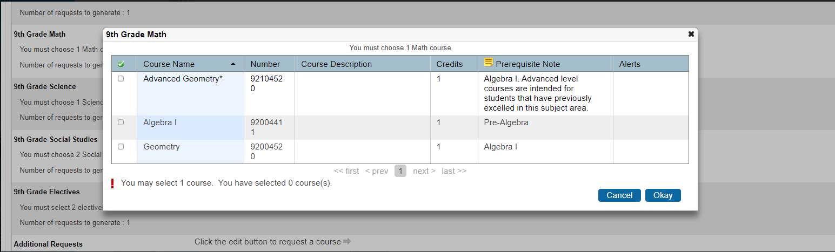
CLASS REGISTRATION
MAKE YOUR MATH SELECTION.
ORDER OF MATH CLASSES:
ALGEBRA I, GEOMETRY, ALGEBRA II, & A 4th MATH OF YOUR CHOICE.
CLICK BLUE OKAY BUTTON TO SAVE.
MATH PATHS

Slide 15
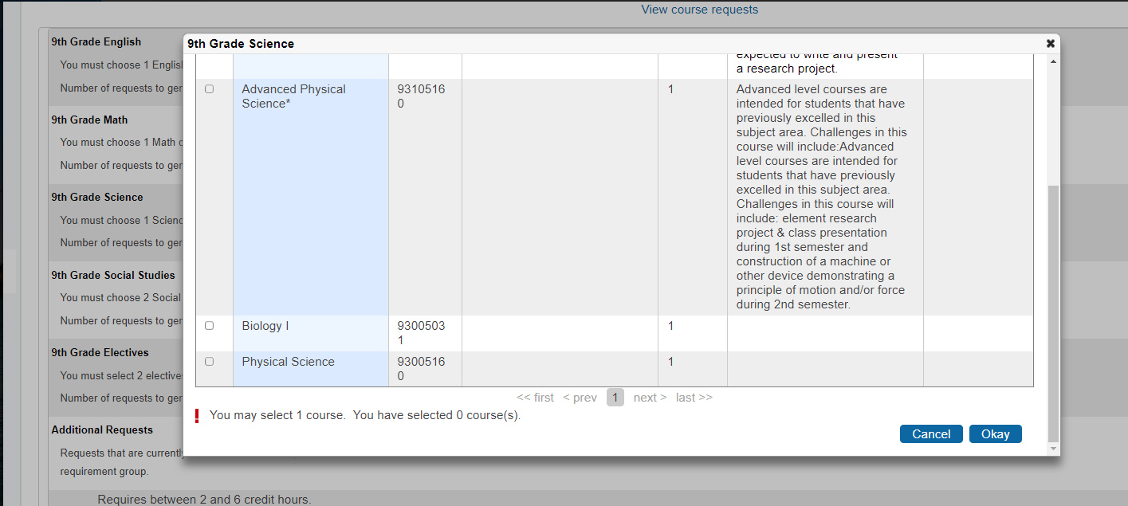
CLASS REGISTRATION
MAKE YOUR SCIENCE SELECTION.
SCIENCE REQUIREMENTS: A PHYSICAL SCIENCE, BIOLOGY, SCIENCE ELECTIVE.
CLICK BLUE OKAY BUTTON TO SAVE.

Slide 16
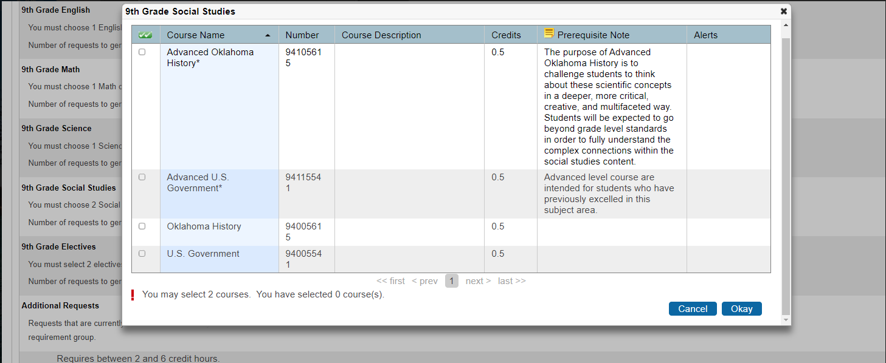
CLASS REGISTRATION
MAKE YOUR SOCIAL STUDIES SELECTION.
SOCIAL STUDIES PATH: OK HIST/US GOV, HISTORY ELECTIVE, US HISTORY
CLICK BLUE OKAY BUTTON TO SAVE.

Slide 17
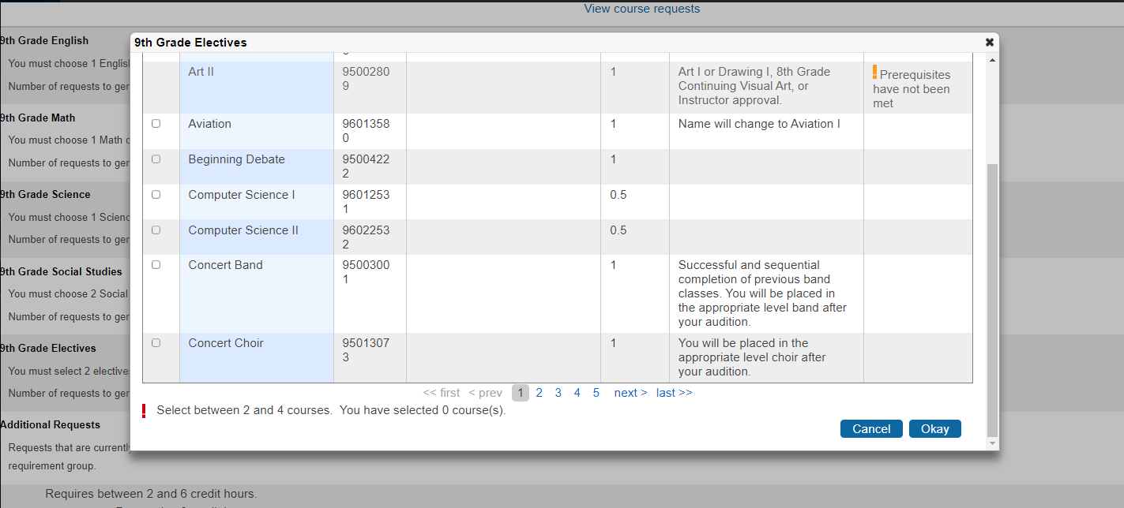
CLASS REGISTRATION
MAKE YOUR ELECTIVE SELECTIONS. (YOU WILL SELECT 2 CREDITS)
CLICK BLUE OKAY BUTTON TO SAVE.
APPLICATION ONLY CLASSES
COURSE GUIDE

Slide 18
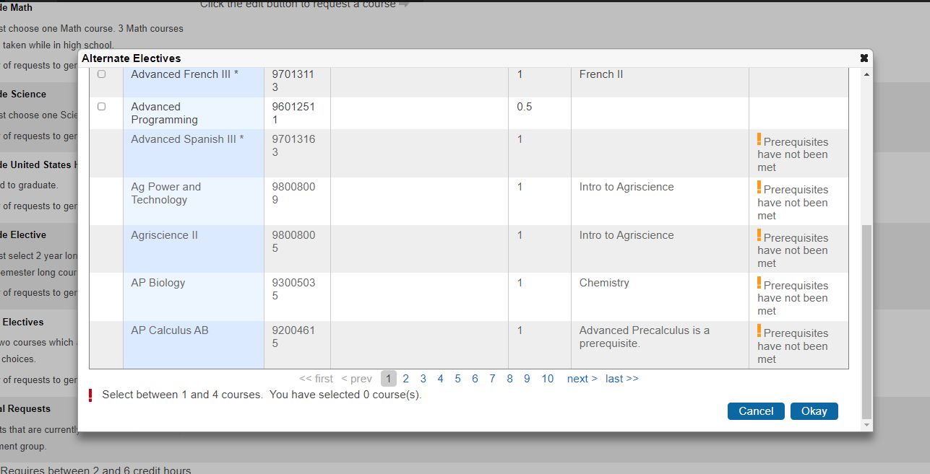
CLASS REGISTRATION
MAKE YOUR ALTERNATE SELECTIONS. (YOU WILL SELECT 2 CREDITS)
CLICK BLUE OKAY BUTTON TO SAVE.
COURSE GUIDE

Slide 19
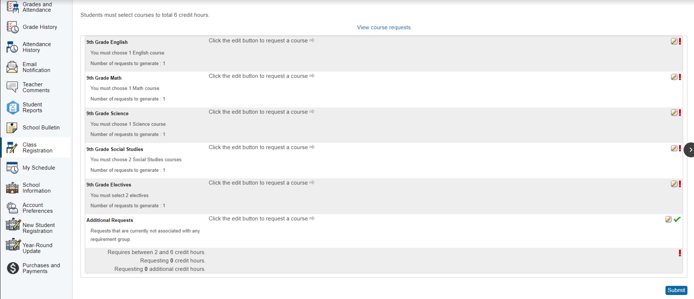
CLASS REGISTRATION
CLICK SUBMIT TO SAVE YOUR CLASS CHOICES. You can edit until:
MARCH 4th, 2026

Slide 20
CONTACT INFORMATION
PLEASE CONTACT WITH ANY ENROLLMENT QUESTIONS
Kassie Dyson (A-G)
kassie.stoutdyson@owassops.org
Emily Drake (H-O)
emily.drake@owassops.org
Jayme Risenhoover (P-Z)
jayme.risenhoover@owassops.org

Slide 21


