Slide 1
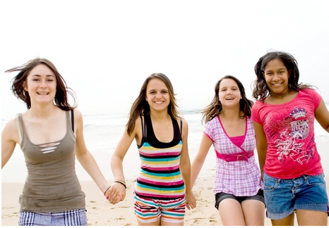
Girl’s Health Focus:
Get Active
Amanda Haney, Dietetic Intern September 2011
Notes:
In this session we will discuss physical activity and health benefits of getting enough exercise. This will include levels and types of exercise, what you should wear, challenges you can overcome, and how to get active today!

Slide 2
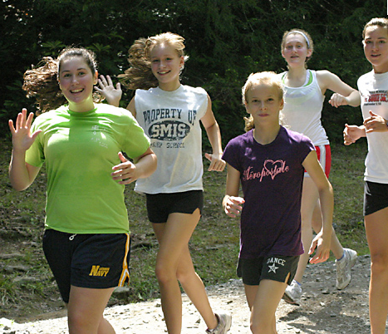
Why should I be active?
Daily exercise will prepare you for a lifelong habit of great health and overall wellness!
Get creative with your physical activity. You can try new things and exercise with your friends!

Slide 3
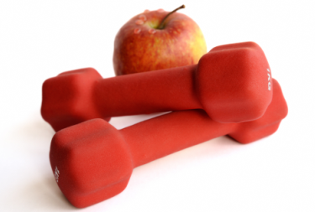
Health Benefits
Girls that exercise have a healthier body weight than girls that do not.
Kids and teenagers that are overweight are twice as likely to become overweight adults.
In addition to weight control, exercise helps strengthen your bones, muscles, heart, and lungs.

Slide 4


Health Benefits
Type 2 diabetes has increased drastically in kids and teenagers.
    It used to be called “adult-onset diabetes” but the name was changed because so many younger people were getting it!
Diabetes is a disease where your body cannot digest sugars the normal way. Once you get diabetes, you have to be very careful what you eat and you must avoid sugary foods.
Exercise and a healthy lifestyle will help prevent Type 2 Diabetes for teenagers.

Slide 5
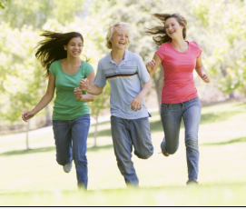
Health Benefits
Studies in science have shown that exercise helps prevent cancer.
Breast cancer affects many women in the United States.
    In 2011 over 200,000 women developed breast cancer, and over 35,000 women died from breast cancer.
Teenage girls who are active are less likely to develop breast cancer.
Physical activity can also help prevent colon cancer.
http://www.cancer.org/Cancer/BreastCancer/OverviewGuide/breast-cancer-overview-key-statistics

Slide 6
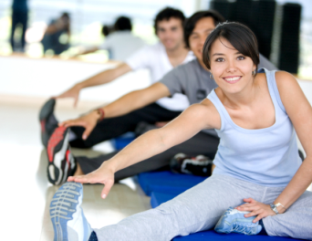
Other benefits
Exercise produces chemicals in your brain that improve your mood and make you feel happier.
Exercise can help you feel less stressed, boost your self-esteem, and help you feel more relaxed.
Feel tired? Being active will help you sleep better and feel more rested.
    Better sleep and exercise helps girls concentrate and do better in school!

Slide 7
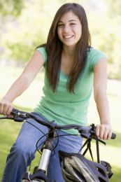

How much is enough?
Teenage girls should get 60 minutes of physical activity each day.
You can do this all at once, or you can break it up into smaller activities.
    Doing 20 minutes of activity 3 times each day will meet the 60 minute requirement.
    You can even do 10 minutes of activity 6 times each day
There is always time to get enough exercise!

Slide 8
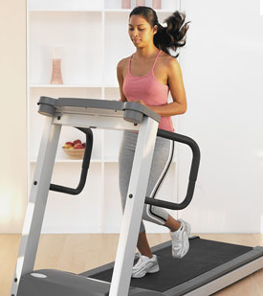
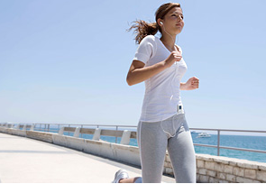
Levels of Exercise
There are three levels of exercise:
    Light: Not sweating
    Moderate: Sweating but breathing is still normal
    Vigorous: Heavy sweating and breathing hard
Everyone has a different pace, so make sure you exercise at the level that is comfortable for you.
Make a goal to improve!
    Once your level becomes too easy, speed up your activity to the next level

Slide 9
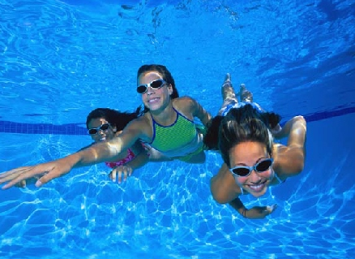
Levels of Exercise
What types of activity would be a light level?
Slow walking, dancing
What types of activity would be a moderate level?
Walking fast, skipping, jumping rope
What types of activity would be a vigorous level?
Running, swimming laps, playing basketball

Slide 10
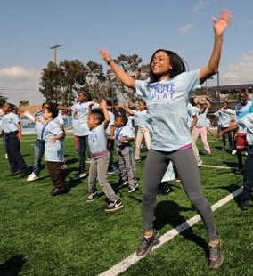

Types of exercise
Exercise is anything that moves your muscles and raises your heart rate.
    There are three categories: aerobic, strength training, and flexibility.
It is important to include different types of exercise in your routine to improve your heart, lungs, muscles, and bones each day.
    As we learn about each type, try to think about two activities that you like to do from EACH category!

Slide 11


Aerobic Training
Aerobic exercise is activity that increases your heart rate and breathing rate.
This category helps to strengthen your heart and lungs.
Activities in this category include:
    Rollerblading, skateboarding, bicycle riding, baseball, softball, jumping rope, karate, running, soccer, hockey, basketball, swimming, tennis, playing tag
Can you think of any other aerobic activities?

Slide 12
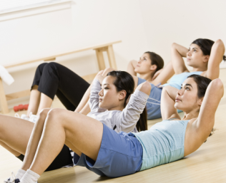

Strength Training
Strength training is moving your muscles against resistance.
    Resistance can be against your own body weight (like pull-ups) or objects (like lifting weights or even vacuuming).
This helps build strong muscles and strong bones.
Activities in this category include:
    Push-ups
    Pull-ups
    Playing tug-of-war
    Sit-ups
    Swinging on playground equipment and bars
Can you think of any other strength activities?

Slide 13
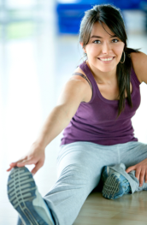

Felxibility Training
Any type of stretching is flexibility training because it loosens and lengthens your muscles.
This category is important to include in your daily activity because it helps prevent muscle injuries such as sprains, strains, and tears.
  Injuries can be very painful and prevent you from doing activities you enjoy!
Make sure you always stretch before beginning any of your favorite activities!!

Slide 14
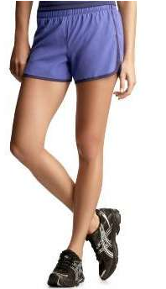
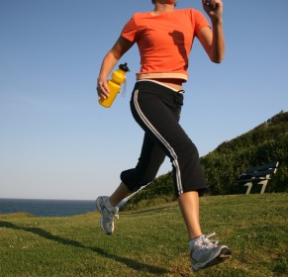
What should you wear?
The clothes you wear when exercising are important to help you stay comfortable and prevent injuries.
Your clothes should fit loosely so you can move around freely.
    Try wearing light colors in the summer to help you stay cool.
    Dark colors in the winter can help you stay warmer outdoors.
Shoes are very important. They should be sturdy and fit well to support you.
    Don’t forget to wear socks! They will help your feet stay dry and prevent painful blisters.

Slide 15
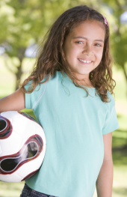
No more excuses!!
We have learned how important it is to exercise, but sometimes it is hard to get started…
Let’s review some tips that can make exercise easier for you

Slide 16
If you are really busy
    Do short activities often. Some great times to exercise are before school, during recess, at lunch time, after school, and after homework.
If exercise seems boring
    Get creative! Make a list of activities that fit into each category that you would enjoy. Mix it up!
If you don’t have a gym or any equipment
    Many activities don’t require anything but YOU! Jogging, dancing, skipping, playing tag, jumping jacks, and going to the park are all great activities.
If it is hard to remember to exercise every day
    Ask some friends to join you. Not only will it be fun, but you can hold each other accountable.

Slide 17
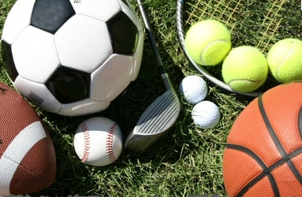
Get Active!
Start today! A healthy lifestyle now will help you combat disease, fight cancer, and become a healthy adult!
What is an activity you can do today to start exercising?
Name an activity from each category that you enjoy.
When do you have time to exercise?
Name your family members and friends that you would like to exercise with.

