Slide 1

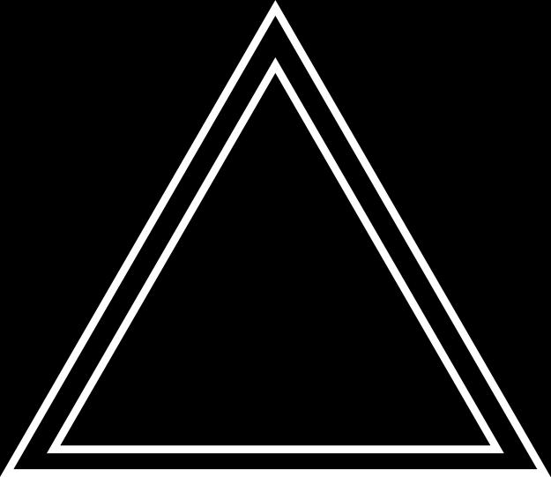
EASTERN SUFFOLK BOCES REGIONAL INFORMATION CENTER
CBT WORKSHOP #2:
STUDENT AND EXAM MANAGEMENT IN THE NEXTERA CONSOLE
Presented by the Student Data Services Department

Slide 2
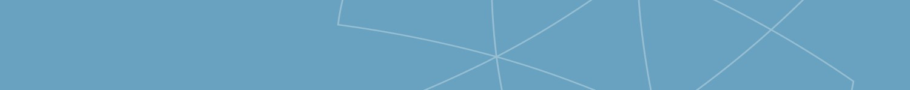




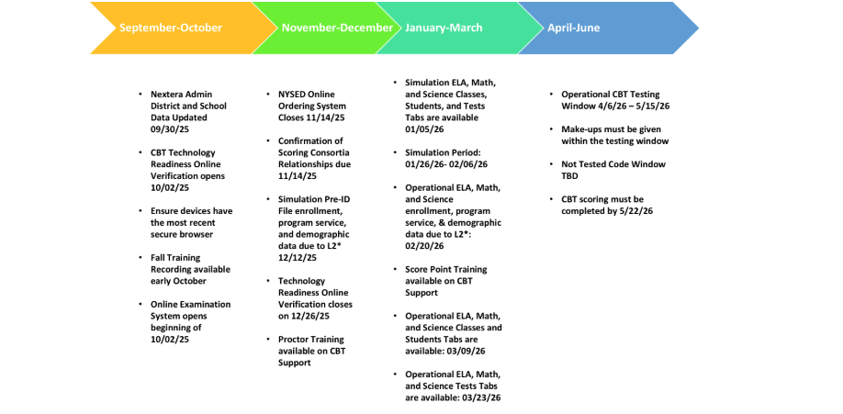

Using the Administrative features of the Nextera Console
Agenda:
  Welcome & Introductions
  Accessing Nextera
  Users
    Roles
    Account creation
  Classes
    Creating classes
    Adding students
  Proctor Pins & Session Codes
  Students
    Adding accommodations
    Adding new students
  Printing Log In Tickets
    Simulation
    Operational Exams
  Getting help

Slide 3
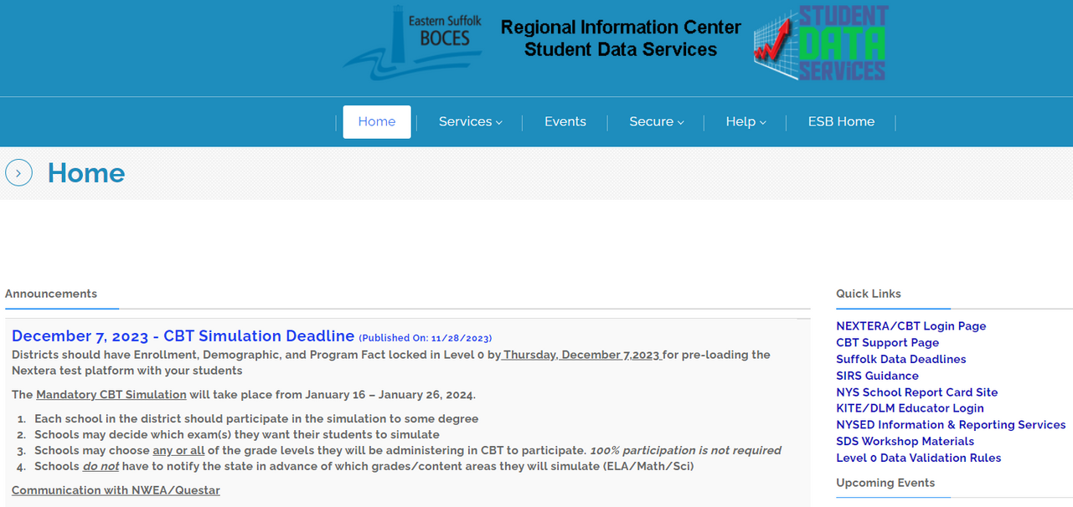

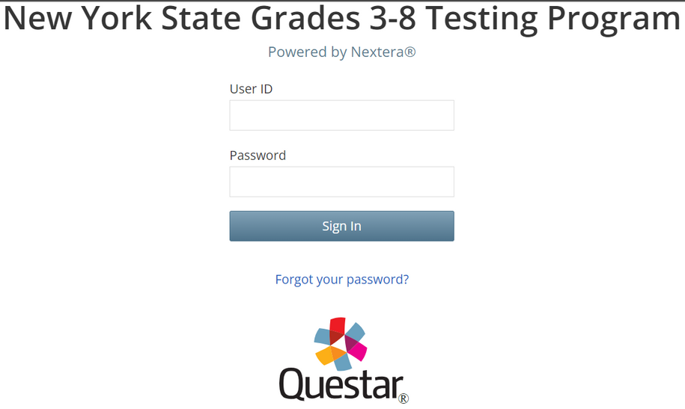
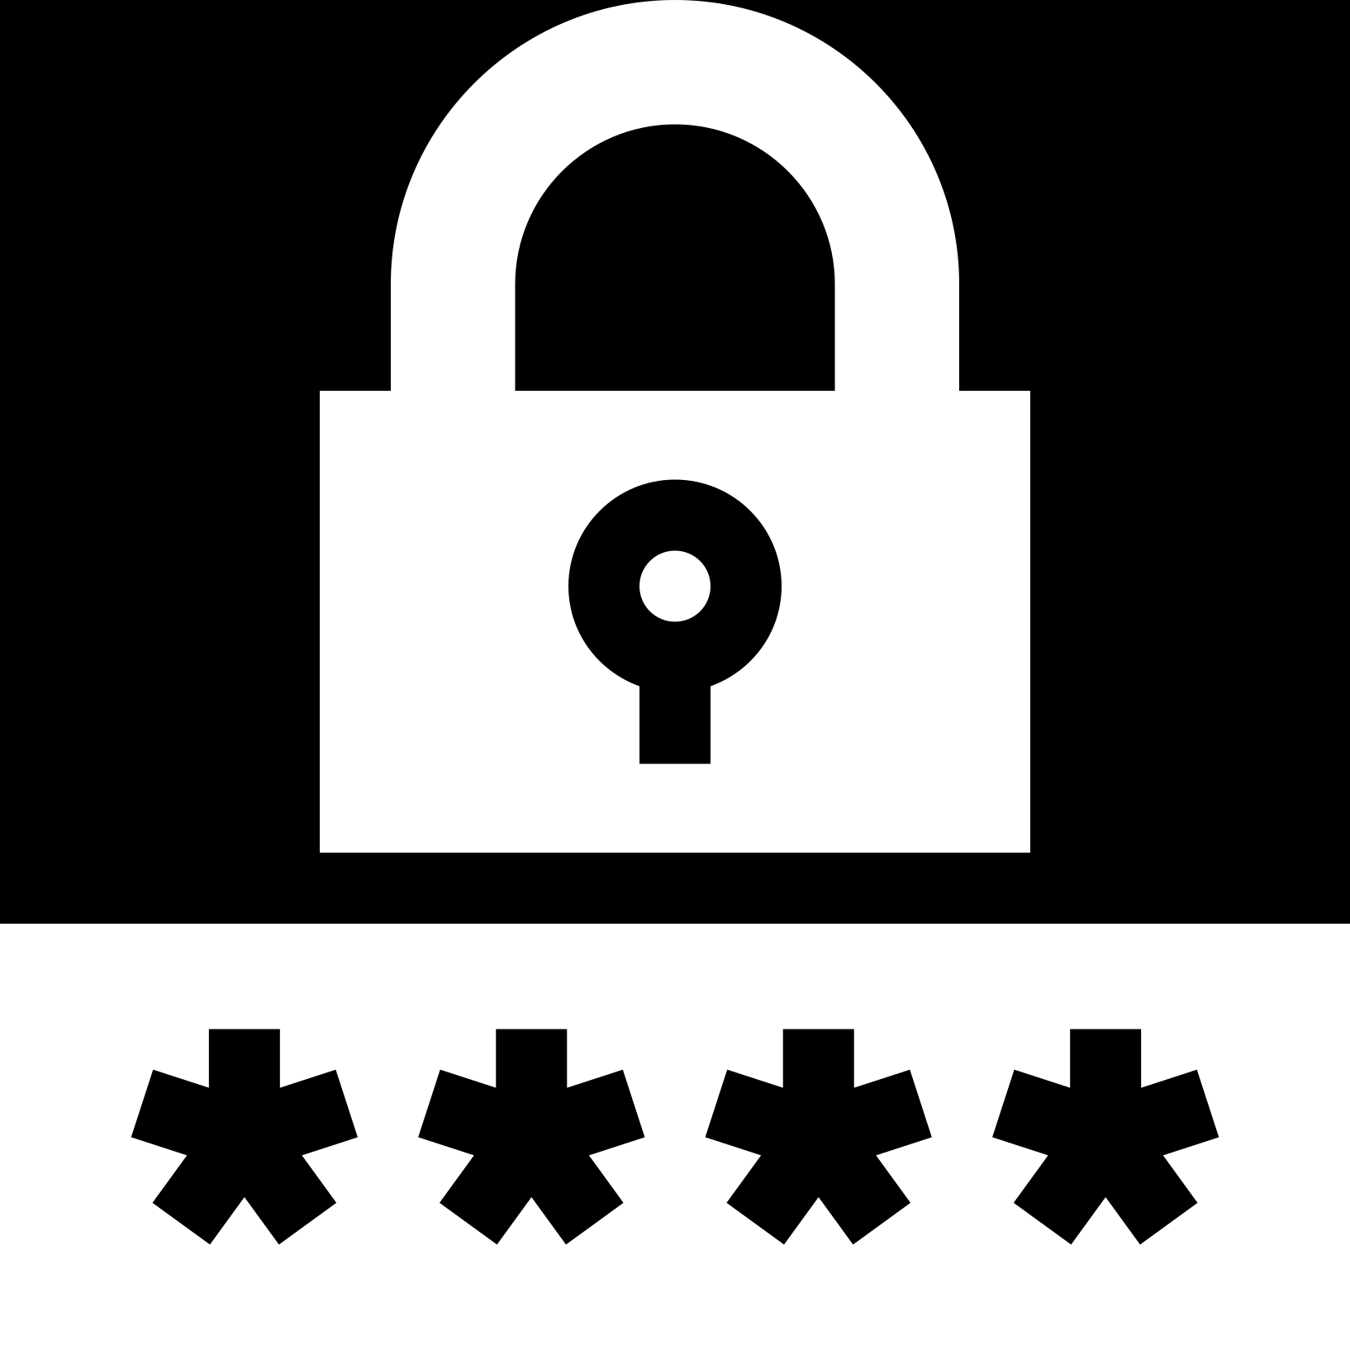
Accessing the Nextera System
SIGNING IN TO THE NEXTERA SYSTEM
  DataCentral Quick Links- www.datacentral.esboces.org
    NYSED CBT Support Site
      This site has everything and a search feature.
    Nextera Login Page
      Access to the console and testing system
      Supts & Principals have default accounts
        Use the ‘Forgot password’ feature on the Nextera homepage
          The site will send a direct reset email
        Email Reset did not work?
          Account questions can be sent to cbtsupport@nysed.gov

Slide 4
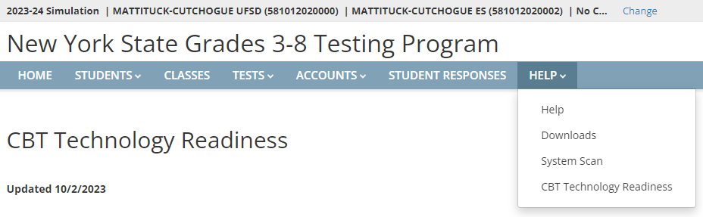



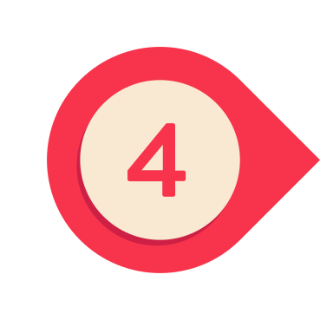
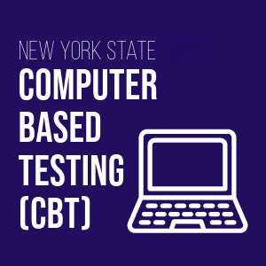
Accessing the Nextera System
THE NEXTERA HELP TAB
  Help - Contact information, Support Documentation, and live chat help feature
  Downloads - Access the Secure Browser file for installation on your machines
  System Scan - Checks that hardware is acceptable
  CBT Technology Readiness - Brings you to the questionnaire

Slide 5
Nextera Admin User Roles

Slide 6
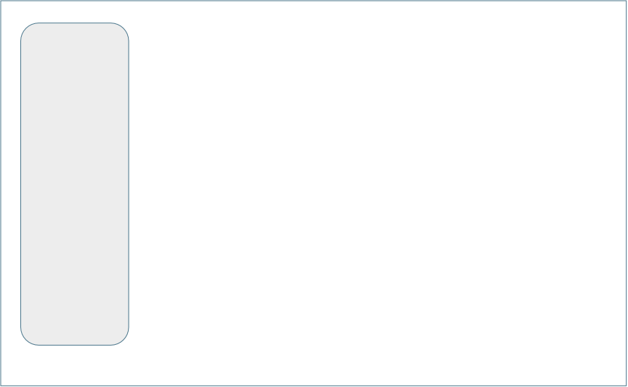
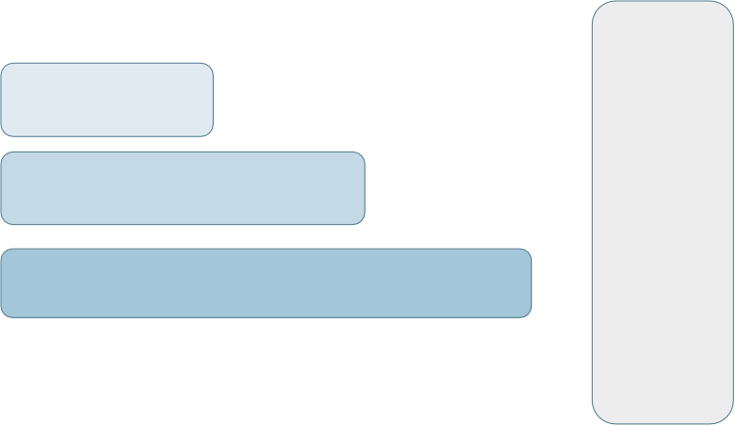
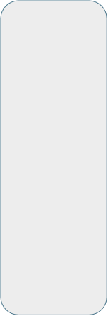
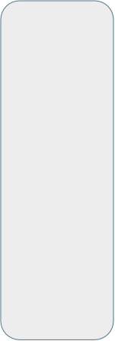
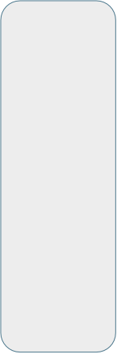

Nextera Admin User Roles
Student
Class
School
District
Region
Teacher
School Level Users
District Level Users
RIC User State Level User

Slide 7

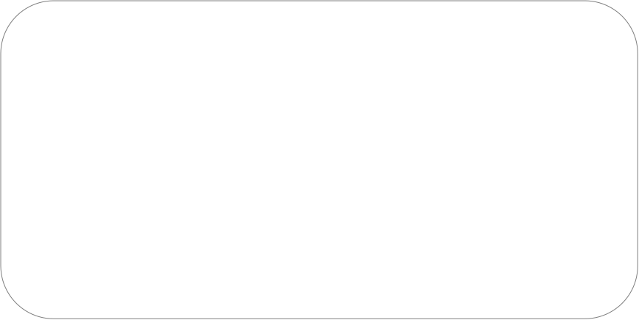
District Level Roles
District Level Users
  District Test Coordinator (DTC) – Main point of contact at the district for Questar and schools, ensures accuracy of all student data in system, manages district-level accounts and sets up primary school level users
  Superintendent (SUP) – Adviser to the DTC, ensures all student data is correct in system, visibility to own district and school level information
  District Level User (DLU) – Same permissions as DTC, assists in managing
  district-level users and students
  District Information Technology Coordinator (DITC) – Information technology point-of-contact for district, can download the secure browser, helps to troubleshoot, does not have access to students or classes

Slide 8

School Level Roles
School Level Users
  Principal (PRN) – Responsible for Technology Readiness, visibility to their own school, classes, and students, can create school level users
  School Test Coordinator (STC) – Handles test coordinator responsibilities
  at school level, manages users and students, schedules tests at school level
  Building Level User (BLU) – Same permissions as STC, assists in managing school-level users and students
  School Information Technology Coordinator (SITC) – Information technology point of contact for school, can download the secure browser, helps to troubleshoot, does not have access to students or classes

Slide 9
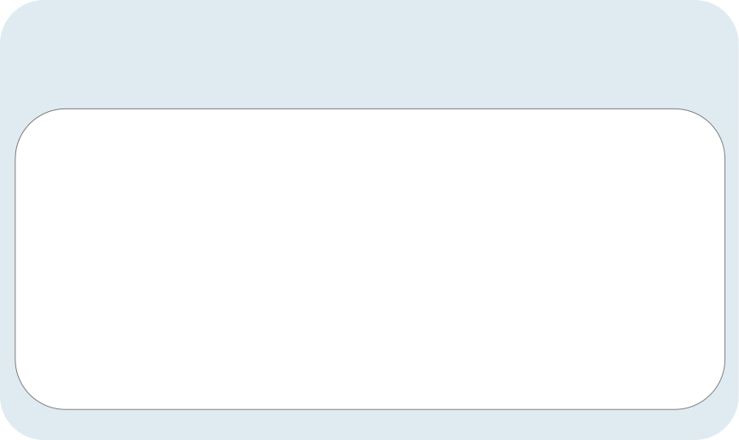
Teacher Role (Not Required)
Teacher
  Can access their class and student information in Nextera Admin
  Responsible for leading the test administration
  Distributes login tickets and reads the directions from the Teacher’s Directions
  Has the Proctor PIN on-hand for students who may need to pause the test
  Note: There is only one teacher per class

Slide 10

Nextera Accounts Tab

Slide 11
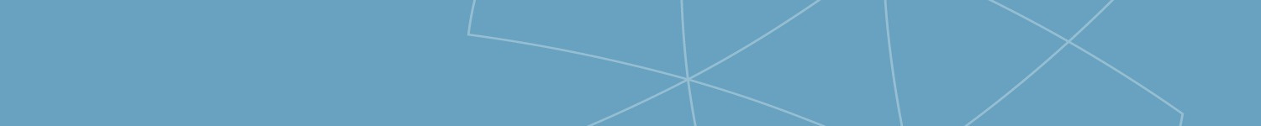

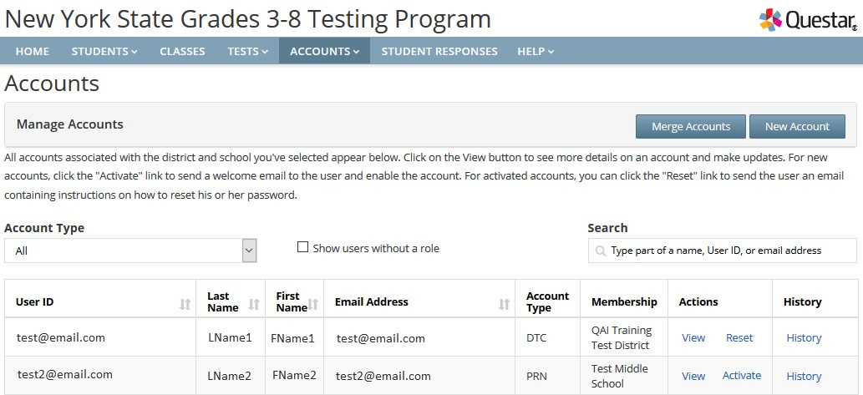

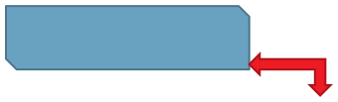

Accounts
PRESENTATION TITLE
Click on Reset to reset a
user’s password
Click on View to
Edit an account

Slide 12

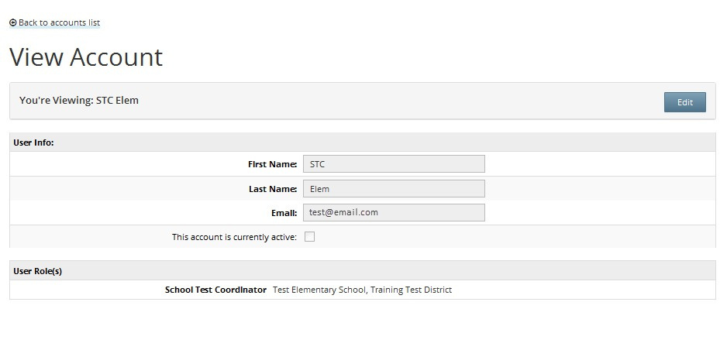



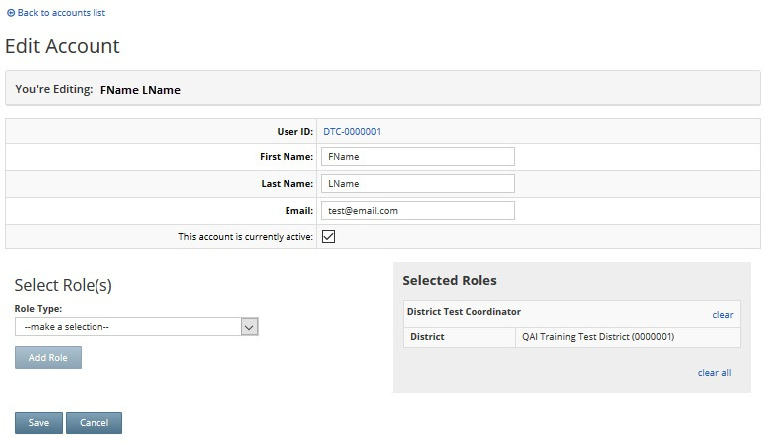






Accounts: Add/Edit a Role
To add/edit a role, choose the role from the dropdown menu and be sure to Save
the changes.
PRESENTATION TITLE

Slide 13

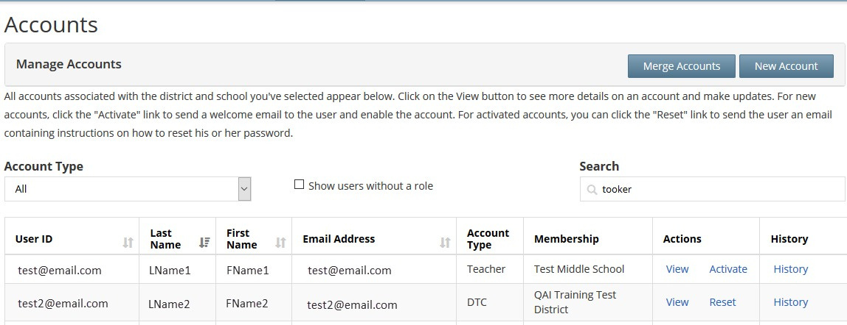


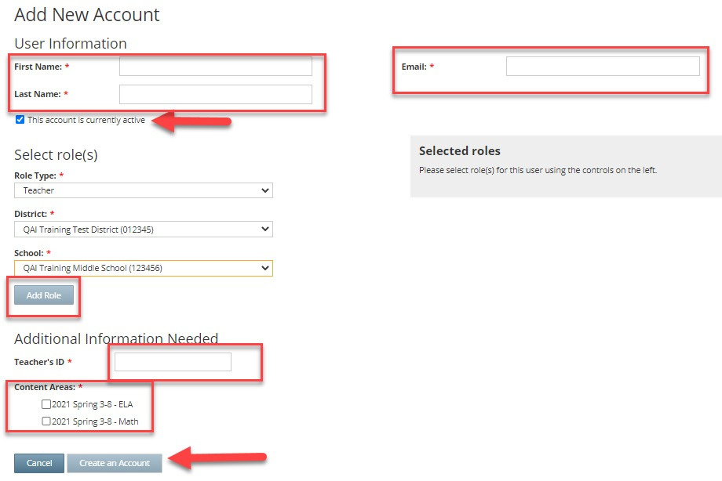
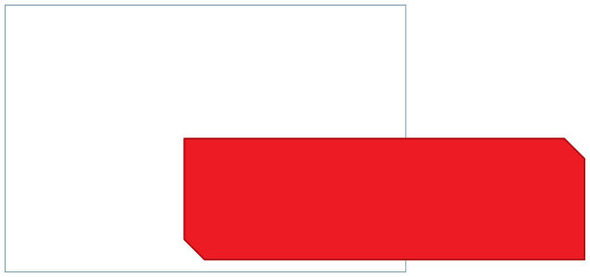

Accounts: Create New User
Create a unique ID or use the teacher’s actual TEACH ID

Slide 14
Adding Users to Nextera:
Online Resources
  CBT Support Knowledgebase
  Adding New Users Video Tutorial
  Roles and Responsibilities Guide
  Adding Teachers PDF Guide

Slide 15
Nextera Classes Tab

Slide 16
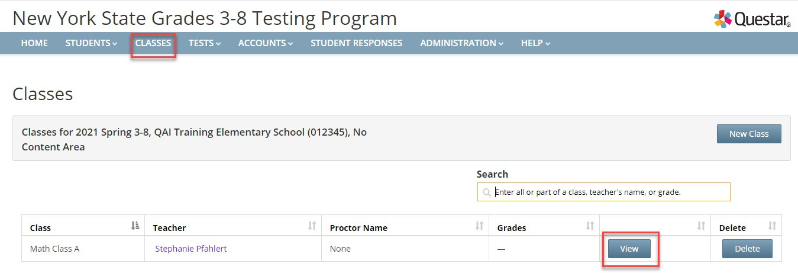
Classes
➢
Classes are virtual classes in Nextera –only for CBT testing purposes –they do not have to align to instruction
➢ ➢
Class names must be unique to a school in Nextera Admin
Consider classes for student testing accommodations, such as “TTS Class,” or for grouping students who are not taking the computer-based tests, such as “Taking Regents” Grouping students by classes allows students in that class to have the same test session access code
PRESENTATION TITLE
32

Slide 17
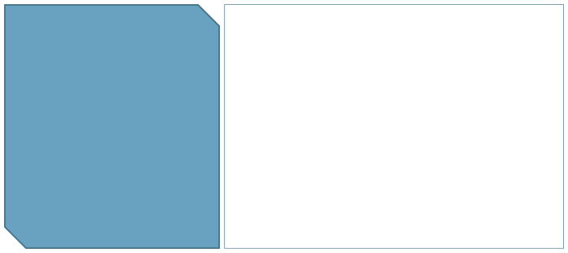
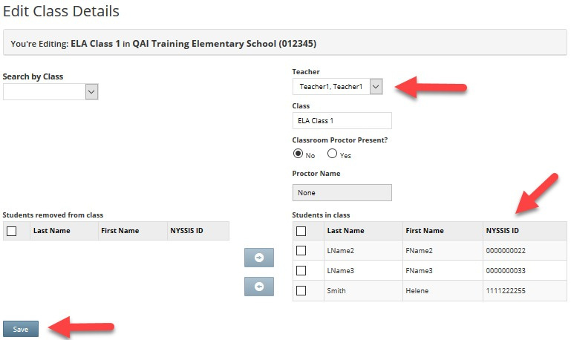
Classes
To create a new class: 1.Choose a Teacher 2.Create a Class Name 3.Move students into
the class
4.Click Save

Slide 18
Nextera Tests Tab

Slide 19
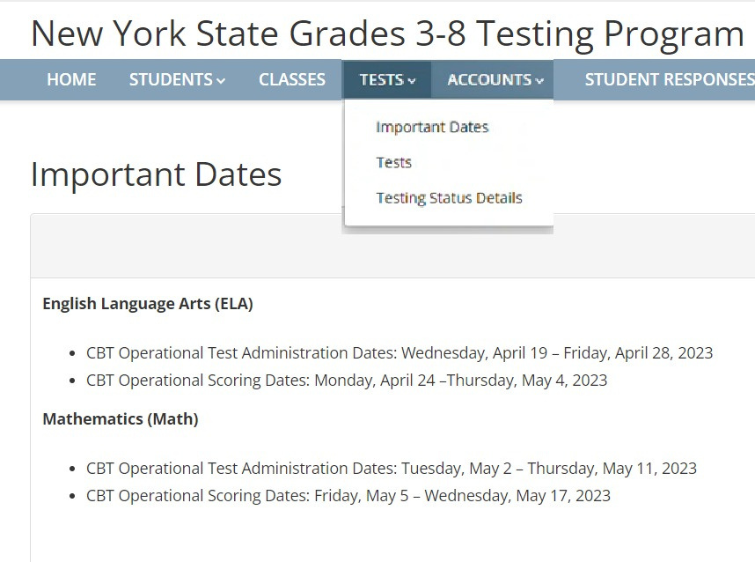
Tests
The Tests Tab is where you will find Important Dates, track student progress, print student login tickets, and find Session Access Codes.
PRESENTATION TITLE

Slide 20
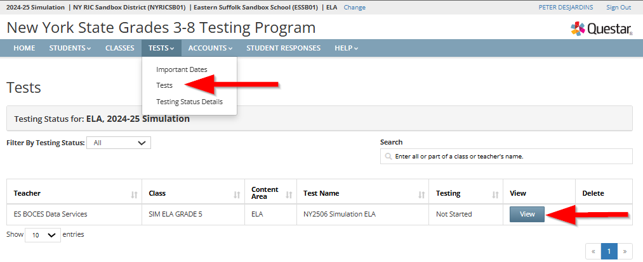
Tests
PRESENTATION TITLE

Slide 21
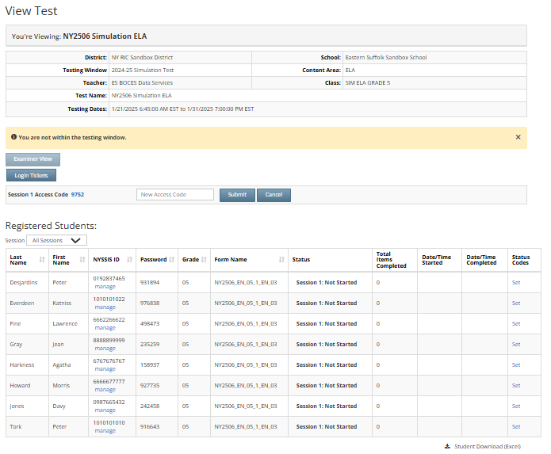

Tests
Session Access Codes are required each time a student logs in
Session Access
Codes
Student Details

Slide 22

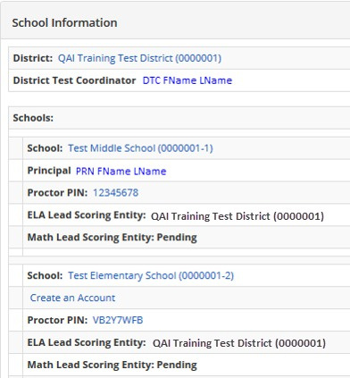



Proctor PIN
Located on the homepage of
Nextera Admin for district and
school level users.
The Proctor PIN is required when a student needs to pause or restart a paused test
EX. Student returns from restroom

Slide 23
Nextera Students Tab

Slide 24
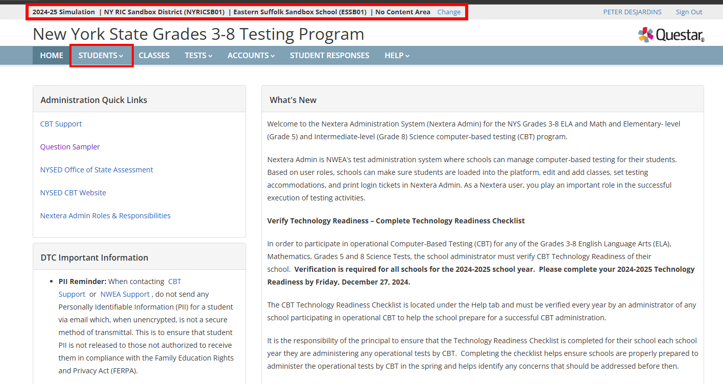
Students:
TIP: Always check your school & content area as it will affect what students and classes you can view

Slide 25
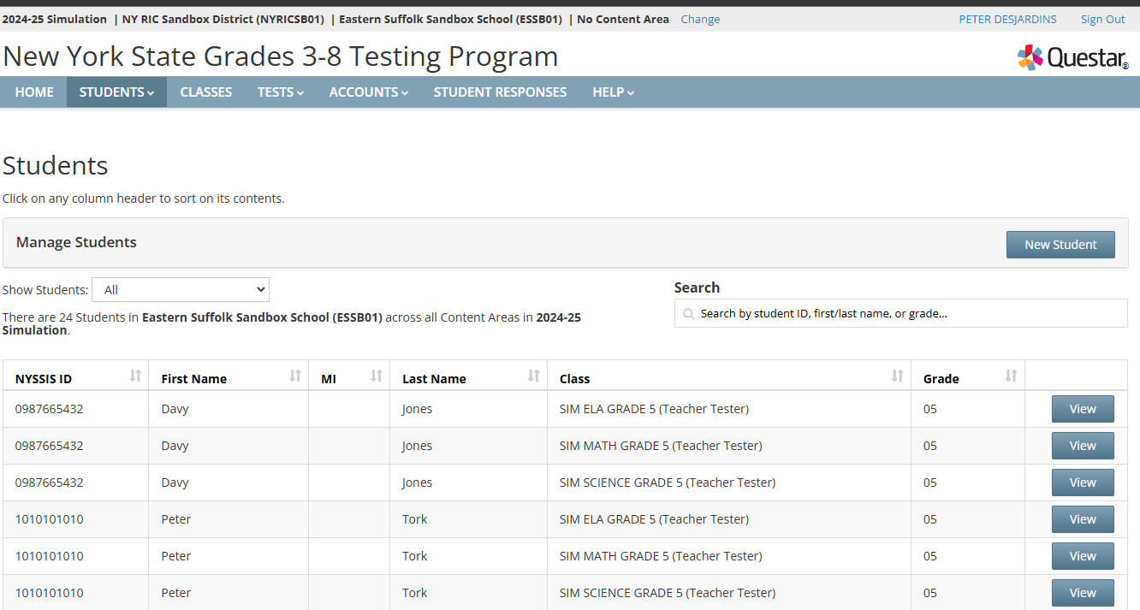
Students
TIP: Always check your school & content area as it will affect what students and classes you can view

Slide 26
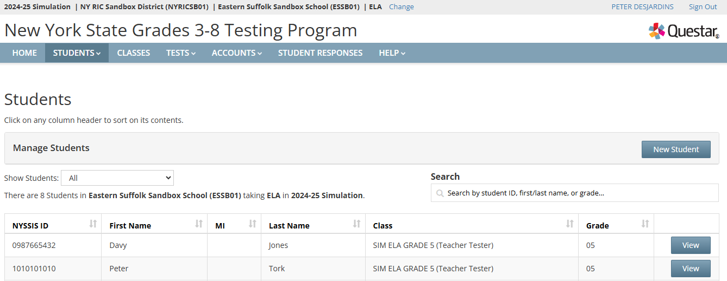
Students
Students
TIP: Always check your school & content area as it will affect what students and classes you can view

Slide 27
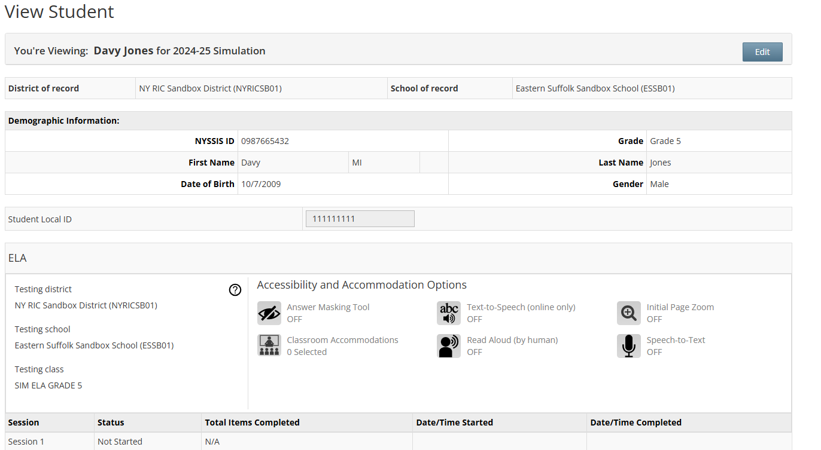
Adding Online Testing Accommodations: Single Student

Slide 28
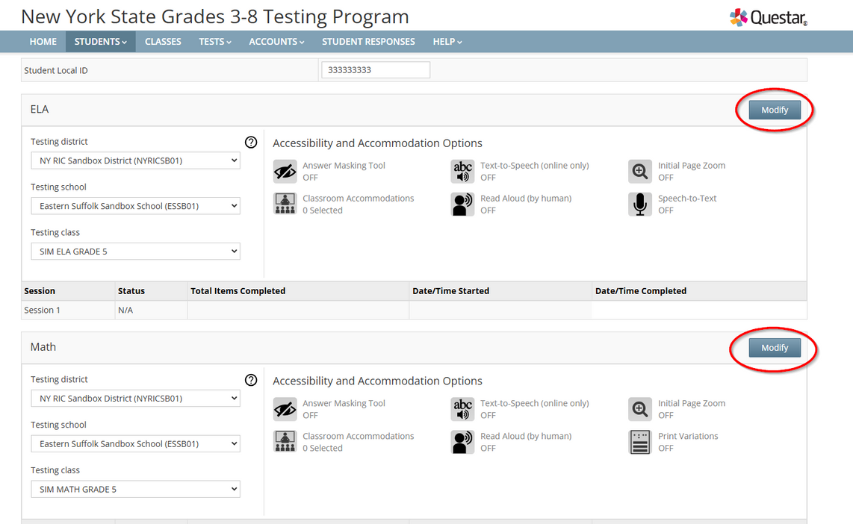
Adding Online Testing Accommodations: Single Student
Accommodations must be entered for each Exam

Slide 29
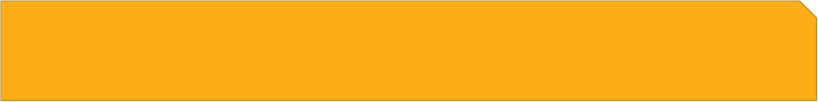
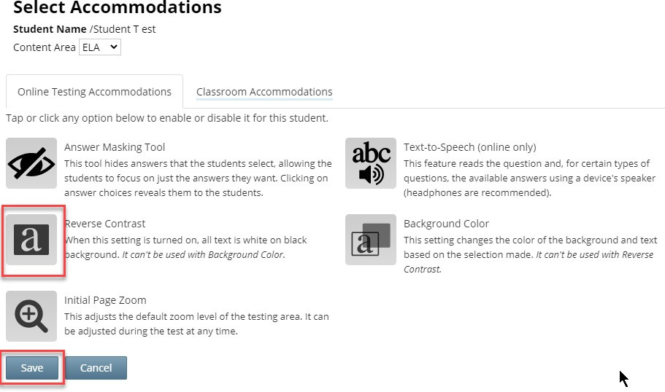
Adding Online Testing Accommodations: Single Student
Online Testing Accommodations are provided within the Nextera platform
These accommodations must be set in Admin prior to testing
To add an accommodation, click the appropriate icon and then click Save

Slide 30

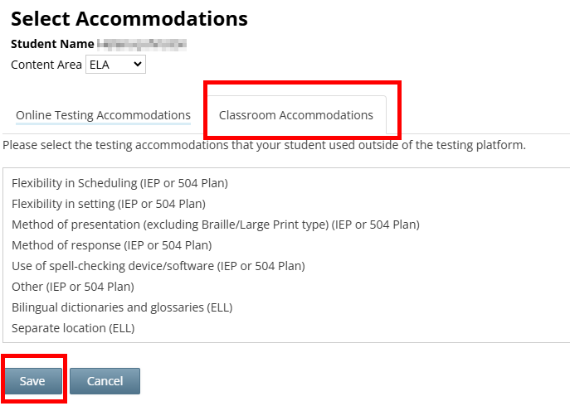

Students: Classroom Accommodations
Adding Online Testing Accommodations: Single Student
Individual Classroom Accommodations are provided by the school during testing. These accommodations must be set in Admin prior to testing.

Slide 31
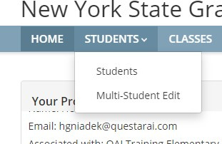
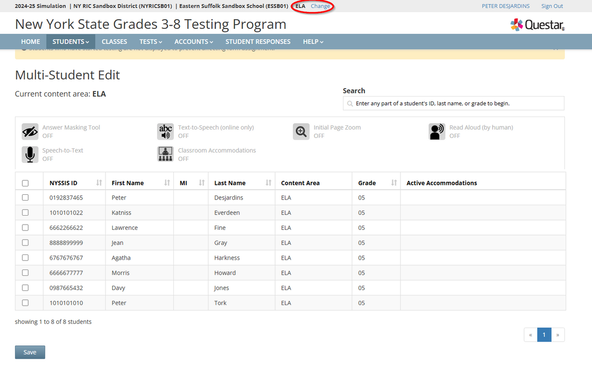
Students: Multi-Student Edit
Multi-Student Edit Feature
This feature allows you to add accommodations to a group of students at the same time
Note: Multi-Student Edit will overwrite any previously assigned accommodations for the students. It is recommended to begin with the Multi-Student Edit, then make necessary individual changes to assign accommodations for individual students.
Accomodations must be entered FOR EACH EXAM
To add a multi-edit accommodation
  click the appropriate icon(s)
  Select Students
  Click Save

Slide 32

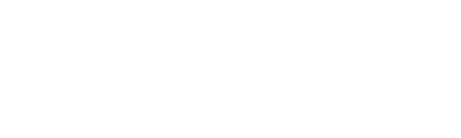
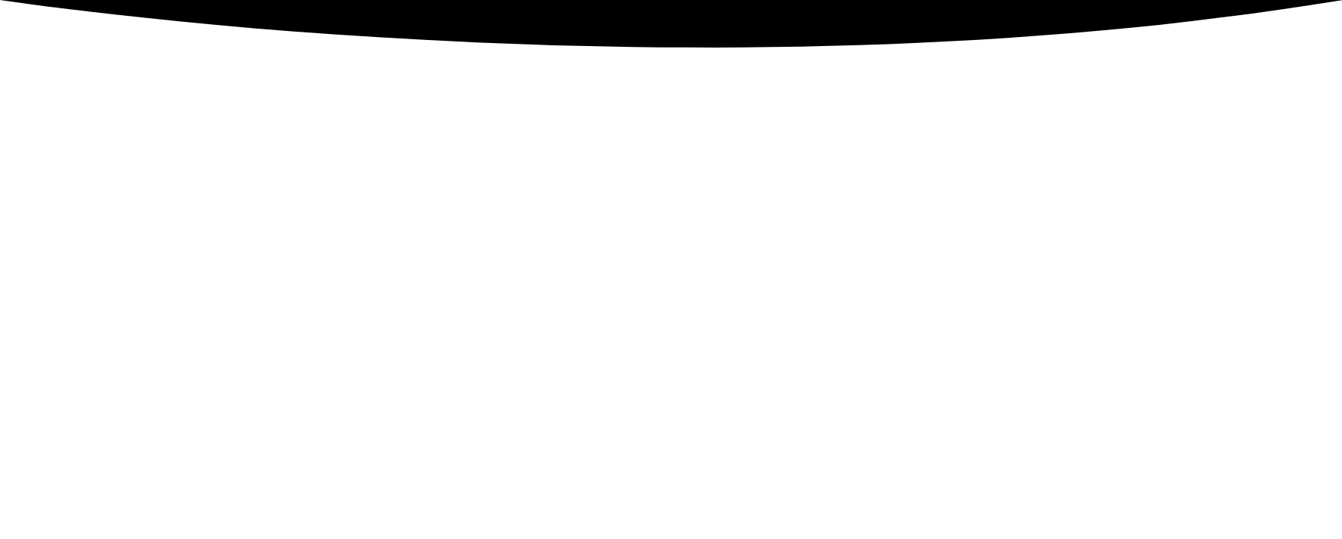
Login Ticket Printing
Classes or no classes that is the Question

Slide 33
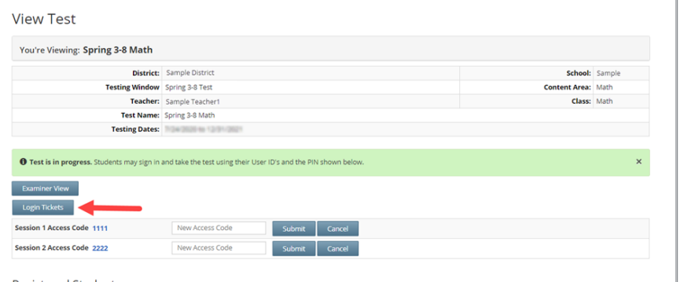
What is a Login Ticket??
  The Login Ticket is needed by each student to login into the Nextera testing system
  The Login Ticket and the Access code will be needed for each testing session
  The Login Ticket consists of the student’s NYSSIS ID and a password
  The Login Tickets and Access Codes can be found in Nextera Admin under the Test tab
  The Login Tickets can be printed on labels or plain paper

Slide 34
Sorting the Data
  The data is loaded into Nextera by SED
  In Nextera, all students will be grouped by building, by subject and grade when Nextera Admin opens
  Students can be found under the Student tab
  The students can be left in the one grouping or classes can be created
    For classes to be created, Teacher accounts must be created first
  All accommodations must be set before printing

Slide 35
Printing Options
  If the students are all left in the Grade Level preliminary classes, the Login Tickets can be printed and manually sorted (this option is best in a small district)
  If classes are created, the Login Tickets must be printed by each class
  If a new student is entered or an accommodation is changed, individual tickets can be printed
  Print Login Guide-found on the CBT Support website
  Only for Operational Exams
  Student Data Services can print your Login Tickets by school, homeroom or test room the same way you can have your Scan Sheets and Labels for Paper Based Exams.
  More on this closer to the operational exam date

Slide 36
SDS Option
  No cost to the district
  The Login Tickets will be sorted without the need to create teacher accounts and classes
  This saves time for the DTC and building level users
  If sort selection is test room, the district will need to supply SDS with a file
    The accommodations must be set by a deadline determined by SDS
    Printing will take place once the Test tabs open in March
  District will receive the Login Tickets on labels and matching rosters
    For students who arrive after bulk printing, Districts will be able to print an individual Login Ticket for that student

Slide 37
Requesting Student Transfers
Student Data Services
dwtshelp@esboces.org
631-218-4195
  Please use the Student Transfer form for the NYS Computer Based Testing 3-8 Exams when a student is missing from the district’s Nextera Platform FOUND HERE
  NYSSIS numbers are now required: NYSSIS IDs can be found in Level 0
    Depending on when data is loaded into Level 0, it can take 24-48 hours for a new entrant to receive a NYSSIS ID.
  Post Completed Forms in your District’s SFTP folder
    The district DDC has access to the SFTP folder, contact dwtshelp@esboces.org if you have any questions
      Email DWTShelp@ESBOCES.ORG to alert us to the file.
  We will follow up with you as soon as the students have been moved.

Slide 38
Questions and Resources
CBT Support Website
Student Data Services
dwtshelp@esboces.org
631-218-4195
Call or Email us with your questions.
Don’t waste time on hold with NWEA first, you will just be told to contact us.

Slide 39
2025 Computer Based Testing Resources
  CBT Support Knowledgebase
  DataCentral
  CBT Workshop Materials

