Slide 1
NORWELL PUBLIC SCHOOLS
Second Quarter
FY’26
Budget Report
As of December 31, 2025
Warren MacCallum
February 9, 2026

Slide 2
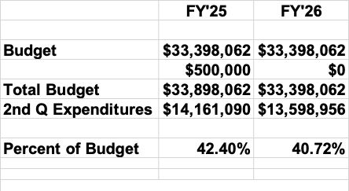
OVERVIEW
Periods ending 12/31/24 and 12/31/25

Slide 3
FY’26 Major Variances @ December 31, 2025
Personnel
(Legal Settlements)
(Operations)
(Utilities)
(Employee Separation)

Slide 4
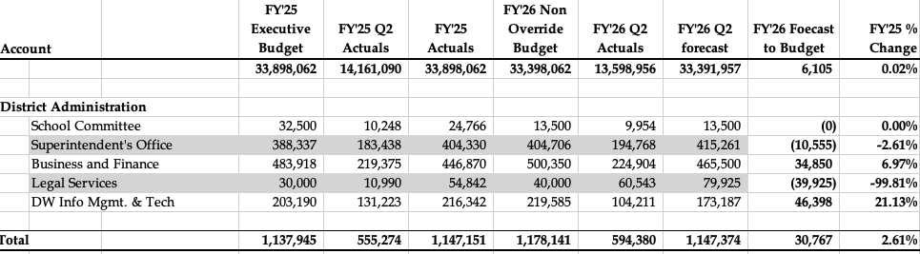
FY’25 to FY’26
Second Quarter Spending Comparison

Slide 5
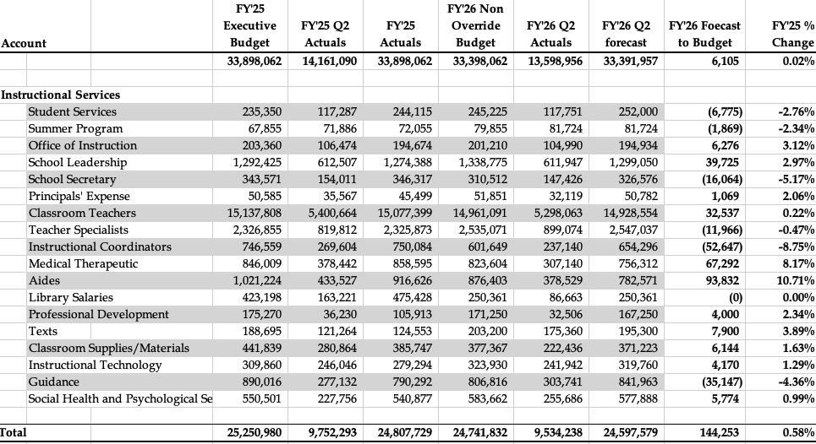
FY’25 to FY’26
Second Quarter Spending Comparison

Slide 6
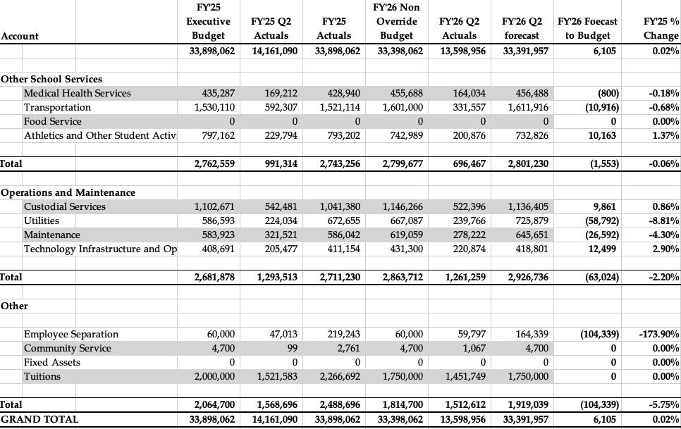
FY’25 to FY’26
Second Quarter Spending Comparison

Slide 7
Budget Management / Risks
Heat and Electricity
  Depends on severity of winter
  PV Solar contract
Special Ed Tuition and Transportation
  Potential placements
Major Repairs – aging facilities
Severance
Notes:
SPED. Unilateral placements were resolved. Sue will be in attendance.

Slide 8
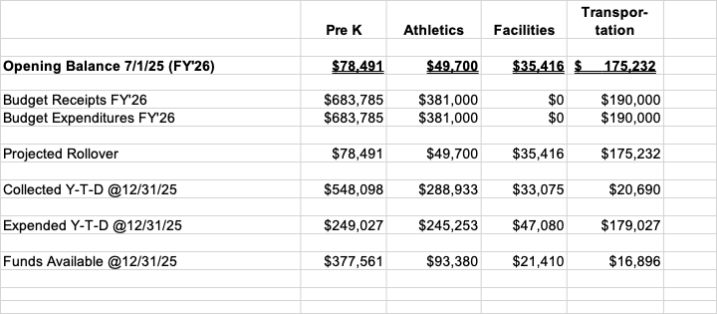
Revolving Accounts Tracking

Slide 9
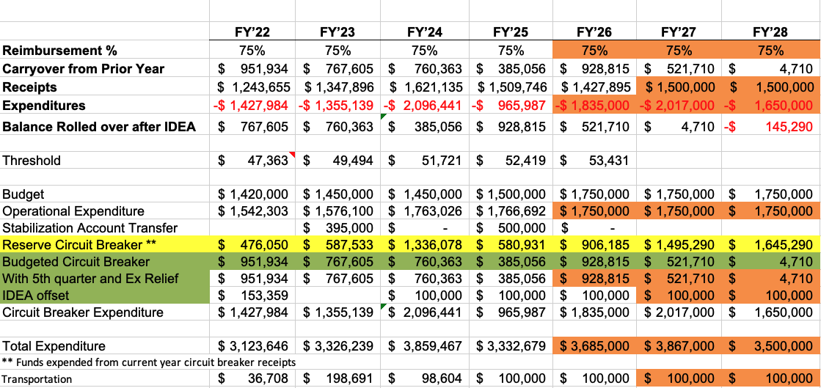
Circuit Breaker FY’26 Q2 Forecast

Slide 10
Summary
Currently in a balanced budget position
Severance is much larger than expected
Still too soon to predict all utilities

