Slide 1
ACT
State Funded Reportable
Spring Reportable: 2/24/26
Accom: 2/24-27 & 3/2-6
Notes:
Update contact list
Cost
*NOTES FROM LAST YEAR!
Talk about irregularity reports. Don’t invalidate a test just because a student misses the 2nd day of testing – ACT will score the part that he completed.
Notify us if you have any of these so that our numbers are correct when we verify the results
If the test administrator does not know the student you MUST verify the student’s ID!

Slide 2
Reminders
Test booklets will have administration type (Standard or ACT-Authorized Accommodated) on the front cover
All students must be listed in ACT Now to test (issued an ACT ID)
Students must complete Pre-test information in MyACT prior to, or within 2 days after testing
ACT does not allow wearing of watches, smart glasses

Slide 3
Students to Test (Reportable)
Schools should offer reportable ACT to ALL enrolled grade 11 students (exceptions are those students who are ACCESS)
11th graders who also want to take ACT-NCR can take in the late spring window (3/24-4/3)
Must give parents an opt-out
FLVS is not testing ACT, so no full-time students will test with you

Slide 4
ACT Now/TCM
You will perform the same tasks for ACT Reportable as you did in the Fall for NCR
Make sure you are under THE ACT STATE>ACT FLORIDA SPRING 2026 – ESCAMBIA COUNTY SCHOOL DISTRICT

Slide 5
Science/No Science
State Funded ACT includes Science subtest
Schools may offer without - BUT
Must give Science to students who want it
Have a way to gauge student interest/need
Bright Futures now calculates scores with/without Science
Option to complete Science after an Extended Break or on Day 2 (2/25)

Slide 6
Students and Accommodations
For reportable ACT, ALL accommodations must be pre-approved by ACT.
Accommodated window is 2/24-2/27 and 3/2-3/6
For students served by IEP/504/ELL
Students with a double or triple time approved accommodation MUST test over multiple days in the accommodated window
Do not “stop” test for multi day options, “Pause” so you can pick up on day 2

Slide 7
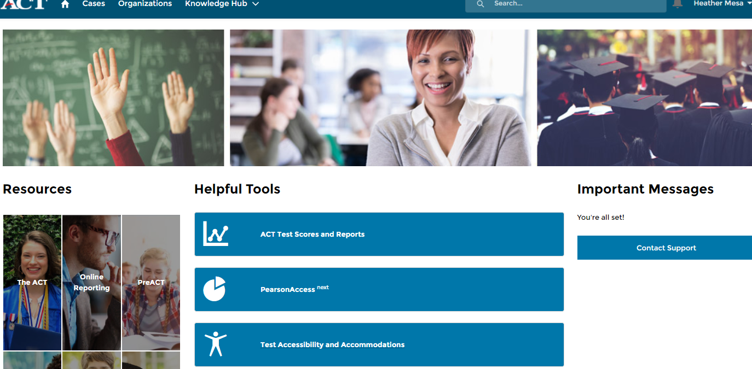
Students and Accommodations
ACTStateAccoms@act.org 1-800-553-6244 x1788

Slide 8
Accommodations
Search for State and District testing
Students can be “Approved”, “Partially Approved”, “Not Approved”, or “Action Required”
If a student is “Not Approved” or “Action Required”, you may click on the blue hyperlink (TAA PIN) and see what option are available
  Usually you can Edit for Reconsideration and Download Decision Notification to view why the student was denied
Once they are Approved, you can assign a test date under the student’s approval

Slide 9
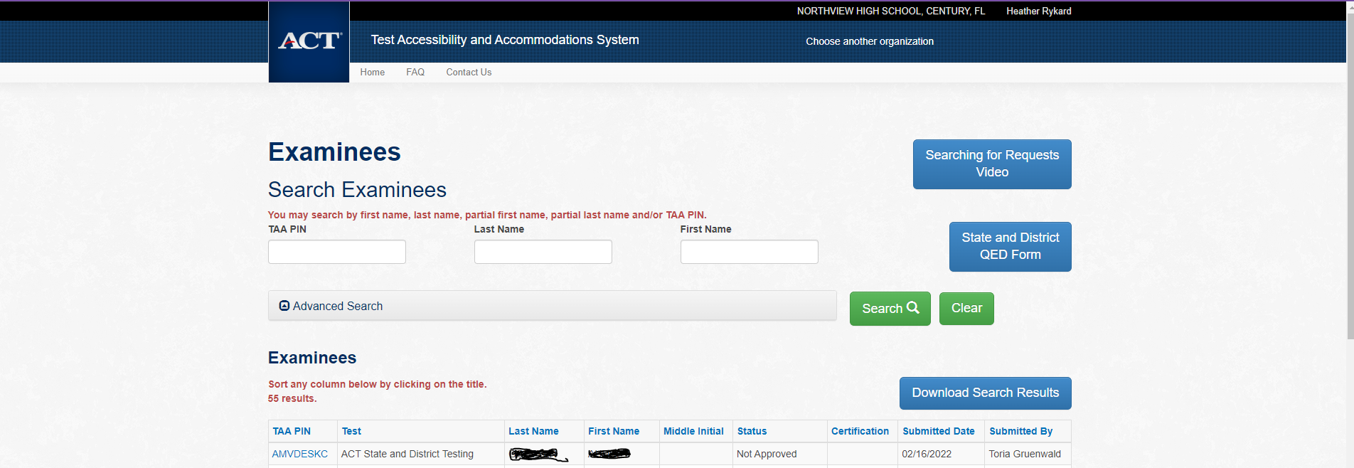
Accommodations

Slide 10
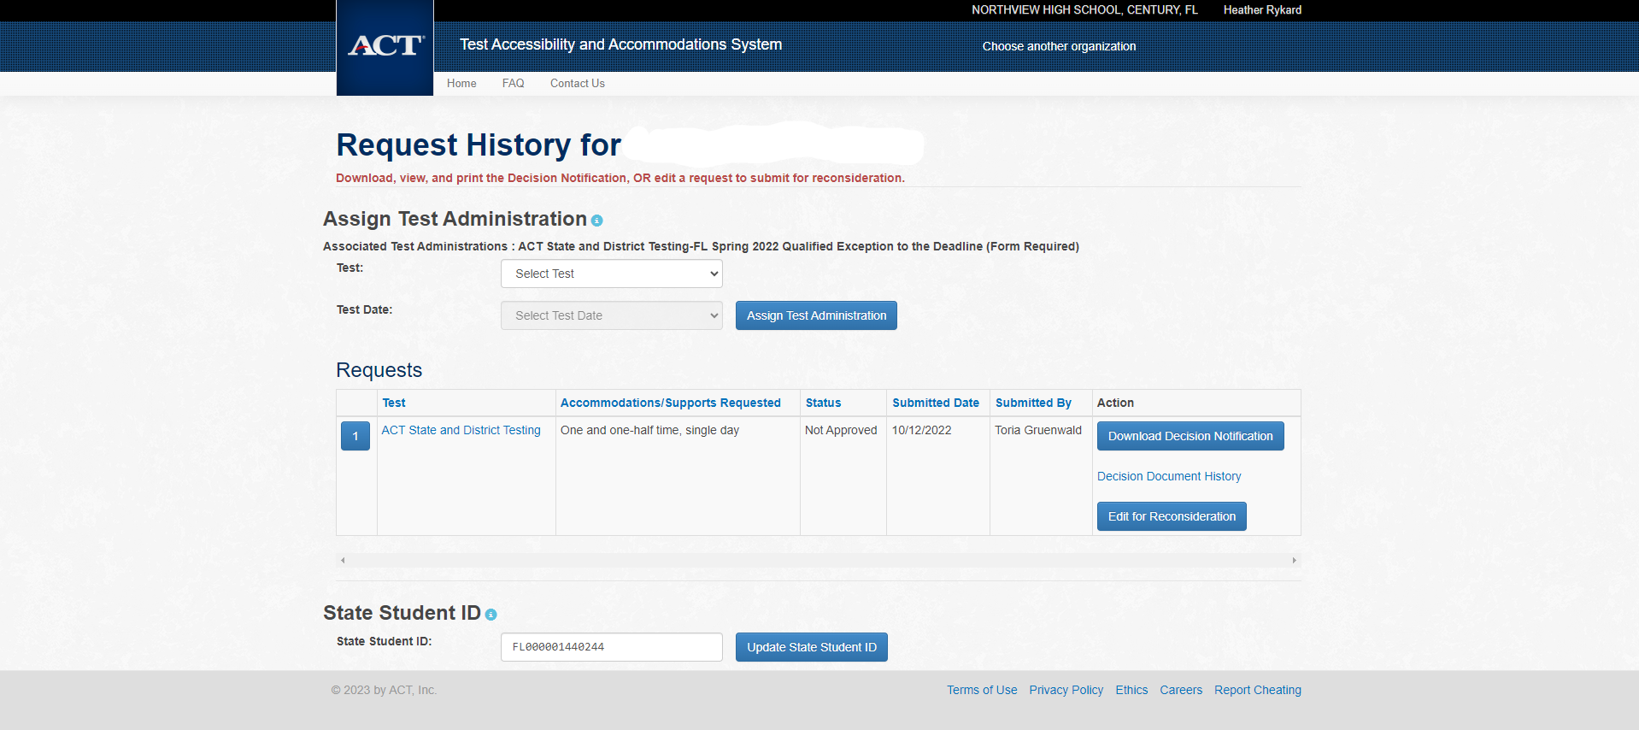
Accommodations

Slide 11
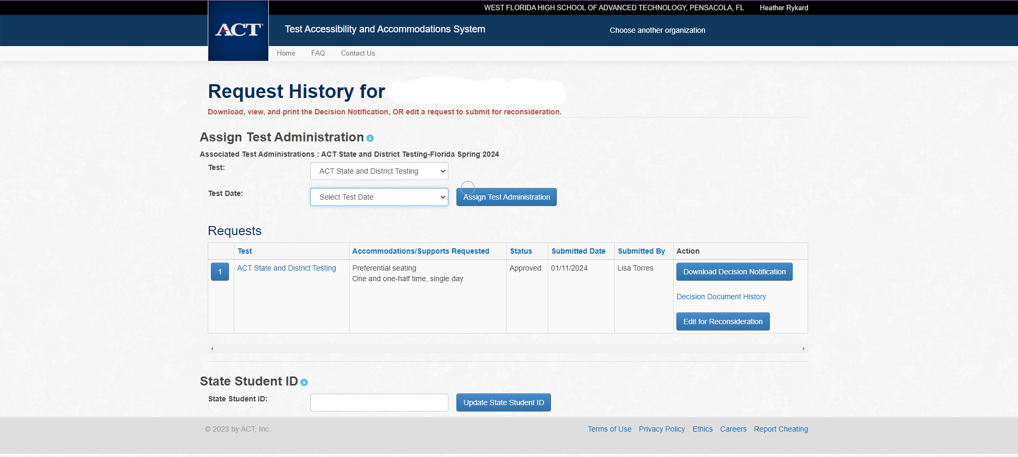

Slide 12
Preparation –
General Reminders
Receive and inventory Reportable materials within 24 hours. Keep your boxes for returning materials
Apply barcode labels to answer documents in designated area
  Recommend NOT applying barcodes ahead of time to account for absences, room moves, etc
Hand grid student information if you don’t have a label
Store materials securely
Check off in TCM
Train test administrators
Notes:
- ACT PAN site is different than our regular PAN site

Slide 13
Test Event Checklists
Agree to Training Modules in TCM
Have Student Complete myACT Accounts
Receive, Secure, and Check-in Test Materials
Select and Set Up Test Rooms
Complete Event Set Up in TCM and ACT Now
Access Rosters and Assign Examinees in TCM
Print Check-in Rosters
Prepare Your Facility
Distribute Test Materials to Room Supervisors

Slide 14
TASK - Complete Event Set Up in TCM and ACT Now

Slide 15
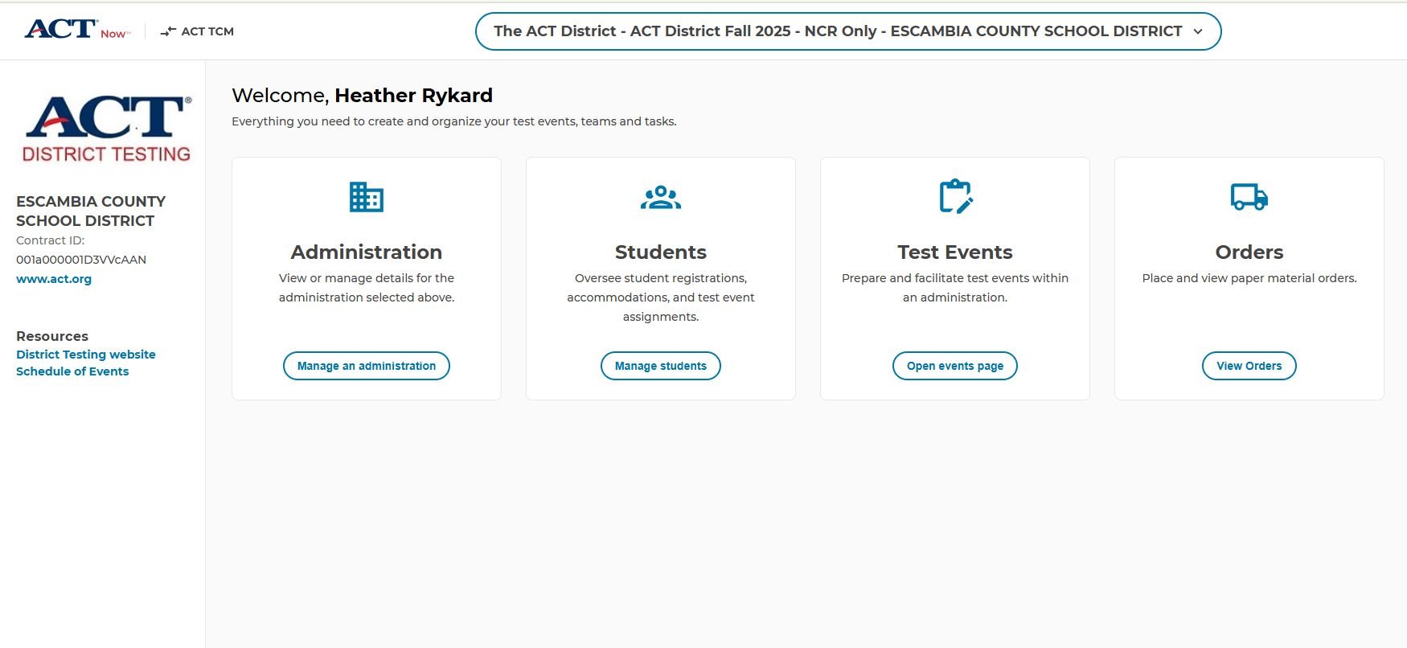
ACT Now

Slide 16
Complete Event Setup in TCM/ACT Now
Create or copy rooms in TCM for each test event
Assign any staff already available in TCM
Invite new users in ACT Now
Assign test event staff to roles and rooms for each event in TCM
Download the printable test day instructions in the event there is an issue accessing TCM on test day

Slide 17
Online Test Admin Materials
ACT Test Center Manager (TCM)
  This digital application, accessed through ACT Now, replaces the use of traditional printed ACT administration manuals by providing separate test coordinator and room supervisor policy modules on ACT policies, test facilities, test staff, test materials, test administration, and non-test activities. Pre- and post-test checklists are also included to make sure you are prepared for test day and ready to return materials after testing.
Printable Administration Manual
  This document contains all of the test coordinator policy modules found in TCM in an easy-to-read, printer-ready pdf.
Test Day Instructions for Paper Testing
  This document provides test day verbal instructions for paper testing in the event there are technical difficulties with TCM, or your site isn't using TCM on test day.

Slide 18
TASK – Agree to Training Modules

Slide 19
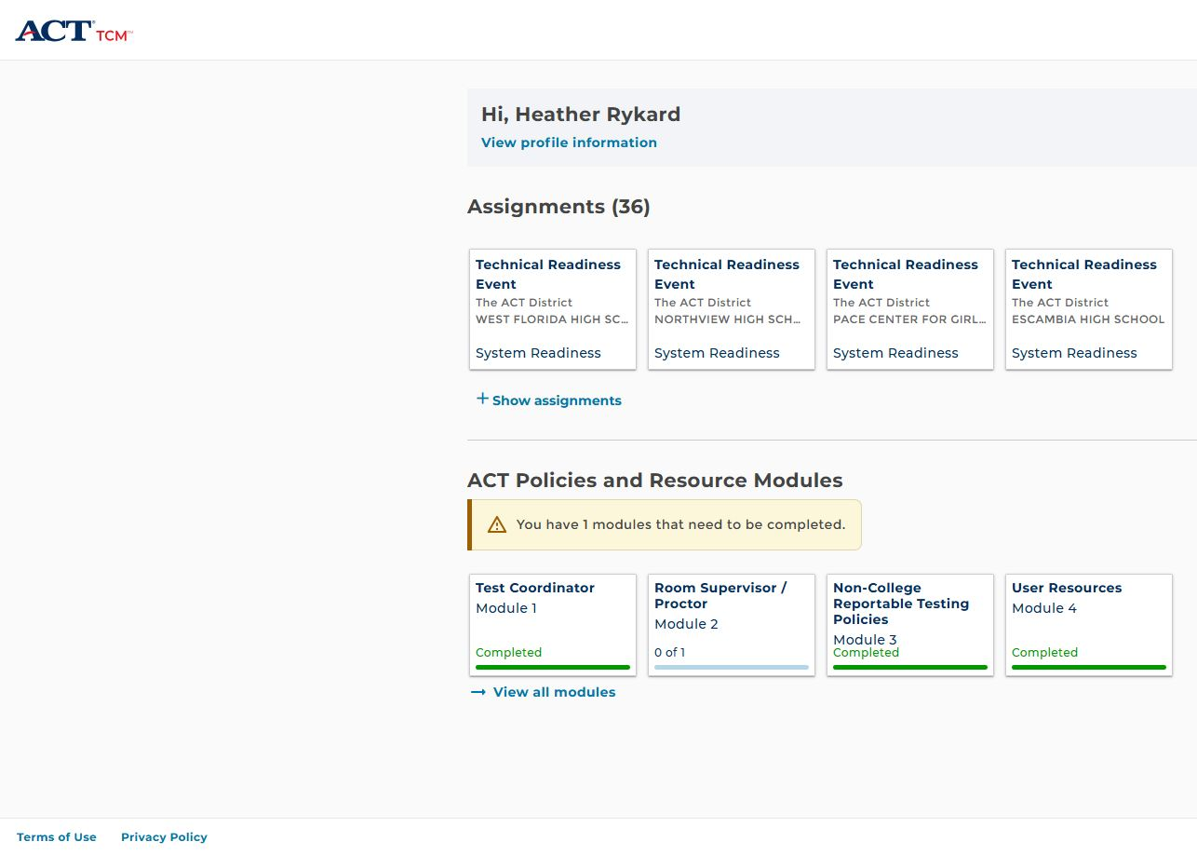
ACT Now – TCM

Slide 20
Staff Accounts
Test coordinators must invite users (test event staff) to the administration in ACT Now. Test event staff must accept the invitation and create a user account in ACT Now.
All test event staff (room supervisors, proctors, and roving proctors) must have ACT Now user accounts to access TCM for training before test day and to administer the exam on test day. Please do not share accounts or create more than one account per person.

Slide 21
Preparation –
Staff Training
The test coordinator is responsible for providing training materials to all test center staff before test day.
The test coordinator, and room supervisor, must log in to TCM and complete the required training housed in TCM.
It is especially important that the room supervisors read and understand ACT policy and resource modules prior to administering the test.

Slide 22
Preparation –
Staff Training
School test coordinator is responsible for providing manuals, supplements, and training to all test site staff before test day.
Training needs to cover:
  Facilities (Room) requirements and set up
  Test Materials
  Non-Test Activities
  Test Administration
Test Coordinators complete Testing Staff Lists for each test date

Slide 23
TASK - Have Student Complete myACT Accounts

Slide 24
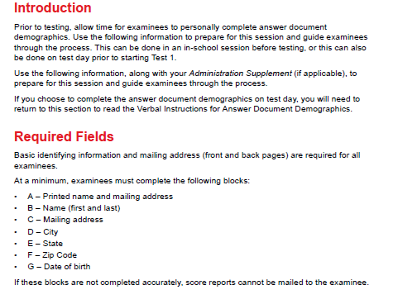
Preparation –
Non-Test Portions

Slide 25
MyACT
Student login information is found in ACT Now
In “Students”>”Manage Students”>”Reports”
Select “Student Code Usage Status in MyACT” to view student logins and completions
MyACT
Non-Test Information:
  Examinees will complete additional non-test information online through MyACT. You may choose to schedule an in-school session to complete this portion or you may inform examinees that they can complete the non-test information on their own. Provide examinees with a personalized Non-Test Instructions for Student form and the Taking the ACT State Testing and District Testing to assist them in completing the non-test information online. Refer to the Non-Test Instructions for Test Coordinators for information on completing the non-test information online and hosting an in-school session.

Slide 26
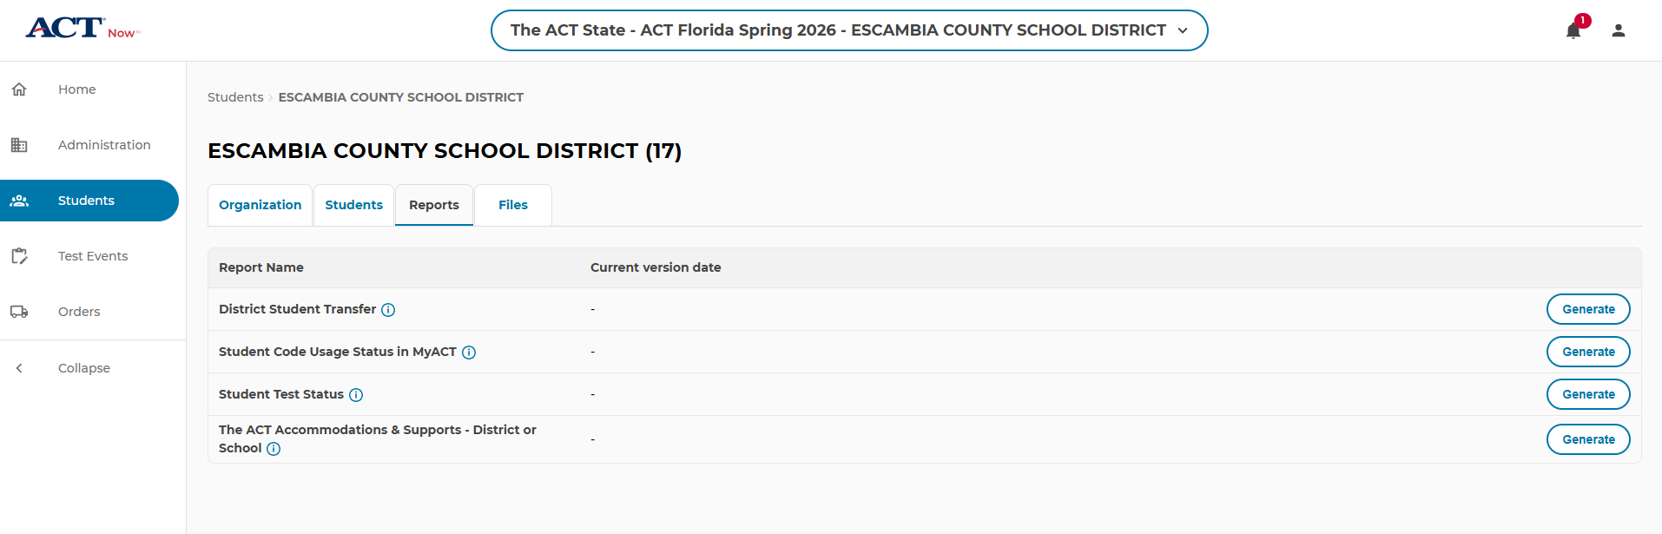
Student Logins
www.testadmin.act.org

Slide 27
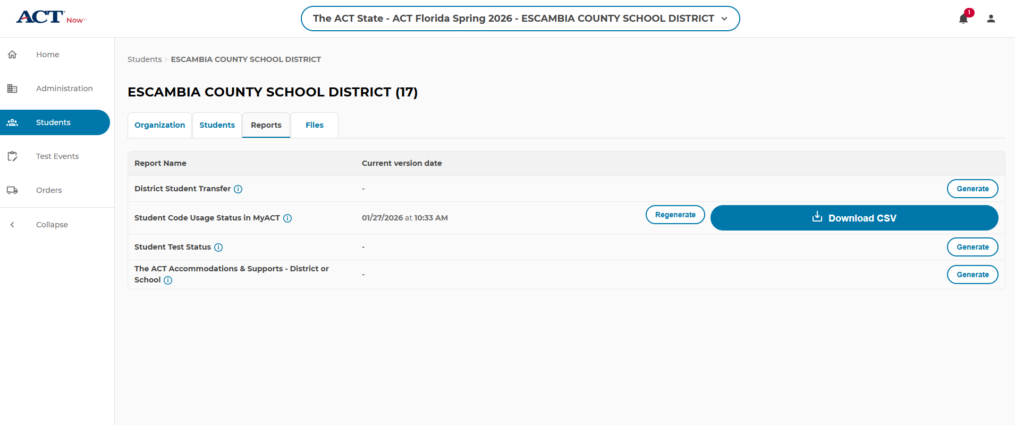
Student Logins
THE ACT STATE>ACT FLORIDA SPRING 2026 – ESCAMBIA COUNTY SCHOOL DISTRICT

Slide 28
TASK - Receive, Secure, and Check-in Test Materials

Slide 29
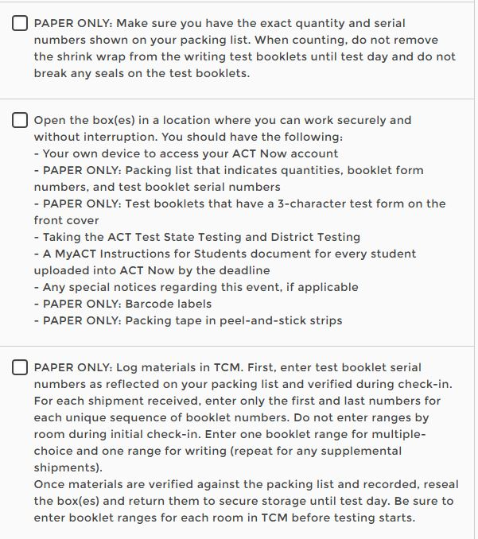
Receive, Secure, and Check-In

Slide 30
Preparation –
Materials
Test materials are sent for a specific date and type (regular or NCR).
Schools must ensure they use correct materials during the test window
Secure
  Test Books
Non-Secure
  Barcode labels
  Answer documents
  Applicable supplements (i.e. Calculator Policy)
  Site Header
  Administration manuals
  Return materials

Slide 31
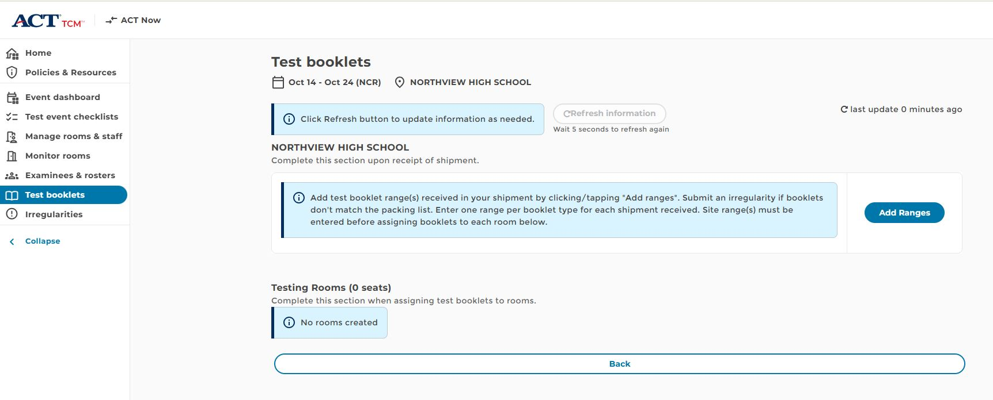
Test Booklets

Slide 32
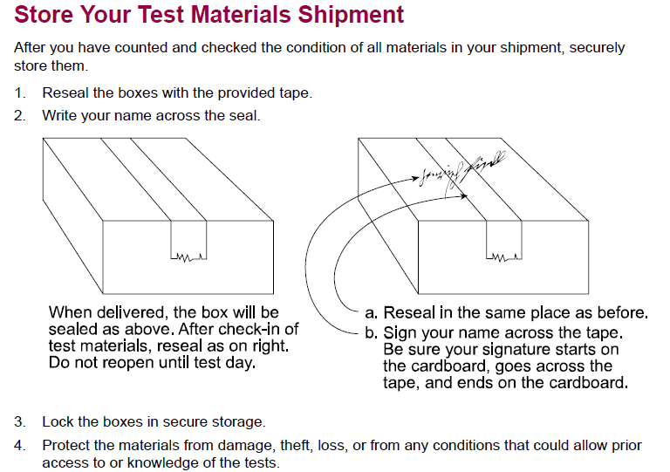
Receive, Secure, and Check-In

Slide 33
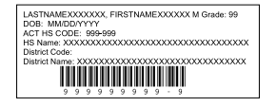
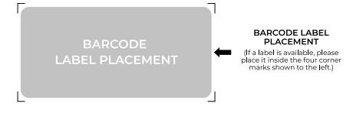
Preparation –
Materials
Check barcode correctness – if incorrect, manually grid the correct student code in Block U
Apply barcode in the correct location

Slide 34
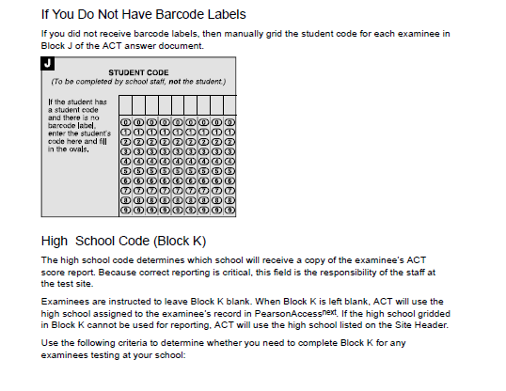
Preparation - Materials

Slide 35
TASK - Select and Set Up Test Rooms

Slide 36
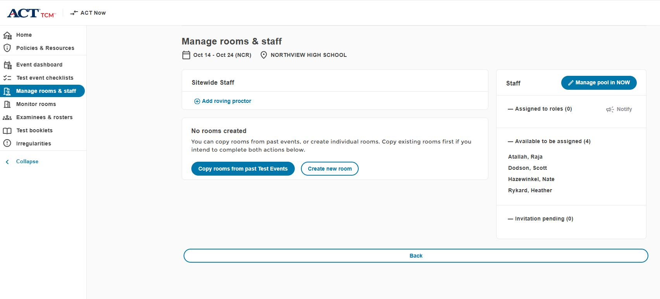
Manage Rooms & Staff

Slide 37
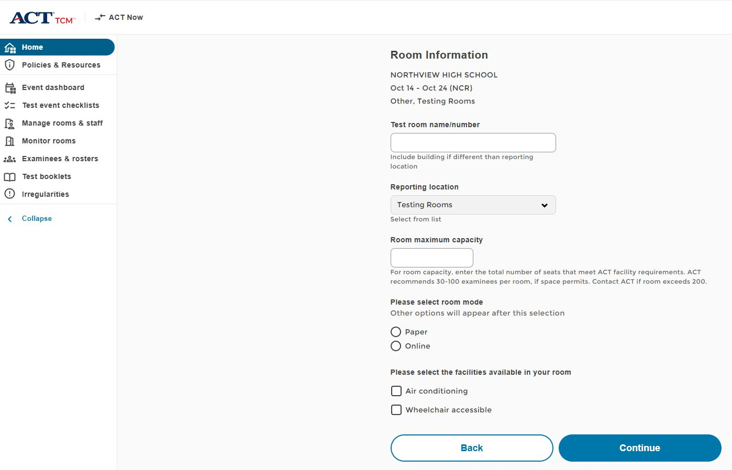
Create Room

Slide 38
TASK - Access Rosters and Assign Examinees in TCM

Slide 39
Access Rosters and Assign Examinees in TCM
Select test day assignment in TCM -> Examinees & rosters
  Students are displayed by delivery mode
Assign examinees to test rooms
  All examinees in a test room (in a sitting) test as a group. They must receive the same verbal instructions, work on the same test, and take breaks at the same time. Assign examinees to separate test rooms accordingly. Tests will not be scored or scores will be canceled if this policy is violated.
To move examinees between rooms, remove from currently assigned and assign to new room

Slide 40
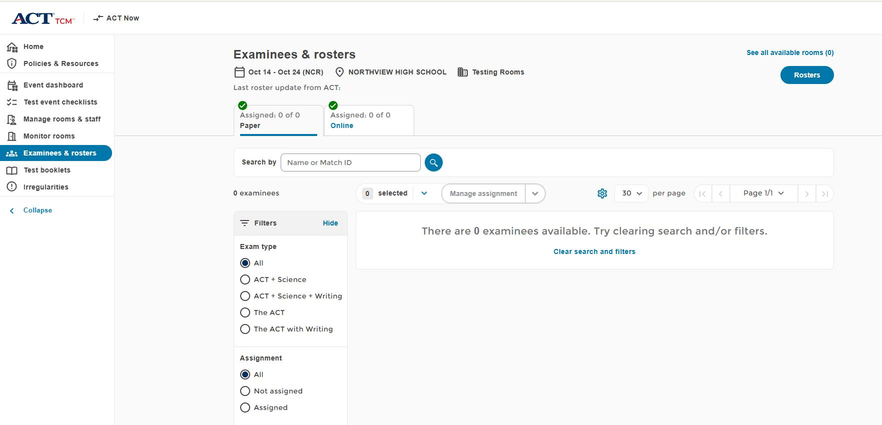
Examinees & Rosters
Assign students to rooms
by using “Manage Assignment”

Slide 41
Rosters
Click here to view
Or print rosters

Slide 42
TASK – Prepare Your Facility

Slide 43
Preparation –
Test Room Setup
Students should all face the same way
Students should be at least 3 feet apart
Carrels are not allowed
Remove visual aids
Specifics for desks, tables by type, etc.

Slide 44
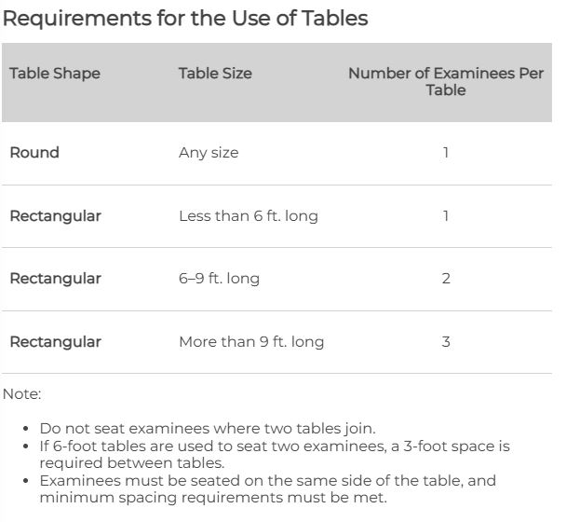
Table Requirements

Slide 45
Preparation -
Staff
Room supervisors and proctors may be current or retired faculty members, school admin or clerical employees, substitutes, student teachers, or paraprofessionals
May not serve as test coordinator if a relative is testing in the ACT window
Relative is: children, stepchildren, grandchildren, nieces, nephews, siblings, in-laws, spouses, and persons under your guardianship.
Staff must remain attentive to their testing responsibilities throughout the administration
Coaches may serve as a room supervisor, but may not supervise one-to-one testing for a student-athlete

Slide 46
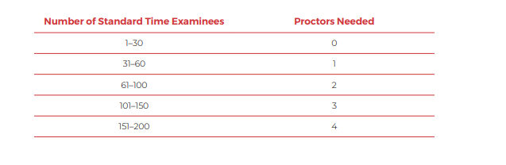
Preparation –
Proctors
Notes:
The proctor requirements are the same as the standard time test. Once you reach 50 students, an additional proctor is required for each additional 50 students.

Slide 47
TASK - Distribute Test Materials to Room Supervisors

Slide 48
Test Day –
Handling Materials
Room supervisors will pick up materials from SAC
To ensure security of test materials, distribute to examinees ONLY when directed to do so in the instructions, not before
Be sure each examinee receives the answer document with his or her name on the barcode label or the student code gridded in Block U (another way to verify attendance)
Personally hand one test booklet individually to each examinee in sequential serial number order

Slide 49
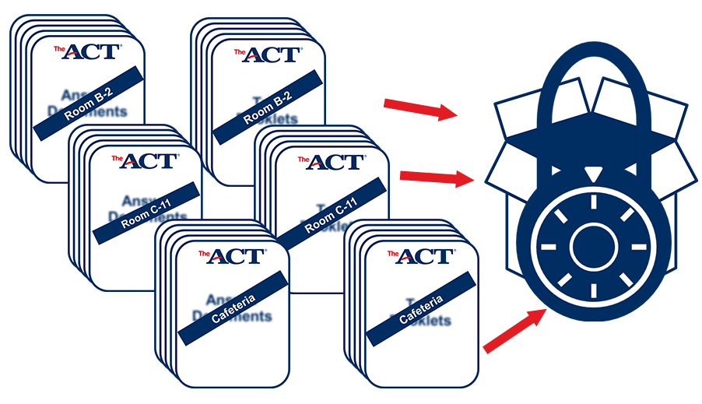
Test Day –
Room Materials
Printed script (correct timing)
Roster
Answer documents and test booklets by room
  Apply bar codes day of testing once students check in
Seating Chart (District req’t)
Room Details/Test Timings
Calculators
Pencils & erasers

Slide 50
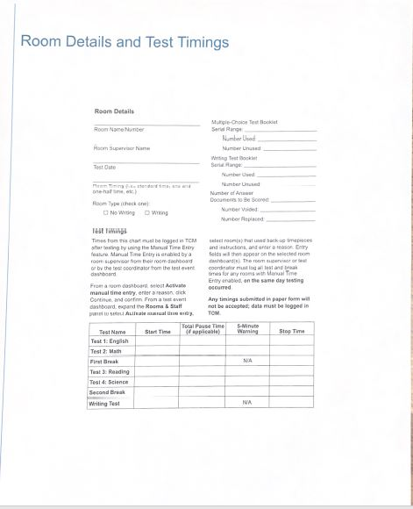
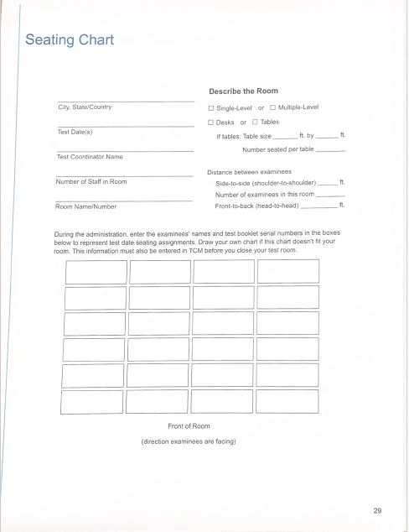
Test Day Materials

Slide 51
Room Supervisor
Check-in activities on test day:
Individually identify and admit examinees to rooms; verify IDs and mark the roster.
Remove absent students from the room in TCM.
Unlock student records.
Direct examinees to seats once admitted.
Make sure all examinees admitted to a room are assigned the same timing.
Make sure all examinees authorized to test over multiple days are ready to begin the same test.

Slide 52
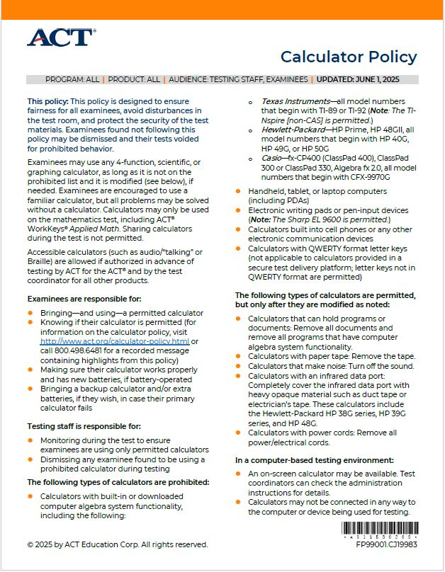
Preparation - Calculators
Make sure you are only handing out/allowing
authorized calculators
Policy prohibits sharing of calculators, so make
sure you have backups
If a student uses a prohibited calculator, the test
will be invalidated

Slide 53
Test Day –
Guidelines
Tests MUST be taken in order –
  Test 1 – English
  Test 2 – Mathematics
  Test 3 – Reading
  Test 4 – Science(Optional)
Notes:
Can move on once all students have finished that session – Eng (70), Math (90), Reading (55), Science (55)

Slide 54
Flexible Scheduling Options
The test coordinator decides if a school’s examinees test on the same day or over two days, if taking Science subtest.
This decision applies to ALL standard time and single-day accommodations testing rooms and administrations for that testing event/window at the school.
Based upon this decision (same-day or two-day), please refer to the appropriate text and table below.

Slide 55
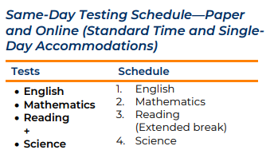
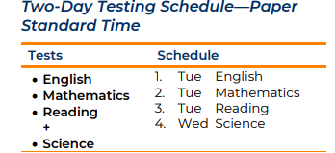
Flexible Schedule Options (if giving Science)
Test coordinators may determine the length of the extended break (e.g., lunch or snack break). All rooms at the school must resume testing on the same schedule and complete testing by the end of the school day.

Slide 56
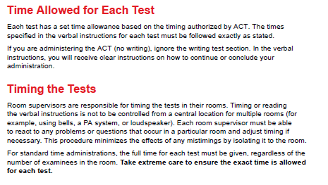
Test Day –
Timing Options

Slide 57
Timing
English | Math | Reading | Science | Total
35 | 50 | 40 | 40 | 165
ACT requires that you allow a 10-15 minute break at the end of Test 2. Each room supervisor is to begin the break at the end of Test 2 as dictated by individual testing activity in the room. Do not attempt to preset an exact break schedule for all test rooms.
125 minutes of testing time if not giving Science

Slide 58
Room Supervisor
Administer the test:
Take responsibility for a test room and provide an environment conducive to testing.
Read verbal instructions on task cards verbatim to examinees.
Monitor the TCM timer.
Monitor assigned test room in TCM.
Unlock the student records in TCM.
For one and one-half time testing, use the TCM timer to ensure the exact time is allowed for each test.
Lock each student in TCM if testing over multiple days. Note: Students should NOT be marked complete in TCM if the student will continue testing on a subsequent day. Rooms in TCM should not be closed if students are testing on multiple days.
Close room and resolve any alerts before marking the task as done.

Slide 59
Room Supervisor
Maintain security:
Keep test materials secure during testing and breaks.
Monitor for prohibited behavior during testing and breaks.
Submit irregularities in TCM.
Collect and account for all test materials before dismissing examinees.
Ensure complete documentation:
Complete all information in TCM, following the task cards.
Document irregularities in TCM and, as required, void examinees' tests.
Return all test materials to the test coordinator after testing.

Slide 60
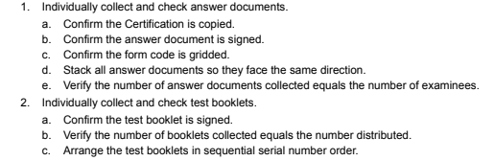
Test Day –
Handling Materials
After Testing, room supervisors must:
*Also remind Room Supervisors to ensure that students fill/bubble in name
And grade level

Slide 61
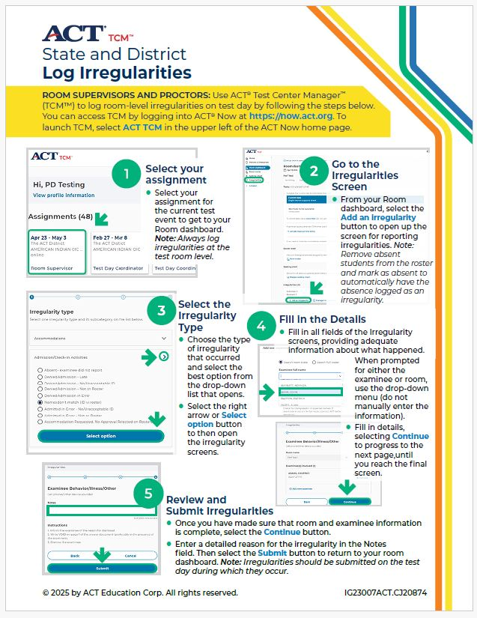
Test Day –
Irregularities

Slide 62
Irregularities - Science
For all students who do not take the Science subtest, you will add them as an Irregularity

Slide 63
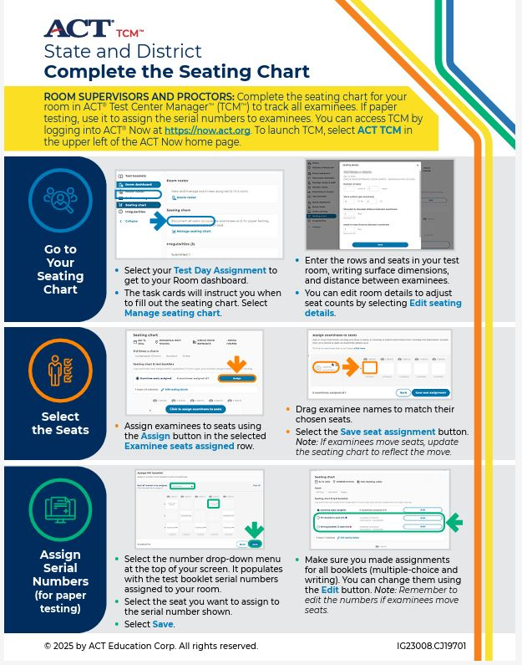
Test Day – Seating Diagram

Slide 64
Test Day –
Reminders
Electronic devices are prohibited
Calculators are allowed during the math test only
Collect and pack materials after testing (see manual)
Answer documents must be in the envelope
Include irregularity reports (if any)
Make copies of all admin records to keep on your campus
Return materials to ACT right away
Destroy all unused within 72 hours
Email Heather Rykard when you have shipped your materials

Slide 65
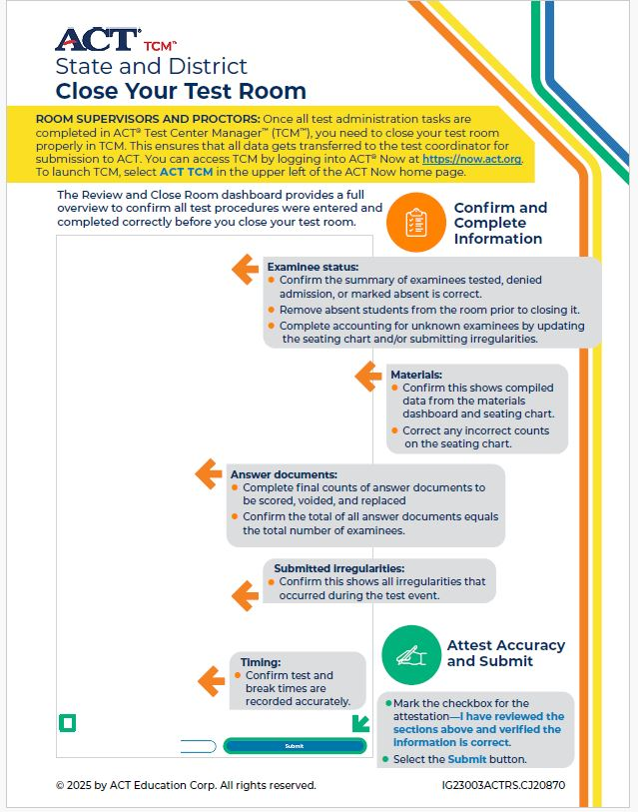
Close Room

Slide 66
Shipping
Immediately after the administration, return the test materials to ACT. Failure to return materials in a timely manner may prevent tests from being scored.
Instructions for how to collect, pack, and return materials to ACT can be found in your TCM Post-Test Event Checklist.

Slide 67
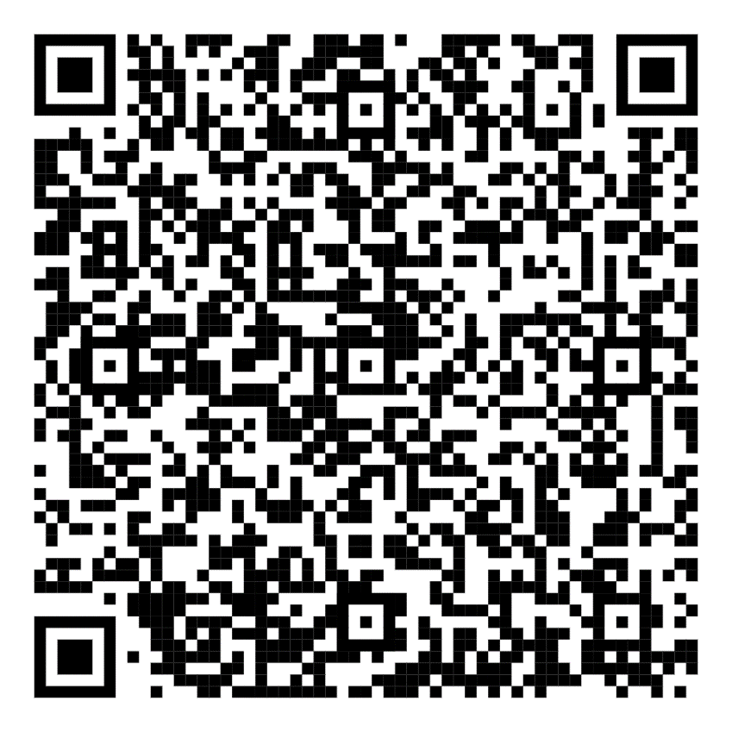
Resources

Slide 68
Questions
Contact Evaluation Services
  Heather Rykard (Test Procedures, Administration, Accommodations)
    850-469-5387
    hrykard@ecsdfl.us
  Scott Dodson (Pre-ID, Testing Data files, Score reporting)
    850-469-5389
    sdodson@ecsdfl.us

