Slide 1

Rising 9th Information Night
Presented by the Milton Counseling Department
FEBRUARY 2, 2026
HOGLANDER

Slide 2
Presentation Agenda
Introduction
Counselor Roles & Responsibilities
High School 101
Registration Information
Course Catalogs and Resources
Elective Information
HOGLANDER

Slide 3
Final Caseloads for 26-27 SY are released in July 2026
Counseling Department
Casey Lahman | Suite 1380 | LahmanC@fultonschools.org
Christine Hoglander | Suite 1340 | HoglanderC@fultonschools.org
Lyvelle Simms | Suite 1380 | SimmsL1@fultonschools.org
Samantha Latham | Suite 1360 | LathamSJ@fultonschools.org
Heidi Ruppe | Suite 1360 | Ruppe@fultonschools.org
Blaze Chriscoe | Suite 1360 | WilsonB@fultonschools.org
Tiffany Harrison | Suite 1340 | HarrisonT3@fultonschools.org
Hoglander

Slide 4
Additional Support Staff
Damien Bentley School Social Worker | Suite 1340 | BentleyD@fultonschools.org
Amy Barr Registrar | Suite 1320 | BarrAl@fultonschools.org
Tricia Mueller Records | Suite 1320 | MuellerT@fultonschools.org
Maria Echeverria Bilingual Liaison | Suite 1320 | Echeverria@fultonschools.org
Erika Strakova 504 Coordinator | Rm. 2209 | StakovaE@fultonschools.org
Missey Hall RTI Coordinator | Suite 1240 | HallM4@fultonschools.org
HOGLANDER

Slide 5
What Do Counselors Do?
Communication Advocates
Counselors are in a unique position to help you establish positive communication with your teachers, coaches, and administrators.
Academic Coaching
Counselors help to make informed decisions about your academic future based on data (grades, attendance, teacher feedback, behavior, and more!)
Post-Secondary Planning
Need help determining what to do next? Counselors will help match your skill set to the perfect post-secondary option for you.
Social/Emotional Support
Counselors are available to offer support and refer you to outside resources in difficult times of grief, anxiety, and more.
HOGLANDER

Slide 6
What Do Counselors NOT Do?
Parking
We have zero influence or power in resolving parking issues.
Attendance
Attendance issues should be handled with the front office with Mrs. Anderton.
Extensive Social/Emotional Counseling
It is not in the scope of a school counselor to provide extended 1:1 counseling to students. We can absolutely help refer you to appropriate resources if your student needs this type of support.
Discipline
Counselors are not a part of the disciplinary process. If you feel that your student needs this intervention, you should reach out to your grade-level AP.
HOGLANDER

Slide 7
High School 101
    Typical Day at Milton
      7 class periods (6 Academic, 1 Lunch)
      5 minutes between classes
      School day runs from 8:20-3:30
    Progress Reports
    Distributed at 4.5 Weeks, 9 Weeks, and 13 Weeks
  Report Cards
    Semester grades are earned in December and May
  Infinite Campus for Parents & Students
    View grades from home at any time!
HOGLANDER

Slide 8
High School 101
Middle School Grades: Calculated using the system of averages | High School Grades: Each semester is INDEPENDENT and not averaged
Example: 8th Grade English *Semester 1 = 60 *Semester 2 = 80 *Yearly Avg = 70 = Student passes course | Example: 9th Grade Lit/Comp I *Semester 1 = 60 *Semester 2 = 80 *No Yearly Avg = Student fails Lit/Comp I A (1st semester), passes Lit/Comp I B
    High School Grading Scale
    A = 90-100
    B = 80-89
    C = 70-79
    F = 0-69
    Honors and AP Courses
  Students will receive 7 rigor points on the Semester Grade
HOGLANDER

Slide 9
Core Area | Number of Credits | Courses
English/Language Arts | 4 | 1 Credit of Lit/Comp I (formerly 9th Lit/Comp) 1 Credit of Lit/Comp II (formerly 10th Lit/Comp) 2 Additional Credits of ELA, including equivalent AP/DE courses
Science | 4 | 1 Credit of Biology 1 Credit of Physical Science OR Physics 1 Credit of Chemistry OR Earth Systems OR Environmental Science OR AP/DE equivalent 1 Credit of an approved 4th Science, including AP/DE Science courses
Mathematics | 4 | 1 Credit of Algebra: C&C 1 Credit of Geometry: C&C 1 Credit of Advanced Algebra: C&C 1 Additional Credit of Math (Precalculus, AMDM, AP/DE Course)
Social Studies | 3 | 1 Credit of World History 1 Credit of US History 0.5 Credit of Personal Finance & Economics 0.5 Credit of American Government/Civics (excludes AP Comparative Government)
World Language, CTAE (Career, Technical, & Agricultural Education), and/or Fine Arts | 3 | World Languages (Spanish, French, Latin, Japanese) CTAE (Entrepreneurship, Sports Medicine, Surgical Technology, Food/Nutrition Wellness, Film & Television, Computer Science, Forensic Science) Fine Arts (Art, Drama, Music)
Health/Physical Education | 1 | 0.5 Credit of General Health 0.5 Credit of Personal Fitness
Electives | 4 | 4 Additional Credits of courses. Can be Core/WL/CTAE/FA
Total Credits (Minimum) | 23
Graduation Requirements
Students interested in attending a 4-year college need two consecutive years of the same World Language
Some courses count towards graduation requirements but may not be recognized as core credit by colleges. Verify by viewing USG’s Staying On Course document
Personal Fitness Waiver is now digital. Instructions are on the Milton Counseling Website > Academic Advisement > Personal Fitness Waiver
Promotion from 9th to 10th Grade = 5 Credits
Promotion from 10th to 11th Grade = 11 Credits
Promotion from 11th to 12th Grade = 17 Credits
CHRISCOE

Slide 10
Middle School Credits for High School
Some students were able to take courses in middle school for high school credit.
Examples are:
Physical Science (not to be confused with Sci/Phy World, the 8th Grade Science)
Spanish 1 or 2
Algebra I C&C
Lit/Comp I
In 8th Grade, you and your family have the option to accept these credits or to deny them for high school credit. There is a form that you/your family will sign off on with the Middle School. Milton High School is NOT able to alter credits from middle school for high school credit.
We get many questions on if you should deny credit and repeat a course. This is a personal decision based on the grade earned. There are many nuances per course, the most popular being:
You deny your Algebra I credit; this means you must take Algebra I again. You cannot move on to Geometry until you earned the credit on the HS transcript.
You deny your Spanish 1 credit but want to move on to Spanish 2. This is allowed, but you will have to take Spanish 2 and Spanish 3 in HS to meet the 4-year college WL requirements (2 years of WL on HS transcript).
The option that you/your family accepts or denies in 8th Grade stands.
CHRISCOE

Slide 11
Types of Courses at Milton
In-Person Courses | Fulton Virtual School (FVS)
Taken F2F in the high school Students are not permitted to change an in-person course to online after Spring registration OR midyear It is recommended that 9th Graders take ALL courses in-person | Taken 1st/2nd or 6th/7th in student schedule Students need transportation to come in late/leave early. There is no designated space for students to take online courses in the building. Self-Paced, with fewer deadlines throughout the semester Higher likelihood for procrastination, we see high stress towards the end of the semester Statistically, students earn lower grades if they do not stay on top of the coursework Speak with your counselor if you want to take on online course that is not offered through FVS
CHRISCOE

Slide 12
Retention Policy & Credit Recovery
How many credits are required to be promoted to the next grade?
  5.0 Credits to be promoted to 10th Grade
  11.0 Credits to be promoted to 11th Grade
  17.0 Credits to be promoted to the 12th Grade
Credit Recovery: Making Up Failed Classes
  Summer School
    Information comes from county late March/early April
  Fulton Virtual School (FVS) – www.fultonschools.org
  Fulton County Credit Recovery (FCCR) – Mrs. Bendall is the lab support
    Students must meet with their assigned counselor to register for any FCCR course.
    Credit Recovery courses taken through FCCR are not NCAA approved! NCAA has returned to pre-COVID requirements, so make sure you know your needs.
CHRISCOE

Slide 13
2026-2027 Registration Timeline
DATES ARE SUBJECT TO CHANGE:
Registration 101 Session will be released on the counseling website on January 6, 2026
Middle School teachers will make recommendation for core courses January 26-February 5, 2026
Students will receive a Course Selection Form on February 9, 2026 stapled to the teachers’ core course recommendations
  Student will be selecting and writing their elective choices on the Course Selection Form
Students will submit ALL desired changes on the Course Selection Form to Middle School by February 13, 2026
  If your student will be on the field trip during this time, they will need to return their forms to their middle school counselor as soon as possible
Teachers and students will receive one FINAL opportunity to make adjustments in late March/early April
If you are not a member of a feeder school at Milton, you will register for courses when you enroll your student.
CHRISCOE

Slide 14
Building a Schedule
Core Classes: TEACHERS make recommendations for these courses
Electives: STUDENTS choose 2 credits worth of electives every year (in 9th grade, choose 2.5)
          Students will also choose 2 additional options (in case you don’t get your first pick)
          You must have a total of 6 classes each semester
      Factors to Consider:
      Graduation Requirements
      Prerequisite Courses (ex: you want to take Ceramics I, but you must take Intro to Art first)
      Rigor Requirements
CHRISCOE

Slide 15
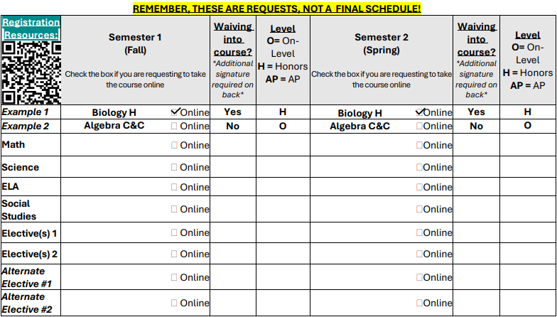
Building a Schedule
Completing the Course Selection Form
Students must list 2 alternate electives.
Students should be comfortable taking any of the 5 electives listed.
Counselor will do their best to give students their top picks, but there are many factors that go into scheduling. Many times, a student does not get their top choice due to seniority, seat count, or schedule conflicts.
Scheduling Conflict Example
Your student requests to have 6th and 7th period online, because she plays tennis competitively. She also requested AP Human Geography, which only had enough students interested to create one section (or class period). That section is being offered 6th period. This results in a conflict, where your student either has to move the 6th period online somewhere else or take an elective other than AP HUG. Your student has a seat in the course she wanted, but it does not line up with your period preference. This is called a schedule conflict.
Don’t panic! This is a SNIP of the form you will receive on February 9. There are additional instructions and explanations on the complete form.
CHRISCOE

Slide 16
Building a Schedule
IMPORTANT NOTES:
The Course Selection Form IS NOT A SCHEDULE. The requests are used to build a master schedule for the Student Information System, which creates schedules in the summer.
Students should very carefully consider the full picture of all time commitments BEFORE making selections/changes. You are seeking balance in the schedule. Do not set yourself up for stress, anxiety, or failure!
Families need to be prepared to make informed decisions by deadlines. You can:
      Watch the Registration 101 video released on January 6, 2026 to better understand course progression and available options for your student.
      Students should email their MIDDLE SCHOOL COUNSELOR with questions or concerns about course selection. Students begin working with high school counselors once they are officially enrolled at Milton.
      We aim for AS FEW SCHEDULE CHANGES AS POSSIBLE every year.
CHRISCOE

Slide 17
Creating a BALANCED Schedule
When selecting instructional levels (ex: On-Level, Honors, AP, Dual Enrollment), look at the totality of the schedule. For best results, follow the teacher recommendations.
  Be HONEST with yourself. Consider your work ethic, how much time you can contribute to studying, how do you handle academic pressure, and outside time commitments (ex: sports, volunteering, part-time job, helping with family)
  Properly evaluate time-management and what you can realistically handle
  Mental health and overall wellness should be considered when making a final decision
  Remember, having a mental breakdown as a result of stress does not do anyone any good.
  Take a healthy mix of rigorous courses, get involved in and out of school, and you will be GREAT! Colleges love a well-rounded student. You are so much more than course selection and grades.
CHRISCOE

Slide 18
Qualities of an Honors/AP Student
Has the ability to grasp new concepts at a rigorous pace without intervention
Has the ability to link new material with old and across disciplines
Advocates for self if struggling with material
Independent and self-motivated
Completes homework independently and thoroughly in an appropriate amount of time
Makes efficient and effective use of class time
Works effectively with other students
Interested in an AP Course? Check out the AP Courses at Milton page on our counseling website! You can access curriculum information for every AP course we offer at Milton.
CHRISCOE

Slide 19
Mental Health Matters
Preparing for the future is important, but so is your mental health
Consider your workload and cut where necessary. You don’t win any awards for being the first to break down over the stress
Take time to pursue your interests beyond post-secondary planning. Spend time doing things that fill your cup:
  Quality time with family, friends, pets
  Community service
  Exercising
  Reading
  Cooking
  Gaming
  Arting (doing the Art?)
Practice healthy coping mechanisms:
  You are not alone; lean on others
  Take walks
  Yoga/Breath Work/Meditation
CHRISCOE

Slide 20
Electives at Milton
SIMMS

Slide 21
Physical Education & Health
To graduate from MHS students are required to take Personal Fitness and Health.
Freshman Students that play football should not take Physical Conditioning first semester.
Freshman students should take General Health, Personal Fitness, or another PE Elective if interested.
PE electives offered at MHS:
Weight Training
          Physical Conditioning (Football Only)
          General PE 1 and 2
          Body Sculpting
          Intro to Rec Games
          Intro to Lifetime Sports
SIMMS

Slide 22
Fine Arts
Band
Audition not required if you previously played an instrument
Those interested in the Advanced Performing Band Ensemble: materials are distributed to the middle school in early March
Email director@miltonband.org with any questions
Chorus
For all information related to Chorus Placement Exams, visit https://www.miltonchorus.com/join
Email bowers@miltonchorus.com with any questions related to Placement Exams
Orchestra
Audition not required if you previously played an orchestral instrument
Visit miltonorchestra.org/placement for Ensemble Placement information
Email cummingsas@fultonschools.org with any questions
SIMMS

Slide 23
Fine Arts
Theatre
Advanced Drama
Auditions are March 24-25 after school by appointment
Visit https://www.miltontheatrecompany.com/drama-auditions for more information on Advanced Drama Auditions.
Email ankiell@fultonschools.org to secure an Audition slot
Cirque
Auditions are April 1 from 4:00-8:00 PM
Callbacks as needed
Visit https://www.miltontheatrecompany.com/cirque-auditions for more information on Cirque Auditions.
Email kurtzl@fultonschools.org for more information.
Additional Theatre Electives
Acting 1
Fundamentals of Theatre
Film & TV 1
Dance
Visual Arts
We offer a full array of visual arts classes including 2D, 3D, Graphic Design and Digital Design.
Email browndrew@fultonschools.org with questions about placement.
SIMMS

Slide 24
World Language
Students interested in attending a 4-year college are required to take two consecutive years of the same World Language; three consecutive years is preferred by many colleges.
World Language Electives offered at MHS:
French
Japanese
Latin
Spanish
Milton HS offers all our languages in levels 1-AP (Levels 2-4 have On-Level & Honors sections)
On-Level = 75% Target Language used for Instruction; Activities vary per level, but all practice speaking, writing, reading, and listening; students are highly encouraged to communicate in target language as much as possible.
  Honors = 90% Target Language used for Instruction; Students expected to communicate in target language; more in-depth work from the on-level courses, but same curriculum; students are prepped for the AP Level; requires at least an 85 average from previous level.
SIMMS

Slide 25
World Language
All languages have Language Clubs and Honor Societies.
Spoken languages participate in numerous county, state, and national competitions including: GHP, National Tests, Fulton Forum, etc.
Latin competes in 10+ contests each year!
All SPOKEN languages and Latin offer the Georgia Seal of Biliteracy to Seniors:
      Completion of all English Language Arts requirements for graduation with an overall grade point average of 3.0 or above in those classes.
      Proficiency in one or more languages other than English, demonstrated by passing a foreign language Advanced Placement (AP) Exam with a score of 4 or higher.
SIMMS

Slide 26
World Language
Course Placement
Placement in most courses is determined by Teacher Recommendation. Teachers know your child and strive to place them in a course that appropriately challenges them.
Placement in the Spanish for Native Speakers course is determined by a short placement test and teacher recommendation.
The Spanish for Native Speakers course is designed to address the unique needs of Native Speakers. It will help to advance their language skills and cultural knowledge. Students placed in this course are too advanced for the non-Native Speaker track and will not benefit from it.
Students and Parents must contact the TEACHER (not the counselor) if they feel the student should be placed differently.
SIMMS

Slide 27
World Language
Thoughts for a student taking a Level 1 Language in the Fall:
Each language opens doors to distinct cultural perspectives and global connections.
Students should discover a language that aligns with their interests and challenges them to develop diverse linguistic skills.
While Spanish is a popular choice, it is essential to recognize that it is as academically challenging as the other languages and is taught almost exclusively in Spanish.
Consider the unique opportunities and challenges presented by languages such as ASL, French, Japanese, and Latin!
Direct questions to the World Language Dept. Co-Chairs:
Ms. Jennifer Brubaker - BrubakerJ@fultonschools.org
Dr. Alex Marsh - MarshAJ@fultonschools.org
SIMMS

Slide 28
LATIN
WHY TAKE LATIN?
Latin improves SAT Scores!
SIMMS

Slide 29
LATIN
Georgia SAT State Profile Report
Language Taken | Read/Math (Read/Math/Writing)
None | 832 (1232)
Spanish | 973 (1445)
French | 980 (1457)
Latin | 1081 (1604)
Data based on College Bound Seniors in Georgia who took 2+ years of a language per the 2018 SAT State Profile Report
SIMMS

Slide 30
LATIN
What about Milton?
At Milton in the last 4 years:
50% of the National Merit Scholars (highest PSAT scores) took Latin
2 of the last 4 STAR Students (highest SAT scores) took Latin
SIMMS

Slide 31
Career Tech
Healthcare Science Pathway
Intro to Healthcare > Essentials of Healthcare > Surgical Technician or Sports Medicine > Medical Internship
Essentials of Healthcare is a dual credit course and is a Science credit (1 Essentials of Healthcare credit & 1 Anatomy & Physiology credit)
Business Pathway
Intro to Business Technology > Legal Environment of Business > Entrepreneurship (or vice versa)
Computer Science Pathway
Intro to Digital Technology > AP Computer Science Principles > AP Computer Science A
Law Enforcement Services Pathway
Intro to Law & Public Safety > Criminal Investigations > Criminal Justice Essentials (or vice versa)
Forensic Science/Criminal Investigations is a Science credit
Nutrition & Food Science Pathway
Food Nutrition & Wellness > Food Science > Food for Life (or vice versa)
See the MHS Course Catalog for full descriptions of the elective courses offered at Milton!
SIMMS

Slide 32
Course Catalogs & Resources
MHS Course Catalog | https://milton.fultonschools.org/academics/academics-overview/overview
Registration 101 Presentation | https://milton.fultonschools.org/academics/counseling
Fulton Virtual (FVS) Course Catalog | https://www.fultonschools.org/all-departments/academics/learning-teaching/virtual-learning/registration/course-information
AP Course Information | https://milton.fultonschools.org/academics/counseling/academic-advisement/ap-courses-at-milton
MHS Athletics | https://milton.fultonschools.org/activities/athletics
MHS Clubs | https://milton.fultonschools.org/activities/school-clubs
MHS Counseling Website | https://milton.fultonschools.org/academics/counseling
HOGLANDER

Slide 33
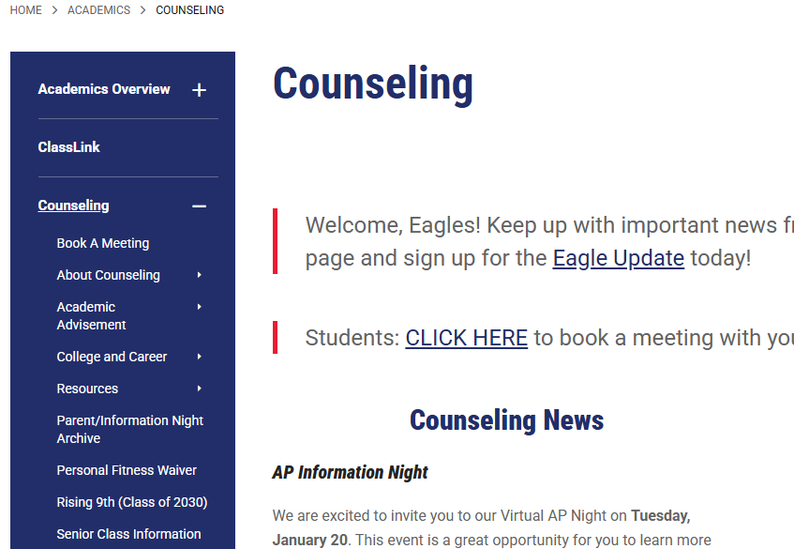
Your Top Resources for Information
Want to stay in the know?
Bookmark the Milton Counseling website
There is a now a Rising 9th Grade Page
Sign up for the Eagle Update
Update your email address in IC to receive IC Messenger emails
HOGLANDER

Slide 34
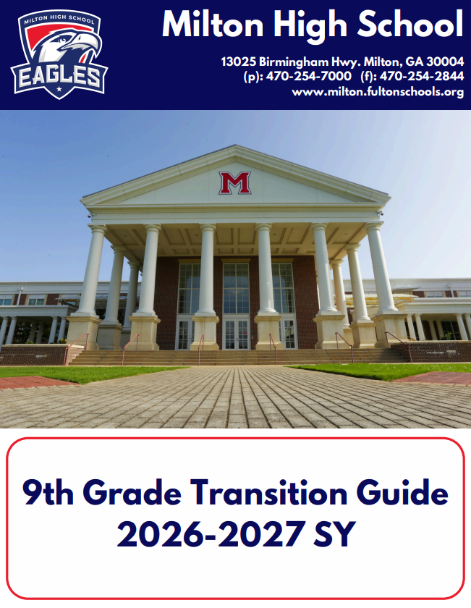
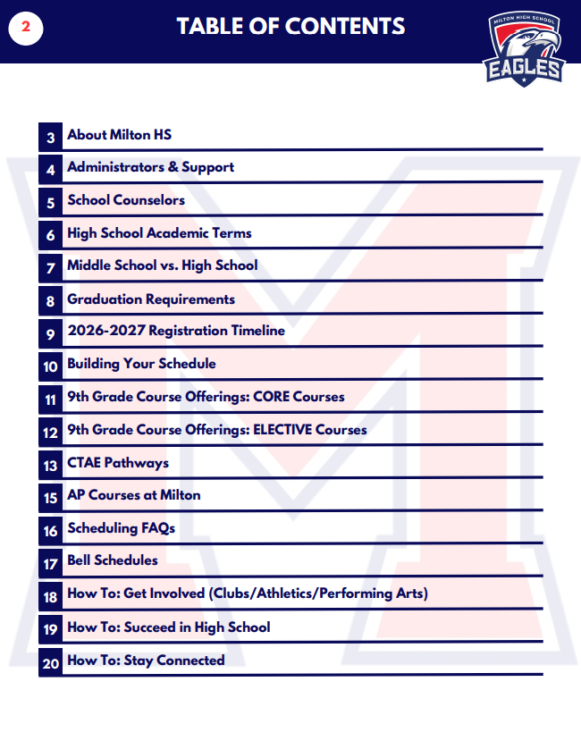
Rising 9th Grade Transition Guide
Milton Counseling Website > Rising 9th (Class of 2030) > Helpful Resources
This packet has a lot of information. Bookmark this resource to reference when you have questions!
HOGLANDER

Slide 35
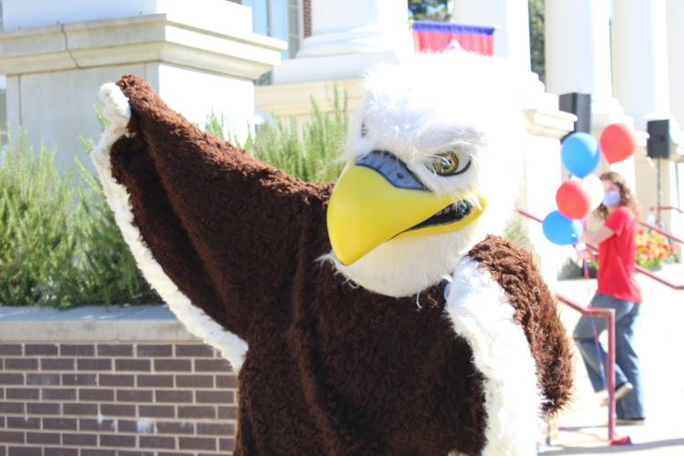
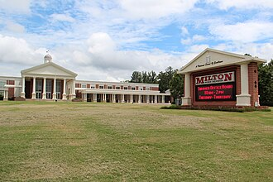
Tour the Nest Night
Save the date!
  April 1st at 6pm
Meet current students and your future classmates
Take a Scavenger Hunt around Milton's campus
Sneak a peek into MHS classrooms
More information will be put out through the Eagle Update as well as on the counseling website.
We can't wait to see you there!

Slide 36
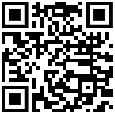
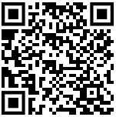
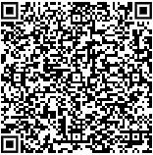
Instagram:
@miltoncounseling
Stay Connected
Counseling Website:
Homepage > Academics > Counseling
Eagle Update:
Weekly Newsletter
HOGLANDER

Slide 37
Questions?
Counselors are on duty to answer general questions tonight.
This is not the appropriate time to 4-year plan or ask college admissions questions. These discussions will happen with your assigned counselor once your student is officially enrolled at Milton.
Thank you and WELCOME TO MILTON!
HOGLANDER

