Slide 1
Annual Information Session
for Public Schools

Slide 2
What is College Credit Plus?
College Credit Plus is Ohio’s dual credit program
  Students can earn high school and college credit at the same time
  Ohio residents in grades 7-12; enrolled at a public/private high school or homeschooled
  Take a variety of courses at any public and participating private college in Ohio
  Courses held at the high school, on a college campus, or online
ORC 3365.02, ORC 3365.03
Notes:
Additional Notes for Presenters:
Students in the state of Ohio only
Variety of college courses available, HS credits can meet graduation requirements
3+ college credit hours = 1 HS unit
All public colleges/universities in Ohio, some private colleges, very few eligible out-of-state
Take classes in fall, spring or summer
Adhere to policies/requirements of college

Slide 3
How can students participate?
  Step 1: Eligibility
  A student is eligible for the College Credit Plus program if the student meets any of the following criteria:
    Obtains a remediation-free score on one of the standard assessment exams
    Has a cumulative unweighted high school grade point average of at least 3.00
    Has a cumulative unweighted high school grade point average of at least 2.75 but less than 3.00 and received an "A" or "B" grade in a relevant high school course.
ORC 3365.03, OAC 3333-1-65.14
Notes:
Additional Notes for Presenters:
Must meet only one, “multiple measures” of eligibility
Remediation free scores on ACT, SAT, Accuplacer, ALEKS, PlaceU, MapleSoft
May differ from tests taken for course placement

Slide 4
How can students participate?
Step 2: College Admission
Students must apply for admission at each institution
  Admission is reviewed per the requirements of the college or university; contact the college to find specific information
College applications include the permission slip for mature content and a questionnaire about emotional maturity
Colleges have the final decision on student admission
ORC 3365.05, 3365.035, OAC 3333-1-65.3

Slide 5
How can students participate?
Step 3: Course Registration
The college will discuss course options with the student, based on assessment scores, prerequisites, and other requirements
School counselors can help students understand graduation requirements and CCP course substitutions
High schools and colleges develop 15 and 30 credit hour pathways to help you determine your plan
ORC 3365.13
Notes:
Additional Notes for Presenters:
Students work with both a college advisor and their HS counselor to plan their courses
Some HS may have additional graduation requirements beyond the state requirements
Students are not limited to only taking courses on the pathways, they just exist as a guide/resource

Slide 6
Course Eligibility Rules
Students must complete their first 15 credits in Level I courses, which include:
Transferable courses
Courses in IT, Computer Science, Anatomy & Physiology, foreign language
Courses that are part of a technical certificate
Courses that are part of a 15- or 30-credit pathway
Courses in study skills, academic or career success
Notes:
Additional Notes for Presenters:
Colleges must post their Level 1 courses
Students can move on to Level II courses after completing 15 credit hours of Level I
Level II courses are any other allowable college courses that they meet the prerequisites for

Slide 7
Course Eligibility Rules
Non-allowable courses include:
Private applied courses with one-on-one instruction (such as performing art lessons)
Courses with high fees
Study abroad courses
Physical education courses
Pass/Fail graded courses
Remedial courses or sectarian/religious courses
OAC 3333-1-65.12, ORC 3365.13

Slide 8
How many classes can students take?
Students may be enrolled in up to 30 credits per year, which includes high school courses:
Calculation: 30 – (HS units x 3) = max CCP credit hours
The maximum number of college credits a student can complete while participating in the program is 120
If a student enrolls in more than 30 credits for the year, they can:
  Drop the course prior to the no-fault withdrawal date
  Pay for the entire course at the college’s standard rates (Option A)
OAC 3333-1-65.12, ORC 3365.13
Notes:
Additional Notes for Presenters:
The HS is responsible for calculating hours each year
The 30 credits per year is calculated with both HS and college credits; the 120 hours for the program is college credit only
Students who exceed 30 hours per year and choose to self pay would pay the college’s standard rate and the cost includes tuition, fees, and books
More info on option A later in presentation

Slide 9
Example on How to Calculate Hours
Example
  4 HS classes, HS CCP ENG, and HS CCP Calculus
    4 X 3 = 12 +3 (ENG) + 5 (MTH) = 20 hours
  3 HS classes, HS CCP GLG, Online PSY, ENG, SOC, Calculus
    3X3 =9 + 4 + 3 + 3 + 3 + 5 = 27 hours
** Student is responsible for tracking hours to make sure they stay below 30

Slide 10
Additional Considerations
Grades
  The final grades earned in the college course are the same grade that will be on the high school transcript
    CCP course grades will be factored into the high school and college GPAs
Grade Weighting
  High schools must weight all advanced standing courses in a subject area consistently(CCP, AP, IB, Honors)
ORC 3365.12, OAC 3333-1-65.2

Slide 11
Additional Considerations
Selective Service
Male students who are at least 18 years of age and Ohio residents are required to be registered with the Selective Service System
Students are required to provide their Selective Service number to the public college or university within 30 days of their 18th birthday
Failure to submit the Selective Service number will result in the student not being considered a College Credit Plus participant for that semester or term
  The student will be responsible for any tuition, textbooks, or fees associated with the course(s)
ORC 3345.32
Notes:
Additional Notes for Presenters:
- Some schools post a fee for students that fail to comply with selective service requirements

Slide 12
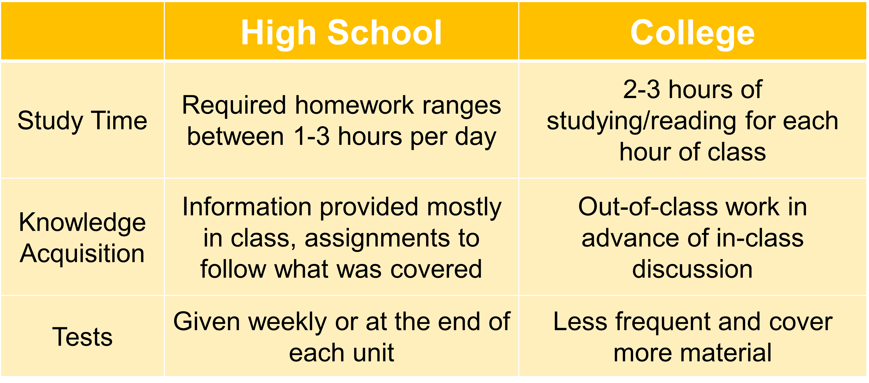
What are differences between high school & college?

Slide 13
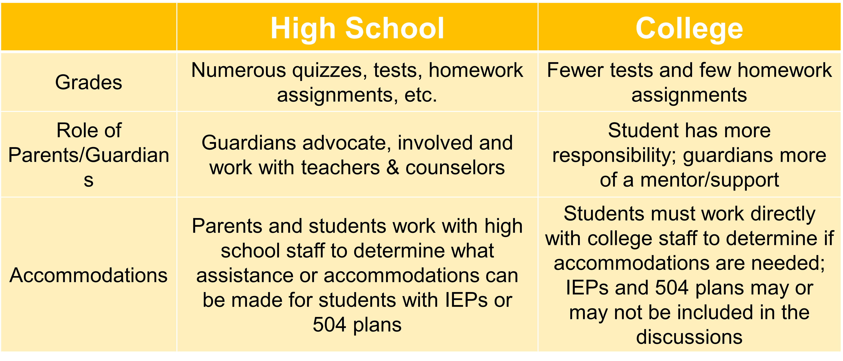
What are differences between high school & college?

Slide 14
What does it mean to be “college-ready”?
Being “college-ready” is more than just being academically ready
Consider emotional and social transition and college expectations
Consider time management and organizational skills

Slide 15
Am I Ready for CCP? (Students)
I earn A’s and B’s in my most rigorous high school courses
I turn in ALL work on time w/o prompting from teacher or parents
  Both in class work and online work (i.e. google classroom)
I meet ALL deadlines
I am self-motivated to do my best
I ask for help when I do not understand
I am a good time manager
I am organized
I am on time, never or very seldom late for class
I have good attendance

Slide 16
What are benefits of participating in College Credit Plus?
Students can:
  Earn high school and college credits at the same time
  Get a head start on career planning and earn degrees or certificate completions
  Experience college early to understand the expectations of college life
  Save tuition and textbook costs
Notes:
Additional Notes for Presenters:
Students get more flexibility in taking courses that interest them
Utilizing pathways can help cut down time to earning a degree
Many students are now graduating with a certificate, associates degree, or bachelor’s degree when they graduate HS

Slide 17
What are the consequences of underperforming?
Families may be asked to reimburse courses if:
The student does not earn a passing grade in their course
The student withdraws after the no-fault deadline at the college
NOTE: A student that is considered “economically disadvantaged” can not be asked to reimburse the cost of the course(s)
ORC 3365.09, 3365.091; OAC 3333-1-65.13

Slide 18
What are the consequences of underperforming?
College Credit Plus Probation
A student will be placed on CCP probation if:
  They earn less than a cumulative 2.0 GPA in CCP courses or
  They withdraw from 2 or more courses in one academic term
ORC 3365.09, 3365.091; OAC 3333-1-65.13

Slide 19
What are the consequences of underperforming?
While on CCP Probation, the student:
May only enroll in one College Credit Plus course for one college term (semester or quarter)
May not enroll in a college course in the same subject in which student previously earned D, F, NC grade (or equivalent grade)
If students on CCP probation do not increase their CCP GPA to a 2.0 or above during the probation term, they will be placed on CCP Dismissal
ORC 3365.09, 3365.091; OAC 3333-1-65.13

Slide 20
What are the consequences of underperforming?
College Credit Plus Dismissal
If a student does not raise their grade during the probation term, they are dismissed from CCP
While on CCP Dismissal, students may not enroll in any College Credit Plus courses
A student can request (appeal) to be reinstated in the program
ORC 3365.09, 3365.091; OAC 3333-1-65.13

Slide 21
What are the consequences of underperforming?
Appeals for Underperformance:
CCP Probation:
  Student may appeal to take a course in the same subject in which they previously earned a non-passing grade or received no credit
CCP Dismissal:
  Within 5 days of being dismissed, the student may submit an appeal to the secondary school to appeal CCP Dismissal or the student may appeal at the end of the CCP Dismissal semester
Note: Each school district must have a policy describing the process for appeals
ORC 3365.09, 3365.091; OAC 3333-1-65.13

Slide 22
What are the consequences of underperforming?
After HS Graduation:
Grades earned in CCP will remain on students’ college transcripts permanently
If students fail or withdraw often, future financial aid may be also impacted negatively
  Satisfactory Academic Progress (SAP) is a requirement for financial aid
  Standards vary by institution
ORC 3365.09, 3365.091; OAC 3333-1-65.13

Slide 23
What are the expenses for College Credit Plus?
Option A:
The family/student can choose to self-pay for college courses at the standard rate of tuition, fees, and textbooks
  Students/families should arrange a plan for payment with the college or university
Students can choose to earn college credit and high school credit OR only college credit
  Students must inform the school of their choice of credit for courses
ORC 3365.06
Notes:
Additional Notes for presenters:
Families must confirm with both the college and high school if they choose Option A
The deadline to choose is the college’s no fault withdraw date

Slide 24
What are the expenses for College Credit Plus?
Option B:
The “default” or standard option for College Credit Plus
All college course tuition, fees, and textbooks will be paid by the state of Ohio
  Supported by the school’s foundation funds and the college’s funds
Students will earn college credit and high school credit
ORC 3365.06
Notes:
Additional Notes for Presenters:
The default choice, but families can still confirm their choice of Option B by the no fault withdraw deadline
Students may be asked to confirm during the college advising process

Slide 25
What are support services are available for students?
Students receive support from both the HS and College:
High school counselors continue to provide assistance to all College Credit Plus students
College advisors provide course selection assistance
Colleges must provide the same academic supports to CCP students such as tutoring, library access, advising, etc.

Slide 26
What about athletic eligibility?
Student athletes should:
Learn the Ohio High School Athletic Association (OHSAA) requirements
Know that summer term CCP courses cannot be used to bring a student into compliance with the OHSAA requirements for interscholastic athletic participation

Slide 27
Will the course credits transfer?
Certain general education and technical courses will transfer, especially from one Ohio public college to another Ohio public college
Students must check with colleges to confirm transferability
Students should also visit https://transfercredit.ohio.gov for transfer information

Slide 28
What are the deadlines?
Intent to Participate
April 1: Complete and return the form to the school office. Submitting your form before this deadline allows you to participate in CCP for the full academic year
November 1: If you did not submit an Intent to Participate form before the April 1 deadline, you may complete and return your form before this deadline. Submitting your form before this deadline allows you to participate in CCP during the subsequent term.
Check ACT and SAT testing dates
Test early to meet college/university admission deadlines (if required)
Semester deadlines
Summer semester deadline will be early as classes usually start in May
Check with the college for all other semester deadlines

Slide 29
Next Steps
Contact the college and discuss assessment testing requirements
Complete the Intent to Participate form and provide to the school office by April 1 (Full Academic Year) or by November 1 (Half Year)
Apply for admission at the college of choice by the deadline
Attend the required CCP Orientation at your CCP Institution
Meet with your school counselor to discuss scheduling and graduation requirements

Slide 30
*Important Information For Parents*
You are a guide to help your child navigate the CCP and learn to advocate for themselves
You are there to offer support for you student
College instructors, College advisors, School CCP Teachers, and School Counselors are not permitted to discuss specific student questions and grades with parents. This can ONLY take place with the student present in person or in a phone call
Parents must be included on a FERPA release in order to be able to see final course grades/educational records/fees
In class grades and questions do not fall under educational records for FERPA
Family vacations are not considered excused absences for some colleges. This being said, CCP classes are taught in conjunction with Ohio colleges, and family vacations may not be an excused absence, and this situation will be handled according to the college policy. Always, best to talk to instructor prior to vacations to work out arrangements.

Slide 31
Do you have other questions?
Visit the CCP website for additional resources:
https://highered.ohio.gov/initiatives/access-acceleration/college-credit-plus
Follow up with us:
ODHE CCP Team (Higher Ed) CCP@highered.ohio.gov
ODEW CCP Team (K-12) CCP@education.ohio.gov

Slide 32
Room Assignments
Southeastern-Grand Hall
Shawnee- Grand Hall
Greenon - Grand Hall
Northwestern -HBC 113
Tecumseh- Turner Studio
Catholic Central- HBC 114
Springfield- HBC 115
Northeastern- Grand Hall
Kenton Ridge- Kuss Auditorium

