Slide 1



Test Administrator Training
February 2026
The Minnesota Comprehensive Assessments (MCA) and Alternate MCA/
Minnesota Test of Academic Skills (MTAS)
Spring 2026

Slide 2
Important Dates – Spring 2026
Testing Windows
MCA Reading & Math – March 2 – May 1
MCA Science – March 2 – May 8
MTAS Math – March 2 – May 1
Alternate MCA Reading & Science – March 2 – May 1
NEW!
Dates for PearsonAccess Next Tasks
MCA Reading, Math, & Alternate MCA Reading & Science
  Create Test Sessions: February 16 – May 1
MCA Science
  Create Test Sessions: February 16 – May 8
MTAS/Alt MCA LCI data entry available: Feb. 16 – May 1
MTAS Math Data Entry: March 2 – May 1
Dates for TestNav Tasks (staff)
Paper MCA Math & Reading Data Entry: March 2 – May 1
Paper MCA Science: March 2 – May 8
Alt MCA Reading & Science Data Entry: March 2 – May 1
  Note: for paper administrations, for online and hybrid administrations the responses can be entered during administration

Slide 3
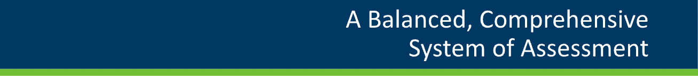
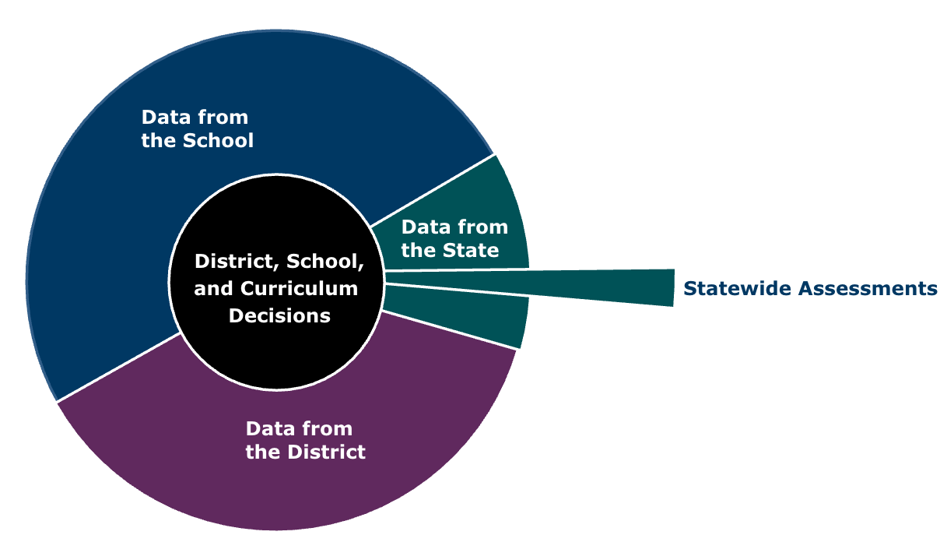
Introduction & Test Overview
Classroom Assessments:
Formative/Summative
Administered on a regular basis
Data used regularly mostly by teachers to inform instruction and to report student learning for grading purposes
Statewide Assessments:
Summative Assessments
Administered once a year
Data used by school and district leaders to evaluate curriculum and programming
Districtwide/School Assessments:
Benchmark/Interim Assessments
Administered periodically throughout the year
Data used by groups of teachers and educational leasers for long-term instructional planning
Purpose of MCA & MTAS/Alt MCA:
The primary purpose of the standards-based accountability assessments is to measure student learning of the Minnesota Academic Standards, to which both the MCA and MTAS/Alt MCA are aligned.
The MCA & MTAS/Alt MCA are designed to provide a snapshot of student learning of the grade-level Minnesota Academic Standards.
  As academic standards are revised, a new series of assessments are developed to align with the updated standards.
The MCA & MTAS are criterion-referenced assessments, which means they measure performance against a fixed set of criteria to determine student learning of concepts and skills defined in the standards. While criterion-referenced tests may provide information about the extent to which students have learned certain concepts, they alone do not illustrate the whole picture of what a student has learned. These assessments provide one data point that should be considered in the context of additional evidence of student learning, such as student projects and assignments, and other data from the district’s comprehensive assessment system.
More information:
  Academic Standards: education.mn.gov/MDE/dse/stds/
  Test Specifications: education.mn.gov/MDE/dse/test/spec/
  MDE Procedures Manual for MN Statewide Assessments 2025-2026

Slide 4
Test Structure – What’s New for 2026
MCA Math:
Students can use the pencil tool to draw or write directly on all questions
Students can use the protractor tool on specific grade 4 questions to measure angles
Grade 4 questions now have the ruler tool available
MCA Reading:
Updated to assess the 2020 MN State Academic Standards for Reading
  Change from MCA-III to MCA-IV
Glossed word lists provide concise definitions or explanations of terms in English, the glossary feature is available on the test items, not the reading passages
  Headphones are now required for the Reading MCA
Accommodations updates:
  Paper tests:
    A separate passages book will be provided automatically with the Reading MCA paper test book
    Large Print 18-pt font Paper test has been improved
      24-pt font no longer available
    Script/Human Reader: Read-aloud accommodations will be an approved accommodation for a small number of students who meet specific criteria (accommodation must be approved by MDE each year to be provided)
Alternate MCA Reading:
Replaces MTAS Reading → Updated to assess the 2020 MN State Academic Standards for Reading
Modes: online, hybrid, or paper
  Mode does not need to be determined in IEP
  Can change during administrations as needed
  Online – has a variety of embedded tools and accessibility supports
Both Reading assessments:
There will be no Preliminary Results and Final Results will be delayed
  Standard setting for the new assessment delays results distribution

Slide 5
Test Structure
Who takes what:
Assessment | Subject | Administered in Grades
MCA or Alt MCA | Reading | 3-8, 10
MCA or MTAS | Math | 3-8, 11
MCA or Alt MCA | Science | 5, 8, High School*
*High school Science MCA/Alt MCA is administered the year a student is completing their Life Science/Biology coursework
All MCA subjects are administered online via student iPads
  Paper accommodations available as indicated on IEP or 504 Plan
MCA Reading and Math are adaptive assessments
MCA Science is a Fixed-form assessment
The MTAS and Alternate MCA is a performance-based assessment in reading, mathematics, and science for students with the most significant cognitive disabilities, and it is available in every grade in which the MCA is available. The MTAS is an alternate assessment based on extended standards of the Minnesota Academic Standards that have been reduced in breadth, depth, and complexity.
More information can be found on the MDE MTAS Participation website:
education.mn.gov/MDE/dse/test/mn/mtas/
All MTAS/Alt MCA subjects are administered in a 1-on-1 setting
MTAS Math is a Paper administration and the Test Administrator scores tasks using a rubric
Alt MCA Reading & Science have 3 administration mode options: paper, hybrid, online. Which to use is based on individual need and can be changed during administration if needed
What is an adaptive assessment?
The assessment adjusts to each student’s performance at an item level. Each item (for mathematics) or passage(s) with associated items (for reading) is selected based on student performance on items taken earlier in the test. This produces an individualized assessment that is well-tailored to measure each student’s proficiency, while still meeting the test specifications.
What is a fixed-form assessment?
Each item is pre-selected. While students are presented with the same items that count for their score, there are multiple forms of the test and the placement of these items varies. These items are selected to meet the content requirements specified in the test specifications.
Notes:
Full-time PSEO students are public school students who attend a postsecondary institution full time during testing. These students are reported as PSEO in enrollment data.
- Districts are responsible for administering the standards-based accountability assessments to these students if they are present when testing is scheduled. If not present, the student’s record will appear in PearsonAccess Next, but the student will not test. No further action is needed

Slide 6
Test Structure – Form Group Types
MCA Reading
MCA Mathematics
MCA Science
Main (online test session)
Data Entry (paper accommodated test session)
Script (online Science accommodation)
Only paper accommodated tests are to be put in a data entry session
Paper MCA responses must be entered into TestNav by the Test Administrator or Coordinator within 2 days of test administration
MTAS Math
Data Entry
  Students are not grouped into test sessions
  Responses are recorded on the Data Collection Form
LCI (Learner Characteristic Inventory) data must be entered in PearsonAccess Next before any MTAS data can be entered
All MTAS data is entered into PearsonAccess Next by the Test Administrator or Coordinator within 2 days of test administration
Alt MCA Reading & Science
Students are placed in a Test Session in PAnext
LCI (Learner Characteristic Inventory) data must be entered in PearsonAccess Next before any Alt MCA data can be entered
For online and hybrid Alt MCA, responses are entered into TestNav directly
For paper Alt MCA, responses are recorded on the Data Collection Form and later entered in TestNav by the Test Administrator or Coordinator
  Alt MCA responses must be entered into TestNav by the Test Administrator or Coordinator within 2 days of test administration
Note: Pearson does not score any paper administered MCA/MTAS/Alt MCA tests - student responses MUST be entered into the system by the school to be scored

Slide 7
Selecting Test Monitors/Administrators
Test Monitors for MCA
Test Monitors should be selected from the highest possible ranking from the list below. If a school has exhausted the availability of persons in category “1,” it should select staff in category “2,” and so on.
Licensed teachers or administrators who work in the school
Licensed teachers or administrators who work in the district
Paraprofessionals who work in the school
School district personnel employed by the school district
Licensed substitute teachers
  Long term substitute teachers may be Test Administrators/Monitors, daily substitute teachers may NOT
Test Administrators for MTAS and Alternate MCA
For MTAS/Alt MCA, MDE strongly recommends that the Test Administrator be someone who is familiar with the student’s response mode, who works with the student during instruction, and with whom the student feels comfortable. If this is not possible, Test Administrators may be any district employee who has completed the applicable MTAS/Alt MCA Test Administrators training in that academic year.
Other Staff:
Only trained staff involved in testing are allowed in the room during testing.
In addition to Test Administrators and Test Monitors, any individuals in the room during test administration, like paraprofessionals, must complete required trainings each school year, including the Test Security Training.
Non-school personnel cannot be present in the testing room. However, they are allowed to be involved with testing in other capacities (for example, volunteers assisting as hall monitors) if they are directly supervised by school personnel. They must also complete the Test Security Training.
Student teachers are allowed to be in the testing room during test administration because they are involved in daily instruction of students. They must complete required trainings for their role. However, student teachers cannot be the sole Test Administrator or Test Monitor, unless they hold a substitute teacher license.
A parent/guardian or relative cannot be involved with their student’s test administration or be in the same room during testing at any time. For this policy, relatives are defined as children, stepchildren, grandchildren, nieces, nephews, siblings, in-laws, spouses, and persons under guardianship.

Slide 8
Staff Roles and Responsibilities
Test Monitors/Test Administrators
Attend training provided by SAC
Complete required training in LMS
Become familiar with procedures for test accommodations
  Who will need what and how to provide
Administer the MCAs while maintaining test security
Actively monitor students during test sessions
For Paper Tests:
  Properly accounts for test booklet security immediately before, during, and after test administration
  Ensure that student responses are entered into TestNav/PAnext after administration

Slide 9
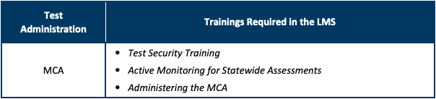
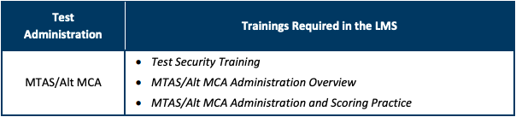
Test Monitor/Administrator Training
MCA Test Monitors
Per MDE: MCA Test Monitors must complete the following three required training courses annually:
MTAS and Alternate MCA Test Administrators
Per MDE: MTAS/Alt MCA Test Administrators must complete the following three required training courses annually:
Optional trainings for Test Administrators:
The following courses are available to support Test Administrators
Learners in the Learning Management System
Handling Secure Paper Test Materials
Understanding MCA Universal Supports and Accommodations
All trainings are housed in LMS: https://mn.mypearsonsupport.com/training/
Resources for Test Administrators:
Test Directions: https://mn.mypearsonsupport.com/test-administration-resources/
User Guides: https://mn.mypearsonsupport.com/user-guides/
MTAS/Alt MCA: https://mn.mypearsonsupport.com/test-administration-resources/
Test Administrators may NOT have access to secure testing materials until fully trained

Slide 10
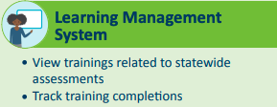
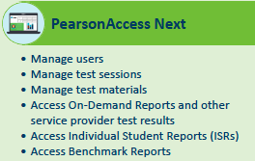




Websites and Accounts
Training Site:
Assessment Management System:
https://mn.mypearsonsupport.com/training/
  Both are password protected:
  DAC give SACs access
  SACs give testing staff access
  Username: @spps.org email address
https://mn.pearsonaccessnext.com/
NEW!
Resource Websites:
SPPS MCA Test Coordination
SPPS and MN specific resources
Links to Pearson sites
Training resources
Manuals
Accommodation information
Link to MCA Family Information site
https://mn.mypearsonsupport.com/
Student Readiness Tools
Test Directions
User Guides
spps.org/about/departments/research-evaluation-assessment/test-coordination/mca
Student Testing App:

Slide 11
Test Monitor Training
School Test Administrator Training
Please make sure you signed in on the provided training sign-in sheet
Training guidance can be found on the SPPS/REA MCA Test Coordination website under “Training” > LMS Resources
  https://www.spps.org/about/departments/research-evaluation-assessment/test-coordination/mca
Test Administrators may NOT have access to secure testing materials until fully trained
  This includes completing all required LMS trainings
Please note:
All test items are secure
Discussions of items are not allowed with students or co-workers (or anyone)
Test Administrators are impartial observers during the test administration
Test items and student tests are not allowed to be reviewed by teachers or school staff
Reproducing or paraphrasing an item in an email or other writing is a security breach
Cell phones and wearable technology (e.g. smartwatches, fitness trackers, Bluetooth headphones) or any other device that can electronically send, receive or capture information is strictly prohibited (see page 14)
Dictionaries may not be used
External/hand-held calculators can not be used on gr. 3-8 Math MCA unless on IEP
Process for managing and securing materials
  Test tickets are secure and must be collected from students before leaving the testing room, securely destroy once done
  Scratch paper is also secure and must be collected from students before leaving the testing room and then securely destroyed
What to do for misadministrations, irregularities and TARs (Test Administration Reports), see page 27
How to reach SAC if needed
Access to basic tech troubleshooting information, see page 28
‘Testing – Do NOT Disturb’ signs must be posted outside of all testing rooms
How accommodations will be communicated and supported
  SACs have list of who needs what accommodations
  Guidance on providing accommodations can be found on the SPPS/REA Test Accommodation website: https://www.spps.org/about/departments/research-evaluation-assessment/test-coordination/accommodations

Slide 12
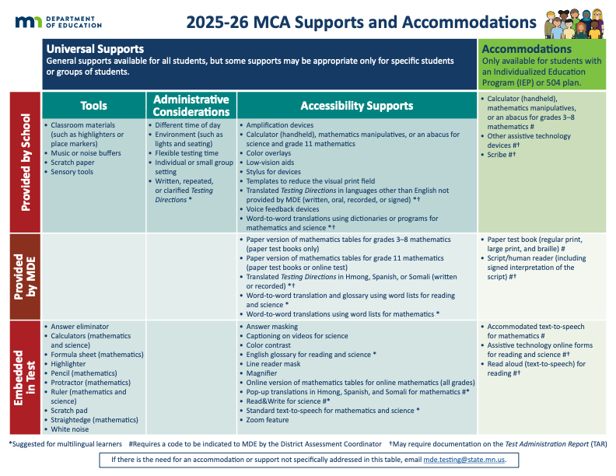
Accommodations and Universal Supports continued
More information about available in the
Guidance for Universal Supports and Accommodations for MN Statewide Assessments

Slide 13
Test Monitor Training continued
Materials Allowed when taking The MCAs
The following materials are to provided for students for the administration:
  Student testing device (usually iPad)
  Student login information (Test Ticket)
  Scratch paper (students must write their name on it, turned in at end of test session)
  A pen or pencil
    Headphones for all subjects (Text-to-Speech, Glossed words, white noise, etc.)
      Remember Bluetooth headphones are not allowed
    Hard-copy of formula sheets, Mathematics (grade specific)
    Hard-copy versions of multiplication and hundreds tables for Grade 11 Math ONLY
    Handheld calculators
      Grade 11 Mathematics only and all Science MCA
      Calculator Guidelines available on the REA Test Coordinator website
    Items approved for accommodations and/or supports
Materials Not Allowed when taking The MCAs
• Dictionaries, thesauruses and other reference materials are not permitted
Calculator manuals are not permitted
Handheld calculators are not allowed for the grades 3–8 for the Mathematics MCA, unless specified in IEP. Students who require a handheld calculator as an accommodation must use a paper accommodated test book
  Test Monitors must actively monitor the student(s) so their handheld calculators are not used on non-calculator test items
• Cell phones and other electronic device, including smartwatches or other “wearable” technology, must be turned off and stored / not visible before the start of testing and throughout test administration and breaks
All academic or instructional posters and graphics, including strategy techniques or methods, in the testing room or on a student’s desk must be covered or removed during test administration. This also includes academic or instructional information not related to the subject being tested (for example, science information must be covered even if reading is being tested)
  There is not a list of materials that can remain visible to students during testing, if there is any doubt if a material is allowed – cover or remove them

Slide 14
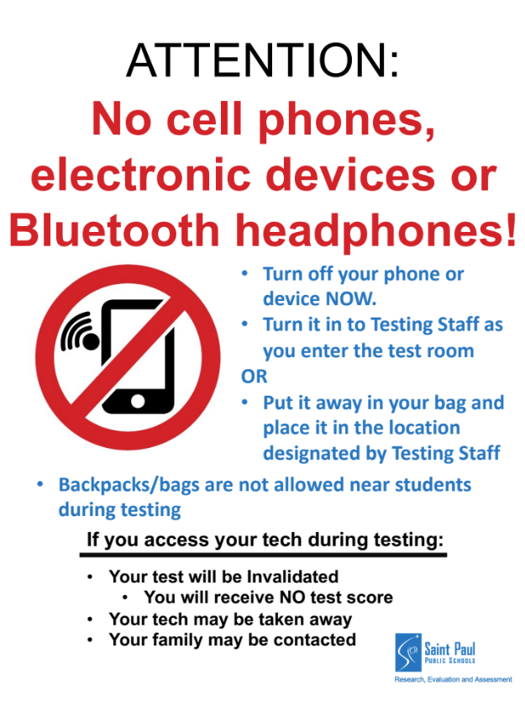
Test Monitor Training continued
Cell phones, Bluetooth headphones and other technology
Students may not have any electronic devices at any point during the testing session
Students who access technology while testing may have their test domain invalidated
  Report any infraction via a TAR
Do not allow any backpacks, bags, coats, etc. in the students’ testing space
All devices should either not enter the room or be turned into the Test Administrator
Post this notice inside and outside of the testing rooms
Test Monitors & Cell Phones
To allow Test Monitors to continue active monitoring with the least disruption, Test Monitors may use their cell phone ONLY to alert others that assistance is needed.
  Must be put away/not visible and silenced when not in use to request assistance
Examples of materials provided to Test Administrators for Online MCA by SACs
Test Directions
Student Test Tickets (secure)
Do Not Disturb sign (1 per door)
Cell phone/device sign (1 per door plus one for in room)
Test Session Attendance Form
TAR
Scratch paper & pencils (sometimes provided by Test Administrator, used scratch paper is a secure material)

Slide 15
Test Monitor Training continued
Reminder!
  Students must be actively monitored by trained staff at all times and cannot be left unsupervised at any point during the test administration
    This also means that Test Administrators cannot be working on any other tasks beyond test session specific tasks
What help can Test Monitors give to students?
Repeat the Test Monitor Directions as written. Scripted directions that Test Monitors will use during online test administrations are included to the Test Monitor Directions
Test Monitors may not paraphrase Test Monitor Directions, define or pronounce a word within a test item, discuss a test item or give an opinion regarding a test item. The only directions Test Monitors can give students are those that are scripted in the Test Monitor Directions
Students must be familiar with how to answer different types of items and Test Monitors cannot provide assistance
Students must be familiar with the functionality of calculators or online tools they are using prior to the start of testing; Test Monitors cannot provide assistance with calculators or online tools
If a student points out a test item that appears to have an error, the Test Monitor should instruct the student(s) to continue the test and note the grade, subject, form (if applicable), test session ID (online assessment only), student MARSS number (online assessments only), item number, and what was wrong. NEVER TAKE A PICTURE!
  Following the testing session, the Test Monitor should notify the School Assessment Coordinator, who will notify the District Assessment Coordinator
  The District Assessment Coordinator will contact MDE and give the information collected by the Test Monitor
  The content of the item itself should never be referenced, copied or emailed within the school or district or in a communication to MDE
More support information available in the Testing Directions: Online Spring 2026
  https://mn.mypearsonsupport.com/test-administration-resources/

Slide 16
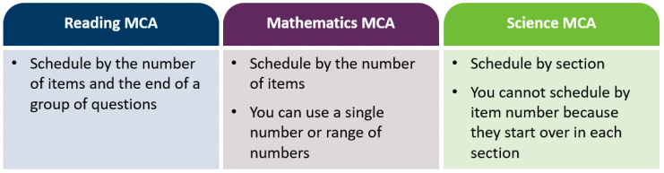
Test Scheduling
Scheduling the Online MCAs
No test sessions will be scheduled for the last week of the window, that week is for Makeups only
Students are not required to exit in the same place as other students
Students must answer each item before they can go on to the next item
Students can review their answers before exiting the test or before going on to the next group of questions for Reading and Mathematics or a section for Science
  Note: Once students go on to the next group of questions (Reading and Mathematics MCA) or section (Science MCA), or exit the test for more than 20 minutes, they cannot go back to items completed previously
Test monitors must use the scripted language in the Testing Directions: Online to alert students prior to the end of the day’s testing session so students have time to review their answers before exiting
Testing Directions: Online can be found at
https://mn.mypearsonsupport.com/test-administration-resources/
Options for scheduling:
By number of items/section
This is an option if wanting to ensure students complete the test in the same number of days
Remember to give enough time to complete this goal
Keep in mind that some students may not be able to complete the items planned for the session, you need to have a plan in place to address this situation (such as, students finish the items in a different testing location, or students resume where they left off on the next day of testing).
By sessions based on time estimates
Estimated testing times listed on the following pages

Slide 17
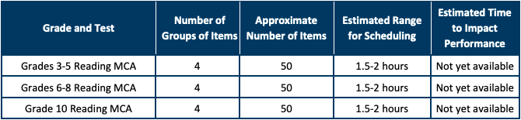
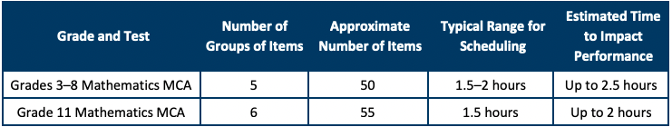
Test Scheduling continued
The Estimated Time to Impact Performance column provides information related to student performance and the amount of time spent testing. Based on past administration data, average scale scores increased as time spent testing increased, up to times listed below. Beyond this point, the average scale scores plateaued or leveled out. As such, scheduling more than the estimated time to impact performance might not lead to significant gains in student achievement.
The estimated times do not include:
Time for students to sign into the test
For Test Monitors to provide scripted directions from the Testing Directions: Online and answer student questions
Time for completion of item samplers or viewing of the online student tutorial
Estimated Test Administration times for Online Reading MCA
New!
Tables including the number of items by section, are provided in the Testing Directions
Estimated Test Administration times for Online Mathematics MCA
Tables including the number of items by section, are provided in the Testing Directions
TestNav Availability:
Student Testing: Monday-Friday, 6am to 5pm
Data Entry: Monday-Friday, 6am to 7pm

Slide 18
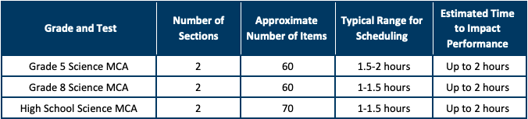
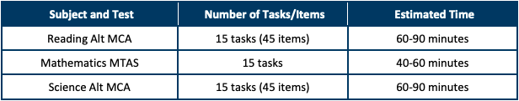
Test Scheduling continued
Estimated Test Administration times for Online Science MCA
Tables including the number of items by section, are provided in the Testing Directions
    High School Science MCA
    Only students completing their Life Science (Biology) course work this school year
    A guide has been created to help define exactly which courses make a student eligible to take the High School Science MCA
      Available on REA: Test Coordination > MCA Test Coordination website
    Estimated Test Administration times for Paper MCA are slightly longer than those for Online MCA times
    Estimated Test Administration times for MTAS and Alt MCA
For both Paper MCA and MTAS/Alt MCA
Pearson does not scan Paper MCA, MTAS, and Alt MCA materials or forms
Test Administrator or SAC must enter student responses into the Pearson system within 2 days of test administration
  Paper MCA and Alt MCA via a Test Session in TestNav
  MTAS via data entry in PearsonAccess Next

Slide 19
Preparing Student iPads
Testing App: TestNav
TestNav will be automatically pushed out onto to student iPads
If TestNav is not on the iPad, it can be downloaded via Self Service
  Either search for “TestNav” then select ‘Install’
  Or find “TestNav” under Online Testing, then select ‘Install’
  Do NOT delete TestNav from an iPad
    In some cases, it doesn’t actually uninstall. The app is still on the iPad but now there is no icon.
Student must select Minnesota when accessing TestNav for the first time
iPad iOS Requirement: 17.3+, 18.x, 26.x
Can students access their test any time, any place on their iPad?
No:
    SACs can activate the ‘lock’ feature in test sessions in PearsonAccess Next
    Student tests can only be logged into on weekdays between 6am-5pm
    Students can not resume testing once logged out until the SAC “Resumes” their test in PearsonAccess Next
MCAs on Computers:
Students may take the MCA on a computer (desktop or laptop w/mouse)
Log on to the computer using “pearson” for both the username and password
System should launch directly into TestNav, if it does not double click TestNav icon to open
If needed, TestNav is available for download or update in Self Service
Computer tech requirements:
  Mac: OS 14, 15,
  Windows: 10 x64 or 11 x64
Student must select Minnesota when accessing TestNav for the first time
Wi-Fi should be connected to either SPPS-INTERNAL or SPPS-Secure

Slide 20
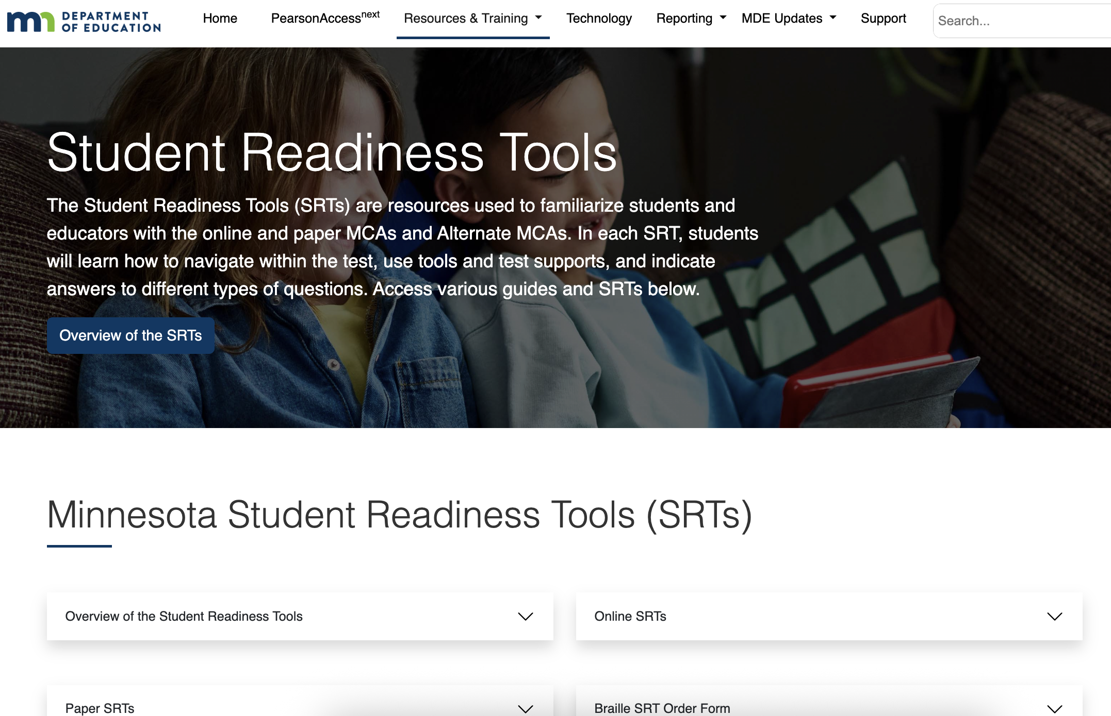
Preparing Students for testing
Student Readiness Tools (SRTs)
- Replaces Item Samplers and Student Tutorial
How to access: https://mn.mypearsonsupport.com/ > Resources & Training > Student Readiness Tools (SRTs)
Direct link: https://mn.mypearsonsupport.com/readiness-tools/
The paper SRTs are available for students taking an MCA paper test. The paper SRTs help students learn to handle the paper test books and how to write their answers to different types of questions. Large print, Braille, and script resources are also available.
Educator guides for both the online and paper SRTs are available. Supplemental information for the online SRT tutorials is also available, which provides detailed information about all functionality.
For MTAS, sample Task Administration Manuals, Presentation Pages, and Response Option Cards are available to prepare both Test Administrators and students for test administration. Sample materials are also provided for the tasks being field tested for the upcoming Math Alternate MCA.
For 2025-26, Reading SRT has been updated for the MCA-IV
For 205-26, Reading Alternate (Alt) MCA SRTs are available for students taking online, paper, or hybrid administrations of the Reading Alt MCAs. Educators can use the SRTs to familiarize themselves with the Alt MCA test environment and then simulate the test for students using the online and paper practice questions.
No login information is needed for the online SRTs. Students select their grade level to review videos and practice activities to learn how to navigate within the test, use the tools, and answer question types.

Slide 21
Parent/Guardian Refusals
Federal and state statutes require all eligible students participate in statewide assessments. It is considered an unethical practice to exclude students from the assessments by actively encouraging students or Parents/guardians to refuse testing.
How do families know about opt outs:
Per MDE, Districts must post the current year’s complete form on the district website and include it in the district’s student handbook
  SPPS posts the form on both the ACCESS and MCA Family information websites and the complete form is in the District Student Handbook
In order for parents/guardians to make fully informed decisions regarding their child’s participation in statewide assessments, districts must provide complete and transparent information when asked by parents/guardians if they can refuse testing; this information must be provided upon request in a timely manner. However, districts are not required to send out specific communications regarding parent/guardian refusals.
  In the MCA announcement letters from SPPS it states, “If you have questions about your student’s participation, please reach out to your child’s principal.”
Per MDE, only written forms of refusal are accepted (e.g. MDE Form, written letters, and emails) Texts, phone calls, and verbal notification NOT accepted
School staff may NOT:
Discourage families or students from testing
Pre-fill out the refusal form
  ONLY a parent or guardian should be completing this form
No school generated forms → if providing a family with a form, it must be both pages of MDE’s Statewide Assessments: Parent/Guardian Participation Guide and Refusal Information
Schools are not required nor expected to provide alternative educational opportunities while other students are testing for students whose families refused testing.

Slide 22
Family Communication
MCA announcement letter - required
Sent out by schools in their regular form of family communication (e.g. Principal’s newsletter, weekly update, Seesaw, or Schoology, etc.) - must include:
Our students in grades 3-8, 10, 11, and those taking high school Biology will be taking the MCA assessment in the months of March through May (you can be more specific if desired)
Brief 'what are the MCA & MTAS/Alt MCA assessments’
Where to find more information (MCA Family Test Information site: spps.org/about/departments/research-evaluation-assessment/test-coordination/mca-family-information)
Who to contact with questions
Generic announcement letters are available
REA: Parent/Guardian Information on Statewide Testing website
spps.org/about/departments/research-evaluation-assessment/test-coordination/mca-family-information
MCA & MTAS/Alt MCA Parent Fact Sheets
MCA & MTAS/Alt MCA ISR (Individual Student Report) guides
All documents available in multiple languages
Parent/Guardian Guide and Refusal for Student Participation in Statewide Testing
Links to MDE Family State Testing websites

Slide 23
Testing Directions
Test Monitor Directions:
The Testing Directions: Online contain
  General instructions for Test Monitors about test administration
  Scripted directions that must be read to students for every test session
  Guidance on supporting student during the test session
  A transcript of the Student Directions that are embedded in the students’ tests
    Student Directions are automatically displayed in the first section of each MCA subject
SACs must provide all Test Monitors with printed copies of, at minimum, the following sections of the Testing Directions: Online (pages 1-10 & 32-33)
  Script to Read to Students – for every test session
  Answering Questions and Providing Assistance
  Transcript of Student Directions
The SAC will send the full 33-page Test Directions: Online (PDF) to Test Monitors by email
Test Directions (for Online and Paper) are available on the Minnesota Assessment Hub: Test Administration Resources website:
  https://mn.mypearsonsupport.com/test-administration-resources/
  Translated versions are available
Student Directions:
Student Directions are embedded in the first section of the student online tests
Students will read/listen to these directions after they login and before they begin the first section of each test subject
An Overview of Student Directions is available on the Minnesota Assessment Hub: Test Administration Resources website:
  https://mn.mypearsonsupport.com/test-administration-resources/
The Transcript of the Student Directions is available on pages 32-33 of the Test Directions

Slide 24
During a test session
Breaks
Cover screen or close test book
  Test content should not be visible or easily accessible to others
Only one student out for a break at a time
  They are NOT allowed to access technology (e.g. cell phones) during their break
Plan for if a Student Finishes the Test Early
Develop a plan for students who finish early during the testing session or need extra time to finish, as well as for students who finished in a previous testing session.
This must be clearly communicated to Test Monitors
If students finish early during the testing session and stay in the testing room, they may read a paper book or complete activities on paper that are not related to the subject being tested
  No access to technology allowed – this include iPads
Know that students who have finished in a previous test session are not allowed to be in the testing room on subsequent days of testing.

Slide 25
Data Entry
All data must be entered into the Pearson systems within 2 days of test administration
MCA Paper
  MCA Data Entry session must be created in PAnext
  Test Administrator or SAC logs into TestNav app and enters the student’s responses from the paper test booklet
Alt MCA Reading & Science
  Alt MCA session must be created in PAnext
  LCI data must be entered into PAnext
    SAC can give Test Administrators access
  For online or hybrid: responses are entered directly into TestNav during administration
  For paper: responses are recorded on Data collection sheet and later entered into TestNav by the Test Administrator or SAC
MTAS Math
  MTAS data is entered directly into PAnext
  LCI data must be entered first
  SAC can give Test Administrators access
Detailed guidance on the User Guide page of the MN Assessment Hub
  https://mn.mypearsonsupport.com/user-guides/

Slide 26
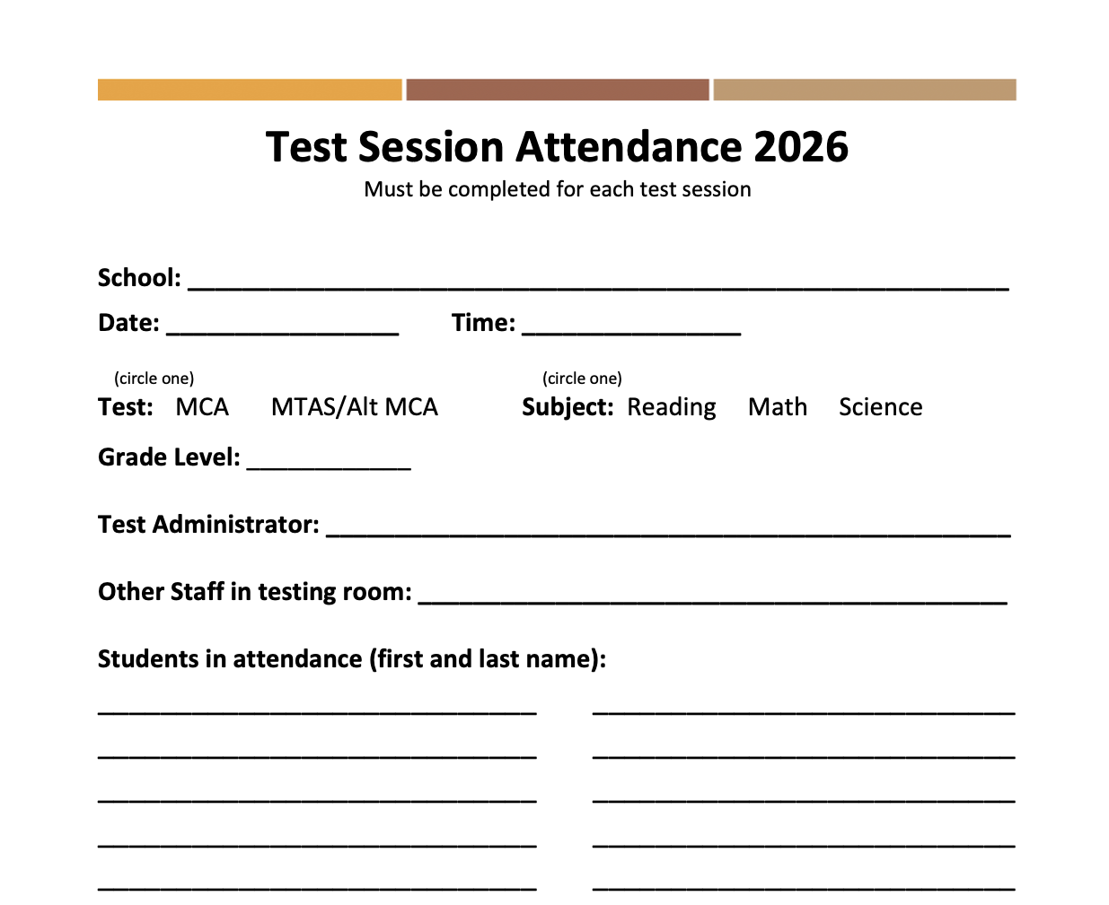
Monitoring Progress
Tracking session attendance:
Per MDE, we must track which students test with which Test Administrator for all test sessions, ideas for tracking:
Test Session Attendance Form, one per test session- available on SPPS Testing website
Session Roster from PAnext (Reports > Operational Reports > Online Testing > Session Roster), print new roster for each test session
Classroom roster
Google Sheets/Excel
What ever form it must include: who tested, adults in the room, date, subject tested
View online testing progress in PearsonAccess Next
Under Testing > Students in Sessions
  Select a test session to view student progress
    Ready, Testing, Exited, Resume, Complete
  Select individual students to see how far they have progressed
Detailed directions on accessing the Student Status Dashboard in PearsonAccess Next available in guide on the SPPS MCA Test Coordination website

Slide 27
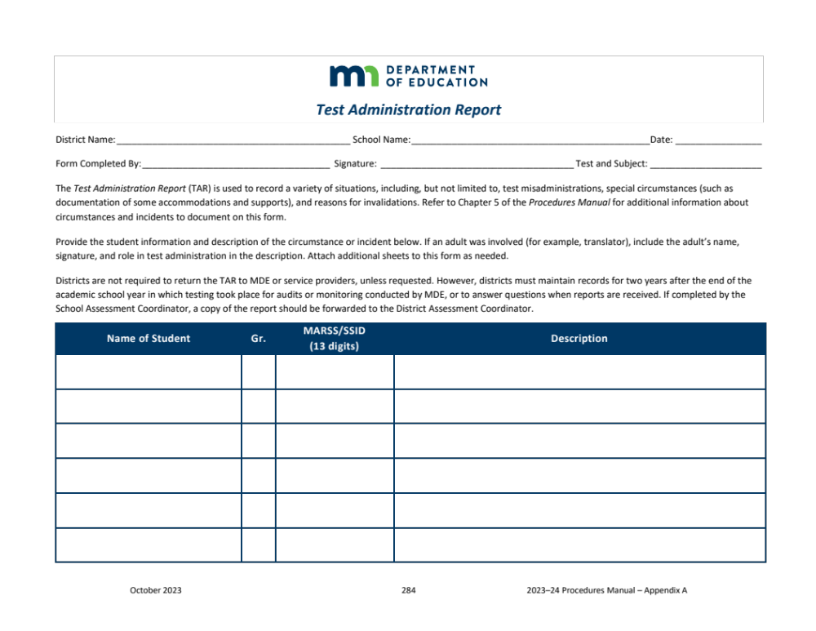
Test Administration Report (TAR)
  TAR is used to record test misadministrations and reasons for possible invalidations
  Test Administrator completes the TAR and the SAC forwards a copy to Jessica ASAP (within 24 hours of incident)
  TAR must be kept with REA at 360 Colborne for two years per MDE
  Blank TAR form is available in your SAC folder and on SPPS Test Coordination website: spps.org/about/departments/research-evaluation-assessment/test-coordination
Examples of misadministrations
  Student engages in inappropriate behavior or action that results in a test being invalidated
  Student refuses to take an assessment or cheats on an assessment, requiring the assessment to be invalidated
  Student’s responses are transferred by staff incorrectly to a scorable answer document or onscreen (online)
The MCA/MTAS Irregularities Doc. will be available on the REA website

Slide 28
Tech Support
If a student can not login to their test:
Double check they are entering their login credentials correctly
Check that it says Minnesota above the Username prompt
  If not, correct by going to User dropdown menu in upper right corner and select Choose a different customer
Double check that the Test Session is Started in PearsonAccess Next
Double check the student’s test has been Resumed in PearsonAccess Next
  Only if this isn’t the first time the student has logged in
  The SAC has access to all test sessions in PA Next
Steps to perform a ‘Hard Reset’ on an iPad
Press and quickly release the volume button closest to the top button
Press and quickly release the volume button farthest from the top button
Press and hold the top button until the device begins to restart
How to available on SPPS MCA Test Coordination website
System Requirements:
iPad iOS of 17.3+, 18.x, 26.x
Mac computers: OS 14, 15, 26
Windows computers: 10 or 11 (64 bit)
Most recent version of TestNav
– available in Self Service
If an error appears, note the Error Code and contact Jessica Lang
jessica.lang@spps.org
Office: 651-744-2119
If we can not fix the issue, then we will submit a service ticket to Technology Services
Link to Pearson System Status website
Link to TestNav support website

Slide 29

MDE Site Monitoring
MDE Site Visit Checklist
MDE has compiled a list that outlines the areas that MDE monitors will observe or discuss during a monitoring visit of ACCESS or MCA administrations. Areas of observation:
Interview with District/School Assessment Coordinator
Observations
The posting and accuracy of the school’s testing calendar
The MDE Minnesota Assessment Monitoring Checklist is available here on the SPPS Test Coordination website: spps.org/about/departments/research-evaluation-assessment/test-coordination
MDE also requires District staff to conduct random, unannounced observations of testing rooms to confirm adherence to state and district assessment policies and procedures
  Trained district staff will visit a few schools during the MCA testing window

Slide 30
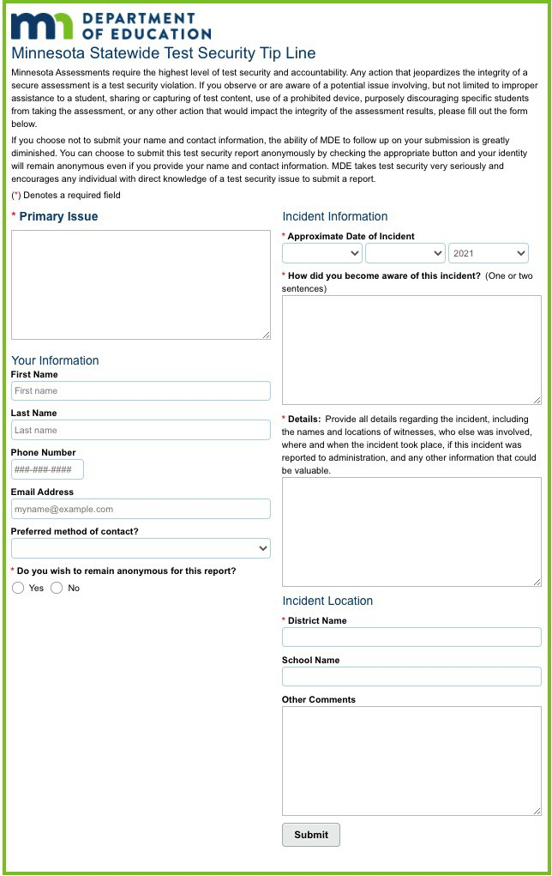
MDE Test Security Tip Line
MDE Tip Line – open to the public
https://public.education.mn.gov/tip/
MDE has a Test Security Tip Line
Educators, parents, students and others can report suspected incidents of cheating, improper or unethical behavior on any Statewide assessments
Links to the Test Security Tip Line are available in two places on the MDE web site https://education.mn.gov/MDE/
˗ View the Statewide Testing page
(MDE > Districts, Schools and Educators > Teaching and Learning > Statewide Testing)
- Under ‘Reporting Testing Administration Concerns’
˗ View the Family Test Security page
(MDE > Students and Families > Programs and Initiatives > Statewide Testing > Student Participation)

Slide 31
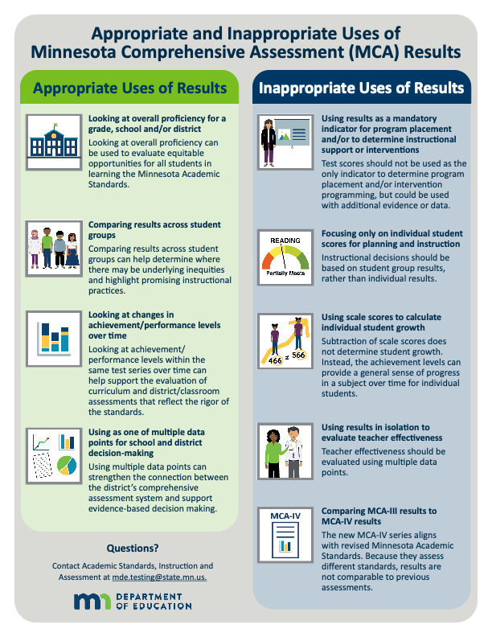
Results:

