Slide 1
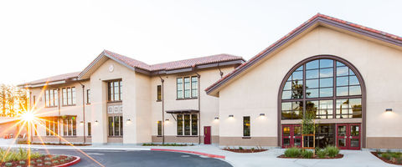
Chat with the Counselors
Preparing for the 2026-27 school year
Notes:
Explain brief presentation which includes FAQs and then time with alpha counselors at the end of the session for Q&A

Slide 2
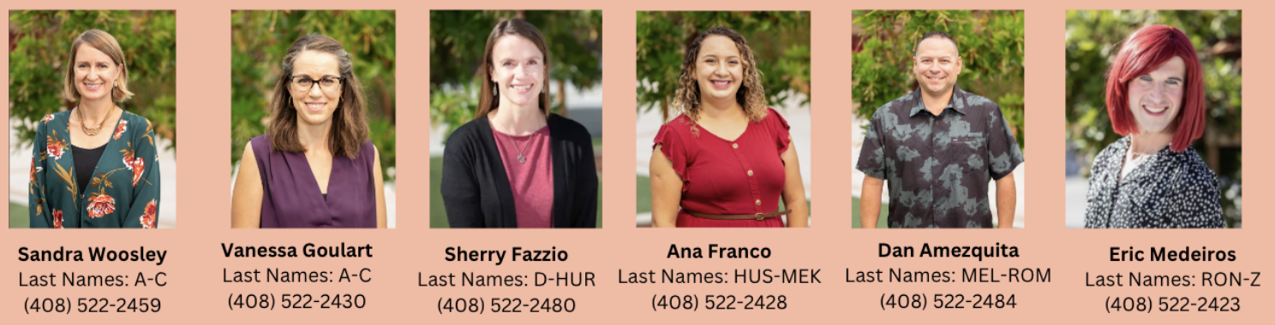
Meet the FHS School Counseling Team

Slide 3
Counseling Curriculum
9th grade – Foundation for Success
Laying the foundation for your high school career, establish yourself through your academics and extracurricular activities
Parents should have open conversations with students about progress in classes, as well as extra curricular activities
There should be a healthy balance between academics and social activities: importance of getting involved
Development of a four year plan; high school and college requirements
Academic and Social Emotional Resources available to all students
Notes:
Sherry

Slide 4
Ethnic Studies/Health
NEW CLASS → **New Graduation Requirement for class of 2030**
The goal of Ethnic Studies is for students to develop the ability to analyze systems and structures of power with a particular focus on the experiences, cultures, and histories of historically excluded and marginalized groups
MUST TAKE IN 9TH OR 12TH GRADE

Slide 5
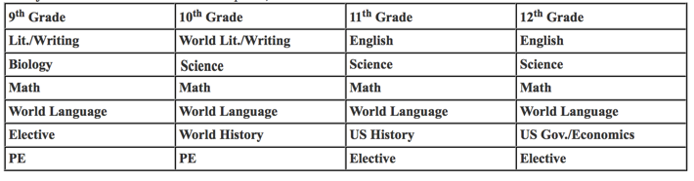
Some Frequently Asked Questions
What does a course of study look like for most students? This represents what FHS students typically take year to year. Some subjects listed in the table below are required, some are not.
Ethnic Studies/Health
(Take either in 9th or 12th grade ONLY)
Ethnic Studies/Health
(Take either in 9th or 12th grade ONLY)
As mentioned, FUHSD guarantees each student six classes IF a student chooses six classes. Students are welcome to request a 7th class, but this class is not guaranteed.
Notes:
Sherry

Slide 6
World Language Placement
No world language experience
Level 1
Successful completion of Level 1 in middle school
Level 2
Placement test will be administered, more information to follow
Home language experience
Sign up for Level 2 AND check off the
Native Speaker box on the form
Placement test will be administered, more information to follow
Notes:
Ana

Slide 7
Language Placement Test Dates and Times
Chinese
Tuesday, March 3: 4pm - 6pm
FHS Library
French
Contact teacher (Janene Rich) for an appointment: janene_rich@fuhsd.org
Japanese
Contact teacher (Erik Duus) for an appointment: erik_duus@fuhsd.org
Spanish
Columbia MS - March 11th at Columbia
Sunnyvale MS - March 10th at SMS
All other feeder Middle schools or makeups
Monday, March 2: 4pm - 6pm
Location - Room C-108 @ FHS
Contact teacher (Israel Gonzalez)for Spanish questions: israel_gonzalez@fuhsd.org
Notes:
Ana

Slide 8
Mathematics Courses
If you are successfully completing ...
For 9th grade you should sign up for…
And in 10th grade you may take ...
Math 8
Algebra 1
Geometry
Algebra 1
Geometry
Algebra 2 or Algebra 2/Trig
Geometry ***
Algebra 2 or Algebra 2/Trig
Options Vary
***UC/CSUs require all students MUST take Geometry in 7th grade or later
Notes:
Ana

Slide 9
As a 9th grader, can playing a sport exempt your student from taking PE 9?
  No, PE 9 is a state requirement for all freshmen students, therefore no 9th grader is exempt from taking PE 9. We do encourage 9th grade students to try out for an athletic team, and depending on their schedule and the number of credits they are taking (6 classes), they may be able to earn 5 elective credits for each sport.
Can an 8th grade student/parent meet with a FHS School Counselor?
  The School Counselors will be happy to meet with you or your students after they begin their first day of high school. We do not have capacity to meet with 8th grade students/parents prior to that.
  All incoming 9th graders will have to attend the Freshman Firebird Fiesta Orientation on August 10th to become more familiar with the FHS community and resources. Parents will also have an opportunity to attend an evening event where we will discuss in detail the resources and supports available on campus.
Notes:
Eric

Slide 10
Can 8th grade students earn credit before starting high school?
No. You cannot earn FHS high school credit prior to your August start date of freshman year. Although a student may not earn high school credit for work completed in the summer between 8th and 9th grade year, coursework completed at an accredited institution that is also on the UC A-G course list may be used for high school placement purposes.
A summer Geometry or Algebra I course will not be recorded on your transcript for a grade or credit.
All students who wish to go to a CSU or UC MUST take one year of Geometry in 7th grade or later, DO NOT SKIP.
Can your student take two classes in the same subject in the year (i.e. two science class or two math classes)?
  No, Our district policy is that students cannot "double-up" in any one subject area. The reality is, due to limited section allocation (directly related to limited school funding), we do not have space available for students to take two of any subject area in any one year.
Notes:
Eric
Vanessa

Slide 11
My student wants to take a math class over the summer to move to the next level, what class should they sign up for?
Sign up for the math class you plan to take in 9th grade. (Ex: 8th grade in Algebra 1, summer Geometry class planned, sign up for Algebra 2 or Algebra 2/Trig on your course request form. )
If your summer plans change, you MUST let us know by April 3rd so we can update your course requests
If you do not let us know, we will not be able to reserve a spot for you in the correct class and there may not be space to move classes in August.
Notes:
Eric
Vanessa

Slide 12
Upcoming Dates
Friday, February 6th - Final course selection form is due this Friday, February 6th via electronic submission of IK12 form.
March 31st - you’ll get an email with a copy of what you requested and will be given one last chance to request a change. This is due April 3rd.
August 10th - Firebird Fiesta (Freshman Orientation)
August 17th - First Day of School
Notes:
Ana

Slide 13

Q & A with the Counselors

