Slide 1
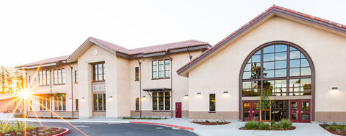
WELCOME FAMILIES TO
FREMONT HIGH SCHOOL
Class of 2030
This presentation will be posted to our website
Notes:
Are we recording this?
Previous ppt

Slide 2
Presentación en Español en la biblioteca

Slide 3
This evening we will cover…
Updates from Principal Emmert or Assistant Principal Rocha
Mental Health Information
Review abridged version of the student presentation
Step by step instructions on filling out the course selection form
Review important deadlines
Optional breakout sessions with elective teachers at the end

Slide 4
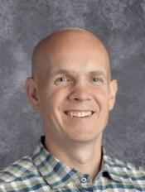
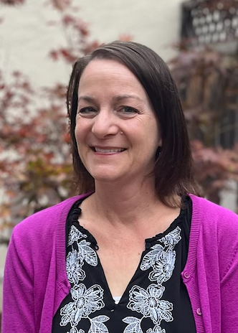
FHS Administrator (Susan Rocha or Bryan Emmert)
Entering high school
  Activities & athletics
  Preparing for college
Parent Groups
  PTSA, Los Padres, Kababayan, School Site Council, Athletic Boosters, Band Boosters and more

Slide 5
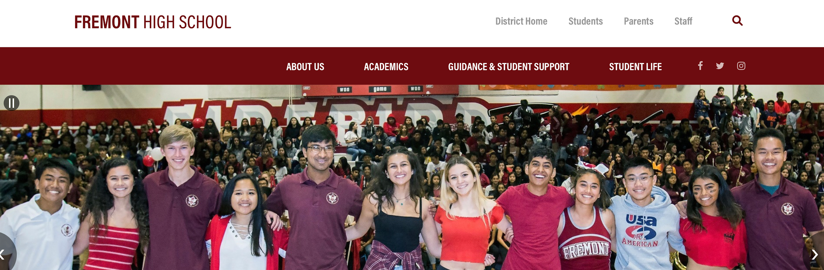
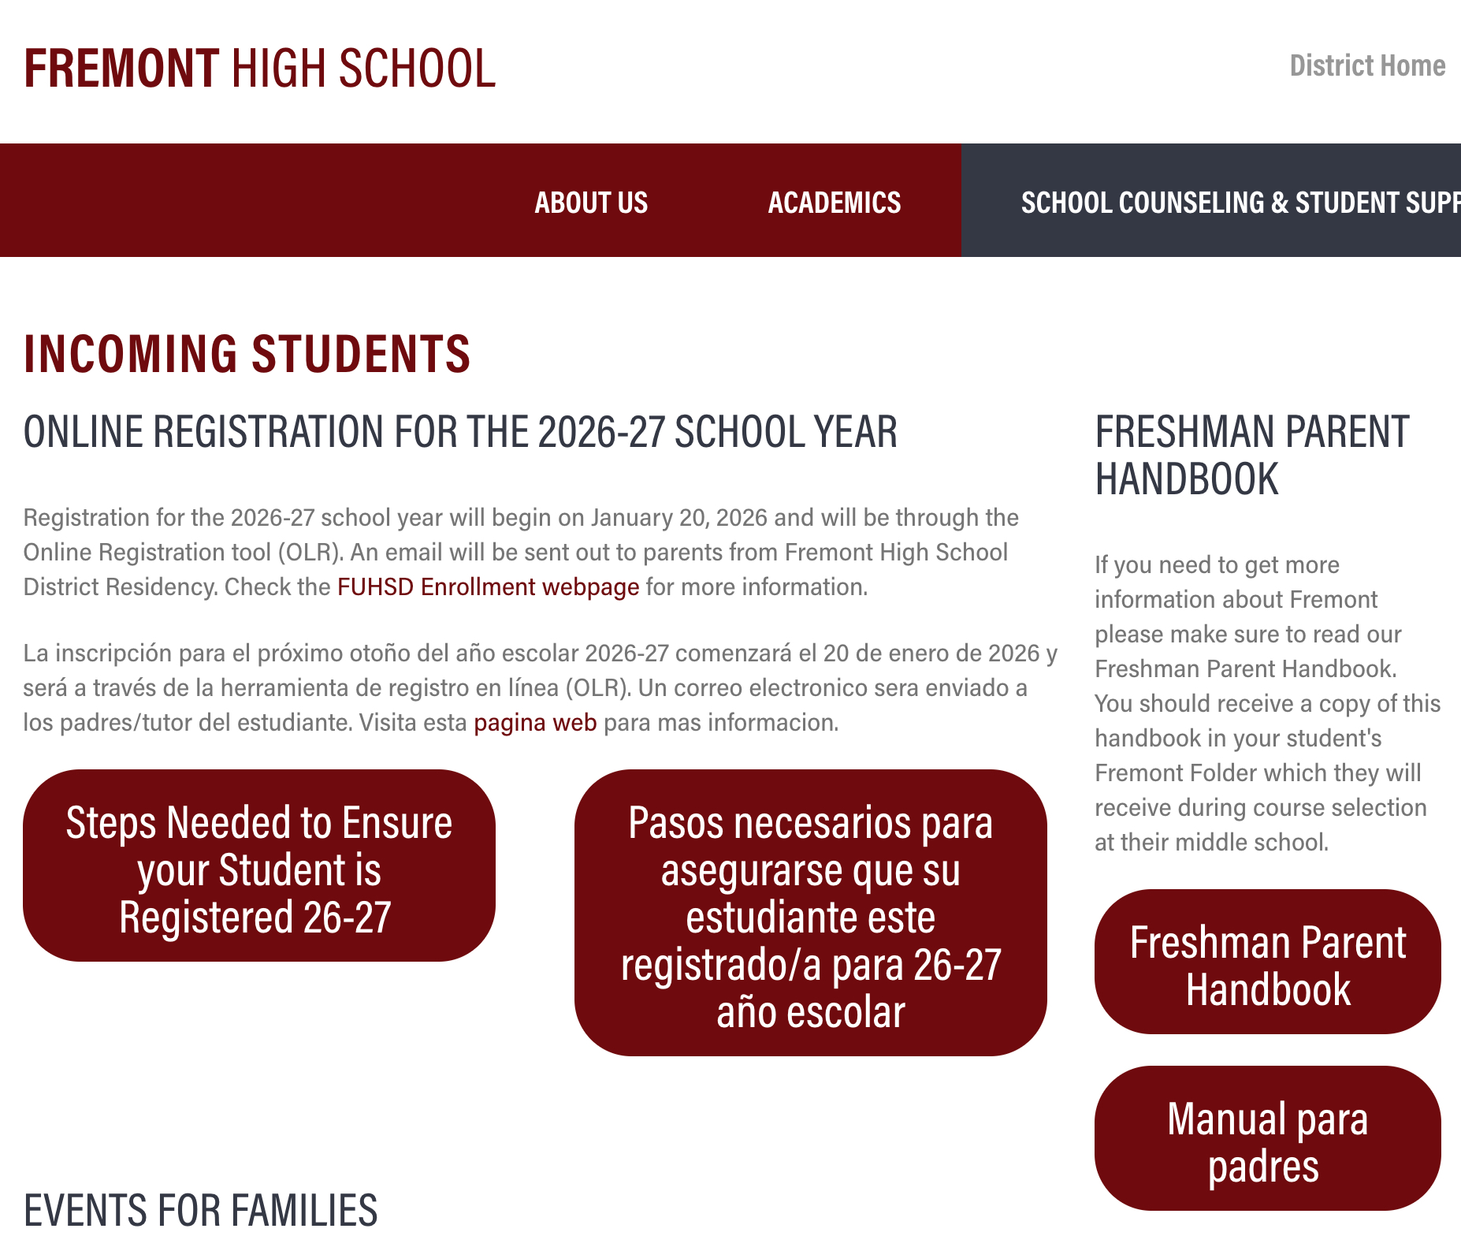
WELCOME TO FHS CLASS OF 2030
Notes:
Update picture of incoming students

Slide 6

RESIDENCY and ONLINE REGISTRATION
Due - APRIL 10th, 2026

Slide 7
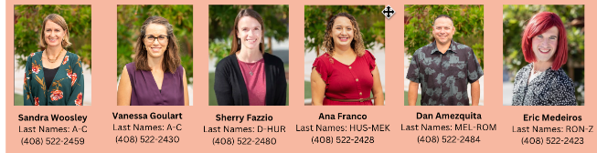
Meet Your School Counseling Team

Slide 8
Mental Health Team
Our team consists of four school-based therapists (all LMFTs) and three school psychologists.
We provide social-emotional support for students, as well as consultation for parents; however, we do not offer ongoing MH treatment for GenEd students.
To make a MH referral for a student:
  Wellness Check-in information
  Contact Deirdre Louie at 408.522.2487 or deirdre_louie@fuhsd.org
Wellness Space
  Supervised support for students to have a comfortable, calming, and quiet space for mental health breaks

Slide 9

Making the Leap
Big Transition
Get Involved
Grades Count

Slide 10
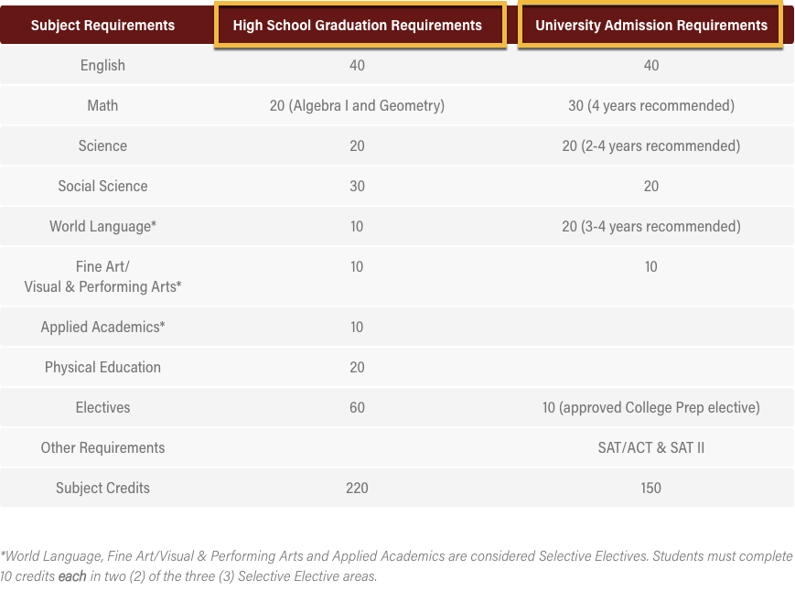

Graduation Requirements
220 credits required for a diploma
10 credits for each year long course
Each high school course is a year long
Ethnic Studies / Health

Slide 11
Freshman Schedule
All students are guaranteed 6 classes:
English (required)
Biology (required)
Mathematics (required)
PE 9 (required)
Elective 1: World Language (recommended)
Elective 2: Fine art or applied academic or Ethnic Studies/Health**

Slide 12
Ethnic Studies/Health
NEW CLASS → **REQUIRED for class of 2030**
The goal of Ethnic Studies is for students to develop the ability to analyze systems and structures of power with a particular focus on the experiences, cultures, and histories of historically excluded and marginalized groups
MUST TAKE IN 9TH OR 12TH GRADE

Slide 13
Mathematics Courses
If you are successfully completing ...
For 9th grade you should sign up for…
And in 10th grade you may take ...
Math 8
Algebra 1
Geometry
Algebra 1
Geometry
Algebra 2 or Algebra 2/Trig
Geometry
Algebra 2 or Algebra 2/Trig
Options Vary
***UC/CSUs require all students MUST take Geometry in 7th grade or later
Notes:
FYI add a note about transcripts for GEOMETRY

Slide 14
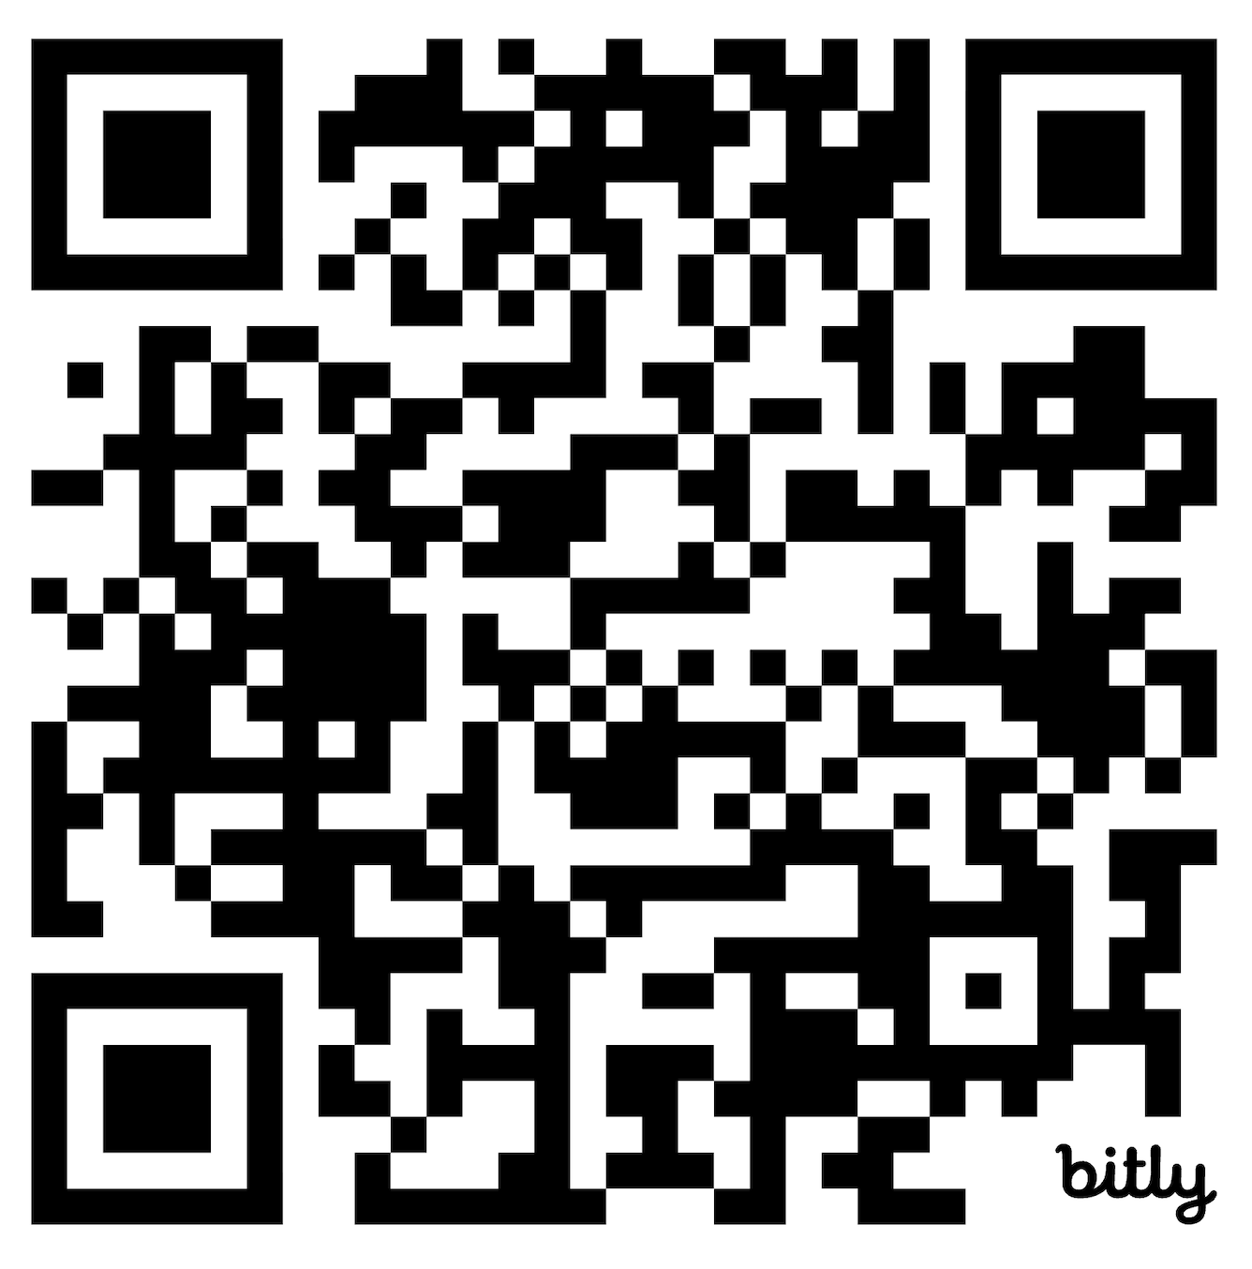
ELECTIVES AT FHS
bit.ly/49d0xss

Slide 15

World Languages
Chinese
Japanese
Spanish
French
  (level 4H/AP only)
Notes:
Districtwide declining enrollment and every school is phasing out one language

Slide 16
World Language Placement
No world language experience
Level 1
DIAGNOSTIC DATES
Chinese
Tuesday, March 3: 4pm - 6pm
FHS Library
Spanish
  March 2 @ 4-6PM
  Rm: C-108
  @ SMS → March 10th
  @ Columbia → March 11th
Successful completion of Level 1 in middle school
Level 2
Diagnostic test will be administered
Home language experience
Sign up for Level 2 AND check off the Native Speaker box
Diagnostic test will be administered

Slide 17
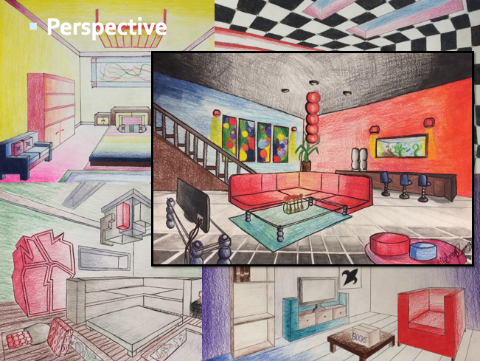
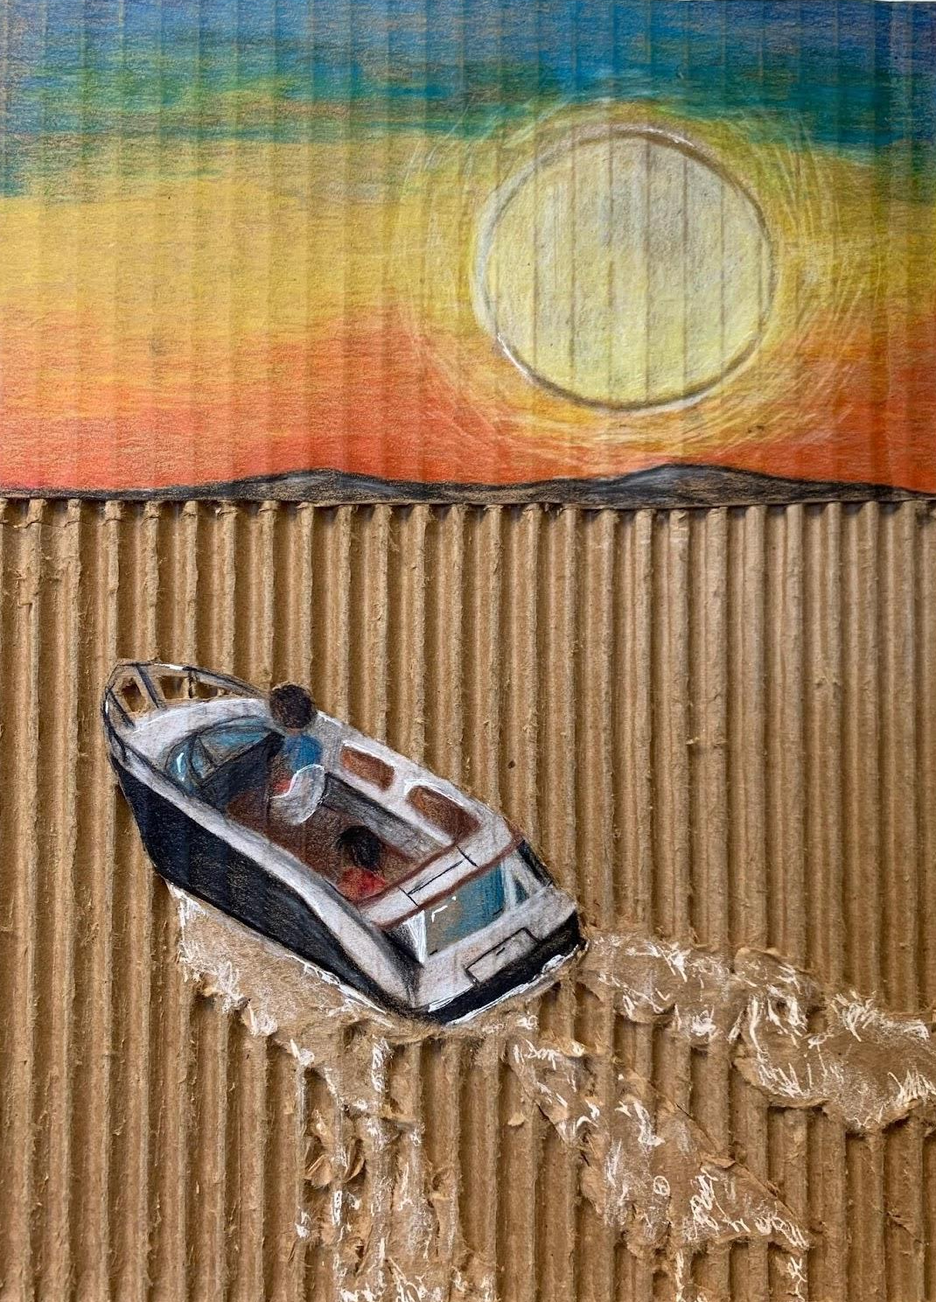
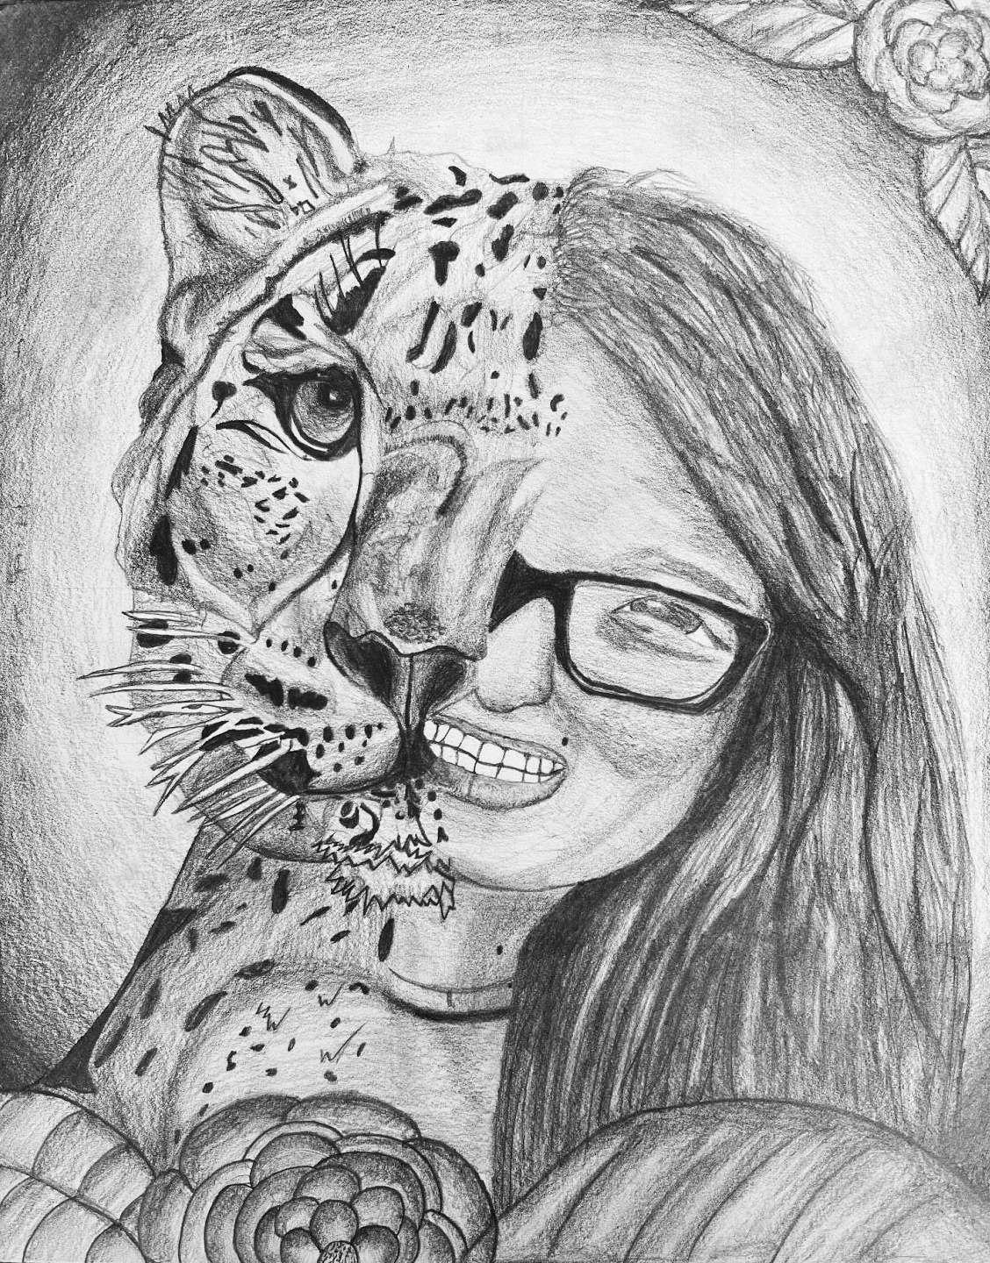
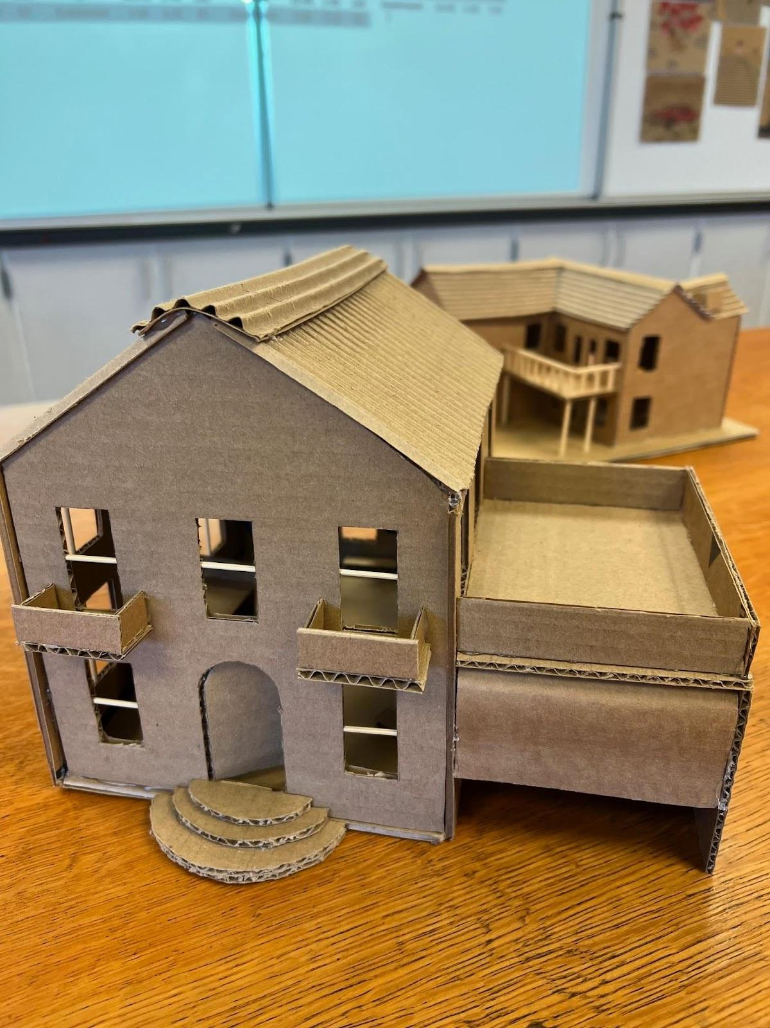
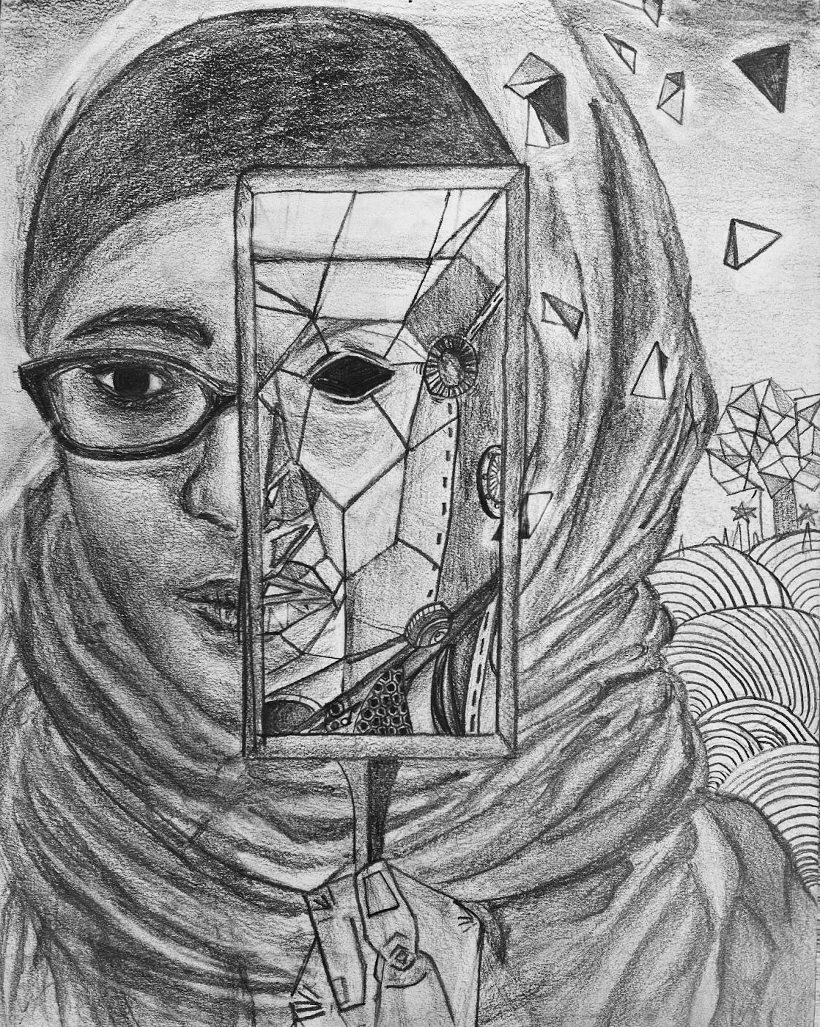
Visual and Performing Arts
Fine Arts
3-D Structure and Design
Fine Arts
Art 1
Notes:
These courses meet Fine Art requirement for 4 year colleges
Music Genesis - history of music, learn how to play various beginner instruments, no musical background is needed.

Slide 18
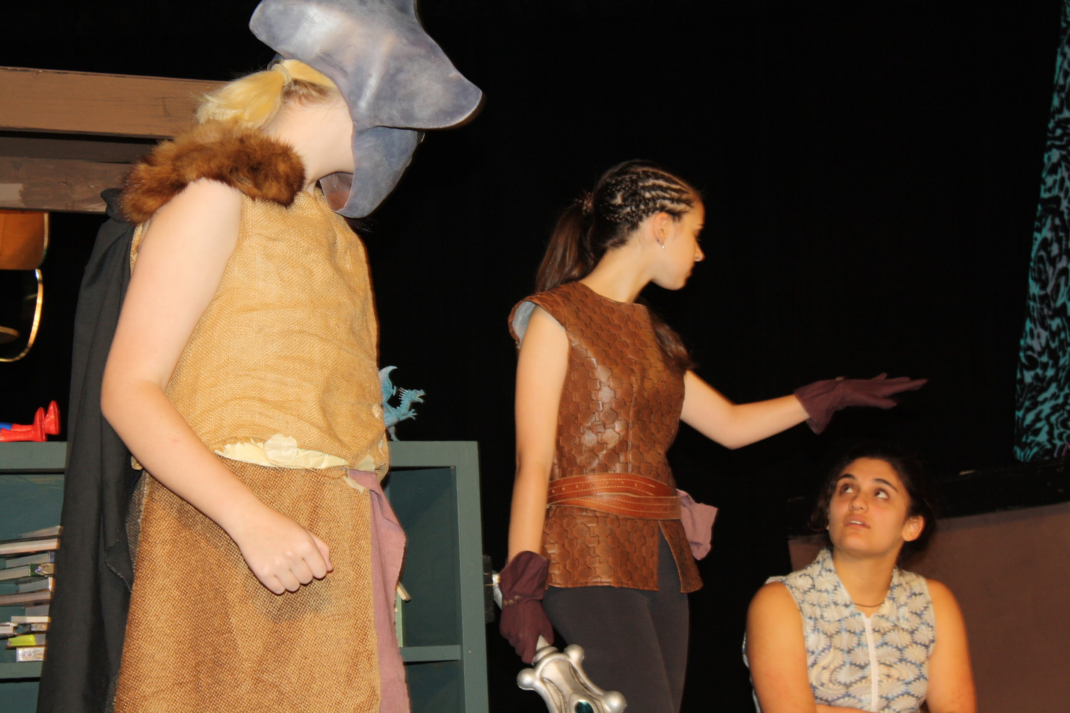
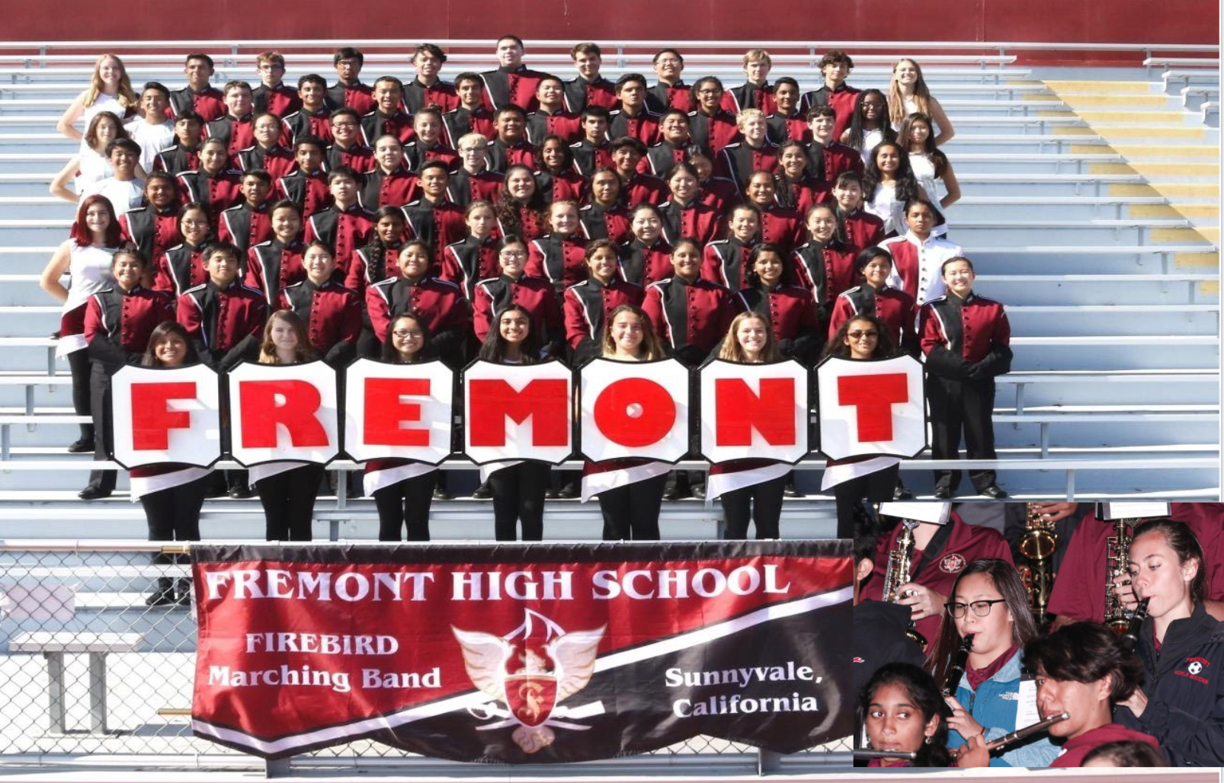

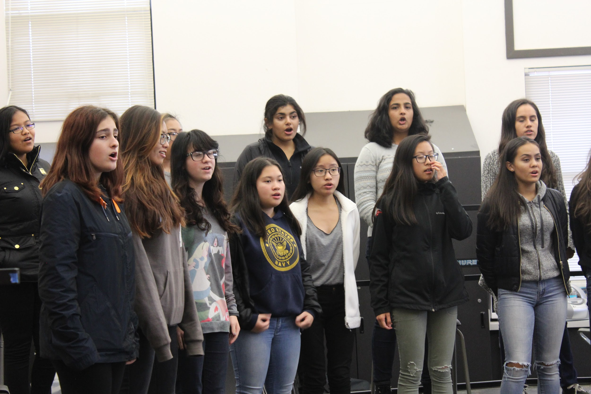
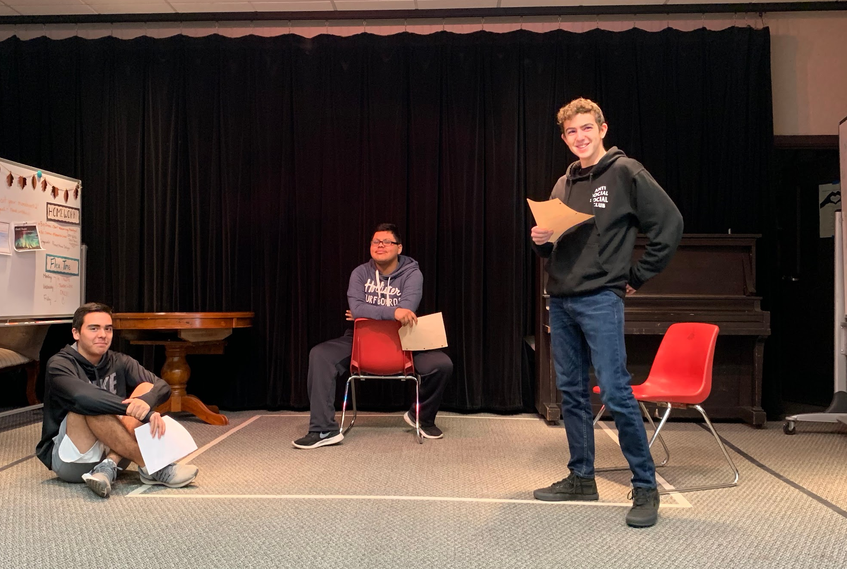

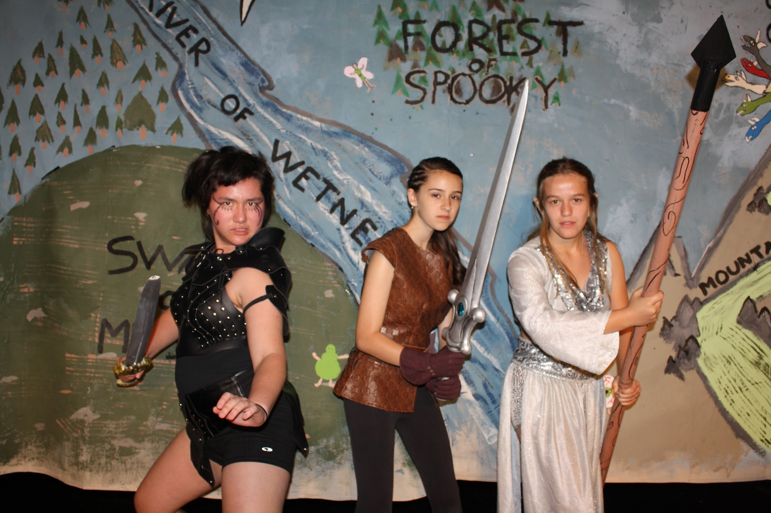
Visual and Performing Arts
Music
Orchestra
Concert Band
Music
Music Genesis
Music
A Choir (Concert Choir)
Theatre Arts
Drama
Notes:
Outside of class work (performance)
These courses meet Fine Art requirement for 4 year colleges
Music Genesis
history of music, learn how to play various beginner instruments, no musical background is needed.
Music appreciation, Introduction to music reading, Different time periods with music, You’ll make your own music instrument
Drama
Theatre history, improv, scene work, monologues

Slide 19
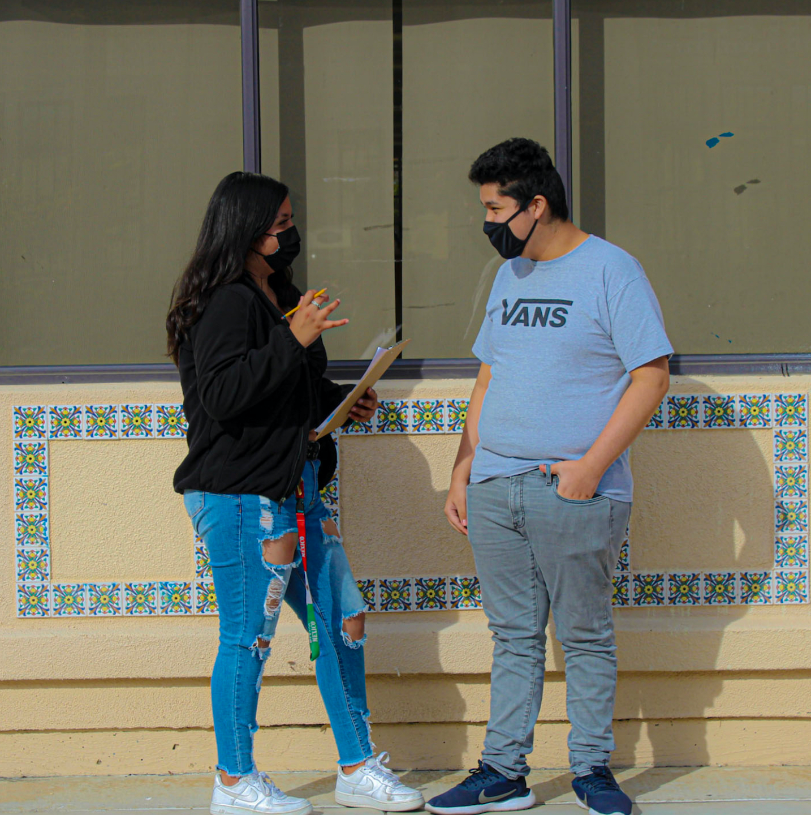
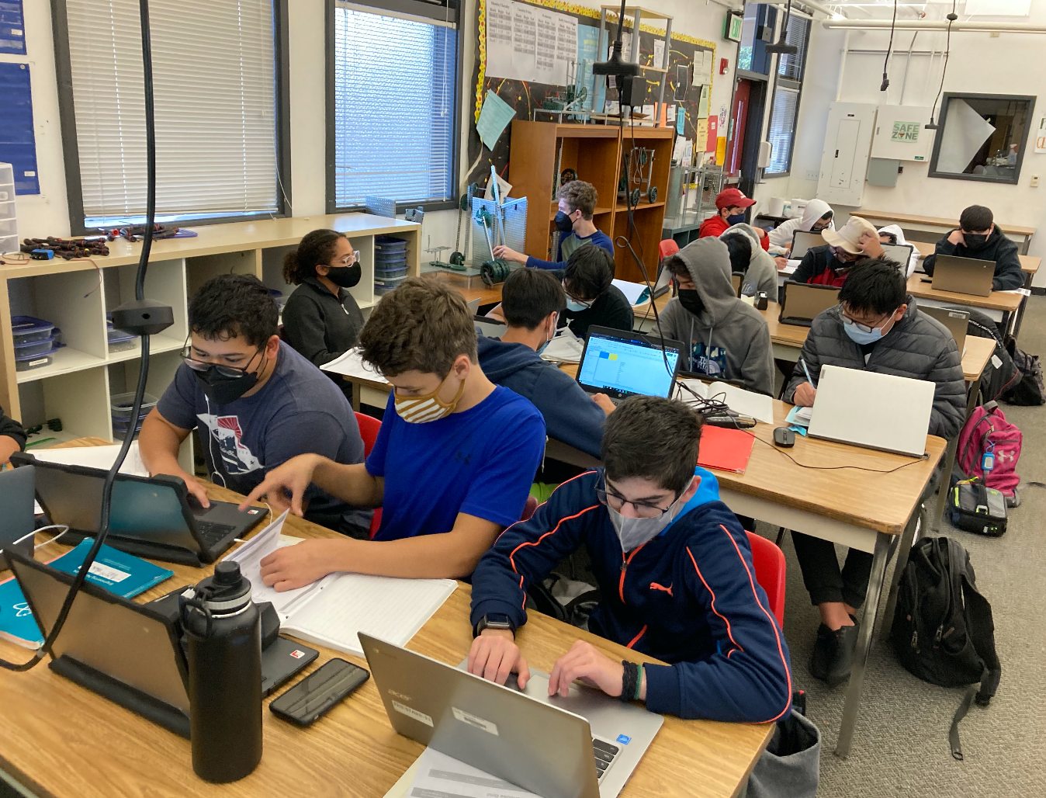

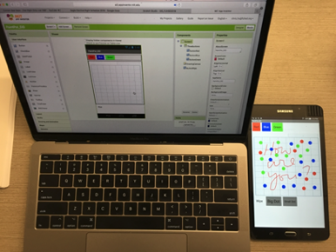
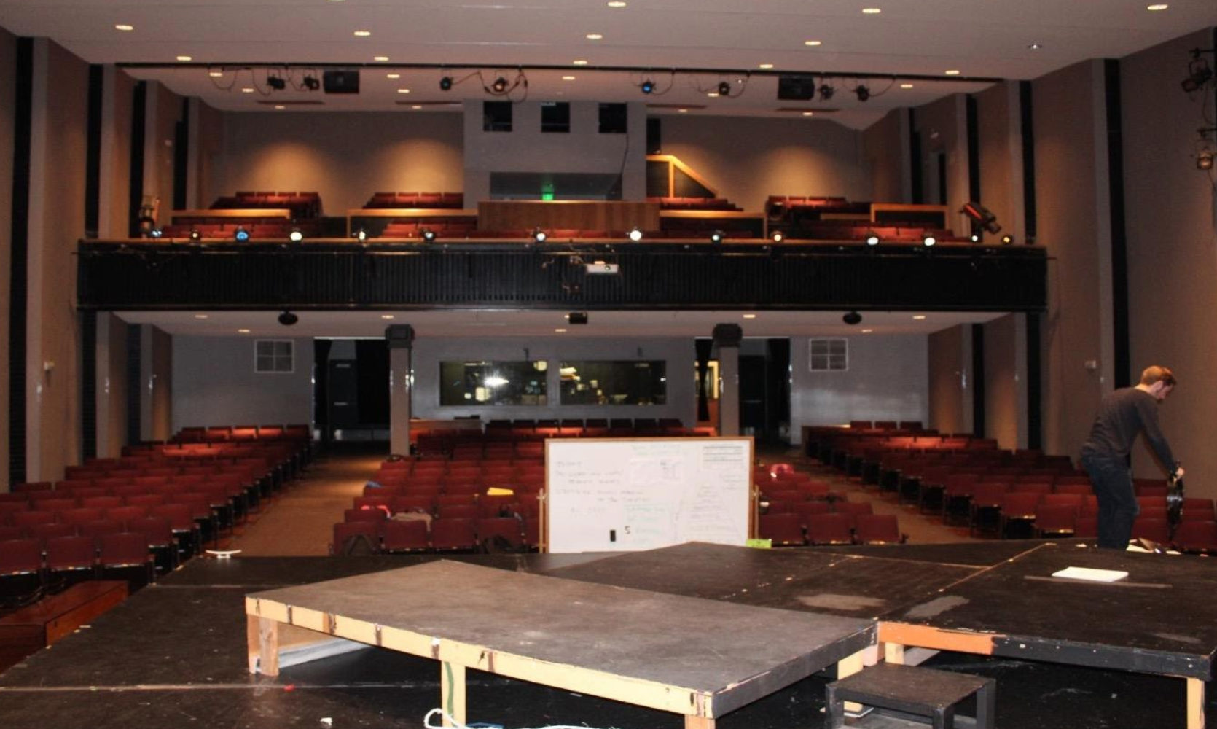
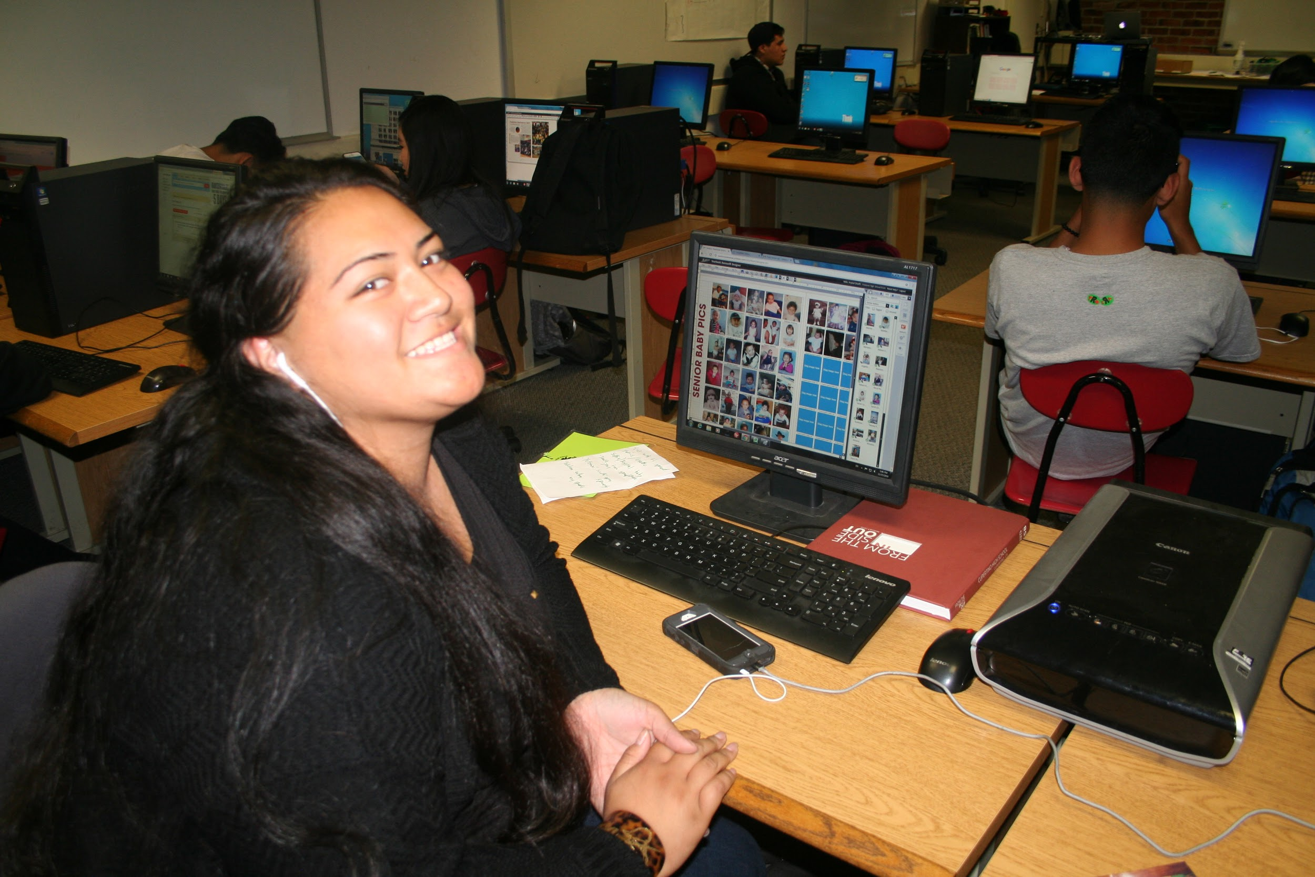
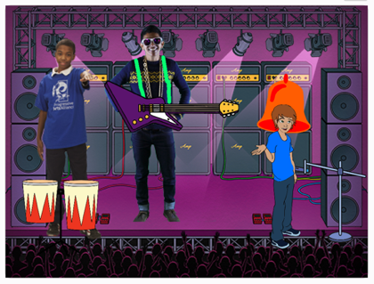

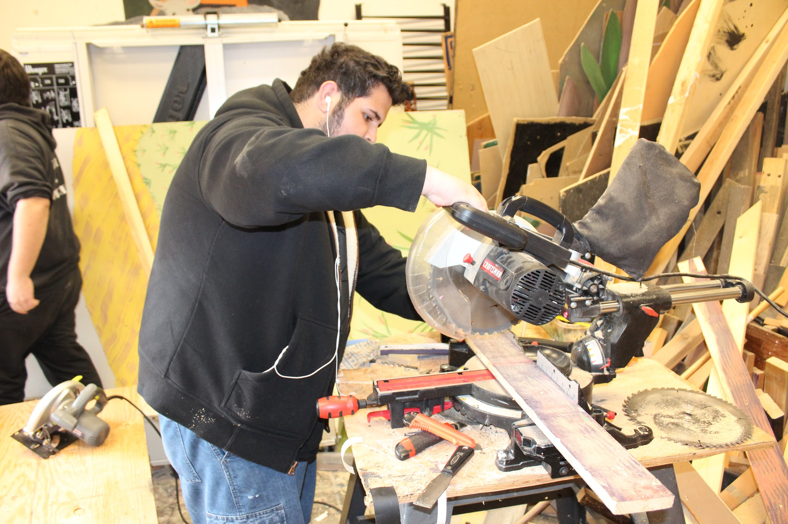
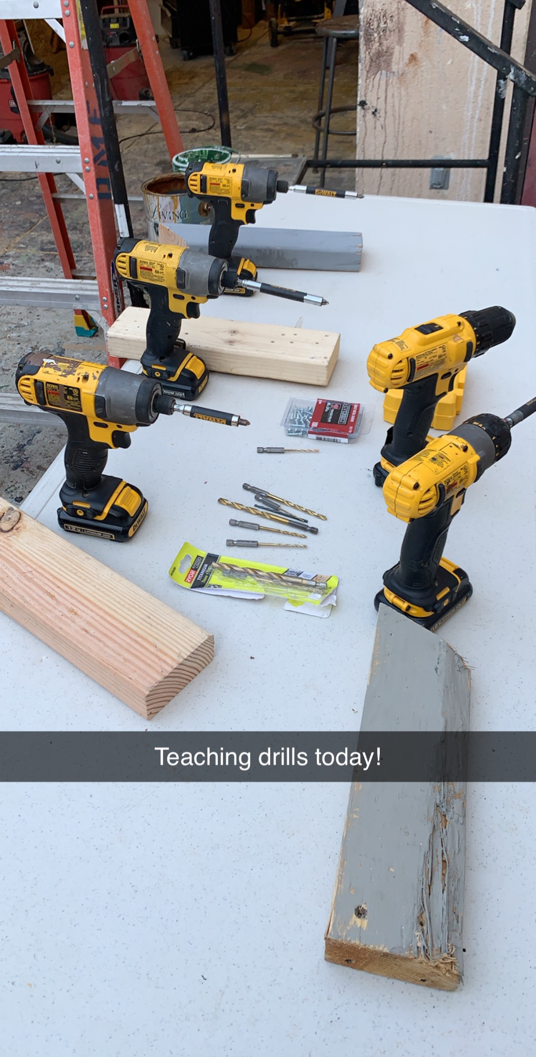
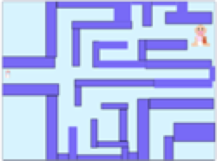



Applied Academics/Career Technical Education(CTE)/Elective
Applied Academics
Yearbook
Applied Academics
Stagecraft Tech
CTE
Digital Innovation and Design
CTE
Engineering Essentials
Applied Academics
Journalism
Notes:
Pathways
Recommend Engineering Essentials is the intro course, no specific math level, no engineering experience, what they do, different fields. You’ve heard about engineering but you’re not really sure what they do. In this class you will be exposed to a broad range of the engineering field and get the opportunity to explore the various fields. If you’re a returning parent and your kid took IED in the past it’s going to be different.
DID:
Learn the inside of a computer (software)—where is the brain?
How the Internet works—why is it so powerful?
Coding—Telling computer what to do
You will Design a game like the ones you play on the computer and Design an app that helps address real life problems
Stagecraft→ sets, lights, sound, props, costumes, helps to build sets

Slide 20
Course Selection Form

Slide 21
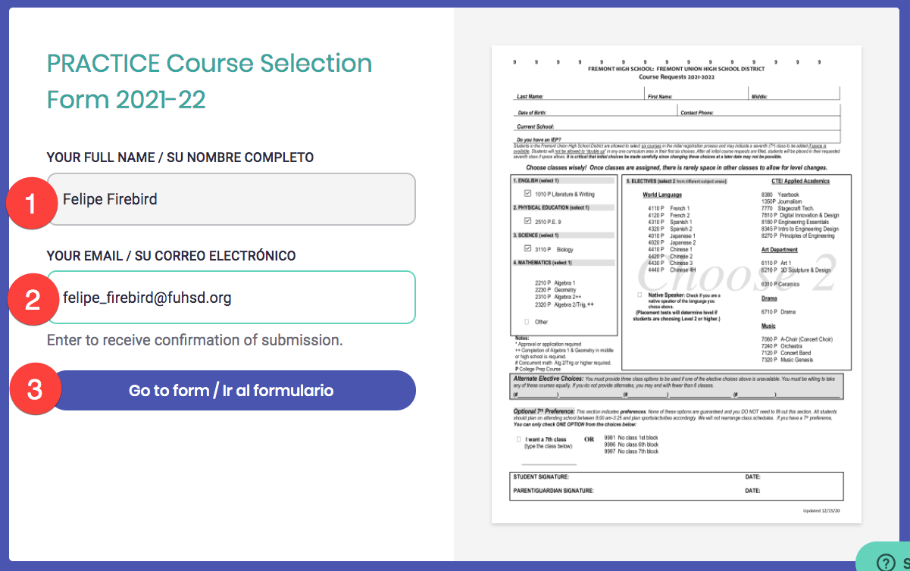
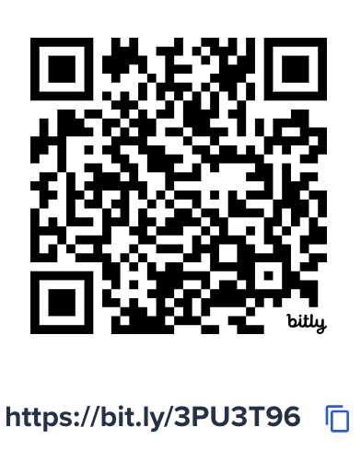
START HERE: Fill out ALL required information
Everyone should have received an email today from Informed K-12
2023-24 Official Course Selection Form
Can’t find it?
Did you check spam and trash?
Still can’t find it? ⬇️
Notes:
Explain what an IEP is for those who don’t

Slide 22
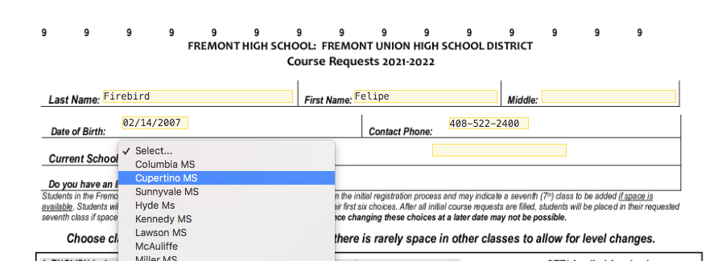
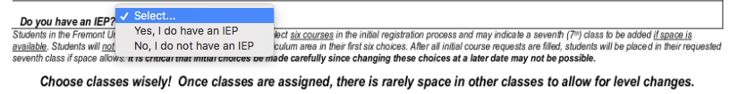
Must fill out all required information
Notes:
Explain what an IEP is for those who don’t

Slide 23
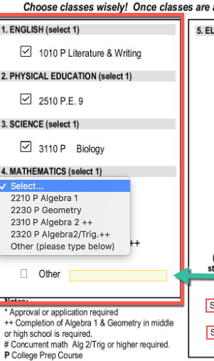
Selecting your core 4 classes
If you are successfully completing ...
For 9th grade you should sign up for…
And in 10th grade you may take ...
Math 8
Algebra 1
Geometry
Algebra 1
Geometry
Algebra 2 or Algebra 2/Trig
Geometry
Algebra 2 or Algebra 2/Trig
Options Vary
***UC/CSUs require all students MUST take Geometry in 7th grade or later. Do NOT skip!
Notes:
Everyone is in the same english, pe, and bio - you get to choose your math. Remember: this is practice!

Slide 24
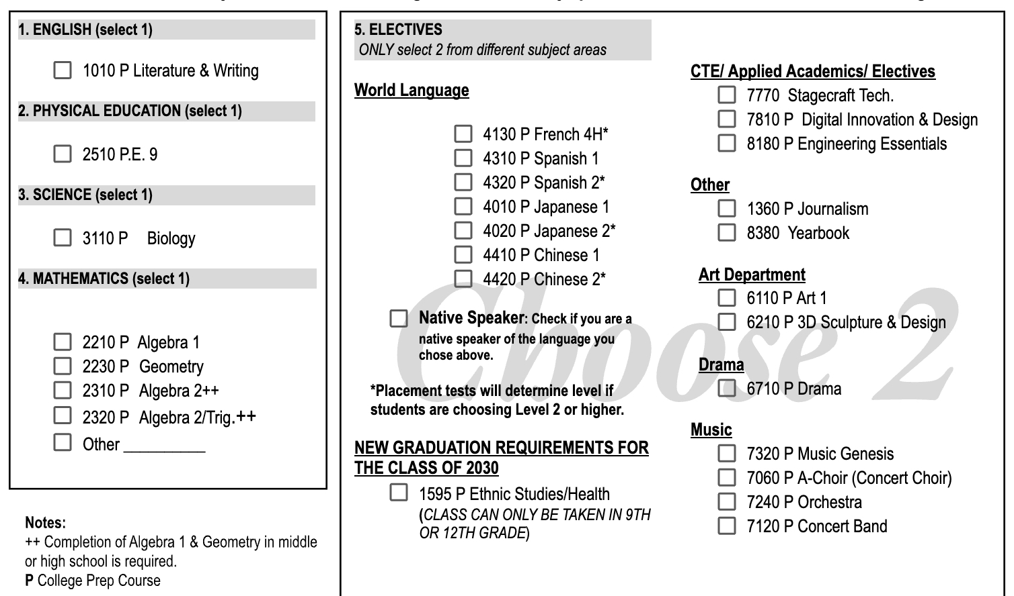
Choosing your elective courses: Choose 2
Must select 2 electives
If you selected a language, and you’re a Native speaker of the language or speak the language at home, please select the box “Native Speaker”
Check this if you speak the selected language at home

Slide 25
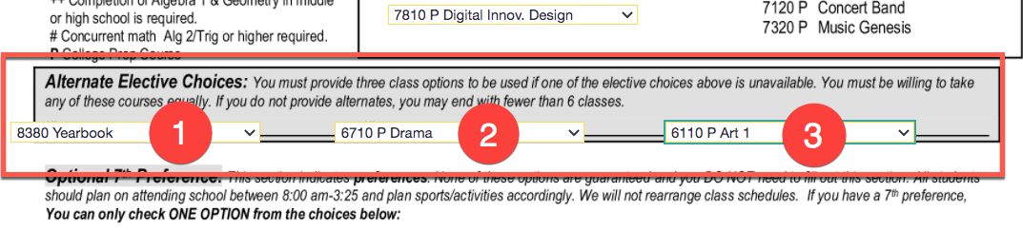
Alternate Elective Choices: Choose 3
What other ELECTIVE classes would you like if we can’t give you your first choice? Write down the name of the class
Notes:
Just as important. Happy with back up choices

Slide 26
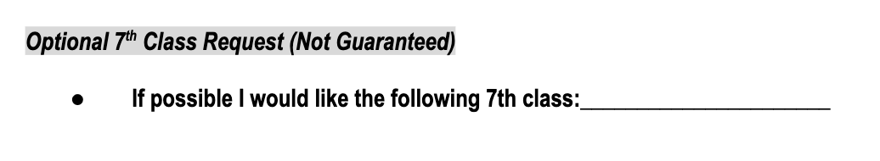
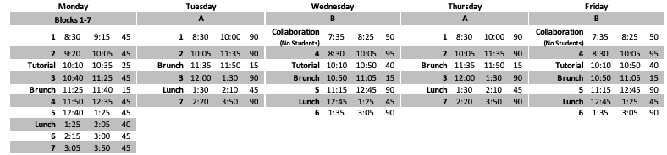
Do you want 7 classes next year?
(NOT GUARANTEED)
Current Bell Schedule
Notes:
.

Slide 27
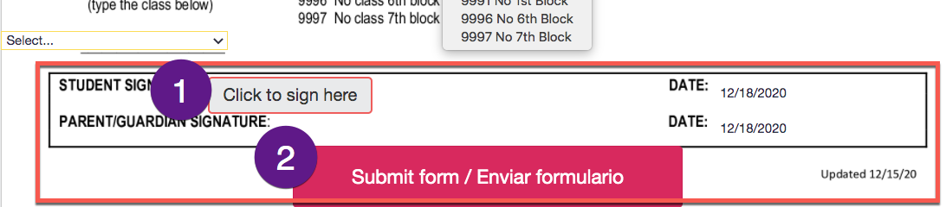
Final Steps: Sign + Click Submit

Slide 28
Next Steps
FEB 4 (9am) - Attend Virtual Chat with Counselors if you have more questions about course selection for next year. Link will be posted on the FHS website in the morning.
FEB 6 - Submit your course selection form via Informed K12 - Each family will receive a course selection form via Informed K12.
MARCH 31 - Review Course Verification Form sent out via Informed K12 email.
APRIL 1 (9am) - Final Virtual Chat with Counselors if you have more questions about course selection for next year.
APRIL 3 - Submit any changes to Course Request Verification Form for 2026-27.

Slide 29
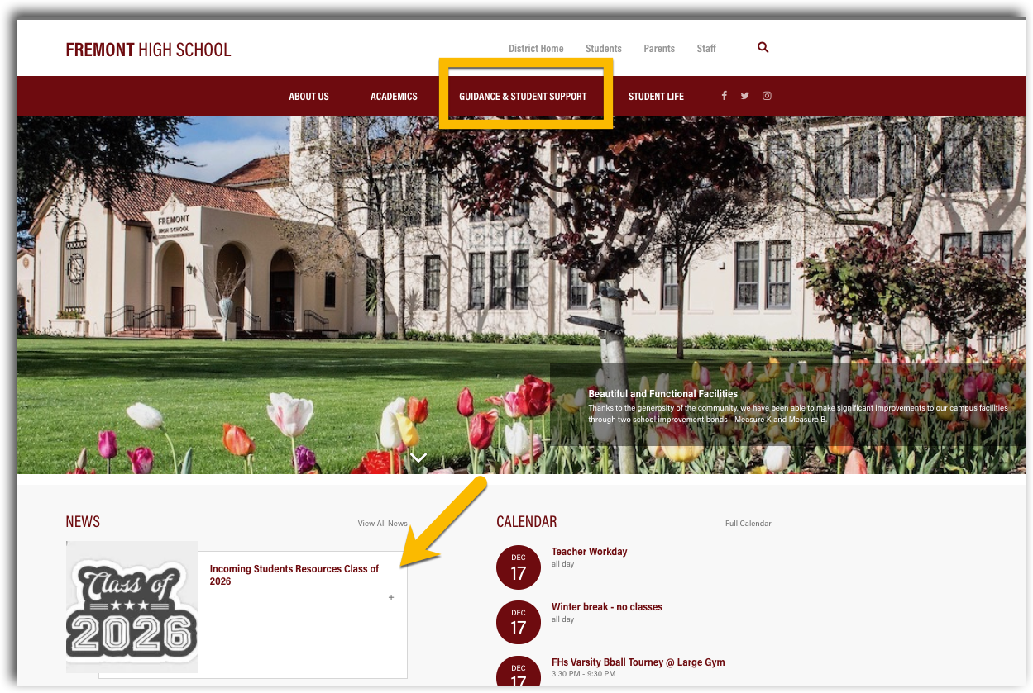

For up to date information check out our
FHS website www.fhs.fuhsd.org
Questions? Join us at the Virtual Chat with the Counselors on Feb 4 9-10am via Zoom*
*ZOOM LINK POSTED TOMORROW MORNING ON FHS WEBSITE

Slide 30
Paths For Tonight
Option 1
You know your elective choices
Have heard this information before
You have NO questions
PLEASE SUBMIT YOUR COURSE SELECTION FORM ONLINE THIS EVENING
Option 2
Want to know more about elective options
Stay for elective presentations
PLEASE SUBMIT YOUR COURSE SELECTION FORM BY FEB. 6
Option 3
Did not receive the Informed K12 form?? Check junk or spam folders
Stay for elective presentations
Still can’t find it?
  QR CODE:

Slide 31
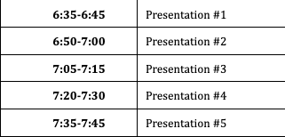
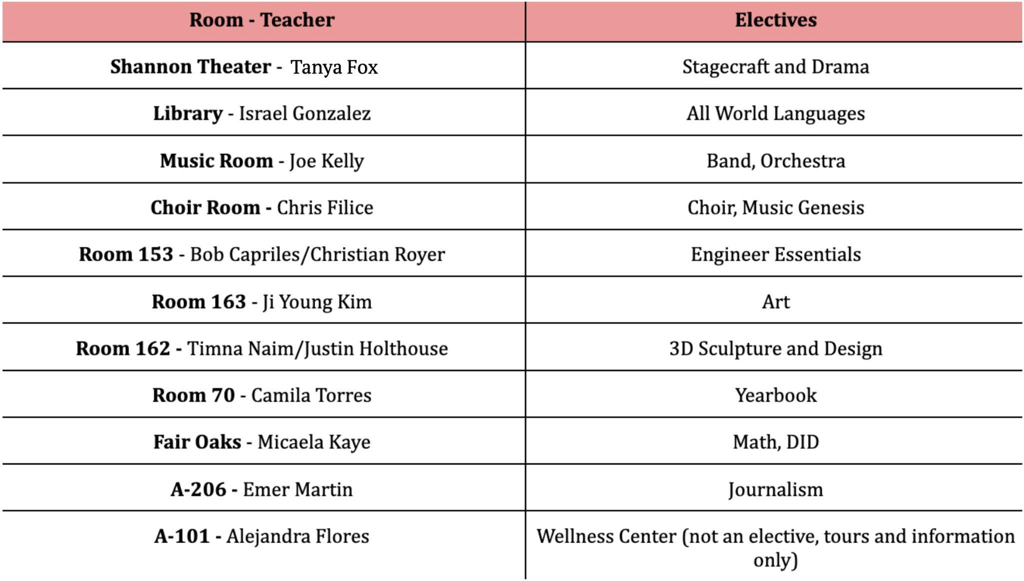
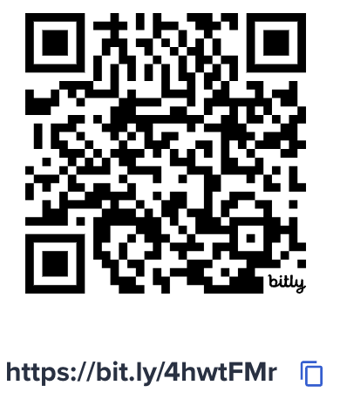
Breakout Rooms
If a classroom is full, please join the next session!
Map

