Slide 1

Full Day Kindergarten in Issaquah
Parent Orientation
2026-27 School Year

Slide 2

Welcome to Grand Ridge : Jill Ravenscraft, Principal Lori Shimizu, Admin. Intern
Registrar: Chris Ross
Secretary to the Principal Kelly Scibetta
Immunizations\Health Forms: Sarah Dellicker, Nurse
PTSA President: Garth Higgins/Elizabeth Parker
Family Partnership Liaison Lina Marin

Slide 3

State-funded Full Day Kindergarten
No cost to families
Provides maximum learning opportunity for students
Offers full access to specialists (PE, Music, Library)
Developmentally appropriate and student centered
Integrated content with rich, hands-on experiences
Based on rigorous standards

Slide 4
State-funded Full Day Kindergarten
State requires full day kindergarten be available to all students
Parents may opt for half-day
  Student will be placed in full-day classroom in the morning for 3 hours

Slide 5




Full-Day Kindergarten
Every student, every classroom, every day
Family Connections
Early Learning Collaboration
Whole Child Assessment
Student centered, hands-on learning experiences promoting creativity
Deep knowledge of child development
Rich learning environments
Balanced and aligned curriculum
Assessment of and for learning
Engaging Interactions and Integrated Content
High Quality Instruction
Planning and preparation
Washington Learning Standards for Kindergarten
Emotional Skills
Math
Communication Skills
World Language
Science
Large Motor Skills
Arts
Approaches to Learning
Social Skills
Physical Education
Social Studies
Literacy
Small Motor Skills
Health
Approaches to Learning
Social Skills
Physical Education
Developmentally appropriate AND academically rigorous

Slide 6
Kindergarten is a transition year
Sept-Oct
Looks and feels more like Preschool
Transition through Kindergarten
May/June
Looks and feels more like 1st Grade

Slide 7

What can we expect at the beginning of the year?
Washington Kindergarten Inventory of Developing Skills (WAKIDS)
  A required component of State-funded Full Day Kindergarten
  A transition process that helps to ensure a successful start to kindergarten and beyond

Slide 8
Preparing for September
Can manage their personal needs without help
Put on/take off coat
Tie their own shoes
Wash their hands
Snap, button, zip and buckle clothes (change their own clothing)
Zip and unzip backpacks
Use the public restroom independently (use, flush, wash)
Open their snack and lunchbox containers

Slide 9

Kindergarten Assessment
Wednesday, May 6, 2026
1:30 – 4:00
In order to assist us in making appropriate classroom placement decisions we will be assessing all incoming kindergarten students.
The assessment will be done at Grand Ridge by one of our kindergarten teachers and will take approximately 10-15 minutes.

Slide 10

What can we expect at the beginning of the year?
Family Connection Meeting
    Classroom teacher meets with each family for 30 minutes on one of the first 3 days of the school year.
    First day of school for grades 1-5 is August 27th
    Family Connection Meetings on August 27, August 28, August 31
    First Day of Kindergarten is on September 1
Whole-Child Assessment: September/October
    Kindergarten teacher observes children during everyday classroom activities
    Helps teachers find out what each child knows and can do at the beginning of the year
    Inventory taken of each child’s developing skills in six areas
        Social-emotional
        Physical
        Cognitive
        Language
        Literacy
        Mathematics

Slide 11
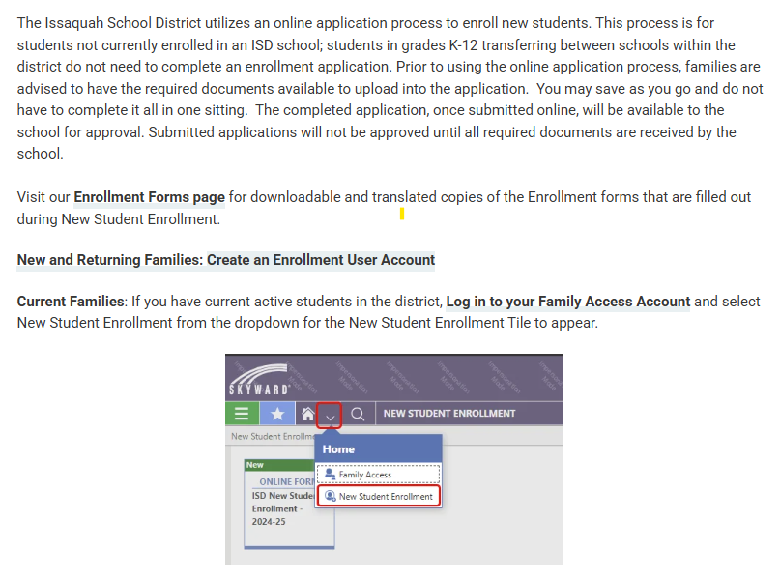
Enroll at www.ISD411.org!

Slide 12

Registration
Your child must be 5 by August 31, 2026
For those families living in the Grand Ridge attendance area.
Check the ISD website attendance map to verify or email transportation department.
Complete online enrollment on the ISD website. Registration opens on February 2 and is due by February 27.
Sign up for Kindergarten Assessment – email to come in April.
The enrollment process can be completed in many other languages.

Slide 13
Information Required to Register
Proof of Birth Date: A copy of birth certificate or passport must be provided. Can be uploaded.
Proof of Residency – 1 item: Property tax statement, mortgage statement, homeowners insurance, unexpired lease agreement, renters insurance policy, documents from public agencies, current utility or cable bill
  A residency document must show your name and address and expiration date if a lease.
  A copy of a utility bill no more than 30 days old. (Utility bill must be power, gas, or cable – not cell phone). Can be uploaded.
Photo ID: The person registering the child must be the legal parent/guardian listed on the registration form. Bring in to the office.
Immunizations: A complete record of shots verified by a physician must be provided. Can be uploaded.

Slide 14
Additional Paperwork
Required additional paperwork to complete enrollment
Parent ID - copy will be made by Registrar – NO NEED TO UPLOAD
Parenting Plan?
Additional information in the kindergarten packet:
Kindergarten Readiness Information
Information From the Nurse
Issaquah School District Registration Timeline
Invitation to Ride the Bus this summer
Before and After School Care Information

Slide 15

What’s next?
The Registrar will call you to set up an appointment to finish any paperwork and confirm your child’s profile is set up correctly.
Sign-up for your child’s assessment on May 6th from 1:30-4:00. Registrar will send you a link to the sign-ups in mid-April.
Sign-up to receive the Grand Ridge Bulletin.
In August, watch for information about becoming approved to volunteer. Required annually.

Slide 16

Immunizations &
Life-Threatening Health Conditions
Requirements for Incoming Students
  2026-27 School Year

Slide 17
Proof of Immunization Required
New students need to provide a medically verified immunization record at the time of registration. ​
​
A medically verified record can come directly from:
  The Washington State Immunization Information System (WAIIS). ​
  A medical clinic or office where immunizations were given
  Pharmacy records of immunizations given
  Another state’s or country’s formal immunization database
  Immunizations verified by the State Dept.

Slide 18
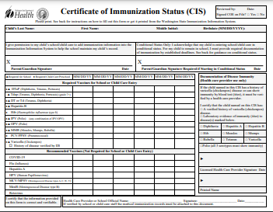
CIS or WAIIS Documentation​
A Certificate of Immunization Status (CIS) printed from the (WAIIS) ​
A physical copy of the State CIS form with a healthcare provider signature. ​
A CIS printed from MyIR.
myirmobile.com
https://doh.wa.gov/you-and-your-family/immunization/access-your-familys-immunization-information

Slide 19
Required Immunizations for K-6 Students
5 doses of DTaP (diphtheria, tetanus & pertussis) given in the appropriate time frames​
  1 Tdap for students 7th grade and above
3 doses of Hepatitis B, given in the appropriate time frames
4 doses of polio (IPV) given in a specific time frames​
​2 doses of MMR (measles, mumps and rubella) given in the appropriate time frames​
2 doses of varicella given in the appropriate time frames

Slide 20
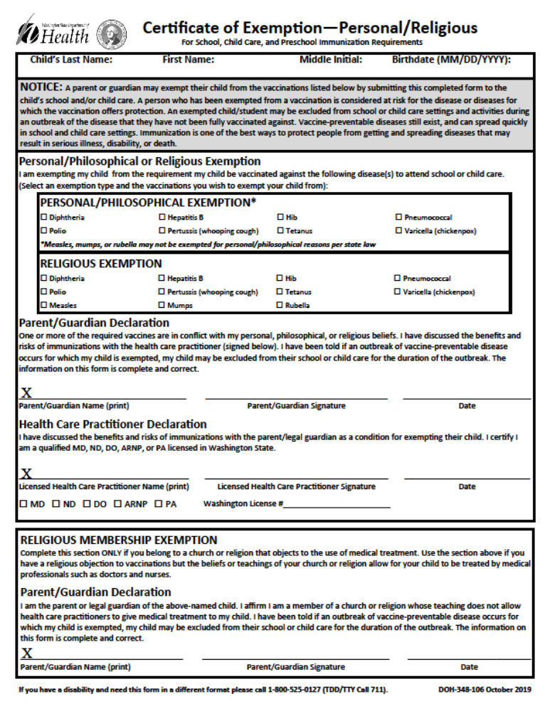
Exemptions
Parent and Child’s Provider signatures
  Medical Exemption
  Philosophical/Personal Exemption
  Religious Exemption
Religion restricting care from medical professional
  Religious Membership Exemption

Slide 21

Is My Kindergartener Too Young?
Children can receive their school immunizations at age 4. Contact your healthcare provider to schedule your appointment. ​

Slide 22
Where Can I Get My Child Immunized?
Your child’s healthcare provider​
WithinReach, Family Health Hotline:
800-322-2588​
http://www.withinreachwa.org/​
Community Health Access Program:
206-284-0331 or 800-756-5437​
https://kingcounty.gov/en/dept/dph/health-safety/health-centers-programs-services/access-outreach-program/community-health-access-program
Your school nurse is a resource for you if you need assistance

Slide 23
SUMMARY of IMMUNIZATION INFORMATION
Your student may register for school, but MAY NOT attend school until provider-verified immunizations have been received and validated by the school nurse. ​
The child must have all immunizations they are eligible to receive prior to starting school.
Or there is a Certificate of Exemption on file signed by the parent AND the licensed healthcare provider.
​

Slide 24
Notify the School if your Child has a Life-Threatening Health Condition such as:
Allergy requiring an Epipen™
Insulin-dependent Diabetes​
Severe Asthma​
A Seizure disorder​
A Cardiac condition​
Adrenal Insufficiency​
Other conditions

Slide 25
Why does the school need to know?
If your child has a life-threatening condition, WA state law says there must be an emergency care plan and any associated medication in place in the school building before the child can attend school.
​
This is to keep the student safe in the event they experience a medical emergency during the school day. ​
If your child has a life-threatening condition, let the school nurse know:
  School Care Plan signed by provider, parent and RN
  Medication prescribed by provider with ISD paperwork

Slide 26
Medications at School
If your child must receive medication during school hours, you need to provide a medication authorization form that has been completed by a licensed healthcare provider and signed/dated by the provider and parent. A new form is required each school year.
  Prescription medications
  Over-the-counter medications
  Medical treatments/procedures
Do not send medications to school with your child.
Students may not carry medications in their backpack (including cough drops, or other over-the-counter medications).

Slide 27

Questions?
Nurse Contact Info:
Sarah Dellicker, RN
Office: 425-837-7930
Email: DellickerS@issaquah.wednet.edu

Slide 28
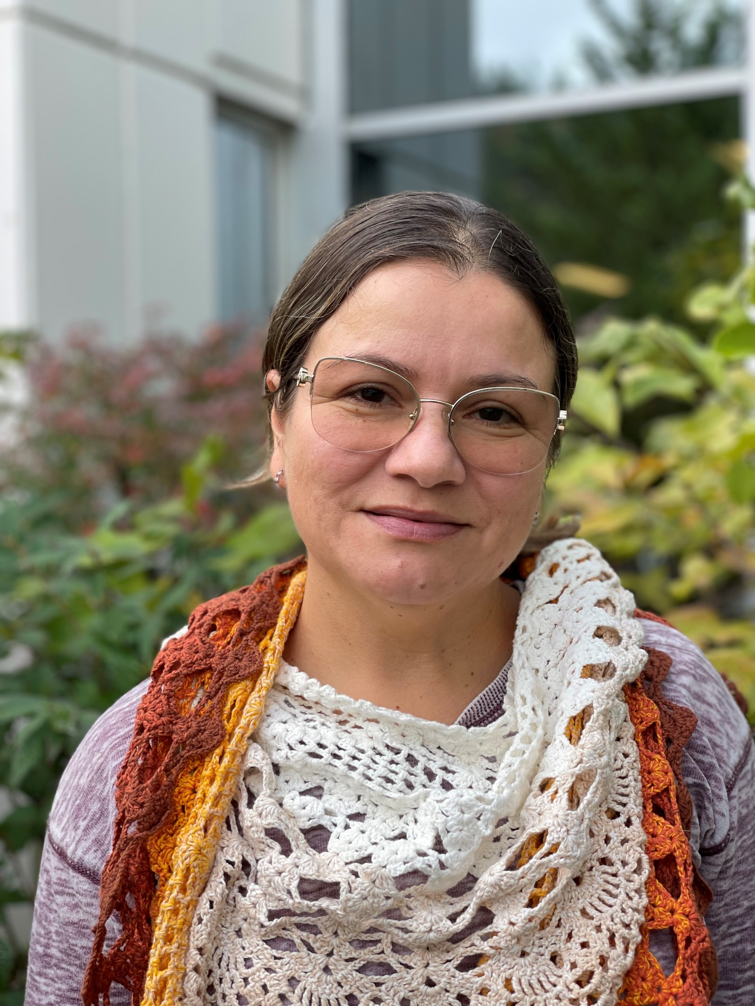

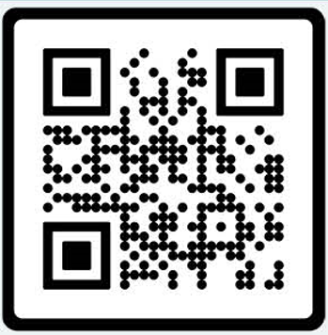
Welcome Families,
My name is Lina Marin, your Family Liaison.
I am part of the ISD Equity, Belonging and Family Partnership Department. We host information sessions for families with a wide variety of topics throughout the school year. Family Partnerships - Issaquah School District 411
If you need interpretation, we arrange to host these sessions in your preferred language.
Feel free to contact me.
MarinIsazaL@issaquah.wednet.edu
Office: (425) 837-7008
Cell: 425 651-9245
Text: 252 563 3498
Languages spoken: English, Spanish.
How Can I Help You?
As your Family Partnership Liaison, I can:
• Welcome new families and explain school systems and procedures
• Help you use tools like Family Access and Canvas
• Guide you in navigating district and school websites
• Support communication with school and district staff
• Connect you with community resources and programs
Schools I support:
Apollo, Briarwood, Cougar Ridge, Grand Ridge, Maple Hills, Newcastle,
Cougar Mountain, Maywood, and Liberty

Slide 29

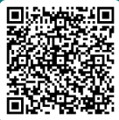

When: Monday, March 9, 2026 from 6:30 to 8:00 p.m. Register here
Where: Zoom – Presentations in English, Español, and 普通話
Who: All incoming Kindergarten families are invited to learn more about the Issaquah School District’s Kindergarten program. While everyone is welcome, this session will be especially helpful for families who are new to the U.S. public school system.
What: Information will include:
  Kindergarten Preparedness
  General school day schedule (lunch and recess)
  Classroom general information
  Transportation
  Immunization
  On-Site Before- and After-School Care Program
  Differences between school systems in the U.S. vs. some other countries
Hosted by the Issaquah School District Family Partnership Team, we warmly welcome you to our community and look forward to supporting you as you navigate our schools.
If you have any questions or need interpretation in another language at the event (한국어, 日本語, Русский, or Tiếng Việt), please contact Lorna Gilmour at gilmourl@issaquah.wednet.edu.

Slide 30


Slide 31

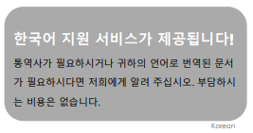
Completing forms and communicating with the school
Please let any school staff know if you need help completing forms or if you have questions.

Slide 32
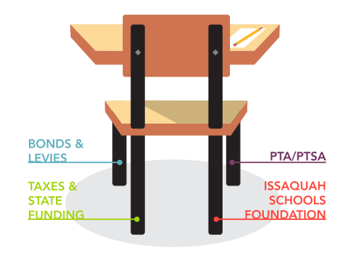
How are schools funded?
Issaquah students’ success sits on the stability of four key funding sources
Bonds & Levies: New school construction, renovations, land purchases. Must be approved by local voters.
Taxes & State Funding: State pays for basic education with state school levies & taxes; does not cover everything a district needs to operate
PTA/PTSA: Non-profit that raises money to fund art, technology, field trips, library book, playground equipment, STEM & cultural activities, assemblies & more.
Issaquah Schools Foundation: Supports programs that benefit all Issaquah School District students including teacher and school grants.

Slide 33

Provides Educational Enrichment for All Students
Supports our School
Builds Community
Grade-level Grants for STEM & Field Trips
Arts Education in the classroom
Musician & Author Visits
Science Fair
Literacy Programs & Tools
Teacher Stipends
Emergency Preparedness & Safety Supplies
Volunteers for School Programs
Reader Board and Newsletter Communications
Staff Appreciation
Family & Community Events like Falloween & Summerfest
Parent Education
Celebrating our Diversity at Cultural Fair
Spelling Bee, Reflections Art Contest & Talent Show
Community Outreach

Slide 34
Five Easy Ways To Support Grand Ridge
Join or renew your family’s PTSA membership
Consider volunteer opportunities
Whether one-time or ongoing, find them on our website
Participate in our fall fundraiser
Check out the calendar on our website and follow Grand Ridge Elementary PTSA on Facebook
Share your questions, ideas & feedback in person or email: grptsa@gmail.com
www.GrandRidgePTSA.org

