Slide 1

The Sayreville War Memorial
High School Guidance Department
Welcome Class of 2030!
We are excited for your transition
to high school!

Slide 2
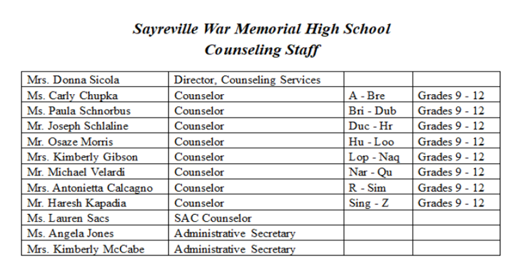
Counseling Department

Slide 3
Mandatory Freshman Elective
The Freshman Foundation course will be prescheduled for you. YOU WILL NOT ADD THIS COURSE AS ONE OF YOUR ELECTIVE CHOICES!
FRESHMAN FOUNDATION: SUCCESS AT SWMHS AND BEYOND 2.5 CREDITS
One Semester
This course is required for all students in grade 9
Freshman Foundations is a project-based course with an overview of school applications, transitioning to high school, and life skills. Students will develop skills in computer programs such as the SWMHS Student Information System by using Google, Microsoft applications, and On Course Connect. They will also receive instruction on the rules and proper procedures of Internet safety/Digital Citizenship. Added focus will be on improving students’ everyday soft and study skills. The course will also include presentations and lessons by the counseling staff, the SAC counselor, and high school administrators to assist them with the transition from middle school to high school.
* * * * The only exemption is for students taking NJROTC – a full year elective * * * *

Slide 4
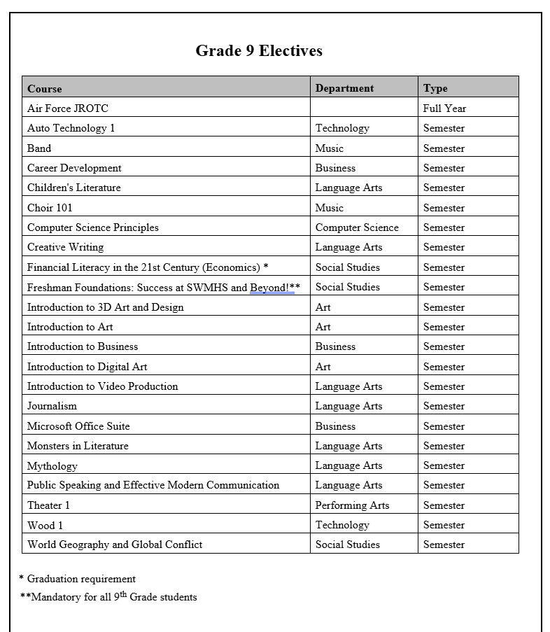

THESE ARE THE ELECTIVES AVAILABLE FOR GRADE 9

Slide 5
Required Classes for Graduation
English – 4 years
Math – 3 years
Science – 3 years
Social Studies – World History, US 1, US 2
World Language – 1 year (2 min. if applying to 4-year college)
Practical Art – 1 year (includes Business, Computer Science, Technology, Family/Consumer Sciences)
Fine/Visual/Performing Art – 1 year
Financial Literacy – Semester
Physical Education/Health – 4 years
**Each elective in the Course Description Book lists if the class is a practical or performing art**

Slide 6
Credit Requirements
120 credits are required to graduate!
You may earn 35 credits each year of high school, or 140 credits by the end of your senior year.
Each student must earn a minimum of 120 credits to earn a high school diploma. Credits are awarded upon the successful completion of each course. A student’s grade level is determined by the number of credits that he/she has earned. Courses currently in progress do not count toward this total until they are completed. Below are the earned credit requirements for each grade level.
To be considered a “sophomore”, a student must accumulate a minimum of 25 credits.
To be considered a “junior”, a student must accumulate a minimum of 50 credits.
To be considered a “senior”, a student must accumulate a minimum of 85 credits. Seniors who have not earned 95 credits must select a full-day schedule.
To be a senior and qualify for early dismissal, students must accumulate a total of 95 credits by the end of junior year AND pass both the ELA and Math sections of the NJGPA.
NOTE: The credits specified must be accumulated before the first day of school.
Work hard and pass all your classes to be able to graduate on time!

Slide 7
Credit Recovery / Summer School
Sayreville War Memorial High School DOES NOT
offer summer school classes.
Students who need to make up courses to be able to graduate on-time are given the opportunity to take online courses through a company called Educere. Courses are completed independently (at home) during the summer. There are only typically eight weeks to complete a full year course.
Students and their families are responsible for the cost which ranges from $250 for a half-year course and $500 for a full-year course.

Slide 8
Graduation Test – NJGPA
To obtain a high school diploma, all students in the state of NJ are required to pass the NJGPA. There are two sections: ELA and math. You need to pass with a 725 score or higher on both sections.
After taking the test one time (in your junior year) if you do not have both passing scores, you can then take an alternate test. These include: PSAT, SAT, ACT, and Accuplacer. If you still need one of the two tests, in the spring of your senior year, you can complete a portfolio of your assessments to be approved by the state of NJ.

Slide 9
Attendance – driven by State of New Jersey
Students must be present minimum 90% of school year.
9 absences allowed for semester class
18 absences allowed for full-year class
Students who exceed 9 or 18 absences will be scheduled for an attendance appeal with the possibility that you are dropped from the course and lose the credits.
Lateness to class:
More than 22 minutes late to 1st period is considered an absence
Five (5) unexcused lates in any specific class will equate to one class
cut and consequenced at the appropriate cut level.
10 unexcused lates in any specific class will equate to two class
cuts and consequenced at the appropriate cut level.
15 unexcused lates will equate to three class cuts and
consequenced at the appropriate cut level
If the 15 unexcused lates are for a particular semester course,
the student will lose credit – earn zero (0) for the course and be withdrawn from the course and assigned to a study hall for the remainder of the semester.
20 unexcused lates – will equate to four class cuts. The student will be withdrawn from the full-year course, earning a zero (0). Student will be assigned to a study hall for the remainder of the semester.
Please see Student Handbook on school website for further details about consequences.

Slide 10
OnCourse Online
Course Requests
This guide will walk you through the online course request feature of OnCourse Connect for you to choose your 2025-2026 electives.
The window for adding electives begins 2/2/2026 and closes on 2/27/2026.

Slide 11
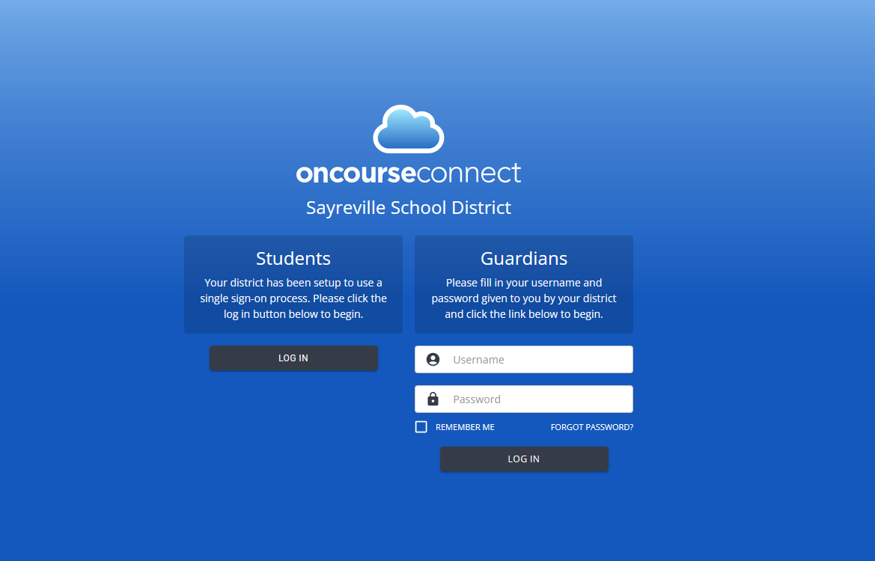

You will only be able to add elective choices when you sign in to the STUDENT PORTAL. The green access button is not available in the PARENT ACCOUNT.
www.sayrevillek12.net
“Students” Tab
Student Portal
4. You must sign in on
the LEFT
side for “STUDENTS”
5. Your sign-in is your
school email address
and password (Google
Login)

Slide 12
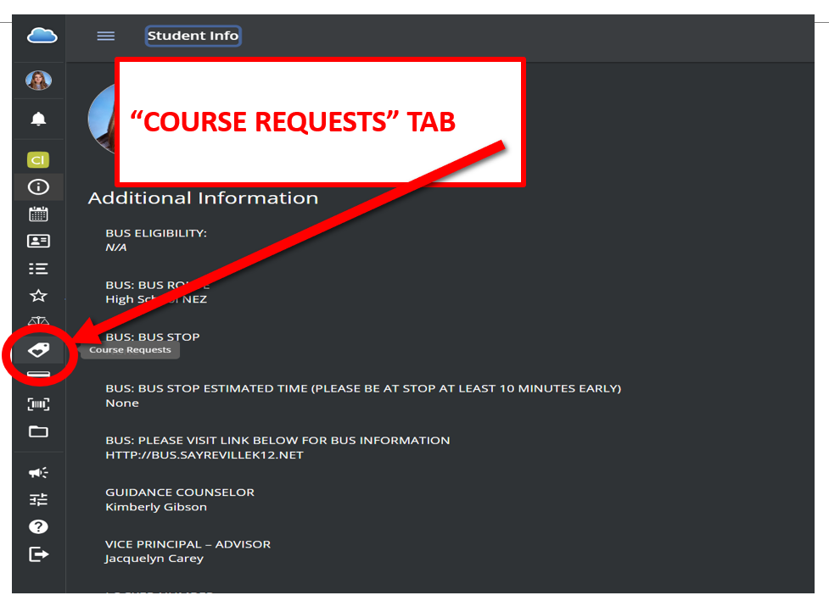
How do I Access the Course Request Menu?
Select the Course Requests icon (see image).
This will take you to the main Course Request menu.

Slide 13
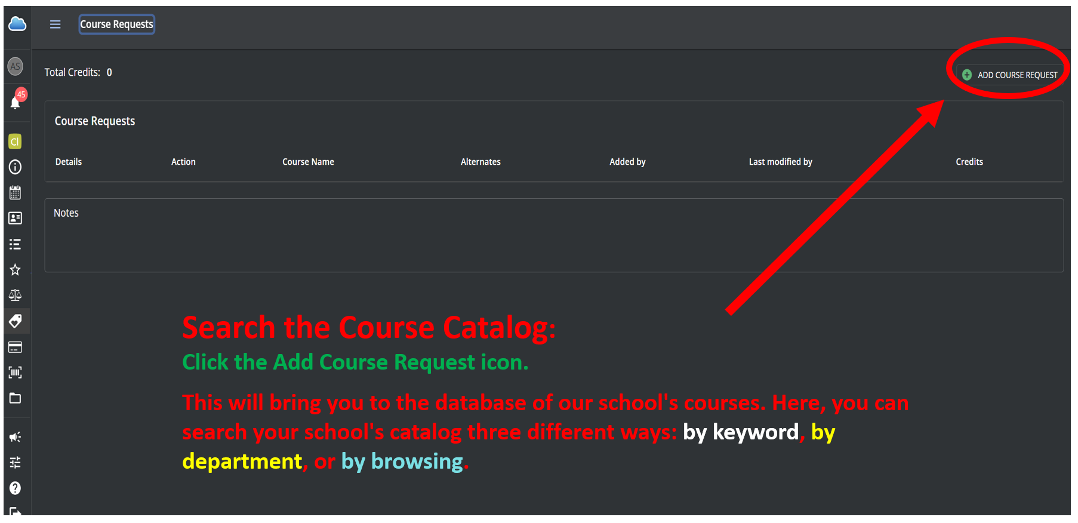

Slide 14
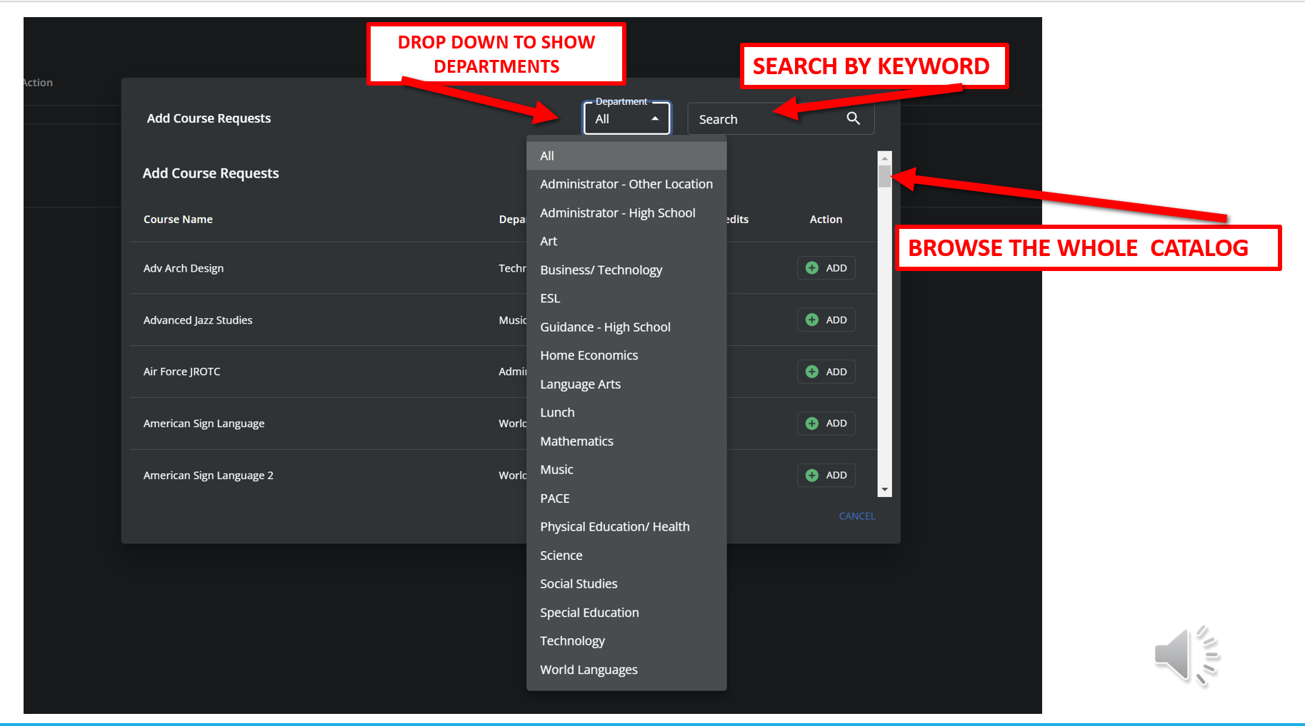

Slide 15
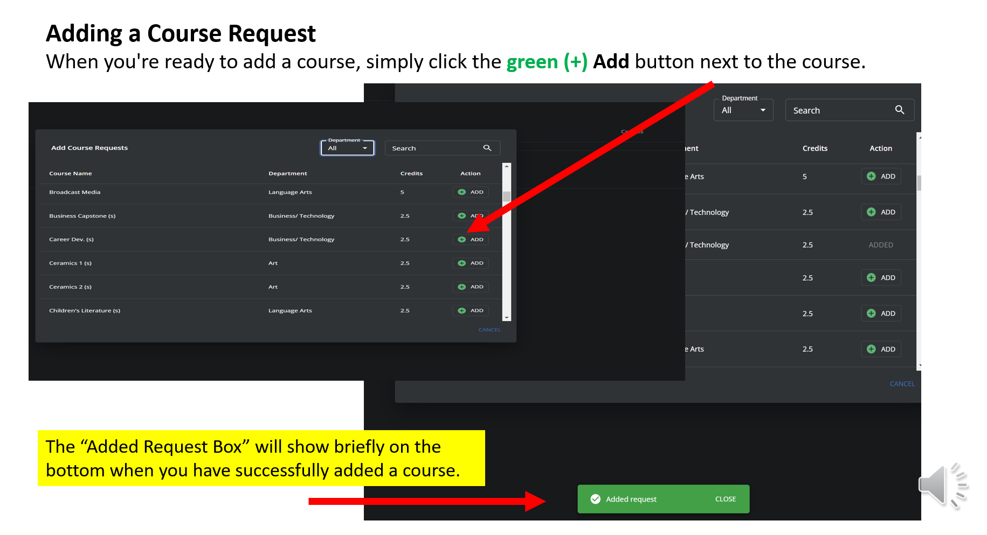

Slide 16
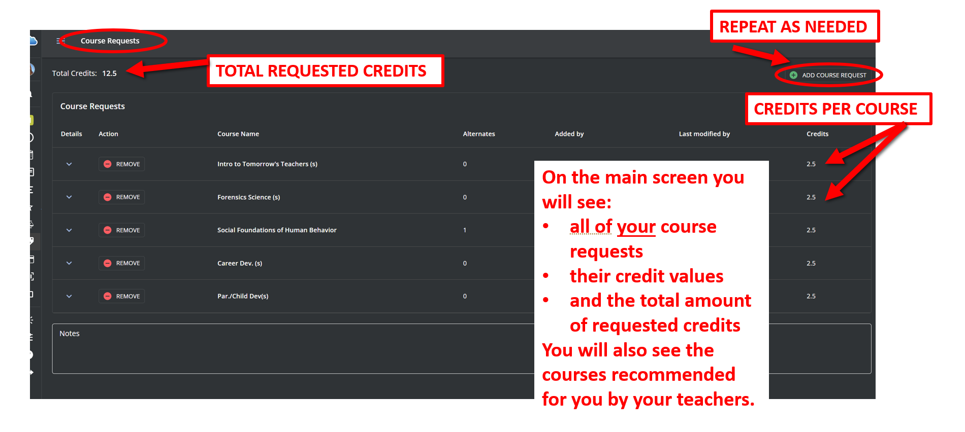

Slide 17
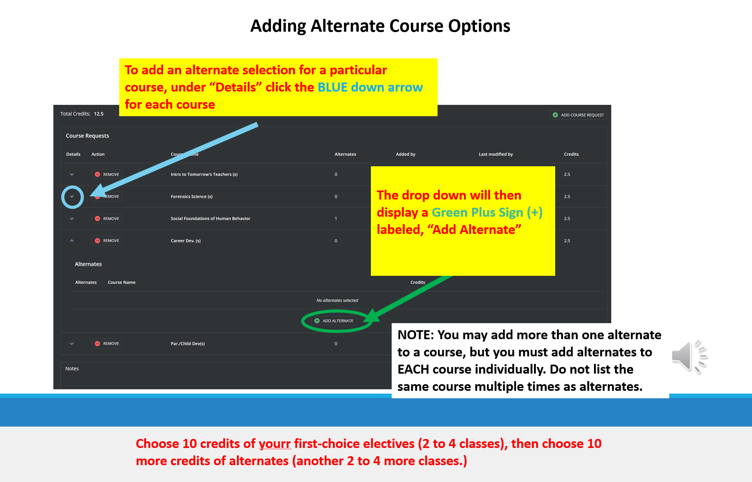

Slide 18
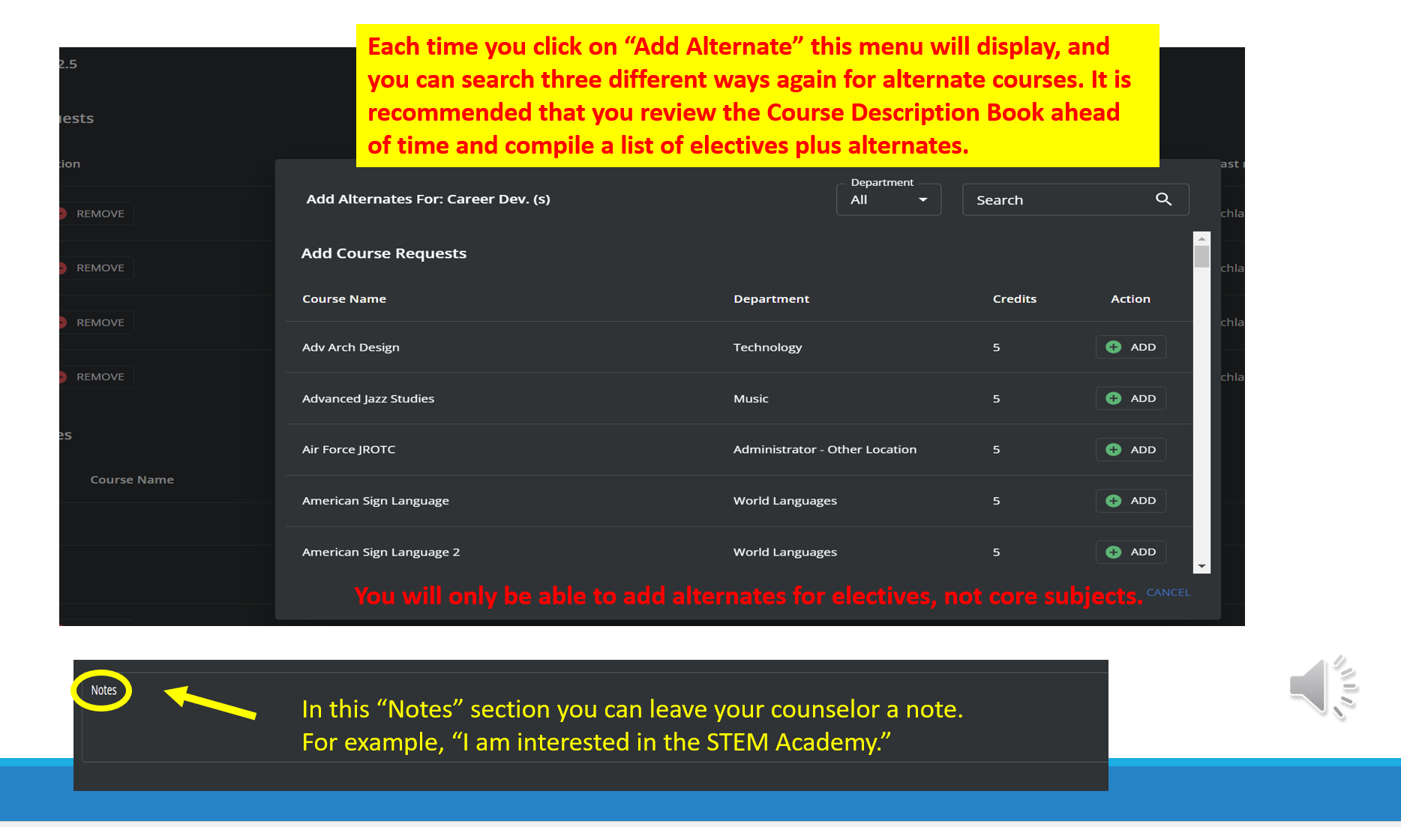

Slide 19
On the main screen you will see all of your course requests, and your total amount of requested credits as well as the teacher recommendations for your core subjects.
Your high school counselor will discuss these courses and your electives with you during your scheduling meeting.

Slide 20


AIR FORCE JUNIOR ROTC 5 CREDITS
Prerequisite: None Full Year
This course will apply principles of science learned in other courses such as earth science, biology, chemistry and physics. The major units covered include: the aerospace environment, the human requirements of flight, the principles and physics of aircraft flight, weather and navigation. Students are provided detailed instruction on ceremonial performances and protocol for civilian and military events and have the opportunity to personally learn drill. Most of the work will be hands-on. Students WILL wear the Air Force JROTC uniform weekly on the designated uniform day and the issued PT uniform on Fridays. (Practical Art)

Slide 21

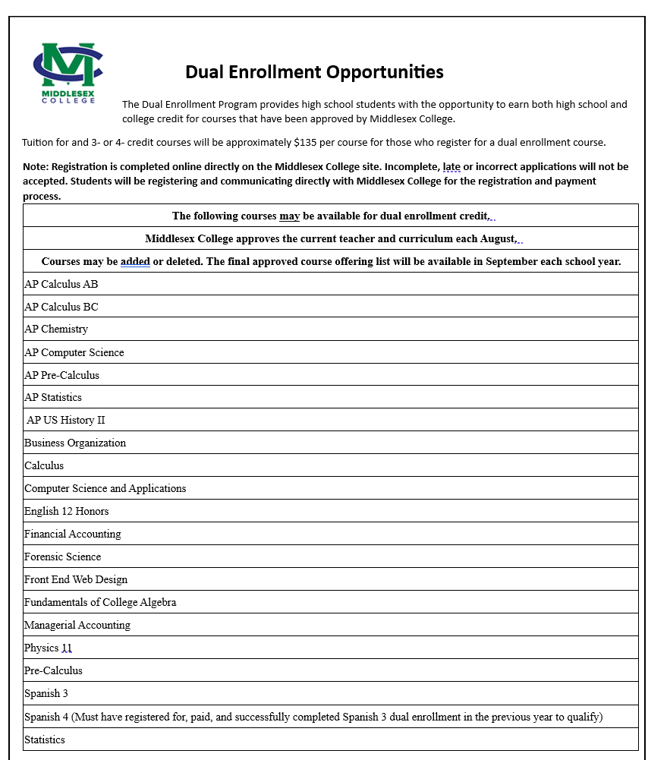

Dual Enrollment
Opportunities
The Dual Enrollment program provides high school students the opportunity to earn both high school and college credit for courses that have been approved by Middlesex College.
Tuition for any 3- or 4-credit course will be $135 for those attending Middlesex College while still in high school.
*Note: Registration is completed online directly in the Middlesex College site, unless otherwise noted. Registrations submitted after your district’s enrollment deadline will not be accepted.
Middlesex College cannot guarantee transfer of any course(s) taken for credit.
Please check njtransfer.org or inquire with the receiving institution(s) prior to registration.

Slide 22


Follow us on
@SWMHSBombers

Slide 23


FINAL REMINDERS
The window to make elective requests is open now!
The window will close on Feb. 27th at 12:00 Noon.
Sign in to On Course using your username and password, NOT your parent/guardian’s username and password.
Make sure you add at least five credits of first choice electives and at least 1-2 alternates for each elective.
Pay attention to the prerequisites for each course.
Talk to your teachers about courses you are interested in and the levels you are being recommended for. Courses and levels have prerequisites as well.
Talk to your family, friends, teachers and school counselor about our classes, your plans, your future!

Slide 24


