Slide 1
WELCOME TO SAYREVILLE WAR MEMORIAL HIGH SCHOOL
ORIENTATION
for
Parents/Guardians and Students
Class of 2030

Slide 2
HIGH SCHOOL ADMINISTRATION
Mr. Richard Gluchowski | Principal
Mrs. Jacquelyn Carey | Vice-Principal
Mr. Anthony Martucci | Vice-Principal
Mr. Michael Salum | Vice-Principal
Mrs. Katelyn Zurawski | Vice-Principal

Slide 3
DISTRICT ADMINISTRATORS
Mrs. Sicola donna.sicola@sayrevillek12.net | Guidance and Counseling District Test Coordinator
Ms. Badami jennifer.badami@sayrevillek12.net | Health, Physical Education and Athletics​
Dr. DeFina cynthia.defina@sayrevillek12.net | Special Education
Ms. Capraro suzanne.capraro@sayrevillek12.net | ELA, ESL, World Language, FEA
Mr. Howard christopher.howard@sayrevillek12.net | Humanities (Social Studies and the Arts)
Dr. Maharana mala.maharana@sayrevillek12.net | Mathematics, Business, Computer Science
Ms. O’Connor carolynn.oconnor@sayrevillek12.net | Science, Practical Arts, Nurses, AFJROTC

Slide 4
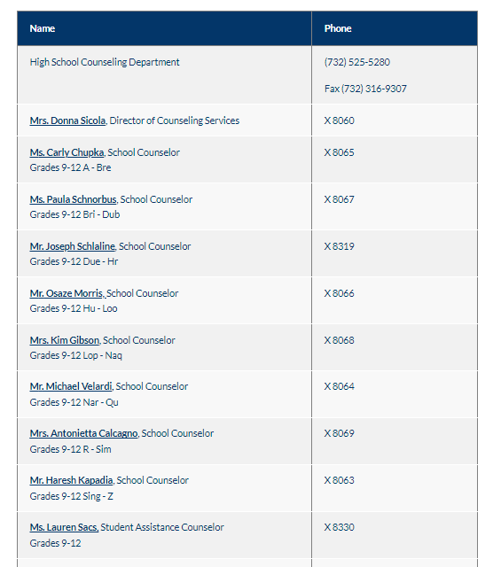
COUNSELING DEPARTMENT

Slide 5
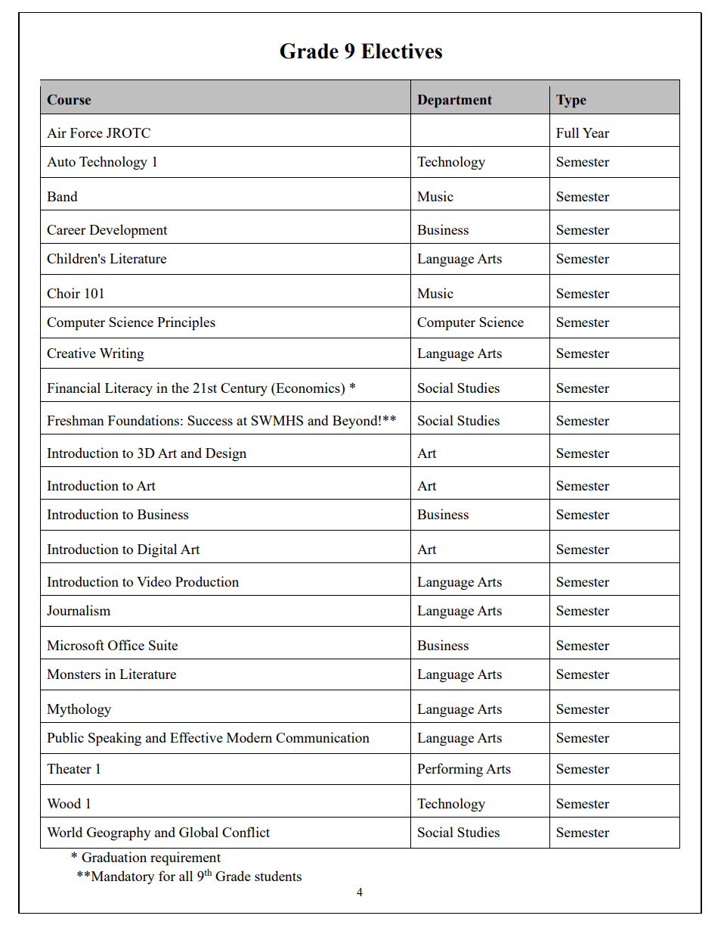
Grade 9 Electives

Slide 6
Class of 2030
Google Classroom
Class code: gl6mxswb
Join and have access to:
Grade 9 electives
Course Description Book
Counselor caseloads
How to add electives in OnCourse Power Point
Credits- how many do you need to pass to the next grade level?

Slide 7
S C I E N C E
Ms. C. O'Connor ~ Science, Industrial Arts, Nurses
Biology Honors
Biology CP
Integrated Science
Placement determination:
Semester grades in science and LAL
Quarterly assessment grades
Teacher recommendation

Slide 8
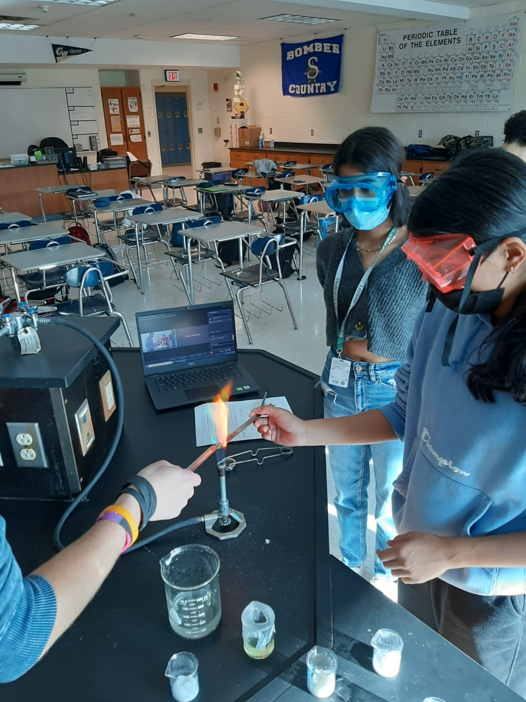
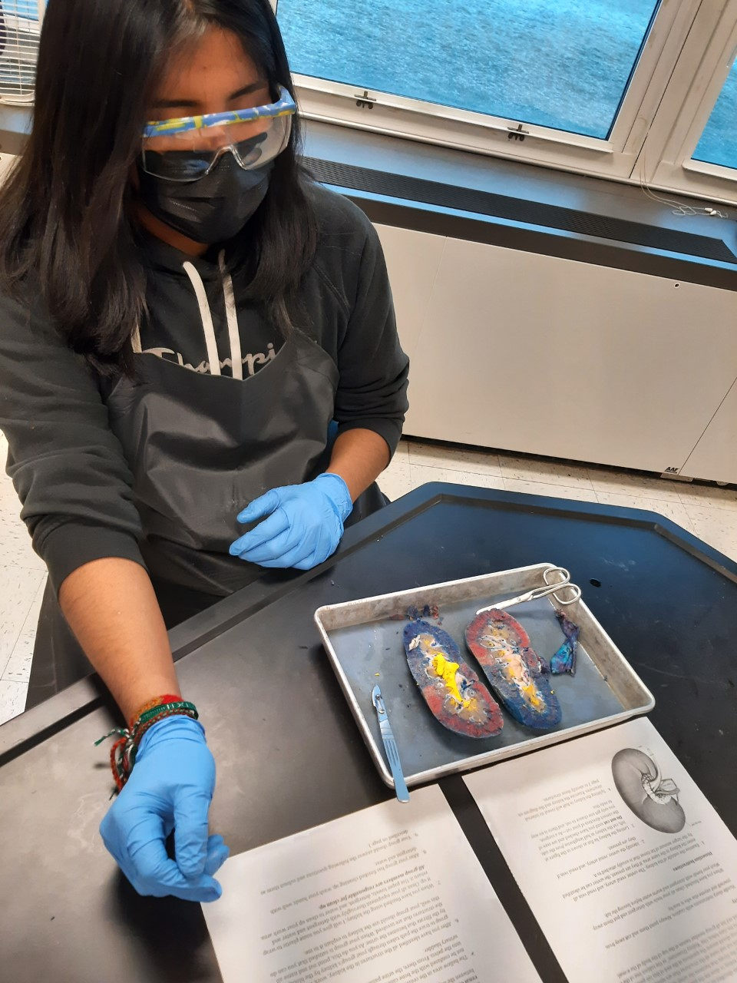
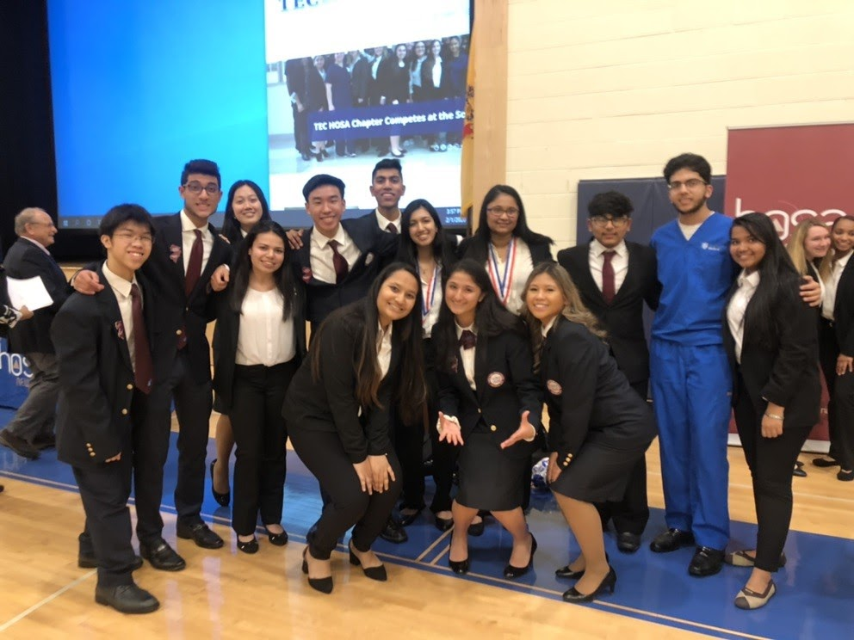
STEM Academy
Biomedical Strand
Required Science Courses |  | Required Math Courses
Biology Honors Chemistry Honors Physics Anatomy & Physiology Honors | AP Biology AP Chemistry STEM Capstone | Geometry Honors Algebra II Honors Pre-Calculus Honors or AP Pre-Calculus Calculus Honors or AP Calculus AB or BC

Slide 9
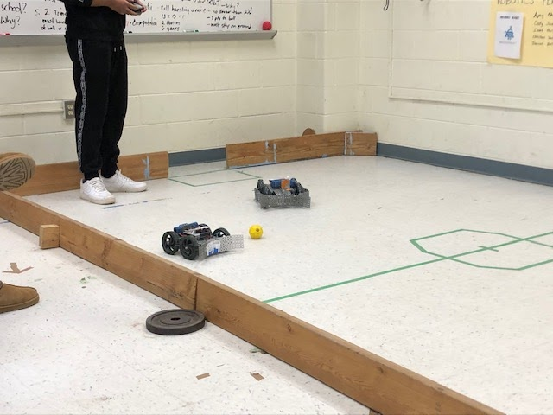
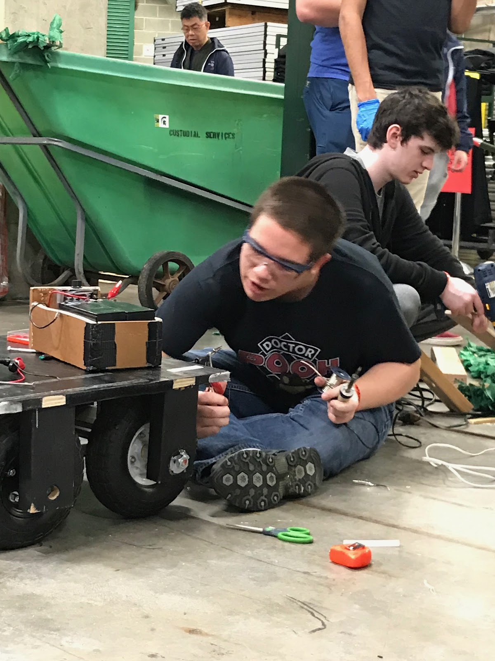
STEM Academy
Engineering Strand
Required Electives | Required Science Courses | Choice of 4 Math Courses | 2 AP Science Courses
Intro. To Engineering Engineering Drawing Robotics Adv. Architectural Design | Biology Honors Chemistry Honors Physics STEM Capstone | Geometry Honors Algebra II Honors Pre-Calculus Honors Calculus Honors AP Pre-Calculus AP Calculus AB AP Calculus BC | AP Biology AP Chemistry AP Environmental Science

Slide 10
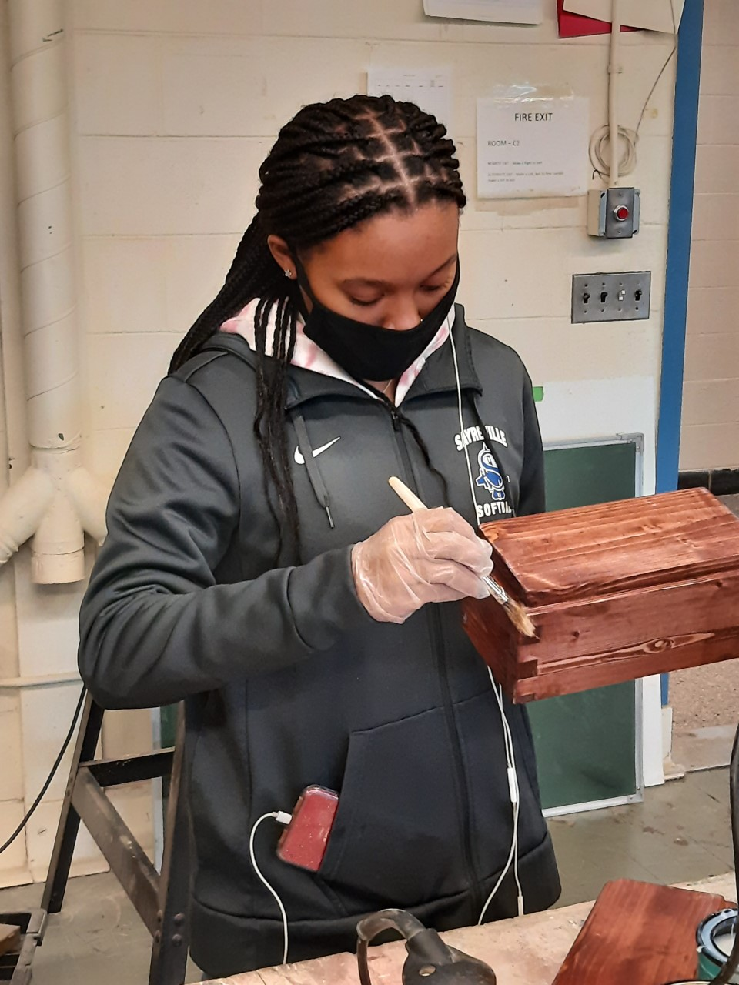
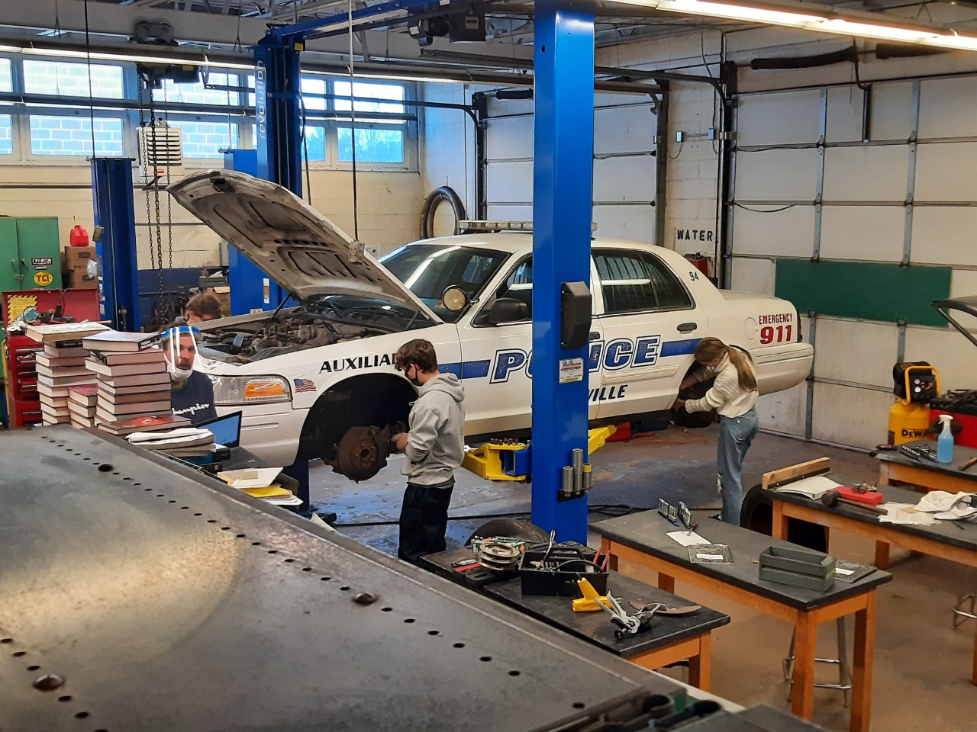
TECHNOLOGY ELECTIVES
Auto Technology 1 (Semester)
Wood Shop 1 (Semester)
Robotics (Full Year)
Engineering Drawing (Full Year)

Slide 11
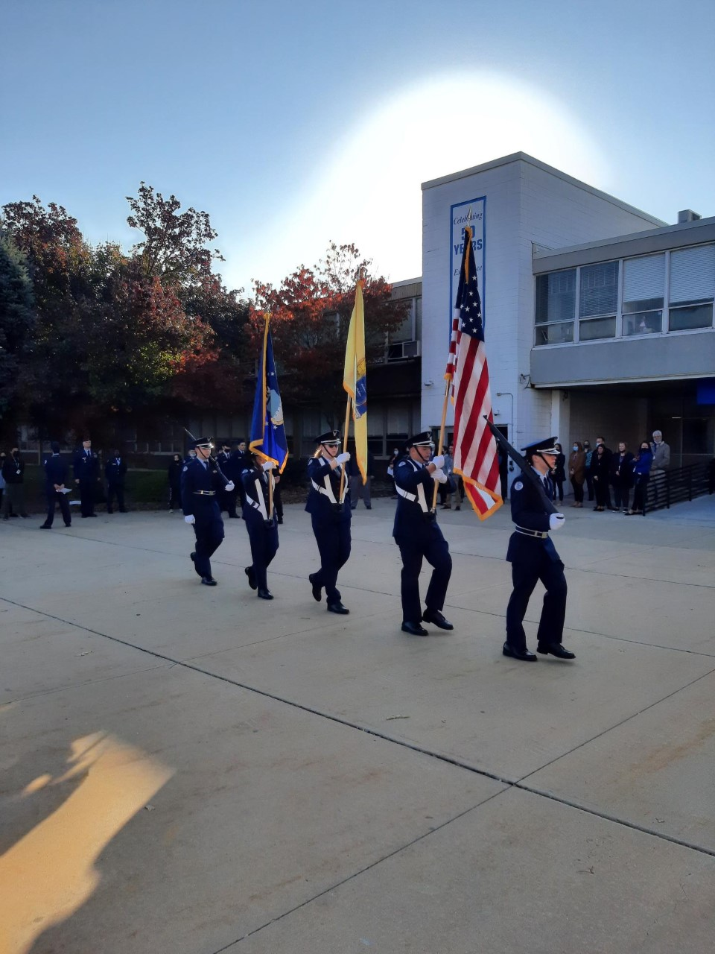
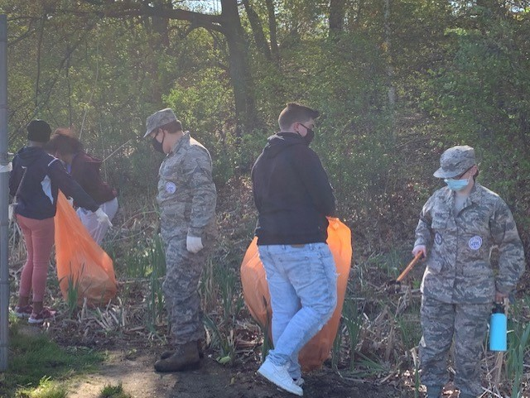
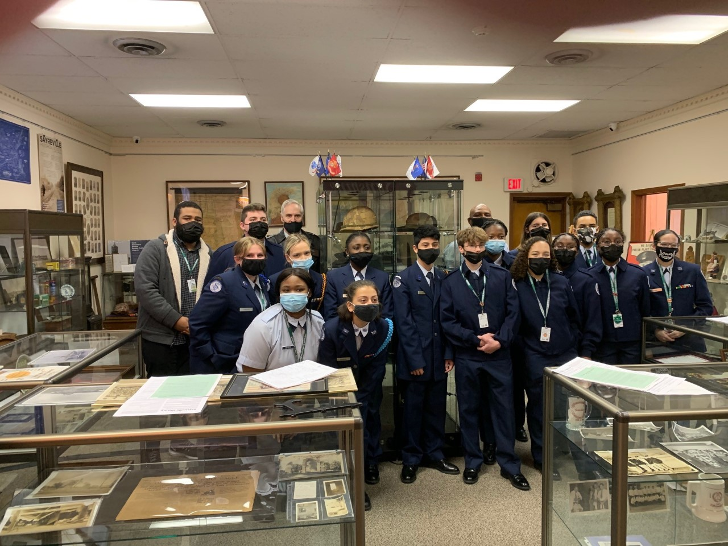
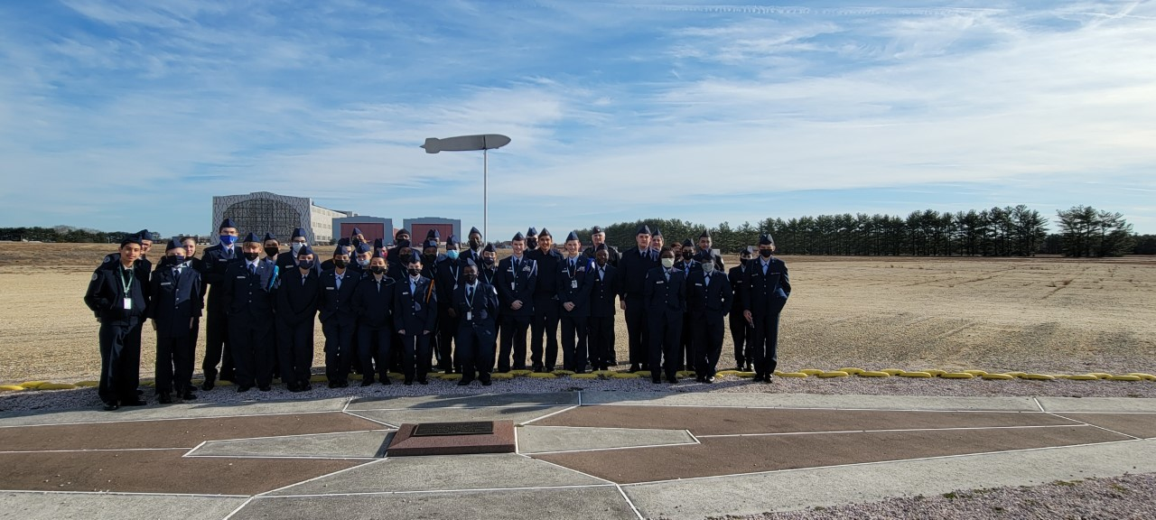
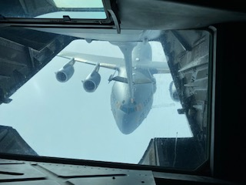
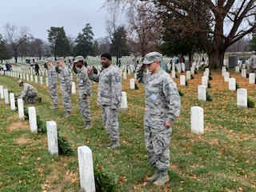
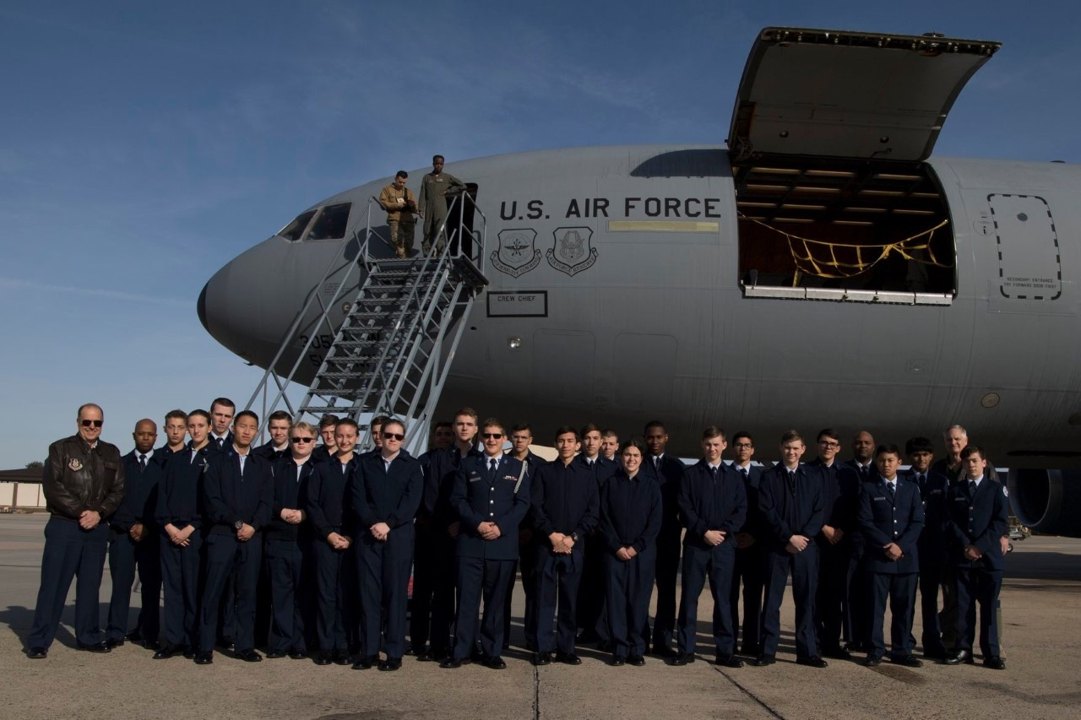
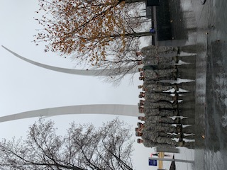
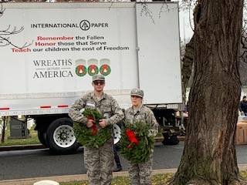
JROTC
Air Force Junior ROTC
Can be taken freshman
through senior years.
Ceremonial performances and protocol for civilian and military events
Drill
Aerospace environment
Human requirements of flight
Principles and physics of aircraft flight

Slide 12
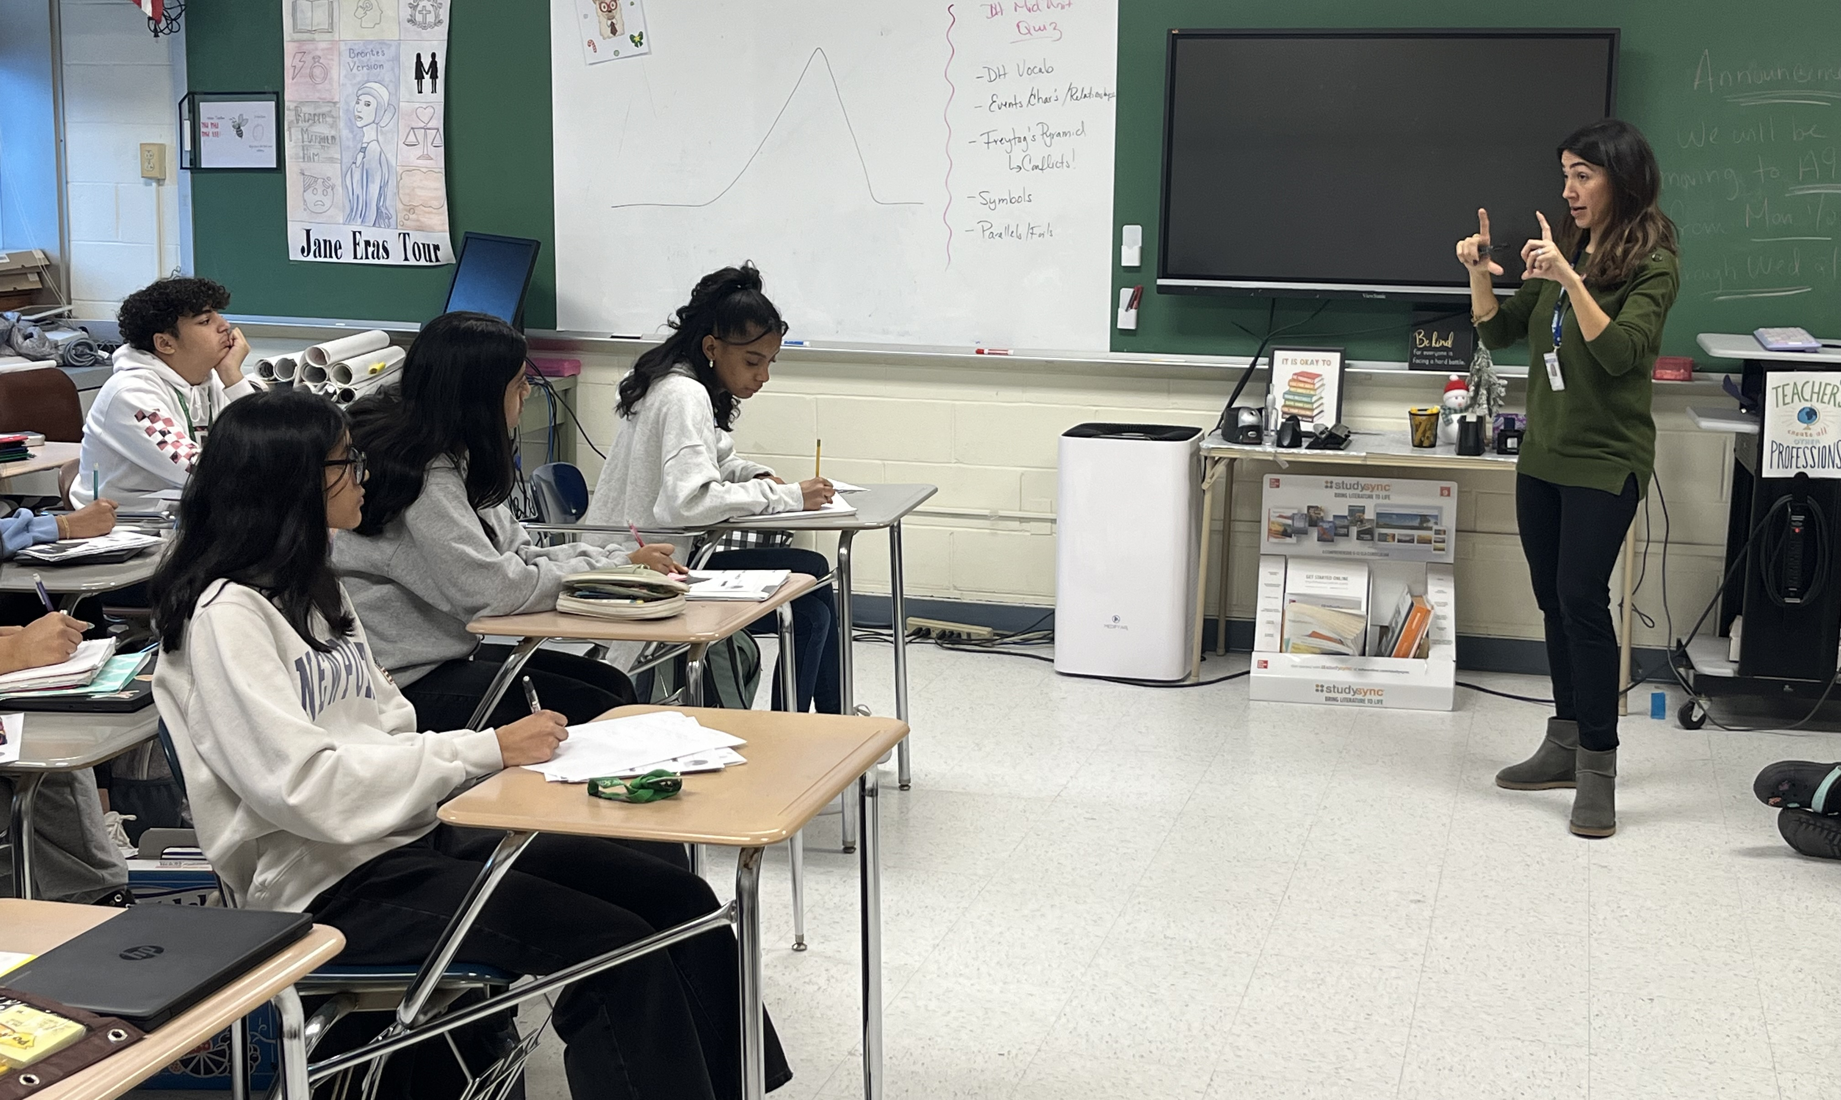
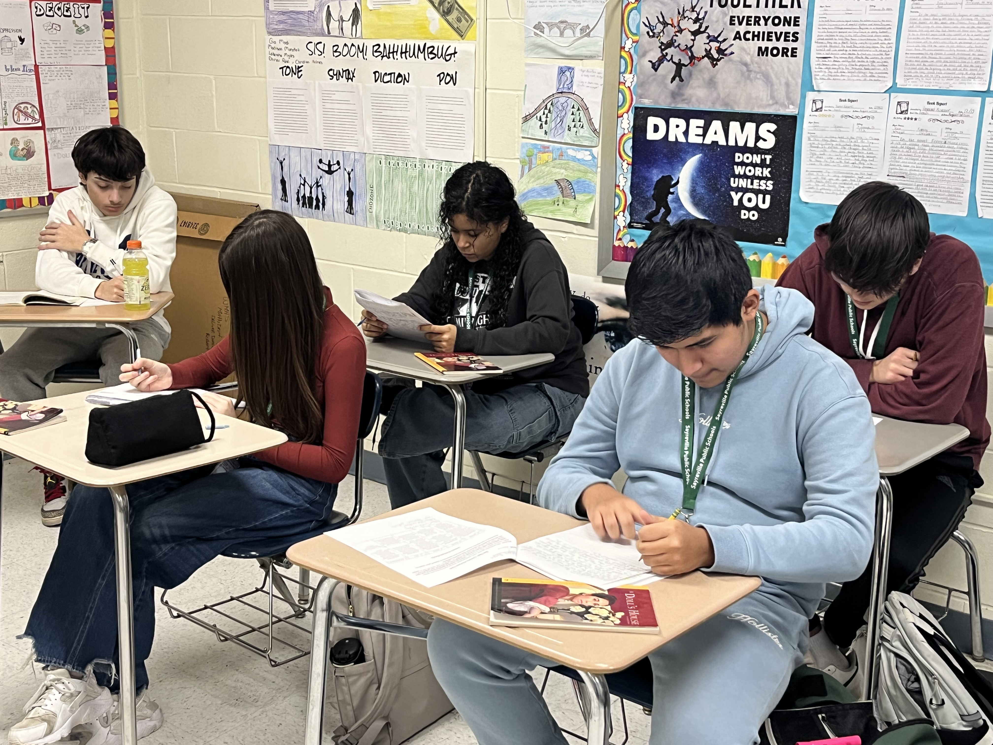
Ms. Suzanne Capraro ~ ELA, ESL, World Language
E N G L I S H: All 4 Years
Freshman Levels:
English 9 Honors
English 9 CP
English 9
Placement Criteria for English includes:
Prior Year's Final Average
Semester 1 Grade
Quarterly Exam Average
LinkIt! Benchmark Form A /B Score

Slide 13
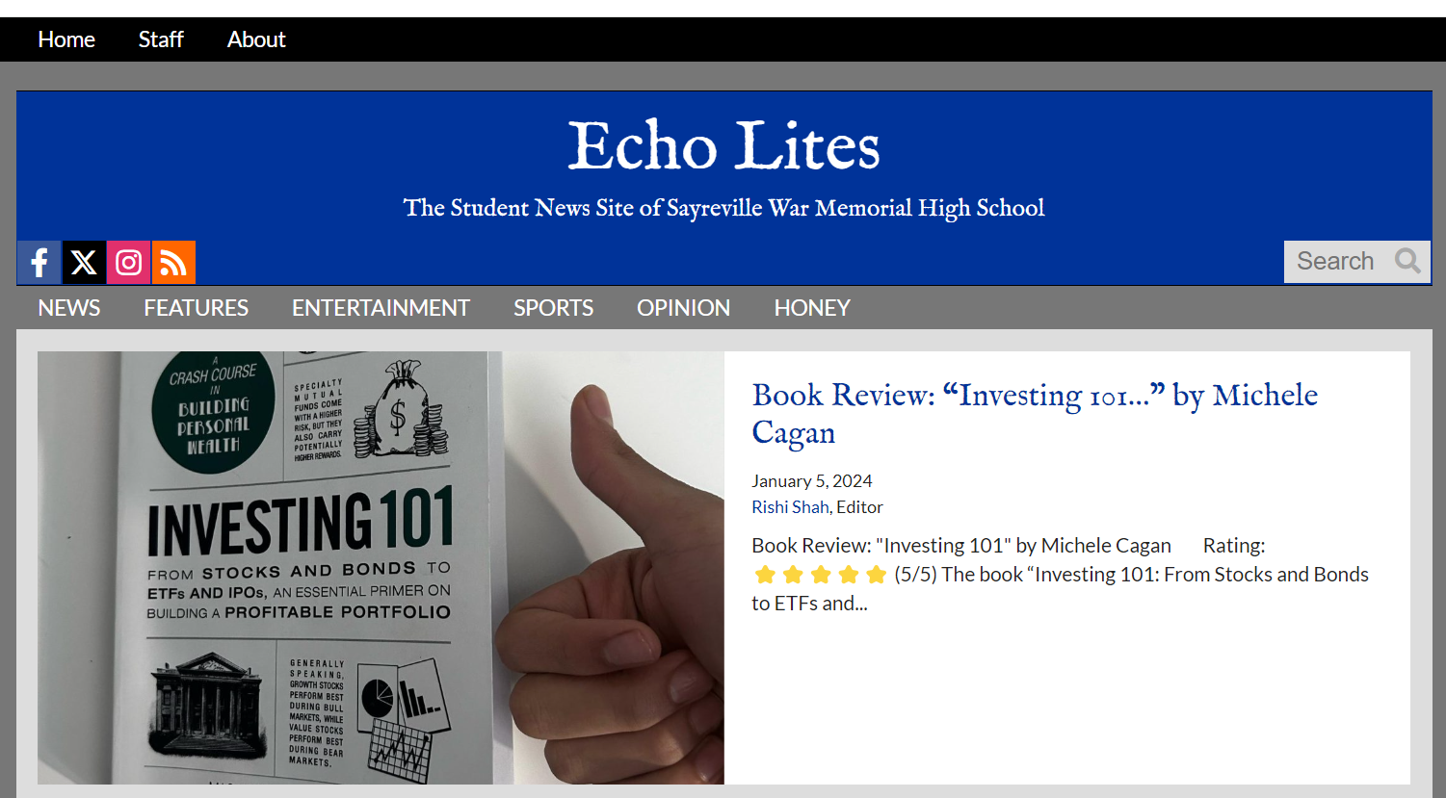
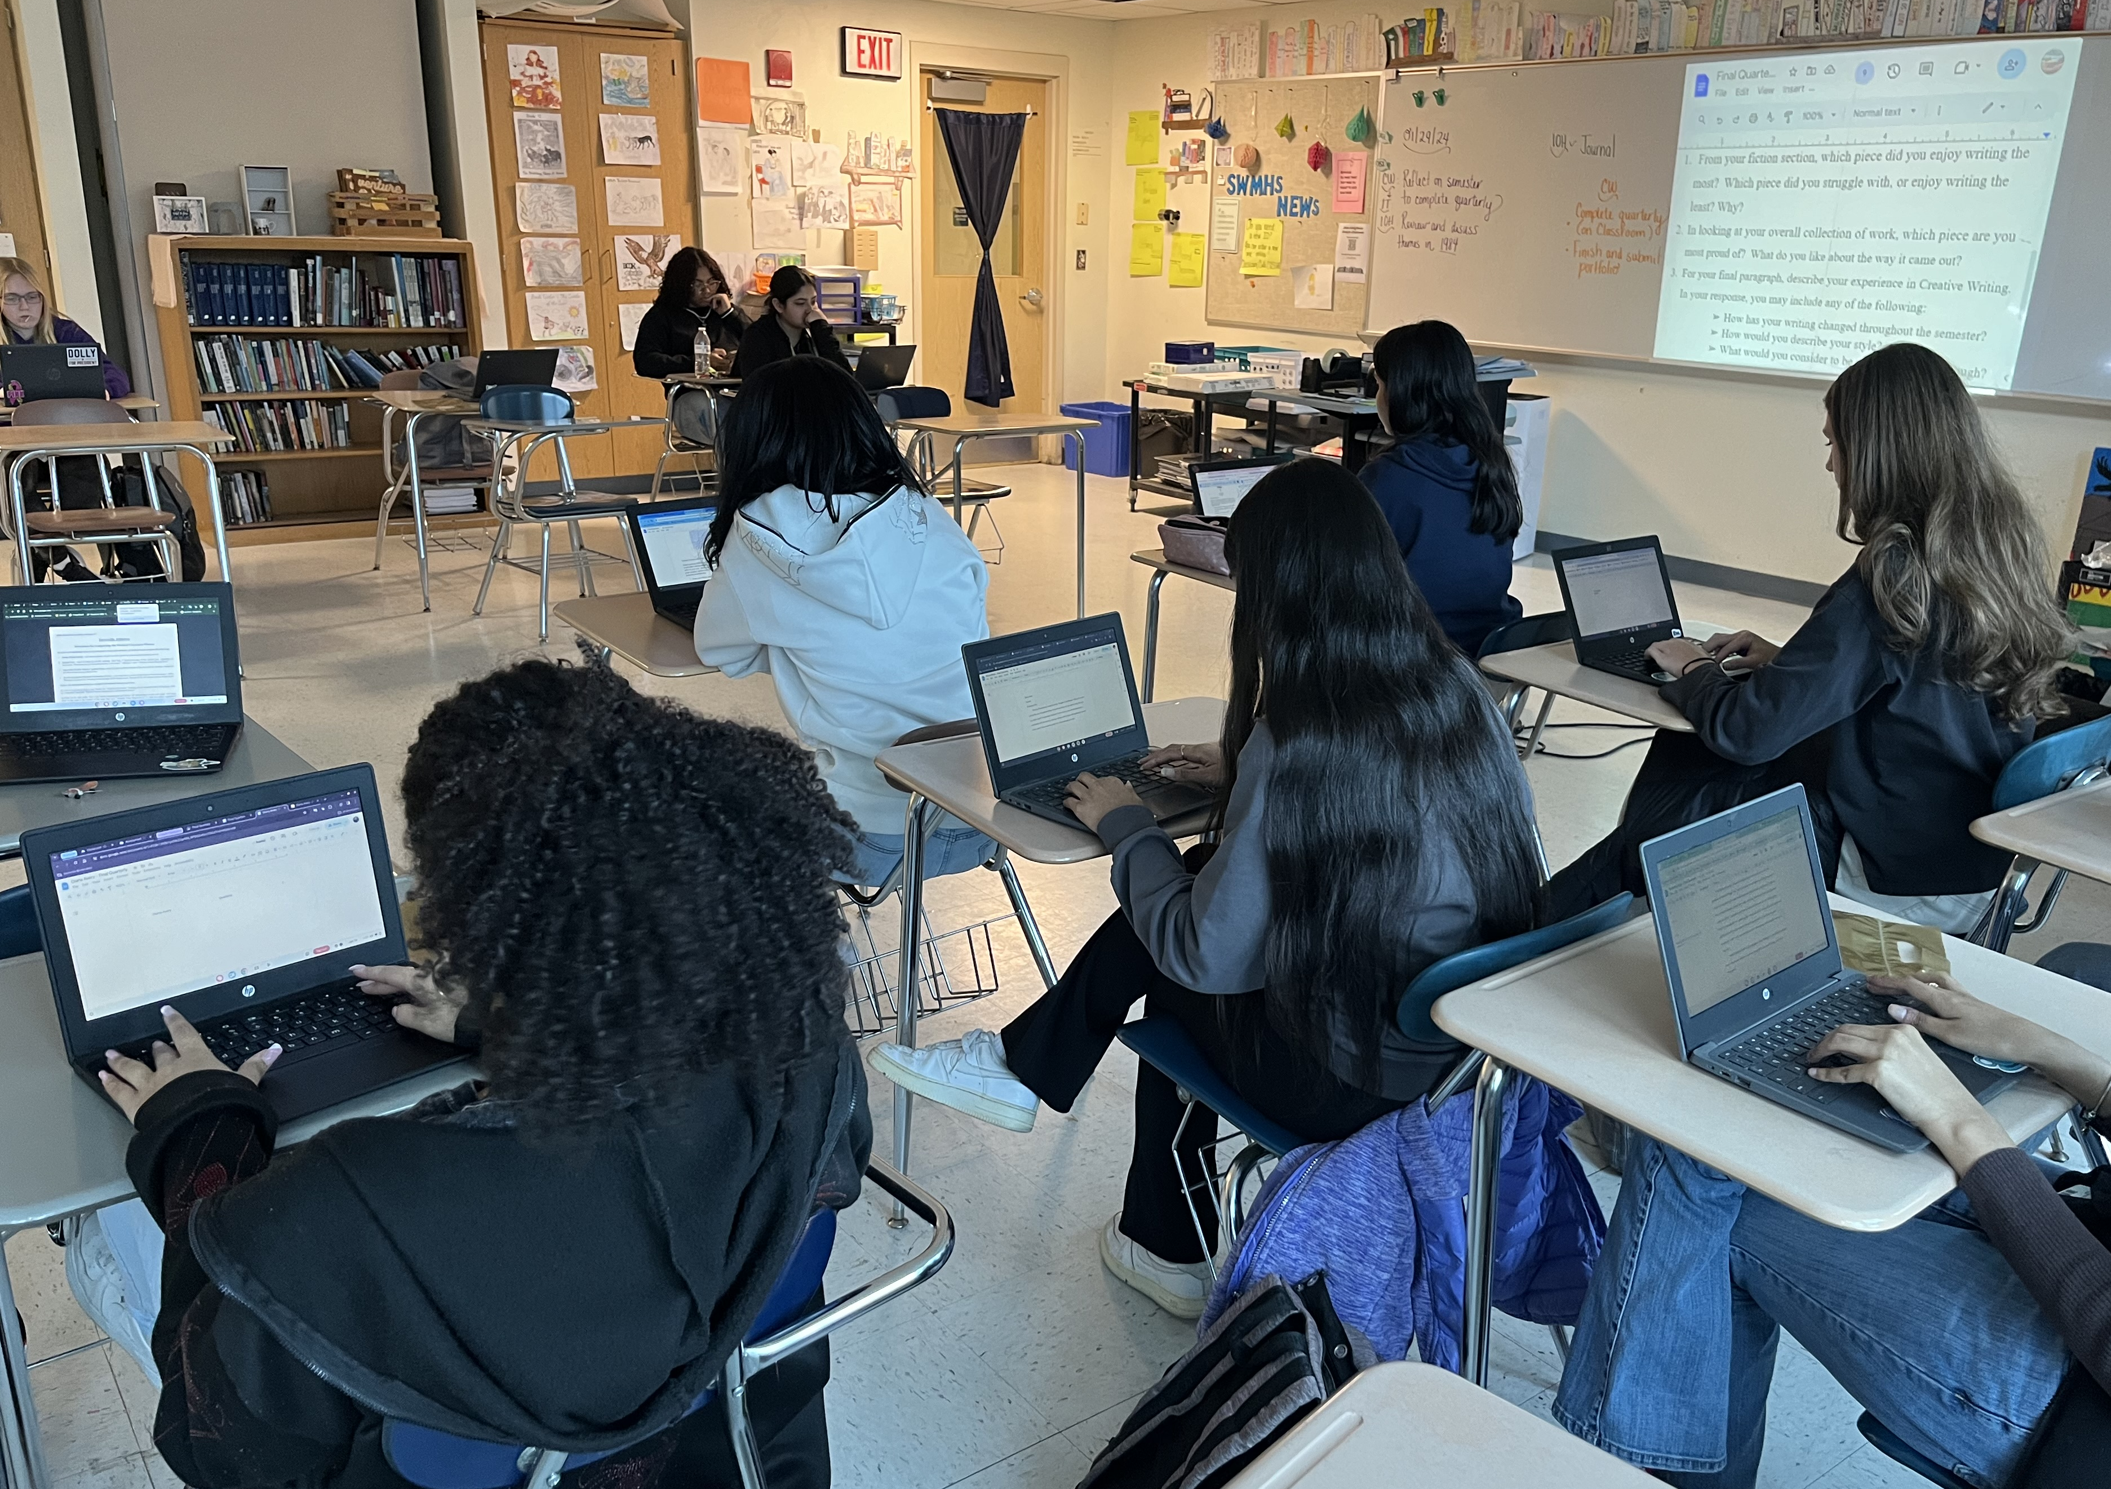
E N G L I S H RELATED E L E C T I V E S
Creative Writing (Images Magazine)
Children's Literature (FEA elective choice)
Monsters in Literature
Journalism (Echolites)
Mythology
Film Studies
Public Speaking and Effective Modern Communication
(Practical Art, FEA elective choice)
Introduction to Video Production
(Practical Art)

Slide 14
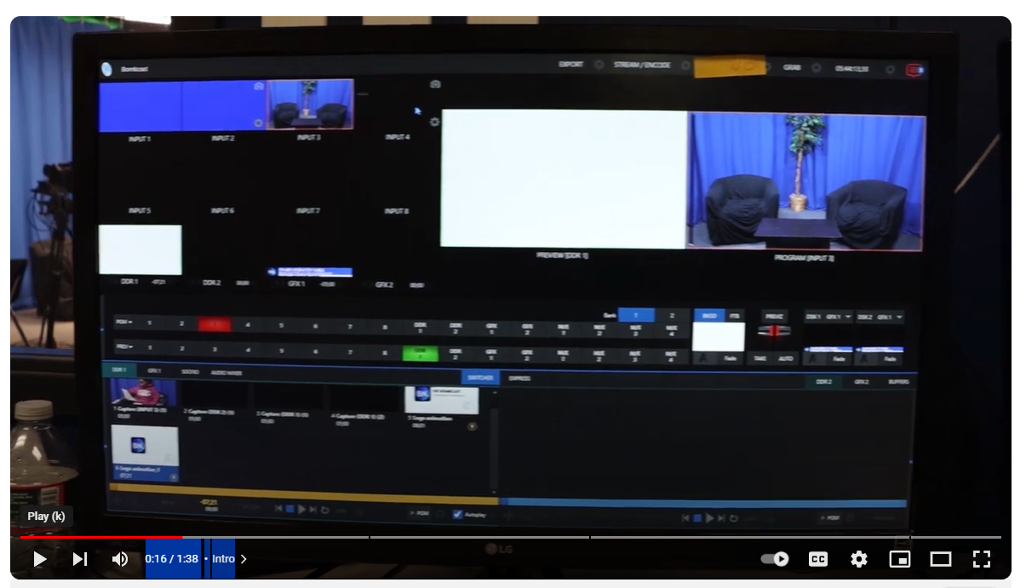
Broadcast Media/TV Production
Aligned to the practical arts graduation requirement
Offered to all grade levels
After intro course, two options:
  Broadcast Media or Filmmaking
Functioning TV Studio at SWMHS
The BombCast: 100% Student Production

Slide 15
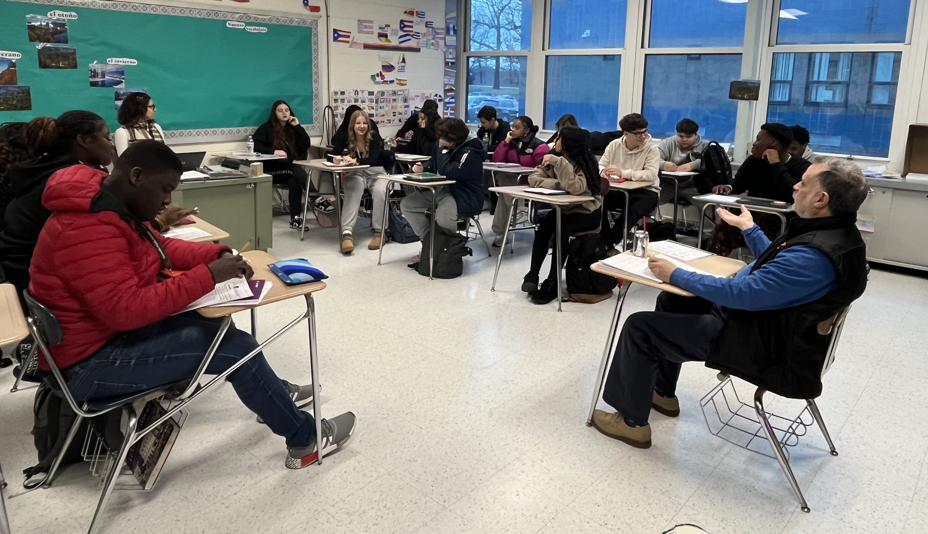
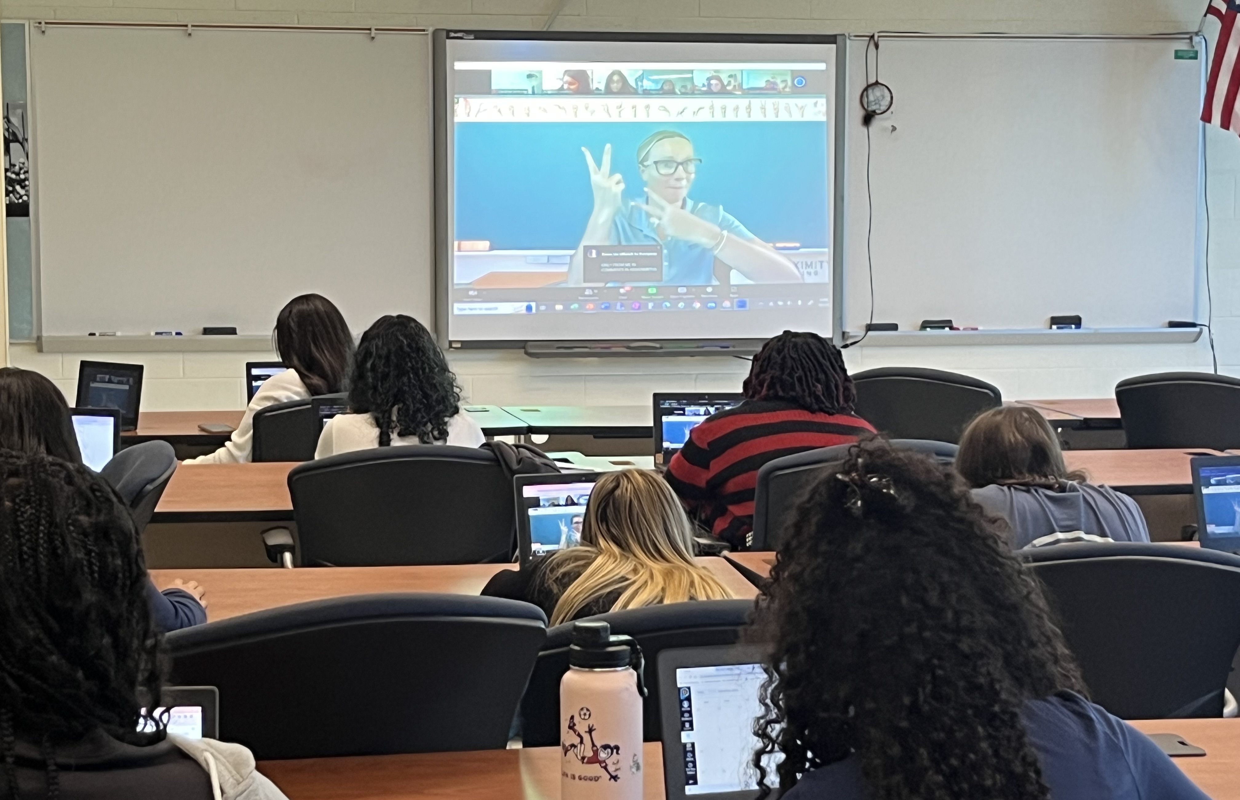
W O R L D L A N G U A G E S
Freshman options:
French 1
Spanish 1
Spanish 2
(if eligible for
acceleration)
American Sign Language

Slide 16

ESL Program at SWMHS
ESL classes for beginner, intermediate
and advanced students
Newcomer course for beginner students new to USA
SEI/SIOP trained content area teachers
Annual WIDA ACCESS testing

Slide 17

NJ State Seal of Biliteracy
Award given by the NJDOE
Recognizes students who demonstrate proficiency in at least one language in addition to English by high school graduation
Assessments administered from January 1 of junior year through early February of senior year
Classes of 2021-2025: 108 Seals of Biliteracy awarded
Class of 2026: 27 students qualified so far
Class of 2027: 36 students passed exam for eligibility

Slide 18
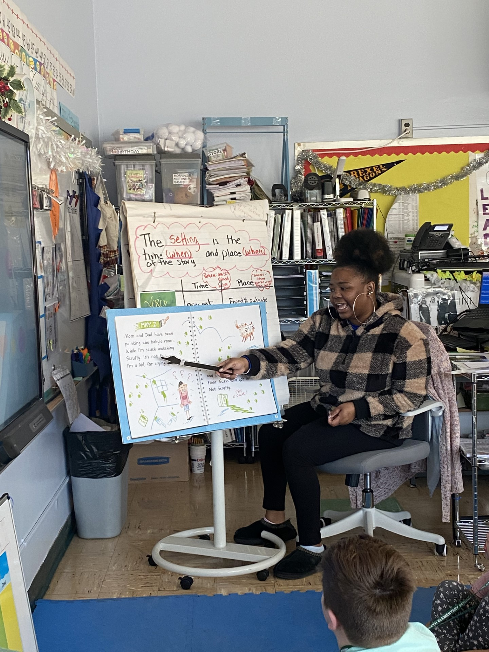
FUTURE EDUCATORS ACADEMY - FEA
The Sayreville War Memorial High School Academy for future careers in education provides a focused course sequence for students interested in exploring the field of education.
Elective Courses (must take two):
Children’s Literature
Public Speaking and Effective Modern Communication
Parent/Child Development
Social Foundations of Human Behavior
Mandatory Courses:
Introduction to Tomorrow’s Teachers (gr 11)
Tomorrow's Teachers Honors (gr 12)*
Suggested/Optional Courses:
Unified Physical Education
Art Together: Exploring Creativity
Stage and Story
*available for dual enrollment through Rider U for a fee

Slide 19
H I S T O R Y
Mr. Christopher Howard ~ Social Studies
World History Honors
World History CP
World History
World History -- CST determined
Placement for World History includes:
Semester 1 Grades
Quarterly Exam Grades
Current Social Studies Level
ELA Benchmark Form B
Teacher Recommendation

Slide 20
SOCIAL STUDIES ELECTIVES
SEMESTER COURSES
World Geography and Global Issues
Freshman Foundations
    Mandatory for all 9th Grade Students
Financial Literacy in the 21st Century
    Graduation Requirement

Slide 21
Mr. Christopher Howard, Arts​
PERFORMING ARTS ELECTIVES
Band (Semester and Full Year)
Advanced Band (Audition required)
Advanced Jazz Studies (Audition required)
Choir 101 (Semester and Full Year)
Theater I (Semester)

Slide 22
Theatre I
Offered to all grade levels
Fulfills Performing/Fine Arts graduation requirement
2.5 credit course
Dramatic Production in Fall
Musical Production in Spring

Slide 23
Visual Arts
Electives
SEMESTER COURSES
Introduction to Art
Introduction to Digital Arts
Introduction to 3D Arts and Design

Slide 24
VISUAL ARTS
CAREER ACADEMY
The Visual Arts strand of the academy offers a comprehensive course sequence for students who may be interested in pursuing careers in the art field.
LEVEL 1 | LEVEL 2 | LEVEL 3 | LEVEL 4
Required course: | Choose two (2) of the following courses: | Choose the following course: | Choose one (1) of the following courses:
Introduction to Art (2.5) | Drawing (2.5) | Studio Art (5.0) | Advanced Art: A Capstone Course (5.0)
Also available: | Painting (2.5) |  | AP Art History (5.0)
Introduction to 3D Arts and Design (2.5) | Ceramics I (2.5)
Introduction to Digital Arts (2.5) | Ceramics II (2.5)
 | Stained Glass (2.5)
 | Fashion Illustration (2.5)
 | Digital Arts II (2.5)
 | Any Other Introduction Course (2.5)

Slide 25
M A T H E M A T I C S
Dr. Maharana: Mathematics, Business, Computer Science
X handle- @MaharanaMala
Algebra 2 Honors
Plane Geometry Honors
Plane Geometry CP
Algebra 1 CP
Criteria for Placement includes​
Semester 1 grades​
Quarterly Exam Performance
Linkit Benchmark Data
NJSLA data

Slide 26
Computer Science Academy
EMPOWER STUDENTS OF TODAY TO BECOME DIGITAL INNOVATORS OF TOMORROW
Grade 9 Required Course | Grade 10 Required Course | Grade 11 Required Course | Grade 12 Required Course
Performing Arts Elective Or AP Computer Science Principles (5.0) | AP Computer Science Principles (5.0) | Front End Web Design (2.5) | AP Computer Science A (5.0)
 |  | Python Programming ( 2.5)

Slide 27
Computer Science Academy
EMPOWER STUDENTS OF TODAY TO BECOME DIGITAL INNOVATORS OF TOMORROW
We currently have 4 courses aligned with MCC courses.
Students who successfully complete the following courses are eligible to earn college credit.
Front End Web Design ( 3 Credits )
Python ( 4 Credits )
AP Computer Science Principles ( 3 Credits )
AP Computer Science A ( 4 Credits )
Earn 14 college credit while taking High School courses.*A nominal fee of $135.00 to the college is necessary for the credits.

Slide 28
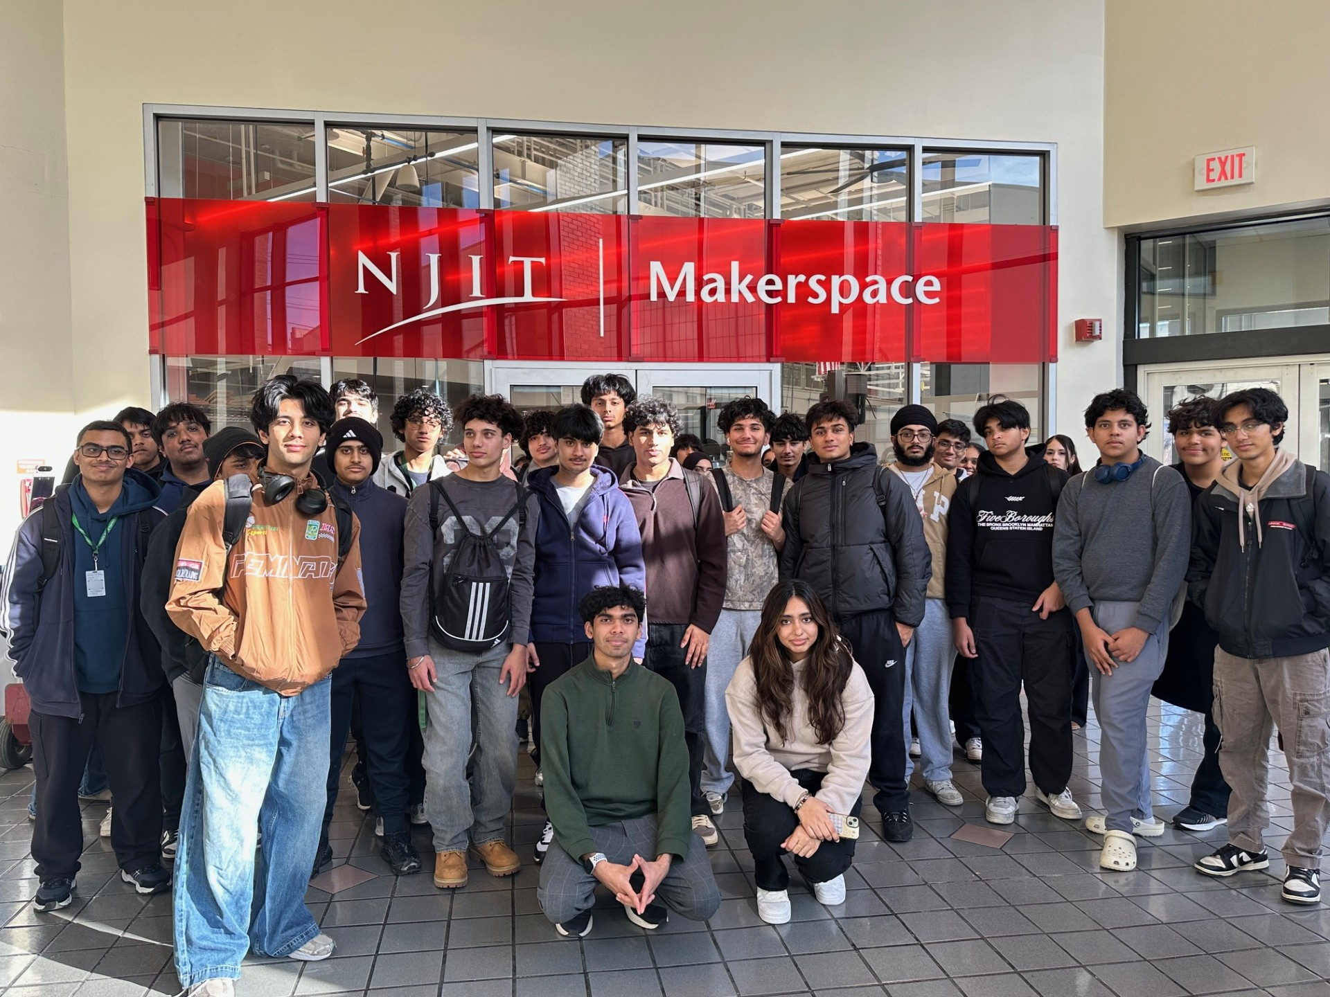
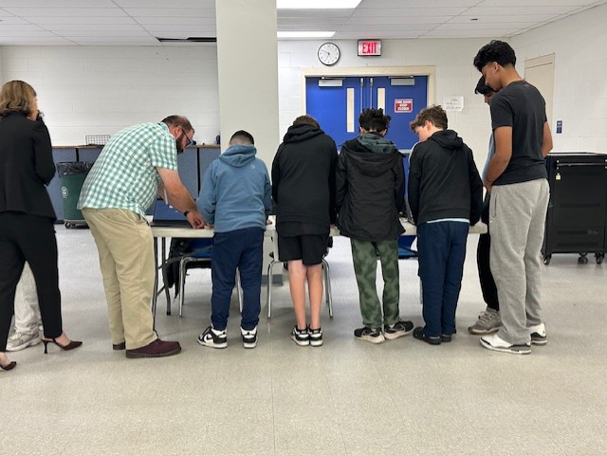
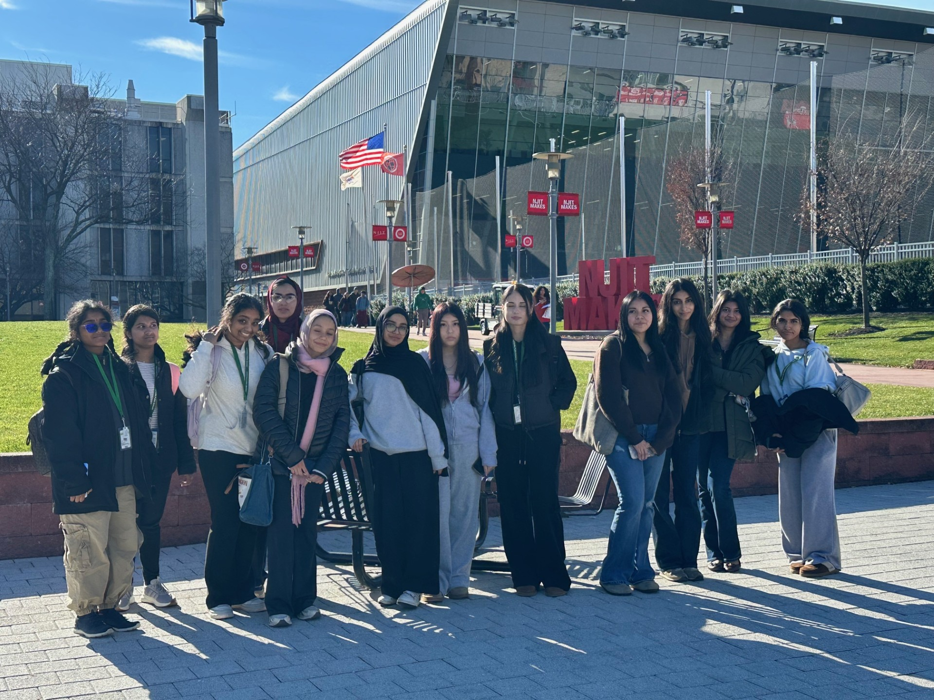
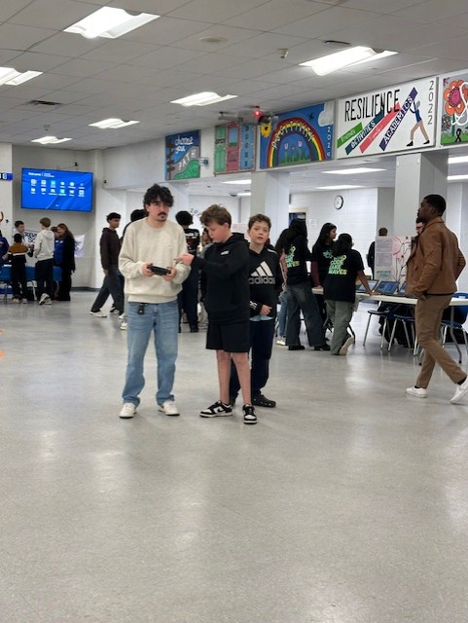
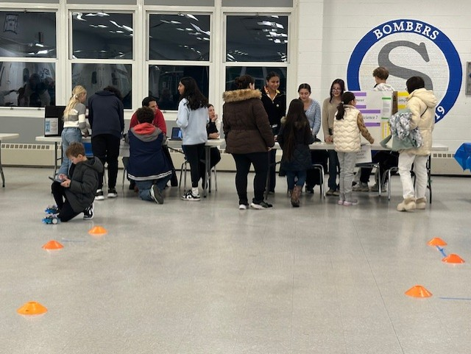
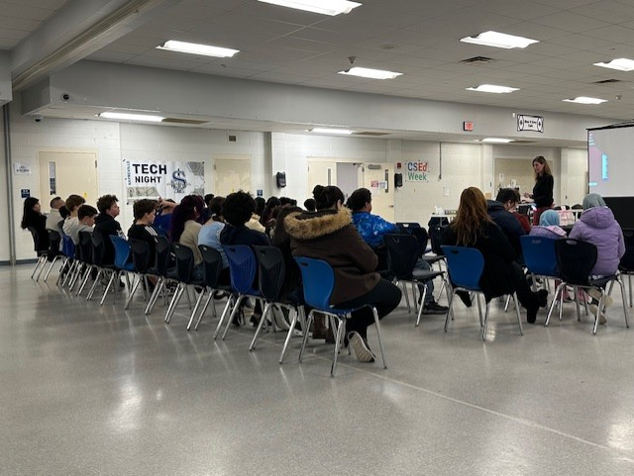
COMPUTER SCIENCE
E L E C T I V E S
Computer Science Principles and AP Computer Science Principles

Slide 29
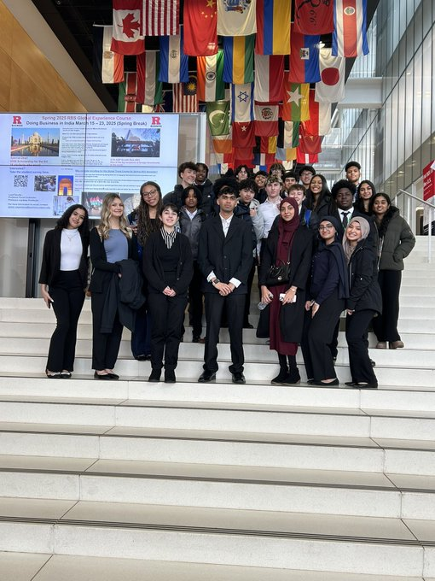
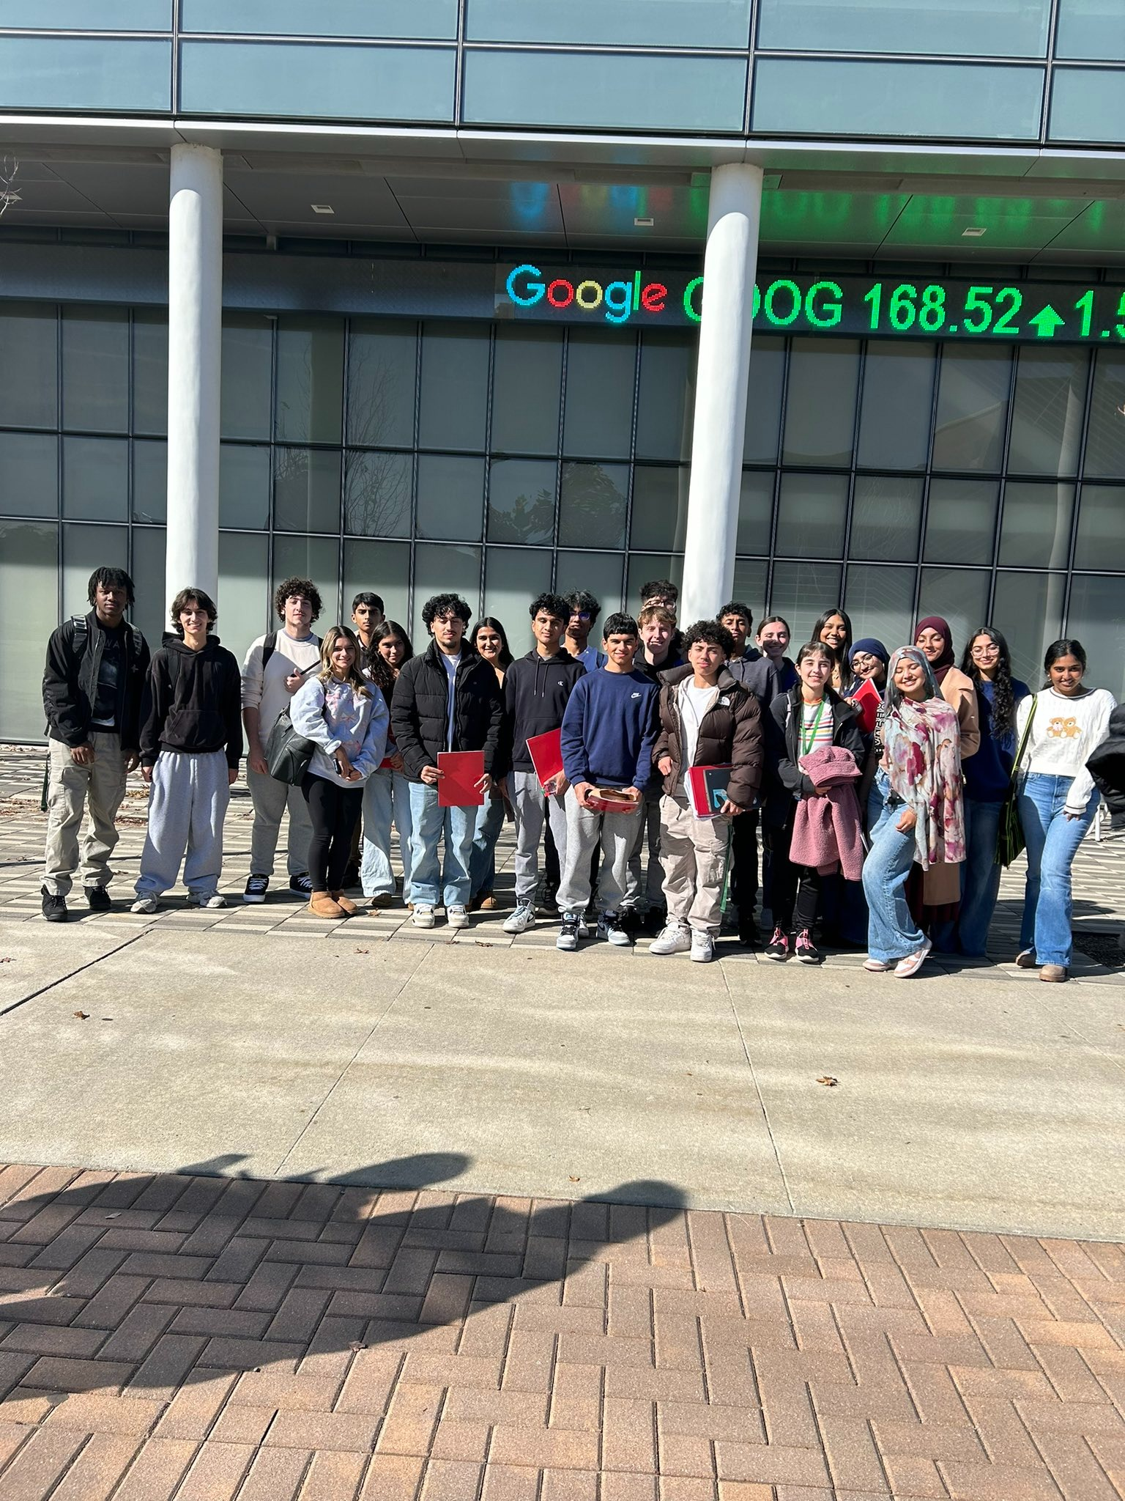
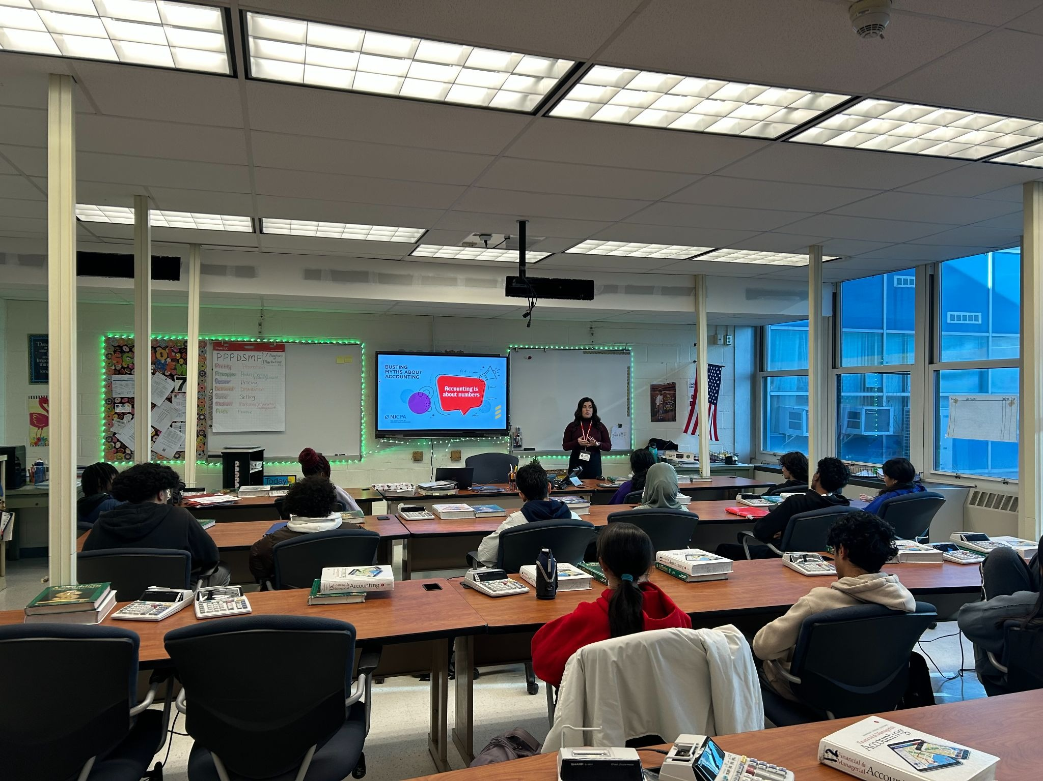
B U S I N E S S ACADEMY
Sayreville Business Academy for business careers provides a focused course sequence that appeals to the students who are interested in exploring a future in business.
RUTGERS UNIVERSITY BUSINESS FOR YOUTH (RUBY)
In May 2026, Juniors and Seniors in SBA will visit WilkinGuttenplan CPAs. WG is a local CPA firm with 140+ staff members. They will tour their offices and have a lunch-and-learn session to give students a closer look at careers in public accounting.

Slide 30
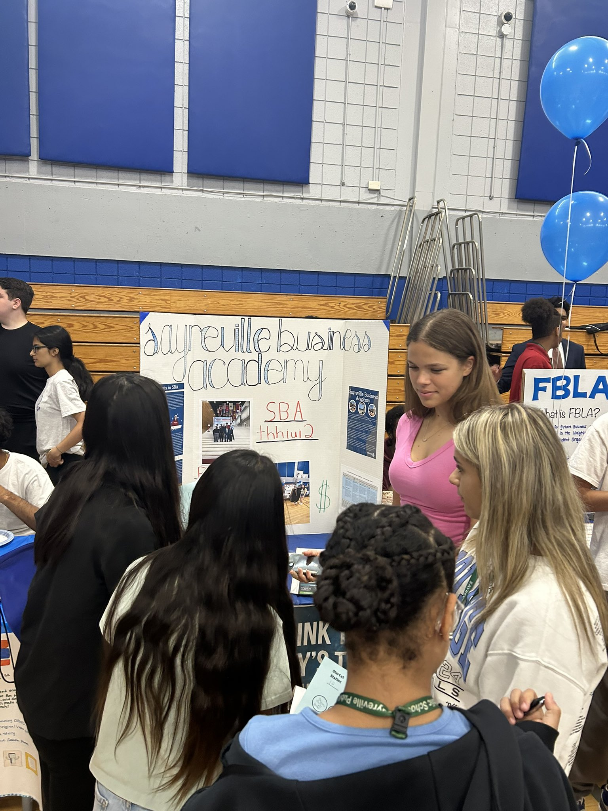
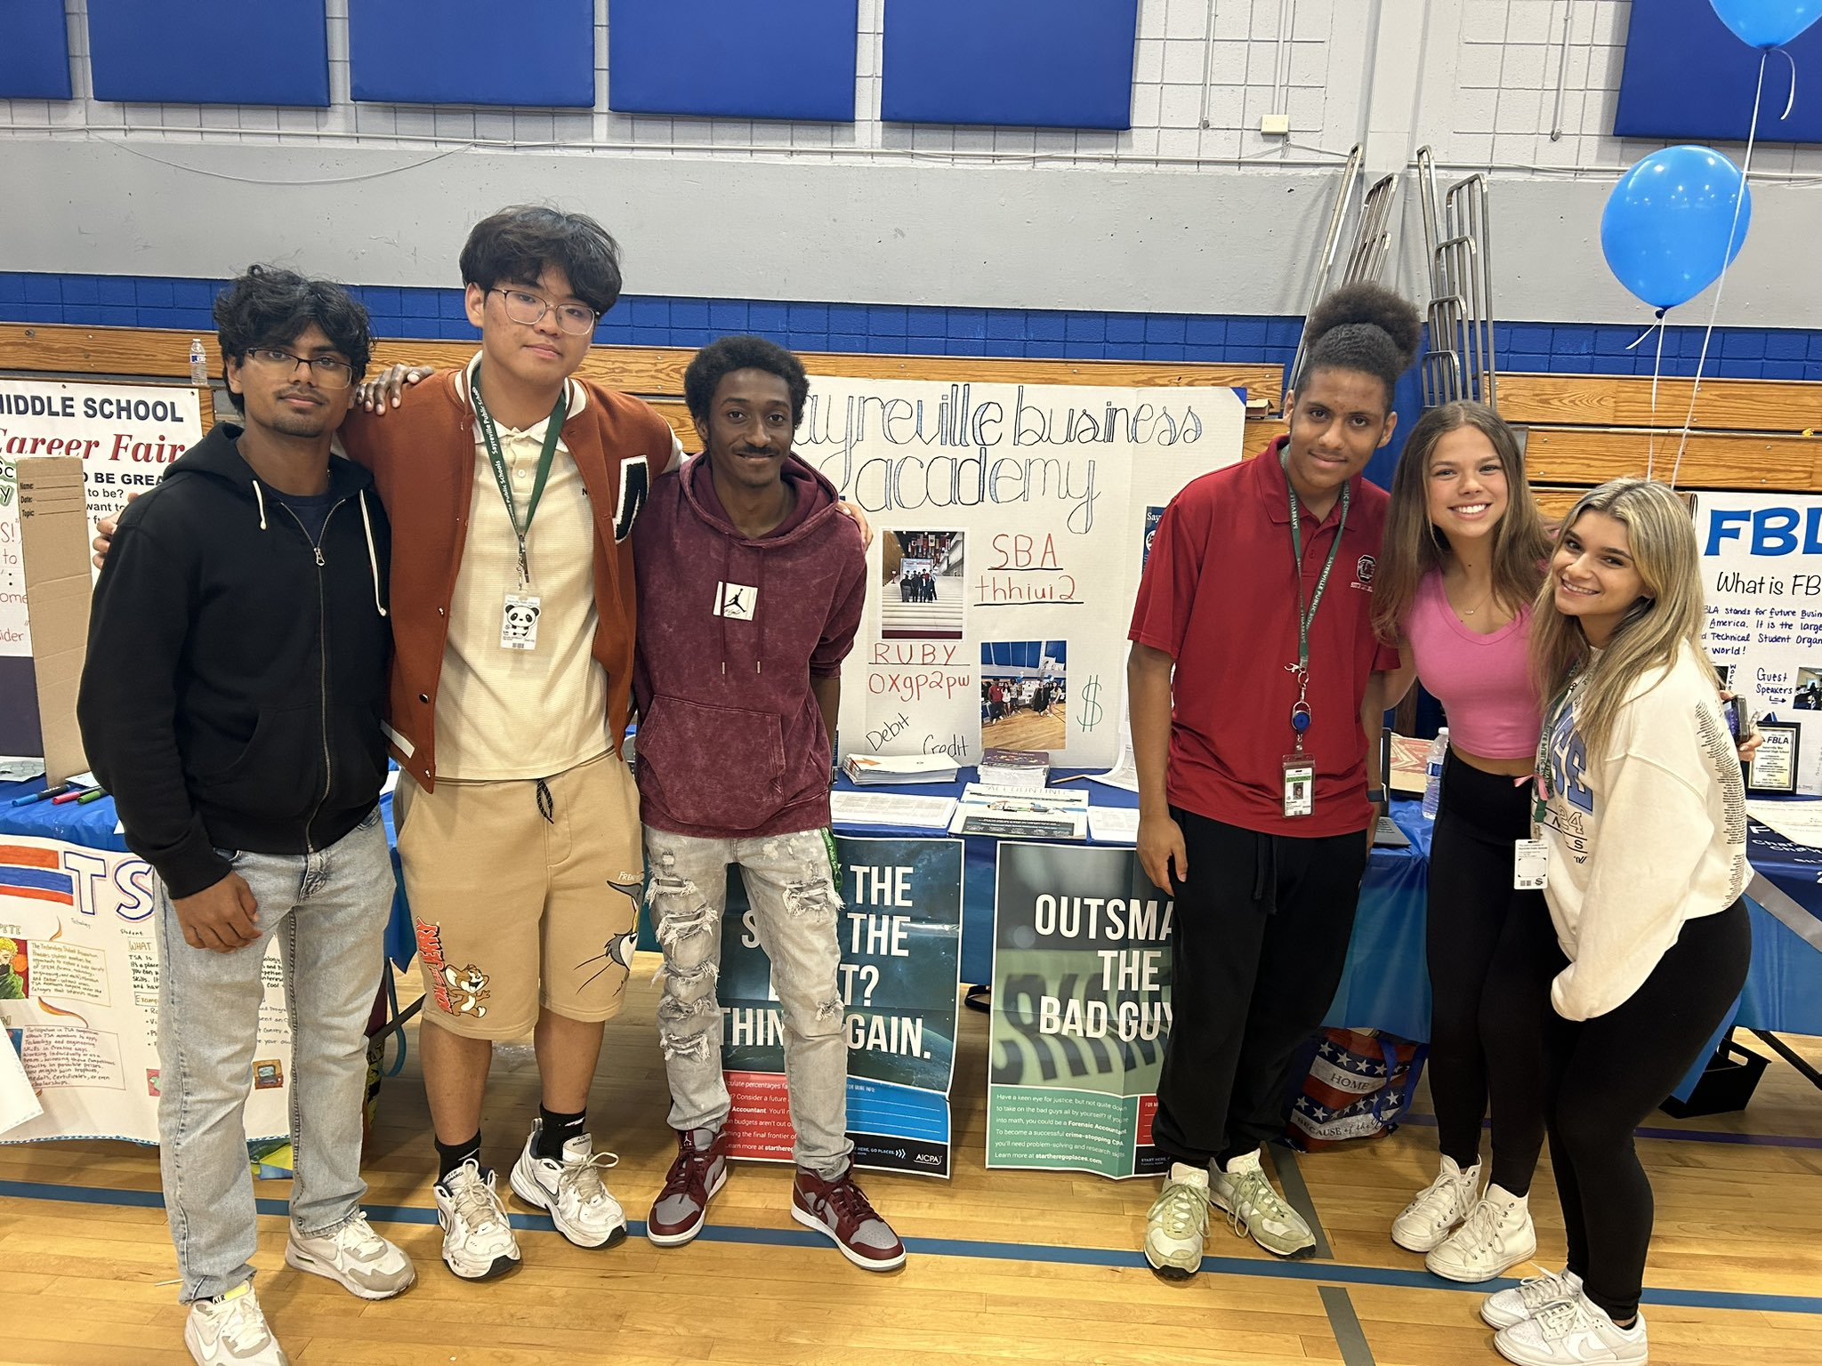
B U S I N E S S ACADEMY
In May 2026, Juniors and Seniors in SBA will visit WilkinGuttenplan CPAs. WG is a local CPA firm with 140+ staff members. They will tour their offices and have a lunch-and-learn session to give students a closer look at careers in public accounting.
June 4, 2026, Middle School Career Fair.

Slide 31
BUSINESS ACADEMY
To empower students of today to become Business leaders of tomorrow
Grade 9 Required Course | Grade 10 Required Course | Grade 11 Required Course | Grade 12 Required Course
Performing Art Elective | Introduction to Business | Financial Accounting Honors | Managerial Accounting Business Capstone
Performing Art Elective | Introduction to Business | Essentials of Marketing 1 Essentials of Marketing 2 | Sports and Entertainment Marketing Business Capstone
There are opportunities for students to receive the New Jersey Society of Certified Public Accountants (NJCPA) Scholarship which awards $1,500 scholarships to college-bound New Jersey high school seniors intending to major in accounting or obtain a concentration in accounting.

Slide 32
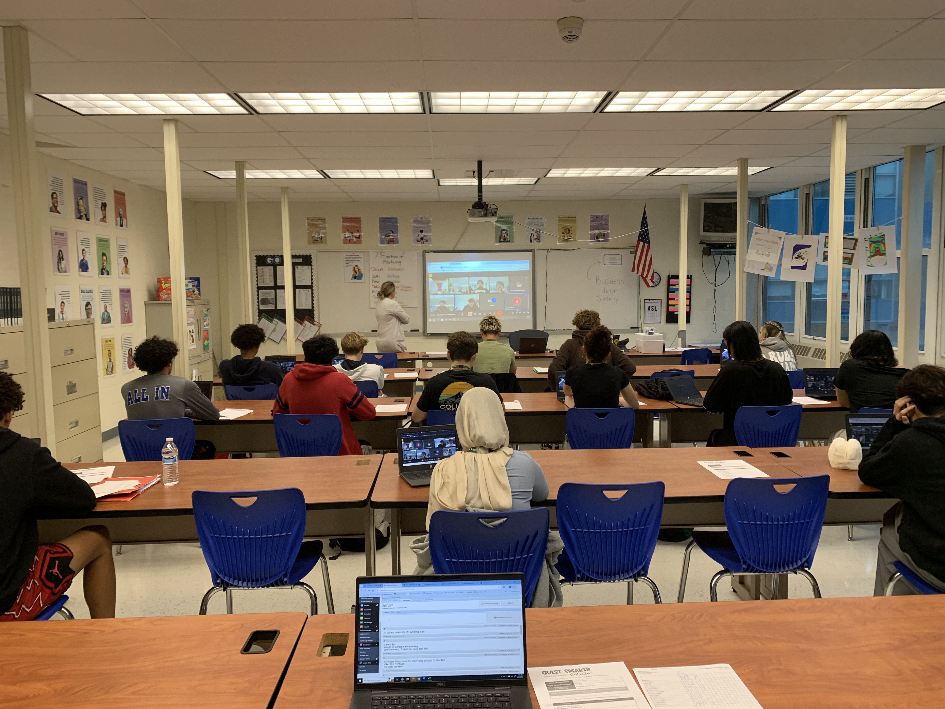
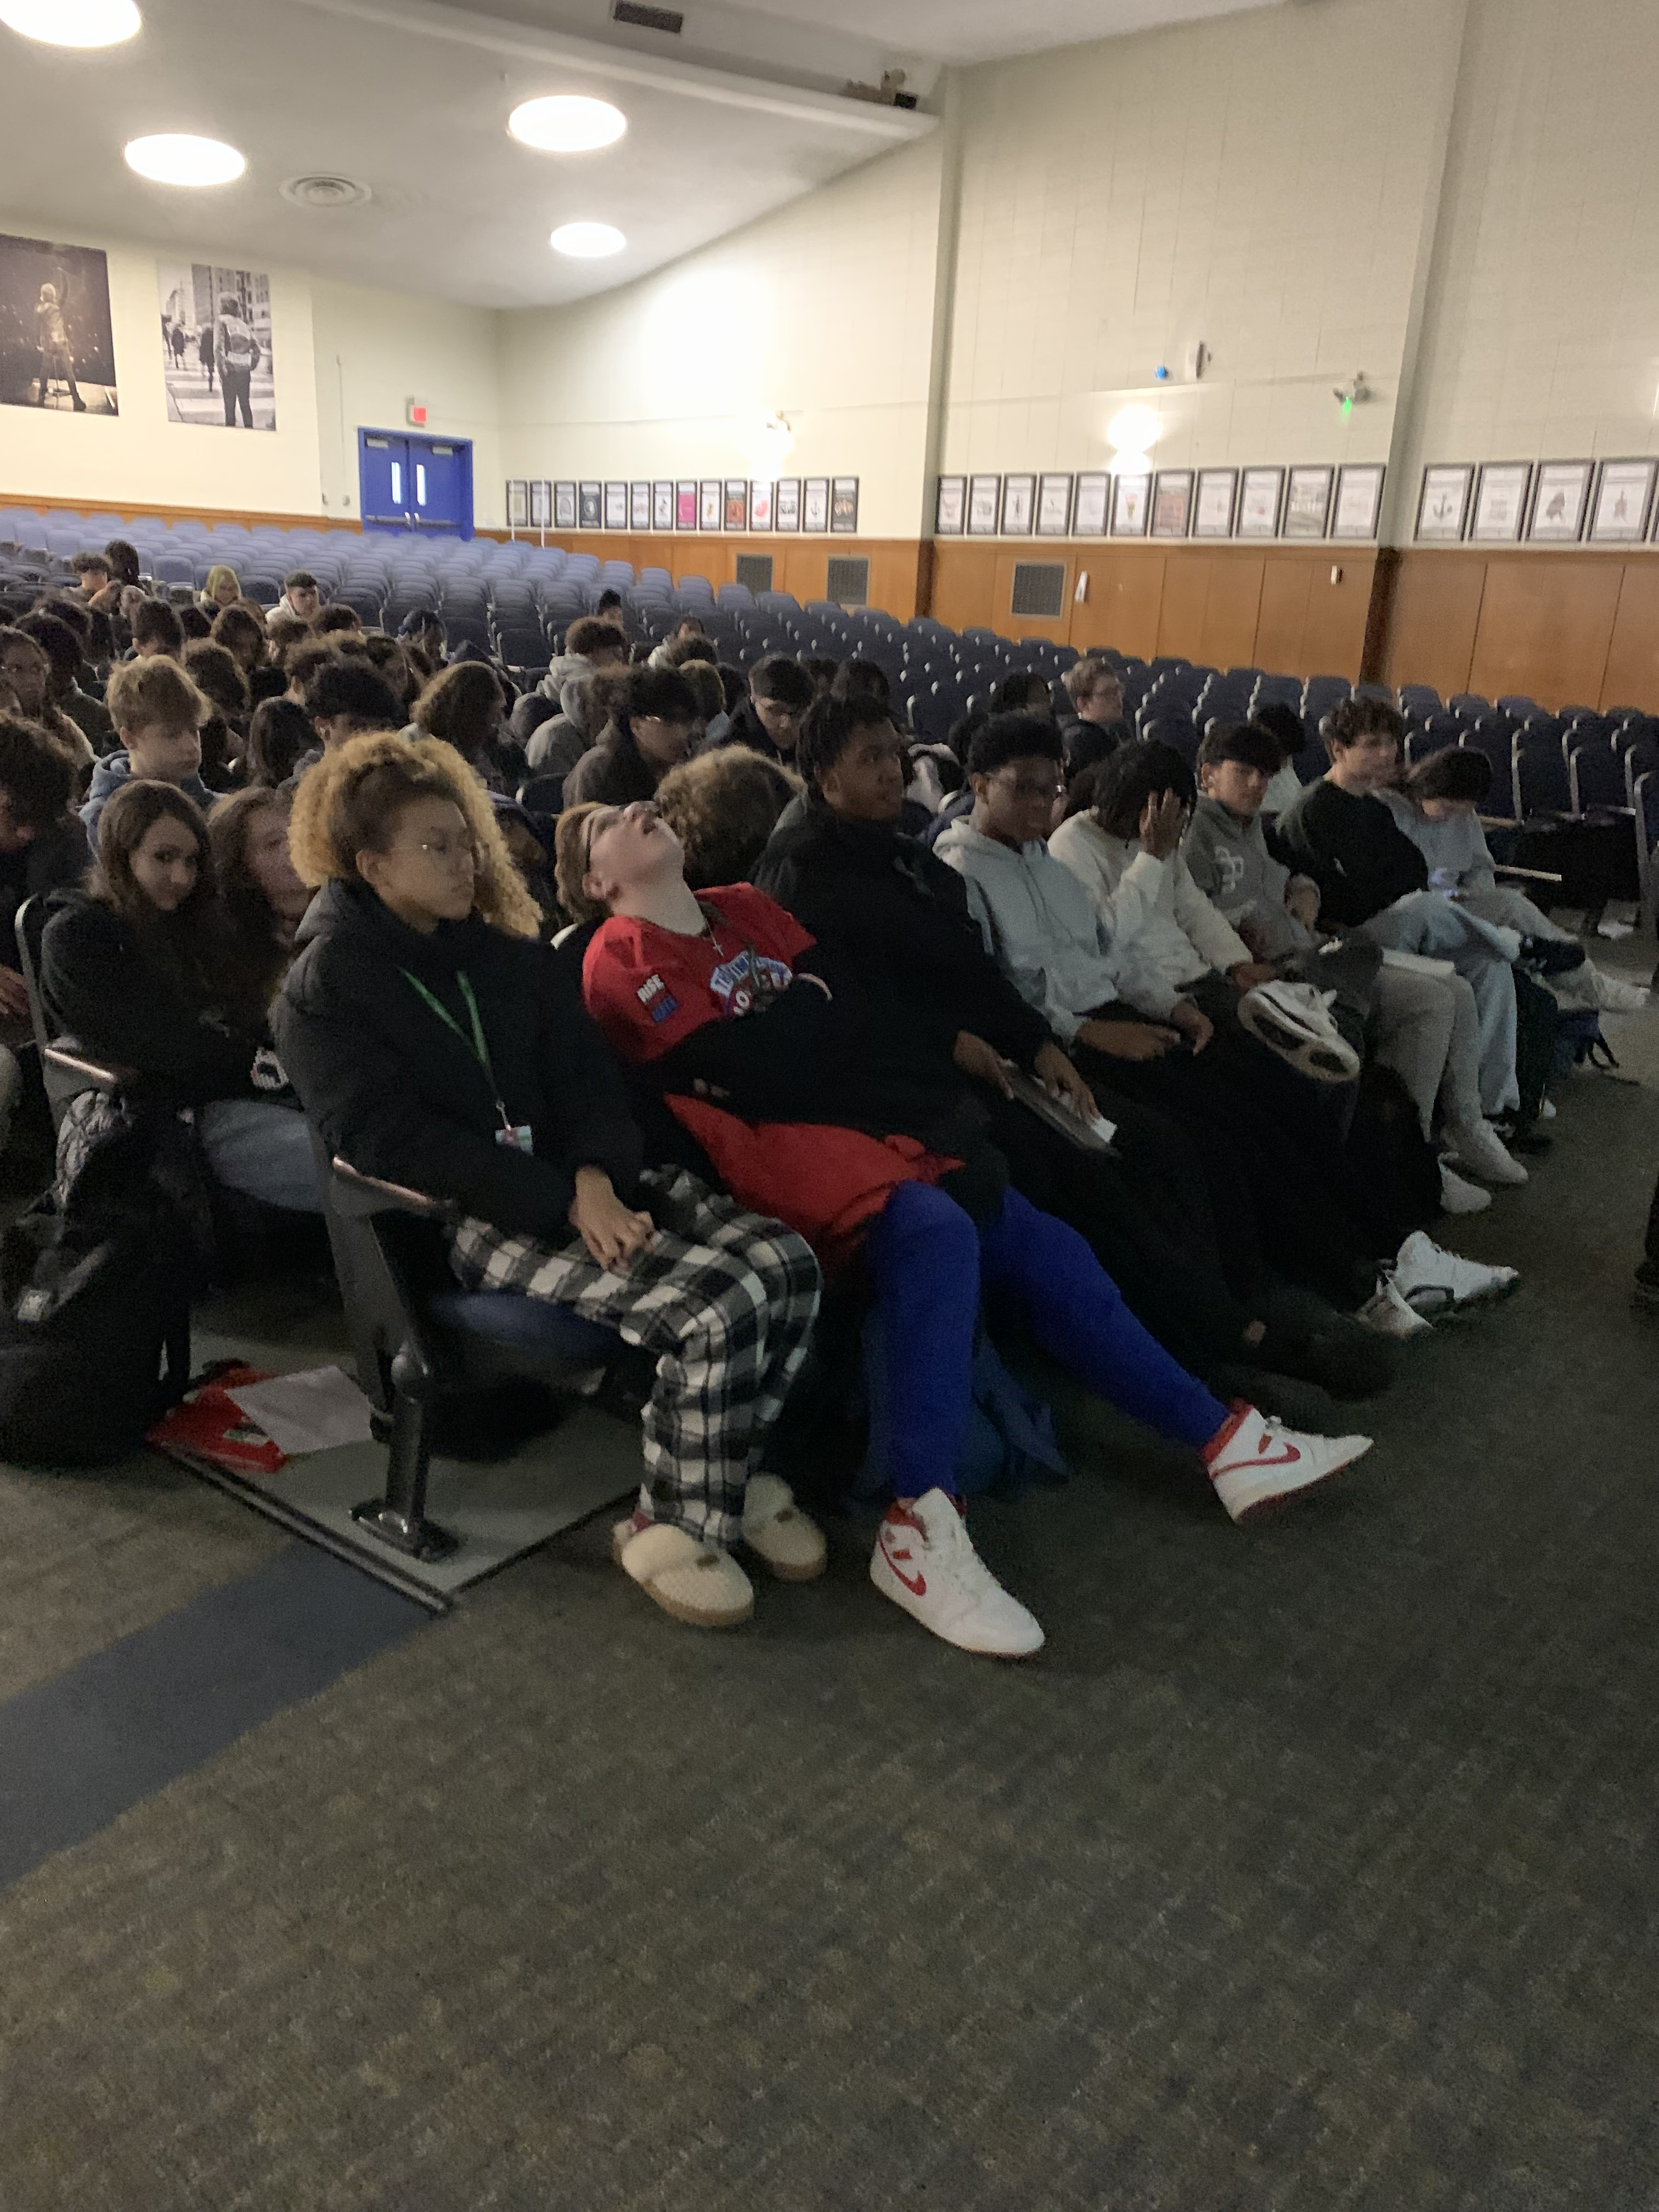
B U S I N E S S
E L E C T I V E S
Introduction to Business (Semester)
Career Development (Semester)
Microsoft Office Suite (Semester)
CTE Advisory Board
Work Based Learning

Slide 33
Ms. J. Badami ~ Health, Physical Education, and Athletics
PHYSICAL EDUCATION & HEALTH
Physical Education- 3 marking periods
Health Education - 1 marking period
For every year in attendance

Slide 34
ATHLETIC ELIGIBILITY
Freshman Fall and Winter Seasons: successful completion of grade eight.
Sophomore to Senior Fall and Winter Seasons: Successful completion of 30 credits the previous year.
Freshmen to Senior Spring Season: successful completion of 15 credits at the end of semester one.
All Athletic Questions: Jennifer.Badami@sayrevillek12.net

Slide 35
GRADUATION REQUIREMENTS
English 4 years
Mathematics including Algebra 1 and Geometry
and a third year of math 3 years
Science including Biology and a choice among Chemistry, Physics or Env. Science and a third inquiry based lab or technical science 3 years
U.S. History 2 years
World History 1 year
World Language 1 year

Slide 36
GRADUATION REQUIREMENTS cont.
Visual/Performing Arts 1 year
Practical/Vocational Arts/21st Century Life
and Careers Education 1 year
Physical Education and Health Each year of
enrollment
Financial Literacy/Economics ½ year

Slide 37
Required Credits
In addition to passing the required courses, students must successfully complete 120 credits.

Slide 38
CREDITS REQUIRED
Cumulative:
20 credits to pass to grade 10
50 credits to pass to grade 11
85 credits to pass to grade 12
120 credits to graduate!

Slide 39
COLLEGE ENTRANCE REQUIREMENTS
MINIMUM
4 yrs. English
3 yrs. History
3 yrs. Mathematics
3 yrs. Science
2 yrs. World Language
Academic Electives
RECOMMENDED
4 yrs. English
3 yrs. History
4 yrs. Mathematics
4 yrs. Science
4 yrs. World Language
Academic Electives

Slide 40
Attendance
If a student's absentee rate is equal to or greater than 10%, the student is considered chronically absent.
Half year class: 9 days
Full year class: 18 days
In order to earn credit for coursework, students must be present for a minimum of 90% of the days the course is in session, i.e.
Full-year course 162 days
Semester course 81 days
Any student who is absent from classes more than the allowed number of days shall be removed from those classes, lose credit and be assigned to study halls.

Slide 41
THE SCHEDULING PROCESS
Students will be choosing their electives directly in On Course. The window for choosing electives is open now and closes on February 27th at midnight. Parents can view and assist their child with this process. Students will be attending a presentation by the high school counselors in their social studies class on January 30th.
The current teachers will be adding their recommended courses in On Course. The school counselors will review these courses with the students as well as the electives they added in On Course during their one-on-one scheduling appointment.
April 7th-April 14th - Students will be scheduled for their grade nine classes with their school counselor during their physical education classes, in-person at the middle school.
The final courses and electives will be computer generated in August.

Slide 42
Adding electives in On Course
This link will take you to the Guidance Department website link with the step-by-step instructions for adding electives in On Course:
https://www.sayrevillek12.net/district/departments/counseling/high-school-counseling

Slide 43
TYPICAL FRESHMAN SCHEDULE
English
Mathematics
Science
Lunch
World History
Freshman Foundations and Visual/practical/performing arts
OR
Academic electives (Reading and/or Math Lab)
Physical Education
World Language

Slide 44
Typical Grade 9 Schedule
Period | Term | Course Name | Credits | Teacher | Room
Period 1 | 26-27 | Spanish 1 | 5.0 | Feliciano | B211
Period 2 | 26-27 | English 9 CP | 5.0 | Smith | A202
Period 3 | S1 | PE 1S/Health 1S | 2.5 | McGarry | GYM
Period 3 | S2 | PE 2S | 2.5 | Nugent | D006
Period 4 | S1 | Lunch Fall |  |  | CAFE
Period 4 | S2 | Lunch Spring |  |  | CAFE
Period 5 | 26-27 | World History CP | 5.0 | Ferreri | A223
Period 6 | 26-27 | Plane Geometry | 5.0 | Jerome | B004
Period 7 | S1 | Freshman Foundations | 2.5 | Smith | A89
Period 7 | S2 | Mythology | 2.5 | Wrightson | A210
Period 8 | 26-27 | Biology CP | 5.0 | Cicciari | D212

Slide 45
Remediation and Intervention Courses
Students take the NJSLA 08 for Math, English and Science.
Students who do not meet expectations of the grade eight NJSLA may be placed in a remedial math and/or language arts class instead of an elective. Student schedules will reflect this change in August.

Slide 46
SCHEDULING TIPS
Review the freshmen electives and course descriptions on the
Guidance Department website
Or under "Departments" choose "Counseling Department"
Or join/visit the Class of 2030 Google Classroom
Class code: gl6mxswb
Choose 2 electives and have 4-5 more alternate electives​
Make elective selections in On Course
​
After scheduling….​
​​
Study, work hard and maintain good grades. Do your very best on the NJSLA assessments.​

Slide 47
Freshman Student Orientation
In late August, an in-person orientation will be held at the high school.
Watch your school email, Parent Square, and check the district website for notification of the date and time.

Slide 48
Class of 2030
We wish you success as you complete your last year
in the Middle School.
We look forward to September and the beginning of your high
school career!

