Slide 1






PHARR-SAN JUAN-ALAMO INDEPENDENT SCHOOL DISTRICT
Annual Report on
PSJA ISD’s Performance on Texas Academic Performance Report (TAPR)
Presented by Office of Academics
January 26, 2026

Slide 2
PHARR-SAN JUAN-ALAMO INDEPENDENT SCHOOL DISTRICT
Pharr-San Juan-Alamo Independent School District
Texas Academic Performance Report (TAPR)
2023–2024 Accountability Overview
2025 District Accountability Rating: B
2025 Special Education Determination Status: Meets Requirements
Notes:
Today we are presenting key highlights and strategic insights from the 2024–25 TAPR. The full report has been provided for your reference and will be published online in full within 10 days, as required. Our presentation focuses on summary results and priority areas to support informed governance and planning.

Slide 3
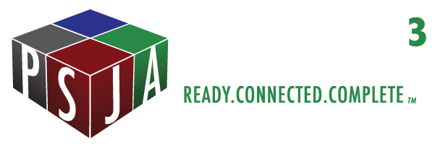

2025 TAPR Student Performance – Elementary
Highlights and Key Findings

Slide 4
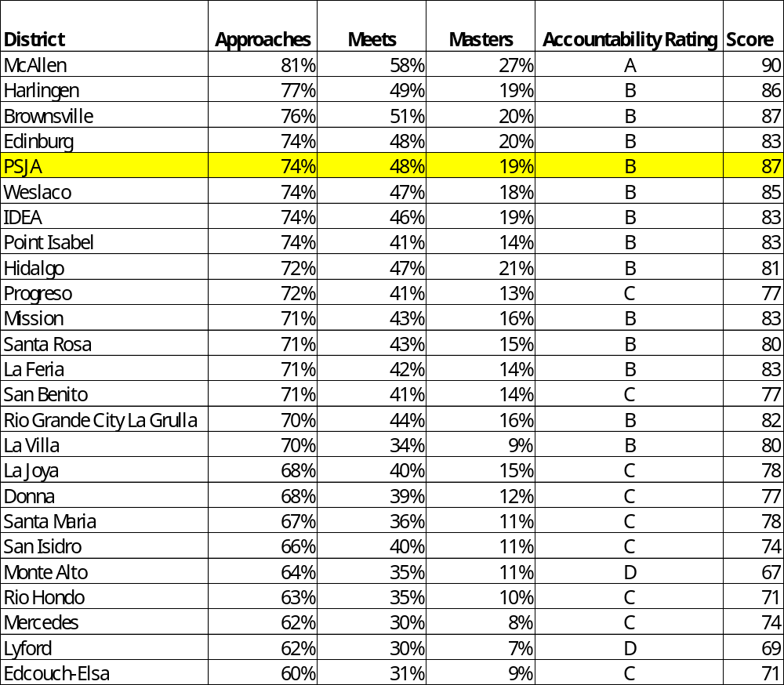
2025 District Comparison: All Grades, All Subjects

Slide 5
2025 TAPR
Attendance, Graduation and Dropout Rates

Slide 6
2025 TAPR District Attendance Rate
Notes:
Done. Dr. YG

Slide 7
2025 TAPR District Dropout Rate
7th – 8th
7th – 8th
9th – 12th
Notes:
Done. Dr. YG

Slide 8
2025 TAPR District Longitudinal Graduation Rate (Gr 9-12)
Notes:
Done. Dr. YG

Slide 9
2025 TAPR District Longitudinal Graduation Rate (Gr 9-12)
Notes:
Done. Dr. YG

Slide 10
2025 TAPR District Longitudinal Graduation Rate (Gr 9-12)
Notes:
Done. Dr. YG

Slide 11
2025 TAPR District
RHSP/DAP/FHSP-E/FHSP-DLA/Texas First-DLA Graduates (Annual Rate)
Notes:
Done. Dr. YG

Slide 12
2025 TAPR
Postsecondary Readiness

Slide 13
2025 TAPR District
College, Career, and Military Readiness (CCMR) (Year 2023 – 2024)
Notes:
Change colors.

Slide 14



Equity for All
District Improvement Plan Strategic Planning & Outcomes

Slide 15
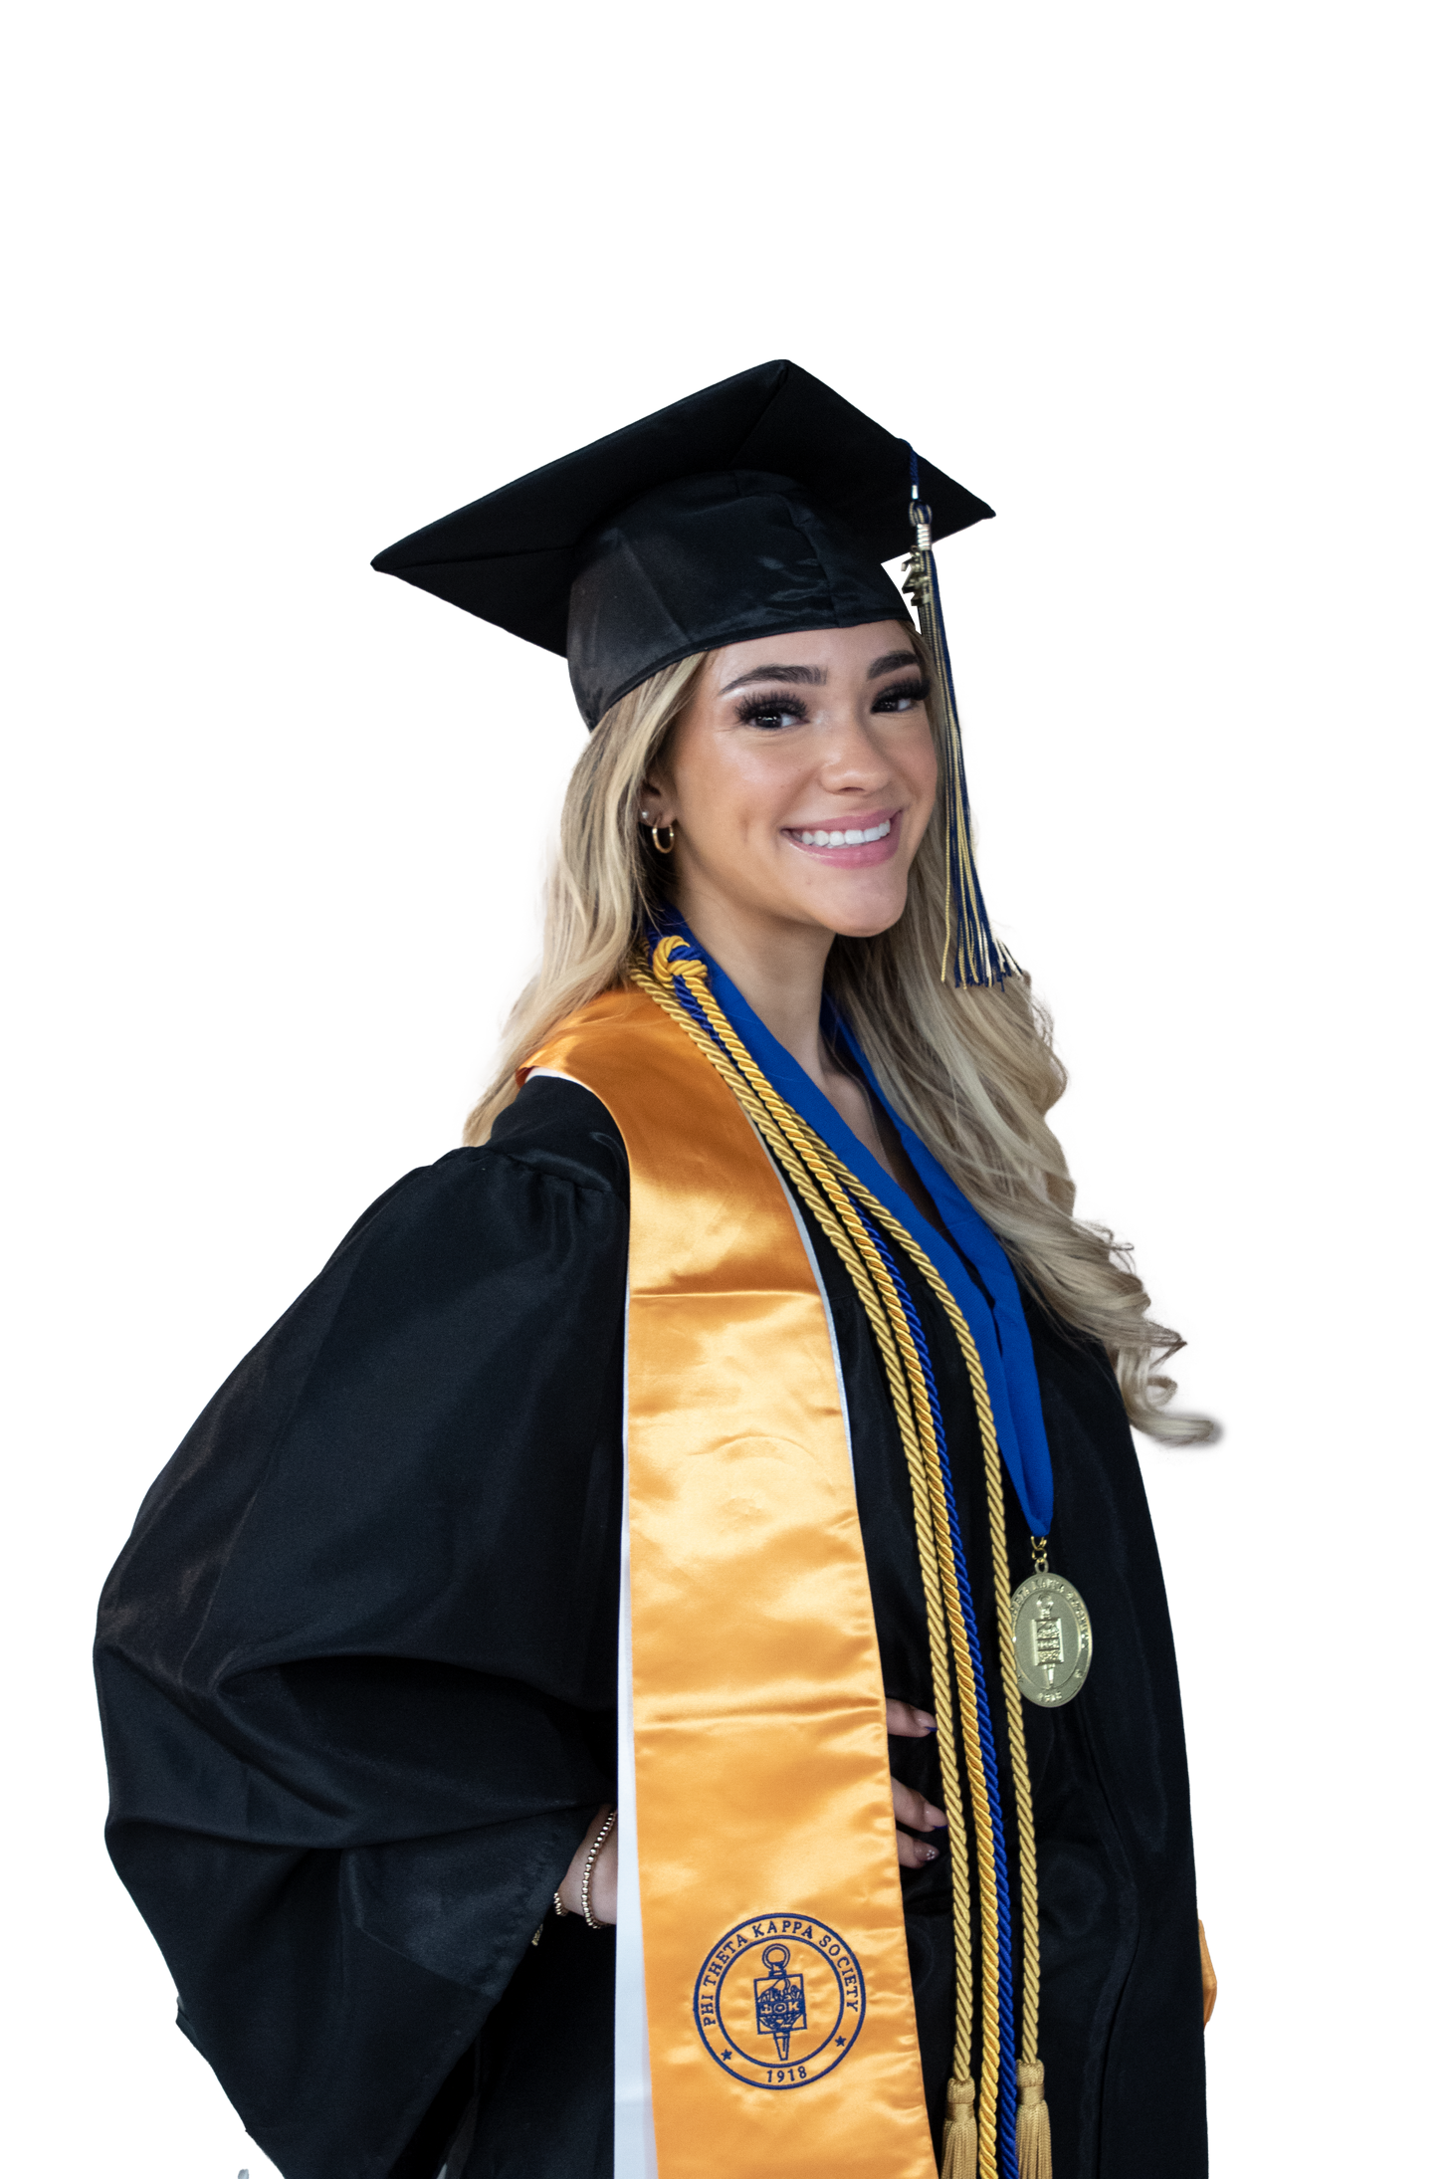


PHARR-SAN JUAN-ALAMO INDEPENDENT SCHOOL DISTRICT
Stay Connected!
yolanda.gomez@psjaisd.us | 956.354.2000
psjaisd.us | facebook.com/psjaisd | twitter.com/psjaisd
All materials, content and forms contained in this presentation are the intellectual property of PSJA ISD ​and may not be copied, reproduced, distributed or displayed without PSJA ISD’s express written permission. ​
If written permission is granted, information may be used accompanied ​by an acknowledgement that PSJA ISD is the source.

