Slide 1




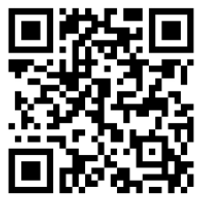
Welcome to
Cedar Trails Elementary
Parent Orientation for
2026/2027 Kindergartners
January 28th, 2026
While you wait...
Follow our PTSA on Facebook

Slide 2

Tonight’s Plan:
  Meet the office team (minus a few...sorry) & learn who is who and who does what
  Hopefully ease some jitters
  Get a LOT of kindergarten information
  Get questions answered
  Receive next steps (HOMEWORK)

Slide 3
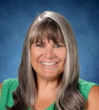
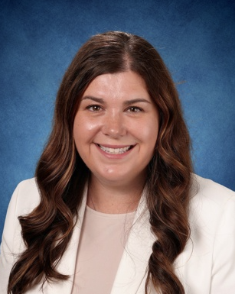
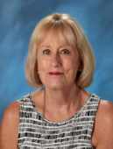
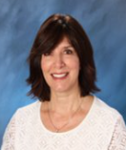
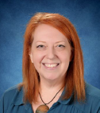
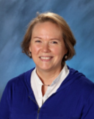
Principal
Tera Coyle
Dean of Students
Janelle Penney
Assistant to the Principal
Kathy Strilaeff
Introductions...
Registrar &
Attendance Secretary
Dolores D’Alo
Nurse
Cassie Kuver
Health Room Specialist
Ann Stout

Slide 4

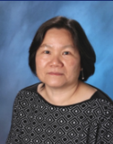


Counselor & Principal Intern
Megan Larson
Introductions...
Family Partner Liaison
Wenli Mithal
PTSA President
Kasey Trefethen
Wolf Club (BASC)
Jeff Womack

Slide 5
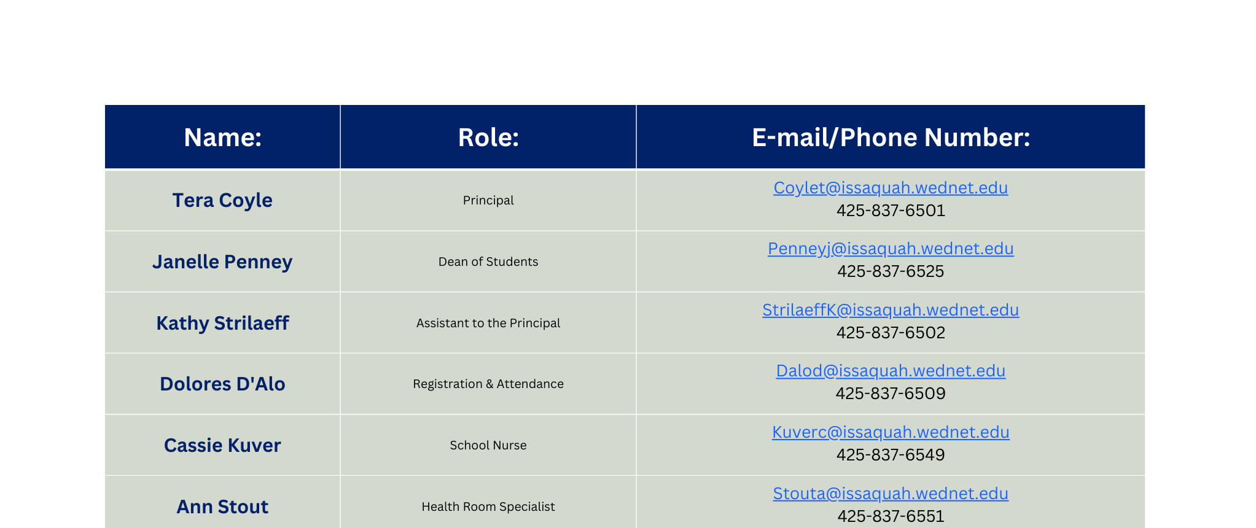
Contact Information...

Slide 6

KINDERGARTEN

Slide 7



FULL Day K...HOORAY!!!
State Funded Full Day Kindergarten
  No cost to families
  Provides maximum learning opportunities for students
  Offers full access to specialists (PE, Music, Library)
  Developmentally appropriate and student centered
  Integrated content with rich, hands-on experiences
  Based on rigorous standards
  State requires full day kindergarten be available to all students

Slide 8
½ Day Options...
Parents may opt for a ½ day
  Students will be placed in full-day classroom in the morning for first three hours of the school day
  Transportation is provided in the morning, but parents must transport at the end of the half-day

Slide 9


Slide 10

Kindergarten is a transition year!
Sept – Oct
Looks & Feels
more like Preschool
Transition
through
KINDERGARTEN
May - June
Looks & Feels
more like 1st Grade

Slide 11

Dual Language Kindergarten Program
  Spanish/English
  Housed at Issaquah Valley Elementary (IVE)
  No transportation provided
  Enrollment priority is provided to families living within the IVE school attendance area and siblings of current students in the program
  NOT likely that there will be openings for any Cedar Trails students, but there is a lottery, and the district is tracking interest for possible future sites
  See Dual Language option in the kindergarten registration portal for more information on this program

Slide 12
SCHOOL
FUNDING

Slide 13

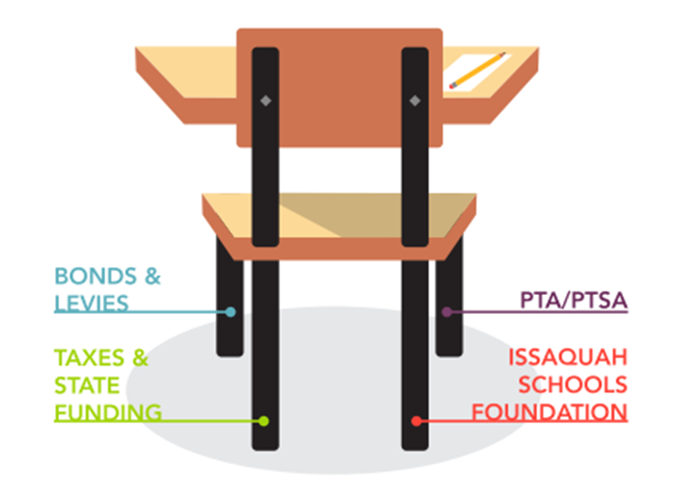

How are Schools Funded?

Slide 14
How are Schools Funded?
Taxes & State Funding
  State pays for BASIC education with state school levies/taxes. This does NOT cover everything a district needs to operate.
Bonds & Levies
  Bonds/Building (new school construction, land purchase)
  Levies/Learning (renovations, technology, safety, buses)
  Must be approved by local voters
PTSA (Parent-Teacher-Student Association):
  Non-profit that raises money to fund art, technology, field trips, library books, playground equipment, STEM & cultural activities, assemblies
ISF (Issaquah Schools Foundation):
  Supports programs that benefit all ISD students (includes grants)

Slide 15

Visit our website www.cedartrailsptsa.org
PTSA
Follow our Facebook page Cedar Trails Elementary PTSA​

Slide 16
PTSA (Parent-Teacher-Student Association)
The PTSA is the oldest child advocate institution in the country and works at all levels (school, district, state and federal).
The Cedar Trails PTSA continues to strengthen our school/family partnership by providing the following:
  Participates annually in the National Reflections Contest
  Supported teachers & staff with snacks or meals during their teacher workdays throughout the school year and provided a cookie exchange before the holidays
  Planned and threw multiple school wide events including Fall Festival, Bingo & Brownies, After School Movies, End of the Year Celebration and the Festival of Cultures!
  Brought Spirit Wear to the Cedar Trails community
  Organized a large-scale fall fundraiser "Fun Run" that earned our PTSA over $30,000 in donations to help our kiddos
  Arranged for a food drive that collected 365 pounds of food for the Issaquah Food Bank
  Held several Scholastic Book Fairs and are looking into doing another book fair in the spring!
  Facilitated a reading program which encourages reading stamina for our readers
  Funded $6,000 of teacher enrichment grants, one of which included an in-person author visit for our students
  Our art docent program brings art projects into every classroom via our parent volunteers
How can you help?
  Become a member - Join PTSA; we are only as strong as our community, and YOU make our voice stronger
  Donate - Without donations none of these things would be possible
  Volunteer - Everything we do is run by parent volunteers like you. We know that not everyone can do everything, but we ALL can do something!

Slide 17

PTSA (Parent-Teacher-Student Association)

Slide 18
2026/2027
What’s to come...

Slide 19
NOW through SUMMER
Get Ready for Kindergarten
Tips from the teachers...
  Follow school supply lists (soon to be published)
    Box of 24 crayons (96 might be tempting, but NO thank you)
    Say YES to Ticonderoga, but no to any other brand of pencil
    Backpack that fits a lunch box & a folder (practice using backpack ~ placing items in/out, putting on/off, zipping closed)
  Try out some public bathrooms (waiting in line, flushing, using bathroom INDEPENDENTLY, latching door, wiping, etc.)
  Snap, button, zip

Slide 20
Get Ready for Kindergarten continued...
Tips from the teachers...
  Demonstrate how to wait your turn (example: grocery store line)
  Work on modeling promptness with your child(ren) (arriving to school ON TIME is VERY important)
  READ TO YOUR CHILD
  Start prepping your child for the bus ride...
    Pointing out buses this spring
    Visit bus stop prior to first day of school
    Start talking about the bus ride and that you’ll pick them up after school at the bus stop
    Sign up for the kindergarten bus ride that happens over the summer months

Slide 21

August/September
Washington Kindergarten Inventory of Developing Skills (WAKIDS) is a required component of State-Funded Full Day Kindergarten. It is a transition process that helps to ensure a successful start to kindergarten and beyond.
Family Connection Meetings
August-September
First 3 days of school, classroom teacher meet with each kindergarten family (including student)
  Thursday, August 27th
  Friday, August 28th
  Monday, August 31st
4th day of school is first day of school for kindergarteners
  Tuesday, September 1st
NOTE: Save the date for
Curriculum Night (parents ONLY)
on Wed., 9/9/26 @ 6 pm

Slide 22

September/October
Washington Kindergarten Inventory of Developing Skills (WAKIDS) is a required component of State-Funded Full Day Kindergarten. It is a transition process that helps to ensure a successful start to kindergarten and beyond.
Whole Child Assessment
  Kindergarten teachers observe children during everyday classroom activities
  Helps teachers find out what each child knows and can do at the beginning of the year
  Inventory taken of each child’s developing skills in six areas (social-emotional, physical, cognitive, language, literacy, & mathematics)

Slide 23
Nurse &
Health Room

Slide 24


Health Conditions Questionnaire
  If your child has any health condition that could be considered life-threatening such as asthma, food allergies, seizures, diabetes...
    According to the law, your child must have an emergency health plan, which includes medication orders from your child’s health care provider in place before he/she can attend school.
  Forms will be sent to families after review of the Confidential Emergency Health Information by Nurse.

Slide 25

Immunization Laws for Washington State
  All incoming kindergarten students must have all immunizations the student is eligible for before the first day of school​.
  If they do not have all their required immunizations, they will not be able to start school​.
  Immunizations must be printed on the CIS card from the state registry OR physical copy of CIS card signed off by LHCP OR physical copy of CIS with accompanying medical immunization records from LHCP OR a CIS printed from MyIR. A flier with these options is in each student's blue folder that you will be collecting from the office at the Pre-K screener.​
  Further information regarding this is on the District’s website.

Slide 26
Minimum Vaccines Required for
Kindergarten Attendance
  All boosters required for kindergarten can be given on or after the 4th birthday. ​
  Records are reviewed on an individual basis as needed.​
  Physician verification of a history of varicella disease, or blood test (titer) showing immunity to varicella is acceptable(Chickenpox)​
  If exemption from immunizations is desired, a meeting with the nurse is required.​
  ALL STUDENTS MUST BE COMPLIANT TO START KINDERGARTEN. ​

Slide 27
Wolf Club
Before & After School Care (BASC)

Slide 28


Wolf Club
Before & After School-Age Care
Serving K-5th Students
Site Manager, Jeff Womack: womackj@issaquah.wednet.edu
Days of Operation:
Monday - Friday
Note: School break services are available through a separate registration process.
  The Before & After School-Care Program (BASC) provides a positive environment for children to grow socially, emotionally, and intellectually under the guidance of our well-trained team. We offer diverse activities to meet the interests and skill levels of our participants, including STEM, cooperative games, community service learning, art, and cooking.
  During non-school time, children will be able to access many areas of our school, including the gym, playground and commons (lunchroom). In addition to our well stocked club rooms, we provide a designated homework time, AM/PM snacks, family nights, enrichment activities, school break care, and summer day camps.
Program Hours:
6:30 am to Start of School
End of School to 6:30 pm
Note: There is no care provided during the school day for ½ day kindergarten students.
Locations:
All 16 Elementary Schools
Learn More:
www.isd411.org/programs-services/basc

Slide 29
Parent
Homework

Slide 30
Parent Homework
  Sign up for District and Cedar Trails E-news, www.isd411.org/about-us/announcements/sign-up​
  Online Registration opens February 2nd (upload required documents: Child's Birth Certificate, Immunization Record, Lease, PSE bill, parent ID)​
    Paper registration packets available in the office if needed; address documents required to pick up packet​
  Pre-K Screener for entering kindergarteners (April/May dates, TBD), SIGN UP via SignUpGenius later this Spring (must have submitted enrollment to get email invite)​
  Pick-up Part 2 of the Registration Packet at the school office during your child's Pre-K Screener appointment​ (Note: if you attended the meeting you received this packet at the meeting)
  Sign up for BASC (Wolf Club) or find an alternate child-care plan if needed​
  Transportation “Invitation to Ride” mid-August, needs registration online​
  Medications turned into the Health Room by mid-August ​
DEADLINE for all medical forms and medication: August 14th ​

Slide 31
Need Help?
Family
Partner
Liaison

Slide 32

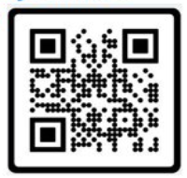
Welcome Families!
My name is Wenli Mithal, your Family Liaison.
I am part of the ISD Equity, Belonging & Family Partnership Department. We host information sessions for families with a wide variety of topics throughout the school year. Family Partnerships-Issaquah School District 411. If you need interpretation, we arrange to host these sessions in your preferred language.
How can I help you?
  Help new families with registration and other online forms.
  Answer questions about your school, the district or the school system.
  Connect you with community resources and programs.
  Support you to connect and communicate with school and district staff.
Feel free to contact me (I speak English & ):
Office: 425.837.7106 :: Cell: 425.651.5205 :: Text: 978.252.3686

Slide 33

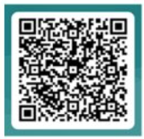
Welcome to Kindergarten
This event is designed for families that are NEW to US public schools!
When: Wednesday, March 9, 2026 from 6:30 to 8:30 pm
Where: ZOOM ~ Presentation in English, Espanol, &
Who: All parents and caregivers of 2026/2027 incoming kindergarten students.
What: Information will include:
  Kindergarten preparedness
  General school day information
  Transportation
  Immunization
  On-site before & after school care program
  Differences between school systems in US vs. some other countries

Slide 34

Completing forms
& Communicating
With the School
Please let any school staff know if you need help completing registration or if you have any questions.

Slide 35
Next
Steps

Slide 36
Next Steps...
  Starting February 2nd: Complete Online Enrollment including the uploading of required documents. Enrolling early = accurate numbers for staffing!​
  Sign up for the Pre-Kindergarten Screener (via email invite from SignUpGenius.com ~ April/May)​
  Sign up for school and district e-news communication on www.isd411.org/about-us/announcements/sign-up ​
  Follow Cedar Trails PTSA on Facebook and watch the PTSA webpage now and throughout summer​
  BREATHE

Slide 37
Questions
&
Answers
Questions that only pertain to YOUR child should
be e-mailed to the appropriate staff member!
Thanks for understanding!

