Slide 1


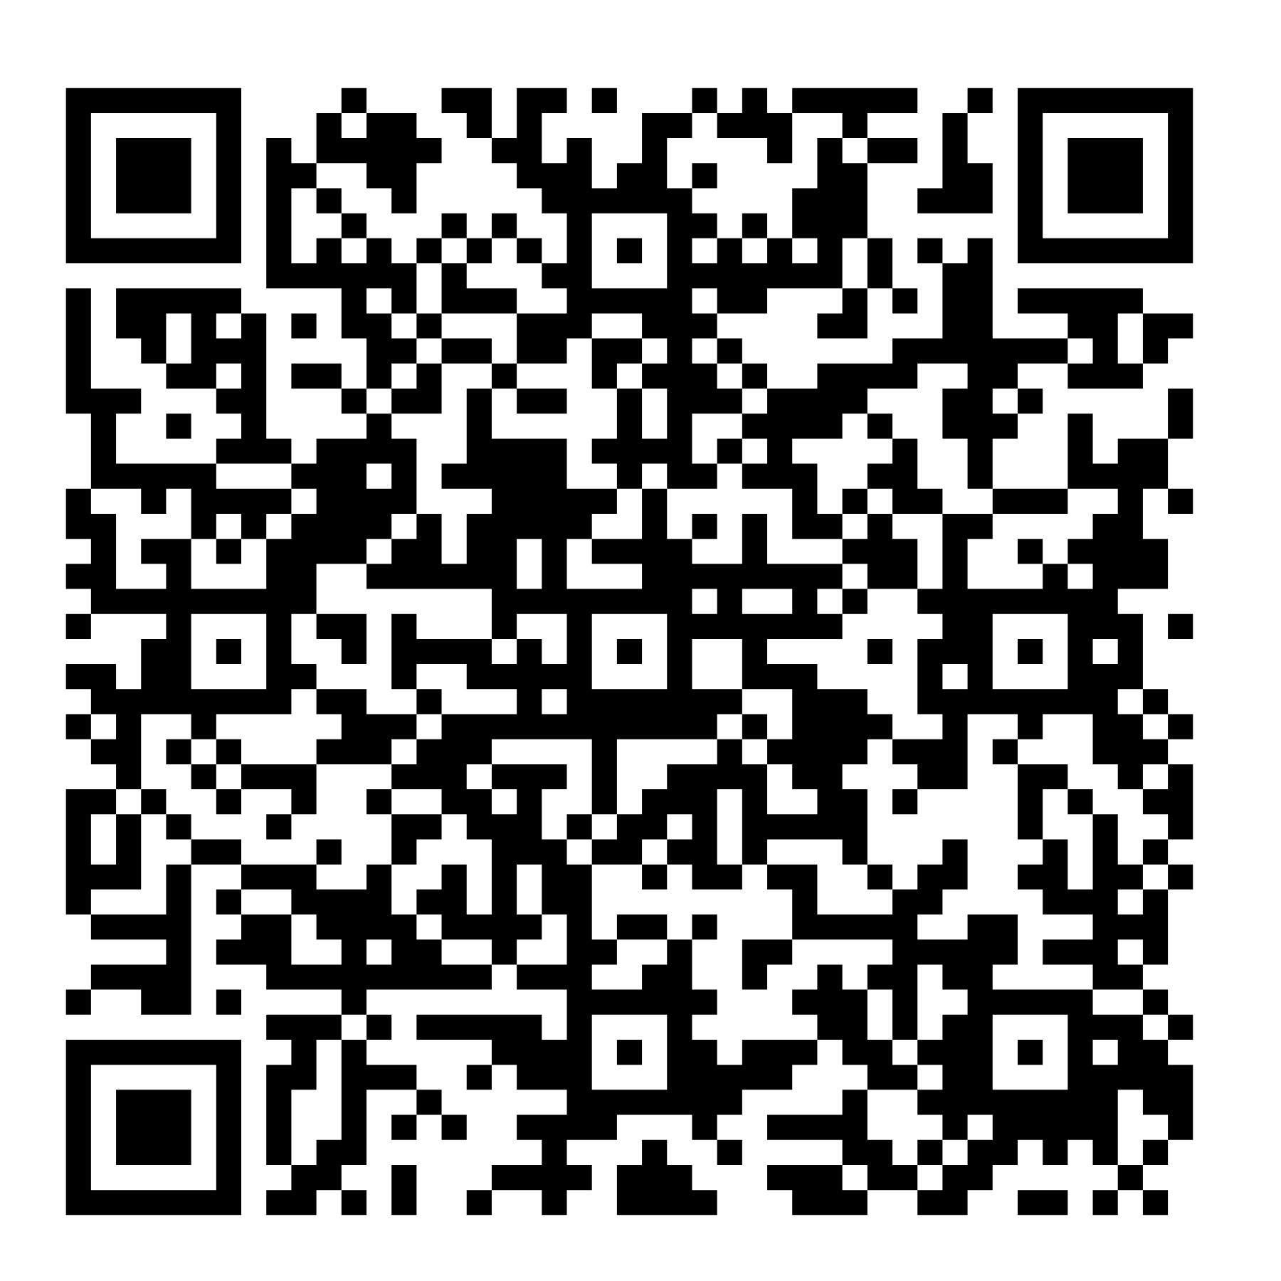
NEW Indiana Diploma
Class of 2030 Course Information Night
Please scan QR code: and complete the Sign In Sheet.
Wifi: Danville Guest
Pw: guestnet24
Our Goal: Explain the new Graduation Requirements and Choose courses for your student’s 9th grade year.

Slide 2
Agenda:
Review New Diploma Requirements for Class of 2030
Examples of 4 year Course Plans
Discuss CTE Pathways at DCHS
Choose 9th grade Courses: *Complete Green Worksheet
**Turn in Before Leaving!

Slide 3


Slide 4


Slide 5

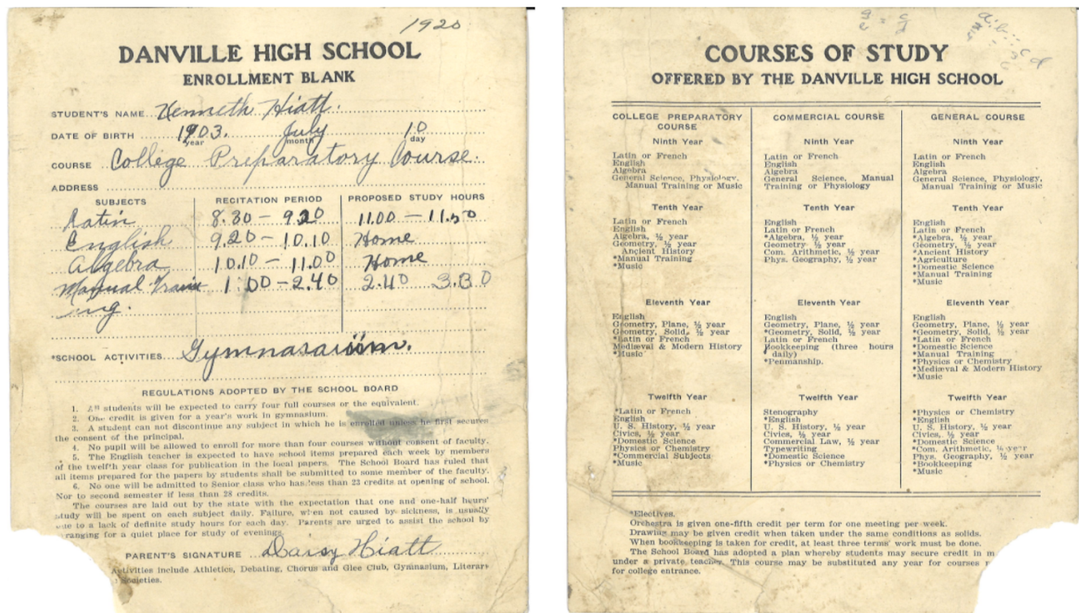
PAST
*still required

Slide 6
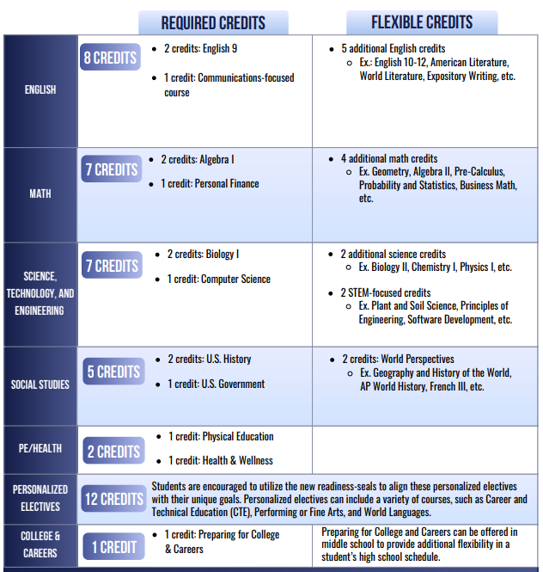
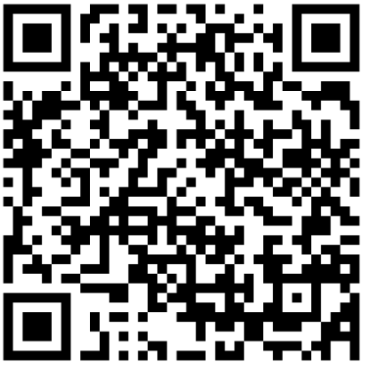
NEW Diploma Requirements:
Please scan QR code under Graduation Requirements:
Then click on: “Diploma Requirements One Page for Class of 2029 and beyond”
Students are encouraged to seize the flexibility by personalizing their high school experience!

Slide 7
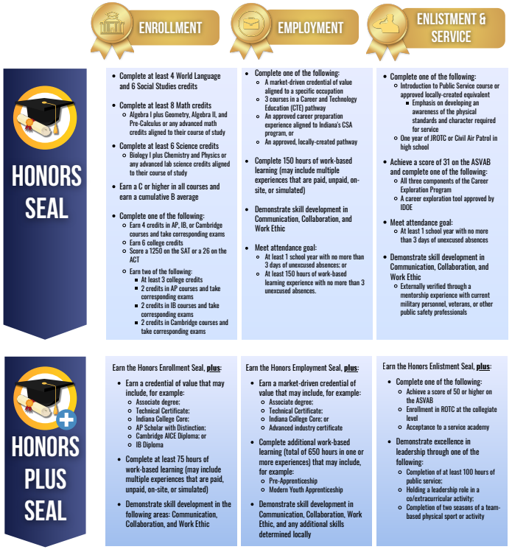
Readiness Seals
*Everyone will choose a Seal to work towards.
The new seals provide additional intentionality to maximize readiness for after high school.
Per the state of Indiana: Students who do not earn a seal, must still complete a Graduation Pathway!

Slide 8
Future New IN Diploma Breakdown
New Diploma Requirements
Enrollment Honors Seal
Employment Honors Seal
Enlistment Honors Seal
*College bound
* Area 31
*Area 31
Enrollment Honors PLUS Seal
Employment Honors PLUS Seal
Enlistment Honors PLUS Seal
*AP Scholars or *ICC
*College bound

Slide 9
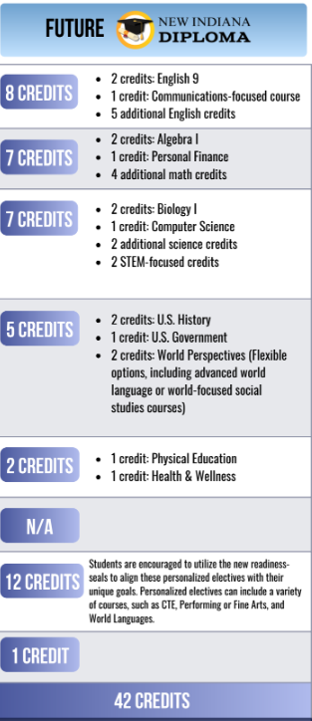
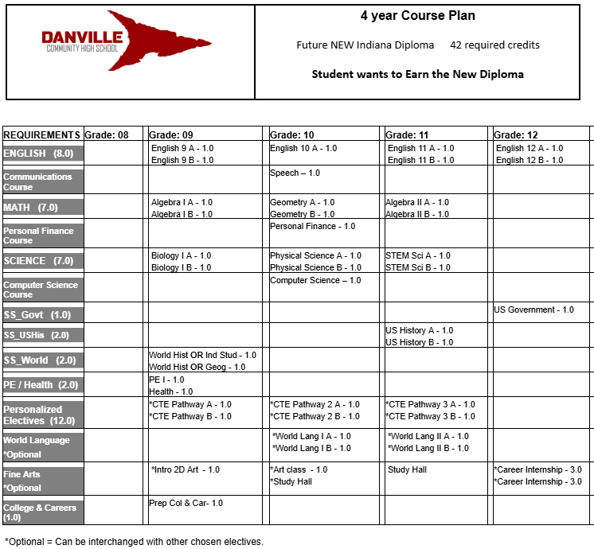


Slide 10

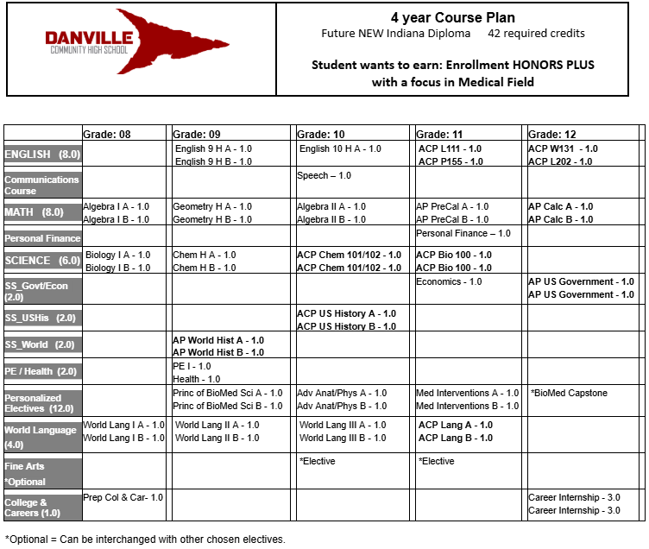
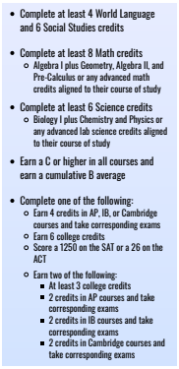
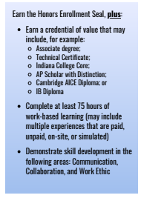
Example of a 4 year plan for a College Bound student

Slide 11


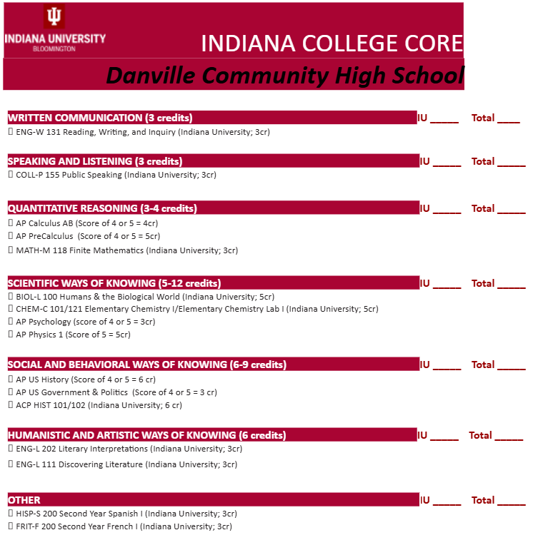
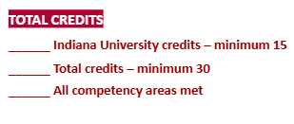
DCHS offers the following upper level courses:
Honors = English, Math and Science to prepare students for AP and ACP courses.
AP = Advanced Placement. (Weighted)
Through College Board, students will take an AP exam at the end of the school year to possibly earn college credit.
ACP = Advanced College Project. (Weighted)
Dual Credit courses through IU. Teachers are licensed through IU and mandated to follow IU curriculum. Students will earn college credit if C or higher.
Dual Credit = PLTW and Agriculture courses will earn college credit through Ivy Tech. Students must register online and meet requirements. (Weighted)

Slide 12

New Indiana Legislation:
If Enrollment Honors Plus is earned, student will receive
Guaranteed Acceptance
to the following schools:
Ball State BSU
Indiana State ISU
Purdue PU
Indiana IU
University of Southern Indiana USI
Vincennes
Ivy Tech

Slide 13

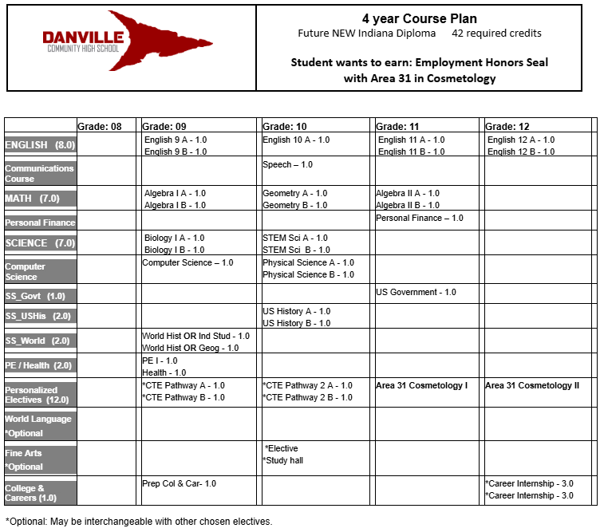
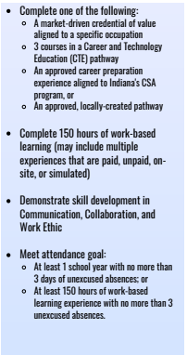

Example of a 4 year plan for a student going into the Workforce

Slide 14

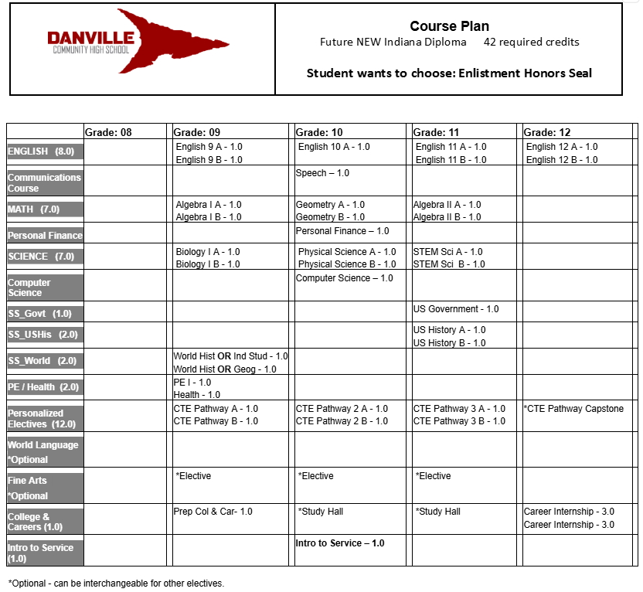
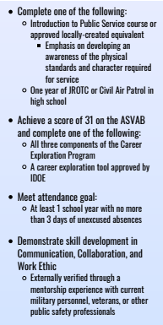
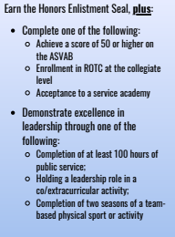
Example of a 4 year plan for a student going into the Military

Slide 15
We are going to focus on 9th grade Course Requests:
COURSE REQUESTS Fill in 7 classes each semester (actual schedule will vary)
SEMESTER ONE | SEMESTER TWO
1. English: | 1. English:
2. Social Studies: | 2. Social Studies:
3. Math: | 3. Math:
4. Science: | 4. Science:
5. Pathway: | 5. Pathway:
6. | 6.
7. | 7.
* Everyone will follow the NEW Indiana Diploma requirements.
*Everyone must have a total of 14 courses.
*It is highly recommended to choose a Pathway!
*Per the state of Indiana: Students who do not earn a seal, must still complete a Graduation Pathway!
How to pick a Pathway??
Electives that are Your Choice!

Slide 16

Career & Technical Education (CTE) Pathways
at DCHS

Slide 17
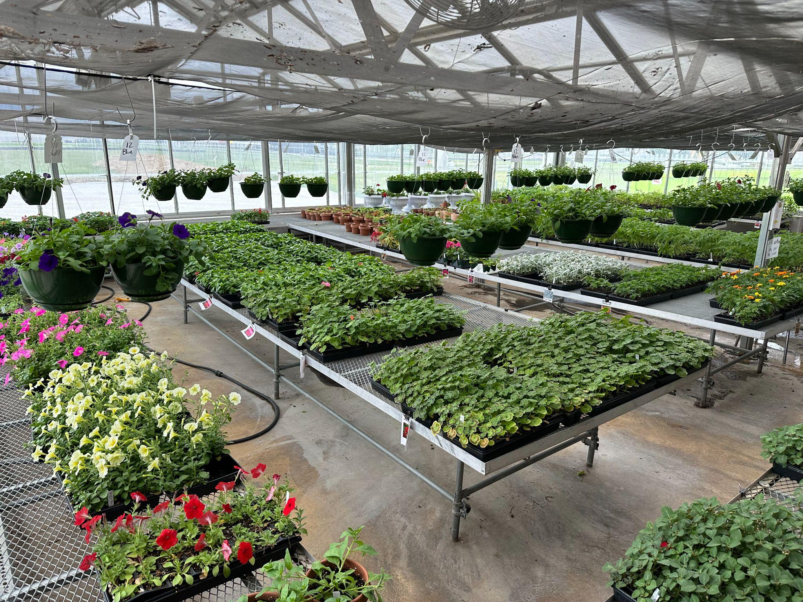

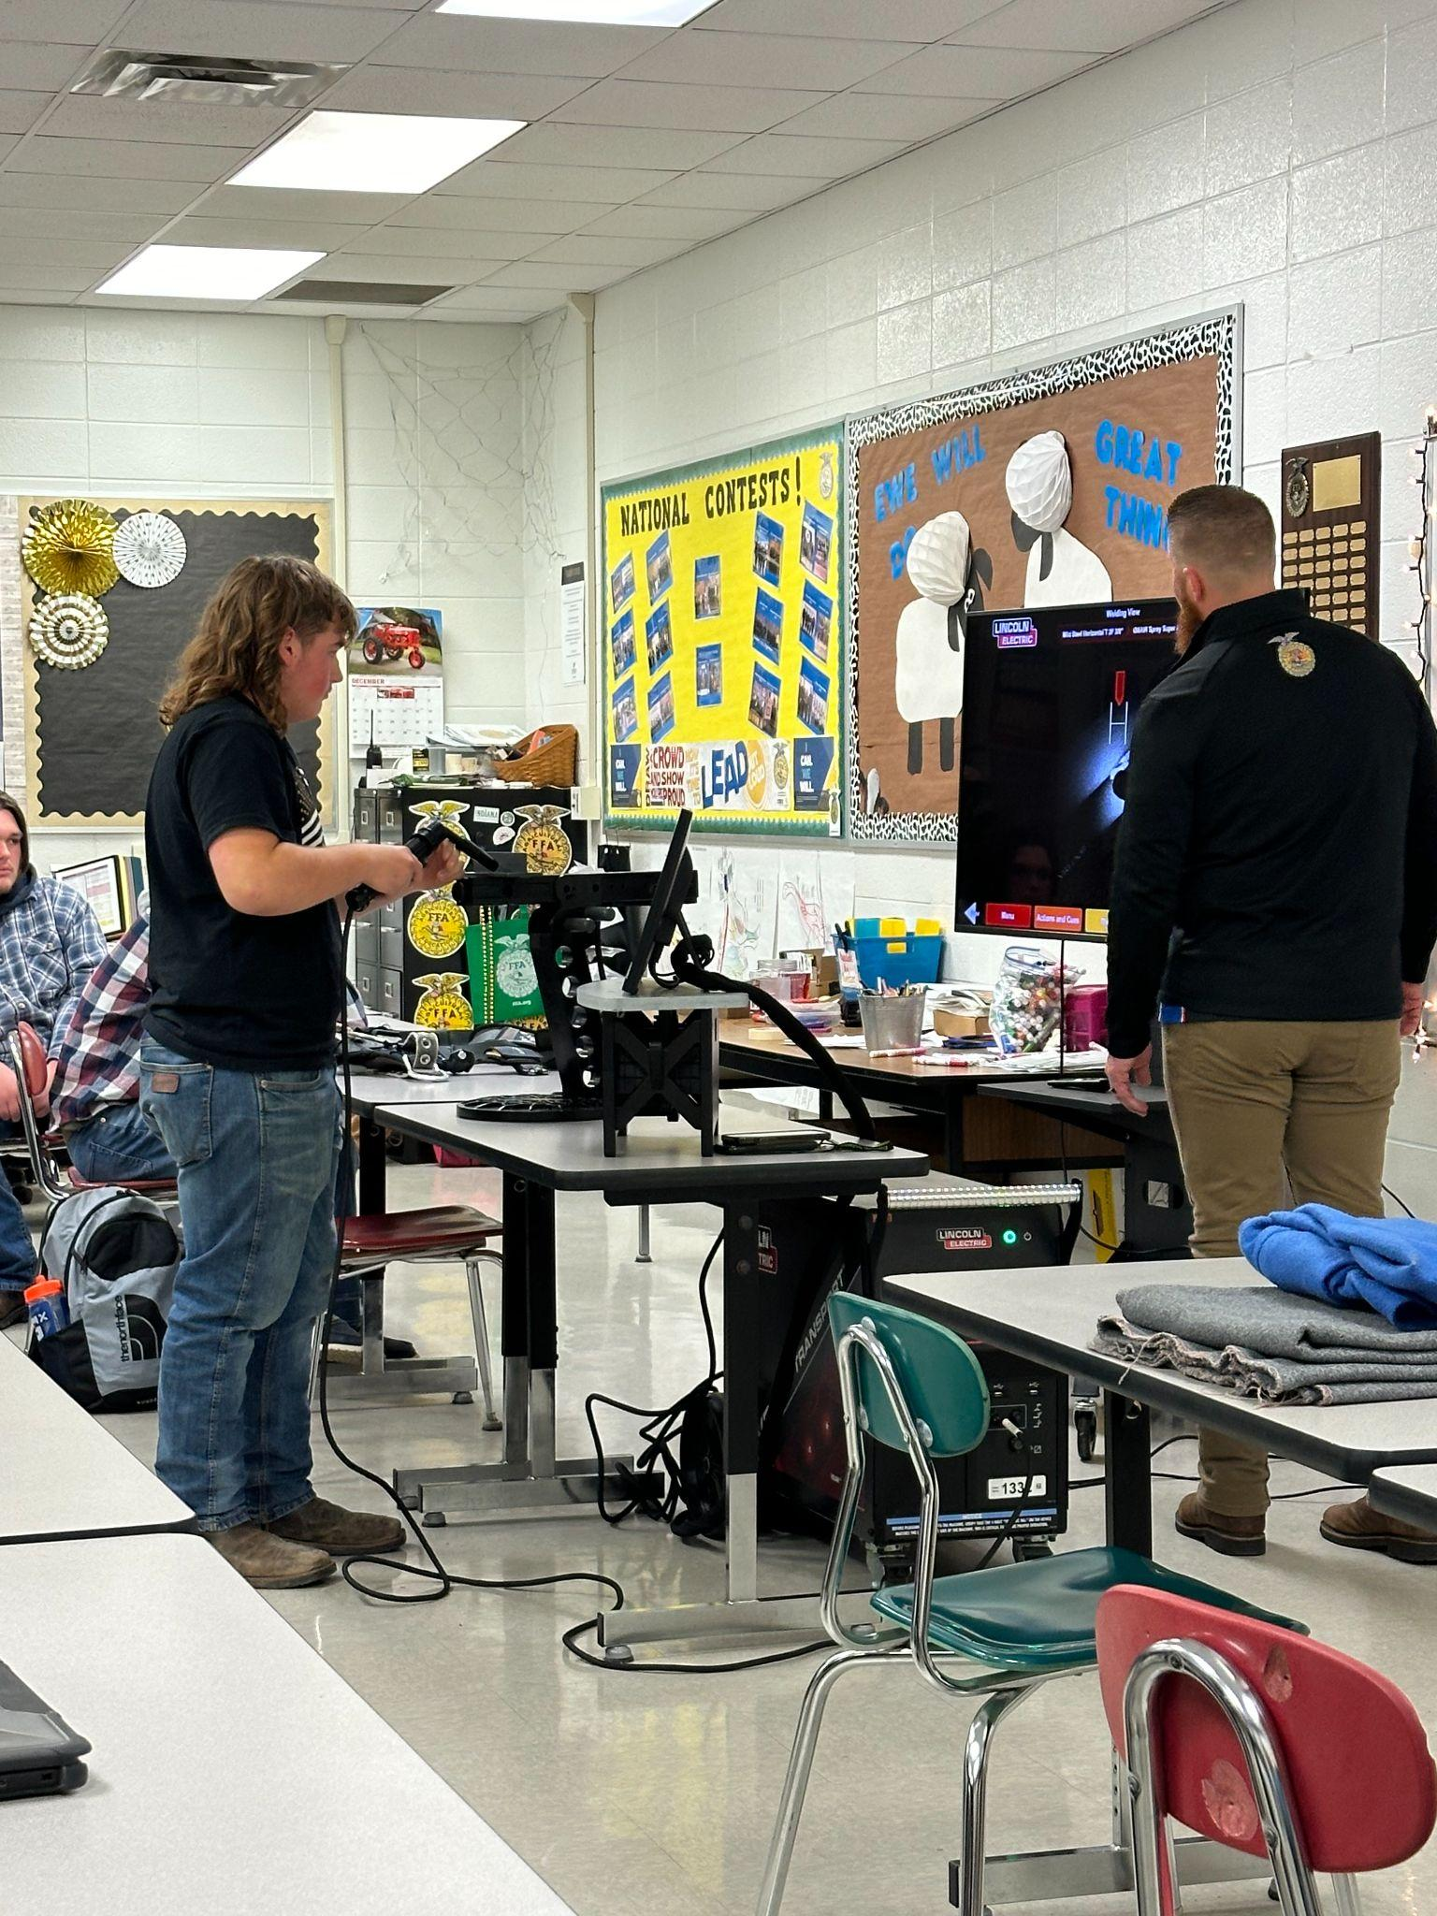
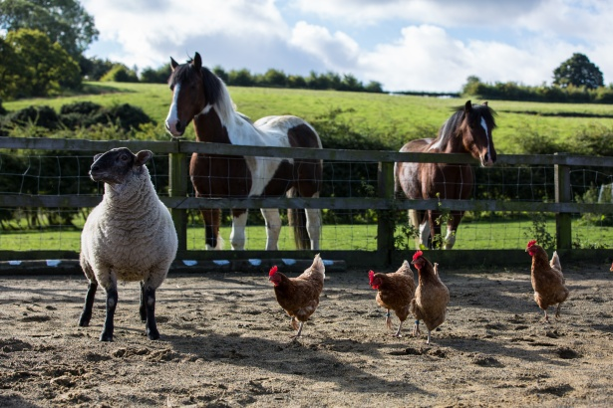

Farming
Horticulture ~ Plants and Soil
AGRICULTURE
Animals
Agribusiness

Slide 18
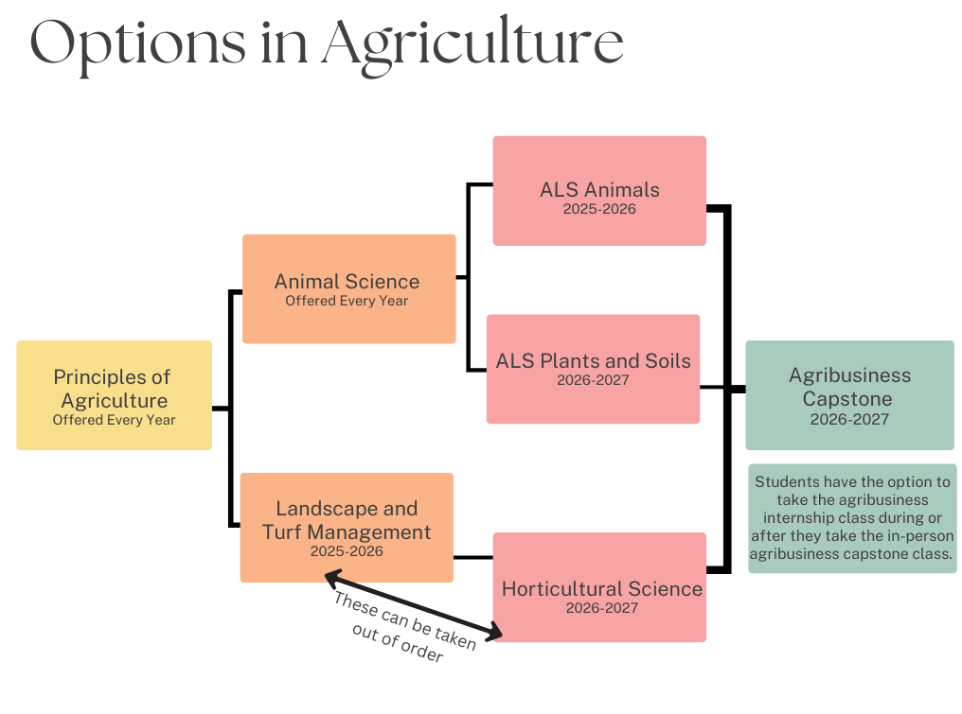




Agriculture Pathways
*Dual credit through Ivy Tech.

Slide 19





BUSINESS
Accounting
Finance
Marketing

Slide 20
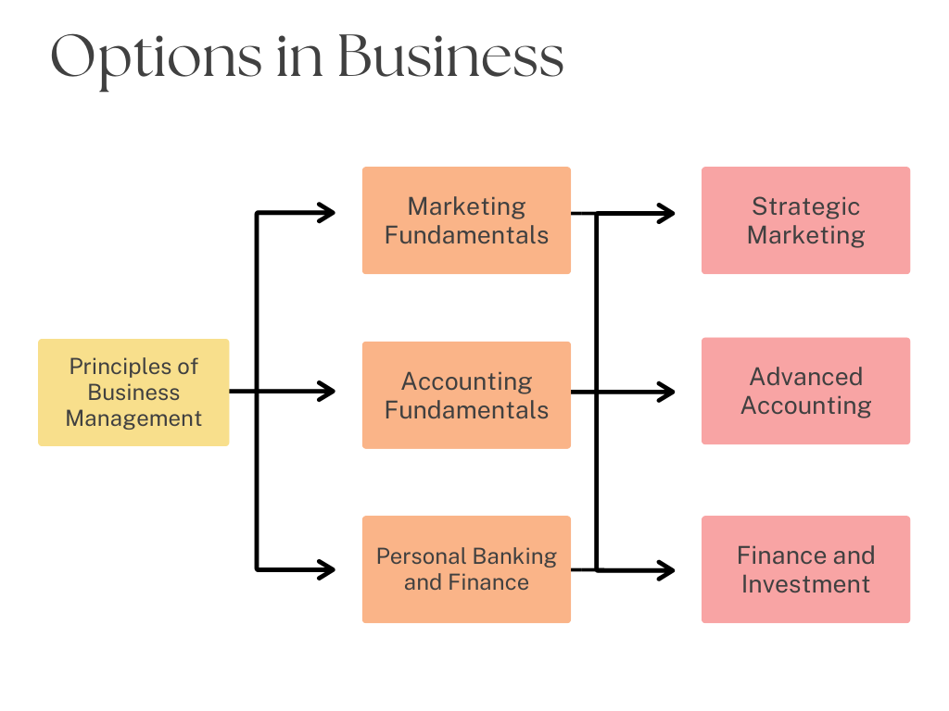

Slide 21





Coding
AI
Apps
Computer Science

Slide 22


Slide 23
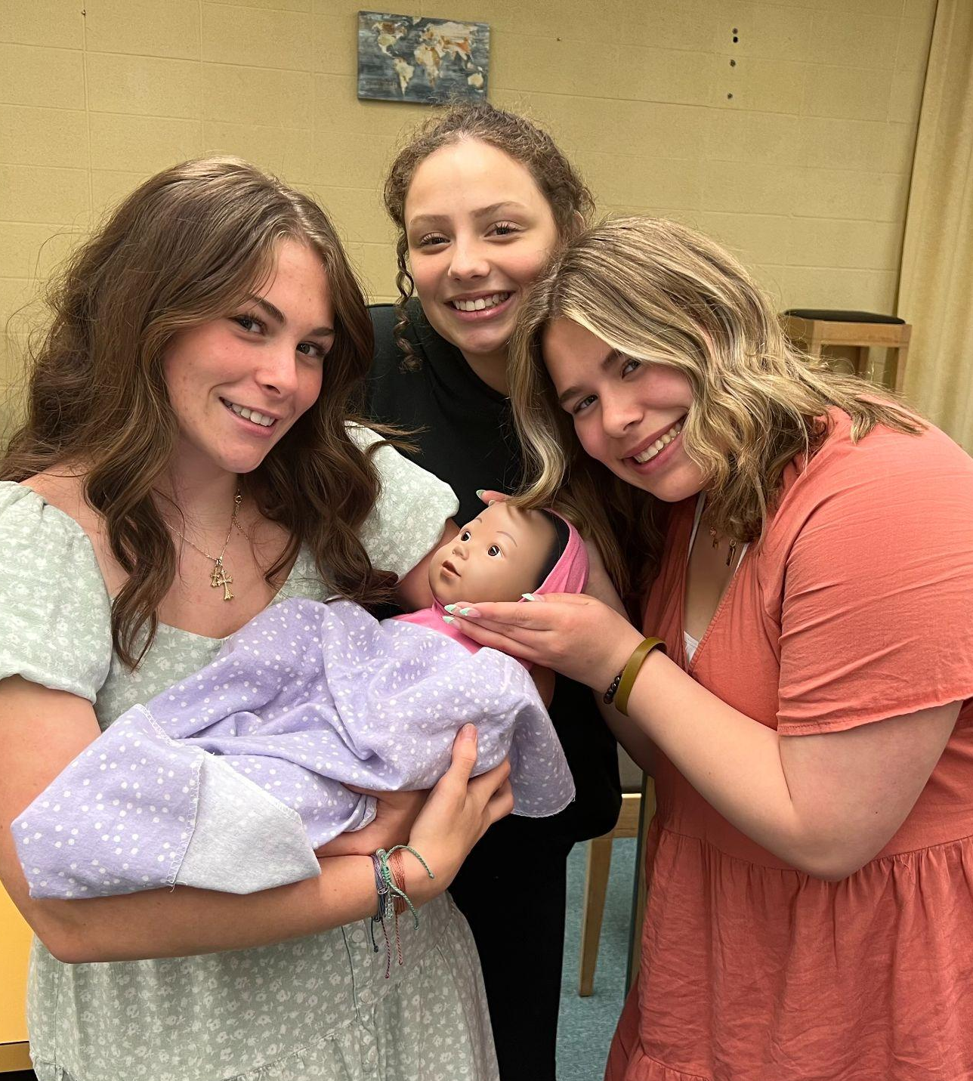


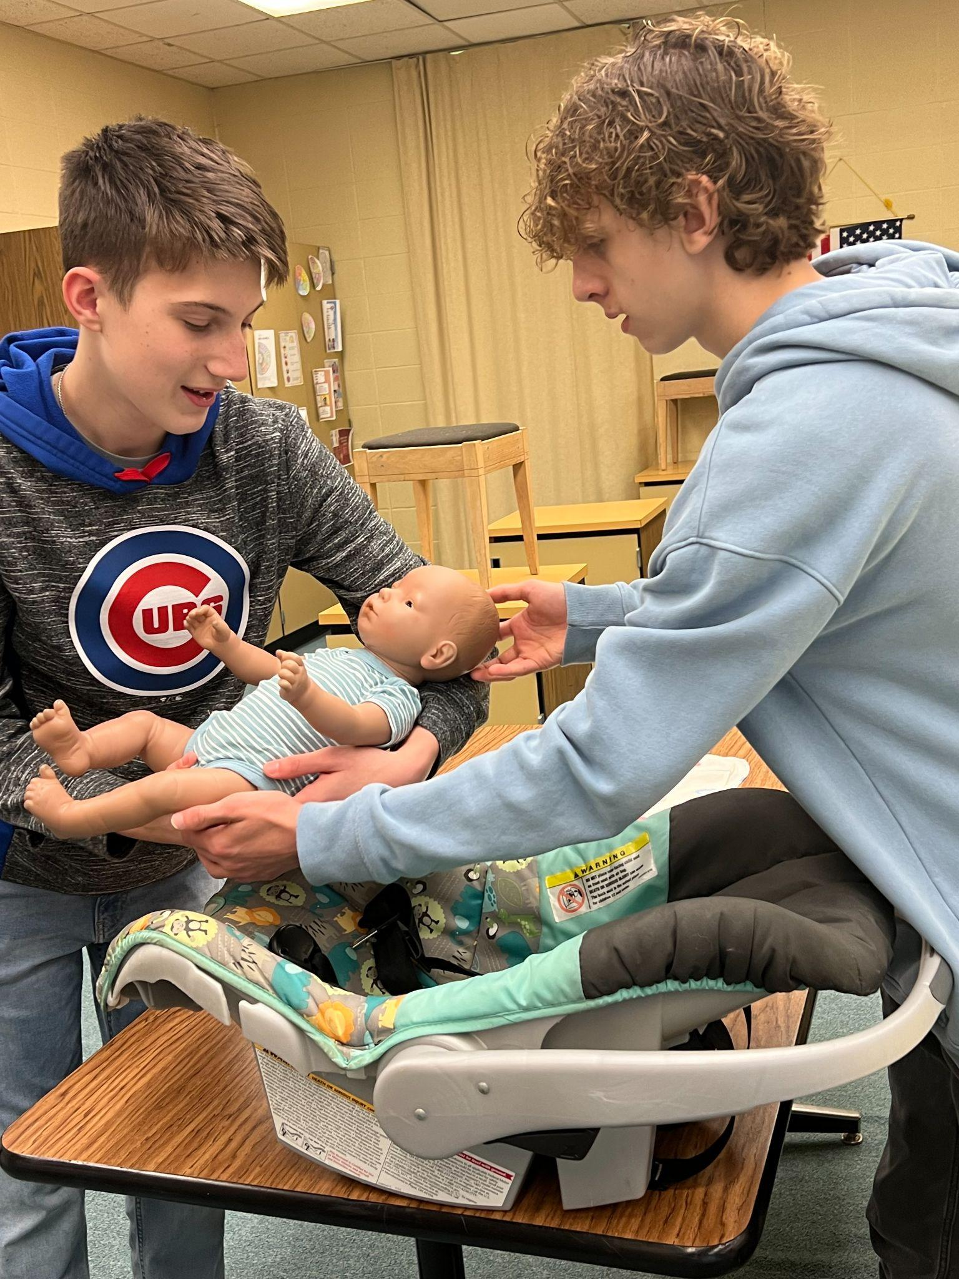
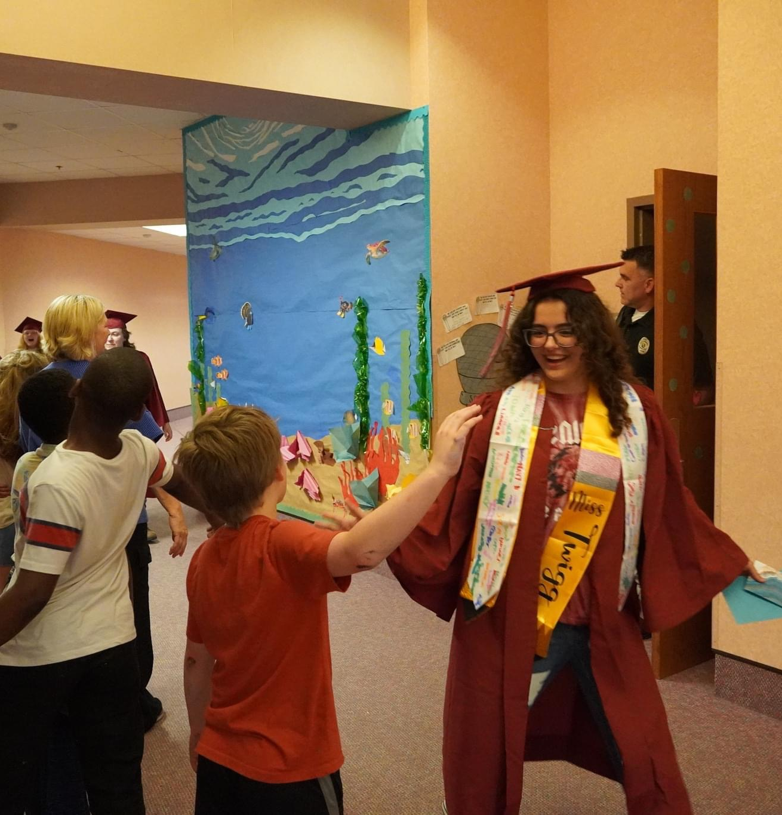
Teaching
EDUCATION
Child Development
School Visits

Slide 24


Slide 25



Engineering
Building models
Civil Architecture

Slide 26
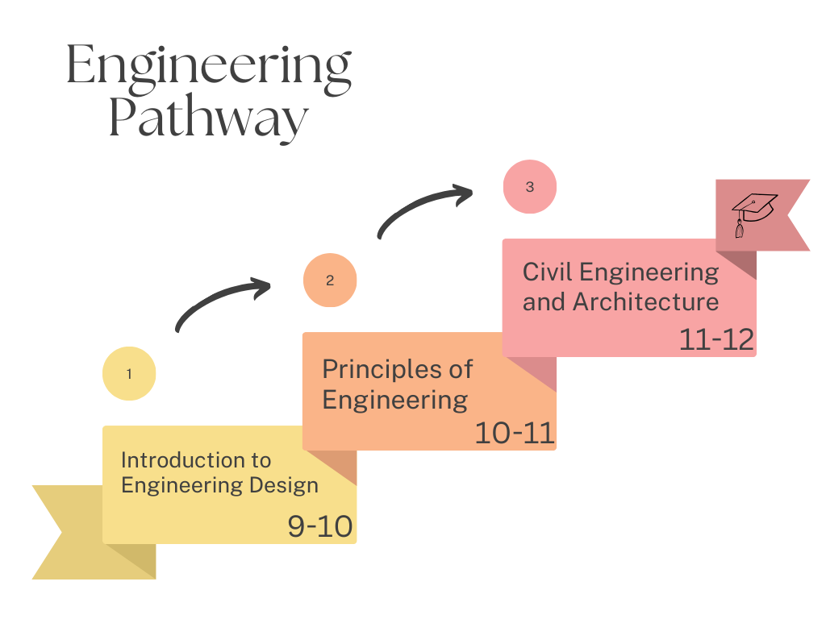
*Dual credit through Ivy Tech.

Slide 27



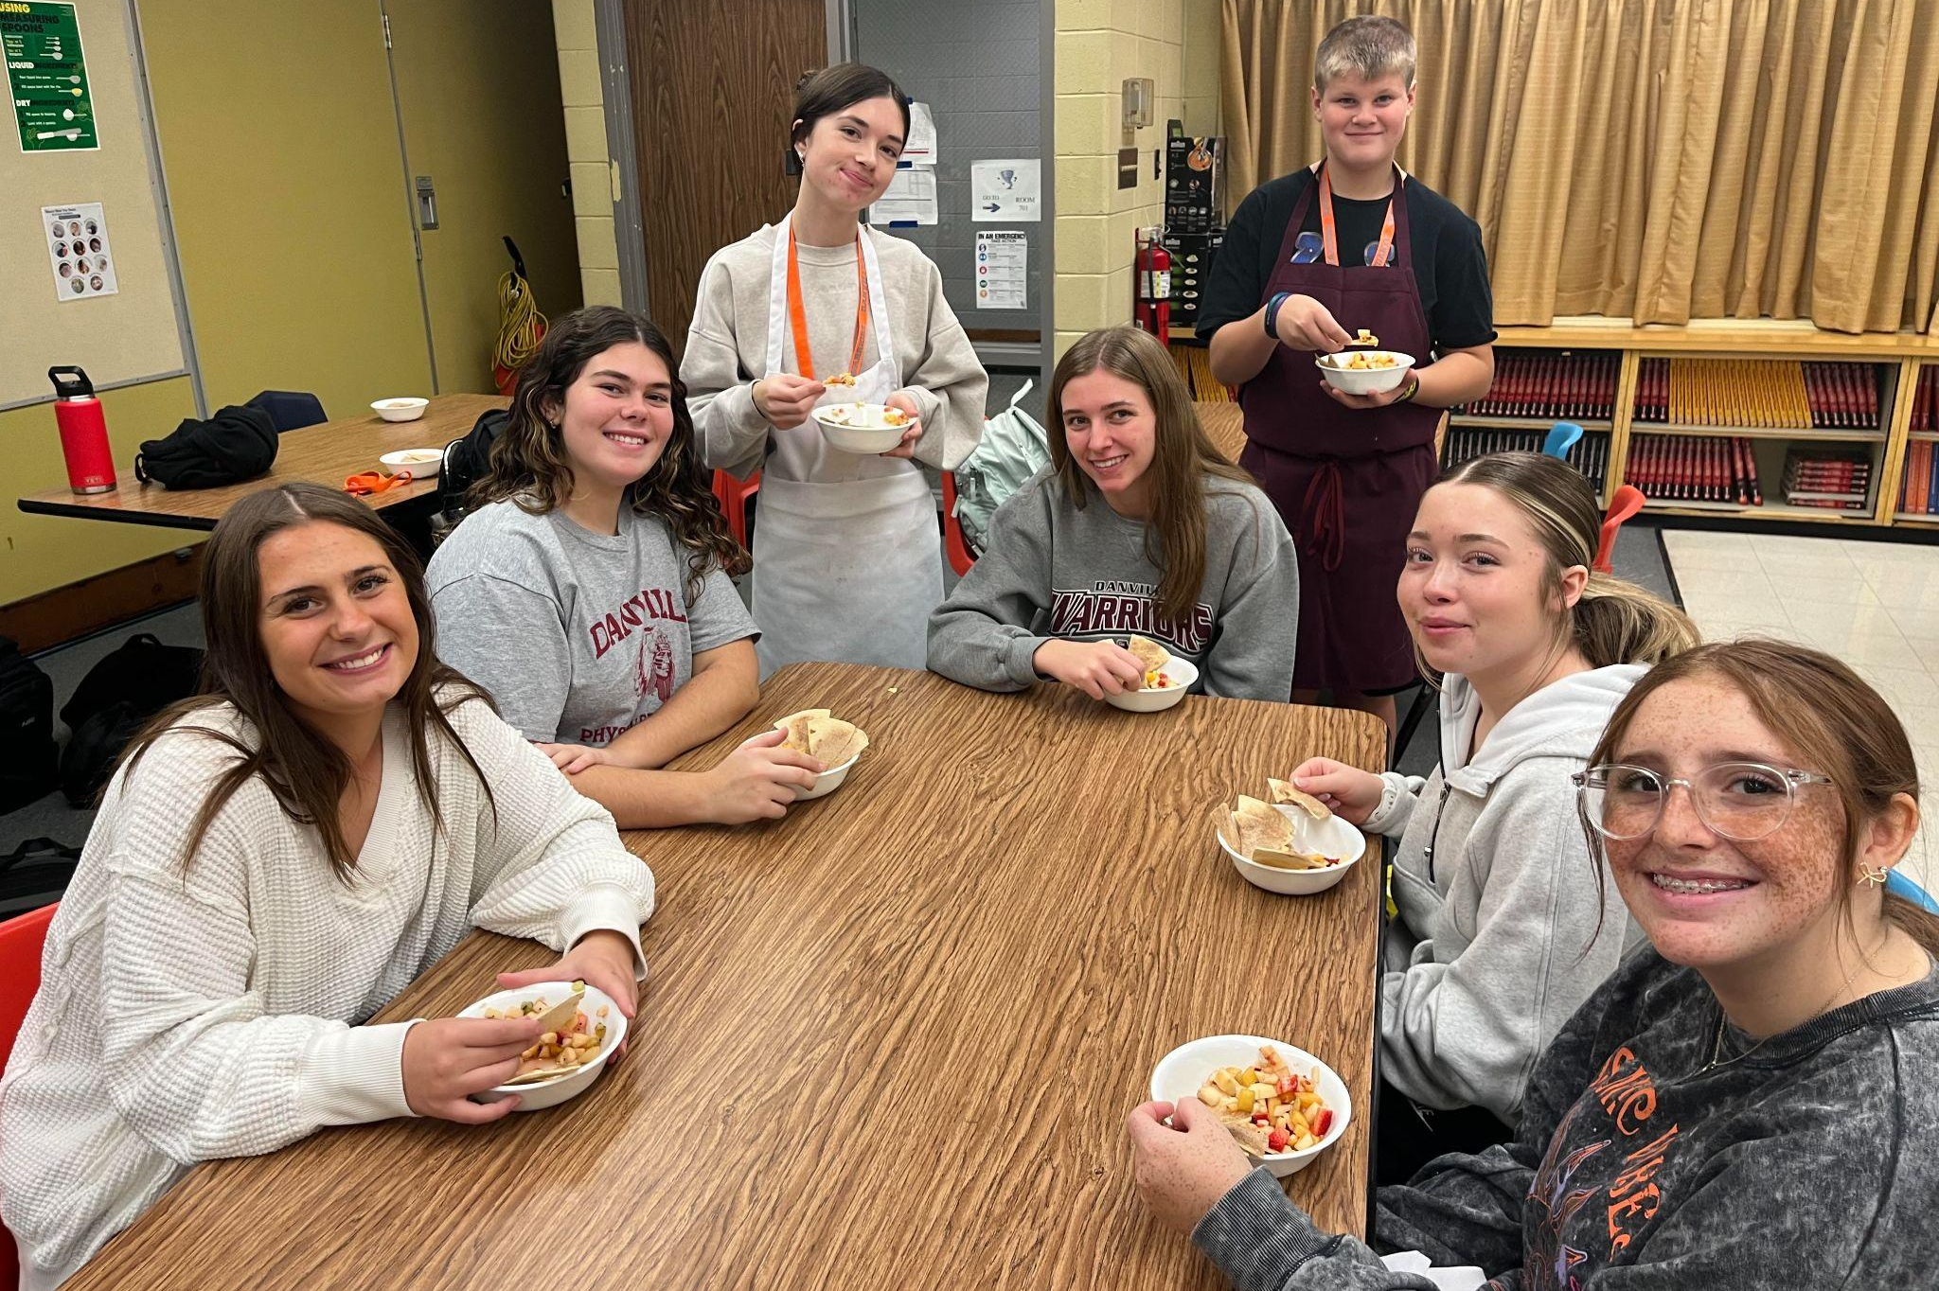



Measuring Ingredients
Knife skills
CULINARY ARTS
Food samples
Leadership skills

Slide 28
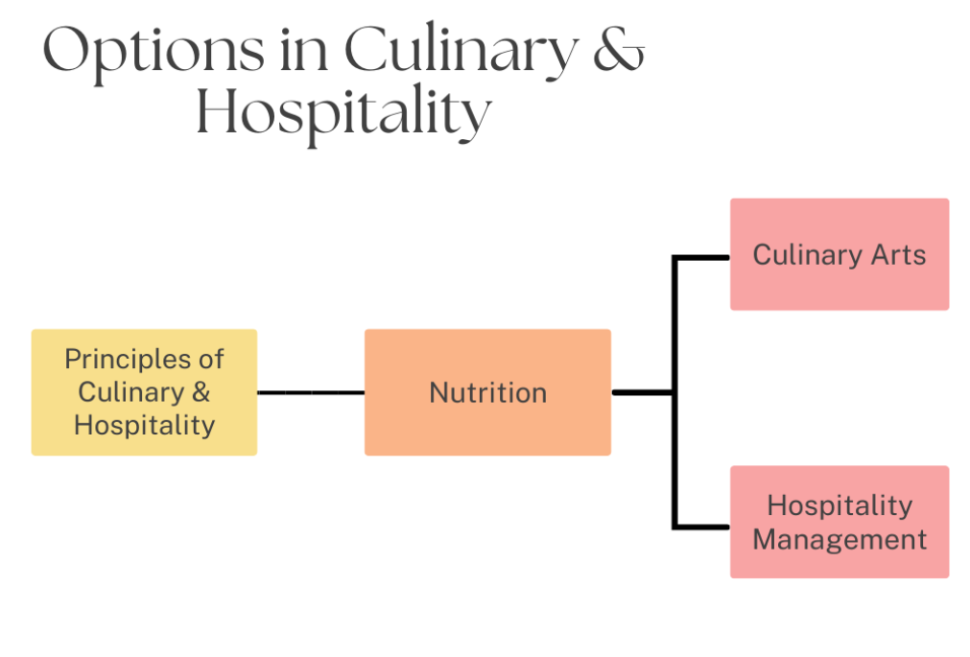

Slide 29

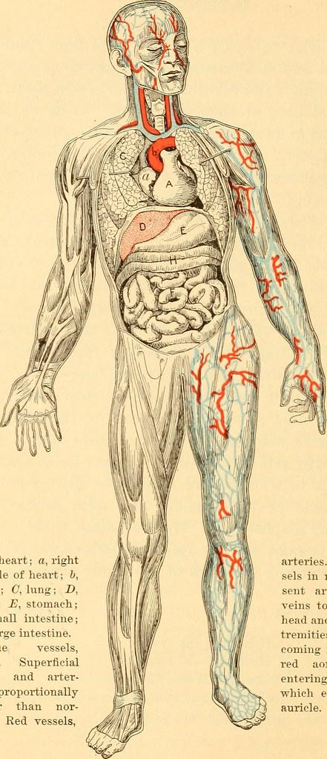
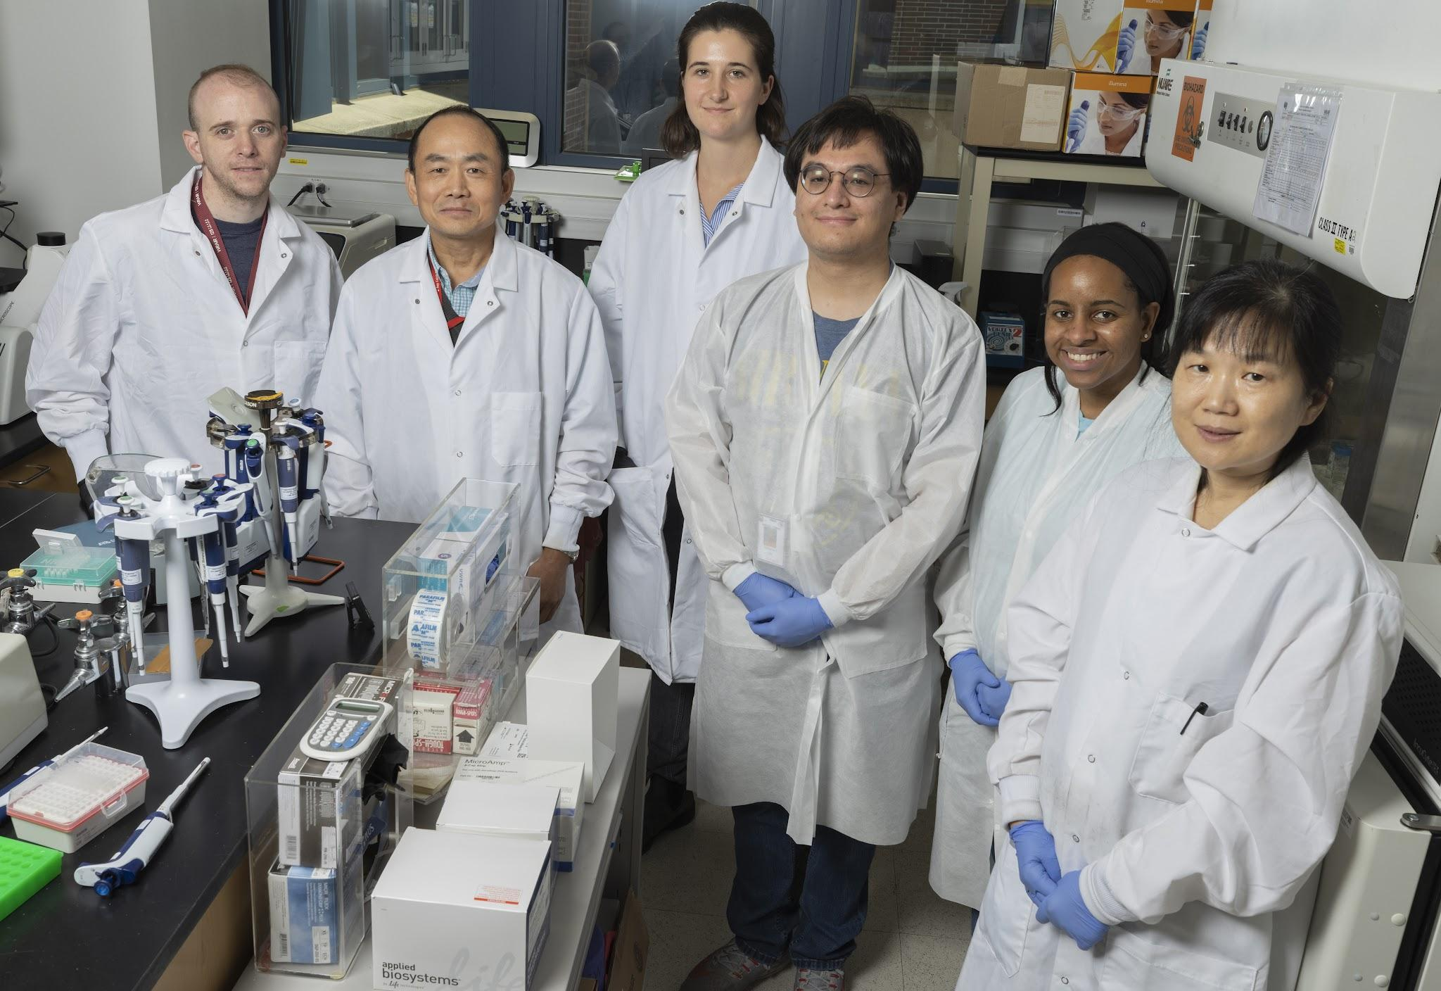
Anatomy
Biomedical Sciences
Science and Medical Field

Slide 30
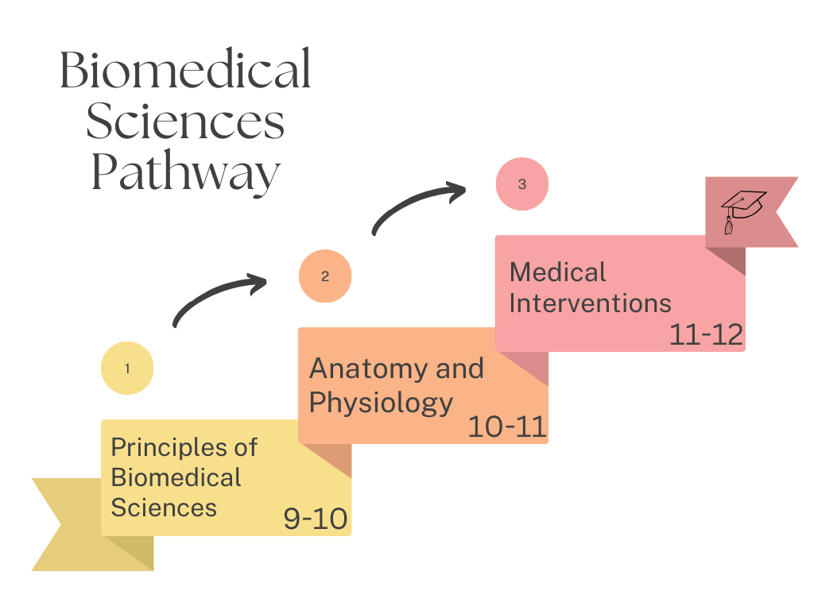
*Possible Dual credit based on end of year exam.
Must have already completed Biology Honors, or currently enrolled in.

Slide 31


Click here to view the Area 31 Career Center Programs
All Area 31 Programs count as CTE Pathway courses. Area 31 is a competitive enrollment process that begins in second semester of the 10th grade year.
*Visit: https://www.area31careercenter.com/ for more information.

Slide 32
We are going to fill in your 9th grade Course Requests:
ENGLISH: All students will take a full year of English 9.
*If the student is on Enrollment Seal, then choose - English 9 Honors.
SOCIAL STUDIES: All students need 2 semesters of a World perspective course. Please choose from the following:
World History, World Geography, Indiana Studies
*If the student is on Enrollment Seal, then choose either - AP World History or AP Human Geography
MATH: All students will take a full year of Algebra 1.
*If the student completed Algebra 1 in 8th grade, then choose - Geometry Honors.
SCIENCE: All students will take a full year of Biology.
*If the student completed Biology Honors in 8th grade, then choose - Chemistry Honors.
**PLEASE NOTE: PE I is a one semester requirement. A student can earn PE credit by participating in 2 consecutive seasons of the same school sport or other approved school activity (marching band, cheerleading, etc.)
Be sure to have a total of 14 courses.
COURSE REQUESTS Fill in 7 classes each semester (actual schedule will vary)
SEMESTER ONE | SEMESTER TWO
1. English: | 1. English:
2. Social Studies: | 2. Social Studies:
3. Math: | 3. Math:
4. Science: | 4. Science:
5. Pathway: | 5. Pathway:
6. | 6.
7. | 7.
English 9
English 9
World History
World Geography
Algebra
Algebra
Biology
Biology

Slide 33
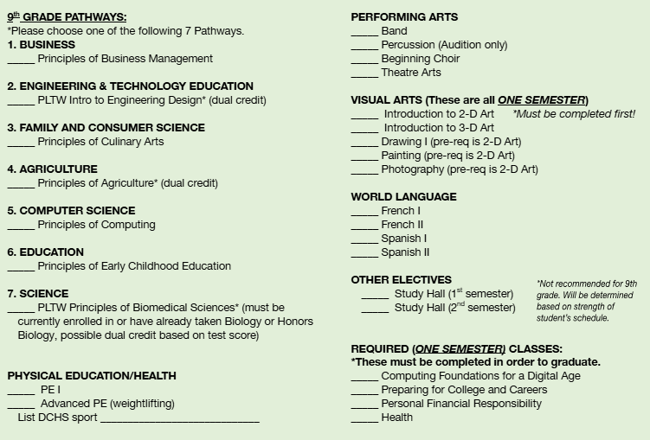
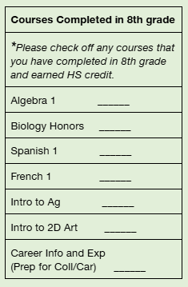
Now for the fun part!
Please check off classes completed in 8th grade.

Slide 34
Example students:
Employment Seal Enrollment HONORS PLUS seal
COURSE REQUESTS Fill in 7 classes each semester (actual schedule will vary)
SEMESTER ONE | SEMESTER TWO
1. English: English 9 | 1. English: English 9
2. Social Studies: World Geography | 2. Social Studies: World History
3. Math: Algebra 1 | 3. Math: Algebra 1
4. Science: Biology | 4. Science: Biology
5. Pathway: Principles of Culinary | 5. Pathway: Principles of Culinary
6. PE I | 6. Health
7. Preparing for College and Careers | 7. Personal Financial Responsibility
COURSE REQUESTS Fill in 7 classes each semester (actual schedule will vary)
SEMESTER ONE | SEMESTER TWO
1. English: English 9 Honors | 1. English: English 9 Honors
2. Social Studies: AP Human Geography | 2. Social Studies: AP Human Geography
3. Math: Geometry Honors | 3. Math: Geometry Honors
4. Science: Chemistry Honors | 4. Science: Chemistry Honors
5. Pathway: Principles of Computing | 5. Pathway: Principles of Computing
6. Advanced PE weights | 6. Advanced PE weights
7. Spanish II | 7. Spanish II

Slide 35
Thank you for attending!
Please sign and return the GREEN paper.
Mr. Cox will be meeting individually with the 8th grade students in Mid-February to confirm all course requests.

