Slide 1
Career
Kick-Off
10th Grade Career Exploration
Presented by ETHS Counselors

Slide 2
Today’s
Objectives
01
IDENTIFY
02
CONNECT
03
Career Industry Sectors
College & Career Resources
ENCOURAGE
Finish your year strong!

Slide 3
Pre-Test
26
https://tinyurl.com/ETsoph2025pre

Slide 4
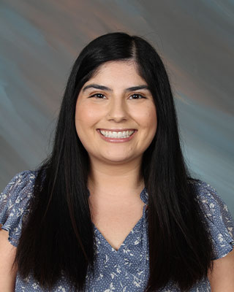
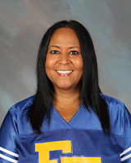
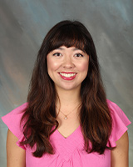
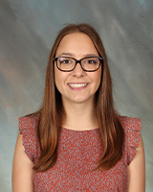
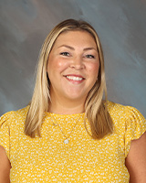
Introducing your School Counselors
Miss Felix
Mrs. Coleman
Miss Kurisu
Mrs. Myers (formerly Miss O’Neil)
Mrs. Baker
Last Names A-Cro
Last Names Mon-R
Last Names Cru-Hern
Last Names S-Z
We can help with:
Social/emotional support
Academic planning
College planning
Career planning
Letters of recommendation
At-risk meetings
Course placement
Confidentiality
Last Names Herr-Mom

Slide 5
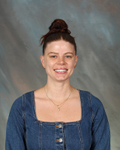
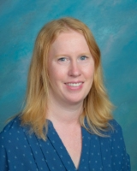
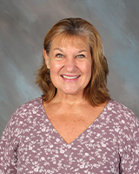
Student Services Technician
Miss Graham
(sub Mrs. Brady)
Last Names A - Ga
Mrs. Rego
Last Names Ge-N
Mrs. Dickelman
Last Names O-Z
Can help with:
Scheduling
New Enrollments
Records
Graduation Status
Athletic Rosters
Aeries updates/ Address changes

Slide 6
SOPHOMORE YEAR
Sophomore year is a chance for you to dive deeper and explore what you truly desire out of life.
Cast a wide net, and become involved in various activities that have the potential to lead you to a desired career path.
This is the turning point for you to kick start your future and get on the best path to achieve your post high school option!
Notes:
How many of you think that what you do in high school matters?

Slide 7
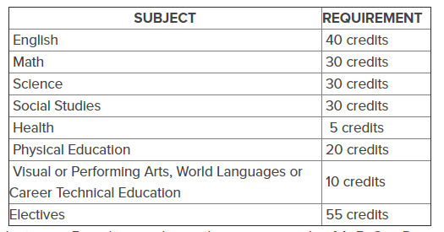
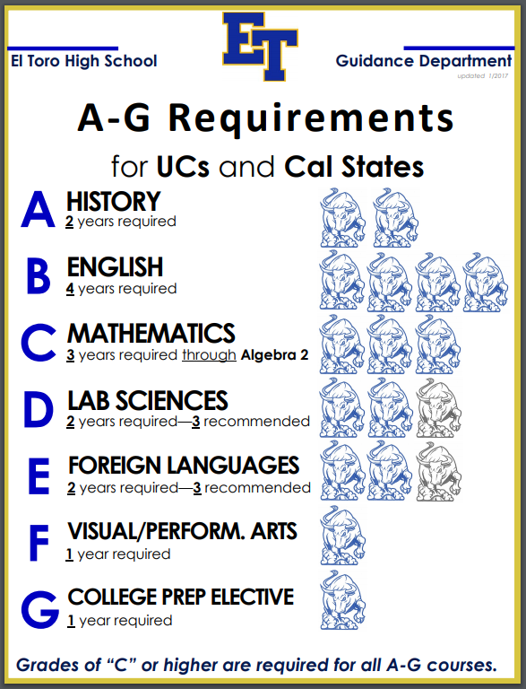
Graduation vs A-G Req’t
Now is the time to decide which path you are taking in high school!

Slide 8
POST-HIGH SCHOOL
TRADE SCHOOL
COMMUNITY COLLEGE
Certification Options, Specialized Training
Certification, AA, Transfer to 4-Year university
Flight Attendant, Auto, Mortuary, Police, Paramedic, Firefighter etc
Plumbing, Piloting, Cosmetology, Electrician, Culinary etc.
4-YEAR
POST GRAD
Bachelors Degrees & Beyond
Masters, Doctorate, Law School, Medical School
Accounting, Teaching, Nursing, Business etc
Surgeon, Psychologist, Pharmacist, Lawyer etc

Slide 9
Military Options
Defender of the Coasts
National Guard and Reserves
ARMY
Defender of the Seas
NAVY
Protect U.S. in the Air
AIR FORCE
Called in First to Fight
MARINES
COAST GUARD
Responsible for marine safety, rescue, and international laws
Main area of service is the ground; serve in a foreign country
Mainly responsible for various coasts; provides crucial support to all branches of the military
Provide air support in critical missions
Protect U.S. in Space
SPACE FORCE
Provide support and protection of the universe in space
Ground Fighting Force; physical and mental toughness
Notes:
Add Coast Guard

Slide 10
SOME POINTS TO CONSIDER
Students are likely to have over 3-5 possible occupational changes and/or careers in their lifetime.
Investigation Options:
ROP/CTE Classes
Interview/Network with professionals
Job Shadow
Volunteer
Join Special Programs/Extracurriculars
These are other great ways to explore your career interests & potential!

Slide 11
FINAL RESULTS
01 | EMPLOYED
02 | ENLISTED
03 | ENROLLED
04 | EXCITED
05 | EMPOWERED
Notes:
Define these words for students.

Slide 12
LET’S EXPLORE!
Find out what your interests are and how they relate to the world of work.

Slide 13
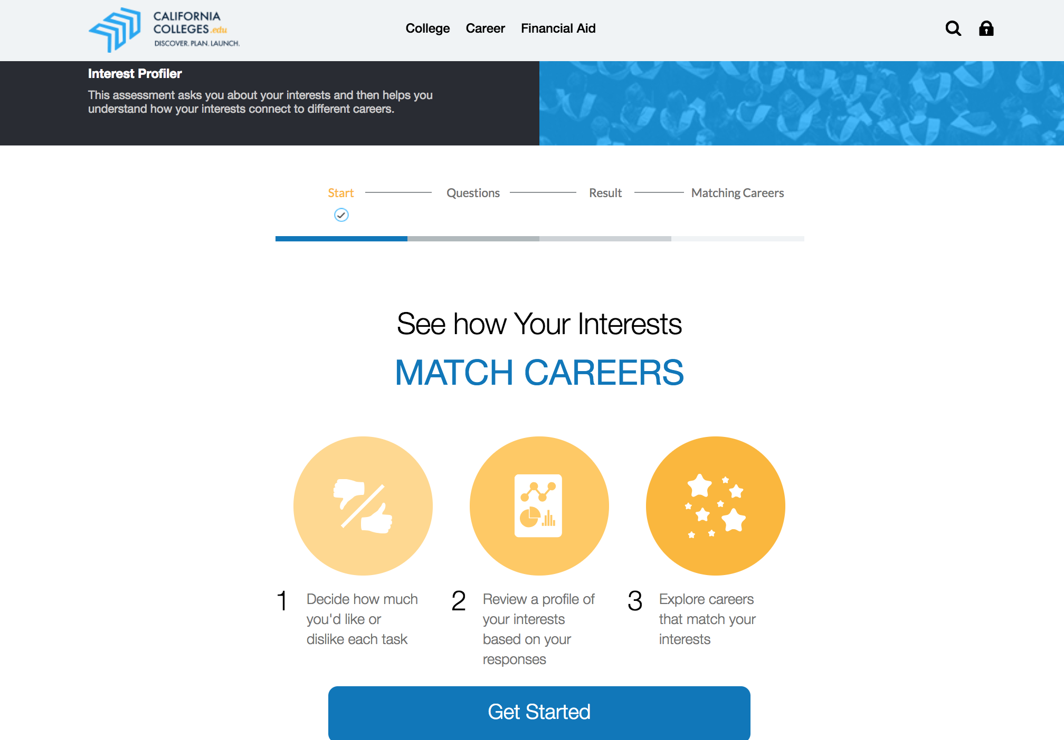
CA Colleges
Interest Profiler
Log in to your account
Hover over “Career”, then select Interest Profiler
  Take the assessment
  See how your interests match with careers
Career Assessment
  Learn about your interests, strengths, skills, and values
Career Search Tool
  Education level
  Salary
What are your interests…?

Slide 14
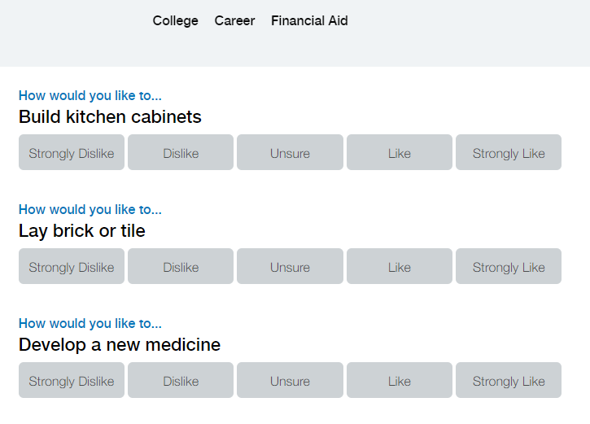
Interest Profiler
For Best Results
Avoid Unsure
Measure questions based on enjoyment
BE HONEST!

Slide 15
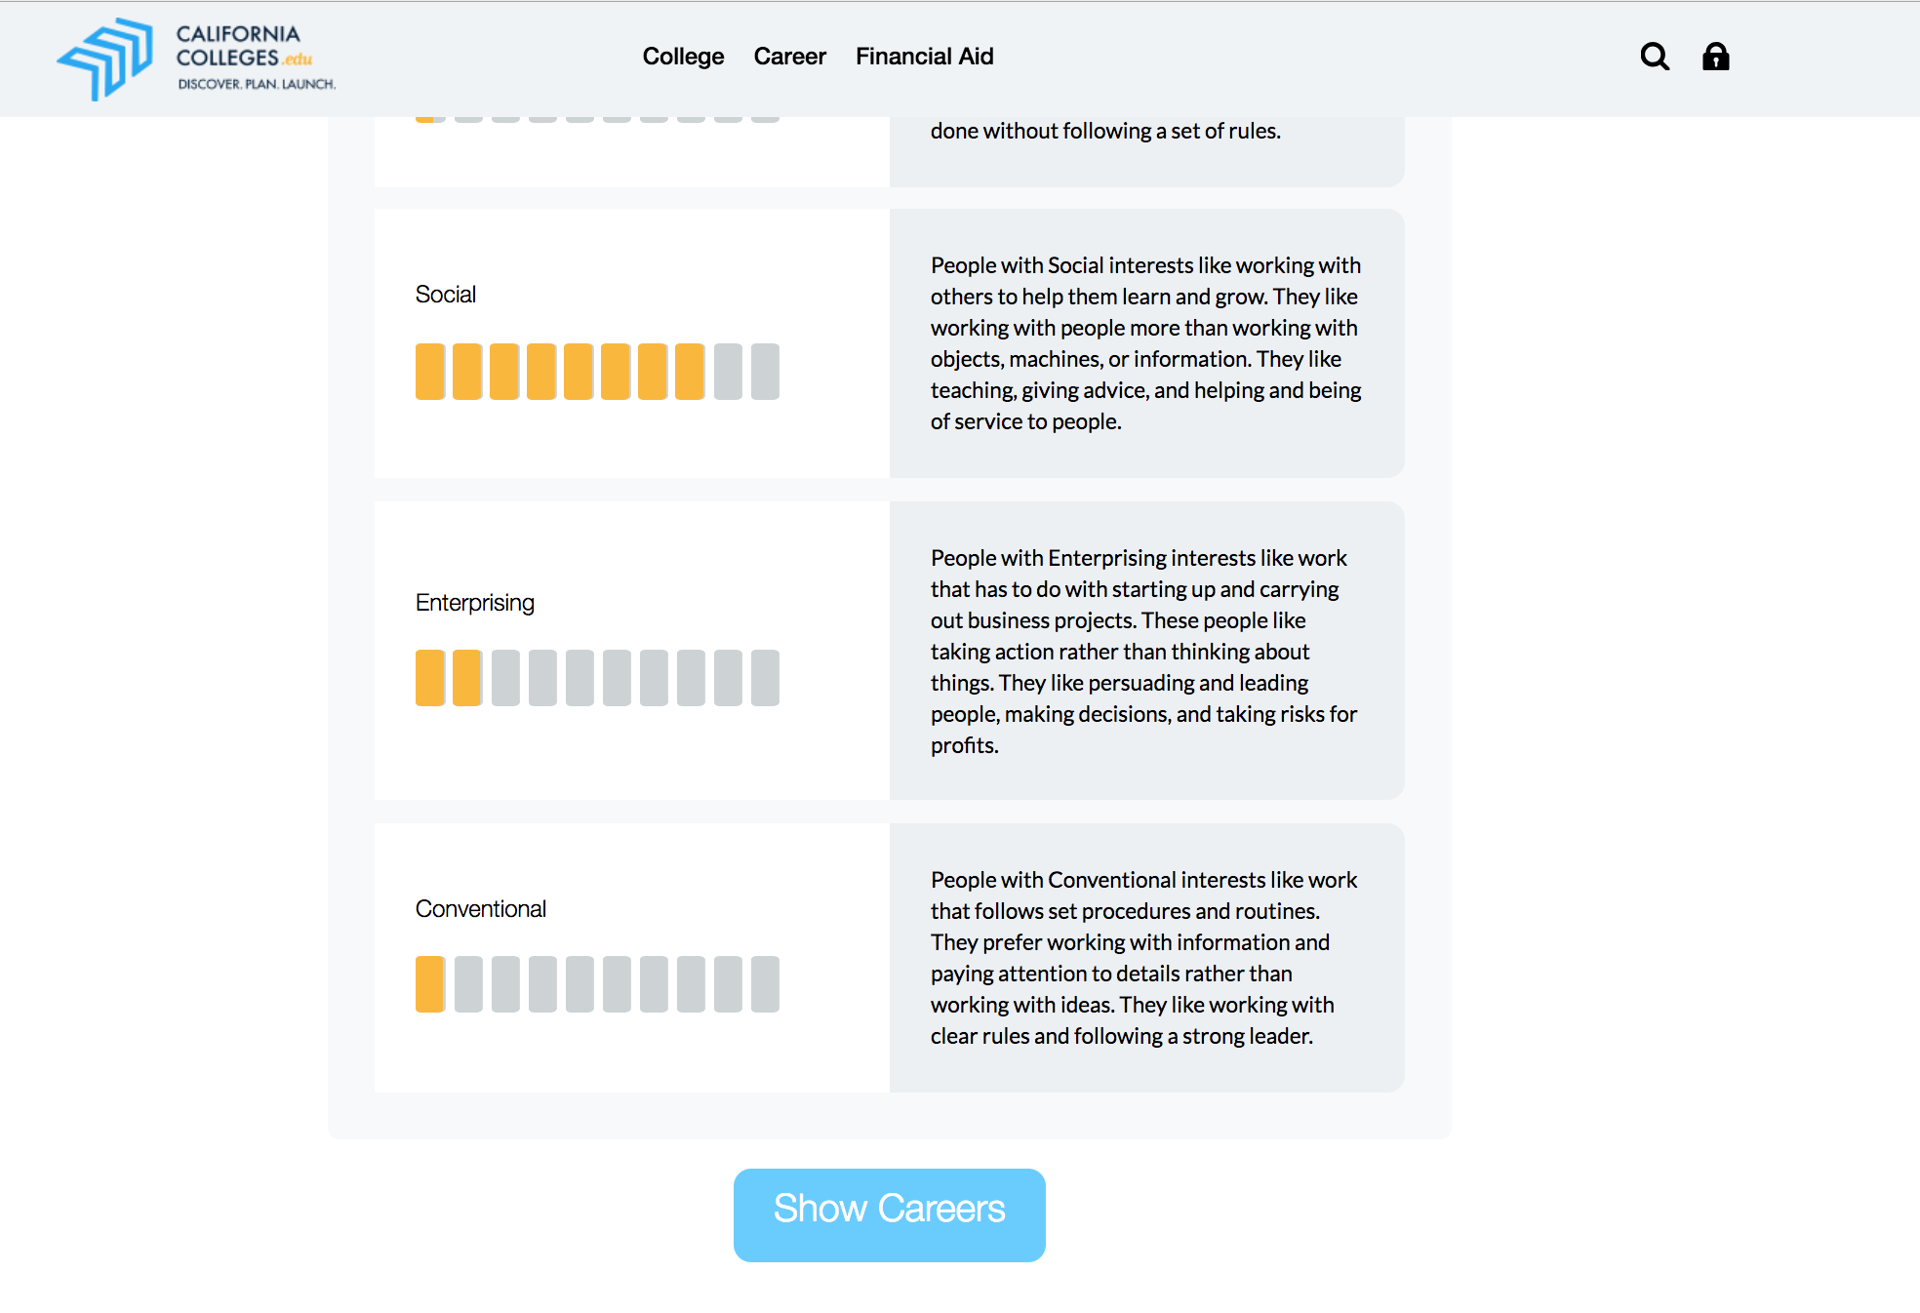
Reviewing Your Interest
Review a profile of your interests based on your responses
Review Interests and click “Show Careers”

Slide 16
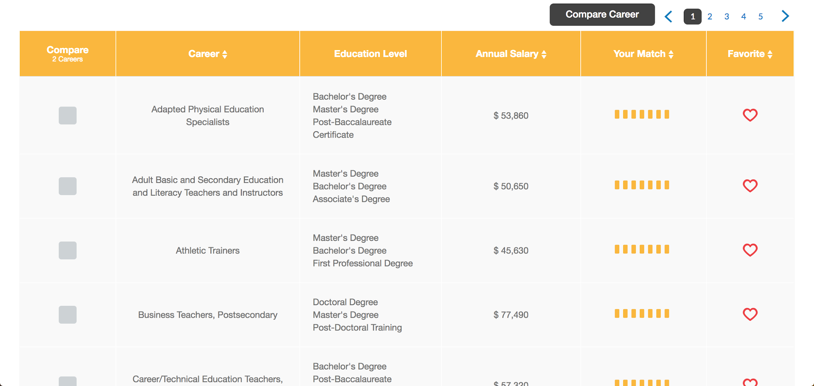

Compare Careers
Compare Careers, Education level, and annual salary
Explore occupations based on your interests.
“Favorite” your top choices

Slide 17
THE BIG GAME
How do I get in the game…?
Notes:
Click link on options to open california career zone. Have students explore industry sectors more and see what jobs are on the rise in California.

Slide 18
Get involved!
Academic Tidbits
Create Community
Emotional Support/Self Care
Check missing assignments
Set achievable goals
Prioritize/Use a planner
Attend academic support/tutoring
Join a school club/extracurricular activity
Foster relationships with peers in your classes
Volunteer
Communicate with your teacher and/or counselor
Eat healthy/HYDRATE
Exercise
Do what brings you JOY
Notes:
Discuss the Sophomore Slump

Slide 19
Growth Mindset!
Fixed Mindset
Growth Mindset
The belief that you have a certain amount of intelligence, a certain personality, and a certain moral character that cannot be fundamentally changed.
The belief that you can learn, change and become better at things with effort, strategies and help.
You can achieve more than you think you can!
What can I say Different to change my Mindset?
~What am I missing?
~I’ll use new strategies.
~This may take extra effort.
~There’s always room for improvement.
~I’m not good at this.
~I give up.
~This is too hard.
~I can’t make this better.

Slide 20

Mental Health Resources
SVUSD Mental Health Resources
  Multiple resources (LGBTQ, Grief Counseling, Counseling Centers etc.)
988 Suicide Crisis Hotline
  Dial 988 or Call 800-273-TALK
Crisis Text Line
  Text “Hello” to 741-741
Mental Wellness Counseling
  Ask your student’s counselor to refer to the District
HAZEL Health
  Parent referral or counselor referral
USC Telehealth
Western Youth Services One Door
ETHS Virtual Relaxation Room

Slide 21
College and career resources
California Colleges
California Career Zone
Scholarships
SVUSD High School Planning Guide
https://fairtest.org/
SAT vs ACT
FAFSA or Dream Act
College Savings Calculator
Niche.com
College Search
Career Activity Ideas
Wheel of Careers

Slide 22
UPCOMING CAREER VISITS
Sign up with Miss Felix in FlexTime today!
MEDICAL DEVICE & DRUG TESTING SALES
CYBERSECURITY / REAL ESTATE
April 16
February 26
TECH / MARKETING
ER NURSE /
BANK EXECUTIVE
March 12
April 23

Slide 23

THANKS!
GO CHARGERS!
https://tinyurl.com/sophpost2026

Slide 24
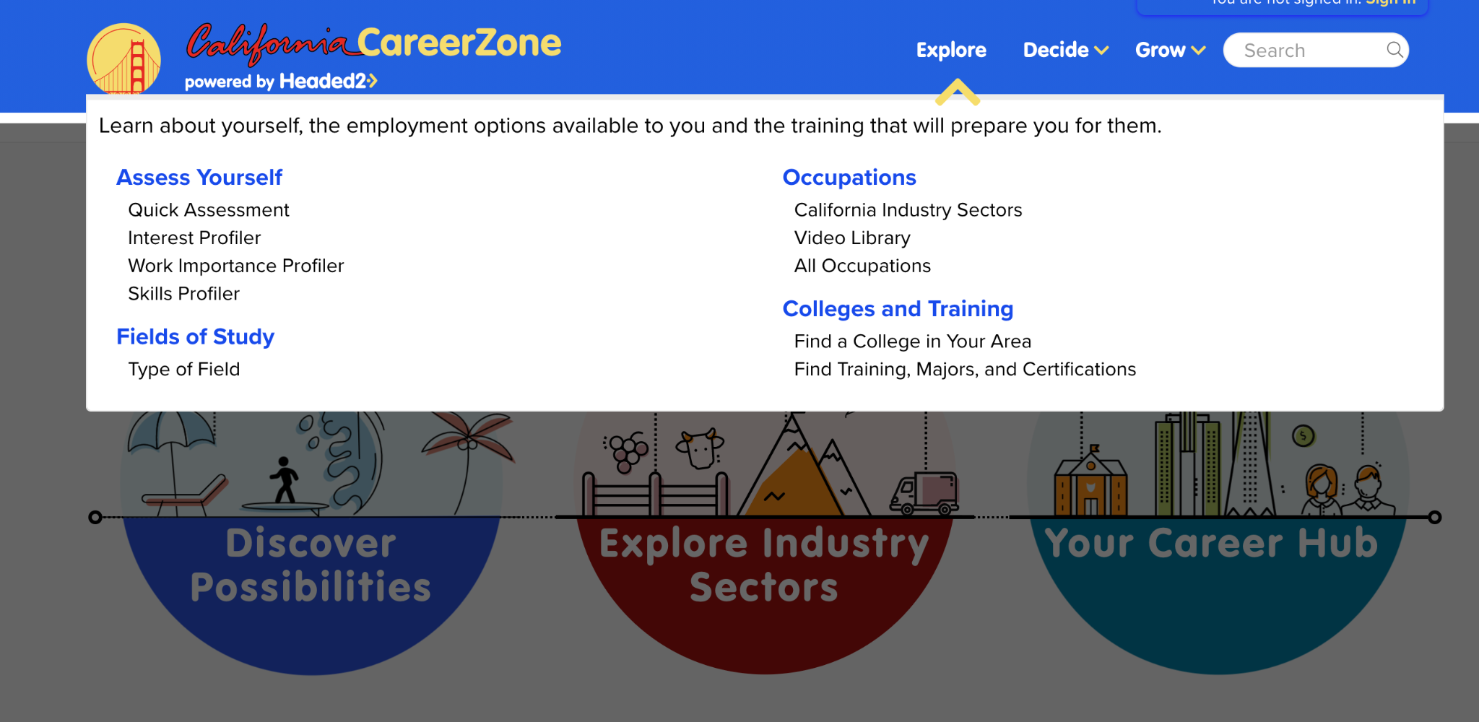
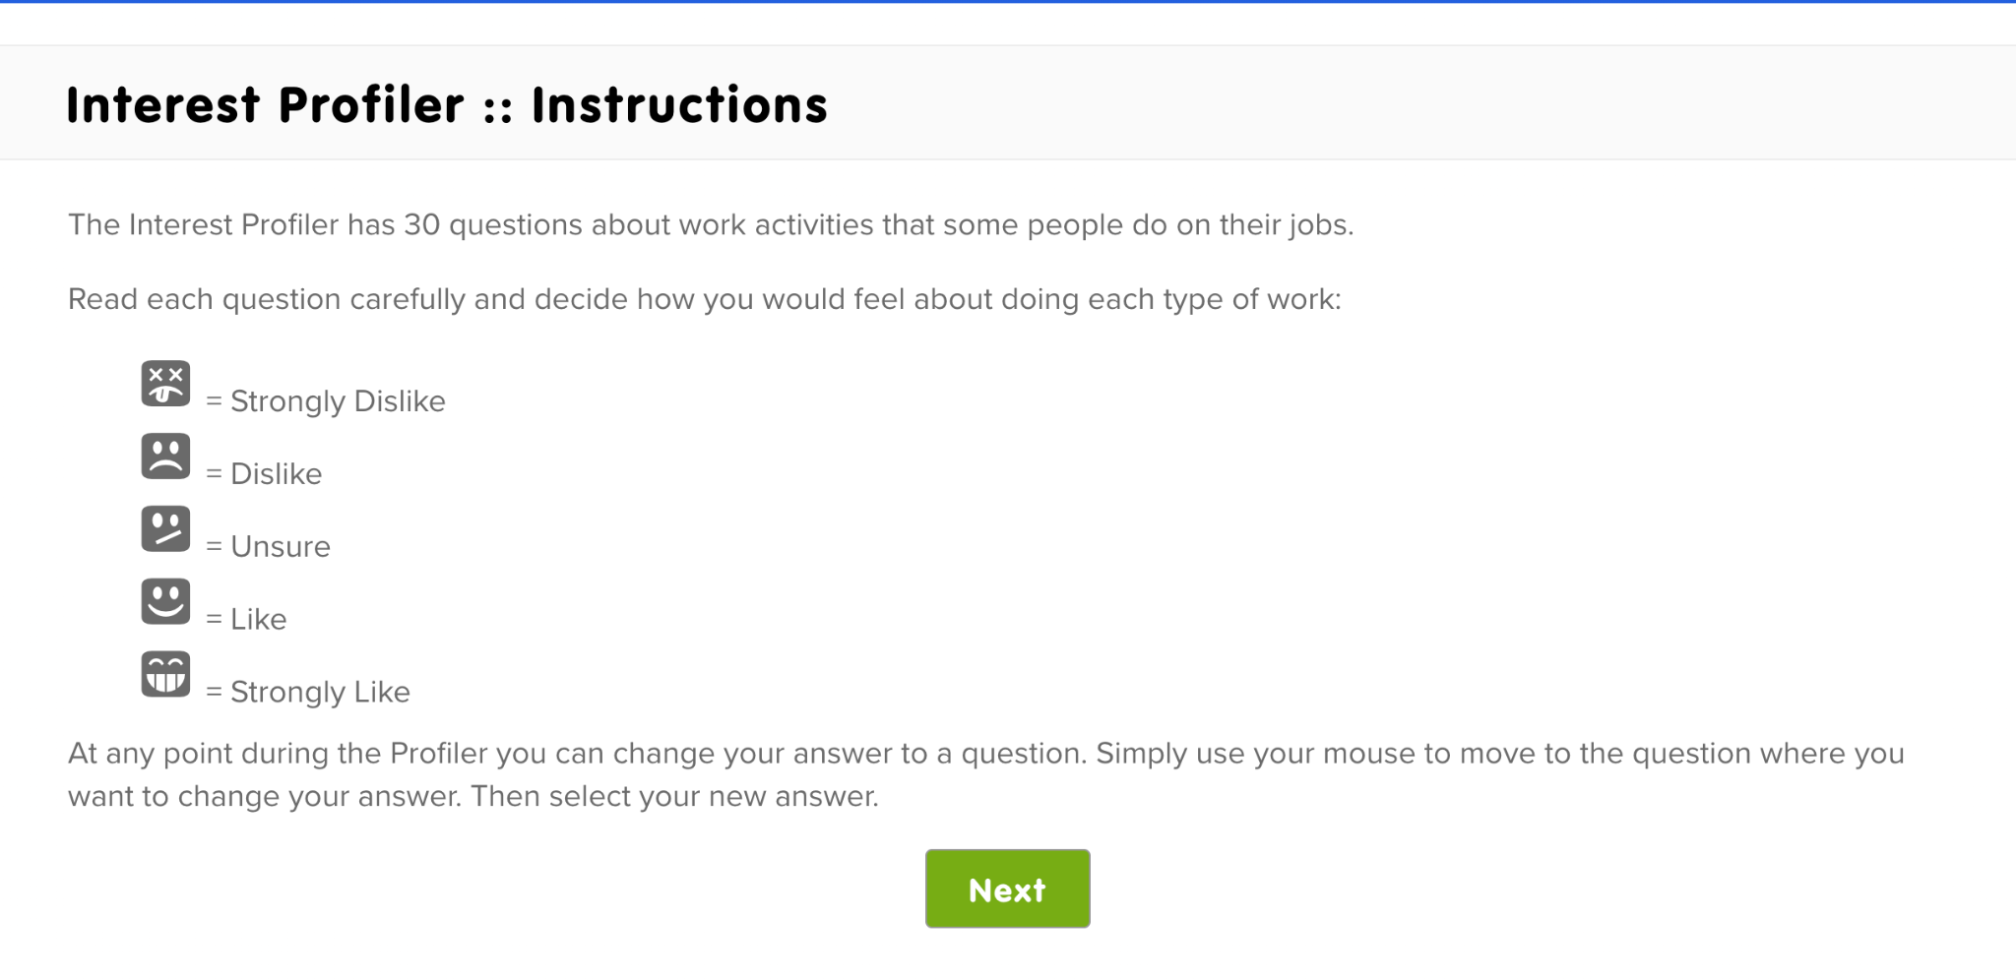
CA Career Zone
Find careers that match your interests
Learn about salary information
Education requirements
Job Duties
Essential skills to acquire
Self Reflection
Lifestyle you want
Commitment to schooling
Understanding Requirements

Slide 25
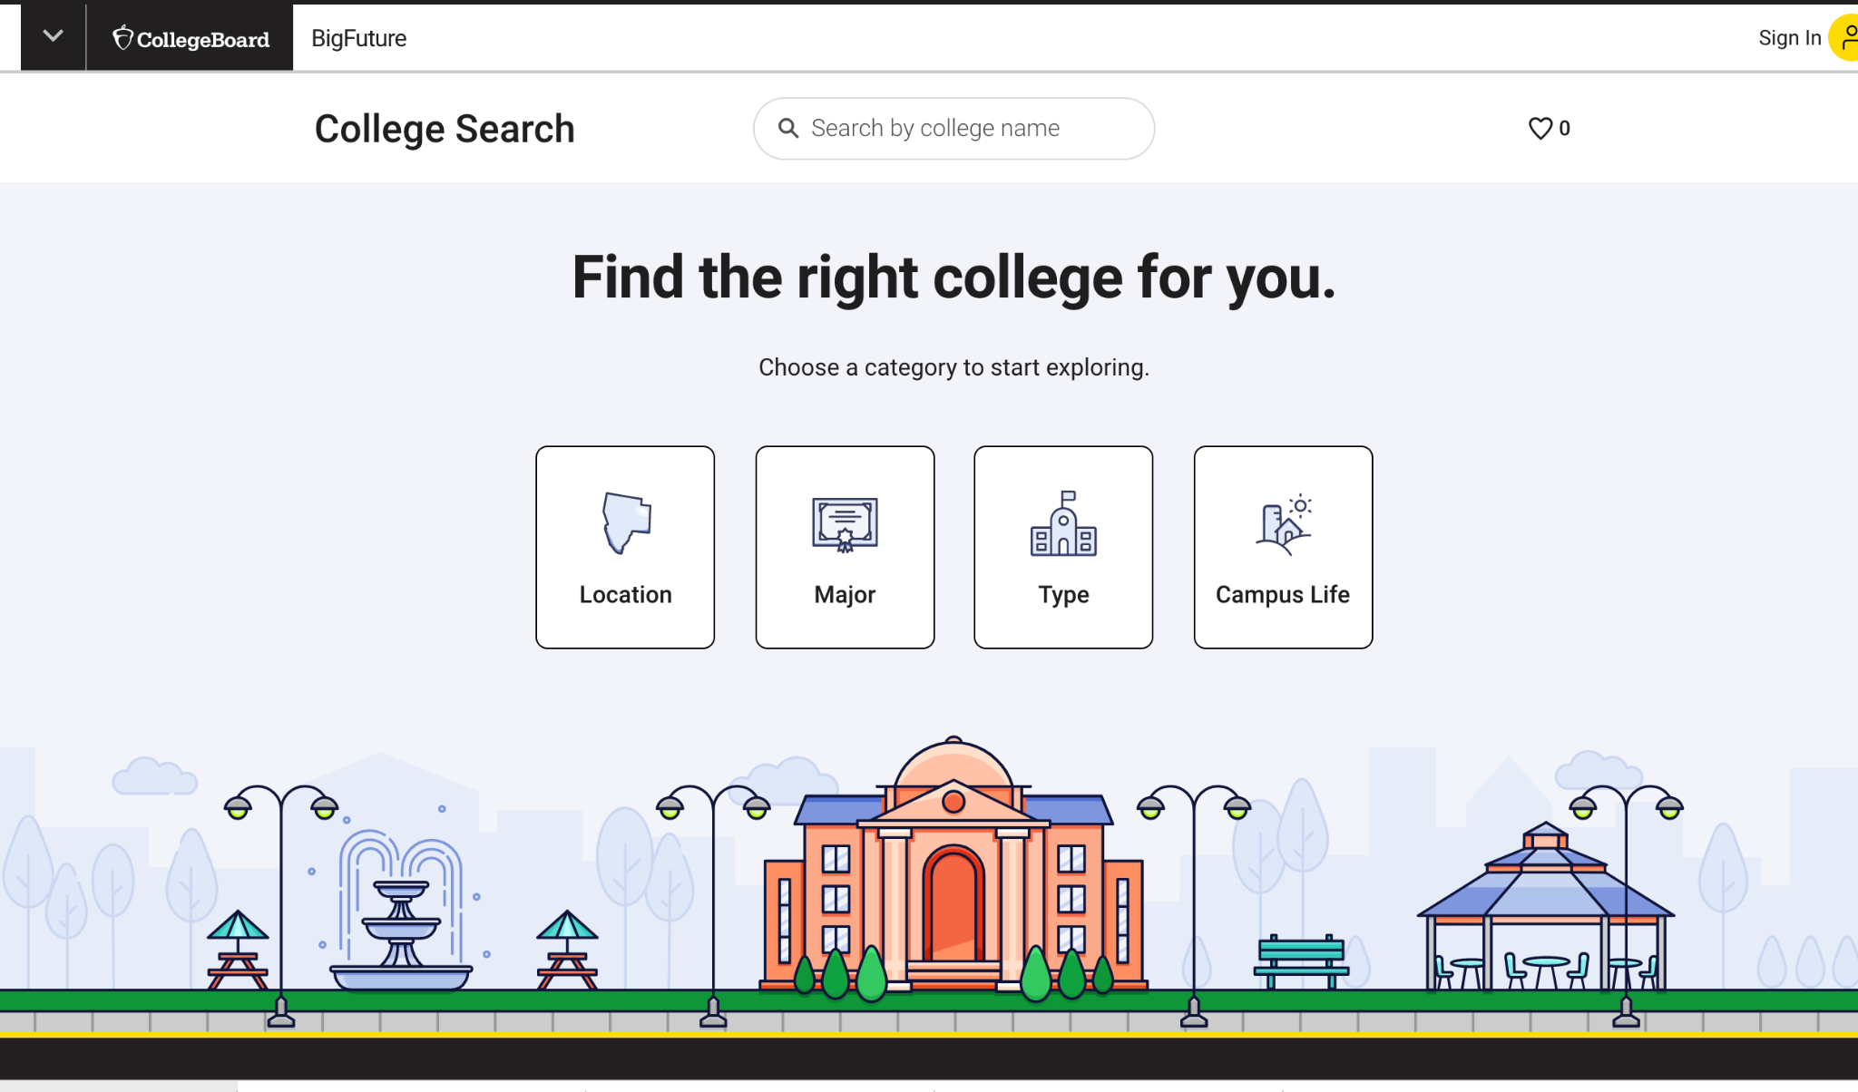
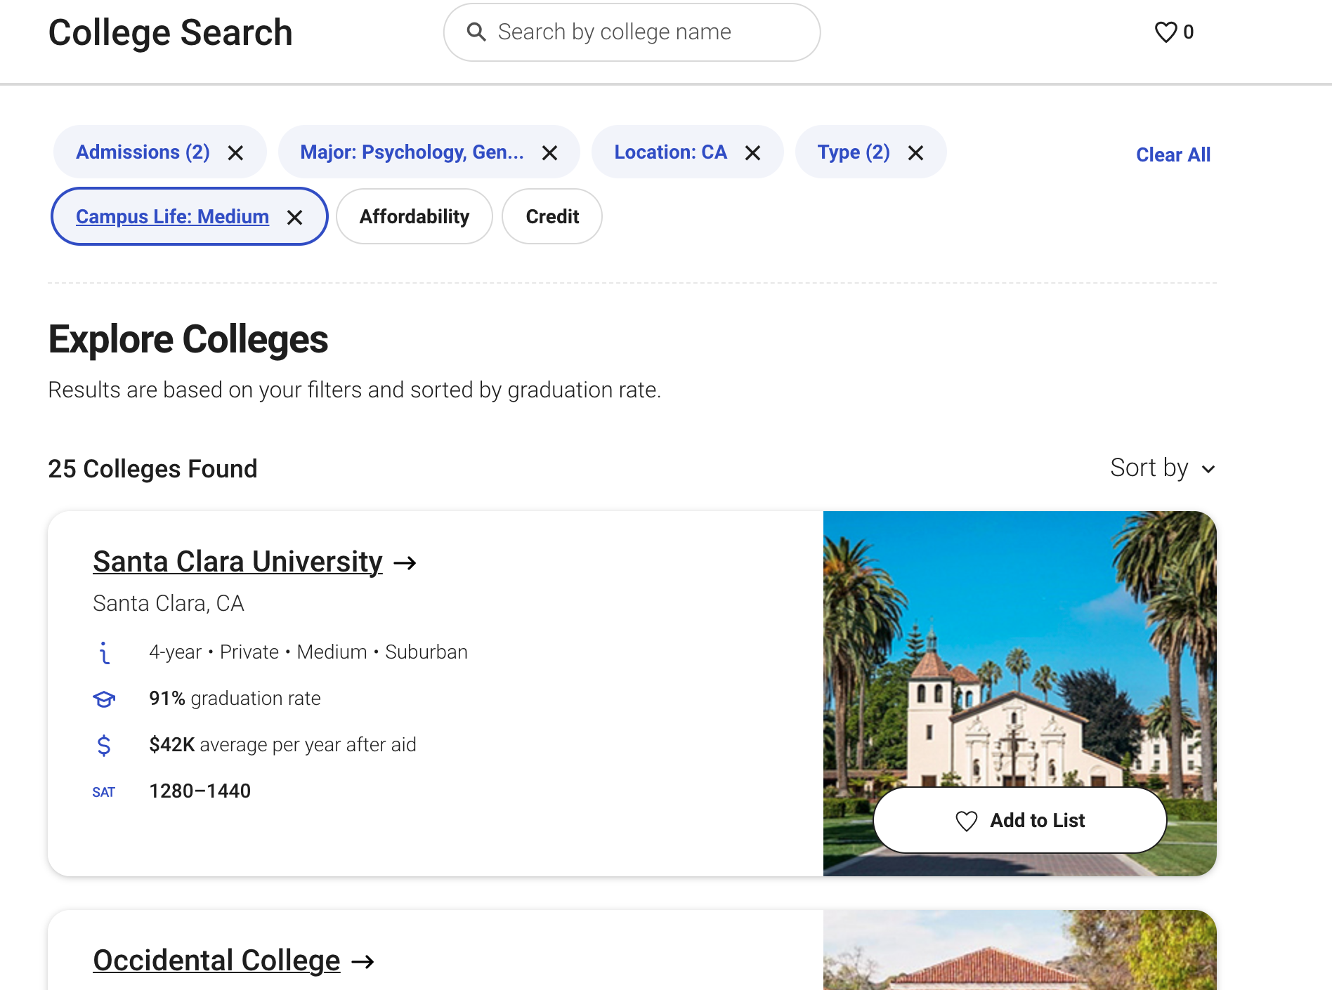
College Search
Selection Based on
Location: California
Major: Psychology
Admissions: 25%-50% Acceptance Rate, 50%-90% Acceptance
Public and Private

Slide 26

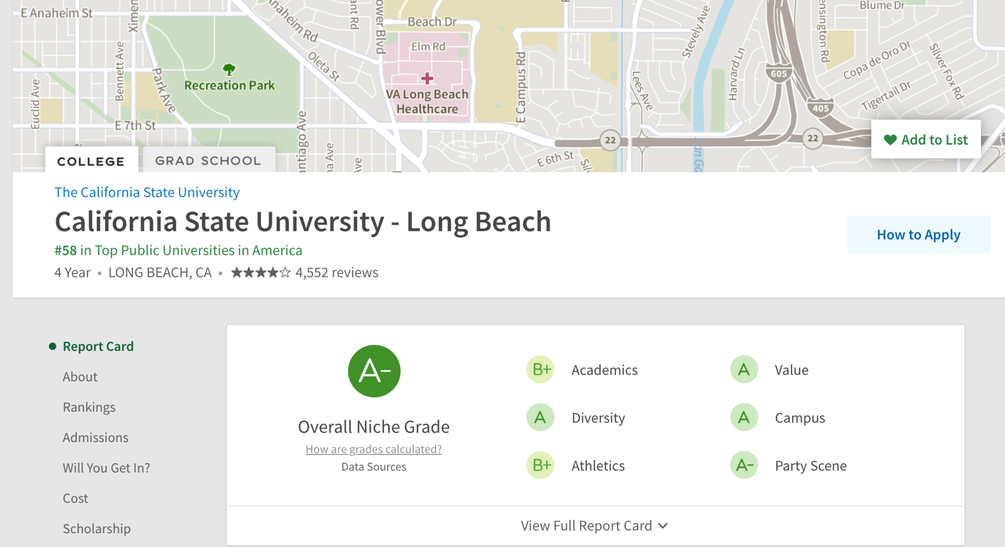
Niche-Choosing a College
Yelp for colleges
Learn about
  Academics
  Diversity
  Athletics
  Values
  Campus
  School Life
From current students and alumni
Compare and contrast different colleges
Help with deciding on a school to attend
After college information
  Median earnings
  Graduation Rate
  Employment information

Slide 27
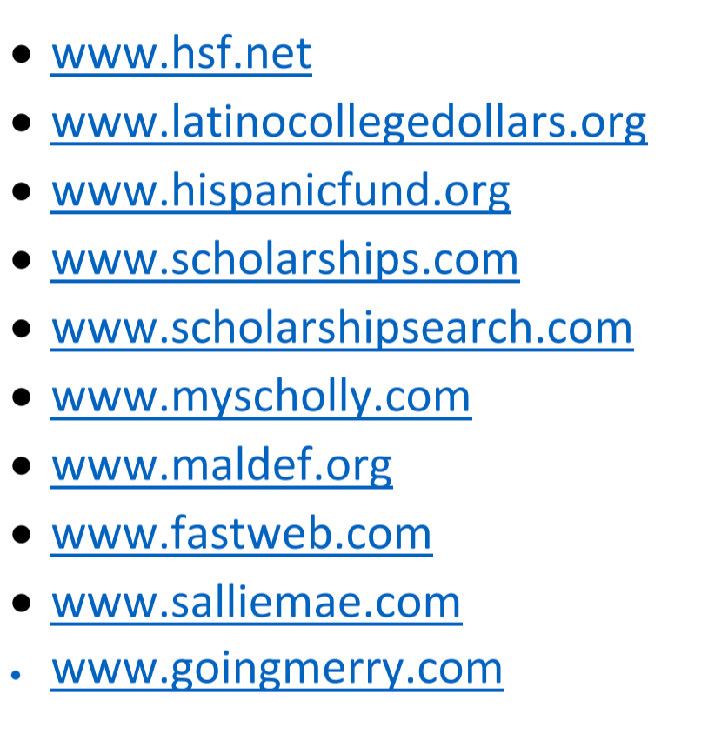
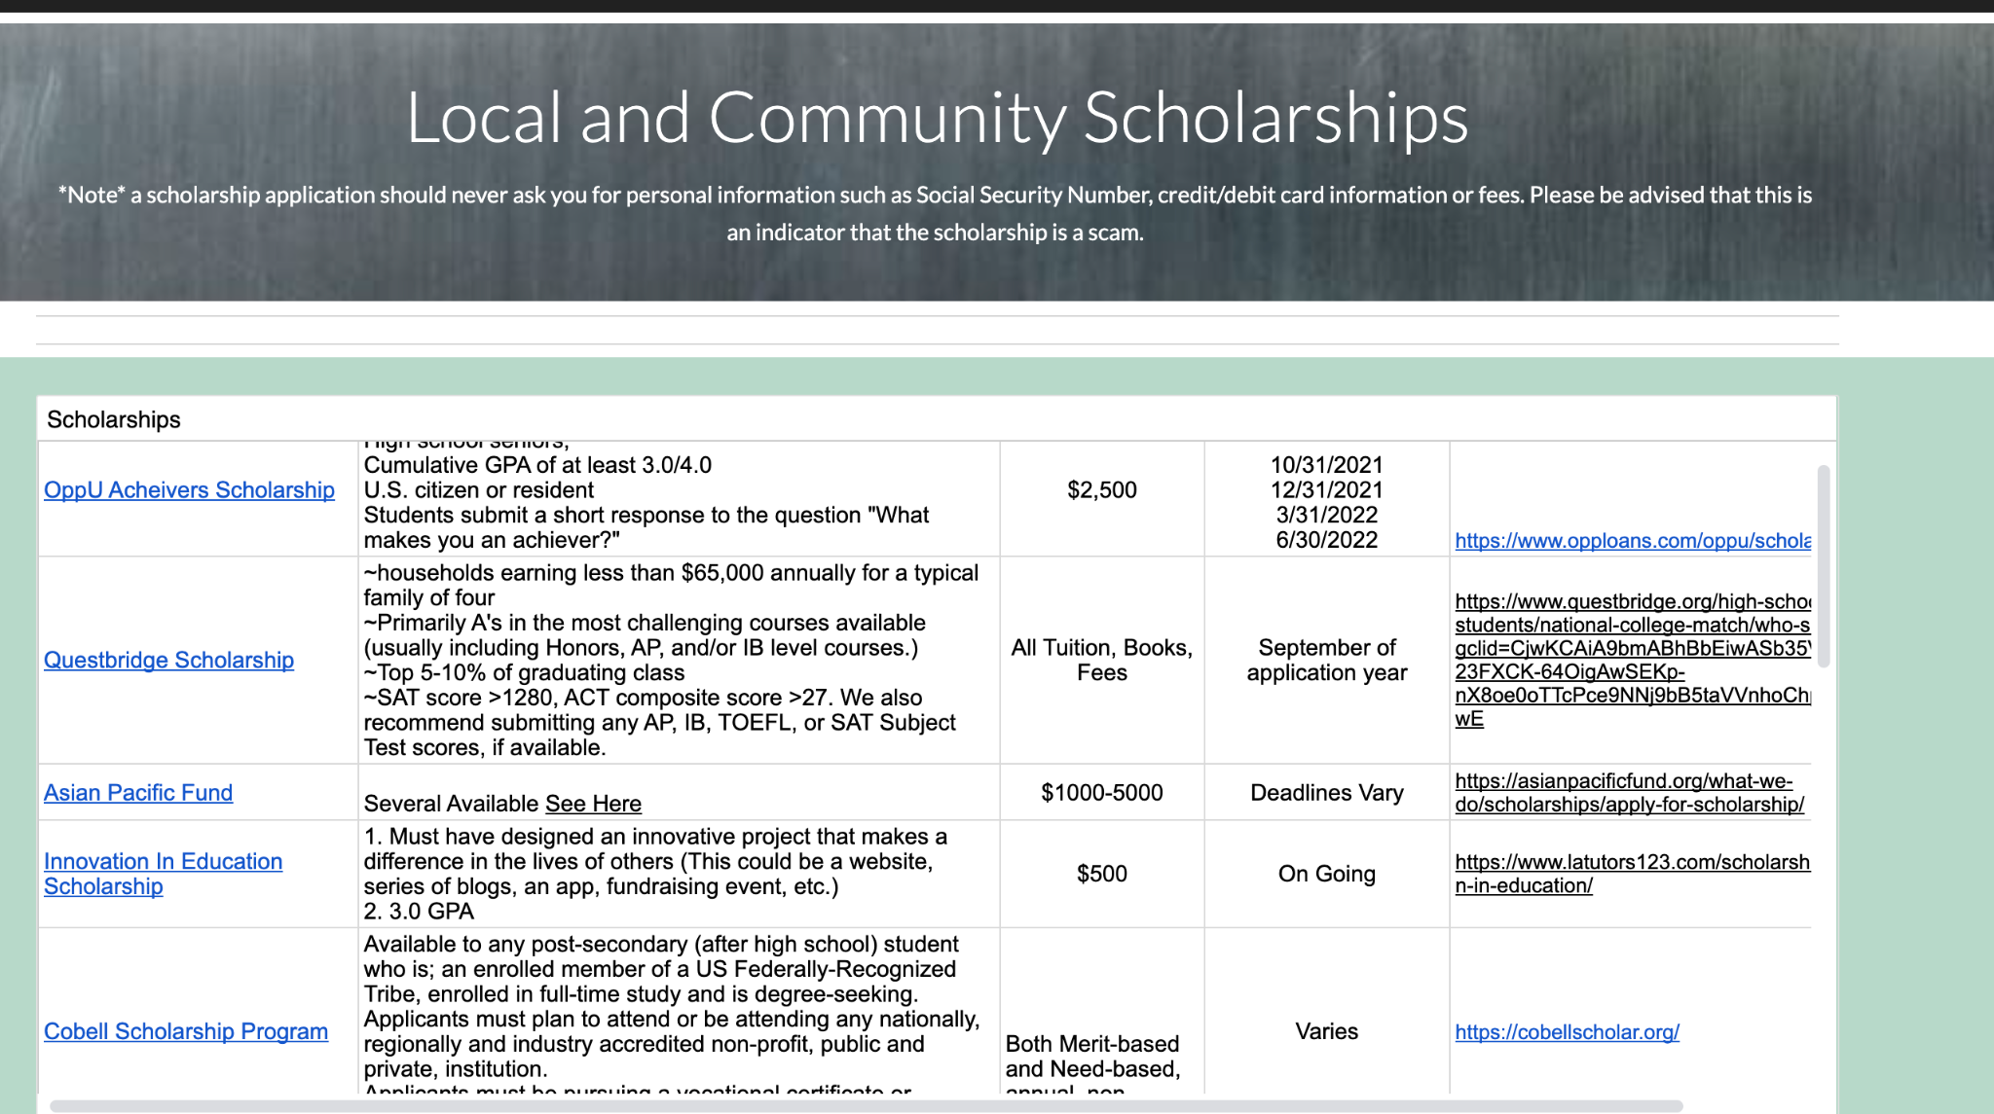
Scholarships
Apply for FAFSA or CA Dream Act
  Grants
  Scholarships
  Loans
CSS Profile for participating schools
  Institutional Funding
Apply for school specific scholarships
  UCLA Alumni
  Baylor Getterman Scholars Program
  USC Town and Gown

Slide 28
BROWNS
JAGUARS
SOME FOOTBALL TEAMS
LIONS
TEXAS
Mars is actually a very cold place
Venus has a beautiful name
Saturn is the only planet with rings
The Earth is the planet we live on

Slide 29

What Are Your Interests?

Slide 30

CaliforniaColleges.edu
Career Interest Profiler
See How Your Interests
Match Careers
Answer each question without over-analyzing
Try not to select “unsure” too often
You may have interests in each area:
  Realistic
  Investigative
  Artistic
  Social
  Enterprising
  Conventional

Slide 31
LET’S USE SOME PERCENTAGES
35%
80%
FANS
PLAYERS
Mercury is the closest planet to the Sun and the smallest of them all
Venus has a beautiful name and is the second planet from the Sun

Slide 32

DESKTOP SOFTWARE
You can replace the image on the screen with your own work. Just right-click on it and select “Replace image”

Slide 33

TABLET APP
You can replace the image on the screen with your own work. Just right-click on it and select “Replace image”

Slide 34

MOBILE WEB
You can replace the image on the screen with your own work. Just right-click on it and select “Replace image”

Slide 35



OUR TEAM
ASHLEY HILTON
TOM ANDERSON
PETER SMITH
Here you can talk a bit about this person
Here you can talk a bit about this person
Here you can talk a bit about this person

Slide 36
IMPORTANCE OF AF DAY
02
You can enter a subtitle here if you need it

Slide 37
WHY WE LOVE FOOTBALL?
PEOPLE TOGETHER
Saturn is the ringed planet and a gas giant
TRUE TEAMWORK
It’s the biggest planet in the Solar System

Slide 38
THIS IS A MAP
WASHINGTON
It has a beautiful name, but it’s hot
COLORADO
Mercury is the closest planet to the sun
ARKANSAS
Despite being red, Mars is a very cold place

Slide 39
UNIFORM PARTS
HELMET
SHOULDER
Venus has a beautiful name, but it’s hot
Despite being red, Mars is actually cold
JERSEY
THIGH PADS
Mercury is the closest planet to the Sun
Saturn is the ringed one and a gas giant

Slide 40
AF DAY DATES
YEAR | DATE | DAY
2021 | November 5 | Friday
2022 | November 5 | Saturday
2023 | November 5 | Sunday
2024 | November 5 | Tuesday
2025 | November 5 | Wednesday

Slide 41
ACTIVITIES FOR THE DAY
 | FRIDAY 5 | GROUP 1 | GROUP 2
11 AM | Football pool
12 PM | Watch the game
1 PM | Lunch celebration
2 PM | Call more friends!
3 PM | Party at home

Slide 42
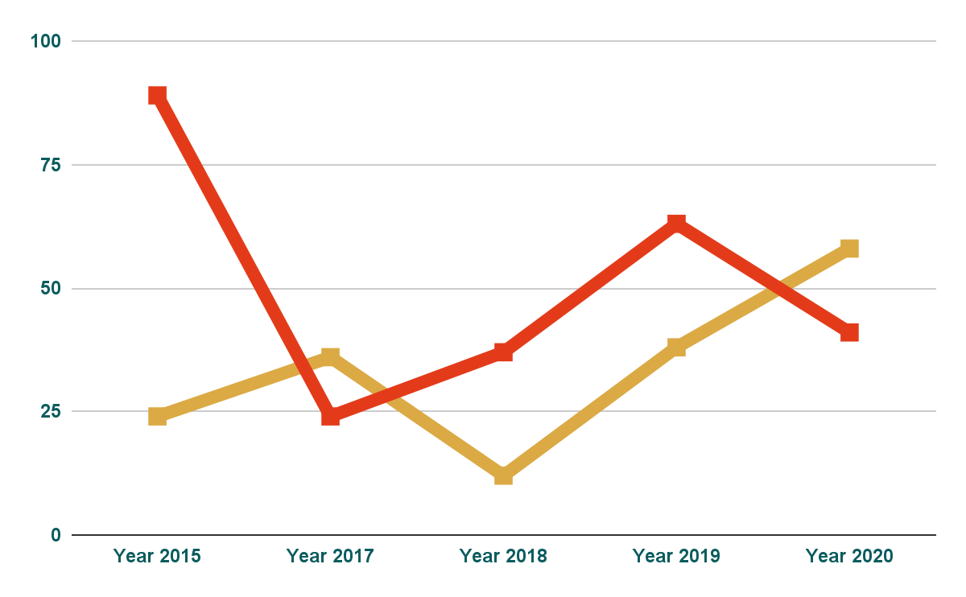
CHART DATA
PLAYS
Despite being red, Mars is cold
POINTS
Mercury is the closest planet to the Sun
Follow the link in the graph to modify its data and then paste the new one here. For more info, click here

Slide 43
COMPETITIONS
GROUP A
GROUP B
Taylor Smith
Peter Johnson
Robert Williams
John Brown
Carlos Jones
Julian Miller
Wilson Hilton
Bradley Lopez
Tom Anderson
Harry Walker
Rick Adams
Scott Mitchell
Bryan Miller
Sam Bailey
Richard Hall
Logan Moore

Slide 44
PLAN A STRATEGY
CORNERBACK
TACKLE
Despite being red, Mars is a cold place, not hot. Mercury is the closest planet to the Sun
SAFETY

Slide 45
PLAYOFFS 21’
TEAM 6
TEAM 5
TEAM 6
TEAM 6
TEAM 3
TEAM 1
TEAM 4
TEAM 1
TEAM 1
TEAM 5
TEAM 1
TEAM 2
TEAM 6
TEAM 5
TEAM 4
TEAM 4
TEAM 5
TEAM 3
TEAM 2
TEAM 2

Slide 46
VS.
TEAM 1
TEAM 2
Despite being red, Mars is cold
Venus has a beautiful name, but it’s hot

Slide 47
THANKS!
Does anyone have any questions?
addyouremail@freepik.com
+91 620 421 838
yourcompany.com
Please keep this slide for attribution

Slide 48
Fonts & colors used
This presentation has been made using the following fonts:
Alfa Slab One
(https://fonts.google.com/specimen/Alfa+Slab+One)
Montserrat Medium
(https://fonts.google.com/specimen/Montserrat)
#fffae1
#ffd34e
#dbaa44
#e33b1a
#0b5c5e

Slide 49
CONTENTS OF THIS TEMPLATE
Here’s what you’ll find in this Slidesgo template:
A slide structure based on a multi-purpose presentation, which you can easily adapt to your needs. For more info on how to edit the template, please visit Slidesgo School or read our FAQs.
An assortment of graphic resources that are suitable for use in the presentation can be found in the alternative resources slide.
A thanks slide, which you must keep so that proper credits for our design are given.
A resources slide, where you’ll find links to all the elements used in the template.
Instructions for use.
Final slides with:
The fonts and colors used in the template.
A selection of illustrations. You can also customize and animate them as you wish with the online editor. Visit Storyset to find more.
More infographic resources, whose size and color can be edited.
Sets of customizable icons of the following themes: general, business, avatar, creative process, education, help & support, medical, nature, performing arts, SEO & marketing, and teamwork.
You can delete this slide when you’re done editing the presentation.

