Slide 1
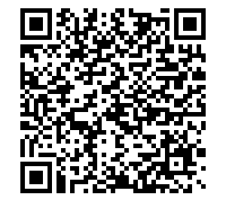
Welcome to Sophomore Family Night
We are so happy you could join us!
Please scan the QR code to sign in.
If you prefer to sign in on paper, please come to the front of the room to sign in.
¡Nos alegra mucho que haya podido unirse a nosotros!
Escanee el QR a continuación para registrarse.
Si prefiere registrarse en papel, acérquese al frente del salón.
Habrá interpretación en español disponible.

Slide 2
Welcome to
Sophomore Family Night!
Class of 2028
Presented by: ETHS Counselors

Slide 3

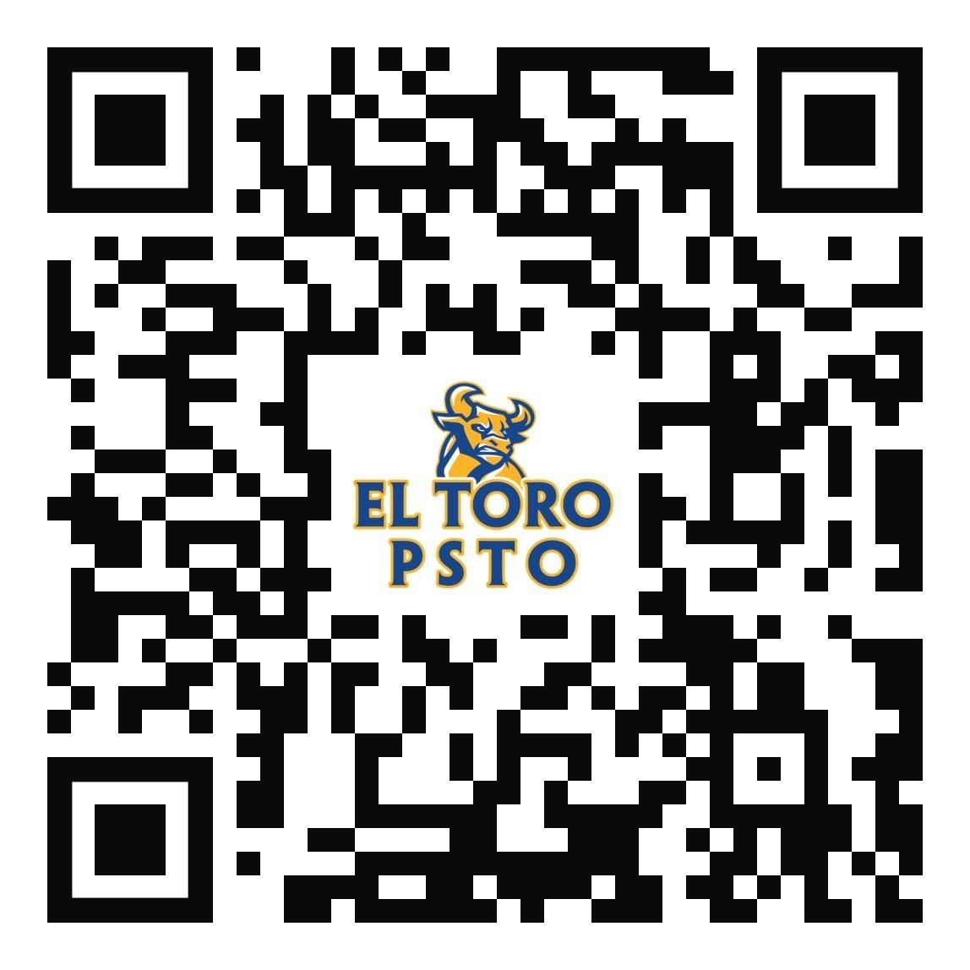
The PSTO is the ONLY parent run group on campus that supports EVERY student at
El Toro High School
Join the ETHS PSTO Today!

Slide 4
What does PSTO do?
Family Education Nights
Student Support
Education Boosters - classroom needs
Staff/Teacher Appreciation Luncheons
  3 Staff/Teacher Appreciation Luncheons
Parent & Student Volunteer Opportunities
  Teacher Appreciation in May - upcoming volunteer opportunity
  El Toro 5K/1k on July 4th - upcoming volunteer opportunity
Join the ETHS PSTO Today!
Notes:
Family Education Nights
Student support: Finals Treats, Bullring Welcome and Awards Celebrations
Classroom needs through Education Boosters
3 Staff/Teacher Appreciation Luncheons
Parent & Student Volunteer Opportunities
6 General Meetings

Slide 5
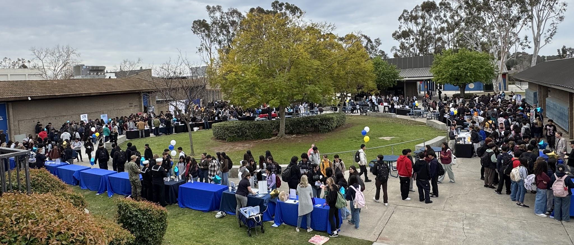
Student Support Programs
SVUSD College & Trade Fair
@ ETHS in Fall 2025
Career Expo - Feb 11, 2026
Finals Treats - throughout the year
Awards Celebrations
Senior Scholarships for Post-HS Plans
Grad Nite & Senior Breakfast & Prizes
Join the ETHS PSTO Today!

Slide 6


OCT Driving Academy Fundraiser
Use code “ETHS” and the PSTO will receive $50 when you sign up!

Slide 7
PSTO Family Education Night
Thurs 3/26 @ 6:30pm in Bailey Innovation Center PSTO General Meeting & elections followed by presentation by Dr. Ramirez,
District Coordinator, College & Career Readiness
(CTE and ROP opportunities)

Slide 8
Connect with PSTO
Join the PSTO Family Remind Group: Text “@pstofamily” to 81010
Follow us on Instagram and Facebook:
  @ETHSPSTO and @ElToroChargers5K
Visit us at www.ethsPSTO.org
Faith Lattomus - president@ETHSPSTO.org
Join the ETHS PSTO today!

Slide 9

Agenda
ET Counseling Staff and resources
Graduation vs. A-G requirements
Post High School Options
Sophomore Presentation Overview
Communications and Resources

Slide 10

MTSS - Positive Behavior Supports at ETHS
In August 2025, ETHS launched our Positive Behavior Supports. All students are aware of the classroom-based and school-wide behavior expectations. When they demonstrate actions that align with being Respectful, Responsible, and Kind, they will be rewarded with a point that is redeemable for items in our MTSS prize store. When they demonstrate actions that do not align with our expectations, there will be consequences and parents/guardians will be notified.
Notes:
Prizes include priority seating at Pep Rallies, special shout outs, skip the lines for snack, lunch, dances and sporting event tickets. PBIS creates a safe, effective, and positive learning environment

Slide 11
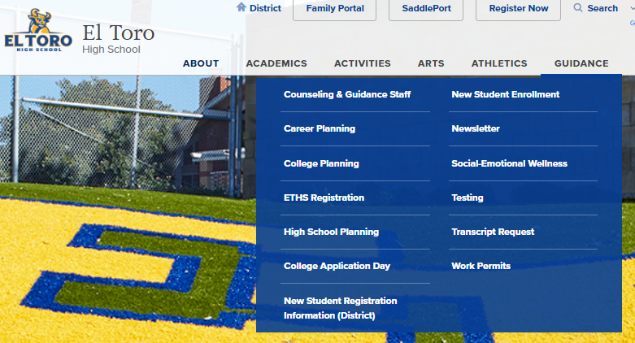
Counseling Information
Encourage your student to visit us in the Counseling Hallway before school, during Snack or Lunch, or after school
Visit our Counseling Website
Follow us on Instagram
@eths_counselors
Resources Google Folder
(end of presentation)

Slide 12
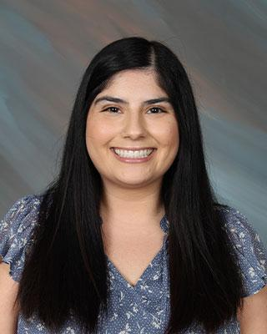
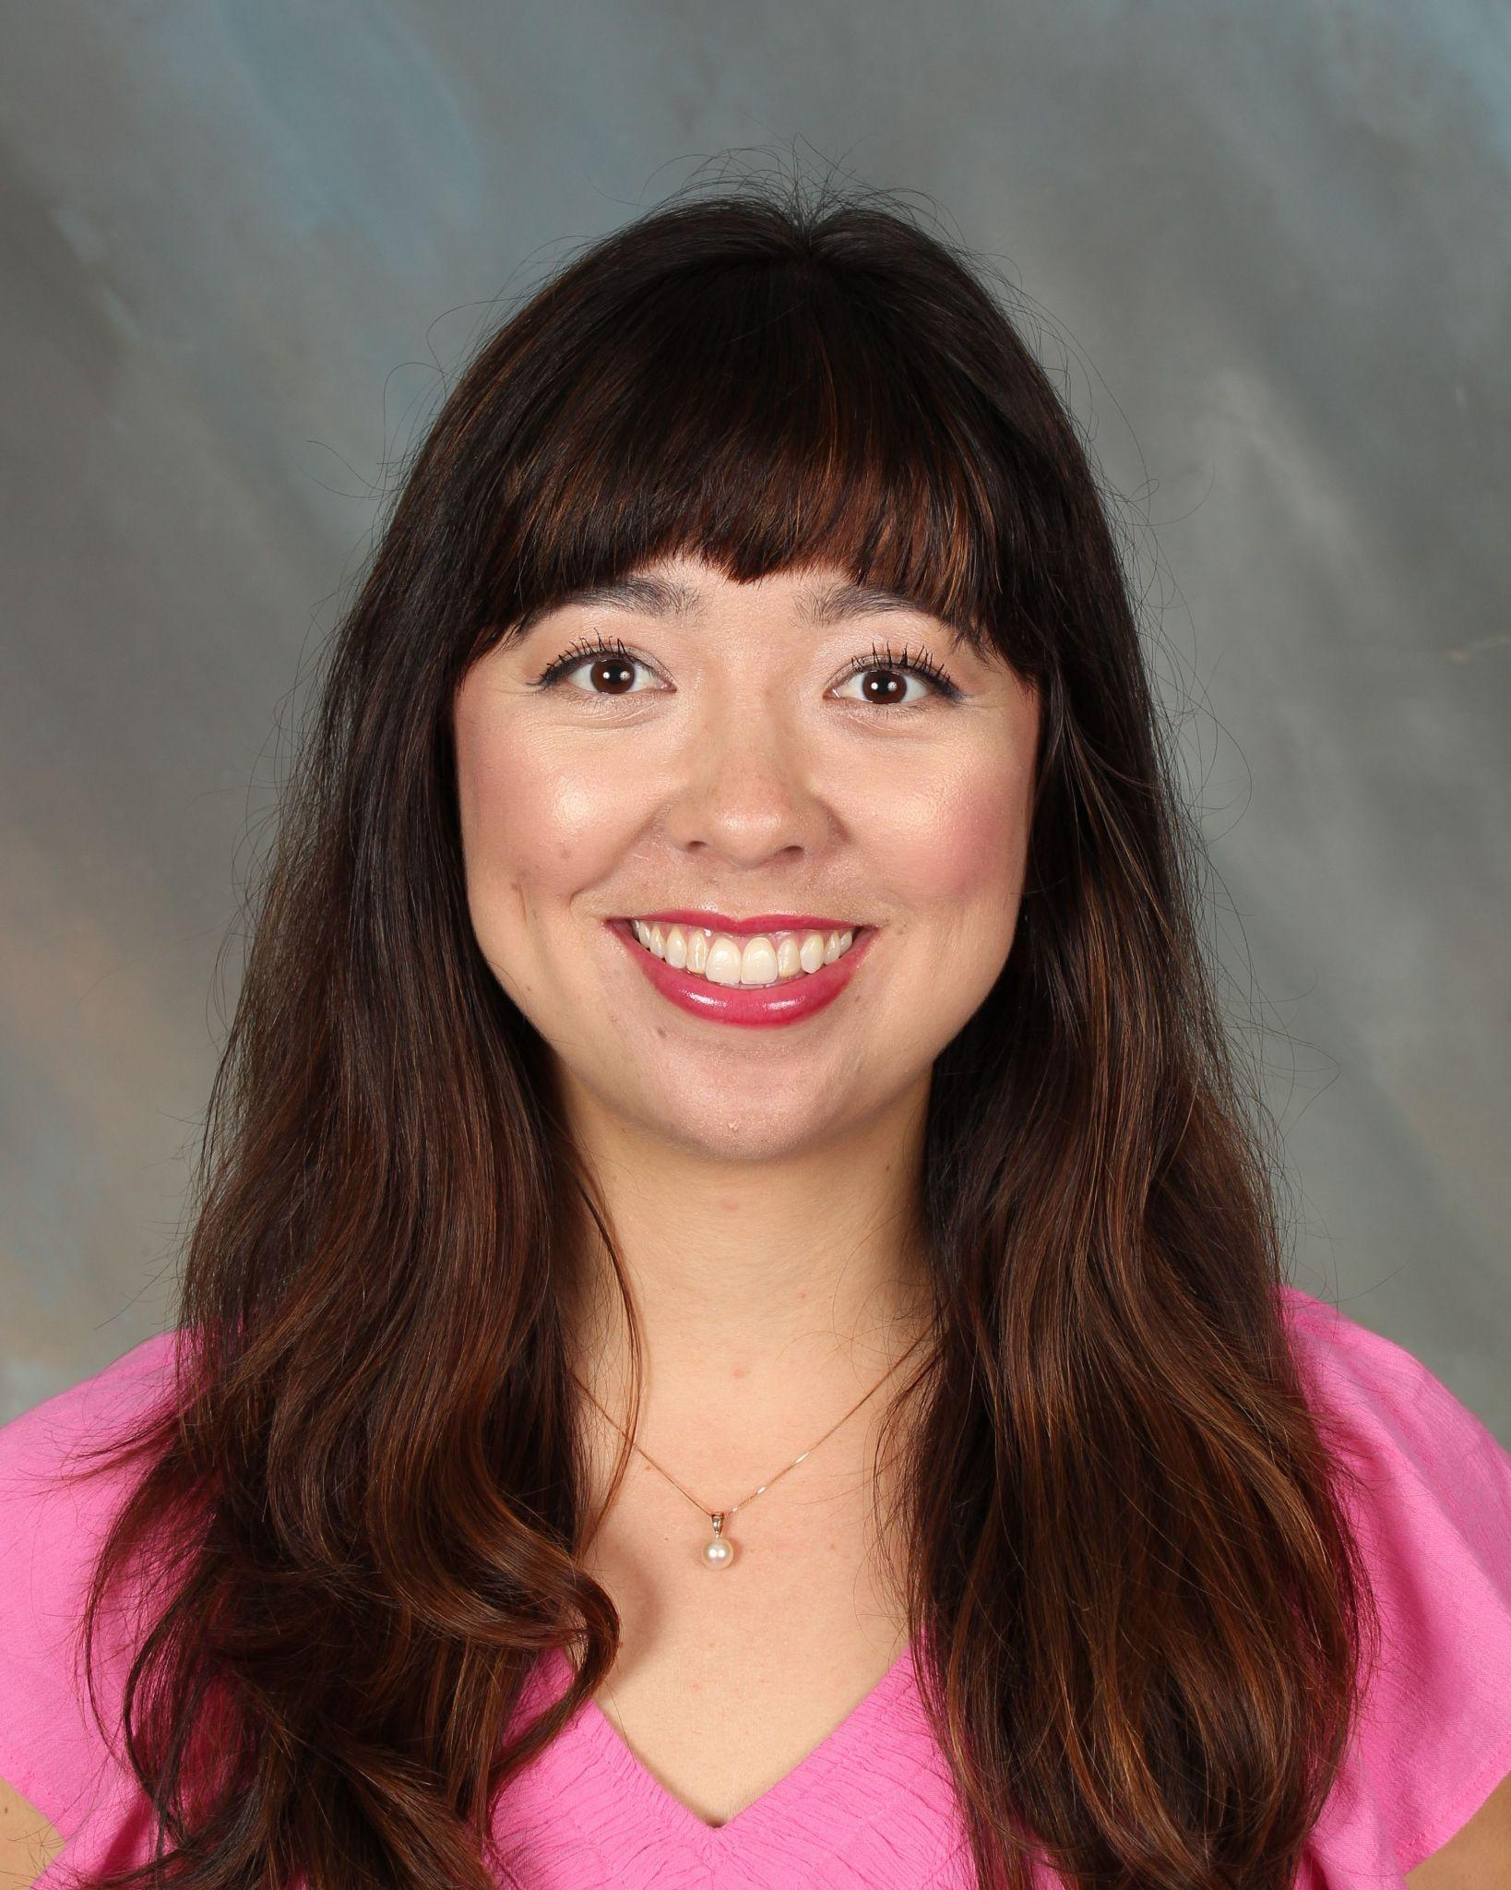

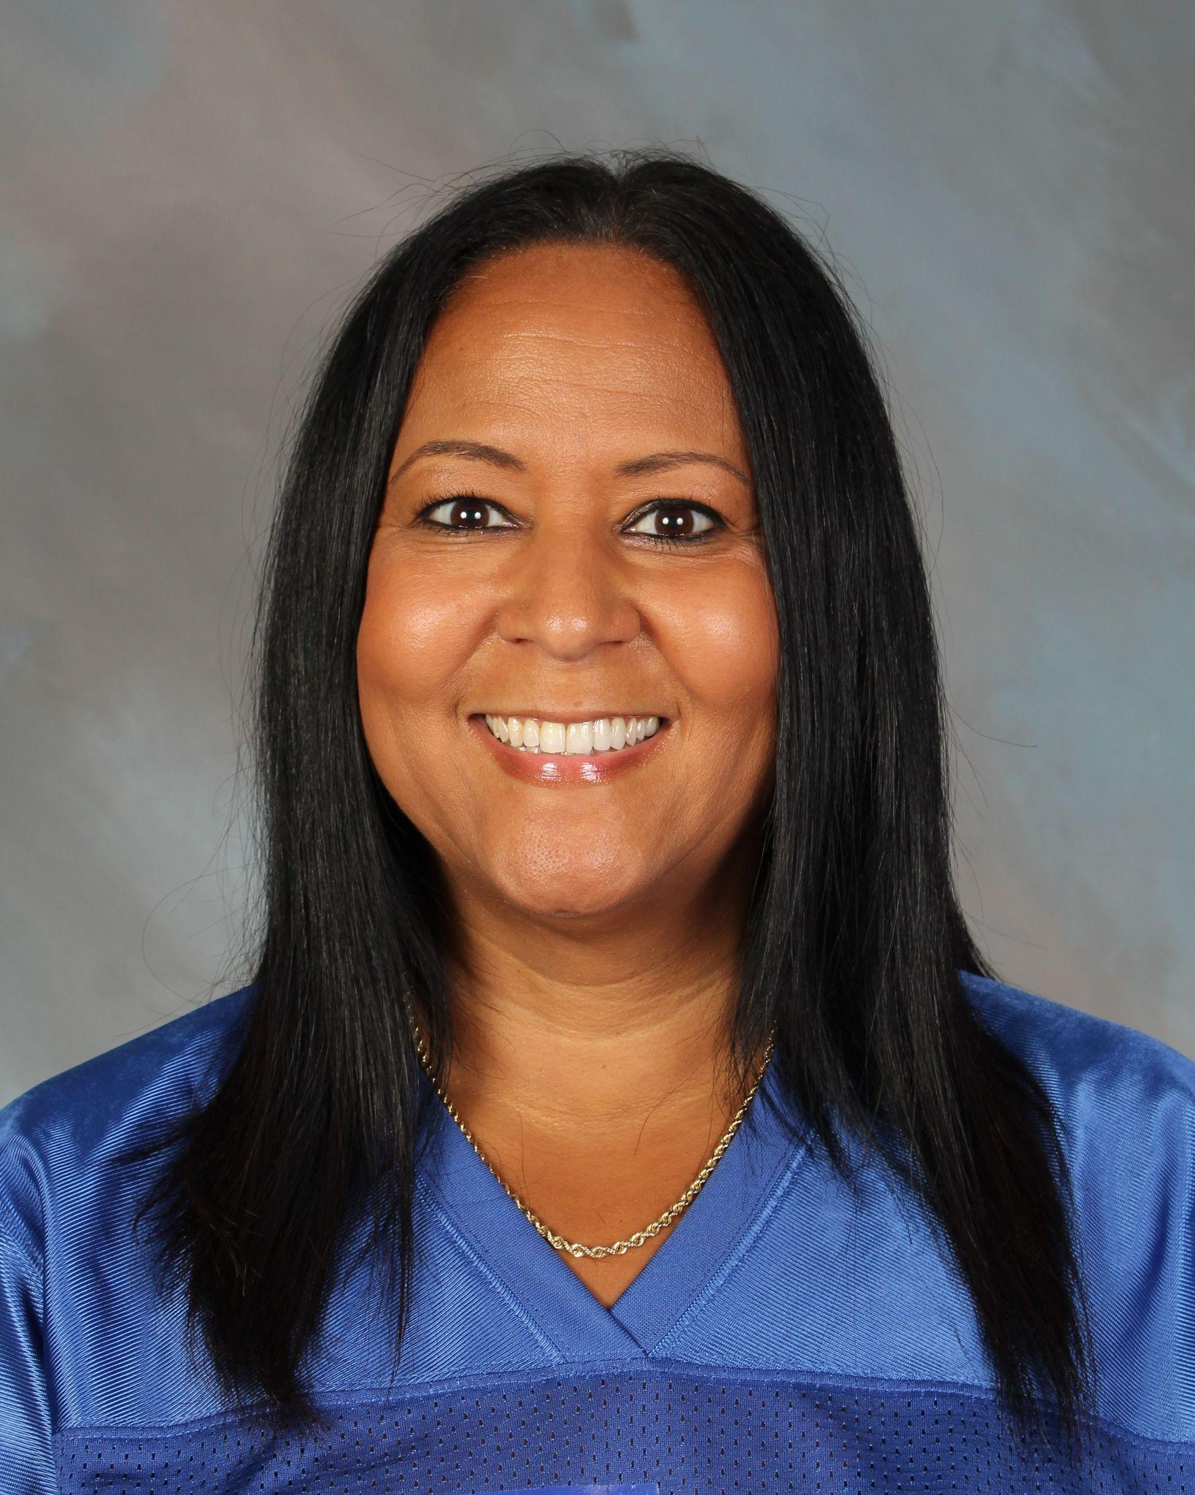
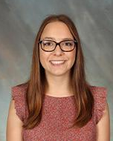
ETHS School Counselors
Audrie
Felix
Kami Kurisu
Carlyn
Baker
Dionne Coleman
Dasha Myers
(formerly Ms. O’Neil)
A-Cro
Cru-Hern
Herr-Mom
Mon-R
S-Z

Slide 13
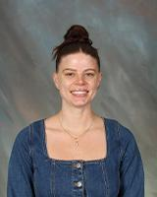
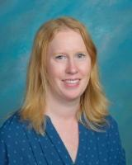
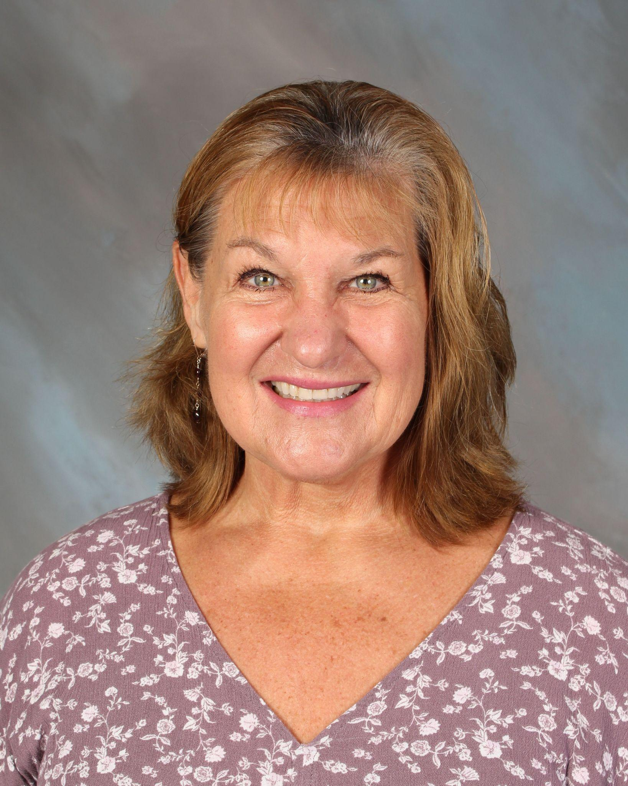
ETHS SSTs (Student Services Technicians)
Aly Graham
Aimee Rego
Julie Dickelman
A-Ga
Ge-N
O-Z
Current Sub:
Mrs. Brady

Slide 14
How Can We Help You?
SST’s (Student Service Technicians) help with….
Registration
General Guidance Questions
Class Scheduling
Graduation Status & Requirements
Community Service Form
Proof of Residency
Counselors help with….
College & Career Guidance
Social-Emotional/Mental Health Support
Academic Intervention
Referrals for Additional Support

Slide 15
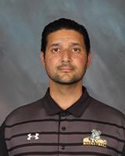
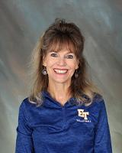
ETHS Guidance Staff
Rod Hosseinzadeh
Brenda Tettemer
AP of Guidance and Curriculum
Guidance Secretary

Slide 16
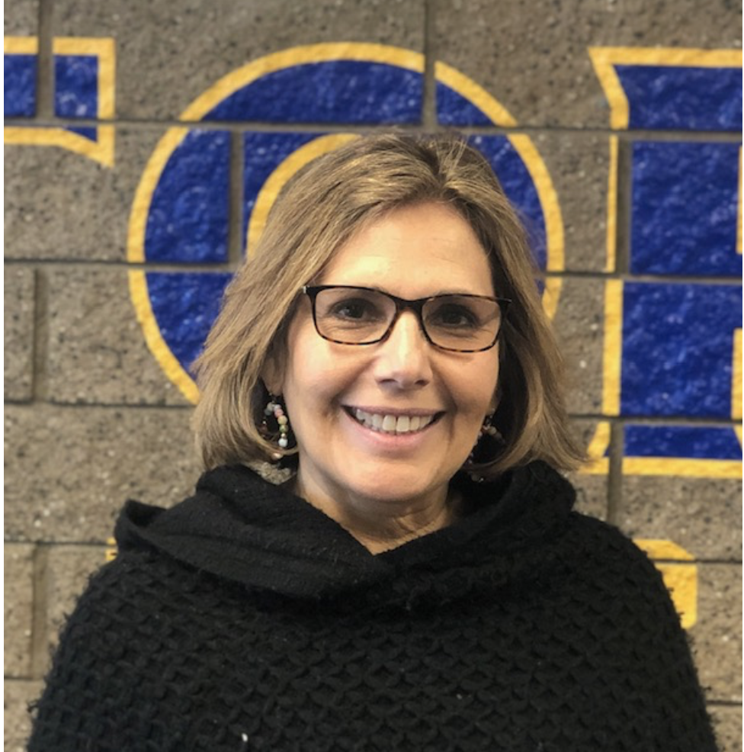
ETHS Community Liaison/Enlace con la Comunidad
Help to multilinguals on any school related subject
In need of resources - housing, food, medical, mental health, etc?
Ayuda a Multilingües sobre cualquier tema relacionado con la escuela
Información sobre recursos comunitarios - vivienda, alimentos, servicios médicos, salúd mental, etc.
Karen Kazemi
karen.kazemi@svusd.org
Extension 236168

Slide 17
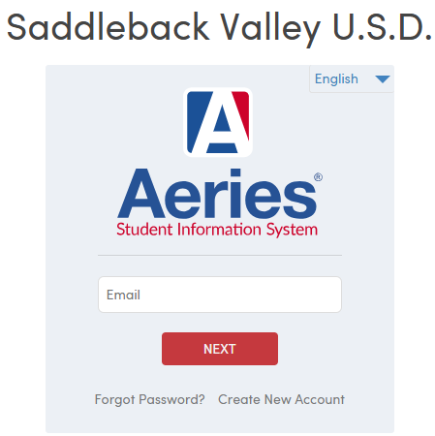
Aeries Family Portal
Make sure you are logged into your Family Portal to access important information regarding your student (attendance, transcript, grades, etc.) If you don’t remember your login info, follow the portal’s instructions to reset your password or contact SVUSD Technology Services (949) 855-4357.
Step 1: Go to the SVUSD website and click “Family Portal”
Step 2: Login with your email and password

Slide 18
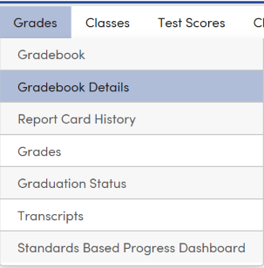
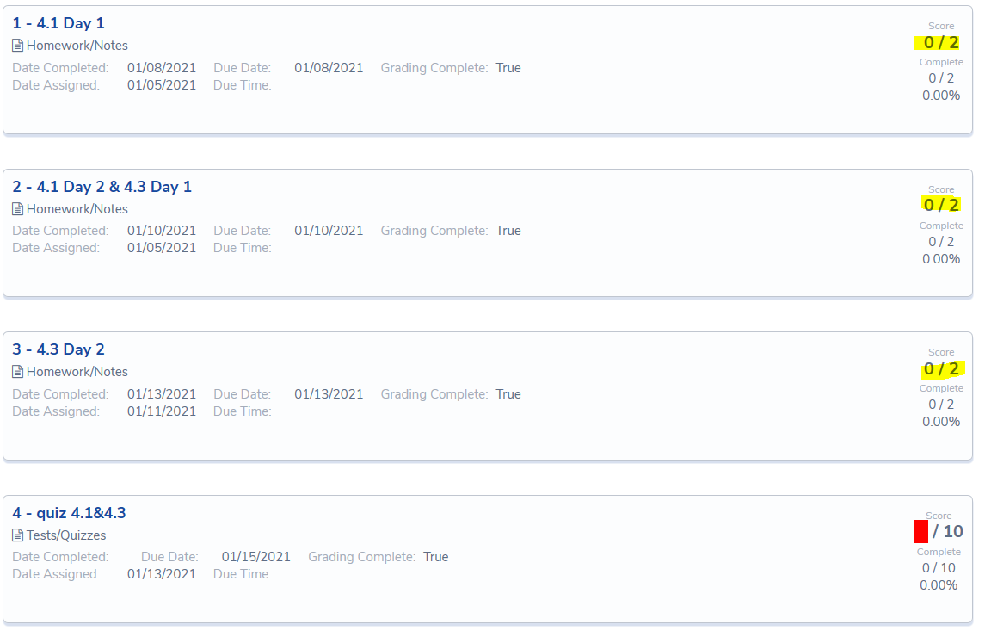
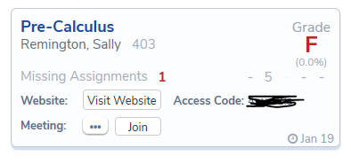
Aeries Family Portal - Gradebook Details
If you have any questions regarding the assignments
or grades listed, please contact the teacher directly.

Slide 19
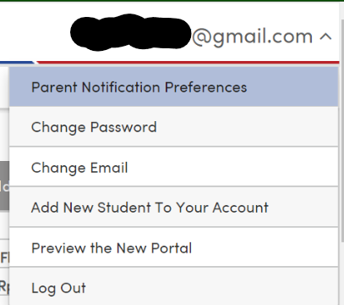
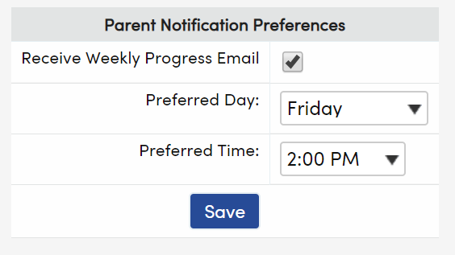
Aeries Family Portal - Weekly Progress Checks
example
Set weekly grade check notifications to track your student’s academic progress!

Slide 20
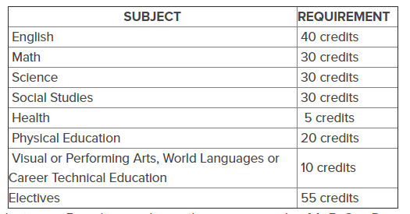
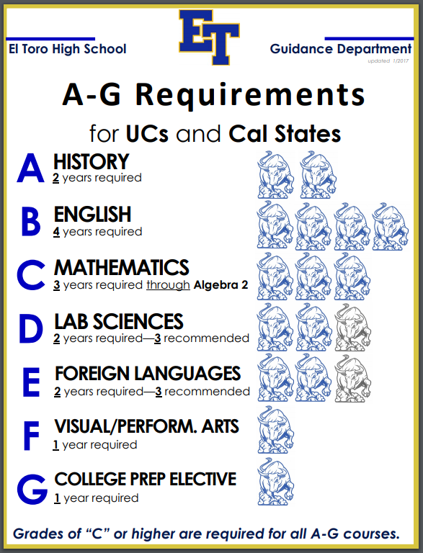
Graduation Requirements vs. A-G Requirements
220 Credits Required for Graduation
What classes count for PE credit?
  PE
  Athletics, Pep Squad
  Marching Band, Color Guard
  Power Walking, Weight Training (for 10th - 12th only)
Community Service - 8 hours total (over 4 years)

Slide 21
A-G Requirements
How do I make the goal of attending a 4 year university a reality?
*Must get Cs or HIGHER in ALL classes taken!*
Class Requirements
World Language Requirement
A: History (2 yrs)
B: English (4 yrs)
C: Math (3 yrs)
D: Science (2 yrs)
G: College Prep (1 yr)
E:
2 years of the SAME language
CSU: 2.5+
UC: 3.0+
Private/OOS: Varies by school
VAPA Requirement
GPA
F:
1 year of a Visual Arts/Performing Arts course

Slide 22
Credit Recovery
What if my student earned a D or F?
Graduation vs. “A-G” requirements
Options
  Summer School - information available in March/April
  Night School - Weekly class(es) at Silverado High School
  During school - Period 1 or take the class again in-seat
  Silverado High School
* * For Credit Recovery, please contact your student’s SST * *

Slide 23
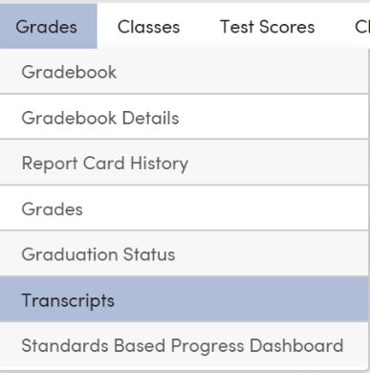
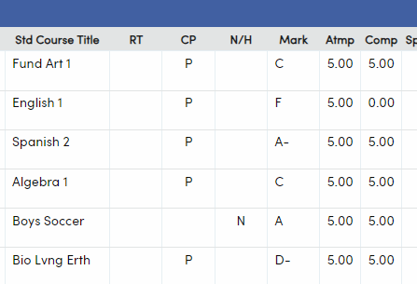
Transcript Check
Check your student’s transcript to make sure they are on track to graduate and/or be A-G eligible!
“A-G” GPA
Overall GPA
Must make up for graduation
Must make up for A-G requirements

Slide 24






Post High School Options
Military
Trade School/ Work
What are my student’s options after HS?
4-Year University
Community College

Slide 25
UC (University of California)
Answer 4 Personal Insight Questions (PIQ)
Utilize the “additional comments” section
Requirements
No testing requirement (ACT/SAT)
No letter of rec (exceptions for impaction)
Extra
General Info
9
Campuses
across
California
3.0 GPA (minimum)
A-G Requirements (C or better)
Supplemental
*UC/CSU GPA: only 10th and 11th grade marks are calculated!!!

Slide 26
CSU (California State University)
Simple application
Local Area Schools:
- CSU San Marcos
- CSU Fullerton
Requirements
No testing requirement (ACT/SAT)
No letter of rec
No essay
Extra
General Info
23
Campuses
across
California
2.5 GPA (minimum)
A-G Requirements (C or better)
Supplemental
*UC/CSU GPA: only 10th and 11th grade marks are calculated!!!

Slide 27

GPA Clock for UC/CSU
The GPA clock (calculation) to apply to UC/CSU Universities begins in 10th grade and ends after 11th grade summer!
So…
Your student MUST remediate any D’s
before 12th grade begins!

Slide 28
Private/Out of State
Want to go out of state but not pay out of state tuition?
Western Undergraduate Exchange (WUE)
Requirements
Most require letters of rec
Many require essays
Some require SAT/ACT
Extra
General Info
Many use the Common Application (check school website)
GPA varies (strive for 3.0 minimum)
Admission req’ts vary (strive for A-G completion)
Supplemental

Slide 29
Community College
Certificate Programs available!
Want to attend CC for free?
Promise Program;
Freshman Advantage
Requirements
No letters of rec
No essays
No SAT/ACT
Extra
General Info
116 California Community Colleges
Pathway to graduate from 4-year
Must have high school diploma
- OR -
Be at least 18 years old
Supplemental

Slide 30

Get Your Student Involved!
Make your student’s high school career count at ETHS!
Extra-
curricular
activities
Work
Experience
Remember, most colleges are looking at the “whole student” and how they will be an asset to their campus!
Clubs
Volunteer
work

Slide 31

Sophomore Classroom Lesson
Lesson Objectives:
Take the CA Colleges Interest Profiler Assessment
Explore Career Options
Discover tools to “Get in the Game!” of being future ready!

Slide 32

California Colleges - Explore Colleges & Careers!
Explore potential colleges your student is interested in attending
  Location, cost, programs offered, etc.
  Start building your student’s college list
Explore careers that align with your student’s strengths and interests
  “Intelligences” or “Interest Profiler” assessments
  Explore career options for your student based off their results
Learn about how to fill out the FAFSA/CADAA and/or about scholarships
  Financial Aid Tab
Have your student log in to CaliforniaColleges.edu with their SVUSD Student Email and password!

Slide 33
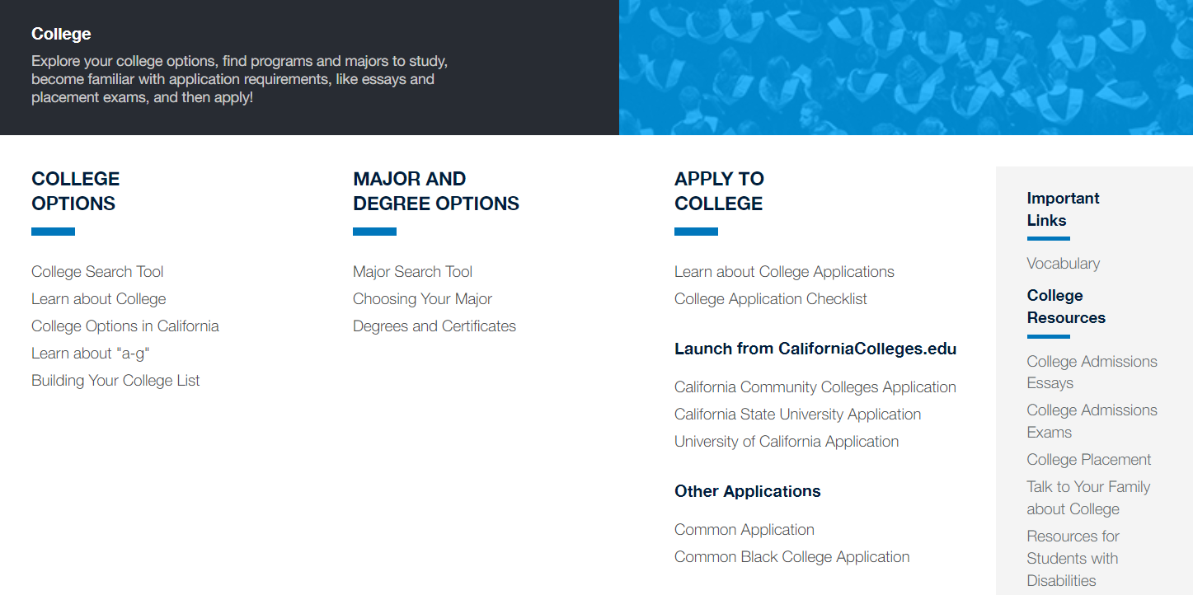
California Colleges - College tab

Slide 34
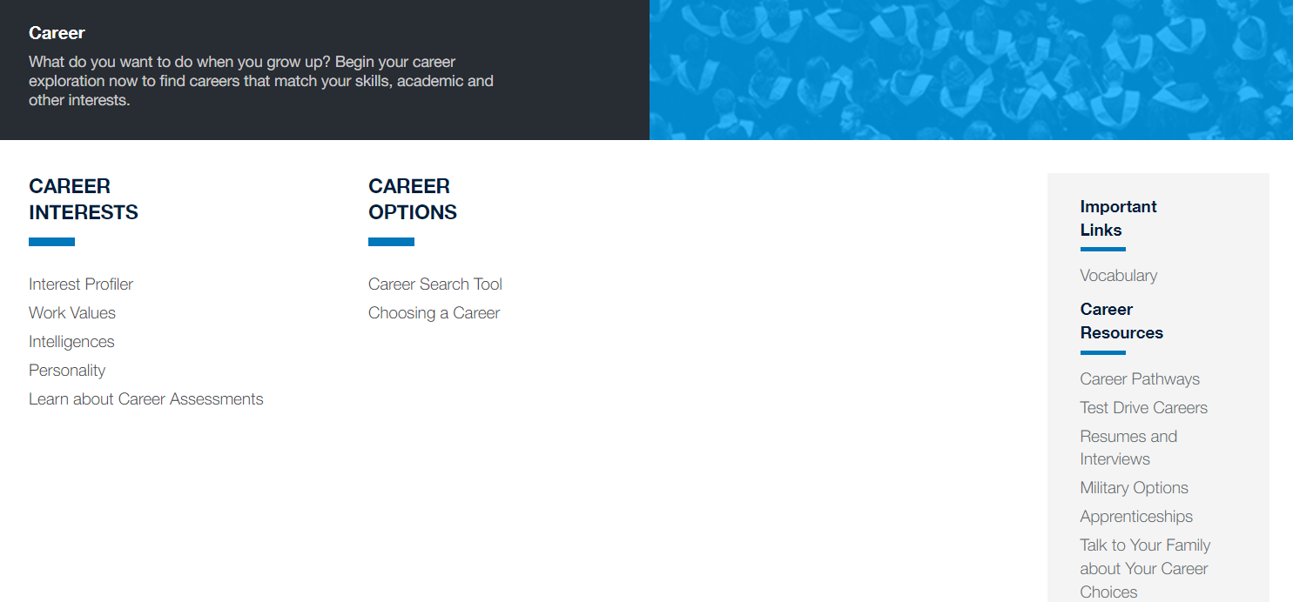
California Colleges - Career tab

Slide 35
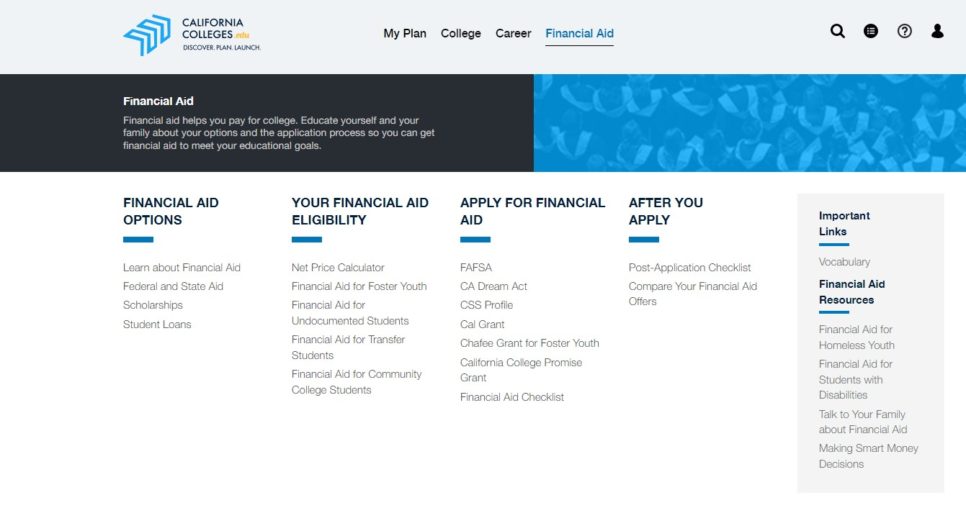
California Colleges - Financial Aid tab

Slide 36

College & Career Resources
Roadtrip Nation
  https://roadtripnation.com/
  https://roadtripnation.com/roadtrip/california-community-college-documentary
California Community College Roadtrip
The College Tour
  https://www.thecollegetour.com/watch-now/
Now on Amazon Prime!

Slide 37



Student Support
Academic/College/Career
Social/Emotional
Future Ready CA!
  Senior year in October
Future Ready Thursdays
  College Rep/Career guest speakers
  FAFSA/CADAA support
Course Registration
  1-1 meetings
Classroom lessons
Individual/Group Counseling
Wellness Wednesdays
  Workshops & activities that support student wellness
Mental Health Fair
  April 1st during Tutorial
rETreat (Wellspace)
  Open during lunch
Outside referrals and resources
Classroom lessons

Slide 38


Mental Health Resources
Soluna - Free Mental Health App for all CA Students (13-25 years old)
  Interactive tools, peer connection, care navigation, 1:1 coaching
SVUSD Mental Health Resources
  Multiple resources (LGBTQ, Grief Counseling, Counseling Centers etc.)
988 Suicide Crisis Hotline
  Dial 988 or Call 800-273-TALK
Crisis Text Line
  Text “Hello” to 741-741
Mental Wellness Counseling
  Ask your student’s counselor to refer to the District
HAZEL Health
  Parent referral or counselor referral
USC Telehealth
Western Youth Services One Door

Slide 39
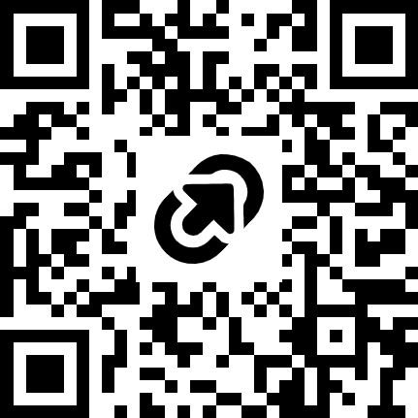
Family Feedback
Please fill out the link below to let us know your thoughts!
https://tinyurl.com/sophfam2026

Slide 40
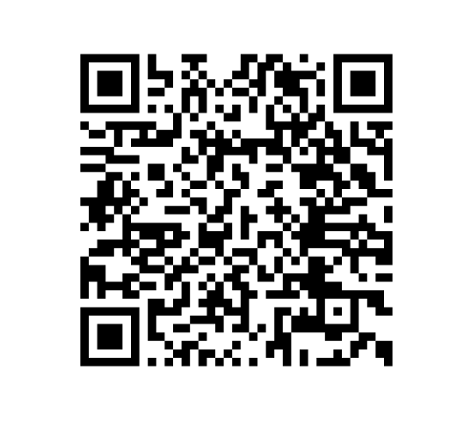
Thank you!
Please scan the QR code for digital resources
(or click here).
Questions? Please email your student’s School Counselor.
Miss Felix (A-Cro): audrie.felix@svusd.org
Miss Kurisu (Cru-Hern): kami.kurisu@svusd.org
Mrs. Baker (Herr-Mom): carlyn.baker@svusd.org
Mrs. Coleman (Mon-R): dionne.coleman@svusd.org
Mrs. Myers (S-Z): dasha.oneil@svusd.org
*formerly Ms. O’Neil

