Slide 1
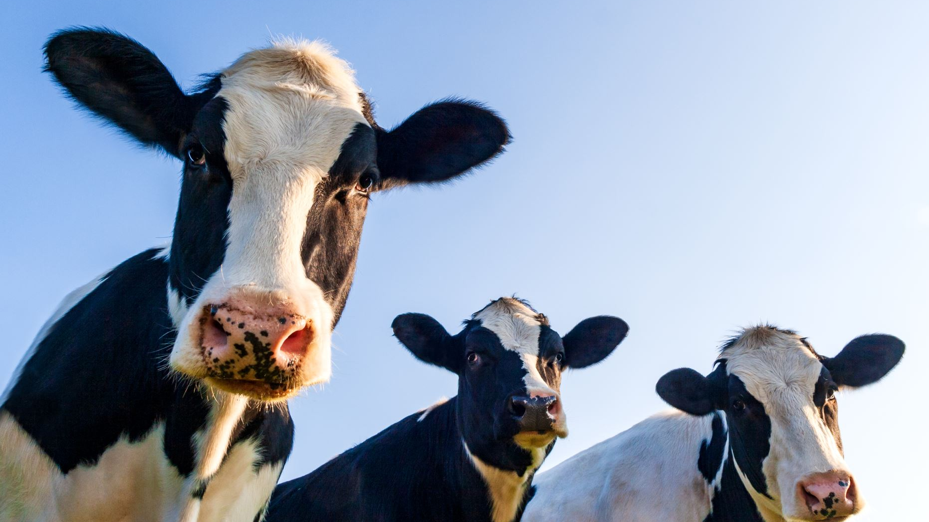
New Milk Guidelines

Slide 2
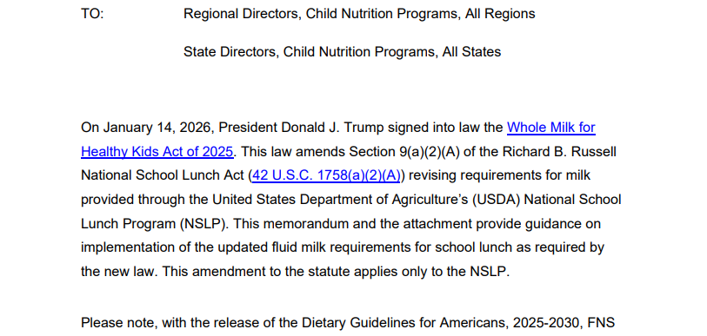

Slide 3
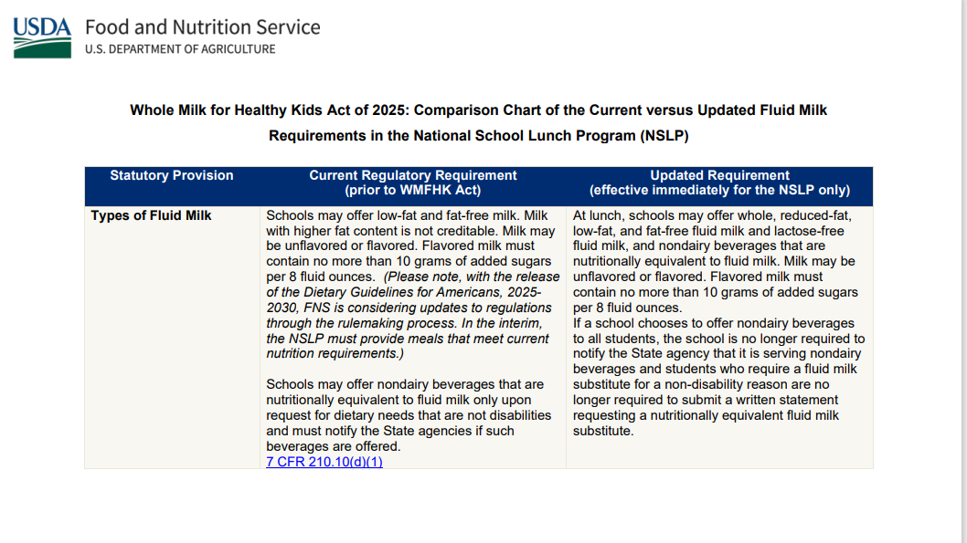

Slide 4
Cost and roll out date
2% white milk is about .015 cents more than fat-free
Whole is around .02 cents more than fat-free.
Items will not be available until the second week of February

