Slide 1

4/5/6 Highly Capable Program
Family Information Night
January 22, 2026
6-7 p.m.

Slide 2
Agenda
  Introduction
  Highly Capable Overview
  4/5/6 Highly Capable Program Overview
  Referral & Identification Process
  Q&A with Highly Capable Teachers & TOSA

Slide 3
Highly Capable Program Contact
www.sno.wednet.edu/hicap/456
Brianne Loomis
Highly Capable TOSA
brianne.loomis@sno.wednet.edu
360-563-7296
Administrative Assistant
highlycapable@sno.wednet.edu

Slide 4
Highly Capable
Overview

Slide 5
Highly Capable Program Purpose
The Snohomish School District is committed to an education philosophy that recognizes and promotes academic excellence by meeting the educational needs of all students. Our program for highly capable students has four main goals that guide the development of the curriculum:
  Goal 1: Emphasize higher-level thinking skills in all aspects of curriculum design.
  Goal 2: Introduce students to a wide range of intellectual horizons.
  Goal 3: Foster in students a desire for academic excellence and a commitment to developing their talents.
  Goal 4: Build an awareness that intellectual development is an active, integrative and collaborative process.

Slide 6
Highly Capable Program Purpose
Our district practices seek to:
  expand access to accelerated learning and enhanced instruction at our schools.
  advance equitable enrollment practices
  identify students who are ready to engage in more rigorous coursework and can benefit from accelerated learning and enhanced instruction.

Slide 7
Highly Capable Students
Highly capable students are students who...
  perform or show potential for performing at significantly advanced academic levels when compared with others of their age, experiences or environments
  demonstrates outstanding abilities within their general intellectual aptitudes, specific academic abilities and/or creative productivities

Slide 8
Highly Capable Students
Students who may be benefit from highly capable services are those who exhibit some of the following characteristics:
  Learns more rapidly and easily than their peers
  Offers original and imaginative responses
  Has extensive vocabulary
  Asks many questions
  Has a sophisticated sense of humor
  Thinks of unusual ways to solve challenging problems
  Generates numerous ideas
  Comprehends complex and abstract ideas
  Has insights from multiple perspectives

Slide 9
Highly Capable Services
K-6 Highly Capable Services
K-6 Classroom-Based
4/5/6 Self-Contained
  Enhancement opportunities within student’s grade level class.
  Supports Math and/or Literacy Domain strengths.
  Acceleration and enhancement within a multi-age, highly capable class.
  Supports Math and Literacy Domain strengths.

Slide 10
4/5/6 Highly Capable
Program Overview

Slide 11
4/5/6 Elementary Program Overview
This program is offered at each elementary school and is a multi-age, full-time class that emphasizes:
  abstract thinking, depth, complexity and acceleration when appropriate in content and process.
  higher level thinking skills with learning opportunities around critical, creative and evaluative thinking.

Slide 12







4/5/6 Highly Capable Classrooms
Strategies to provide differentiated instruction may include:
Pre-Assessment /Formative Assessment
Flexible Groupings
Open ended & Higher-level Questioning Strategies
Compacting of Curriculum (Content and/or Process)
Critical, Creative & Evaluative Thinking
Project-Based Learning
Interest Units/Choice Options

Slide 13

Literacy Highlights
  Goals: to encourage students to read, explore and think deeply about new ideas, to analyze content and to construct meaning to expand their horizons through: Mini Lessons, Literary Devices, Book Clubs, Word Study, Shared Reading, Independent Reading, Interactive Read- Alouds
  Curriculum: Being a Writer, Fountas & Pinnell
  Supplemental: Lexia, Highly Capable Book Club Rotations
  Three-year rotation of literacy and informational texts

Slide 14

Social Studies Highlights
  Goals: provide opportunities for students to learn to understand and appreciate multiple perspectives and cultures
  Curriculum: three-year rotation of Washington State & Native Americans, United States History, and Ancient World Civilizations
  Emphasis on reading Non-Fiction text and includes research projects

Slide 15

Mathematics Highlights
  Goals: to deepen student’s conceptual understanding, computation, and problem-solving strategies and to compact, accelerate, and enrich content based on student need
  Curriculum: Big Ideas (Common Core State Standards)
  Supplemental: Dreambox

Slide 16
Middle School & High School
Middle School
  Language Arts Honors
  Advanced Math Placement (7th grade, 7th grade Accelerated, Algebra)
High School
  AP program offers students the chance to refine the skills necessary to succeed in college and the opportunity to earn college credit while in high school. Course offerings vary from year to year.

Slide 17
Referral & Identification Process

Slide 18
4/5/6 Program Referral Window
  December 1 to January 30, 2026
  Referrals
Referrals may be submitted by:
      Parents
      Students
      Teachers
      Other staff
      Members of a community

Slide 19


due January 30
4/5/6 Referral Steps
Permission to Test
Who: Parent/Guardian
How: Electronic submission (ParentSquare) or paper submission
Parent/Guardian Student Inventory
Who: Parent/Guardian
How: Electronic submission (ParentSquare) or paper submission
Student Self Inventory & Personal Reflection
Who: Student
How: Paper submission (sent from Highly Capable Office)
Teacher Student Inventory
Who: Teacher
How: Electronic form (sent from Highly Capable Office)

Slide 20
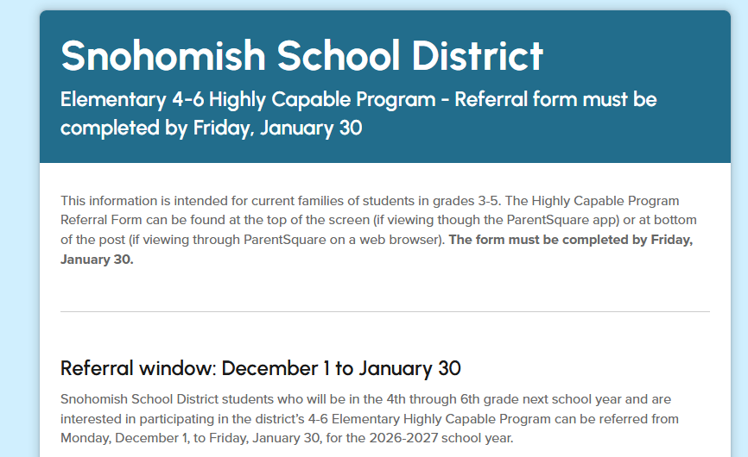

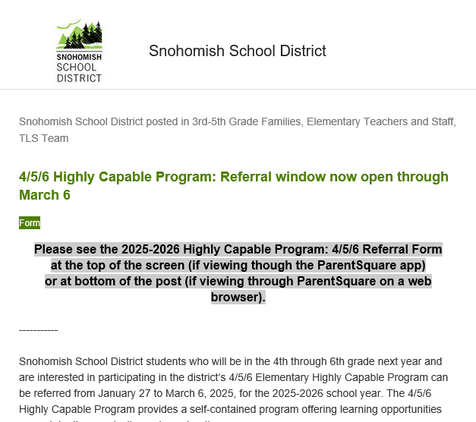
Online Submission Option
Permission to Test
Who: Parent/Guardian
Parent/Guardian Student Inventory
Who: Parent/Guardian

Slide 21
Highly Capable Testing
  CogAT measures cognitive development of a student’s learned reasoning ability in three areas: Verbal, Quantitative, and Nonverbal.
  CogAT testing will take place at the student’s home school electronically, during the school day.
  Testing will begin late February. Parents/Guardians will be notified by email of the testing date.

Slide 22
Highly Capable Testing
  How can my child prepare for the CogAT assessment?
  Sleep
  Breakfast
  Aware of routine change
  Encouragement
  Optional water bottle
  It is not required or recommended to study.

Slide 23
Multi-Disciplinary Placement Committee
  A classroom teacher with experience in teaching highly capable students
  A psychologist or other qualified practitioner
  A district highly capable specialist/coordinator with responsibility for the district program
  School building principal
Notification Letters will be sent in May. Full timeline is posted on our website.

Slide 24
Multiple Objective Criteria
Cognitive Data
Achievement Data
Supplemental Data
  CogAT Test
    Verbal
    Quantitative
    Nonverbal
  Star Reading
  Star Math
  SBA ELA & Math
  WIDA
  Student Inventory & Self Reflection
  Parent Student Inventory
  Teacher Student Inventory
Snohomish School District logo

Slide 25
Timeline
Date | Timeline
December 1 | Referral packets available
January 22 | Family Information Night
January 30 | Referral forms due to Highly Capable Office
February- March | Highly Capable Testing at schools Emails will be sent to families for school testing dates
April | Multi-Disciplinary Placement Committee meet to review data
May | Identification notification letters mailed home
June 12 | 4/5/6 Acceptance and Appeals deadline
Fall 2026 | Services begin

Slide 26
Questions

