Slide 1
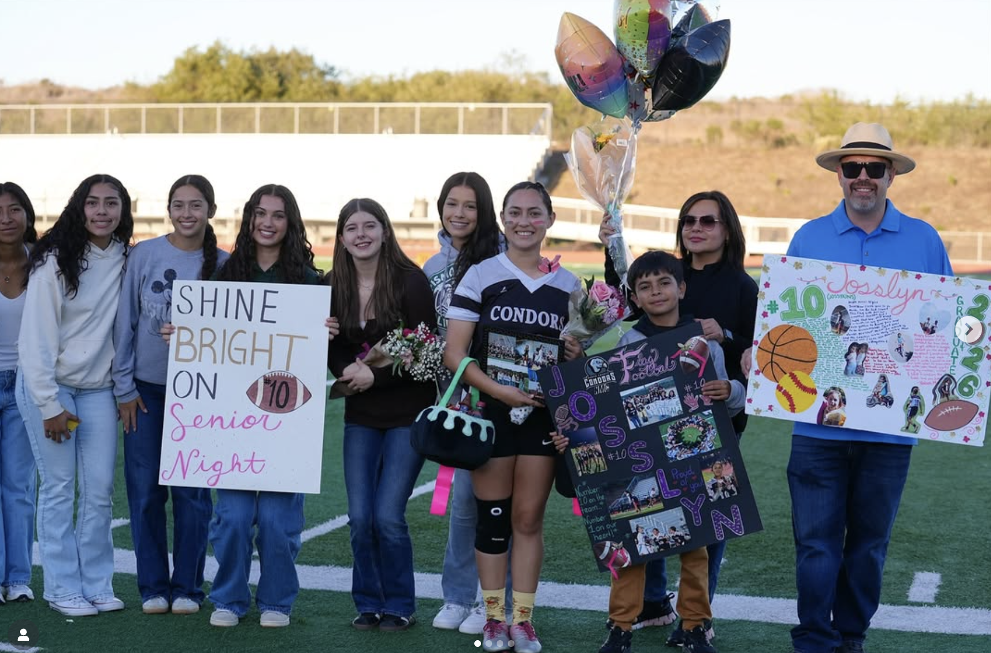
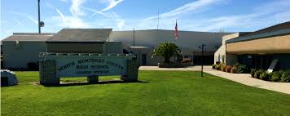

2025 Facilities Master Plan:
Overview / Findings / Next Steps
Presentation to the Board of Trustees
January 8, 2026

Slide 2

What we will cover this evening
Introductions
Intent of a Facilities Master Plan (FMP)
Overview of the process
Major findings
Recommendations for next steps
Notes:
Dr. Susan Wildes

Slide 3
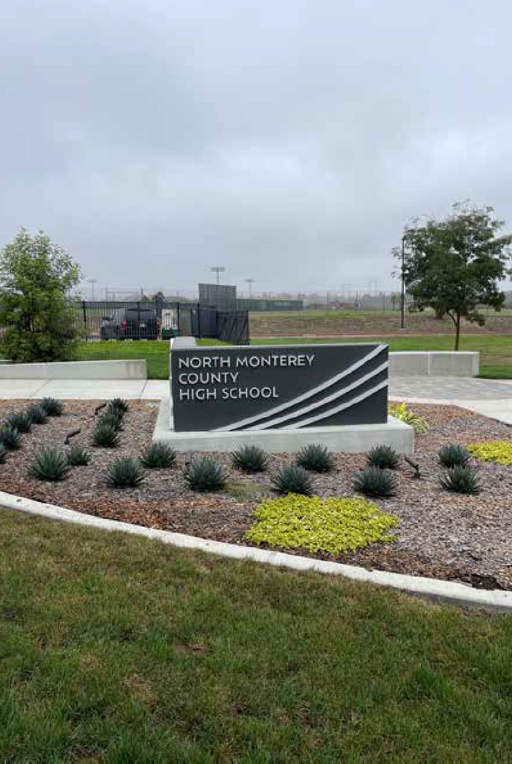
Facilities Master Plan:
It’s purpose and intent
Provides a short and long-term strategy for facility improvement.
Offers an initial needs assessment of each school site.
Based on stakeholder input / feedback.
Designed as a “living” document to guide long-term decision making and District priorities.
Notes:
Dr. Susan Wildes

Slide 4
Plan Development Process
The FMP is developed off of nine (9) key components.
Stakeholder engagement and on-site assessment are critical steps
Key Components
Stakeholder engagement
Define goals and objectives
Review standards and guidelines
Site condition assessment (i.e. walk sites)
Develop scope of work
Establish cost estimates
Review funding resources
Define Priorities
Develop / recommend an implementation plan
Notes:
Dr. Susan Wildes

Slide 5
Overview of Key Findings
Significant facility needs: The vast majority of facilities are 60+ years old. Campus infrastructure and core building systems are in need of significant investment and modernization.
Need for ongoing strategy: Limited funding and a lack of a focused and ongoing facility improvement strategy has compounded deteriorating facility conditions.
Impacts to instruction: The absence of a long-term facilities investment strategy hamstrings the District’s ability to provide safe, effective, and flexible educational opportunities for its students and community.
Deferred maintenance: Additional focus and funding should be allocated to deferred and ongoing maintenance issues.
Notes:
Dr. Susan Wildes

Slide 6
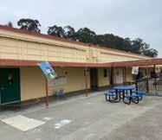
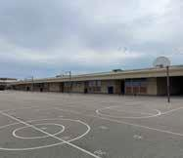
Facility and Project Priorities
District-wide Facility Priorities
Upgrade and replace aging HVAC systems across all campuses.
Improve core site infrastructure.
Enhance campus safety and security.
Address maintenance and modernization needs in permanent buildings.
Implement a district-wide portable replacement strategy.
Right-size multipurpose, dining, and support spaces.
Notes:
Dr. Susan Wildes

Slide 7
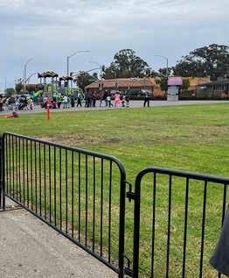
Site Specific Priorities:
The FMP includes site-specific priorities and recommendations, along with cost estimates.
Identified and developed via a collaborative and informed process, including detailed on-site assessments.
Recommendations are specific to the needs identified for each school site and grade spans served.
Notes:
Dr. Susan Wildes

Slide 8
Cost Estimate Summary
Category Description Est. Cost
Five-year maintenance and modernization plan
Long-Range Vision: Redesign or build for modern standards
Total Estimated Investment
Repairs, system replacements, accessibility upgrades, modernization to sustain functionality of existing facilities and infrastructure.
Major capital projects, including new construction or repurposing of existing facilities, address outdated or undersized support spaces, aging portables or programmatic growth.
$88,414,989
$105,846,000
$194,260,989*
NOTE: Cost estimates are based on current school construction pricing. Annual construction cost escalation should be factored into long-term facility planning.
Notes:
Dr. Susan Wildes

Slide 9
Summary Observations
The District’s facilities are in need of significant investment via a long-term, focused facility improvement strategy.
A successful strategy will require:
  A focused and sustained 10+ year effort
  Student focused priorities
  Local funding measure(s)
  Acquiring eligible state matching funding
  Dedication of ongoing funding for deferred maintenance needs.
Notes:
Dr. Susan Wildes

Slide 10

Next Steps
Acknowledge realities facing the District:
  The challenges are significant
  However, there are also opportunities
  Addressing facility needs will require ongoing, student-focused, and long term commitment.
Recommendation:
Develop and adopt a strategic plan for District-wide facility modernization, new construction, and ongoing maintenance
Notes:
Dr. Susan Wildes

Slide 11
Draft Action Plan and Timeline
January - June 2026
Jan/Feb
Board study session
Review and adopt FMP
Launch stakeholder and community engagement effort
Create Facilities Advisory Committee
Prepare and release community opinion survey
March/April
Hold FAC meetings
Community and stakeholder engagement
Provide information to community and stakeholders
Present survey and outreach feedback to board
Initiate development of bond documents
May/June
Additional community engagement via townhalls / other forums
Notify appropriate local gov’t agencies
Board study session
Review final bond documents and resos
Update District’s eligibility in St. Facility Program
Notes:
Dr. Susan Wildes

Slide 12
Conclusion
Thank you for your time and partnership.
Questions?
Notes:
Alan/Susan

