Slide 1

Preparing for
FY27 Budget Development
West Manor Elementary
GO Team Business Meeting
January 2026

Slide 2
Agenda
Action Items Approval of Agenda
  Approval of Previous Minutes
Discussion Items
Finalize 2025-2030 Strategic Plan
  2026-2027 Strategic Objectives Ranking
  FY27 Budget Development Preparation: School Allocation (Optional)
Information Items (add items as needed)
  Principal’s Report
Announcements
Public Comment
Adjournment

Slide 3


Today We Will…:
School Strategic Planning Process: Step 5
1
Sample GO Team Business Meeting Cadence
Business Meeting 1:
Review Data (MAP, GMAS, Graduation Rate, CCRPI, etc.)
Business Meeting 2:
Review Data (School KPIs)
Align Mission/Vision/ Purpose
Confirm 2030 Goals
Business Meeting 3:
Identify 2025-2030 Strategic Objectives
Business Meeting 4 :
Approve Your Strategic Plan & Rank Your Strategic Objectives for FY27
Review Data
2
Align Mission/Vision/Purpose
3
Confirm 2030 Goals
Create CIP Goals to 2030
Identify Additional Goals
4
Identify 2025-2030 Strategic Objectives
Reflect on 2020-2025 Strategic Plan
Review and Discuss Additional Objectives Going Forward
5
Approve Your Strategic Plan & Rank Your Strategic Objectives for FY27

Slide 4

West Manor Mission and Vision:
The MISSION
West Manor Elementary School commits to cultivating inquiring, knowledgeable and caring scholars who strive to think, act, and reflect with a value and understanding of multiple cultures, languages, and perceptions.
To this end, the school will work collaboratively with all stakeholders to meet the needs of all learners while providing a safe and supportive learning environment. The school implements a rigorous, inquiry-driven international curriculum which supports the development of socially, emotionally, and academically balanced lifelong learners who are committed to creating a more peaceful world through intercultural understanding and respect.
The VISION
The vision of West manor is to be a nurturing, comprehensive, and high performing school where faculty, staff, parents, and all stakeholders will concertedly prepare our students to become globally productive citizens and leaders.

Slide 5

West Manor Proposed Goals for the 2025-2030 Strategic Plan:
During the 2025 school year we will Increase the number of students in grades 3-5 scoring proficient from 35 % to 40% on ELA Milestones
During the 2025 school year we will Increase the number of students in grades 3-5 scoring proficient from 32 % to 37% on Math Milestones
During the 2025 School year we will increase the number of students with 10 or less days absent from 74% to 80%

Slide 6
West Manor IB World School
SMART Goals
During the 2025 school year we will Increase the number of students in grades 3-5 scoring proficient from 35 % to 40% on ELA Milestones
During the 2025 school year we will Increase the number of students in grades 3-5 scoring proficient from 32 % to 37% on Math Milestones
During the 2025 School year we will increase the number of students with 10 or less days absent from 74% to 80%
APS Strategic Priorities & Initiatives
School Strategic Priorities
School Strategies
Fostering Academic Excellence for All
Data
Curriculum & Instruction
Signature Program
1.
3.
1A. Implementation of an intervention block to reduce gaps in learning
1B. Employ a literacy block with phonics for grades k-2
1C. Create PLC planning time for teachers to internalize standards and plan for instruction
Increase student phonic awareness and create early readers
Increase student knowledge in numbers and operations domain
Increase student multiplication skills
Building a Culture of Student Support
Whole Child & Intervention
Personalized Learning
Increase student attendance and decrease suspension rate
TBD: Create an attendance team to monitor and address attendance concerns, Create a Care Team to address student needs
TBD: Utilize SLC practices and restorative justice with the Counselor to reduce suspensions
Equipping & Empowering Leaders & Staff
Strategic Staff Support
Equitable Resource Allocation
Increasing Teacher knowledge of Standards
Increase Teacher knowledge of IB Program
TBD: Monthly IB training for staff, Professional development individualized around teacher needs in reading and math, training for phonics program (Fundations)
Ongoing PD for SEL, restorative practices, and trauma
Creating a System of School Support
Collective Action, Engagement & Empowerment
TBD: Conduct data meetings in PLC, with parents and students. Students will also have goal setting meetings with teachers
--Increase Parent Liaison and Social Worker positions to full time to support the needs of students and parents
Improve stakeholder knowledge of school data and how to assist
Provide support to students and stakeholders in need

Slide 7
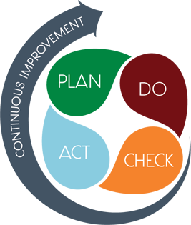
Connecting the
Strategic plan &
Continuous Improvement Plan
1.Increase student phonic awareness and create early readers
Increase student proficiency on ELA assessments by 5%
Milestones and MAP Scores
2. Increase student knowledge of new math standards
Increase student proficiency on Math assessments by 5%
Milestones and MAP Scores
Improve student attendance
Increase average attendance rate from 95% to96%
CCRPI Attendance Rate

Slide 8
Discussion Items
Finalize the 2025-2030 Strategic Plan
2026-2027 Strategic Objectives Rankings
Proposed Program Changes (If needed)

Slide 9

Finalizing the 2025-2030
School Strategic Plan

Slide 10

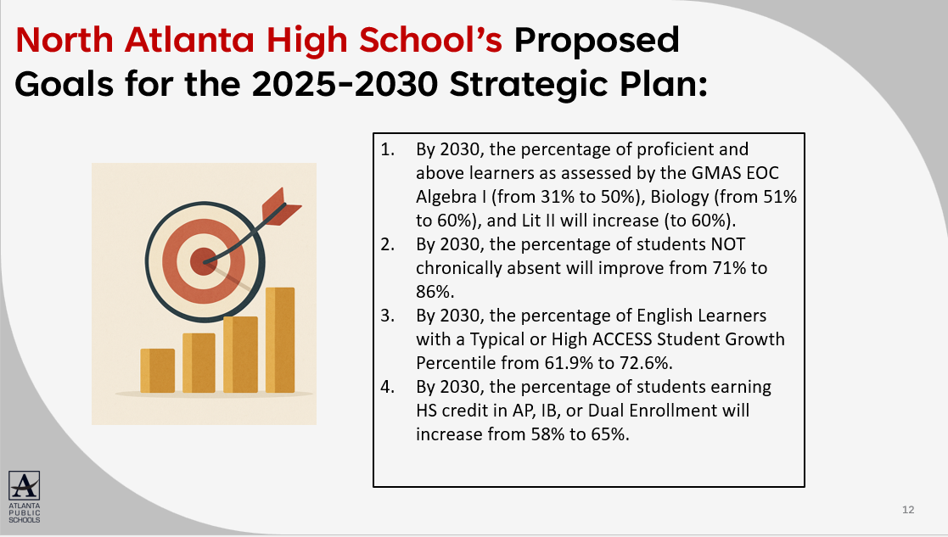
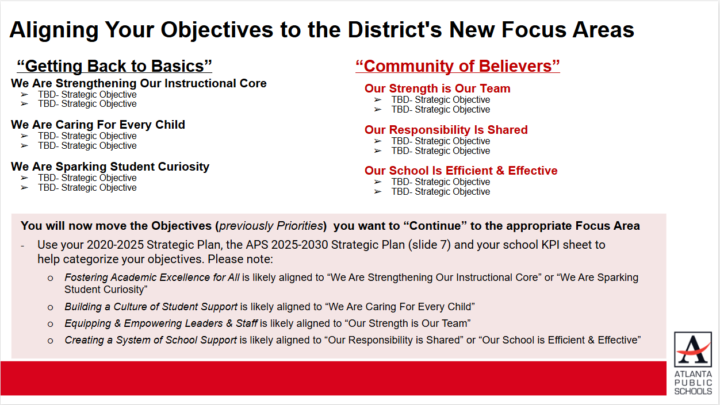
In Our Last Meeting We…
Reviewed Our Proposed Mission and Vision for 2025-2030
3
Reviewed Our Proposed Goals for 2025-2030
4
Identified Our 2025-2030 Strategic Objectives
2

Slide 11
Aligning Your Objectives to the District's New Focus Areas
“Getting Back to Basics”
“Community of Believers”
Our Strength is Our Team
Implement high quality, relevant, and engaging materials and professional learning in all core content areas
Retain effective staff while training and promoting from within
Our Responsibility Is Shared
Improve stakeholder knowledge of school data and how to assist
Improve communication and partnerships with stakeholders
Our School Is Efficient & Effective
Maximize facility usage
We Are Strengthening Our Instructional Core
Increasing Teacher knowledge of Standards
Increase student phonic awareness and create early readers
Increase student knowledge in numbers and operations domain
We Are Caring For Every Child
Provide support to students and stakeholders in need
Increase student attendance and decrease suspension rate
We Are Sparking Student Curiosity
Increase Teacher knowledge of IB Program
Continue to provide clubs and extra curricular activities
Notes:
Use the APS 2025-2030 Strategic Plan (slide 7) and your school's KPI sheet to help guide your team's discussion of how your objectives align to the district's new focus areas.

Slide 12
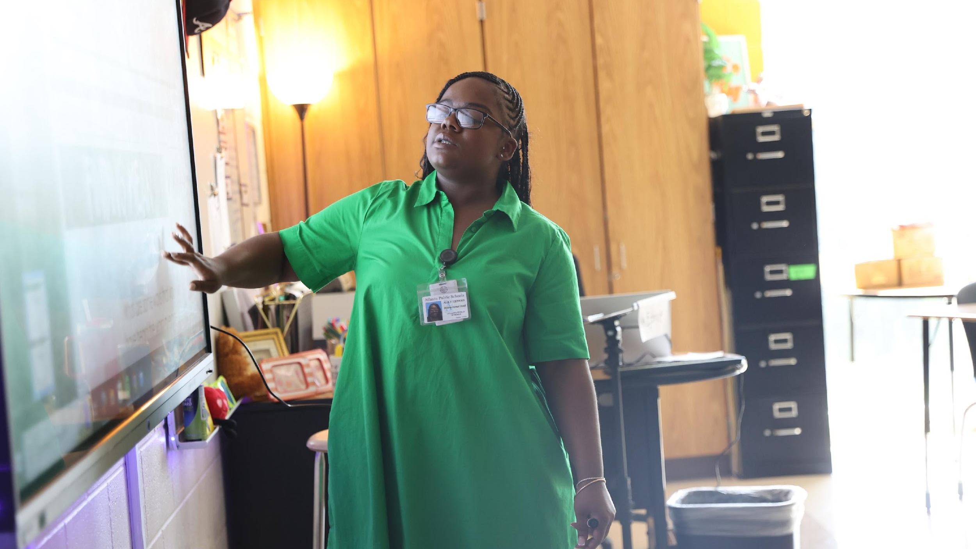

5. Approve Strategic Plan & Rank Strategic Objectives for FY27 Budget Development
Review and Discuss your school's 2025-2030 Strategic Plan
  Action on your 2025-2030 Strategic Plan
Review and Discuss your 2026-2027 Strategic Plan Objective Rankings
  Action on the 2026-2027 Strategic Plan Objective Ranking
One District. One Goal. Every Child.

Slide 13
Discussion
Strategic Plan Objectives Ranking
The GO Team ranked its Strategic Plan Objectives in preparation for the 2026-2027 Budget Development Process (January–March 2026).
The ranked objectives will serve as budget parameters during FY27 budget discussions.

Slide 14
Identifying 2025-2030 Strategic Objectives:
1.Increase student phonic awareness and create early readers
2 Increase student knowledge in numbers and operations domain
3. Increase student multiplication skills
4. Increase student attendance and decrease suspension rate
5.Increasing Teacher knowledge of Standards
6.Increase Teacher knowledge of IB Program
7. Improve stakeholder knowledge of school data and how to assist
8. Provide support to students and stakeholders in need

Slide 15

Action on the
Strategic Plan Objectives Ranking
The GO Team needs to TAKE ACTION (vote) on its ranked Strategic Plan Objectives. After the motion and a second, the GO Team may have additional discussion. Once discussion is concluded, the GO Team will vote.

Slide 16

Action on the
2025-2030 Strategic Plan
The GO Team needs to TAKE ACTION (vote) on its new 2025-2030 Strategic Plan.
After the motion and a second, the GO Team may have additional discussion. Once discussion is concluded, the GO Team will vote.

Slide 17
FY2027 Budget Allocation
FY2027 TOTAL SCHOOL ALLOCATIONS
School | West Manor Elementary School
Location | 2569
Level | ES
FY2027 Projected Enrollment | 259
Total Earned | $5,331,904
Per Pupil | $20,587
FY2026 TOTAL SCHOOL ALLOCATIONS
School | West Manor Elementary School
Location | 2569
Level | ES
FY2026 Projected Enrollment | 252
Total Earned | $5,325,297
Per Pupil | $21,132
School | West Manor Elementary School
Location | 2569
Level | ES
Change | 7
Total Earned | $6,607
Per Pupil | -$546

Slide 18
What’s Next?
February
  GO Team Feedback Meeting(s) February
    GO Team Takes Action (votes) on draft budget before the principal’s staffing conference
  Cluster Superintendent Review
  HR Staffing Conferences (February 23– February 27)
March
  Final GO Team Approval Meeting- AFTER your school’s Staffing Conference and BEFORE Friday, March 13
    GO Team Takes Action (votes) on final budget recommendation before March 13

Slide 19

Questions?

Slide 20

Principal’s Report

Slide 21

Announcements

Slide 22
Thank you

Slide 23
FY27 Budget Development Process:
FY27 Budget Allocation

Slide 24

FY 27 GO Team Budget Development Process Timeline
Step 3 Principals & Assoc. Supt. Discussions
Step 1 Finalize Strategic Plan & Rank Objectives
Step 6 Principals HR Staffing Conferences Begin
February 23-27
Step 2 District-wide Budget Allocation Meeting
January 2026
Step 7* GO Team Budget Finalization Meeting
Budgets finalized by March 13th
Step 5 Associate Supt. Review
Step 4* GO Team Feedback Mtg. Completed February 2026 (BEFORE STAFFING CONFERENCE)
GO Teams are encouraged to have ongoing conversations
* GO Teams will need to take ACTION on the budget at these meetings.
Notes:
As a reminder this is the district's 2025-2030 Strategic Plan. We will use this as a guide as we continue our work today to develop our school's 2025-2030 Strategic Plan that is aligned to the district's new plan.

Slide 25
Budget Allocation Meeting
What
During the this GO Team meeting the principal will provide an overview of the school's budget.
Why
This meeting provides an opportunity for the principal and GO Team to ensure alignment on the school’s key strategic priorities, gain a deeper understanding of the budget and position allocations, and gather input to drive the development of the draft budget.
When
January 2026

Slide 26
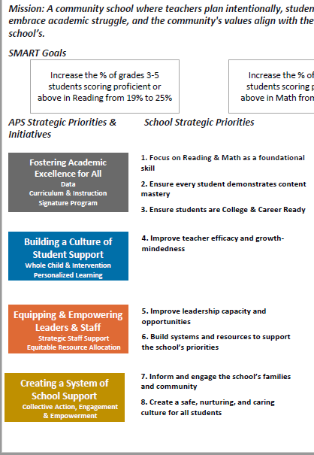
FY27 Budget Development Process
Principal’s Role
Design the budget and propose operational changes that can raise student achievement
Formulate strategies, implement and manage them at the school level
Focus on the day-to-day operations
Serve as the expert on the school
Hire quality instructional and support personnel
Collaborate with the GO Team on the use of school-level flexibility for position allocations
The GO Team’s Role
Focus on the big picture (positions and resources, not people)
Ensure that the budget is aligned to the school’s mission and vision and that resources are allocated to support key strategic priorities
Collaborate with the Principal on the use of school-level flexibility for position allocations

Slide 27
Guiding Questions: Are there any new “objectives” we must START to completely address our 2025-2030 Strategic Goals? Do we have 1-2 Objectives to support each Focus Area?
“Getting Back to Basics”
“Community of Believers”
We Are Strengthening Our Instructional Core
Increasing Teacher knowledge of Standards
Increase student phonic awareness and create early readers
Increase student knowledge in numbers and operations domain
We Are Caring For Every Child
Provide support to students and stakeholders in need
Increase student attendance and decrease suspension rate
We Are Sparking Student Curiosity
Increase Teacher knowledge of IB Program
Continue to provide clubs and extra curricular activities
Our Strength is Our Team
Implement high quality, relevant, and engaging materials and professional learning in all core content areas
Retain effective staff while training and promoting from within
Our Responsibility Is Shared
Improve stakeholder knowledge of school data and how to assist
Improve communication and partnerships with stakeholders
Our School Is Efficient & Effective
Maximize facility usage

Slide 28
2026-2027 Strategic Plan Objectives Ranking
Insert the school’s objectives from Higher to Lower
Higher
1.Increase student phonic awareness and create early readers
2 Increase student knowledge in numbers and operations domain
3. Increase student multiplication skills
4. Increase student attendance and decrease suspension rate
5.Increasing Teacher knowledge of Standards
6.Increase Teacher knowledge of IB Program
7. Improve stakeholder knowledge of school data and how to assist
8. Provide support to students and stakeholders in need
Lower

Slide 29
FY 27 Budget Parameters
FY26 Ranked School Priorities | Rationale
Increase student phonic awareness and create early readers Increasing Teacher knowledge of Standards | Increase student knowledge of phonics and phonemic awareness to support early readers. Improve student writing in all genres A combination of phonological awareness, phonics, and high frequency words can increase students success as early reader
Increase student knowledge in numbers and operations domain Increase student multiplication skills Increasing Teacher knowledge of Standards | Teachers need to internalize new Math standards in efforts to increase student achievement Need for more support of implementation of new Math standards
Increase student attendance and decrease suspension rate Increase Teacher knowledge of IB Program Improve stakeholder knowledge of school data and how to assist Provide support to students and stakeholders in need | Parents need to partner with the school to assist the scholars with assignments and to attend school regularly Parent participation has dropped over time due to unknown causes

Slide 30
Discussion of Budget Allocation

Slide 31
Executive Summary
This budget represents an investment plan for our school’s students, employees and the community as a whole.
The budget recommendations are tied directly to the school’s strategic vision and direction.
The proposed budget for the general operations of the school are reflected at $5331904
This investment plan for FY27 accommodates a student population that is projected to be 259 students, which is a increase of _7_ students from FY26.

Slide 32
School Allocation Tab Overview
The Allocation Tab has 3 tables that show the allocations for FY27, FY26, and the Change in each area. This helps you understand how our school earned funds and positions for FY27 in comparison to FY26, and how changes in each line impact our overall school budget.
FY2027 TOTAL SCHOOL ALLOCATIONS |  |  |  |  | FY2026 TOTAL SCHOOL ALLOCATIONS |  |  |  |  | Change
School | West Manor Elementary School |  |  |  | School | West Manor Elementary School |  |  |  | School | West Manor Elementary School
Location | 2569 |  |  |  | Location | 2569 |  |  |  | Location | 2569
Level | ES |  |  |  | Level | ES |  |  |  | Level | ES
FY2027 Projected Enrollment | 259 |  |  |  | FY2026 Projected Enrollment | 252 |  |  |  | Change | 7
Total Earned | $5,331,904 |  |  |  | Total Earned | $5,325,297 |  |  |  | Total Earned | $6,607
Per Pupil | $20,587 |  |  |  | Per Pupil | $21,132 |  |  |  | Per Pupil | -$546
SSF Category | Count | Weight | Allocation |  | SSF Category | Count | Weight | Allocation |  | SSF Category | Count | Weight | Allocation
Base Per Pupil | 259 | $5,964 | $1,544,655 |  | Base Per Pupil | 252 | $5,962 | $1,502,312 |  | Base Per Pupil | 7 | $2 | $42,343
Grade Level |  |  |  |  | Grade Level |  |  |  |  | Grade Level
Kindergarten | 33 | 0.60 | $118,086 |  | Kindergarten | 41 | 0.60 | $146,654 |  | Kindergarten | -8 | - | -$28,569
1st | 45 | 0.50 | $134,188 |  | 1st | 44 | 0.50 | $131,154 |  | 1st | 1 | - | $3,034
2nd | 50 | 0.50 | $149,098 |  | 2nd | 47 | 0.45 | $126,087 |  | 2nd | 3 | 0.05 | $23,011
3rd | 42 | 0.50 | $125,242 |  | 3rd | 40 | 0.45 | $107,308 |  | 3rd | 2 | 0.05 | $17,934
4th | 45 | 0.45 | $120,769 |  | 4th | 38 | 0.40 | $90,616 |  | 4th | 7 | 0.05 | $30,154
5th | 44 | 0.45 | $118,086 |  | 5th | 42 | 0.40 | $100,154 |  | 5th | 2 | 0.05 | $17,931
6th | 0 | 0.25 | $0 |  | 6th | 0 | 0.25 | $0 |  | 6th | 0 | - | $0
7th | 0 | - | $0 |  | 7th | 0 | - | $0 |  | 7th | 0 | - | $0
8th | 0 | - | $0 |  | 8th | 0 | - | $0 |  | 8th | 0 | - | $0
9th | 0 | 0.05 | $0 |  | 9th | 0 | 0.05 | $0 |  | 9th | 0 | - | $0
10th | 0 | - | $0 |  | 10th | 0 | - | $0 |  | 10th | 0 | - | $0
11th | 0 | - | $0 |  | 11th | 0 | - | $0 |  | 11th | 0 | - | $0
12th | 0 | - | $0 |  | 12th | 0 | - | $0 |  | 12th | 0 | - | $0
Poverty | 207 | 0.35 | $432,086 |  | Poverty | 214 | 0.35 | $446,521 |  | Poverty | -7 | - | -$14,435
EIP/REP | 31 | 1.00 | $184,881 |  | EIP/REP | 36 | 1.00 | $214,616 |  | EIP/REP | -5 | - | -$29,735
Special Education | 43 | 0.05 | $12,822 |  | Special Education | 38 | 0.05 | $11,327 |  | Special Education | 5 | - | $1,495
Gifted | 37 | 0.75 | $165,499 |  | Gifted | 33 | 0.75 | $147,549 |  | Gifted | 4 | - | $17,950
Gifted Supplement | 0 | 0.75 | $0 |  | Gifted Supplement | 0 | 0.75 | $0 |  | Gifted Supplement | 0 | - | $0
ELL | 17 | 0.20 | $20,277 |  | ELL | 24 | 0.20 | $28,615 |  | ELL | -7 | - | -$8,338
Small School Supplement | 191 | 0.10 | $113,911 |  | Small School Supplement | 198 | 0.20 | $236,078 |  | Small School Supplement | -7 | (0.10) | -$122,167
Baseline Supplement | Yes |  | $81,645 |  | Baseline Supplement | No |  | $0 |  | Baseline Supplement |  | - | $81,645
Transition Policy Supplement | No |  | $0 |  | Transition Policy Supplement | No |  | $0 |  | Transition Policy Supplement |  | - | $0
New School | No |  | $0 |  | New School | No |  | $0 |  | New School |  |  | $0
Capacity | No | 0.40 | $0 |  | Capacity | No | 0.25 | $0 |  | Capacity |  | 0.15 | $0
Total SSF Allocation |  |  | $3,321,246 |  | Total SSF Allocation |  |  | $3,288,990 |  | Total SSF Allocation |  |  | $32,256

Slide 33
West Manor Additional Earnings
Additional Earnings |  |  |  |  | Additional Earnings |  |  |  |  | Additional Earnings
Innovative Programming Allotment (Previously called Signature) |  |  | $199,724 |  | Innovative Programming Allotment (Previously called Signature) |  |  | $205,932 |  | Innovative Programming Allotment (Previously called Signature) |  |  | -$6,208
Turnaround |  |  | $0 |  | Turnaround |  |  | $0 |  | Turnaround |  |  | $0
Title I |  |  | $186,750 |  | Title I |  |  | $185,250 |  | Title I |  |  | $1,500
Title I Holdback |  |  | $0 |  | Title I Holdback |  |  | -$18,525 |  | Title I Holdback |  |  | $18,525
Title I Family Engagement |  |  | $6,225 |  | Title I Family Engagement |  |  | $6,175 |  | Title I Family Engagement |  |  | $50
Security Grant |  |  | $0 |  | Security Grant |  |  | $45,000 |  | Security Grant |  |  | -$45,000
Field Trip Transportation |  |  | $0 |  | Field Trip Transportation |  |  | $9,359 |  | Field Trip Transportation |  |  | -$9,359
Dual Campus Supplement |  |  | $0 |  | Dual Campus Supplement |  |  | $0 |  | Dual Campus Supplement |  |  | $0
District Funded Stipends (Academics and Fine Arts) |  |  | $20,500 |  | District Funded Stipends (Including Athletics) |  |  | $19,500 |  | District Funded Stipends |  |  | $1,000
AVA Holdback |  |  | $0 |  | AVA Holdback |  |  | $0 |  | AVA Holdback |  |  | $0
Phoenix Holdback |  |  | $0 |  | Phoenix Holdback |  |  | $0 |  | Phoenix Holdback |  |  | $0
SSF Holdback |  |  |  |  | SSF Holdback |  |  | 0 |  | SSF Holdback |  |  | $0
Flex |  |  |  |  | Flex |  |  | $0 |  | Flex |  |  | $0
Total FTE Allotments | 14.15 |  | $1,597,460 |  | Total FTE Allotments | 14.85 |  | $1,583,616 |  | Total FTE Allotments | (0.70) |  | $13,844
Total Additional Earnings |  |  | $2,010,659 |  | Total Additional Earnings |  |  | $2,036,307 |  | Total Additional Earnings |  |  | -$25,648
Total Allocation |  |  | $5,331,904 |  | Total Allocation |  |  | $5,325,297 |  | Total Allocation |  |  | $6,607

Slide 34
Where We’re Going
During our next meeting the principal will present the proposed FY27 Budget for feedback and discussion.
Let the principal or the Chair know of any additional information you need for our next discussion.

