Slide 1
Registration for the 2026-2027school year is about to begin!
Counselors will be in your classrooms next week. They will be distributing registration materials and teaching you how to request your classes for next year.
It is time to get excited and begin exploring all the wonderful courses that Lindbergh offers.

Slide 2





Things to Think About When Choosing Classes

Slide 3
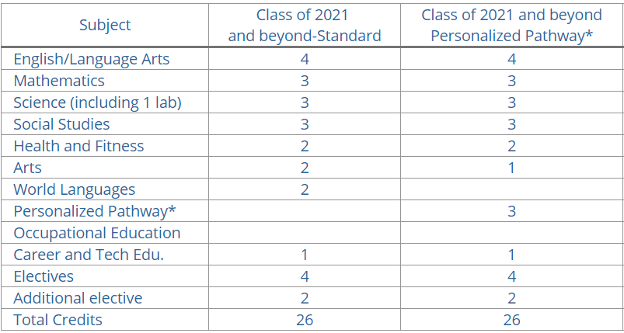
The Basics:
What classes do I need so I can graduate high school?
*Personalized pathway is for students who are passionate about a field that does not require a 4-year education, they can take 3 credits that will prepare them for a field to replace the 2 credits of World Language and 2nd credit of Fine Art.

Slide 4
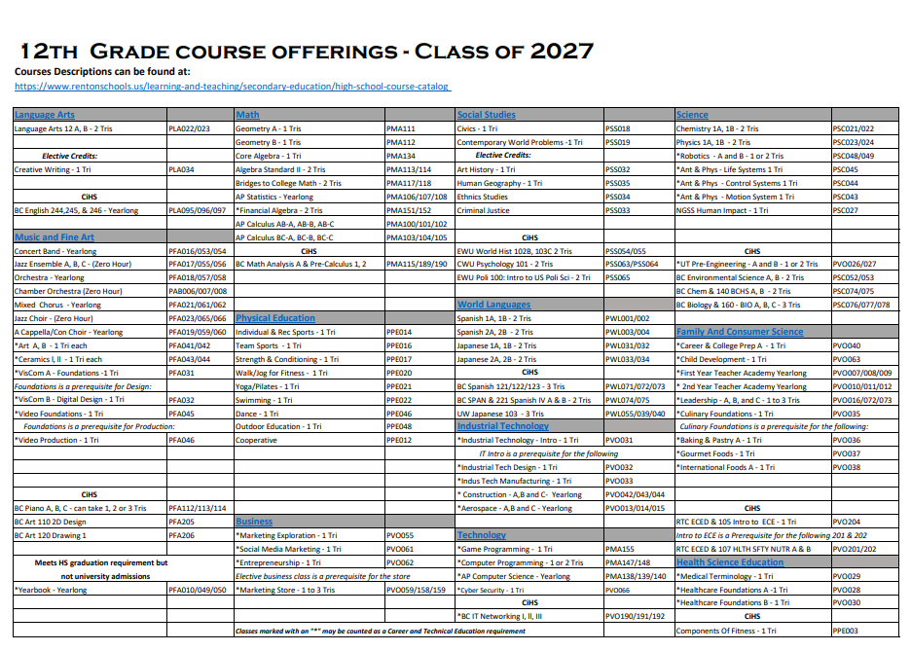
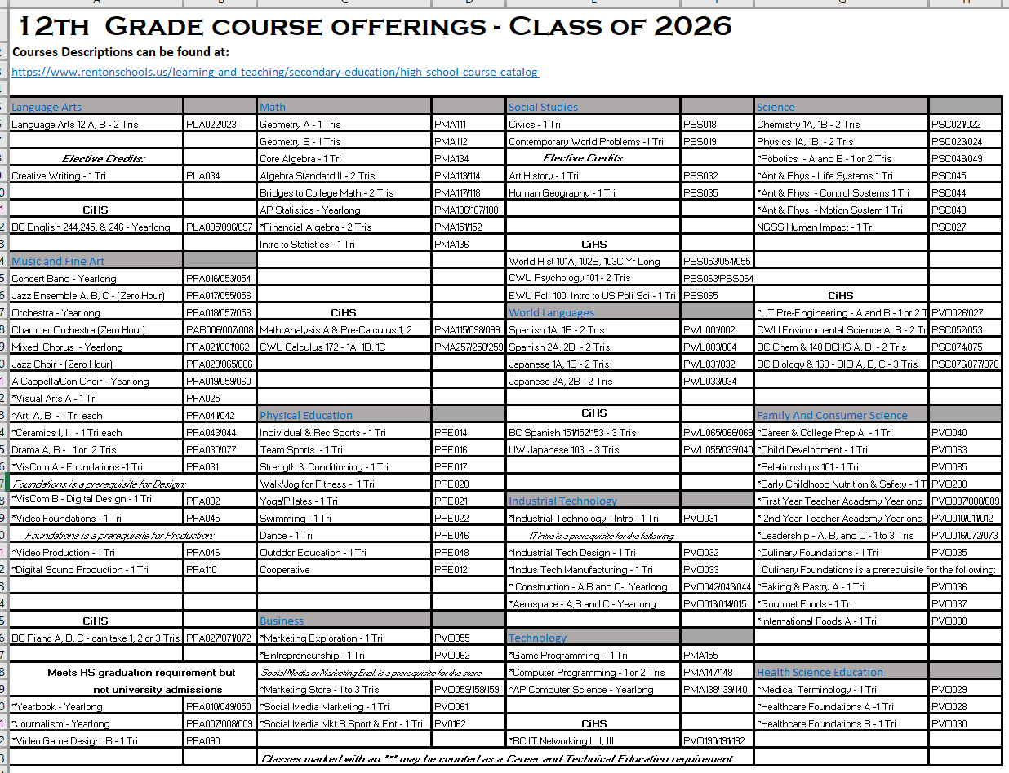
Look at all the Courses to Choose From
Go to the Lindbergh Counseling Website.
Click on the Registration Tab and go to the
  “Class of 2027 – Current Junior” page
Find the “Course Offering Sheet for Seniors”
For descriptions of these courses click on the "Elective Fair Link". When you click on the blue heading it is a hyperlink to course descriptions.

Slide 5
Lots of different ways to fulfill the Core requirements
Language Arts – Do you want Regular, Honors, AP or College in the
High School?
Social Studies – Do you want Regular, College in the High School or AP?
Math –Algebra, Geometry and more?
Science – 3 years but there are so many to choose from
PE Choices – I see over nine to choose from
Fine Art Choices – There is an entire column of Fine arts to choose from
World Language Choices – Japanese or Spanish? You can take these for several years and reach college level.

Slide 6
Electives – What is an “Elective”?
These are classes that you take in addition to the
basic requirements.
Prepare for: What are you graduating to?
      Four-year Colleges and Universities
      Two-year Community Colleges
      Career/Technical Trade Schools
      Apprenticeship
      Military
      Employment
Courses that don’t necessarily apply to any of the above, but look like something you’d like to try (you never know where it might lead!)

Slide 7

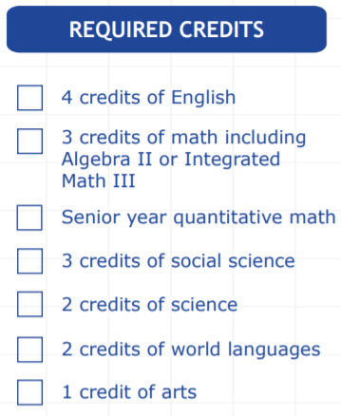
If you are planning to apply directly to a four-year university then your electives are going to be:
Meeting the minimum entrance requirements does not guarantee admittance.
Some colleges have additional requirements, so visit their websites to see what else they require.
More Math, more Science, more World Language- Make yourself academically competitive while still maintaining a strong gpa and a healthy balance.
Balance is key!

Slide 8
What are you trying to graduate to?
What would your electives be if:
You want to do something in Construction?
You want to join the Marines?
You want to start your own business?
You want to work at Boeing?
You want to be a Nursing Assistant?
Thus- anything can be an “Elective”.
For some of you it may be more sciences and more math classes.
For others it may be construction, strength training, business classes etc
It is up to you and your future plans as to what courses you choose to fulfill your elective boxes.
You want to pursue a career in the Performing Arts?

Slide 9
The level of rigor that you choose needs to be individual to you.
Think about other responsibilities such as sports, clubs, outside activities, family obligations, etc.
Balance is key.
Ask for teacher recommendations when choosing core classes
Choose AP or College in the High School courses in subjects you enjoy
Choose courses needed to complete graduation requirements
Read the online High School Course Catalog for information about each course and any additional requirements.

Slide 10
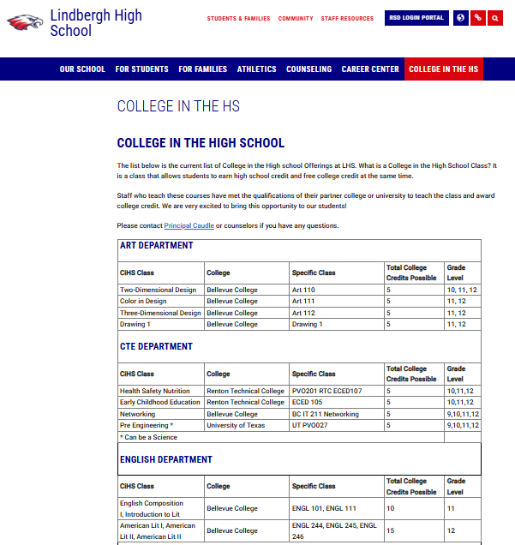
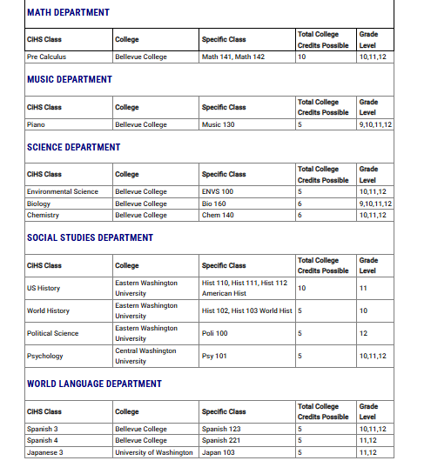

Slide 11
What about my grades?
Grades are important! Here are the typical GPAs of students admitted to some well-known public and private in-state universities:
WSU – Pullman: 3.19 - 3.76
UW – Seattle: 3.7 - 3.95
UW – Bothell: 3.37
Central WA: 2.8 - 3.5
Eastern WA: 3.22
Gonzaga: 3.5 - 3.88
PLU: 3.48 - 4.0

Slide 12
Okay, the grades slide scared me. Do I have other options?
Yes! Another common pathway is to start at a community college and transfer to a 4-year college from there.
Community Colleges are also a place where you can prepare for careers that don’t require a 4-year degree

Slide 13
So, you’re saying my high school grades don’t really matter if I’m going to a community college or trade school?
Umm…NO, that’s NOT what I’m saying.
For core classes like English and Math, you still need to go through a placement process to see what classes you are eligible to take.
  Most high school graduates are eligible to take English 101 right away. If you have AP credit, you may even get to test out of it.
  For math, it’s common to take a placement test or have your placement based on your grade in the most recent class you took.
    Only 100-level classes or higher earn college credit
    Many students who don’t do well in math in high school are placed in remedial (less than 100-level) math classes…which means they have to pay to take classes that don’t even get them any college credit. So keep studying for math!!!

Slide 14
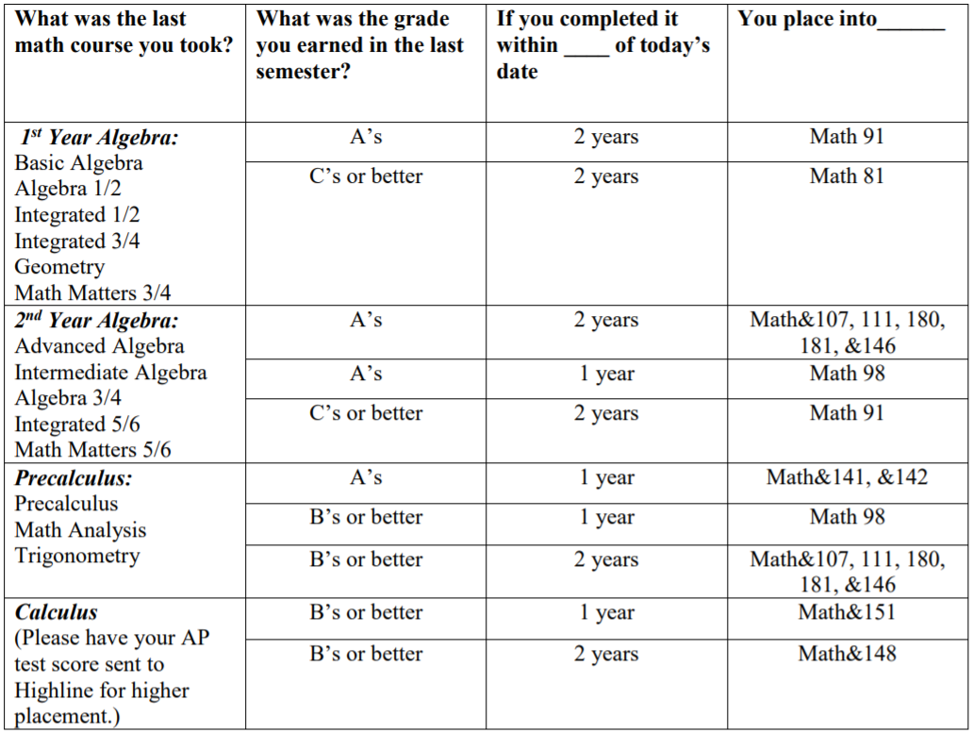
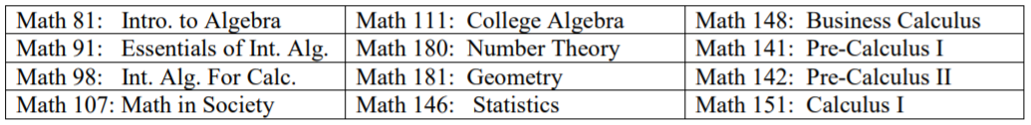
This is an example of how some technical and community colleges determine math placement based on high school math classes. This is from Highline Community College.
Remember, only 100-level classes count toward college credit, so do your best in your high school classes!
They may also place you based on your math SBA scores; if you score Level 3 or higher on the SBA, you automatically get placed in a 100-level class at most in-state colleges!

Slide 15
What other classes should I take next year?
Aside from the required classes, that’s up to you!
  Look for classes that relate to what you plan to do in your career
  Try something you’re interested in
  Talk to your teachers. They have great ideas!
  Talk to your parents. They may also have great ideas!
  Try something entirely new; you never know where it might lead!

Slide 16

Alternates!
You are going to need 6 of them
The Master Schedule is a complicated puzzle.
Not all of your first choices are going to fit.
In order to have a full schedule you MUST pick six alternates.
Look over all of the courses to choose from. Find six of these that you would be willing to take when some of your top choices will not fit.

Slide 17

Counseling Team
Wiam Humadi (A-E)
Beth Lumsden (F-L)
Corbin Sheffels (M-R)
Koy Saechao (S-Z)
College and Career Specialist: Christina Park
Counseling Office Manager: Nelly Moreno

