Slide 1

Kindergarten 2025-26
Carrie Compton – ccompton@paulding.k12.ga.us
Christine Elgaen – celgaen@paulding.k12.ga.us
Denise Morgan – dmorgan@paulding.k12.ga.us
Allison Thomas – athomas2@paulding.k12.ga.us

Slide 2

Priority concepts in Reading
Skills:
  Identify and produce sounds for all letters, including long and short vowel sounds.
  Segment spoken words into individual sounds
  Read 3 letter words by making each sound and blending sounds together
Resources:
  UFLI- Free resources available at UFLI Apps | U F Literacy Institute
  Suggested Activities:
    UFLI online/printable games: Games for UFLI Foundations
    Decodable games: Foundations-Decodables-K.pdf
    Dallas Parent Resource Center

Slide 3
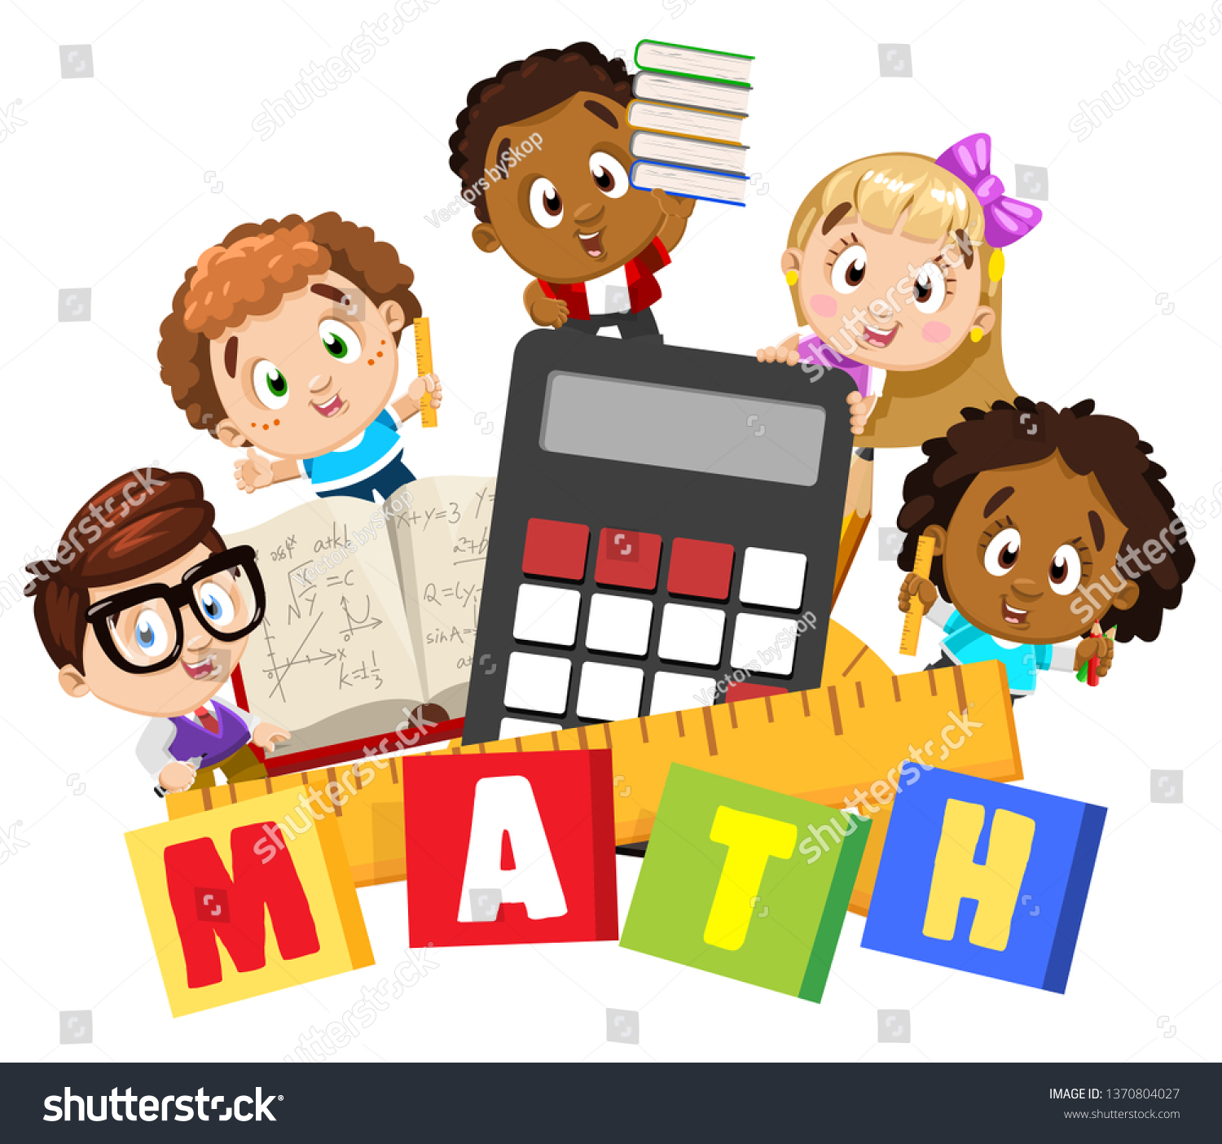
Priority concepts in Math
Counts up to 20 objects; knows the last number named is the total quantity; one more or one less within 10; identify pennies, nickels and dimes.
Count forward from any given number within 100 by ones and 10s and backward within 20
Identify, write, represent numbers to 20 and compare number of objects up to 10
Use a variety of strategies and representations to add and subtract within 10
Compose and decompose numbers 11-19

Slide 4

Priority concepts in writing
Correct letter formation using primary paper
Uppercase letter for beginning of a sentence
Write the pronoun “I”
Be able to identify subject and predicate in a sentence.
Draw, label and write to create a text for expository, opinion, narrative and poems.

Slide 5
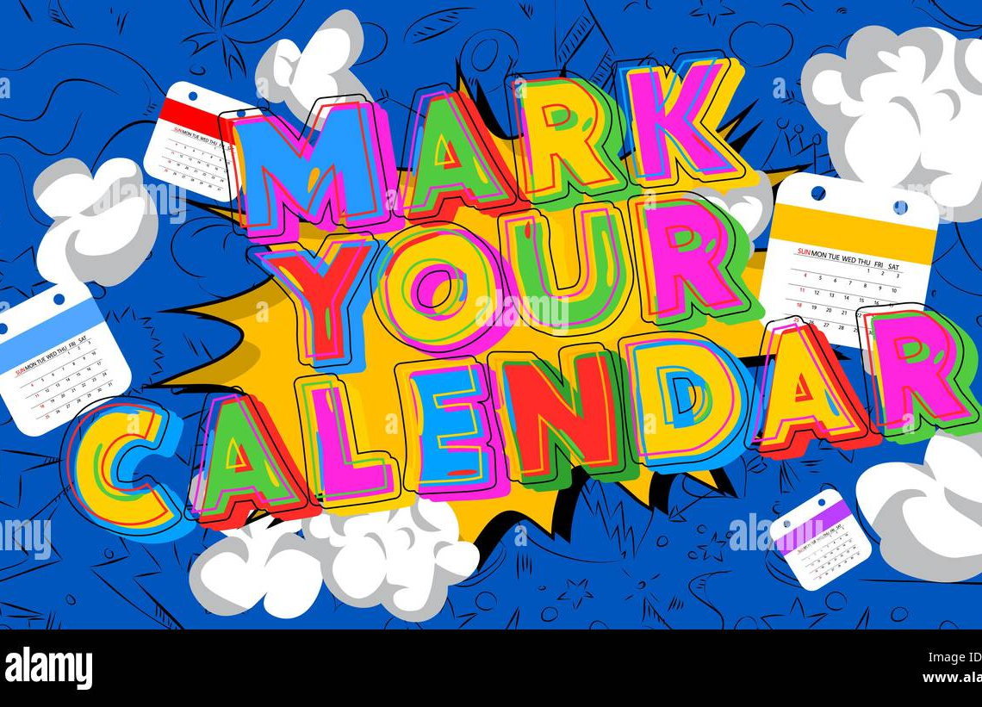
Upcoming events/projects in classroom
Turkey in disguise Assignment due November 17
Veterans day assembly on November 11- Please wear red white a blue.
Jingle jam takes place on December 18 – Students will sing.
The 100th day of school in January. We'd love your help to create a and wear a shirt decorated at home with 100 items. We will celebrate the learning and growing your child has done so far this year. (items can be stickers, buttons, beads, shapes, ect.)

Slide 6
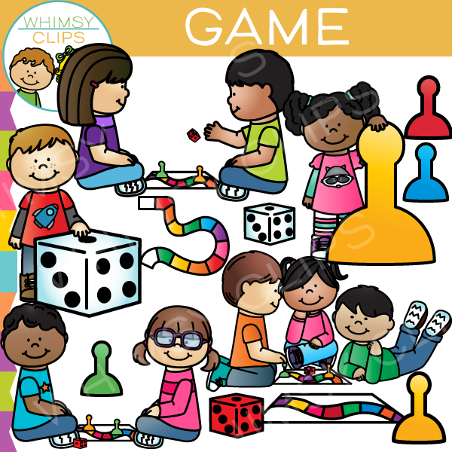
Games/ resources to reinforce learning
Dallas public library – get a library card to check out books and use computers for free.
Visit the Dallas elementary Parent Resource Center.
Splash learn-online game look for invite sent from your teacher.
Starfall- online game. Free access to practice -reading phonics and math.
Ufli- stands for University of Florida Literacy Institute known for its evidence- based reading problem, used to teach foundational reading skills.

