Slide 1


Welcome to
3rd Grade!
2025-2026

Slide 2

Contact Information
Feel free to reach out to your child’s teacher with questions.
Mrs. Baker: lbaker@paulding.k12.ga.us
Mrs. Hannans: dhannans@paulding.k12.ga.us
Ms. Price: lprice@paulding.k12.ga.us
Mrs. Spiva: jspiva@paulding.k12.ga.us
Dallas Elementary Phone Number: 770-443-8018

Slide 3

Grade Level Standards
All lessons adhere to GA Standards of Excellence for all subjects
Parent Resource link to GADOE: https://gadoe.org/parents/
Parent Math Info: 3rd-Grade-Mathematics-Parent-Letter (gadoe.org)
GADOE Suitcase for ELA, Math, SS, and Science Standards: https://case.georgiastandards.org/

Slide 4

Curriculum: ELA/Reading
All teachers follow the Paulding County School District assessment guide. This guide provides teachers a timeline of when to teach and assess standards. For more information, visit www.georgiastandards.org.
Reading (Bookworms Program)
Shared Reading
Interactive Read Aloud
Interventions: UFLI
Science
Heat Energy
Habitats of Georgia
Pollution
Rocks and Soil
Fossils
Writing​
Narrative Writing​
Informational Writing​
Opinion Writing​
Social Studies (integrated during Reading and Writing)​
European Explorers​
Government​
Economics​
Map Skills​
Native Americans​
Colonial Life

Slide 5

Curriculum: Math
Operations and Algebraic Thinking
Numbers and Operations-Fractions
Measurement and data
Geometry
    What is Illustrative Math?
    IM is a problem-based curriculum where students spend most of their time working on sequenced problems. Students gain a rich and lasting understanding of mathematical concepts and procedures and experience applying this knowledge to new situations. Students frequently collaborate with their classmates-they talk about math, listen to each other’s ideas, justify their thinking, and critique the reasoning of others.
    Illustrative Mathematics Grade 3 – Family Support |
    Do the Math- Intervention Support

Slide 6

State Assessment:
Georgia Milestones
Overview of GMA –
  https://www.gadoe.org/Curriculum-Instruction-and-Assessment/Assessment/Pages/Georgia-Milestones-Assessment-System.aspx
We will share additional GMA information with parents in the spring.

Slide 7


District Assessments
Beacon Assessment
  Assesses Reading and Math for GMAS Readiness
  Given 3 times per year 1st-5th (Fall, Winter, Spring)
Amira Assessment
  Assesses Reading fluency, comprehension, vocabulary, etc.
  Benchmarks 3 times a year with regular practice weekly
  Parent letter: https://amiralearning.com/hubfs/Customer_Resources/Family_Letter_2526.pdf?hsCtaAttrib=193817009966

Slide 8
Grading Scale
Grades are on a 1-4 scale.
4 | 3 | 2 | 1
Exceeds Mastery: Student applies the skill or concept independently and correctly; communicates higher level thinking or skill level significantly above grading term expectation. This score is a Satisfactory score. | Demonstrates Mastery: Student applies the skill or concept independently and correctly; communicates clear understanding at grading term expectation. This is a Satisfactory Score. | Progressing Towards Mastery: Student applies the skill or concept with support/not independently; communicates some understanding but is not currently meeting grading term expectation. This is an Unsatisfactory score. | Limited or Minimum Progress: Student has limited ability to apply the skill or concept, even with support; communicates limited understanding and is not currently meeting grade term expectations.

Slide 9

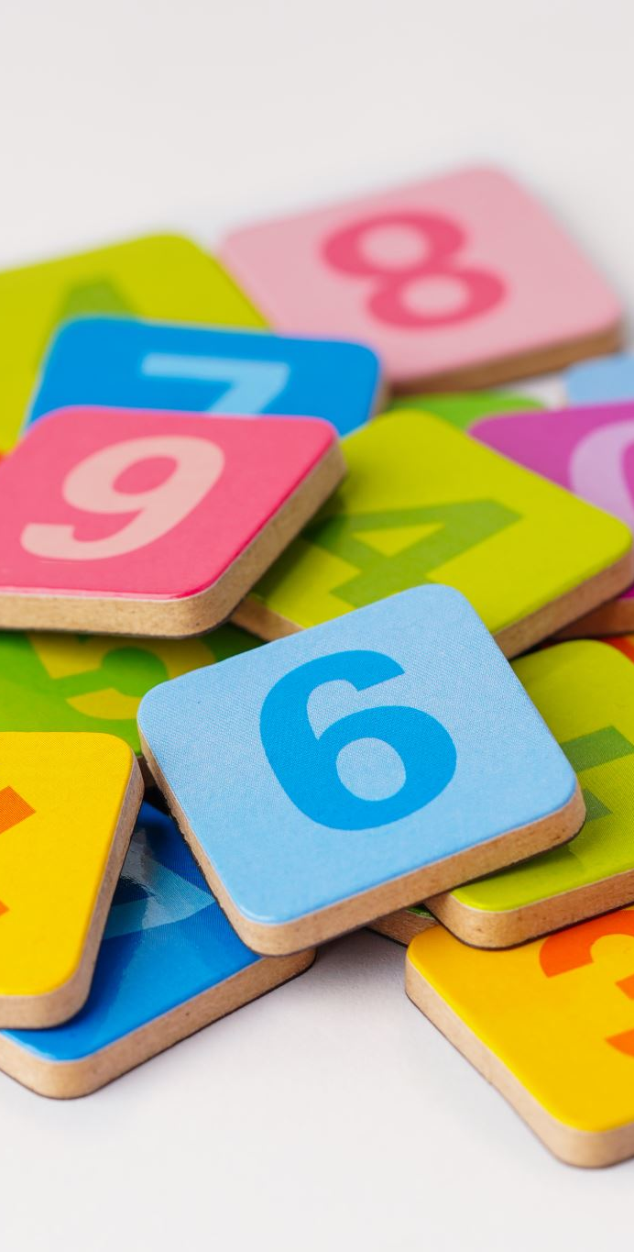
WAYS TO ASSIST AT HOME
WAYS TO ASSIST AT HOME
Encourage your child to read for 15-20 minutes every night.
Let your child log on to Progress Learning.
Encourage your child to read aloud to practice fluency and expression.
Ask your student (who, what, where, when, how/why) to develop comprehension.
Practice math facts.
Utilize our Parent Resource Center for games, cards, etc.
  Info for checking out items here: https://www.paulding.k12.ga.us/Page/25613

Slide 10

Tech Tips
Canvas Student Login –
  Student login - Student ID # @paulding.k12.ga.us
    (i.e. 12345@paulding.k12.ga.us)
  Student Password – first initial + middle initial + last initial and 4 digit birthday (month and day)
    (i.e. abc0102)
Canvas Parent Help Guides -
https://community.canvaslms.com/t5/Observer-Guide/tkb-p/observer
Information for Digital Learning Days – short term and/or long term (pivot) - https://www.paulding.k12.ga.us/Page/42513

Slide 11

Attendance Policy
Students are allowed 3 parent notes per semester and unlimited medical notes to excuse an absence. You can view your student's attendance records in Infinite Campus Parent Portal under the "Calendar" tab, then select "Attendance".
Phone calls from the parent/guardian to the school do not result in the absence being excused. If your child is absent from school, please submit a written excuse to your child's homeroom teacher or by email to the school secretary.
Need help accessing Infinite Campus Parent Portal? Help is here: https://www.paulding.k12.ga.us/domain/4142

Slide 12

Homework
While we do not assign nightly homework, we do ask students to read 15-20 minutes a night.
Students may be assigned incomplete class assignments on an individual, as needed basis.
Students have the option to practice grade-level skills through programs accessed through the PCSD portal using Clever.

