Slide 1

WIDA Access Online
Technology Tips

Slide 2
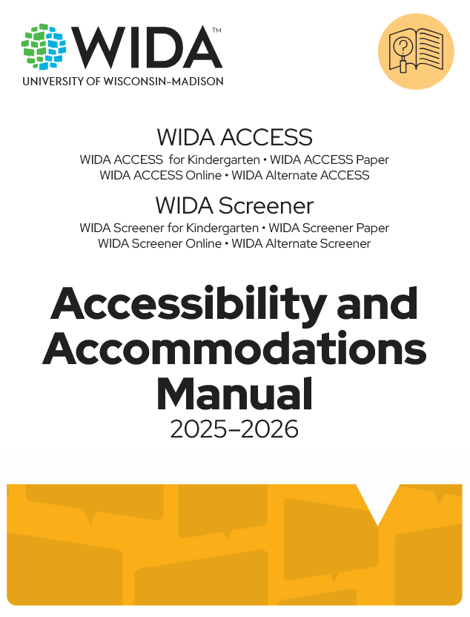
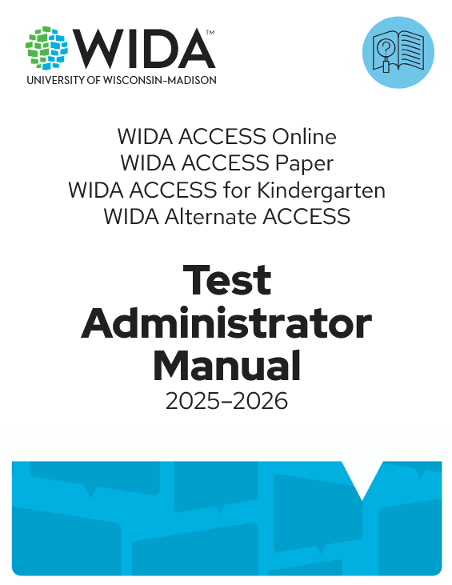
Test Administration Resources
Training Presentations
Test Administrator Manual
Accommodations Manual
Grades 4-12 Script
Troubleshooting Guide
Evaluation Services Website https://www.escambiaschools.org/departments/evaluation-services/home

Slide 3

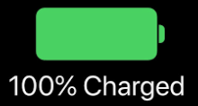

Before Testing
Verify devices are fully charged, or ideally, can be plugged in throughout the test.
Verify the internet connection on each testing device.
Test the audio on all the headphones and the microphones on all the headsets students will use.

Slide 4
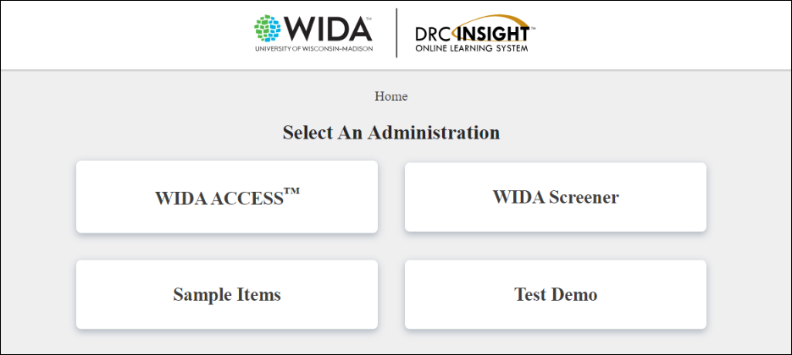
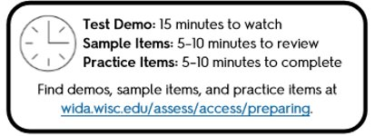
Test Demo, Sample Items, Practice
WIDA ACCESS Online is not a test where students can study but where students need to be comfortable in demonstrating their language skills.​ The more a Test Administrator can expose the student to the administration of the test prior to testing, the more confident the student will be while testing.
WIDA and DRC offer publicly accessible Test Demos, Sample Items, and Practice Items for students, parents and teachers.
Test Administrators should complete the Sample Items and Test Demo to understand the navigation of the test, the layout of the buttons, and the pace and rhythm of the audio.

Slide 5
During Testing
Test Materials
Best Practices
Basic Troubleshooting

Slide 6
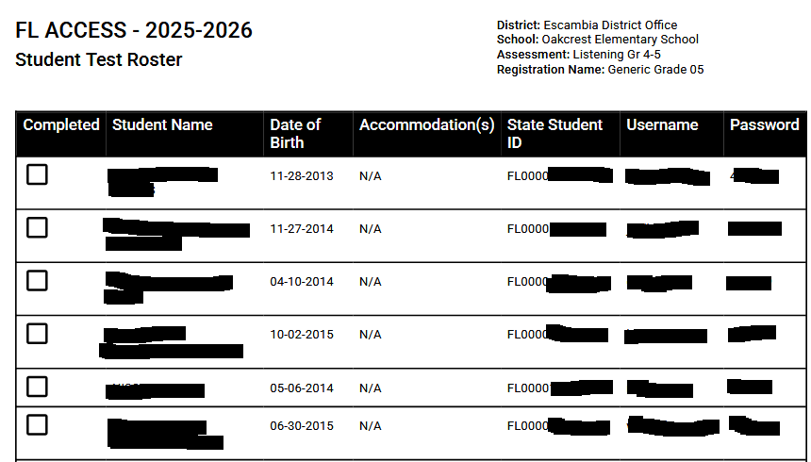
Test Materials – Student Roster

Slide 7
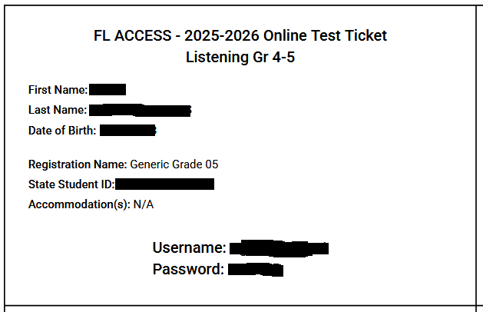
Test Materials - Test Tickets

Slide 8
Best Practices
Follow the Test Administrator Script to guide students through the process of launching and logging in to the test.
Make sure students understand the following basics of the test platform:
  They cannot go back and review or change their responses to test questions. The Writing test is an exception.
  The audio for each page plays automatically and will play only one time. The exception is when a student has been assigned the Repeat Item Audio accommodation.
After students begin testing, collect the test tickets and keep them until the testing session is over. Before, during, and after administration, ensure test materials are stored and handled appropriately.

Slide 9
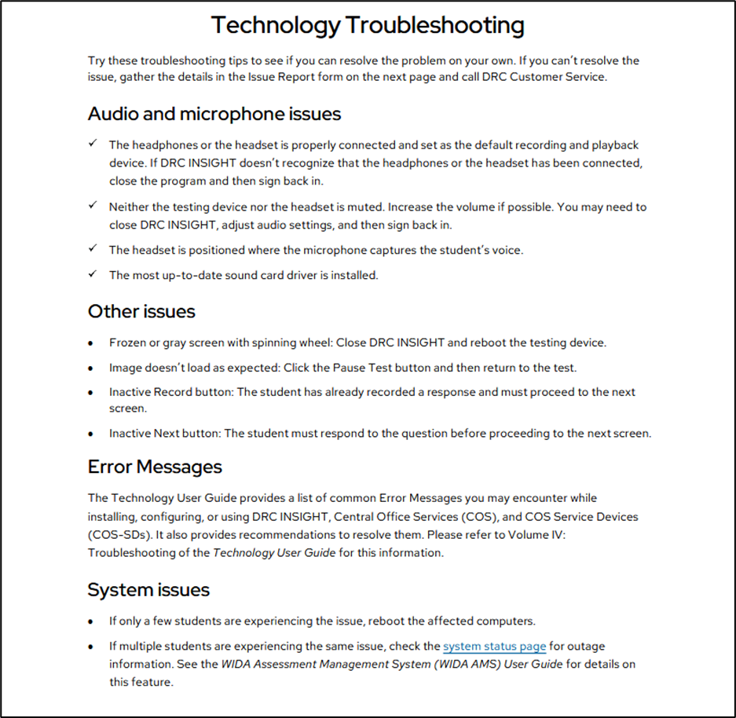
Troubleshooting Tips

Slide 10
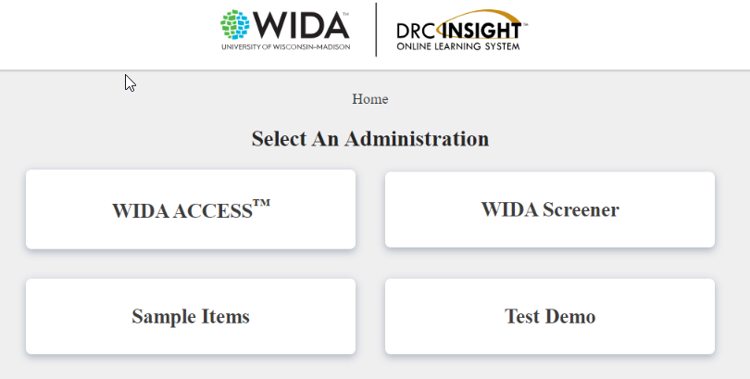
Basic Troubleshooting
Invalid Username and Password​
​
1. Username and password are typed incorrectly.​
​
2. Student is attempting to sign into the wrong Test Sign In location. ​
​
Ways to verify:​
1. Usernames will start with the first initial, full or partial last name, and then a number. Are I's and L's or O's and 0's typed correctly? Usernames are not case sensitive. All passwords should be 6 numbers.​
​
2. Check the test ticket and verify the Test Sign In Location written on the log in screen matches the ticket.

Slide 11
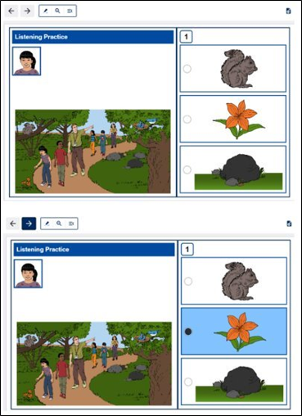
Basic Troubleshooting
Why is the Next button gray?
This will indicate that the student has not answered the question that they are on. For example, if it is multiple choice, the student must select an answer to advance to the next question. For other questions like hot spot or drag and drop, the student must complete the task before the Next button will highlight.
There are also long sections of spoken directions, especially in Listening and Writing. The student must wait for those directions to finish before answering and advancing to the next screen.
Also, check to see if the student has Manual Control of Item Audio. They will have a Play button that must be selected for the audio to start. If the audio cannot start, the student cannot progress.

Slide 12
Basic Troubleshooting
Cannot Type in the Writing Test
If a student cannot type in the test, check to see if the audio is still playing. Some writing prompts have tabs and can have up to 3-4 minutes of audio prior to allowing the student to type responses.
If a student moves away from a question and comes back to the question, the audio will again play in full until the text box activates.

Slide 13
Basic Troubleshooting
Audio and Microphone Troubleshooting
Make sure the headphones/headset is properly connected and set as the default recording and playback device. If DRC INSIGHT doesn't recognize that it has been connected, close the program and then sign back in.
Make sure that neither the testing device nor the headset is muted. Increase the volume if possible.

Slide 14
After Testing
After your student has completed the tests for all four domains (Listening, Reading, Speaking, and Writing), gather all the test materials you initially received, including any materials you modified to meet a student’s needs.
Securely store all test materials until you return them to your test coordinator.

