Slide 1
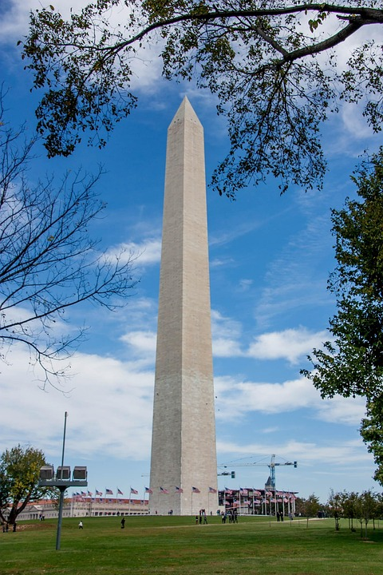

In AP United States Government and Politics, you'll examine the relationships between the president, Congress, and the Supreme Court, and explore how different political ideologies and opinions shape American Politics.
Senior level Ap Government
Ms. Dias-Schindler

Slide 2

Prerequisites and Expectations
This Class has no prerequisites. It is only a semester long and you will take the AP exam in the spring. Therefore, if you take the class in fall you will have six months in between the class and the AP exam.

Slide 3
Expectations
There is a lot of reading required for this class. The work load is quite a lot because we are fitting one year of material into a semester. I would expect to spend at least an hour on this course a night outside of school. Students will need to be able to analyze and interpret graph, charts and reading and be able to relate them back to the Constitution, required reading and court cases. The AP exam is 55 questions and 4 essays. You have 3 hours for the exam. There are four essays which include: and argumentative essay, a concept application essay, a SCOTUS comparison essay and a Qualitative essay. This is one of the hardest AP exams offered.

Slide 4
Fees and Types of Grades
There are no fees for this course.
Major Grades- consist or tests with essay, projects and occasionally guided reading packets
Minor Grades- vocabulary quizzes, content quizzes and guided reading packets
Practice grades- readings, content practice.
Please feel free to email questions to schindlerj@fultonschools.org

