Slide 1
Slips, Trips, and Fall Prevention
Hattiesburg Public Schools

Slide 2
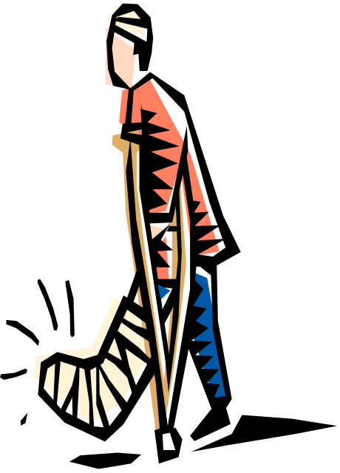
Slips, Trips, and Falls…
  represent a large number of preventable accidents within the district
  can be costly to both the district and the employee
  can occur inside or outside
  may result in serious outcomes
  can happen to anyone at anytime
  can result in lost wages, pain, possible disability, reduced quality of life, possible depression, modified work duty, etc.

Slide 3
Definitions
Slips: The loss of balance caused by too little friction or traction between your feet (footwear) and the walking or working surface.
Trips: A loss of balance caused from a person’s foot contacting an object or dropping to a lower level while moving forward or backwards.
Falls: The result of a trip or slip that causes the body to loose balance and strike a surface or object.

Slide 4
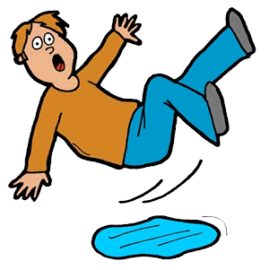
Slips are categorized as:
  Forward motion slips
  Backward motion slips
Slips may be caused by:
  Wet, oily or slippery surfaces
  Occasional spills
  Weather hazards
  Loose, unanchored rugs or mats
  Flooring or other worn walking surfaces

Slide 5
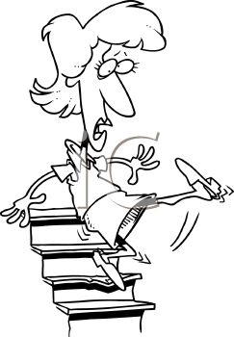
Trips are categorized as:
Toe Stub (front foot strikes an object and is stopped)
Differing Step Height (step height is higher than expected)
Drop Step (step height is lower than anticipated)
Obstructed Path (foot path travel is interrupted)

Slide 6
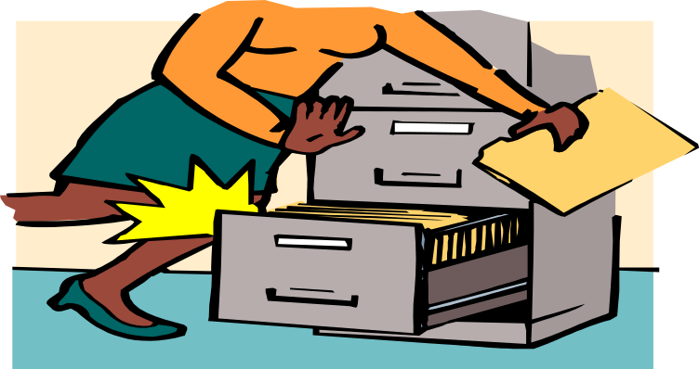
Trips May Be Caused by:
Obstructed view
Poor lighting
Cluttered areas
Uncovered cables
Unclosed drawers
Wrinkled carpeting or lifted floor mats
Uneven walking surfaces (steps, thresholds)

Slide 7

Falls are categorized as:
Type 1: Same level falls
  Slip or trip immediately precedes fall
  to the floor or walkway
Type 2: Elevated falls to a lower level.
  Falls are from a platform, dock, ladder, step or stair

Slide 8

Common Causes of Falls:
Oily or wet surfaces
Elevated walking surfaces (parking lots,
sidewalk cracks, tree roots)
Slippery surfaces due to sand, dust,
gravel, mud or ice
Bus step platforms, door threshold
Waxed or wet floors in a classroom or
cafeteria
continued…

Slide 9
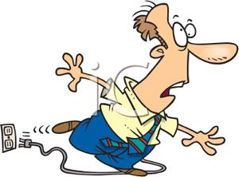
Common Causes of Falls (continued…)
Cables or cords not properly stored away
from the pathway
Food or liquid spillage in the cafeteria
Boxes, books, or carts blocking the footpath
Chairs or tables blocking an entry way or
normal pathway
Improper use of a ladder or step stool

Slide 10
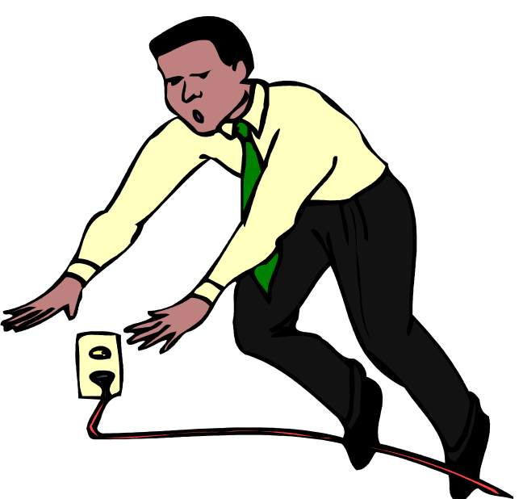
Other Contributing Factors
Impaired senses (sight, hearing or feeling)
Fatigue or illness
Being in a hurry and/or rushing around
Medications, alcohol or drugs
Behaviors/Emotions (angry, sleepy, excited, stressed)
Poor housekeeping (clutter)
Improper or no signage
Not holding onto handrails
Lifting/carrying too much
                continued...

Slide 11

Other Contributing Factors
Lack of sleep
Inattentive behavior (cell phones, iPod, talking)
Clumsy or physically deconditioned
Distractions (noises, music, people)
Obstructed views when carrying/moving something
Taking shortcuts or using undesignated walkways
Language barriers
Unable to read
Poor lighting

Slide 12
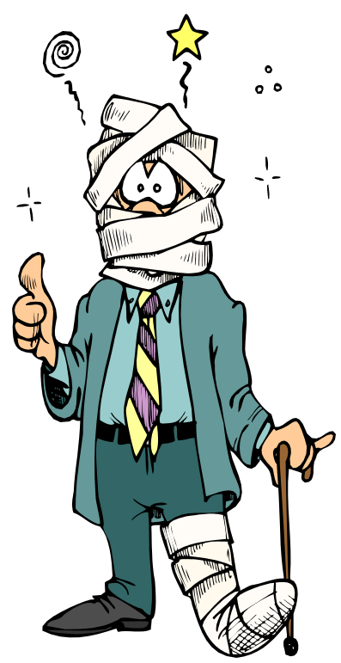
Some Common Injuries Associated with
Slips, Trips, and Falls:
  Sprain and strains
  Bruises and contusions
  Abrasions and lacerations
  Fractures
Remember, the primary cause of any accident
can be attributed to a lack of attention!

Slide 13
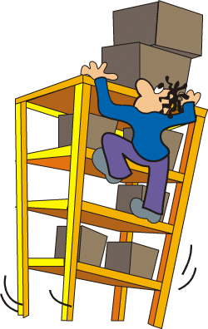
Prevention Strategies
Although there is never any way to completely prevent accidents or injuries, there are ways to reduce the likelihood of them happening.
Promote injury awareness (in-service, presentations, checklists, posters, signage, safety meetings etc.)
Education of supervisors, risk managers, employees
Gather information about injuries
Determine how to reduce injuries
Implement & train prevention strategies
Follow up to determine effectiveness

Slide 14
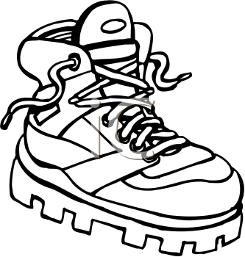
Things to Consider
Selection of proper footwear
  Consider time outdoors
  Discuss proper fit, comfort, fatigue, and safety
Good housekeeping
  Keep floors clean
  Use proper signage
  Remove obstacles from walkways (cover cables, close cabinets drawers, replace burnt out bulbs)
  Use portable lighting when needed
  Be extra alert when carrying or pushing objects
  Secure rugs and carpets
  continued…

Slide 15


More Things to Consider
Walking surfaces/flooring
  Replace or recoat floors (if applicable)
  Install mats with pressure sensitive abrasive strips
  Identify and mark hazard zones
Appropriate pace of work
  Take your time at work
  Pay attention
  Adjust your walking stride to the task
  Make wide turns at corners

Slide 16
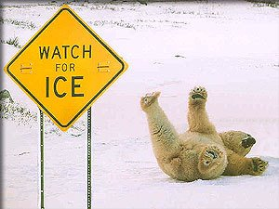
Inclement Weather
Preparing for inclement weather is often the best prevention to reduce the risk of weather related injuries.
Slow down to react to traction changes (walking or
driving)
Wear slip resistant shoes or overshoes (carry your
work shoes)
Wear sunglasses outdoors (sunny, snow or icy days)
Be careful of wet shoes on dry floors

Slide 17

Report Hazards
Report all hazards immediately
Reduce risk of hazards
    Alert all persons in the area
    Mark off the area or stay there until help arrives
Remove the hazards whenever possible
In the event of an emergency, CALL 911!

Slide 18
Thank you!

