Slide 1
Standards Gradebook Training

Slide 2
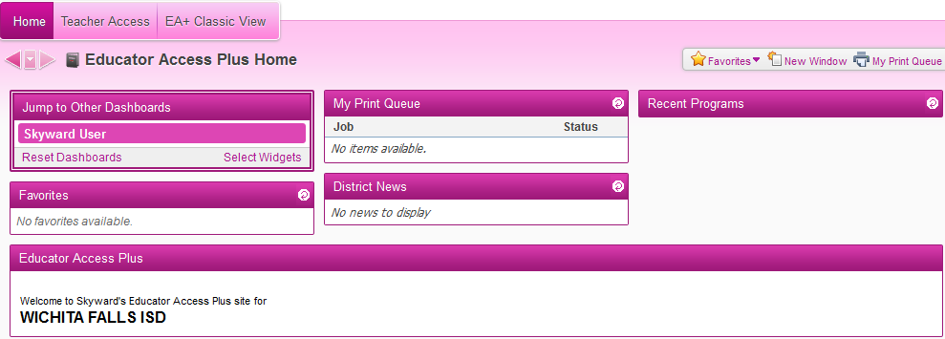
New “Dashboard” Style Home Page
Can customize with widgets
Can move windows around

Slide 3
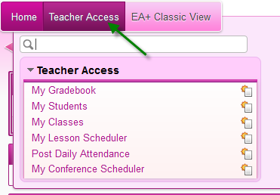
Teacher Access
Use this menu to access your gradebook and attendance

Slide 4
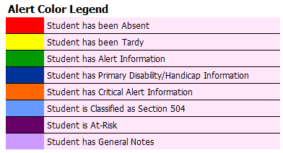
Post Daily Attendance
By Name
Alert Legend
Student Indicators

Slide 5
Post Daily Attendance
Assign Seats
  Create number of rows and sets per row
  Can auto assign seats or manually assign
Take Attendance by Seating Chart

Slide 6
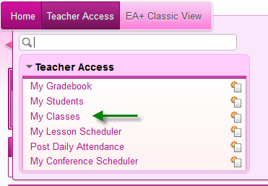
My Classes
My Classes > Class Options

Slide 7
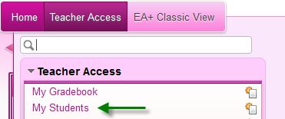
My Students
Profile – Demographic information
Class Summary – Grade information
Schedule
Discipline – Referrals entered by you. Can add a referral here.
Family Access History – Can see when parents have logged in.
Information Report

Slide 8
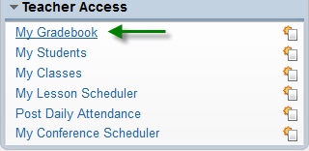

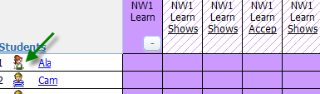
My Gradebook
Students – icon beside student name will display demographic information.

Slide 9

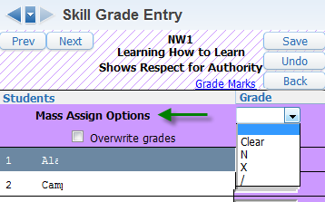
My Gradebook - Skills
Click on the name of the Skill across top to enter value for all students for this particular skill. Can Mass Assign.

Slide 10
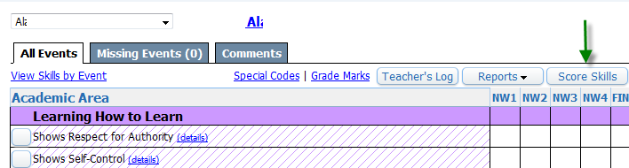
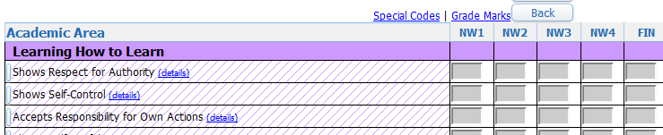
My Gradebook - Skills
Click on name of student, then Score Skills, to assign a score to all skills for this student.

Slide 11
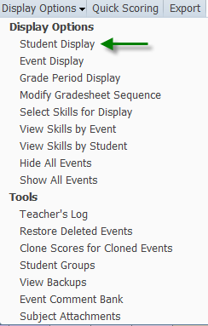
Display Options
Choose how you want student names/information displayed in your gradebook.

Slide 12
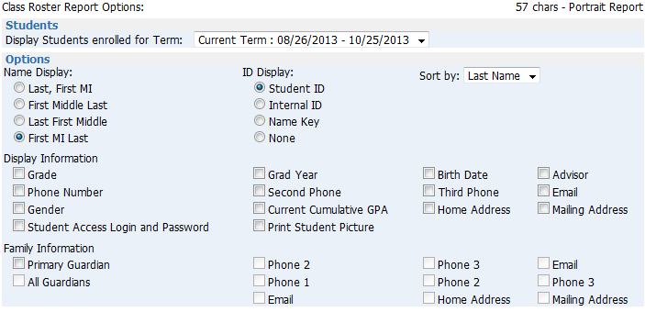
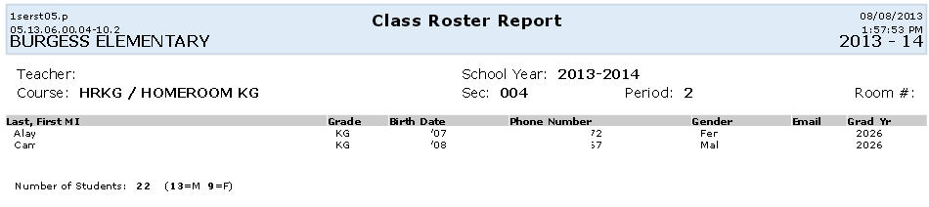
Reports
Class Roster
  Skyward templates or create your own
  Choose information you
  want to display on the
  report

Slide 13
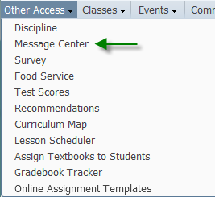

Message Center
Other Access > Message Center
Can post to Family Access
Can send email to guardians
Can select which students will receive message
Can add attachments

Slide 14
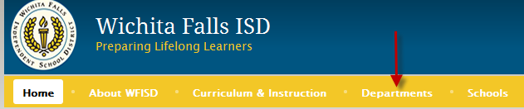
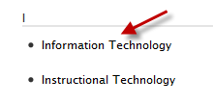
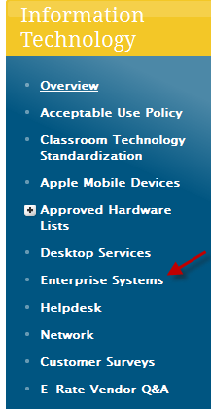
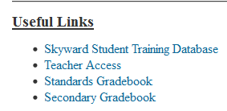
Gradebook Documentation
WFISD homepage > Departments > Information Technology
Enterprise Systems

