Slide 1
New Teacher Gradebook Training

Slide 2
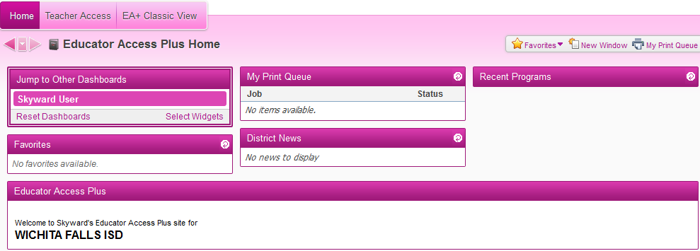
New “Dashboard” Style Home Page
Can customize with widgets
Can move windows around

Slide 3
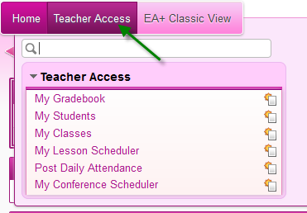
Teacher Access
Use this menu to access your gradebook and attendance

Slide 4
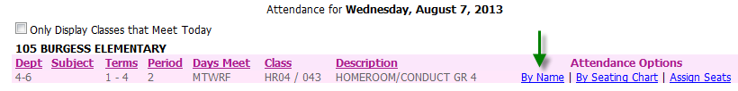
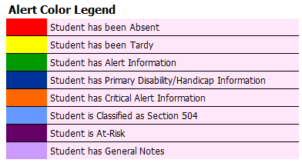
Post Daily Attendance
By Name
Alert Legend
Student Indicators

Slide 5
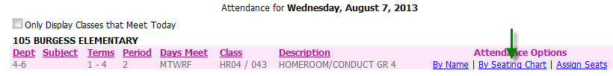
Post Daily Attendance
Assign Seats
  Create number of rows and seats per row
  Can auto assign seats or manually assign
Take Attendance By Seating Chart

Slide 6
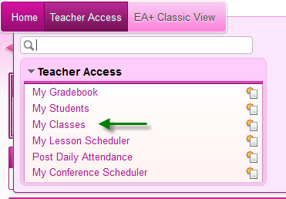
My Classes
My Classes > Class Options

Slide 7
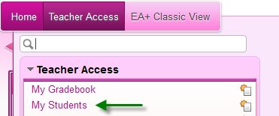
My Students
Profile – Demographic information
Class Summary – Grade information
Schedule
Discipline – Referrals entered by you. Can add a referral here.
Family Access History – Can see when parents have logged in.
Information Report

Slide 8
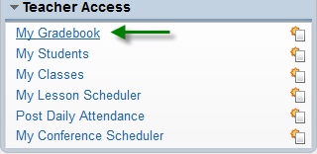
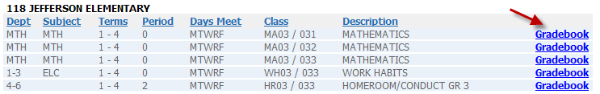
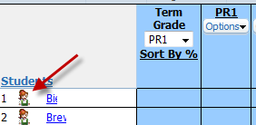
My Gradebook
Students – icon beside student name will display demographic information.

Slide 9

My Gradebook – Add Assignments
Choose category – if teaching elective course and no categories are setup, let me know.
Description – Name of assignment.
Assign Date – Must be within reporting period.
Due Date – Must be within reporting period.
Max Score
Post to Family Access – This must be checked for assignment to show in Family Access.

Slide 10

My Gradebook – Add Assignments
Attach – can add attachments to be viewable in Family/Student Access.
Options – can create online assignments.

Slide 11
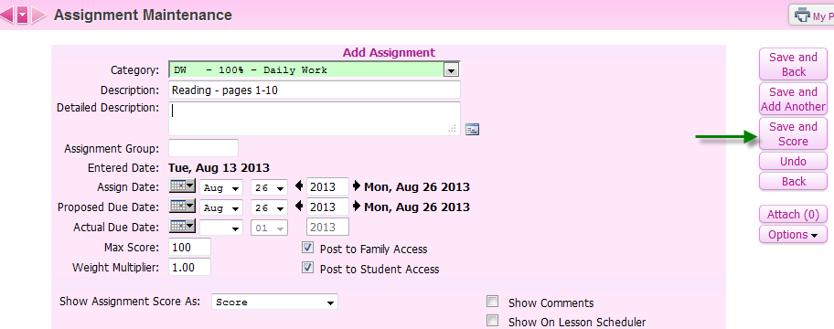
Scoring Assignments
After adding assignment > Save and Score

Slide 12
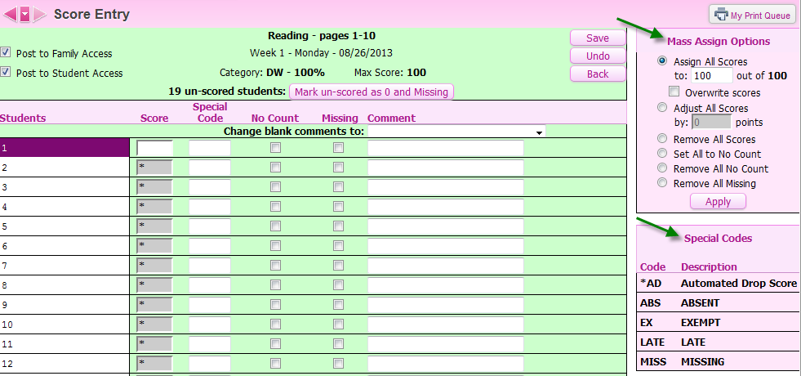
Scoring Assignments
Score Entry screen
  Add grades for all students for this assignment
  Can mass assign a grade for all students

Slide 13

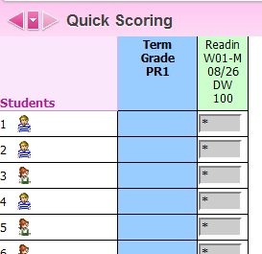
Scoring Assignments – Quick Scoring
Quick Scoring
  Can add scores for all students for all assignments

Slide 14

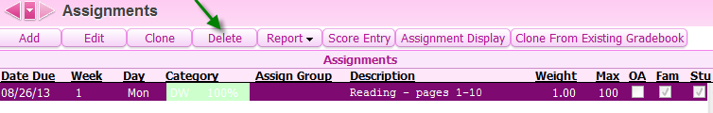
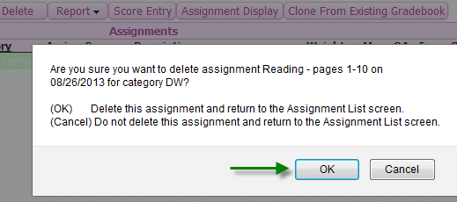
Edit/Delete Assignments
Assignments > List Assignments
Delete assignment
This will delete the assignment and all scores

Slide 15
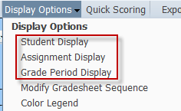
Display Options
Student Display - Choose how you want student names/information displayed in your gradebook.
Assignment Display – information about assignments that you want to display
Grade Period Display – information about grading periods you want to display

Slide 16
Reports
Class Roster
  Skyward templates or create your own
  Choose information you want to display on the report
Grade Sheet report – printout of screen in gradebook
Progress Summary – all students, name and current grade
Progress Detail – assignments and grades, one sheet per student

Slide 17
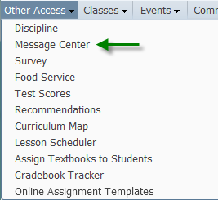

Message Center
Other Access > Message Center
Can post to Family Access
Can send email to guardians
Can select which students will receive message
Can add attachments

Slide 18
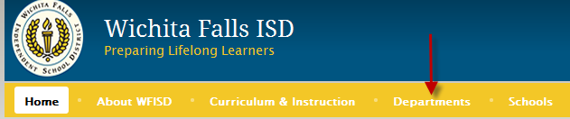
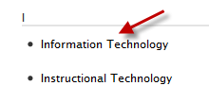
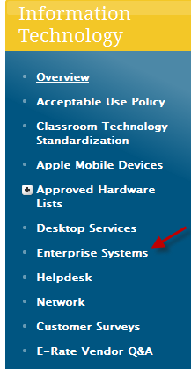
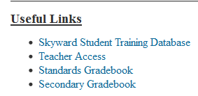
Gradebook Documentation
WFISD homepage > Departments > Information Technology
Enterprise Systems

