Slide 1
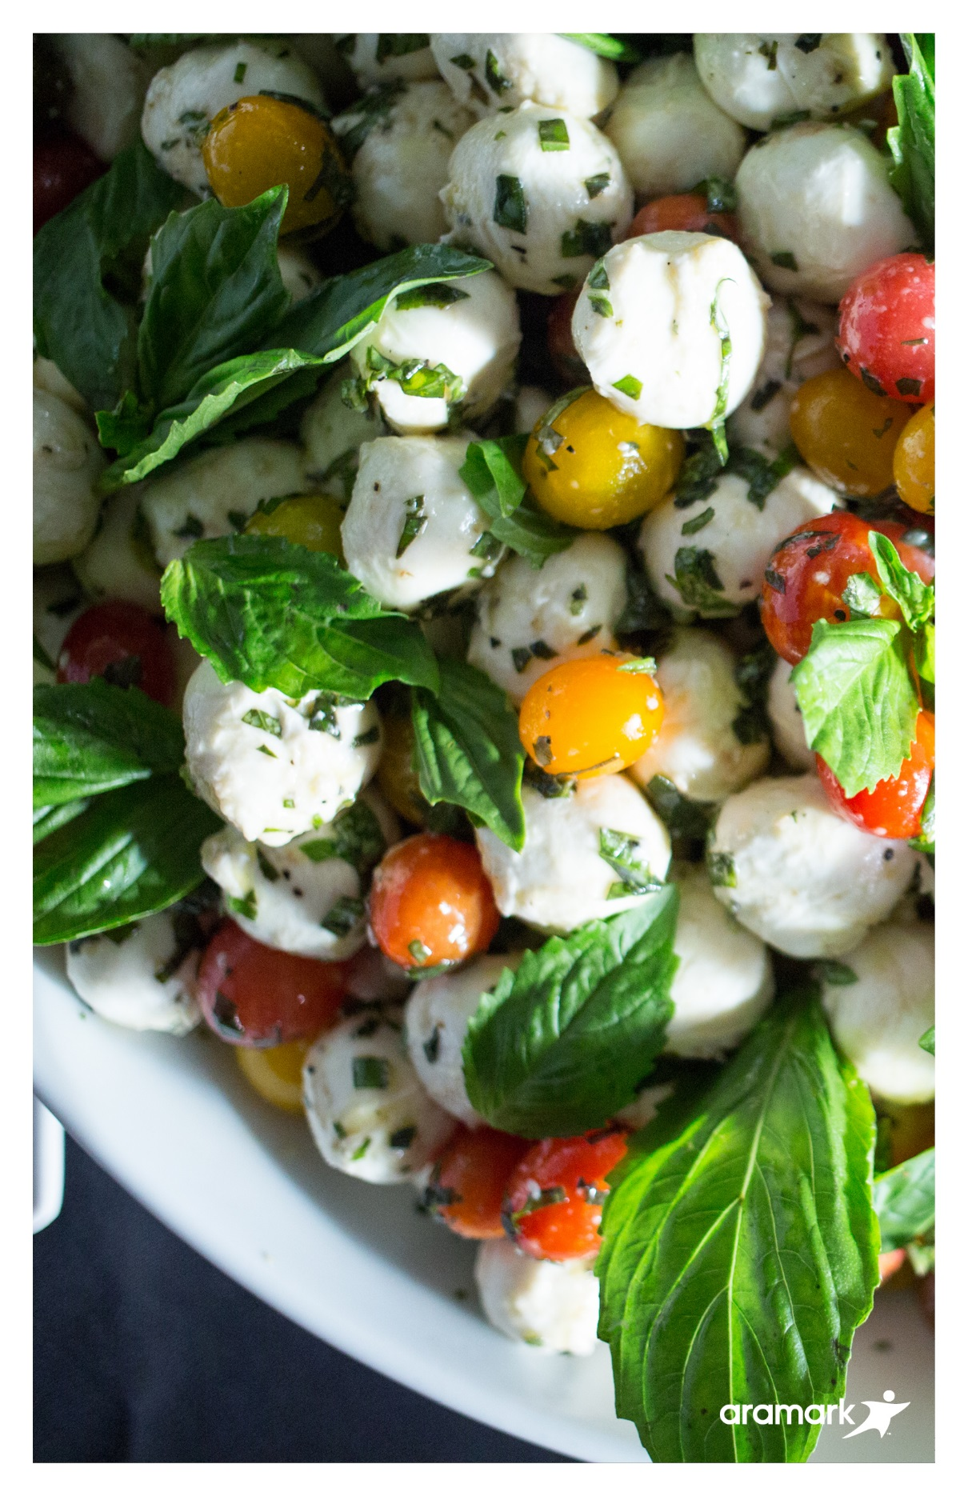
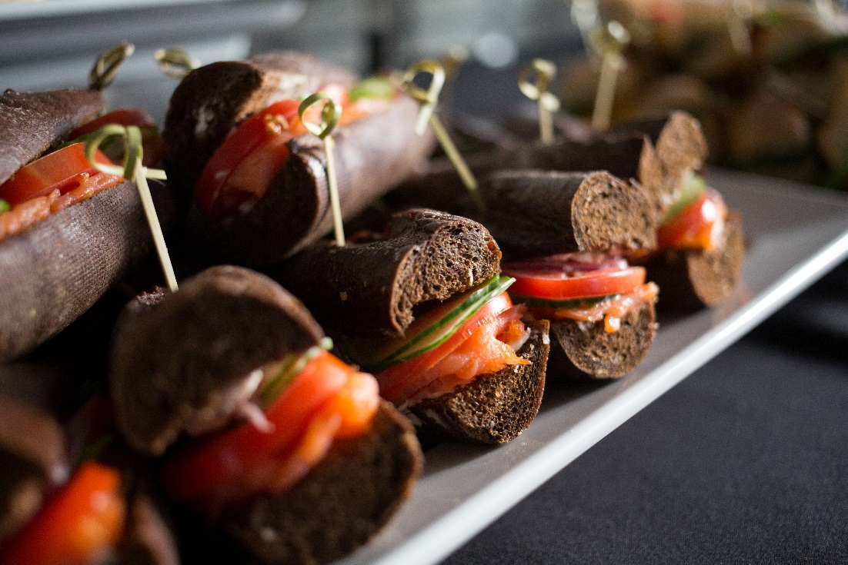

ORDERING & DELIVERY
CATERING GUIDE
Bloomfield Hills Schools
While the many ideas included in this guide provide a wide variety of options in menu planning, it is impossible to reflect the varied tastes of the entire community. Our staff can help design just the right menu to suit your particular needs for your social and professional gatherings.
Can’t find something? We are happy to design a menu that fits your needs!
ORDERING INFORMATION
Whatever your occasion, our wide variety of selections will fit all your needs. Contact our Catering Coordinator to help you create your perfect event!
LAST MINUTE ORDERS
We ask for a week’s notice for all catering orders. However, we understand that last minute needs do arise and will make every effort to accommodate them. For your last minute orders, we will offer a selection of Food & Beverages.
Night events may have an additional labor charge. Please enquire when booking.
To Order
Phone: 248-341-5672
Bloomfield Hills Food Service
4200 Andover Rd, Bloomfield Hills, MI 48302
Email: mromsek@bloomfield.org
Marianne Romsek-Food Service Director

Slide 2

SANDWICHES & SALADS
Individual Bag Setup
BISTRO BOX LUNCHES
Your choice of salad or sandwich, fruit, chips (Muffin with Salad), cookie, pop or water
Chicken Caesar Salad
Michigan Salad
(blue cheese/almonds/dried cherries)
Chef Salad
Greek Salad
Fatoush Salad
Chicken Schwarma Wrap
Roast Beef & Cheddar Sandwich
Cherry Chicken Salad Sandwich
Honey Ham Sandwich
Chicken Caesar Wrap
Roasted Veggie Wrap
$9.99 Per Person
COMBOS
Buffet Style Setup
SANDWICH & SOUP
Choice of ½ sandwiches or wraps, soup, chips, cookies, pop & water
$9.99 Per Person
½ SANDWICH & SIDE SALAD
Choice of sandwich or wrap, salad, chips, cookies, pop & water
$9.99 Per Person
Add Soup $1.25 more per person
SALAD BAR MEAL
Salad Bar with a variety of fresh lettuce and veggies including meat and cheese of your choice with a variety of dressings, roll or muffin, pop, water and cookie
$8.99 Per Person
CAESAR OR GARDEN SALAD
$14.99 medium (16 -1 cup servings)
$24.99 Large (32 -1 cup servings)
$36.99 X-large (60 - 1 cup servings)
SOUP CHOICES
Chicken Noodle
Chili
Herb Tomato Bisque
Cream of Broccoli
Chicken Tortilla
BOUNTIFUL BUFFETS
PASTA BAR
Choice of 2 pastas, 2 sauces, & breadsticks. Served with mixed vegetables, garden salad, cookies & beverage.
*Spaghetti, penne, or fettuccini
*Meat sauce, marinara or Alfredo
$9.99 Per Person
MEXICAN NACHO BAR
Nacho Chips or Tortilla Bowls served with seasoned chicken and ground beef, Spanish rice, refried beans, salsa, sour cream, shredded lettuce, diced tomatoes and shredded cheddar cheese. Served with cinnamon sugar churros & beverage.
$9.99 Per Person
Extra $.50 per person for Tortilla bowls
BREAKFAST & EARLY MEALS
LUNCH & LATE MEALS
BREAKFAST
CONTINENTAL
Combination of Bagels and Cream Cheese assortment, Muffins, and Pastries, an assortment of juice and water, and gourmet coffee
$6.99 Per Person
$8.99 Per person w/ mini parfait bar
BREAKFAST BUFFET
Assorted Bagels, Muffins and Pastries, Scrambled Eggs, Quiche or Egg Strata, an assortment of juice and water and gourmet coffee
$8.99 Per Person
Add Bacon or Sausage $1.00 more per person
YOGURT PARFAIT BAR
Low Fat Vanilla Yogurt with an assortment of Fruit and Granola toppings, assortment of juice
and water and gourmet coffee
$6.50 Per Person
Ala Carte Breakfast
Individual
Bagels and Cream Cheese, Large Danish or Large muffin - $2.50 each
SNACKS
CHEESE & CRACKER PLATTER
An arrangement of cheese &
crackers
Small 12” Large 16”
$39.99 $64.99
FRUIT PLATTER
Seasonal bite-sized fruit
Small 12” Large 16”
$36.99 $61.99
VEGETABLE & DIP TRAY Ranch dressing surrounded by crunchy vegetables
Small 12” Large 16”
$31.99 $51.99
BAKED COOKIES & BEVERAGES
Assorted freshly baked cookies and choice of beverage
$3.50 Per Person
Cookies only - $1.50 Per Person
We can make any tray to fit your needs so please enquire about more options
BEVERAGES
Java City Coffee, Decaf, Hot Tea
$2.00 Per Person
Bottled Water
$1.75 Per Person
Assorted Pop & Tea
$2.25 Per Person
BAKED POTATO BAR
Large baked potato with an assortment of toppings, hearty chili, garden salad, cookies & beverages
$9.99 Per Person
ASIAN DELIGHT BAR
Choice of 2 entrees served with brown or fried rice, veggie egg roll, Asian Cole slaw, fortune cookies & beverages
*Sweet & Sour Chicken, General Tso Chicken, Beef & Broccoli or Asian Blend Veggies
$9.99 Per Person

