Slide 1

First Interim Budget 2025-2026
Created by Lynette kuchta, Director of Budget and finance
Presented by lori toms, chief business officer, Business services
December 17, 2025

Slide 2
Major Updates from adopted budget
The Unrestricted Beginning Fund Balance rose by $4.1 million from the Adopted Budget to the First Interim, primarily due to Interest Income and additional local revenues for 2024–25.
2025-26 Revenues Increase – Allocations for the Mental Health Grant, ELOP, LRE, Prop 28 and SSPDD Block Grant have all increased.
LCAP – Budget allocations were increased by $1.58 million to account for carryover funds included in the 2025–26 budget.

Slide 3
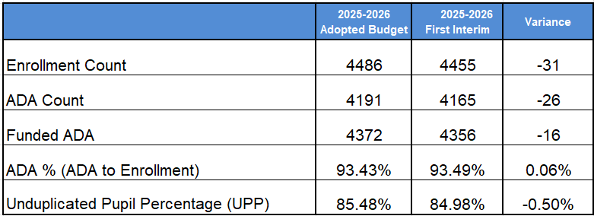
ENROLLMENT AND Average Daily Attendance (ADA)

Slide 4
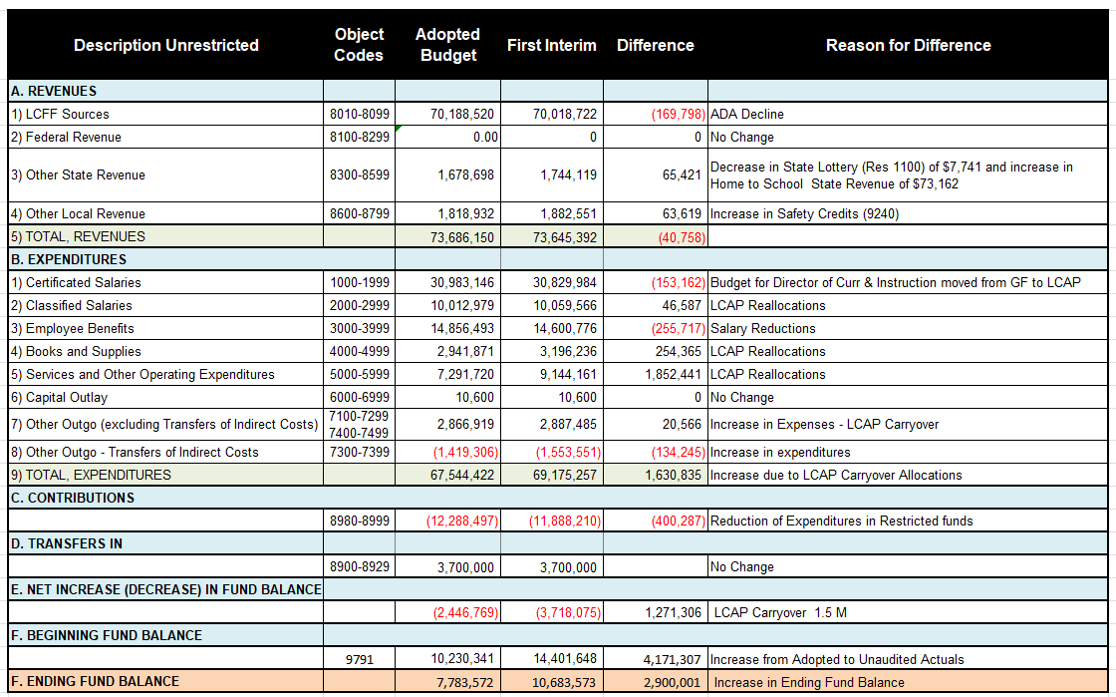
Unrestricted
Adopted Budget vs.
1st interim

Slide 5
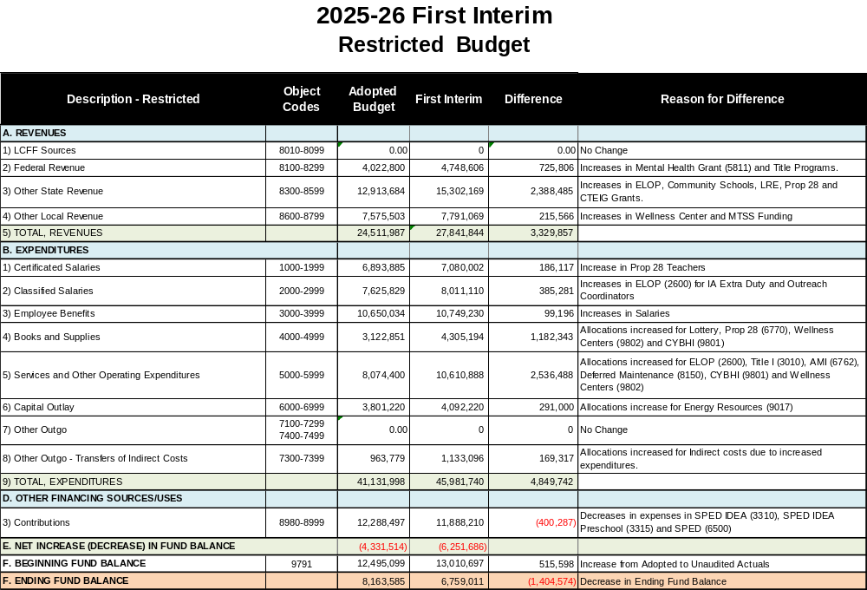
Restricted
Adopted Budget vs.
1st interim

Slide 6
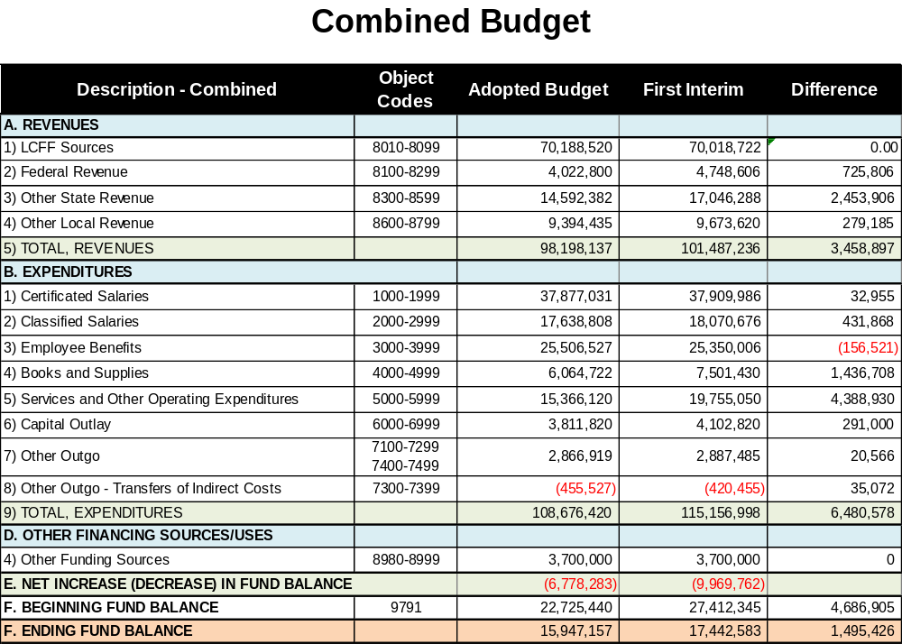
COMBINED
Budget vs.
1st interim

Slide 7
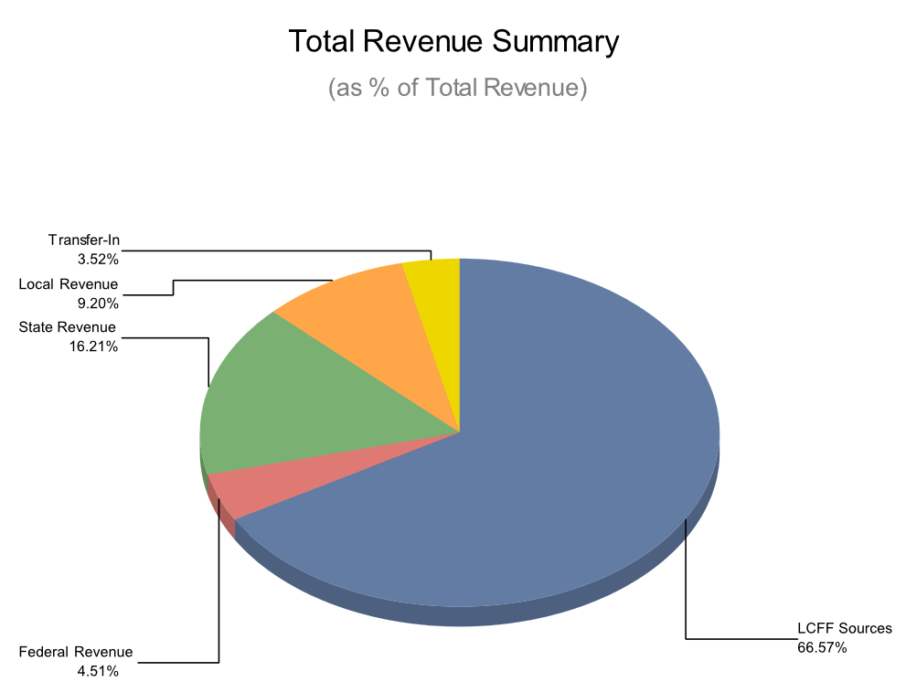
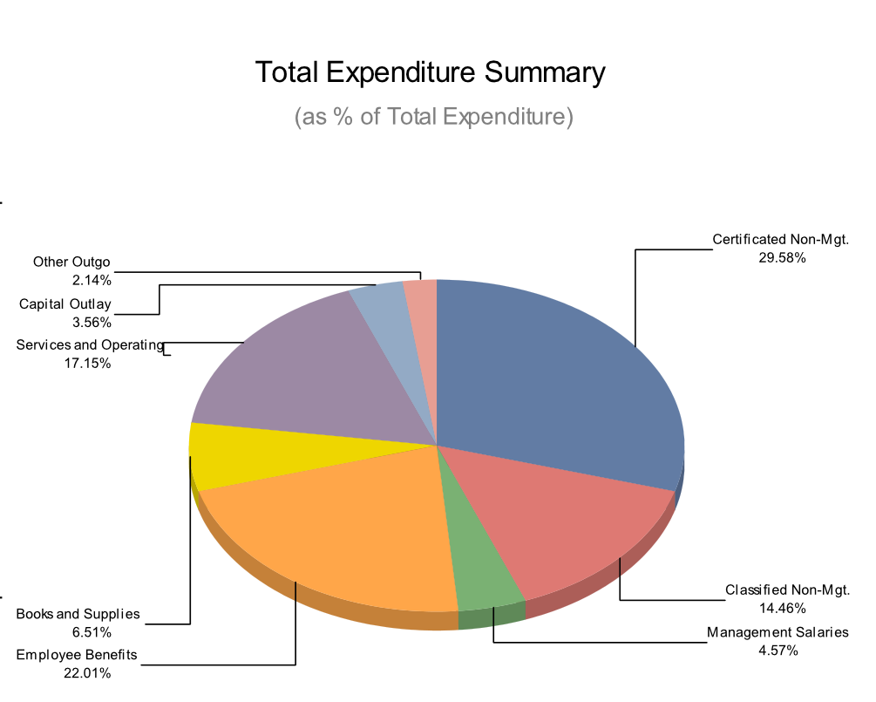
Revenue and expenses 1st interim

Slide 8
Multi-Year Assumptions
Assumption | 2025-26 1st Interim | 2026-27 Projected | 2027-28 Projected
Current Year ADA | 4,164.85 | 4,071.20 | 4,010.30
Funded ADA (3 Year Avg) | 4,322.34 | 4,248.54 | 4,163.13
COLA% | 2.30% | 3.02% | 3.42%
CalSTRS | 19.10% | 19.10% | 19.10%
CalPERS | 26.81% | 26.4% | 26.9%
Unduplicated Percentage | 84.98% | 84.85% | 83.40%

Slide 9
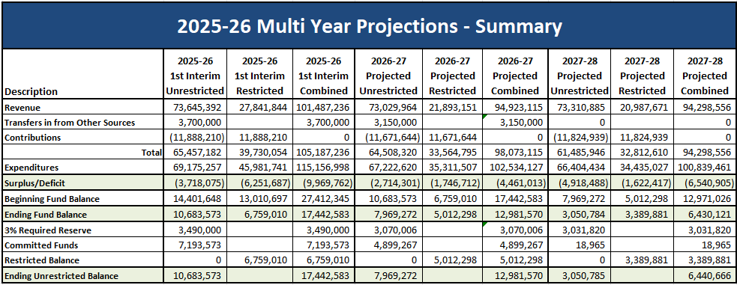
Multi-year projection summary

Slide 10
Looking Forward
Review and consider new and proposed legislation for multi-year impacts
  Incorporate new funding for 2025-26 and beyond
Continue to monitor enrollment and ADA
  Develop a model of continued right sizing
Clarify and define the structural deficit
  Assess expenditures and utilize other resources as appropriate.
Monitor economic forecasts
  Slight COLA increases for the next few years
  May 2026 Governor’s Budget Revision

Slide 11
Questions?

